Slide 1
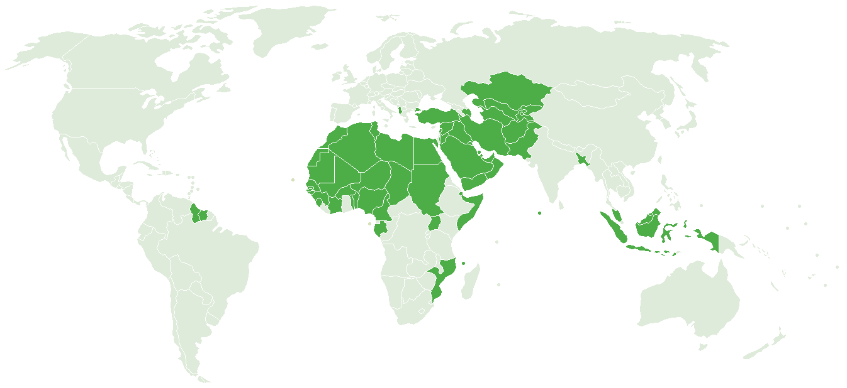
MEMBER COUNTRY RESPONSES TO POLICY QUESTIONS
Ahmet OKUR
COMCEC Coordination Office
26 March 2015

Slide 2
OUTLINE
Policy Questions
Responses of the Member Countries
Room Document

Slide 3
1. Does your country have any Eximbank/Export Credit Agency (ECA)?
Yes ( ) No ( )
If no, is there any intention in the near feature to establish a national ECA? If so, would you seek any assistance?
2. Please identify the main products offered by your AgencyIs there any activation policy/programme for the poor in your country?
a. Buyers’ credit
b. Suppliers’ credit
c. Working Capital Loans/Guarantees
d. Credit Insurance
e. Investment Insurance
f. Bonds and Guarantees
g. Project Financing
h. Other, please specify

Slide 4
3. Does your Agency have any plans for expanding the scope of your business by introducing new products/programs? If yes, how do you intent to expand the scope of your products?
i. In-house studies
ii. On the job training at other ECAs that have similar programs.
iii. Consultancy services
iv. Other, please specify
4. What is the total amount of support by your Agency both in terms of volume and as a percentage of national exports?
5. Does your Agency provide financing for imports?

Slide 5
6. What is your policy towards cooperating with other ECAs/IFIs/Multilateral Institutions? Have you ever provided joint financing under parallel/co-financing schemes?
7. What type of requirements do exporters need to benefit from support provided by your Agency? Please check the applicable
Legal entities established under national laws/regulations
Legal entities established under national laws/regulations and their subsidiaries/affiliates located abroad
Other, please specify
8. What are the main challenges facing the Eximbank/ECA in your country?

Slide 6
Respondent MCs
Oman
Pakistan
Yemen
Saudi Arabia
Iran
Turkey
Indonesia
Bangladesh
Kyrgyzstan
Qatar

Slide 7
2- Responses of the Member Countries
Q1- Does your country have any Eximbank/Export Credit Agency (ECA)?
Yes: 8
No: 2
If no, is there any intention in the near feature to establish a national ECA? If so, would you seek any assistance?
Positive approach on establishment
Need for drafting a project document for establishment
Receiving financial and technical assistance
Notes:
Except Yemen and Kyrgzstan all have ECAs
Yemen detailed its requirements: Drafting a project document for establishment based on a global best practice and technical/financial assistance especially a contribution to its capital from ICIEC.

Slide 8
Responses of the Member Countries
Q2- Please identify the main products offered by your Agency
Notes:
8 MC which have ECAs responded to this question; The main services are…… followed by ………. And finally ……….

Slide 9
Responses of the Member Countries
Q3. Does your Agency have any plans for expanding the scope of your business by introducing new products/programs?
Oman: Documented Credit Insurance Policy, Investment Insurance, Bonds and Guarantees, Buyer & Supplier Credit,
Iran: Sukuk
Qatar: Whole turnover policy, Islamic financing and Islamic insurance
Notes:
All responding MCs are interested in introducing new products, Oman, Iran and Qatar also described specifically new product names they are planning to provide in near future.
In the second part, Turkey, Iran and Indonesia used a combination of all alternatives. While Pakistan prefers On the job training, Qatar uses In house studies and consultancy services. Moreover Indonesia has established internship with other ECA, such as Malaysian ECA, Australian ECA, Korean ECA. And Iran prefers to outsource a project research to identify new products.

Slide 10
Responses of the Member Countries
Q3/2. If yes, how do you intent to expand the scope of your products?
In-house studies | 6
On the job training at other ECAs that have similar programs | 4
Consultancy services | 5
Other, please specify | 2 (Internships, Outsourced Project Researches)
10
Notes:
Indonesia and Qatar provide financing as long as the ending product will be re-exported.

Slide 11
Responses of the Member Countries
Q4. What is the total amount of support by your Agency both in terms of volume and as a percentage of national exports?
COUNTRY | VOLUME | PERCENTAGE of EXPORTS
TURKEY (2014) | USD 31,1 Billion | 20%
INDONESIA | USD 4,2 Billion | 1,13%
SAUDI ARABIA | USD 2 Billion | 1,25%
IRAN (2011) | USD 1,6 Billion | 8,3%
OMAN (2013) | USD 276,4 Million | 2,2%
PAKISTAN (2015-2018) | USD 250 Million
11
Notes:
Indonesia and Qatar provide financing as long as the ending product will be re-exported.

Slide 12
Responses of the Member Countries
Q5. Does your Agency provide financing for imports?
Yes: Iran, Pakistan, Indonesia, Qatar
No: Oman, Saudi Arabia, Turkey,
12
Notes:
Indonesia and Qatar provide financing as long as the ending product will be re-exported.

Slide 13
Responses of the Member Countries
Q6- What is your policy towards cooperating with other ECAs/IFIs/Multilateral Institutions? Have you ever provided joint financing under parallel/co-financing schemes?
13
Notes:
Oman, Iran, Turkey and Indonesia have existing cooperation with other ECAs, IFIs and Multilateral Institutions.
Saudi Arabia, Iran and Turkey have financed transactions jointly with other ECAs
Saudi Arabia, Indonesia and Pakistan open for cooperation in the areas they have not yet actively operate

Slide 14
Responses of the Member Countries
Q7. What type of requirements do exporters need to benefit from support provided by your Agency?
Requirements | Member Countries
a. Legal entities established under national laws/regulations | Oman, Saudi Arabia, Qatar
b. Legal entities established under national laws/regulations and their subsidiaries/affiliates located abroad | Iran, Pakistan, Indonesia
c. Other, please specify | Turkey
Notes:
For Turkish case companies e established under Turkish Commercial code are eligible for financing. Also subsidiaries of Turkish firms established overseas (at least 50% owned by the mother company in Turkey) can benefit from our insurance products. Sales of the subsidiary company and its exports to third countries can be covered.

Slide 15
Responses of the Member Countries
Q8.What are the main challenges facing the Eximbank/ECA in your country?
Underwriting / mitigating risks
Limited type of export products
Narrow capital base and investment options
Developing new products, especially customized ones
Cooperation with other ECAs for transactions with high investment costs

Slide 16
POLICY ADVICES
I: Member States are encouraged to examine and assess the financing needs of their exporters
II: Member States are invited to enhance transactional cooperation among their ECAs
III: Member States are encouraged to review the soundness of their ECAs with the aim of improving the overall performance of the ECA
IV: Member states are called on to promote public-private dialogue within the ECA context
Notes:
Now I will give a brief information on Room Document.
Based on answers to questionnaire and recommendations in the analytical study, a room document is prepared. This document will be finalized after the discussions in this Session and it will be submitted to the Thirtyfirst COMCEC Ministerial Meeting in 23-26 November 2015, this year.
Exporters need a variety of financing and risk management products in their daily operations. So better understanding and assessing the needs of exporters to provide them best matching services & products.
Because of the nature of international trade, ECAs are naturally driven towards collaboration with each other. Number of joint operations are increasing thus there is a need for higher cooperation between the MC ECAs.
Soundness of an export credit system means that the an ECA is well managed and is working with the existing sources of finance and insurance while keeping a balance with the national policy and developmental objectives.
Dialogue with the private ECAs are important since an ECA can be influencial for existing commercial banks to fund export transactions and to share risks.

Slide 17
Instruments to Realize Policy Advices
COMCEC Trade Working Group
COMCEC Project Funding
Capacity Building Activities
Notes:
Trade Working Group may discuss extensively mentioned policy areas in its future meetings to come up with additional policy alternatives.
Member Countries can utilize the COMCEC Project Funding to finance their activities for the mentioned policy areas such as training programs, seminars, study visits.
Capacity Building Programs can be implemented either COMCEC or Member Country resources. As CCO we are open for cooperation with you.

Slide 18
THANK YOU
COMCEC Coordination Office
Necatibey Cad. No:110/A 06580 Ankara-TURKEY Phone : (90) (312) 294 57 10 – 294 57 30 Facsimile : (90)(312) 294 57 77 - (90)(312) 294 57 79 E-mail : comcec@comcec.org
aokur@comcec.org
kakdogan@comcec.org
www.comcec.org

