Slide 1
FIFTH (5TH) MEETING OF THE COMCEC POVERTY ALLEVIATION WORKING GROUP.
FEBRAURY 26, 2015 IN ANKARA – TURKEY.

Slide 2
Theme
Activation policies for youth Employment and underprivileged social strata’s in OIC member Countries.
CASE OF CAMEROON.

Slide 3
PRESENTATION PLAN:
CAMEROON 2035 VISION
CAMEROON GROWTH AND EMPLOYMENT OUTLOOK
CAMEROON PUBLIC EMPLOYMENT SERVICE: The National Employment Fund (NEF)
NEF ACTIVATION POLICY MEASURES; SERVICES AND YOUTH EMPLOYMENT PROGRAMS
DIFFIULTIES AND RECOMMENDATIONS
YOUTH EMPLOYMENT INSTITUTIONAL FRAMEWORK

Slide 4
CAMEROON 2035 VISION
Cameroon a country in Central Africa, 22.25 million People. “Africa in Miniature”
2035 VISION : "Cameroon: an emerging, democratic and united country in diversity ".The growth and Employment strategy paper was adopted 2003 in Cameroon as a road map for development.

Slide 5
YOUTH EMPLOYMENT INSTITUTIONAL FRAMEWORK
Ministry of Employment and Vocational Training (MINEFOP)
The National Employment Fund (NEF)
Employment and Vocational Training National Observatory
Centre for Educational Orientation in Secondary and Higher Education
Interministerial committee for Employment Monitoring (CISE)

Slide 6
YOUTH EMPLOYMENT INSTITUTIONAL FRAMEWORK.
The National Employment Fund (NEF) is a Public Employment Service(PES) set up in April 1990 with overall mission to promote employment is the operational tool of the Ministry of Employment and Vocational Training (MINEFOP) in delivering job search support. The NEF has ten (10) regional branches and six (06) local branches all over the national territory in Cameroon.
Funded by a tax on employers; rate is 1% of total mass salary of private enterprises.

Slide 7
YOUTH EMPLOYMENT INSTITUTIONAL FRAMEWORK
The Integrated Support Program for the Informal Sector (PIAASI) is a support program under MINEFOP with mission to facilitate the transformation of the actors of the informal sector into the formal sector through training and funding support.

Slide 8
YOUTH EMPLOYMENT INSTITUTIONAL FRAMEWORK
In place also is a “Support Program for Urban and Rural Youth (PAJER-U) under the Ministry of Youth and Civic Educatin (MINJEEC).
PAJER-U and PIAASI are financed by the HIPC funds and the government.

Slide 9
CAMEROON GROWTH AND EMPLOYMENT OUTLOOK
GDP Growth in 2014 reached 5.9%.
In 2014 government created jobs that surpassed by a gap of 33,443 projections of 250,000. Thus a total of 283,443 jobs.

Slide 10
CAMEROON GROWTH AND EMPLOYMENT OUTLOOK
In 2015, the Cameroon government intends to create 350,000 new jobs.
Underemployment (71.8%) and the informal sector (absorb >84% of active labour) are significant challenges both because of their scale and impact on poverty. Unemployment rate is more significant in urban areas for youth group(15.5%) and women (16.8%).

Slide 11
CAMEROON PUBLIC EMPLOYMENT SERVICE:
The National Employment Fund (NEF)
The National Employment Fund (NEF) deliver job search support services through it operational services (04) which are;
Matching Service,
Vocational training Service,
Job Creation Service, and
Job market Information Framework.
The FNE has a total of 26 employment programs, and nine (09) are specifically for youth Employment.

Slide 12
NEF ACTIVATION MEASURES; SERVICES & YOUTH EMPLOYMENT PROGRAMS;
Four (4) Operational services
Matching Service; Job seeker/Employer engagement framework,
YOUTH EMPLOYMENT PROGRAMS (04).
Citizen - Graduate Employment Program (PED)
Urban Special Employment Program (USEP)
Job creation Service; Job promotion through capacity building in technical, Entrepreneurial, and Managerial skills, and funding of projects.
Vocational Training service; Training with the purpose of making job seekers employable
Job Market information sharing framework,
Self-Employment and Micro-Enterprise Program (PAME)
Rural Employment Support Program (PADER)

Slide 13
.
NEF ACTIVATION MEASURES; YOUTH EMPLOYMENT PROGRAMS
“GRADUATE EMPLOYMENT PROGRAM” (PED). There is also a revised version to be launch called PED-Ci for a 24 months duration.
PED,
a pre-employment internship to help youths acquires practical training in a specific domain within an enterprise for 12 months duration
Target Group:
Educated youths with at least Ordinary level General Certificate of Education.
Objective:
Inclusion of 50.000 job seeking youths without prior professional experience
Strategy:
50/50 sharing between the government and the private sector of the benefits paid to the trainee
Procedure:
Demand from enterprise, Capacity evaluation, selection, contract signing, training, and evaluation
Advantage to Enterprise: Response to HR problems, sufficient observation time and possible recruitment, return on tax.
2/23/2015

Slide 14
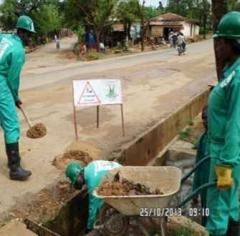
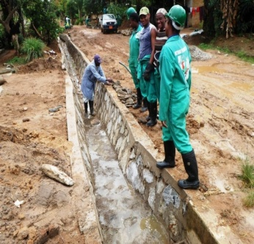
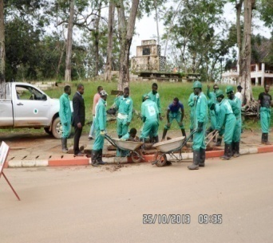
NEF ACTIVATION MEASURES; YOUTH EMPLOYMENT PROGRAMS
“Urban Special Employment Program” (USEP). Unemployment is a big challenge facing Cameroon’s Labour market for youths and women in urban area
NATURE:
Labour Intensive Urban Infrastructure activities.
TARGET: Urban unemployed youths
OBJECTIVE: Create proximity jobs for urban youths in Cameroon while using local resources, give a face-lift of towns and ameliorate of public live framework
PROCEDURE:
Meeting, signing of accord protocol, setting up a steering cell, elaboration of activities , Resources, materials, selection of beneficiaries, monitoring.
PARTNERS:
Municipal councils, Government Ministries concerned, and Urban population.
EXPECTED RESULTS: moving youths into employment, Reduction of insecurity, increase in earnings, Capacity building in urban infrastructure, face-lift of towns in Cameroon.
At the end of this programs, beneficiaries with viable project idea may be funded 3 x saving from income earned through the program.

Slide 15
NEF ACTIVATION MEASURES; YOUTH EMPLOYMENT PROGRAMS
“Self-Employment and Micro-Enterprise Program” (PAME). NEF support project promoters technically in project feasibility analysis, and financially by funding small projects.
OBJECTIVE:
promote self-employment through entrepreneurship. Facilitate the transformation of actors of the Informal sector into the formal sector.
STRATEGY:
Support job seekers in project feasibility elaboration, Training, Funding, and monitoring
TARGET:
jobless Cameroonians possessing entrepreneurial skills and a viable project idea. Or Expansion projects that will create jobs.
EXPECTED RESULTS:
Create Jobs, train project promoter in business, Remove Cameroonians from the informal sector to the formal, increase revenue, and induce new jobs through viable and sustainable projects

Slide 16
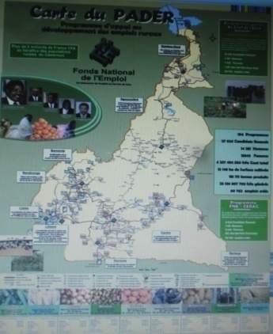
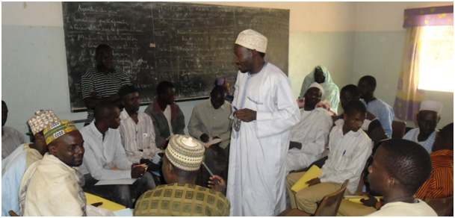
NEF ACTIVATION MEASURES; YOUTH EMPLOYMENT PROGRAMS
Rural Employment Support Program (PADER). It consist of providing beneficiaries with training in new farming methods, equipments, and financing.
OBJECTIVE:
promote Employment and Alleviate poverty in rural milieu
TARGET:
rural population organised in Common initiative Groups (CIG)
STRATEGY: Sensitisation, identification and selection of candidates, Training, Funding of projects, follow up and fund recovery
EXPECTED RESULTS: capacity building, Increase income, reduce rural exodus, and Encourage socio-economic actions

Slide 17
NEF realizations relative to the above mentioned programs as on December 31, 2014
PED
7 511 youths trained in;
USEP
256 youths benefited from USEP in 2014 (Trial phase in Bafia and Banjoum towns) .
Jobs created, poverty and insecurity reduced, skills gained among others.
PAME & PADER
4 623 projects funded, and 54 482 job seekers financed in C.I.Gs.
Funded Projects Induced 105 434 new jobs and poverty alleviated.
Capacity building skills in varying domains, alongside work experience.

Slide 18
DIFFICULTIS AND RECOMMENDATIONS
Limited funding constraint the number of agencies and the number of employment advisors to support job seekers. The FNE case load is 3,000 job seekers per advisor.
Employment advisers work with several job seekers in the morning and employers in the afternoon. Job seekers attend meeting with their advisors once every two weeks.

Slide 19
DIFFICULTIS AND RECOMMENDATIONS
The case load is unsustainable and must be reduced to match the standard of 300 case load / employment advisor if the service delivery is to have impact.
The NEF has set up an integrated Information system to share job seekers data between agencies, but the expansion of this system is dependent upon when funding becomes available.

Slide 20
DIFFICULTIS AND RECOMMENDATIONS
Although all the services of the NEF are free, there is limited incentive in place for employers and job seekers to utilize the NEF, thus many employers do not advertise their vacancies through the FNE. More Incentives should be put in place.

Slide 21
END. Thanks.

