Slide 1
Tunisia Union for Social Solidarity
The main NGO
Founded since 1964
Rassembled 24 regional associations of social solidarity, 264 local commitees of social solidarity, 23 associations for the protection of elderly people
Programs :
* Program of direct assistance to needy families an during natural desasters
* Promotion of preschool children issued from needy family : 264 centers and above 11000 children annually benefit from its services
* Protection of population with special needs : elderly persons and mentaly handicaped without support (13 centers)
* Charity bank of medecines : collecting ant distribution
* Program of local development : 84 areas and 4500 families
* Program of self employment and microcredit

Slide 2
An experience from Tunisia
Activation program based on the training
Participatory project delivery services
for reintegration
in Medenine and Tataouine
Realized by : Tunisian Union of Social Solidarity
Financed By : Word Bank

Slide 3
Implementation time : 30 months (3 October 2012 - 31 March 2015 )
Cost and Financing: 5 million dollars donation from the World Bank
Beneficiaries : Young people undereducated and unskilled from needy families and at least 30% of women who meet the eligibility criteria.
Main components:
Pilot Subprojects local services delivery : 4,30
Training to subprojects : 0.43
Project management , monitoring and evaluation : 0.27
The project development objective : managing participatory approaches to job creation through a payment program cash for basic social services for vulnerable Tunisian households in the governorates of Tataouine and Medenine affected by Libyan conflict .
Areas of intervention subprojects : social care , Education, health

Slide 4
2- Specific objectives:
Integration and Employment | Facilitating the socio -economic reintegration of workers employed through employment opportunities in the provision of social services nearby. Improving the skills of workers employed through specific training for the provision of community-based social services in the initial phase of the project and through learning in the workplace later
Social Protection | Improving access to basic services for Tunisian vulnerable families Improving the relevance of social services nearby in agreement with the perceived needs locally.
Local Governance | Encouraging awareness and mobilization of local communities through local committee meetings around the implementation and evaluation of subprojects. Rebuilding a relationship of trust and responsibility between communities and local governments through participatory management methods, monitoring and evaluation of subprojects.

Slide 5
Mechanisms for implementation
1- Targeting mechanism
Direct beneficiaries | Social criteria (poverty, unemployment ) Technical criteria (depend of the sub project)
Subproject | Selection by a regional committee : 1 st sub-projects list Selection by a central committee : scoring system : final list 5 criteria - 10 pts / criterion - in project accepted if score above 40 pts
2- intervention approach
Project partnership with associations
Associations in partnership with stakeholders in the public and private sectors and CSOs
Participation of local communities in identifying needs , implementation , financing of certain actions , assessment and evaluation of sub-projects
Informal vocational training with payment of an allowance for the cost of cover
Adaptation skills to the needs of the labor market and the needs of local communities
Community Service Delivery

Slide 6
Indicators and achievements
Indicator | Target | Achievements
Number of subprojects | 40 | 92
Number of partner associations | - | 67
Number of direct beneficiaries | 4000 | 6182
Number of beneficiaries of services | 12000 | above 100000
Percentage of women | 30% | 70%

Slide 7
3. Preliminary results about the direct beneficiaries
basic education

Slide 8
Preliminary results about the direct beneficiaries

Slide 9
Aspiration of the beneficiaries from their participation in the project

Slide 10
Motivation of the DB of their participation in the project

Slide 11
DB opinions in relation to the implementation of a micro-project
Man

Slide 12
Employability : statistics at December 31, 2014
employment related training
Self-employment
employment

Slide 13
Conclusions
The project provided capacity building opportunity for young people excluded from the formal vocational training system in order to improve their chances of getting a decent job and well paid
The courses offered are integrated and into the production process and services at local and regional level
The project has enabled young people especially disadvantaged to have expertise to facilitate access to employment
The allocation provides allowed to bear the costs more time to the young so that he learns slowly
The skills are adapted to labor market needs and the needs of local communities
Young people have benefited from a network that enables them to more easily find employment or start their own business.

Slide 14
Recommendations
Improve linkages with the formal system of vocational training
Ensure access to skills validation mechanisms
Diversify the skills provided to young people (eg. Management, marketing, life skills, entrepreneurship,)
Provide funding for the development of micro and small enterprises whose ideas come from training undertaken in the framework of the project
Consider the anchoring of the project through the establishment of a national program with a stable public funding.

Slide 15
Carers training for the elderly

Slide 16
Training in tailoring

Slide 17
Training forgery: recycling of discarded tables of schools

Slide 18
Financial literacy for mentally handicaped

Slide 19
Oasis development training and biological waste treatment

Slide 20
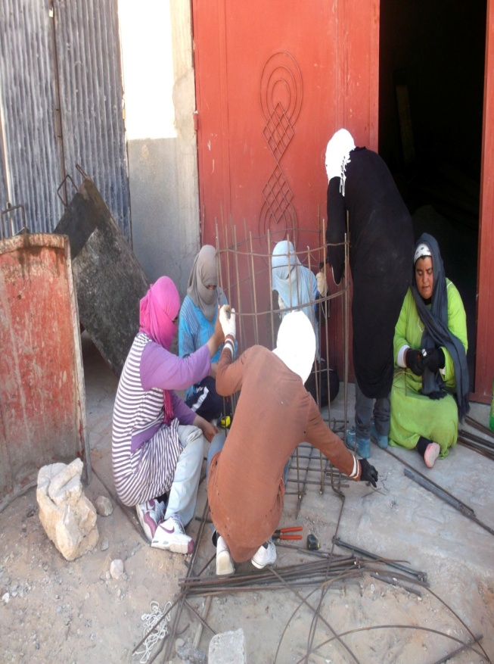
Rural sanitation training

Slide 21
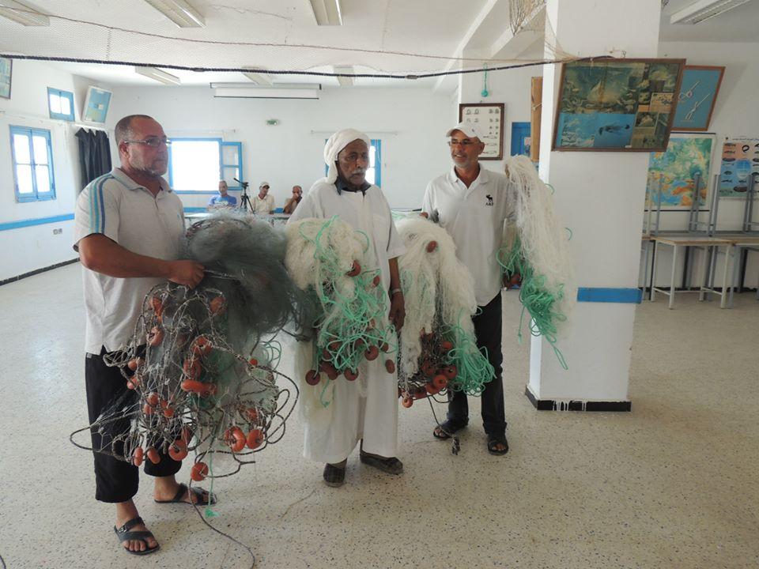
Fishing net mending training

Slide 22
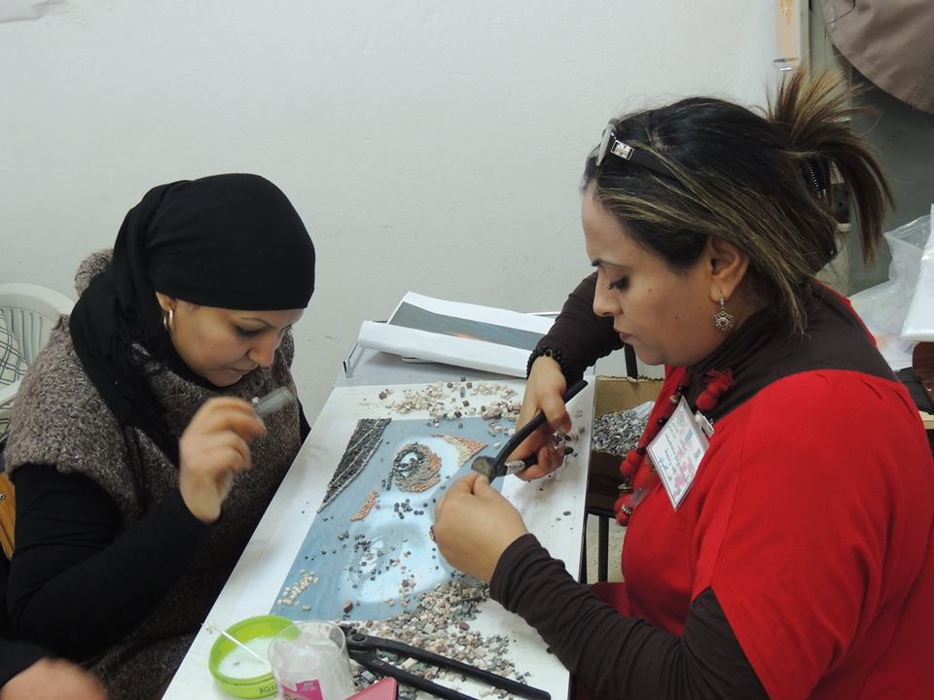
Marble mosaic training

Slide 23
First aid training

Slide 24
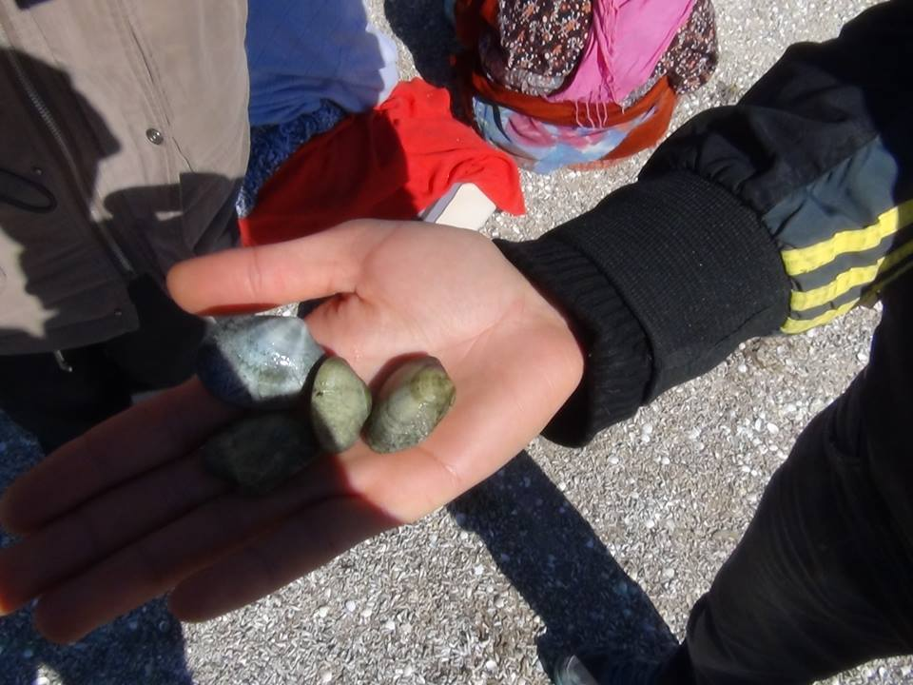
Training collection and storage clam

Slide 25
Start up

Slide 26
Thank you

