Slide 1
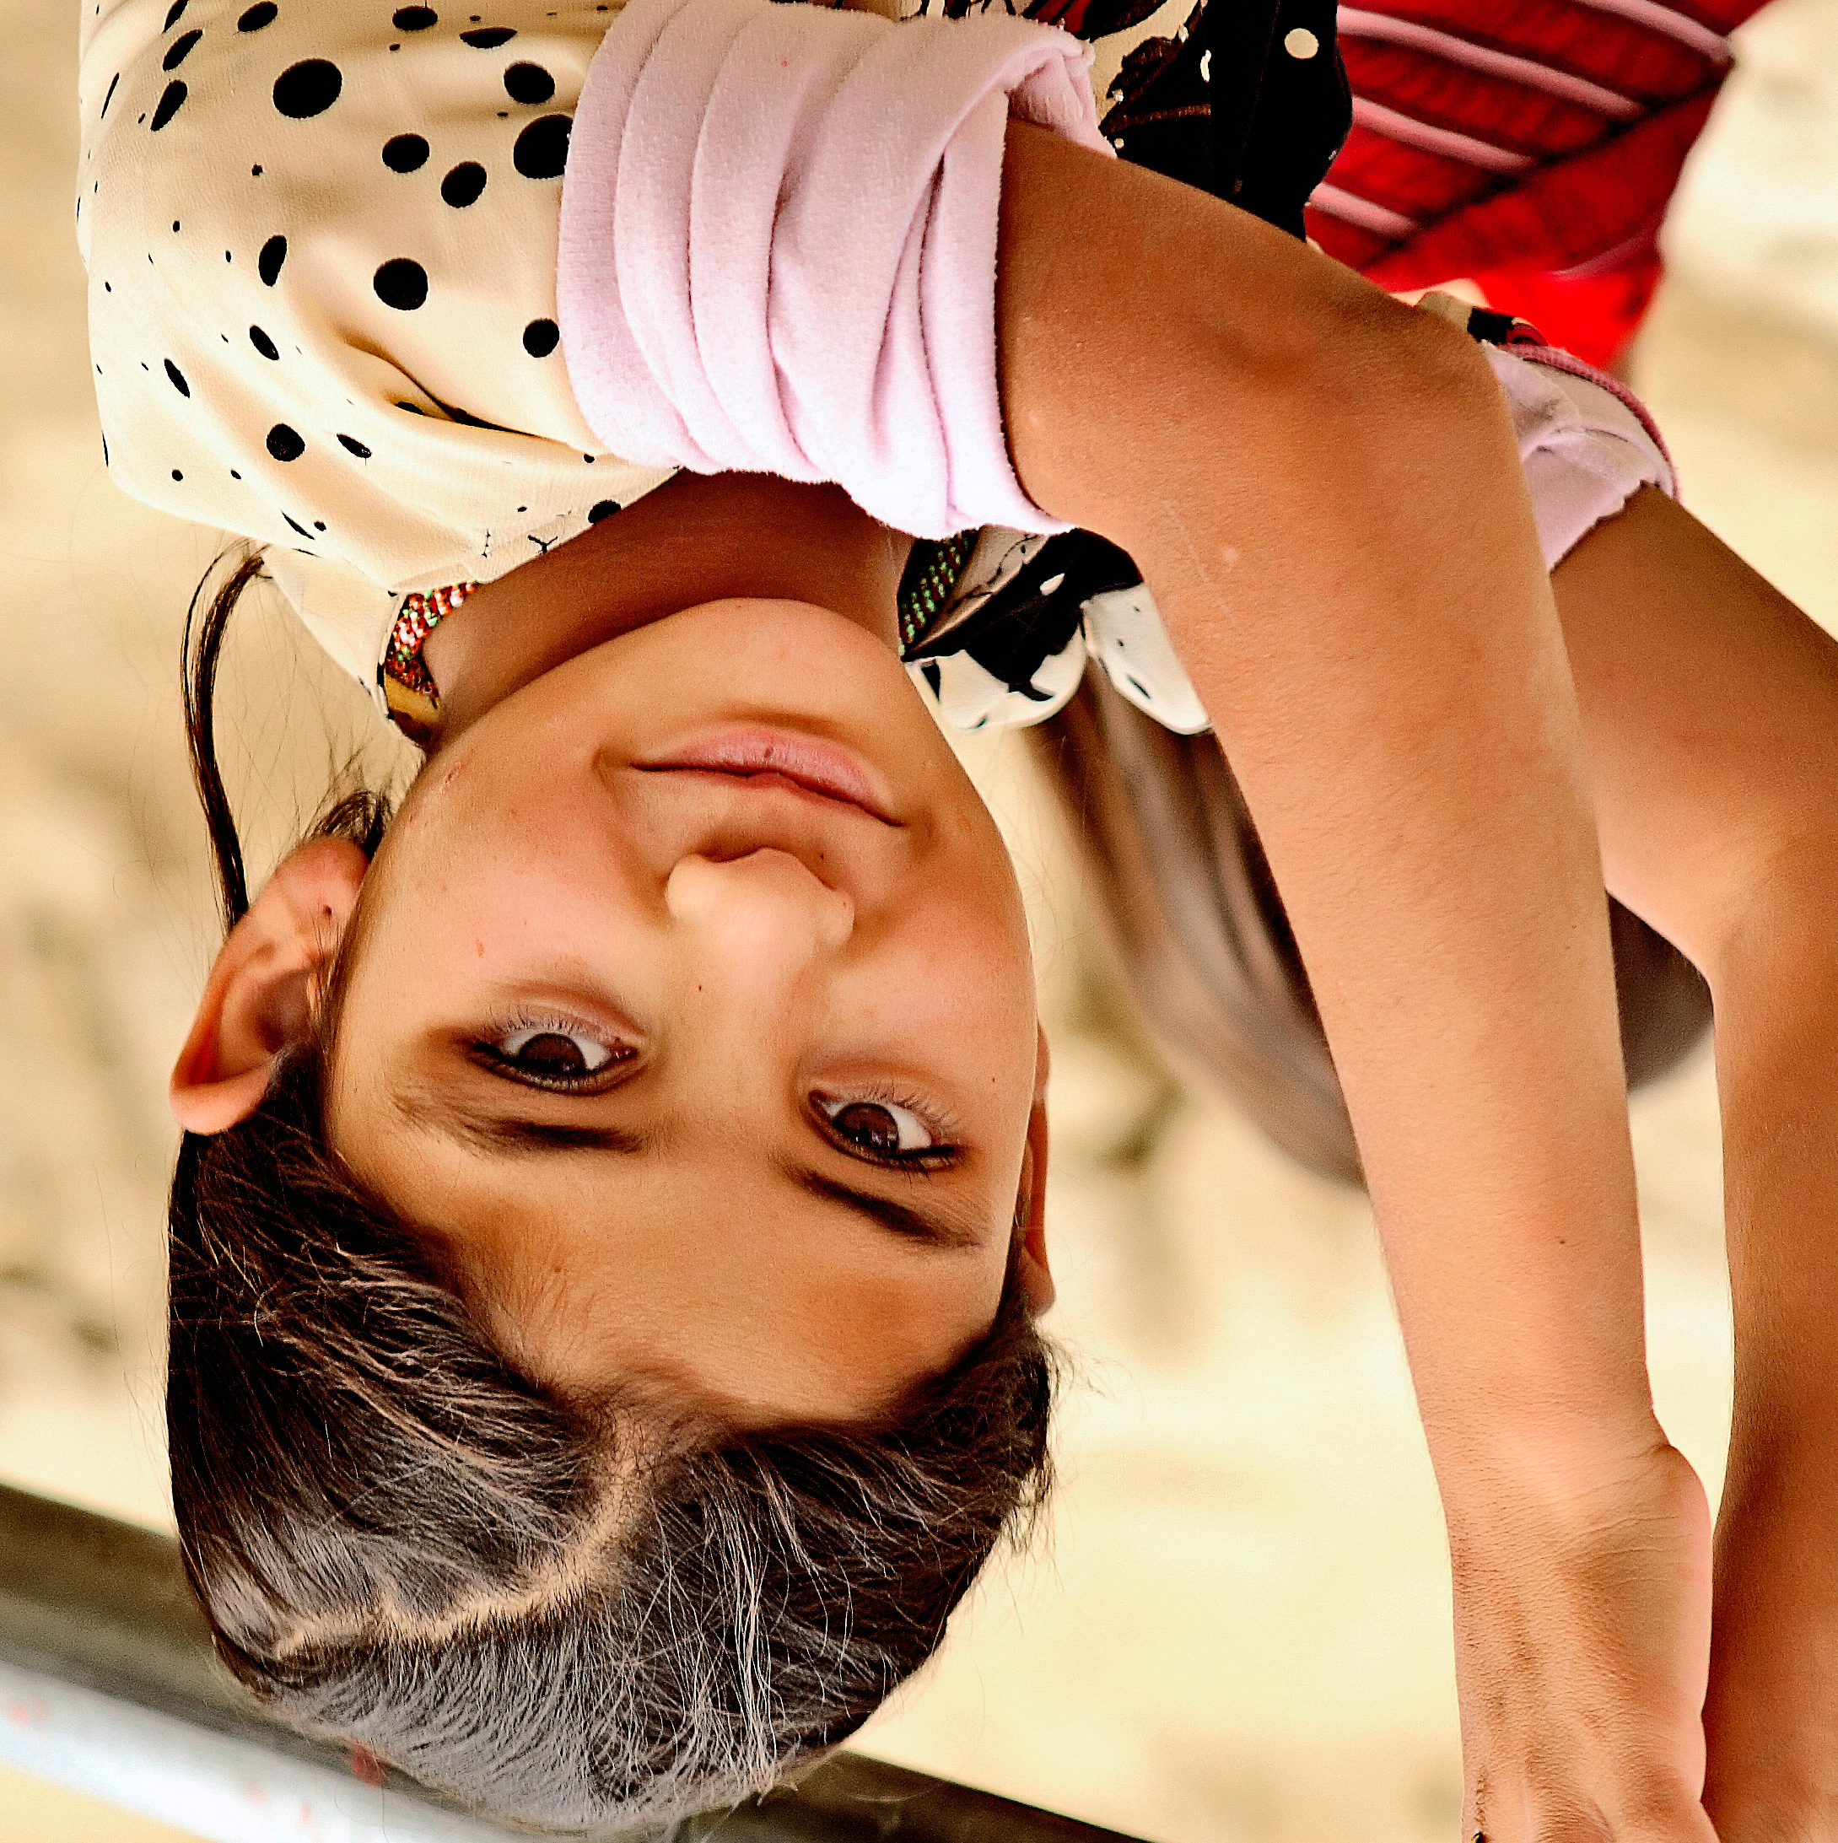
Creating opportunity for the world’s poor

Slide 2
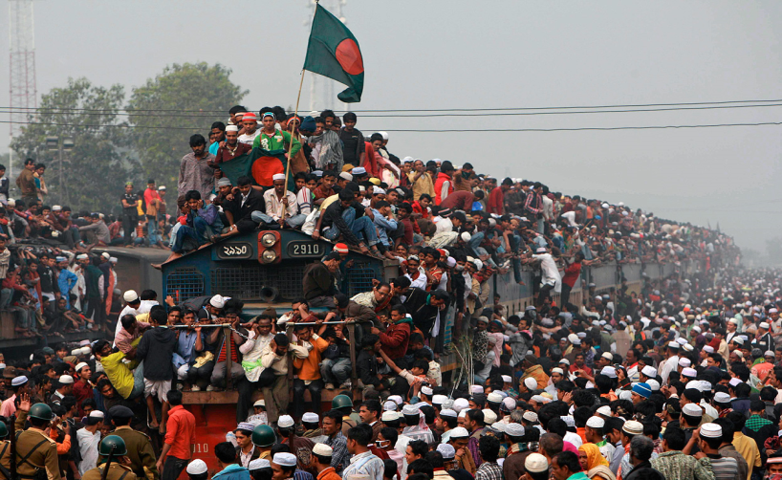

Slide 3
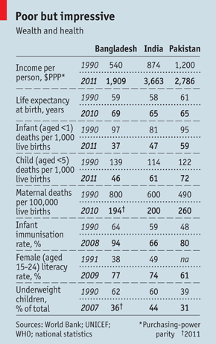
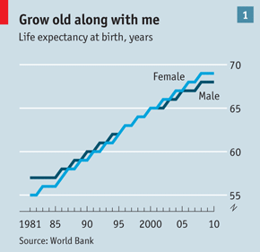
Bangladesh story

Slide 4
solutions at scale
With over 100,000 employees reaching an estimated 135 million people, BRAC is the world’s largest non-governmental organisation
Of the world’s top development and humanitarian relief organisations, BRAC is one of the few based in the global South, spreading antipoverty solutions born in Bangladesh to 10 other developing countries in Asia, Africa and the Caribbean.

Slide 5
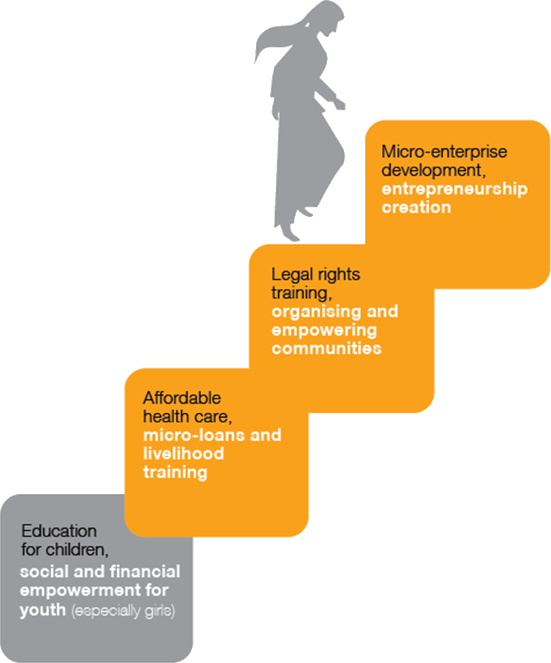
guiding principles
BRAC focuses on women, who are worst affected by poverty
Organising the poor is at the heart of its work
BRAC acts as catalysts, creating an ecosystem where the poor can seize control of their lives
BRAC believes that many of the underlying causes of poverty are interlinked, and takes a comprehensive approach to address them.

Slide 6
Targeted people
POVERTY REDUCTION
MF, Enterprises, Agriculture,
Ultra Poor
COMMUNITY MOBILISATION
Human Rights, Community Empowerment, Gender, Advocacy
CAPACITY DEVELOPMENT
Education, Health, Water and Sanitation, Disaster Management
a holistic approach
There is no single cause of poverty.
Development must be tackled on multiple fronts.

Slide 7
Lack of access to economic systems keeps people trapped in poverty. BRAC intervenes by disbursing over a billion dollars in microloans annually, augmenting microfinance with additional services like livelihood and financial literacy training.
Creating Social Enterprises to create the supply chain for the local producers
Creating new kinds of jobs and training and capacity building in the rural economy
Tapping into apprenticeship model of the informal economy
BRAC’S ACTIVATION INTERVENTION

Slide 8
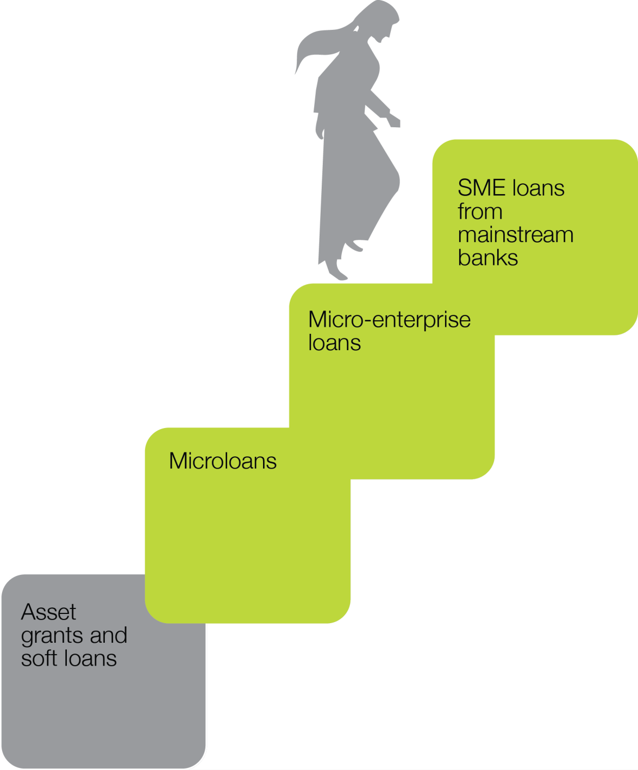
Over the course of the last four decades, we became one of the world’s largest providers of financial services to the poor.
In 2014, more than
USD 1.8 billion disbursed to nearly
five million borrowers

Slide 9
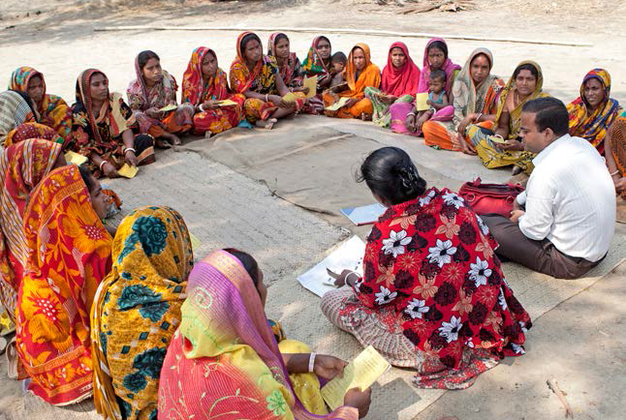
Bringing collateral-free credit and savings services to their doorsteps through our village organisations made up of around 30 to 40 women from the local community.

Slide 10
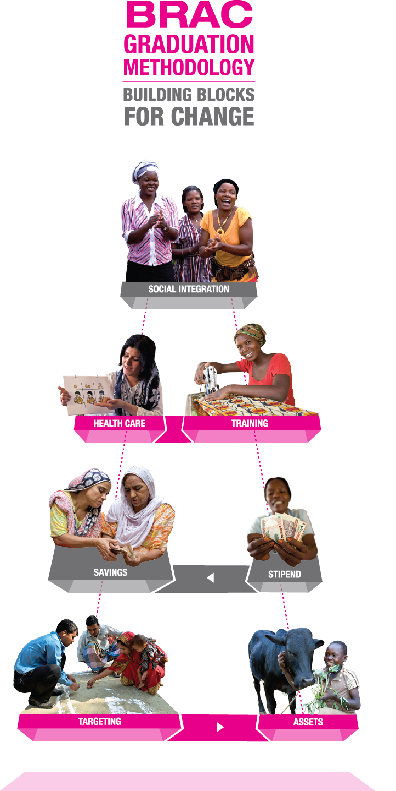
Targeting Extreme Poverty
  Agriculture is built into the social protection intervention and is implemented simultaneously:
    At the time of transferring asset
    When diversifying clients’ means of incomes at later stages
    When selecting an ‘interim’ income generation stream
    When ensuring basic nutrition and minerals in-take
    Stakeholders:
    Village poverty reduction committees: helps clients to get acquire/lease farming lands, emergency fund-raising, free tuition services for clients’ children, ensure social inclusion
    Donors (fund programme), government (fund allocation in national budget and advocacy)
Notes:
Content direction/question: Are both social protection and agricultural interventions implemented at the same time? Or there is sequencing? What seasons are they implemented?

Slide 11
BRAC’S Social Enterprises

Slide 12
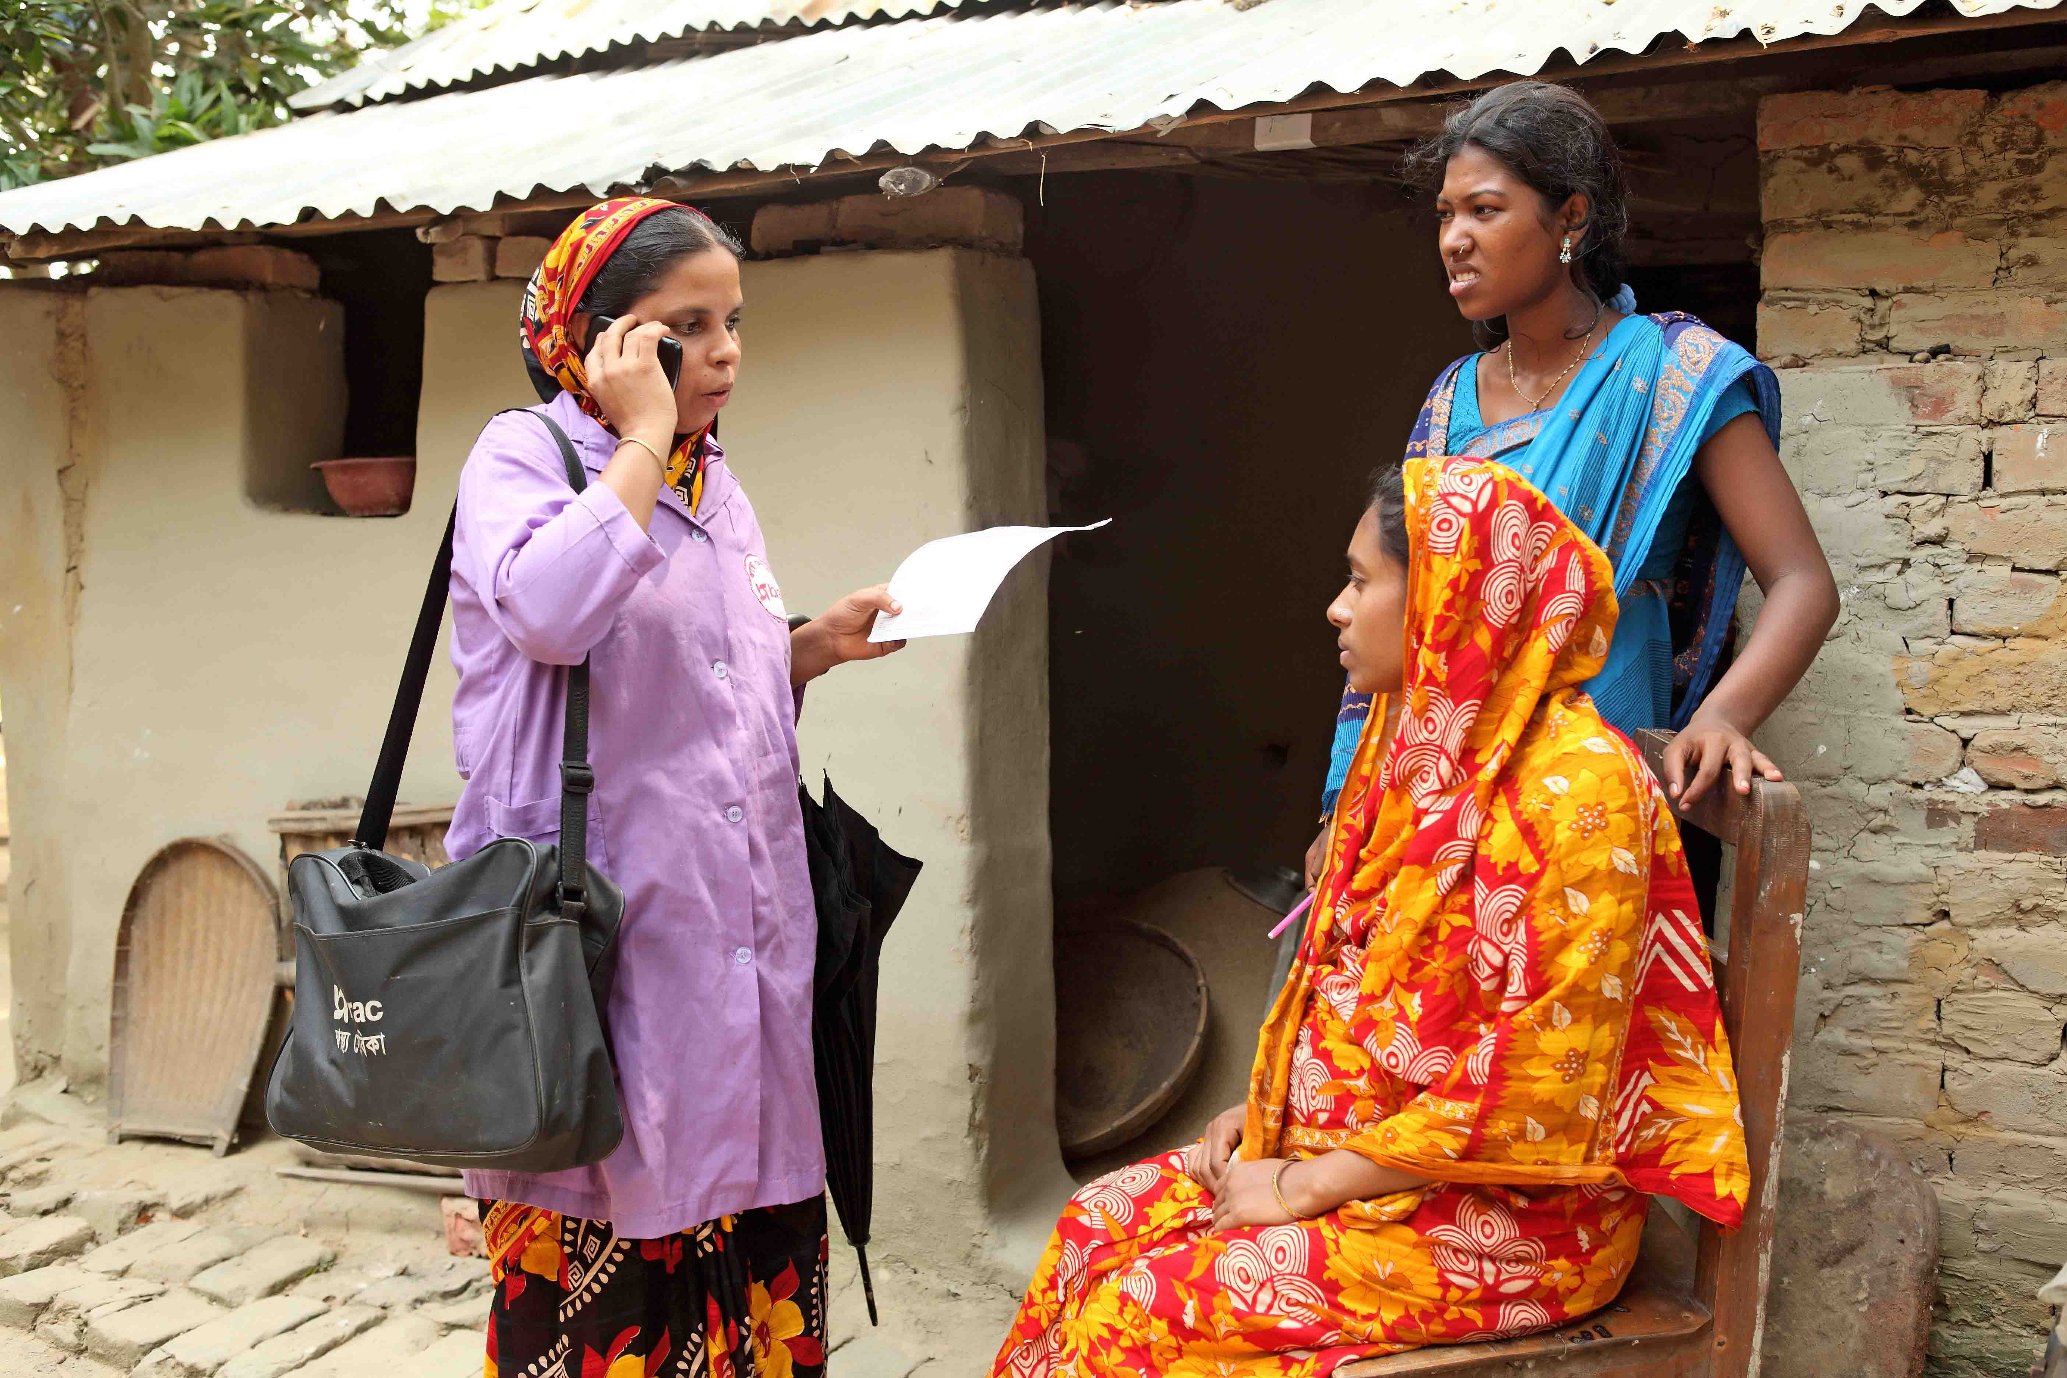
Creating para professionals

Slide 13
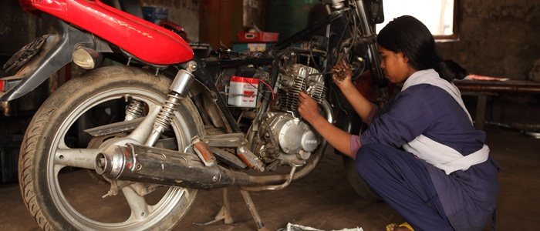
Skills Development in Apprenticeship modelBRAC

Slide 14
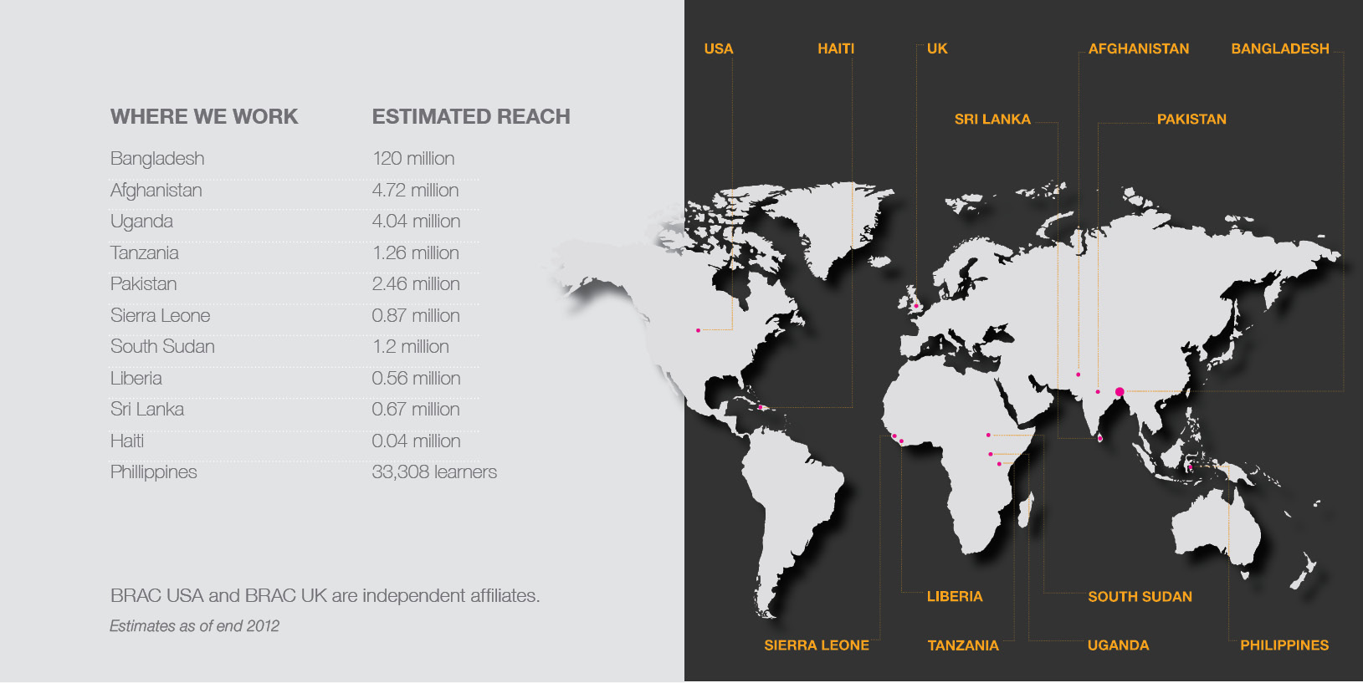
going global

Slide 15
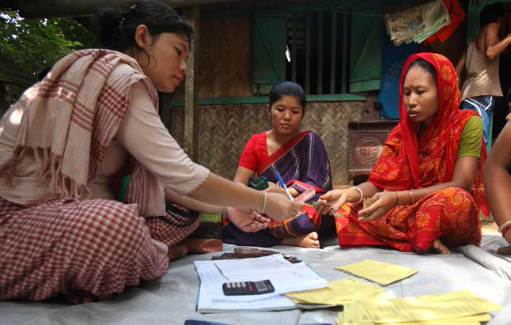
BRAC’s microfinance programme is a critical component of its holistic approach to support livelihoods.

