Slide 1

Investment & Trade Insurance
The Islamic Corporation for the Insurance
of Investment and Export Credit
Member of Islamic Development Bank Group

Slide 2

Table of Contents
ICIEC - Who we are
Business Profile
Products & few Sample Transactions

Slide 3

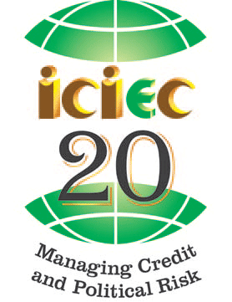

Who We Are
ICIEC is a multinational institution with full juridical personality and multilateral status
Established in 1994 & based in Jeddah – KSA with a representative office in DIFC - Dubai
Owned by the Islamic Development Bank Group in addition to 43 member countries from Asia, Africa and Europe
Subscribed capital is US$ 637 million
Rated Aa3 by Moody's
The only Export Credit Agency in the world that provides export credit & Investment insurance in compliance with the Islamic Shariah
Permanent Member in Berne Union, Coface Alliance, Prague club and founding member of AMAN Union
IFSR Aa3
Credit Alliance

Slide 4





Aa3 rated by Mood’s
Affiliated Institution
Islamic Corporation for Insurance of Investments and Export Credits (ICIEC)
International Islamic Trade Finance Corporation (ITFC)
)
Islamic Research and Training Institute (IRTI)
Islamic Corporation for the Development of the Private Sector (ICD)

Slide 5
ICIEC Mandate …
Investment Insurance
Import Credit Insurance
Export Credit Insurance
Domestic Credit Insurance
To encourage exports from Member Countries to the rest of the World
Covering domestic sales inside member countries
Helping MCs import of strategic and capital goods from the world
To encourage the flow of capital and investment from the World to Member Countries

Slide 6
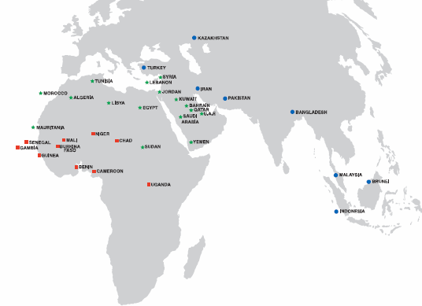
ICIEC Membership – a broad swathe…
19 ARAB
Countries
15 AFRICAN
Countries
8 ASIAN
Countries
ALGERIA
BAHRAIN
EGYPT
JORDAN
KUWAIT
LEBANON
LIBYA
MAURITANIA
MOROCCO
OMAN
QATAR
KSA
SUDAN
SYRIA
TUNISIA
U.A.E
YEMEN
Iraq
Palestine
BENIN
BURKINA FASO
CAMEROON
CHAD
GAMBIA
DIJBOUTI
GUINEA
MALI
NIGER
SENEGAL
UGANDA
NIGERIA
GABON
Ivory Coast
Mozambique
BANGLADESH
BRUNEI
IRAN
INDONESIA
MALAYSIA
PAKISTAN
TURKEY
KAZAKHSTAN
1 EUROPEAN
Country
ALBANIA

Slide 7

ICIEC Product Mix
Banks
Trade Finance and Investment Insurance
Bank Master Policy
Documentary Credit Policy
Loss Payee Assignment for CSTP/STP
PRI for Financing Facilities
Non-Honoring of Sovereign Financial Obligations
Export & Domestic Credit Insurance:
    Comprehensive Short term Policy
    Specific Transaction Policy
    Supplement Medium term Policy
Insurance
Credit
Trade Credit
Political Risk
Suppliers
Investors
Insurance
Insurance
Inward Reinsurance :
      Quota Share Treaty
      Facultative Reinsurance
      Excess of Loss Treaty
Foreign Investment Insurance :
Equity Investments
Non Equity Investments
Reinsurance
ECAs

Slide 8
Facilitating Trade; Insuring Confirmed L/C’s
White Sugar Cane valued at $ 30.0m
Importer in Ethiopia
Export Contract
Exporter in Saudi Arabia
Opens LC
Makes Payments
Payment Settled in 30 days
Importer’s Bank
CBE
DCIP PH
LC confirming Bank
Confirms $30m
Adds Confirmation to LC
Credit Limit Approval for $20 m
$ 20.0m Insured By ICIEC
Tombstone
Amount: $ 30 million
ICIEC’s covered: $ 20 million
Credit Period: 30 days
Pricing– Pre Agreed 3% p.a applied to the credit risk period.
ICIEC cover –Risks Covered- 90% risk of non- payment of LC issuing Bank
Settled in May, 2008
ICIEC provided a cover of
USD 20 million covering
The risk of issuing bank

Slide 9
Facilitating Short Term Trade; Loss Payee Structure
SUBMITS CLAIM,
RECEIVES COMPENSATION FROM ICIEC
Midal Cables
Bahrain
DEFAULT
International
Buyer
CSTP Policy
Exports
Open Account or CAD Terms
Or Even on L/C
COFACE/Atradius/Local Sources
Credit Information/Credit Assessment Assistance
Tombstone
Exporter signs contract with Importer on CAD or Open Account Terms
ICIEC issues CSTP Policy to Exporter
Percentage of cover: 90%
In case of Buyer’s default Exporter will Submit Claim with ICIEC
ICIEC will compensate 90% of the Loss
ICIEC provided a cover of
USD 20 million covering
The risk of issuing bank

Slide 10
Facilitating Foreign Investment: DCT Project Djibouti
Reinsurance
MIGA
(Insurer)
Main Rationale for ICIEC Involvement:
Islamic financing component
Tombstone
Covered Parties – Islamic Financing Tranche providing banks
Insurance Duration – 15 years
Percentage of cover – 90%
Investment Value – USD 427 million
Cover amount – USD 50 million
Status –currently underway
Banks
DPW Djibouti
Direct
Agreement
Islamic financing
Agreement
Doraleh Container Terminal
Concession Agreement
Government of
Djibouti
Djibouti Port Authority

Slide 11


















KEY POLICY HOLDERS

Slide 12
AMAN UNION - Credit Insurance Industry in OIC MCs
Created in 2009, under the leadership of ICIEC and Dhaman.
Aims at strengthening cooperation between ECAs in the OIC MCs.
Aman Union currently includes 17 ECAs from OIC countries,
4 Associate Members and 8 observers.
The last General Annual Meetings took place in Lebanon (2009), Tunisia (2010) and Turkey (2011). The next meeting will be in Malaysia (2012).
ICIEC is currently in charge of the Secretariat General of Aman Union
The Secretary General of Aman Union is currently working on the Database Center Project : a pool to share credit information reports and approvals. Ultimately, we aim at creating a legal entity specialized in selling credit reports.

Slide 13
Aman Union Objectives
1- Development of Credit Insurance Industry in Member Countries
2- Exchange of information,
3- Technical assistance
4- Exchange of expertise and consultation among Members
4- Development of credit information sector in ICIEC member countries
5- Development of debt-collection sector in Member countries

Slide 14
Governance and Management
The UNION is Governed by AMAN UNION Charter.
The organizational structure consists of 3 organs :
A- The General Assembly : Meets once a year
B- The Executive Council : Meets twice a year
C- The General Secretariat : Managed by ICIEC and DHAMAN alternately during 2 years.
The UNION is funded by :
- Membership fees paid by its Members (Full Members, Associate Members and Observers)
- Donations provided by the 2 multilaterals (ICIEC and DHAMAN).

Slide 15
Evolution of business insured
(in USD billion)

Slide 16
Aman Union - Members
17 Full Members
1 | ICIEC | Multilateral
2 | DHAMAN | Multilateral
3 | Turk EXIMBANK | Turkey
4 | EGFI | Iran
5 | Malaysia EXIMBANK | Malaysia
6 | JLGC | Jordan
7 | COTUNACE | Tunisia
8 | ECGE | Egypt
9 | ASEI | Indonesia
10 | SONAC | Senegal
11 | ECGA | Oman
12 | ECIE | UAE
13 | NAIFE | Sudan
14 | SEP | Saudi Arabia
15 | CAGEX | Algeria
16 | SHIEKAN | Sudan
17 | LCI | Lebanon
3 Associate Members
1 | Recovery Advisers B.B. | Dubai
2 | TASDEER | Qatar
3 | ASSURCREDIT | Tunisia
11 Observer Members
1 | ATRADIUS RE | Republic of Ireland
2 | SOLIFAC SAL | Lebanon
3 | COFACE SA | France
4 | ATI | Kenya
5 | RIME | Cyprus
6 | CATLIN | UK
7 | MECOS | Cyprus
8 | MIGA | USA
9 | CEDAR ROSE | Cyprus
10 | GARANT | Austria
11 | National Borge | Netherlands

Slide 17

Thank you

