Slide 1
Thank you for your attention
Modes of Islamic Finance in Support of ECA Export Financing

Slide 2
CONTENT
Direct Murabaha
Two-Step Murabaha Line of Financing
Disbursement under Documentary Collection
Two-Step Murabaha for ECA Export Financing
Assignment of Export Receivable
Restricted Mudaraba

Slide 3
1- Direct Murabaha
Importer
(1-a) Shipment
Exporter
(1-b) Request
(1-b) Notification
(3-a) Repayment of Sale Price
(2-b) Payment of Purchase Price
ITFC
(2) Payment of Purchase Price
(3) Repayment of Sale Price
(3-b)
(2-a)
Bank-A
Mudaraba Agreement

Slide 4
2- Two-Step Murabaha Line of Financing
2-Step Murabaha to Reach SMEs
Supplier
(4) Payment of Purchase Price
(3-b) Notification
(3-b) Advise
ITFC
Local Bank
(3-b) Request
(2) Shipment
(6) Repayment of 2nd Sale Price
(5) Repayment
of 1st Sale Price
SME
(1-a) 1st Murabaha Agreement
(1-b) 2nd Murabaha Agreement

Slide 5
3- Disbursement under Collection
5.
Payment Instruction
ITFC
ITFC’s Paying Agent
4.
Send
Document and
swift message
6.
Payment
Local Bank
3. Forward Shipping Doc.
Remitting
Bank
7.
Payment
8.
Release Doc.
2.
Documents
Importer
1. Goods
Exporter

Slide 6
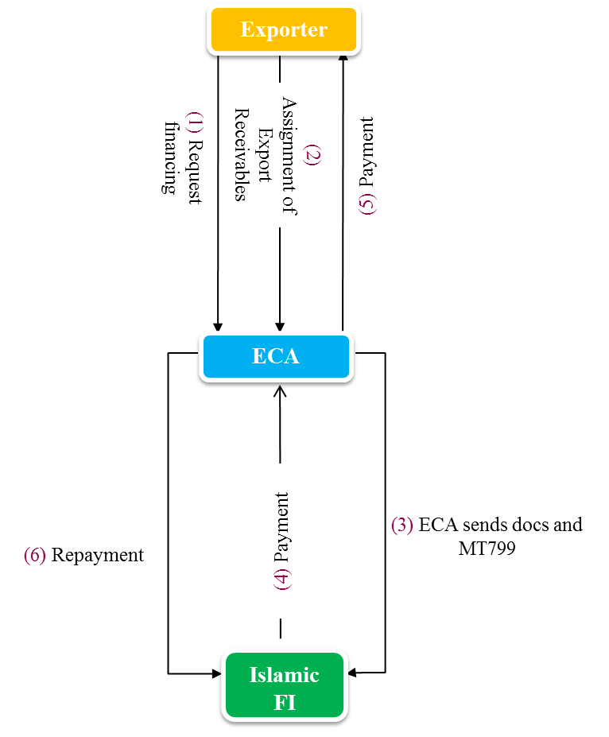
4- Two-Step Murabaha for ECA Export Financing

Slide 7
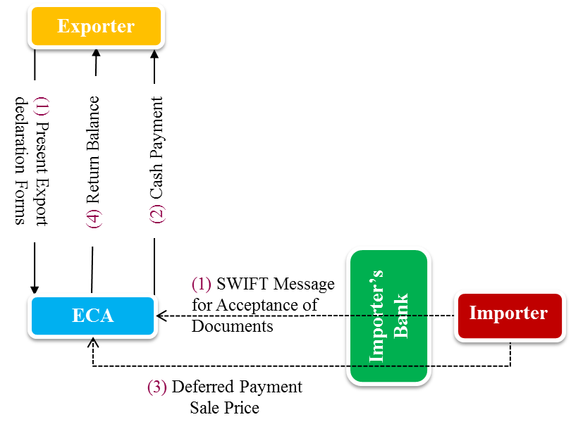
5- Assignment of Export Receivable

Slide 8
6- Restricted Mudaraba

Slide 9
Thank You!

