Slide 1
Program Management and Information System (Online Monitoring)
March 9th, 2020
Ali ORUÇ
Expert
COMCEC
COORDINATION
OFFICE
cpf.comcec.org

Slide 2
Purpose of the Presentation
Inform the project personnel on;
The advantages of online monitoring
The basic working principles of the PMIS
And how to work with it efficiently
Logging in the PMIS
Accessing sections and subsections
Uploading and downloading documents
COMCEC
2
COORDINATION
OFFICE

Slide 3
Online Monitoring
LOGGING IN
COMCEC
3
COORDINATION
OFFICE

Slide 4
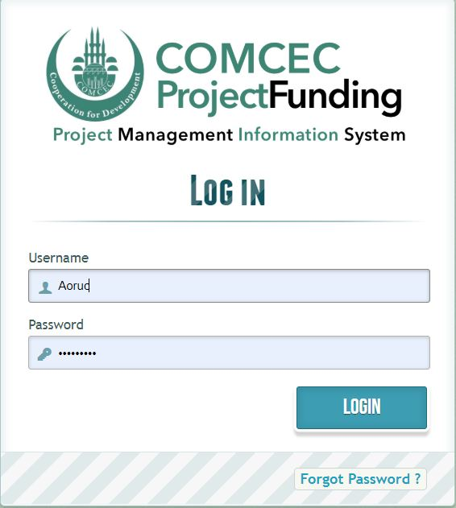
Online Monitoring
project.comcec.org
Login the system
with your username
and password
COMCEC
4
COORDINATION
OFFICE

Slide 5
Online Monitoring
WELCOME PAGE
COMCEC
5
COORDINATION
OFFICE

Slide 6
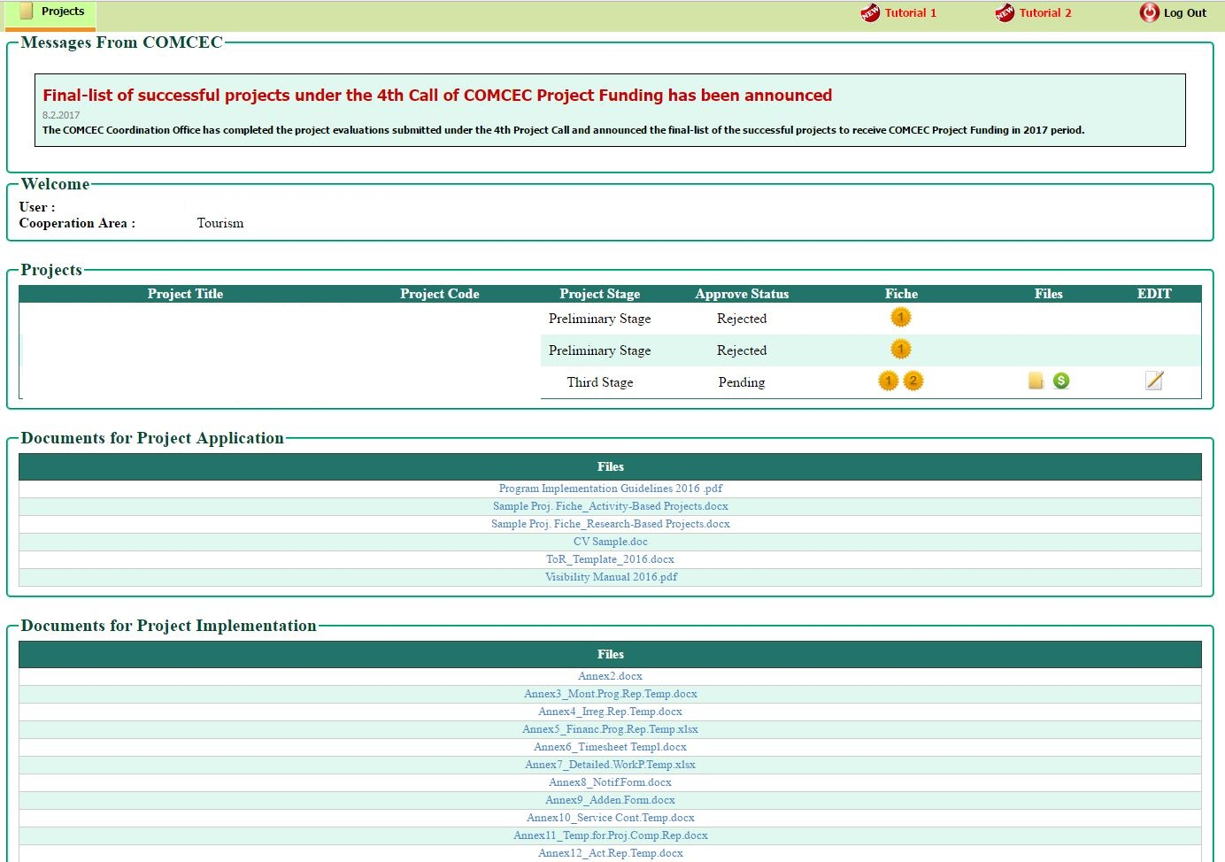
Your project
will appear here
Click here to
begin editing
COMCEC
6
COORDINATION
OFFICE

Slide 7
Online Monitoring
USER INTERFACE
COMCEC
7
COORDINATION
OFFICE

Slide 8
Online Monitoring
Click here to enlarge the file tree.
COMCEC
8
COORDINATION
OFFICE

Slide 9
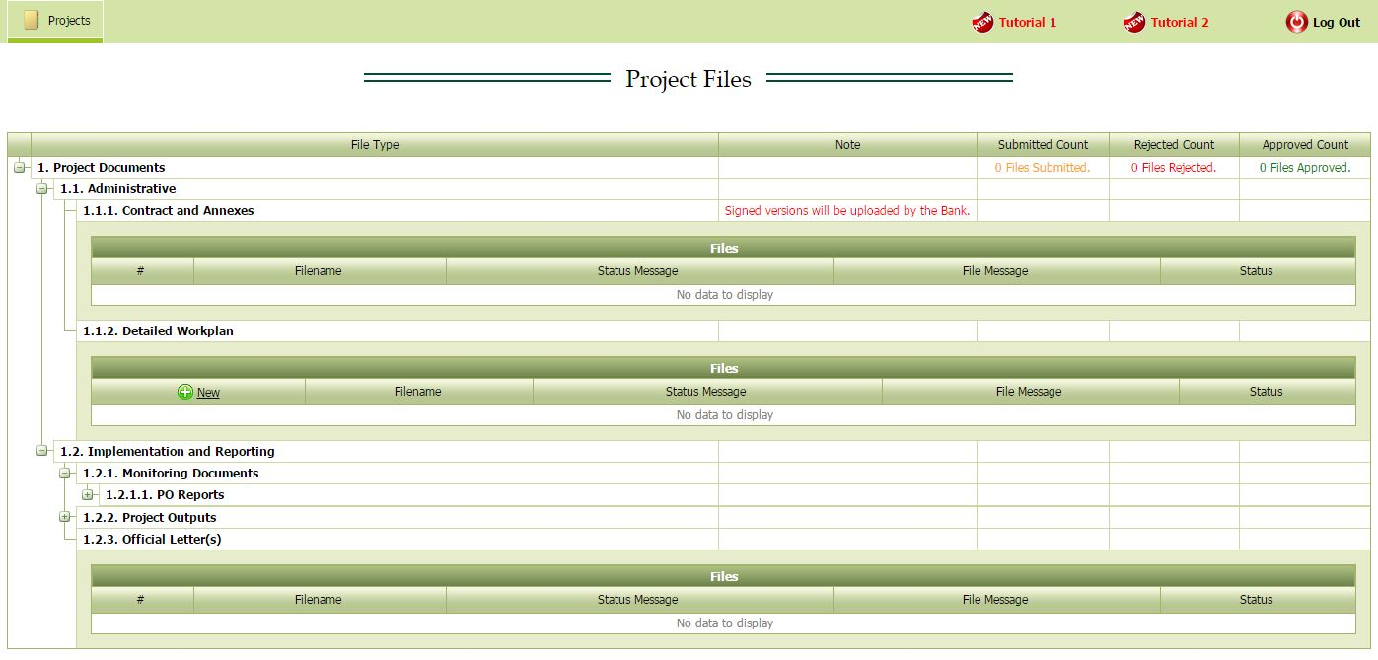
You may click to
Open/close each sub file tree
COMCEC
9
COORDINATION
OFFICE

Slide 10
IMPORTANT: PO cannot upload any documents before project’s Detailed Work Plan is approved by the CCO
COMCEC
10
COORDINATION
OFFICE

Slide 11
Online Monitoring
UPLOADING A DOCUMENT
COMCEC
11
COORDINATION
OFFICE

Slide 12
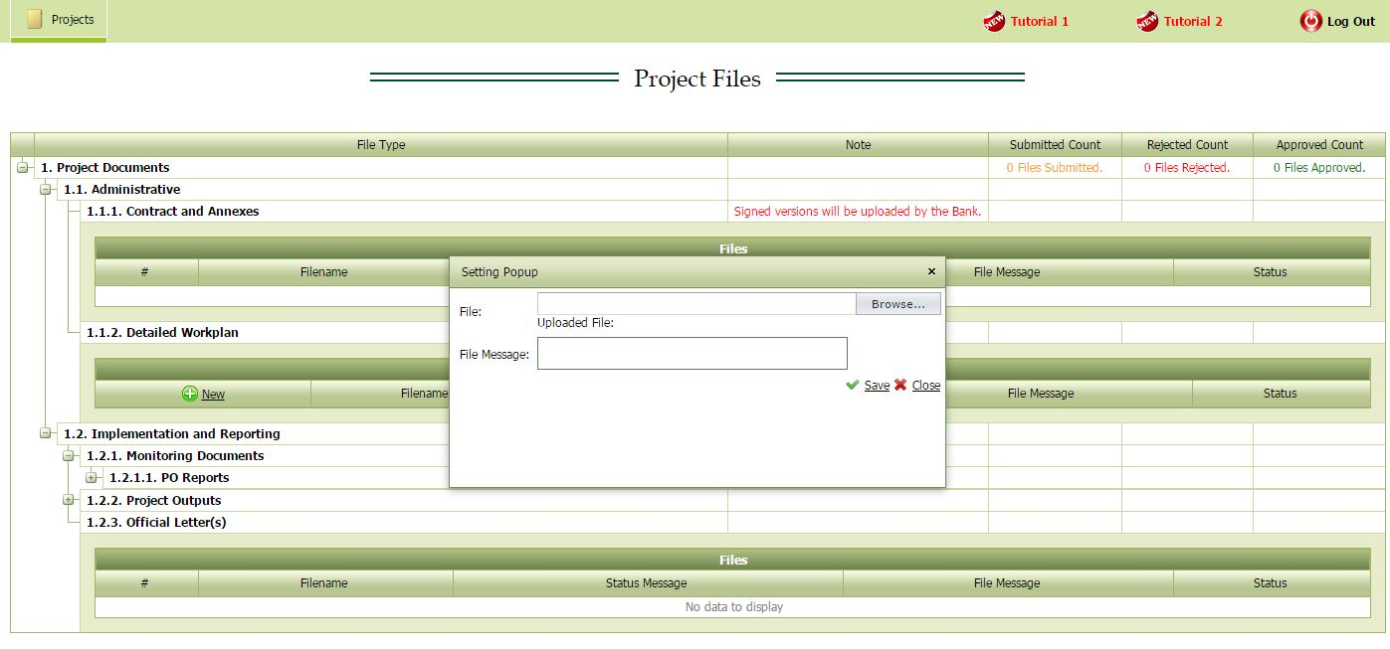
To add a new document, simply click ‘New’ button and add the document with your explanation, then click save.
COMCEC
12
COORDINATION
OFFICE

Slide 13
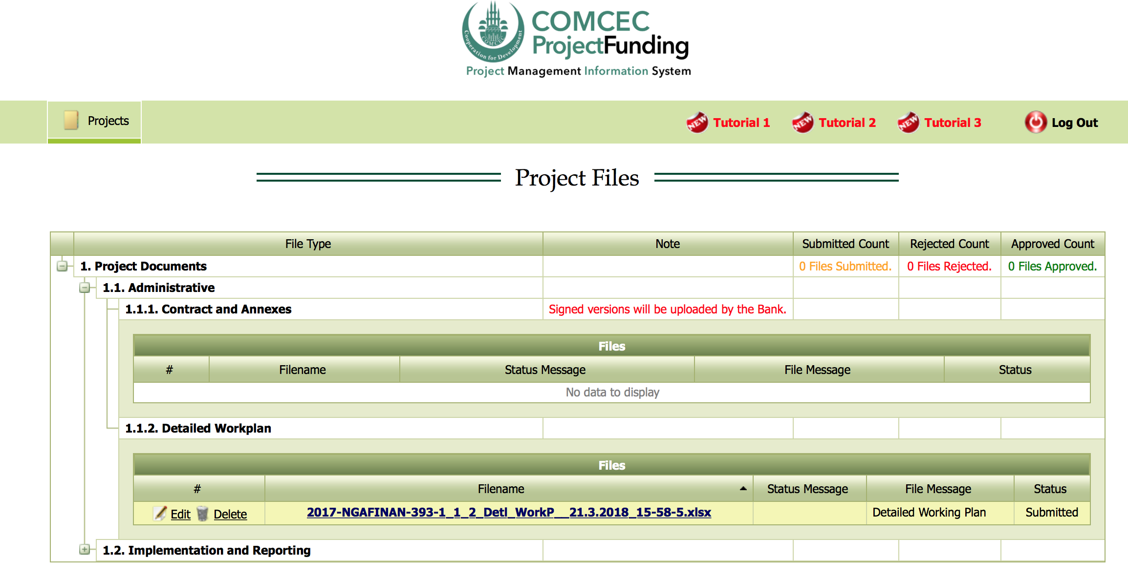
YELLOW: Submitted
COMCEC
13
COORDINATION
OFFICE

Slide 14
Online Monitoring
Possible Actions by the CCO or Bank
Rejection (to be revised by the PO)
Approval
COMCEC
14
COORDINATION
OFFICE

Slide 15
Online Monitoring
1.REJECTION
COMCEC
15
COORDINATION
OFFICE

Slide 16
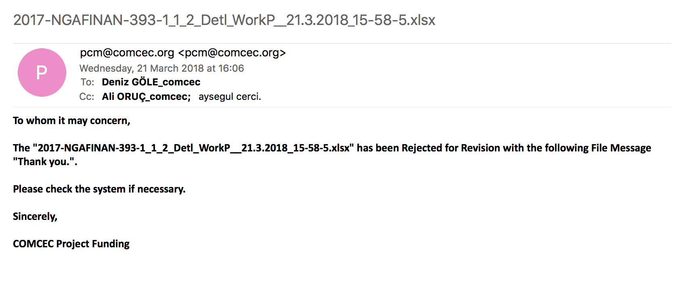
Automated E-Mail Message
COMCEC
16
COORDINATION
OFFICE

Slide 17
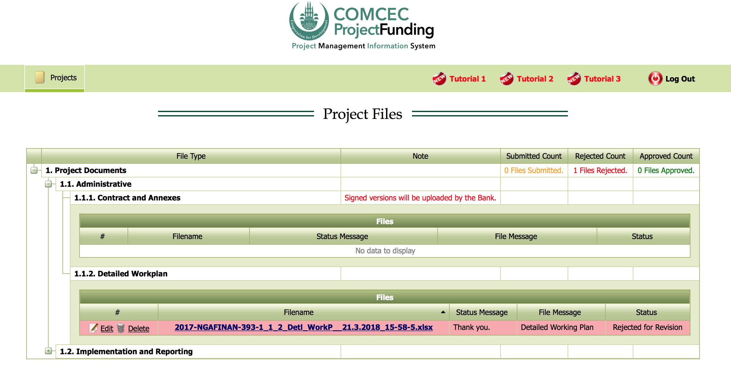
RED: Rejected for Revision
COMCEC
17
COORDINATION
OFFICE

Slide 18
Click Edit to upload the revised document
COMCEC
18
COORDINATION
OFFICE

Slide 19
Online Monitoring
2.APPROVAL
COMCEC
19
COORDINATION
OFFICE

Slide 20
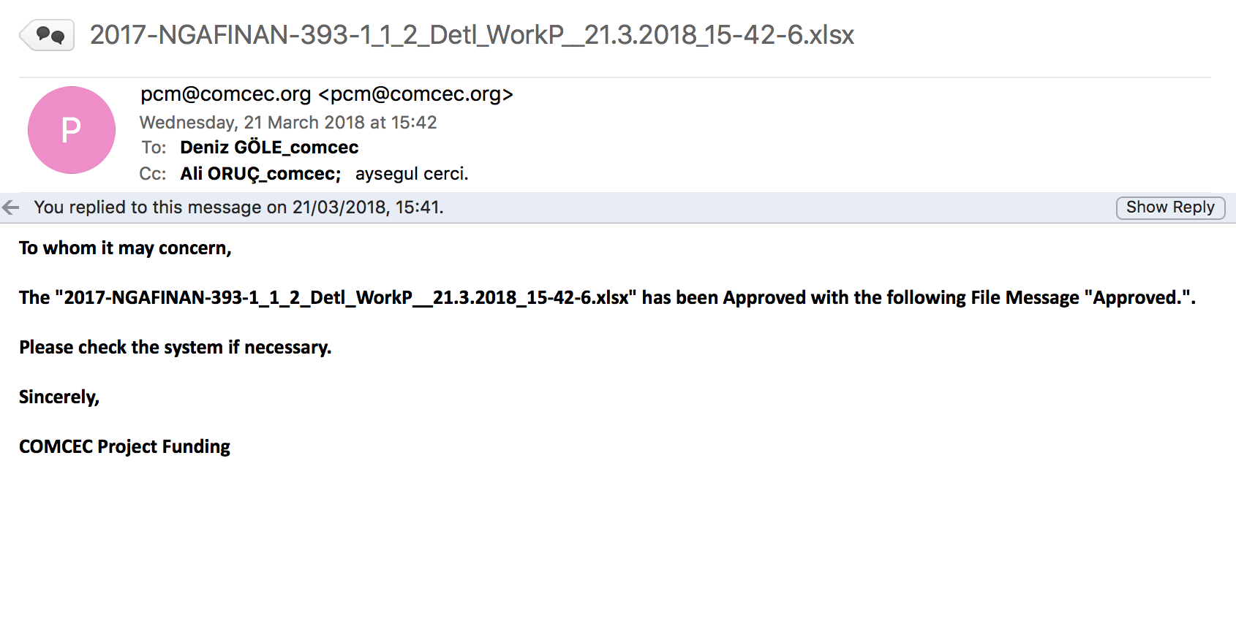
Online Monitoring
Automated E-Mail Message
COMCEC
20
COORDINATION
OFFICE

Slide 21
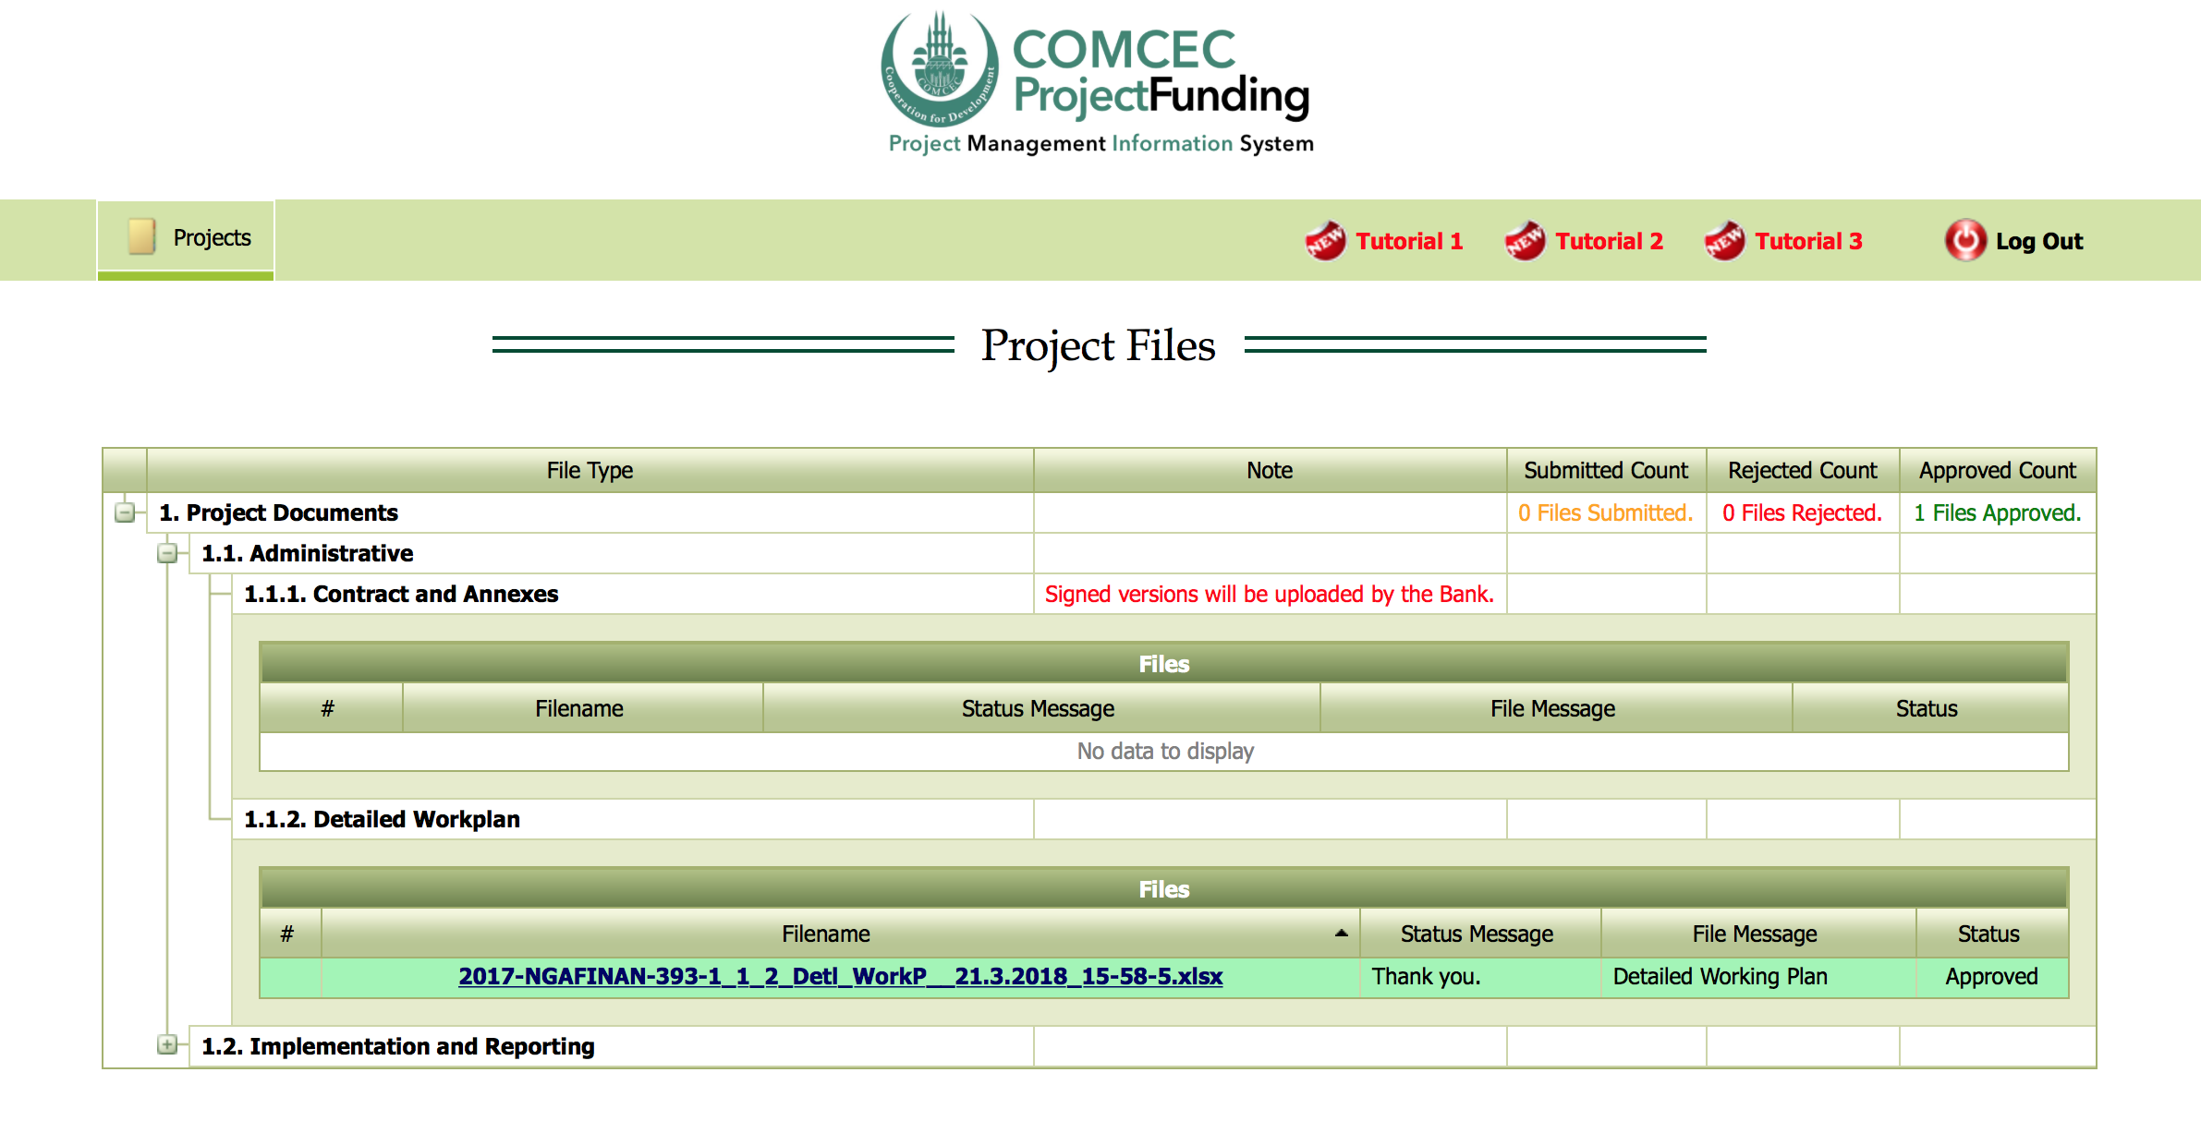
GREEN: Approved
COMCEC
21
COORDINATION
OFFICE

Slide 22
Online Monitoring
STATUS BAR AND DOWNLOADING DOCUMENTS
COMCEC
22
COORDINATION
OFFICE

Slide 23
Online Monitoring
the overall status of the documents can be monitored here.
COMCEC
23
COORDINATION
OFFICE

Slide 24
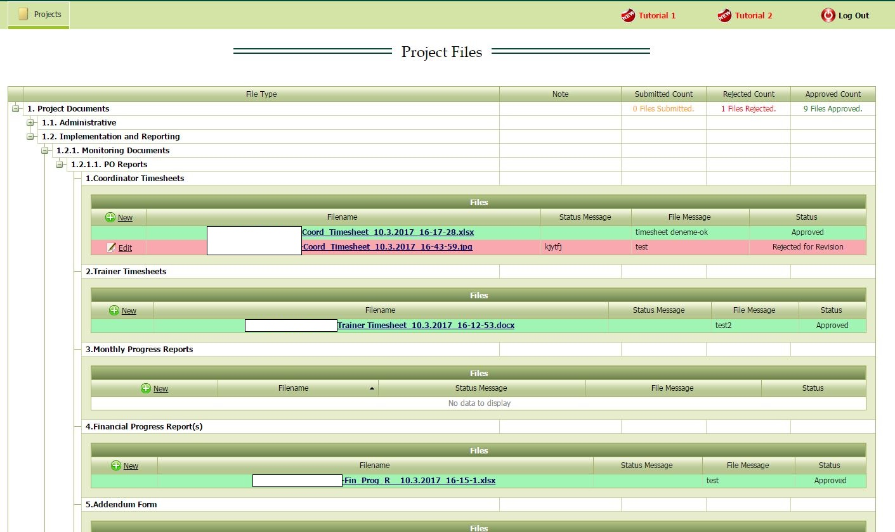
You may click and download the previously uploaded documents
COMCEC
24
COORDINATION
OFFICE

Slide 25
Online Monitoring
For Your Reference
1.1. Administrative | 1.2. Implementation and Reporting
1.1.1. Contract and Its Annexes 1.1.2. Detailed Work Plan | 1.2.1. Monitoring Documents 1.2.1.1. PO Reports Coordinator Timesheet Trainer Timesheet Monthly Progress Reports Financial Progress Reports Addendum Irregularity Report Activity Report Project Completion Report 1.2.2. Project Outputs Project Training Materials Visual Materials
COMCEC
25
COORDINATION
OFFICE

Slide 26
Online Monitoring
DEMONSTRATION
COMCEC
26
COORDINATION
OFFICE

