Slide 1
From Single Window to Cross-Border Paperless Trade:
Recent Developments in Asia and the Pacific
The 9th Meeting of the COMCEC Trade Working Group,
Ankara, Turkey, 9 March 2017
Dr Tengfei Wang
Trade Facilitation Unit
Trade, Investment and Innovation Division
United Nations Economic and Social Commission for Asia and the Pacific
wangt@un.org

Slide 2
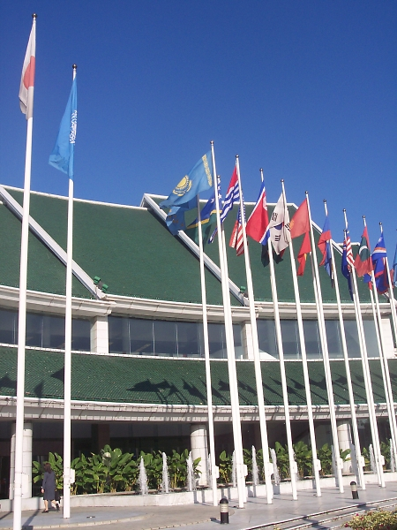
United Nations Economic and Social Commission
for Asia and the Pacific (UNESCAP)
UN ESCAP - Asia and the Pacific Regional Branch of the United Nations Secretariat
53 member countries covering Central,
South, Southeast, East and South Pacific
countries
Mandate: Promote sustainable and inclusive socio-economic development in Asia and
the Pacific through regional cooperation
Areas covered: Trade, Investment and
Innovation, Transport, Macroeconomic
Policy, Environment, Social issues, ICT…
    Trade, Investment and Innovation:
    Trade Facilitation;
    Trade Policy;
    Investment and Enterprise Development;
    Science, Technology and Innovation

Slide 3

COMCEC and ESCAP common members
COMCEC
15 common members:
Afghanistan, Azerbaijan, Bangladesh,
Brunei Darussalam, Indonesia, Iran,
Kazakhstan, Kyrgyzstan, Malaysia,
Maldives, Pakistan, Tajikistan, Turkey,
Turkmenistan and Uzbekistan
2 observers to COMCEC:
Russian Federation and Thailand
ESCAP

Slide 4
What is Single Window?
UNCEFACT Recommendation 33:
  “As specified in UN/CEFACT Recommendation Number 33, the Single Window concept covered in these Guidelines refers to a facility that allows parties involved in trade and transport to lodge standardized information and documents with a single entry point to fulfil all import, export, and transit-related regulatory requirements. If information is electronic, then individual data elements should only be submitted once.”
WTO Trade Facilitation Agreement:
  4 Single Window
    4.1 Members shall endeavour to establish or maintain a single window, enabling traders to submit documentation and/or data requirements for importation, exportation, or transit of goods through a single entry point to the participating authorities or agencies. After the examination by the participating authorities or agencies of the documentation and/or data, the results shall be notified to the applicants through the single window in a timely manner.
    4.2 In cases where documentation and/or data requirements have already been received through the single window, the same documentation and/or data requirements shall not be requested by participating authorities or agencies except in urgent circumstances and other limited exceptions which are made public.
    4.3 Members shall notify the Committee of the details of operation of the single window.
    4.4 Members shall, to the extent possible and practicable, use information technology to support the single window.

Slide 5
Outline
Trade facilitation and paperless trade implementation in Asia and the Pacific: an overview
Lessons learnt in developing Single Windows in Asia-Pacific region
Framework Agreement on the Facilitation of Cross-Border Paperless Trade in Asia and the Pacific
ESCAP’s support in Single Window and paperless trade

Slide 6
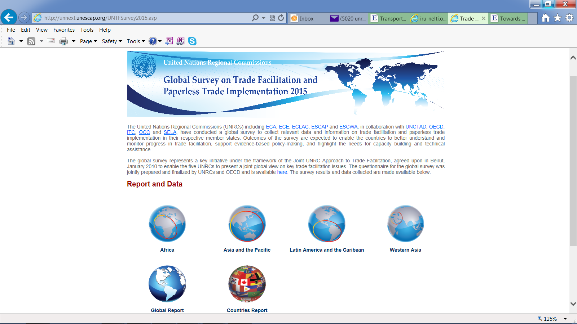
United Nations Regional Commissions
Global Survey on Trade Facilitation and
Paperless Trade Implementation
  unnext.unescap.org/UNTFSurvey2015.asp

Slide 7
Survey process and results
Globally, data were collected from 119 economies across 8 regions
In Asia-Pacific region, the survey covered 44 countries.
A three-step approach was adopted to ensure data reliability.
  Data submission by experts
  Data verification by the ESCAP secretariat
  Data validation by national governments

Slide 8
Survey Scope
General TF Measures | Trade facilitation measure (and question no.) in survey questionnaire
 | Transparency 2. Publication of existing import-export regulations on the Internet 3. Stakeholder consultation on new draft regulations 4. Advance publication/notification of new regulations before their implementation 5. Advance ruling 9. Independent appeal mechanism
 | Formalities 6. Risk management 7. Pre-arrival processing 8. Post-clearance audit 10. Separation of release from final determination of duties, taxes, fees and charges 11. Establishment and publication of average release times 12. Trade facilitation measures for authorized operators 13. Expedited shipments 14. Acceptance of paper or electronic copies
 | Institutional arrangement and cooperation 1. Establishment of a national trade facilitation committee 31. Cooperation between agencies on the ground at the national level 32. Government agencies delegating controls to Customs authorities 33. Alignment of working days and hours with neighbouring countries at border crossings 34. Alignment of formalities and procedure with neighbouring countries at border crossings
Notes:
Notably,
The survey instrument was prepared taking into account the WTO TFA’s final provisions, as well as the draft text of the regional UN treaty on cross-border paperless TF under negotiation at ESCAP.
To ensure comparability of implementation levels across countries, Institutional arrangement and cooperation (No. 33, 34), Paperless trade (No. 20), and Transit facilitation (No. 35) are excluded from the regional analysis.
3) For the purpose of analysis and presentation of results, General TF measures have been further divided into 3 subgroups: Transparency, Formalities and Institutional arrangement and cooperation.
See ANNEX for 38-item survey questionnaire

Slide 9
Survey Questionnaire
Trade facilitation measure (and question no.) in survey questionnaire
Paperless trade 15. Electronic/automated Customs System established 16. Internet connection available for Customs and other trade control agencies at border-crossings 17. Electronic Single Window System 18. Electronic submission of Customs declarations 19. Electronic Application and Issuance of Trade Licenses 20. Electronic Submission of Sea Cargo Manifests 22. Electronic Application and Issuance of Preferential Certificate of Origin 23. E-Payment of Customs Duties and Fees 24. Electronic Application for Customs Refunds
Cross-border paperless trade 25. Laws and regulations for electronic transactions are in place 26. Recognized certification authority issuing digital certificates to traders for electronic transactions 27. Engagement of the country in trade-related cross-border electronic data exchange 28. Certificate of origin electronically exchanged 29. Sanitary and Phytosanitary (SPS) Certificate electronically exchanged 30. Banks and insurers retrieving letters of credit electronically without paper-based documents
Transit Facilitation 35. Transit facilitation agreement(s) with neighbouring countries 36. Customs Authorities limit the physical inspections of transit goods and use of risk assessment 37. Supporting pre-arrival processing for trade facilitation 38. Cooperation between agencies of countries involved in transit
Notes:
Notably,
The survey instrument was prepared taking into account the WTO TFA’s final provisions, as well as the draft text of the regional UN treaty on cross-border paperless TF under negotiation at ESCAP.
To ensure comparability of implementation levels across countries, Institutional arrangement and cooperation (No. 33, 34), Paperless trade (No. 20), and Transit facilitation (No. 35) are excluded from the regional analysis.
3) For the purpose of analysis and presentation of results, General TF measures have been further divided into 3 subgroups: Transparency, Formalities and Institutional arrangement and cooperation.
See ANNEX for 38-item survey questionnaire

Slide 10
Overall implementation of trade facilitation measures in 44 Asia-Pacific economies surveyed
East and North-
East Asia (69.6%)ª
Australia and New Zealand (86.6%) ª
South-East Asia (56.1%) ª
South and South-West Asia (41.3%) ª
North and Central Asia (41.5%) ª
Pacific Islands Developing Economies (25.2%) ª

Slide 11
Implementation of different groups of trade facilitation measures: Asia-Pacific average
Note: Blue dots show regional average implementation level of individual measures within each group.
Average regional implementation level by groups of measures.

Slide 12
Implementation of “paperless trade” measures: Asia-Pacific average

Slide 13
Single Window and other initiative for cross-border paperless trade
Type |  | Countries/Economies/Cases
National Electronic single Window | fully implemented | Azerbaijan, Japan, Indonesia, Malaysia, Republic of Korea, Singapore, Thailand
 | Partially implemented | Armenia, China, India, Kyrgyzstan, Philippines and Turkey
Bilateral Initiatives (examples) |  | Electronic Certificate of Origin between Republic of Korea and Taiwan Province of China Electronic Exchange of Preferential Certificate of Origin among ASEAN members Electronic Sanitary and Phyto-Sanitary (e-SPS) exchange between Australia and New Zealand
Subregional Initiatives |  | ASEAN Single Window Pan Asian e-Commerce Alliance (PAA) SASEC Customs data exchange Eurasian Economic Union
Source: updated from the Survey on trade facilitation and paperless trade implementation, 2015

Slide 14
Outline
Trade facilitation and paperless trade implementation in Asia and the Pacific: an overview
Lessons learnt in developing Single Windows in Asia-Pacific region
Framework Agreement on the Facilitation of Cross-Border Paperless Trade in Asia and the Pacific
ESCAP’s support in Single Window and paperless trade

Slide 15
Requirements to Single Window Implementation
Stakeholder
Coordination
Legal
Framework
Political
Will
(Mandate)
Business
Model
Technical
Issues
Notes:
Implementing a Single Window demands several prerequisites. Implementing a Single Window is not simply developing an automation system. Rather, it is a process of creating an enabling environment for a Single Window to properly operate. The five core prerequisites are:
Political will with strategic mandate. For the success, you should have a strong political commitment at high-level. If such political commitment is aligned to national strategic mandate, it increases the chance of succcess.
Once you have political commitment, you have to coordinate stakeholders. Implementing a Single Window involves active participation of stakeholders from both public and private sectors. Unless stakeholders are properly coordinated, Single Window implementation can face great difficulty.
Implementing a Single Window also needs legal support. Unless there is clear legal basis and supportive legal provisions, a Single Window cannot be properly implemented and operated.
You have to also think about proper business model for implementation and operation of a Single Window. Because “one size cannot fit all,” you have to choose most suitable business model based on national requirements.
Implementing a Single Window demands to resolve issues of technical nature such as process simplification, data harmonization, and application of information and communication technology.

Slide 16






Korean Case: Political Commitment at the Top Level
National e-Trade Committee
Private e-Trade Committee
Chair : Prime Minister
Chair : Dr. Jung Uck, Seo
Administrative Committee
Chair : Vice Minister of MOCIE
Korea e-Trade Facilitation Center
Platform
W/G
Law
W/G
Finance
W/G
Logistics
W/G
Marketing
W/G
Global
W/G
e-TP PM
e-TDR
Law Reform
e-L/C
e-Nego
RFID
e-L/G
e-D/O
e-MP
e-Catalog
Solutions
e-C/O
e-B/L
APEC,ASEM
Bilateral Networking
Source: Hee-Chul Jung, “Republic of Korea” UN/CEFACT Single Window Repository
Notes:
The level of political commitment and push might vary from country to country. Most importantly there must be a champion with the power to take decisions and enforce them. As you can see in the slide, the national single window in the Republic of Korea was championed by the Prime Minster. In the case of national Single Window in Singapore, it was championed by then the Minister for Trade and Industry, who is currently Prime Minister.

Slide 17
Thai Case: Political link through Strategic Mandate
Vision
World Class Logistics System to support Thai Business and Industries
Objectives
Cost Efficiency / Responsiveness / Reliability and Security
Business value creation
Strategic
Agendas
Manufacturing Logistics improvement
Infrastructure and logistics network optimization
Logistics service international-ization
Trade facilitation enhancement
Capacity building
1
2
3
4
5
2. Manufacturing logistics Action Plan
5. Logistics data system Action Plan
3. Trade logistics Action Plan
4. Single Window e-Logistics Development Plan (SWeL)
1. Urgent logistics Development
AP 2007
6. Logistics human resource development Action Plan
Source: Suriyon (NESDB), ESCAP/ECE SW Workshop, Mongolia, 2009
Notes:
A Single Window implementation is better off if it is linked to national strategic mandate for its sustainability and support. As you can see in the slide, Single Window implementation was not an isolated project. It was part of national vision to realize ‘World class logistics system to support Thai business and industries.” Therefore, the “Single Window e-Logistics Development Plan” was tightly linked to strategic agendas, objectives and ultimately to vision.

Slide 18
Requirements to Single Window Implementation
Stakeholder
Coordination
Legal
Framework
Political
Will
(Mandate)
Business
Model
Technical
Issues
Notes:
Implementing a Single Window demands several prerequisites. Implementing a Single Window is not simply developing an automation system. Rather, it is a process of creating an enabling environment for a Single Window to properly operate. The five core prerequisites are:
Political will with strategic mandate. For the success, you should have a strong political commitment at high-level. If such political commitment is aligned to national strategic mandate, it increases the chance of succcess.
Once you have political commitment, you have to coordinate stakeholders. Implementing a Single Window involves active participation of stakeholders from both public and private sectors. Unless stakeholders are properly coordinated, Single Window implementation can face great difficulty.
Implementing a Single Window also needs legal support. Unless there is clear legal basis and supportive legal provisions, a Single Window cannot be properly implemented and operated.
You have to also think about proper business model for implementation and operation of a Single Window. Because “one size cannot fit all,” you have to choose most suitable business model based on national requirements.
Implementing a Single Window demands to resolve issues of technical nature such as process simplification, data harmonization, and application of information and communication technology.

Slide 19
Importance of Inter-agency Coordination: Indonesia
Indonesia National Single Window
(INSW)
Ministry Of Trade
Customs & Excise
FDA
Animal Quarantine
Fish Quarantine
POST & TELCo
Ministry of Industry
Ministry of Health
Ministry of ICT
Port Authority
Ministry of Transportation
Ministry of Defense
National Police
Nuclear Control NA
Ministry of Environment
Ministry of Energy
Central Bank
Ministry of Agriculture
Source: Muwasiq Noor, Capacity Building Workshop on Implementing Single Window Environment for Mongolia (2014)

Slide 20
Requirements to Single Window Implementation
Stakeholder
Coordination
Legal
Framework
Political
Will
(Mandate)
Business
Model
Technical
Issues
Notes:
Implementing a Single Window demands several prerequisites. Implementing a Single Window is not simply developing an automation system. Rather, it is a process of creating an enabling environment for a Single Window to properly operate. The five core prerequisites are:
Political will with strategic mandate. For the success, you should have a strong political commitment at high-level. If such political commitment is aligned to national strategic mandate, it increases the chance of succcess.
Once you have political commitment, you have to coordinate stakeholders. Implementing a Single Window involves active participation of stakeholders from both public and private sectors. Unless stakeholders are properly coordinated, Single Window implementation can face great difficulty.
Implementing a Single Window also needs legal support. Unless there is clear legal basis and supportive legal provisions, a Single Window cannot be properly implemented and operated.
You have to also think about proper business model for implementation and operation of a Single Window. Because “one size cannot fit all,” you have to choose most suitable business model based on national requirements.
Implementing a Single Window demands to resolve issues of technical nature such as process simplification, data harmonization, and application of information and communication technology.

Slide 21
Legal Framework
Enabling Legal Environment
Legal basis for
Single Window
e-Documents
Liability
Data protection
e-Archiving
Data quality
Data access
authority
Competition
Arbitration and
dispute resolution
Single Window
structure &
organization
Identification,
authentication &
authorization
IPR and
data ownership
Source: UN/CEFACT Recommendation 35
Notes:
Creating an enabling legal environment involves enacting new laws as well as revising existing legal provisions.
The legal issues to be taken into account includes:
1. Legal basis for establishing a Single Window
2. Legal validity of electronic document
3. Issue of liability
4. Data protection
5. e-Archiving of trade data
6. Data quality
7. Data access authority
8. Competition
9. Arbitration and dispute resolution
10. Intellectual property right and data ownership
11. Single Window structure and organization, and
12. Identification, authentication & authorization

Slide 22
Requirements to Single Window Implementation
Stakeholder
Coordination
Legal
Framework
Political
Will
(Mandate)
Business
Model
Technical
Issues
Notes:
Implementing a Single Window demands several prerequisites. Implementing a Single Window is not simply developing an automation system. Rather, it is a process of creating an enabling environment for a Single Window to properly operate. The five core prerequisites are:
Political will with strategic mandate. For the success, you should have a strong political commitment at high-level. If such political commitment is aligned to national strategic mandate, it increases the chance of succcess.
Once you have political commitment, you have to coordinate stakeholders. Implementing a Single Window involves active participation of stakeholders from both public and private sectors. Unless stakeholders are properly coordinated, Single Window implementation can face great difficulty.
Implementing a Single Window also needs legal support. Unless there is clear legal basis and supportive legal provisions, a Single Window cannot be properly implemented and operated.
You have to also think about proper business model for implementation and operation of a Single Window. Because “one size cannot fit all,” you have to choose most suitable business model based on national requirements.
Implementing a Single Window demands to resolve issues of technical nature such as process simplification, data harmonization, and application of information and communication technology.

Slide 23
Steps for SW Implementation
e-Single Window & Paperless Trading
Cross Border Data Harmonization & Exchange
National Data Harmonization
Documentation Simplification & Standardization
Process Simplification & Harmonization
Business Process Analysis
Source: UNECE, 2006, Background Paper for UN/CEFACT Symposium on
Single Window Common Standards and Interoperability

Slide 24


Documents related to Exportation of Rice
(from purchase order until the cargo container leaving the sea port)
Thai Case Example
36 Documents involving 15 parties, and more than 1,140 data elements to be filled in
Proforma Invoice (35)
Purchase Order (39)
Commercial Invoice (51)
Application for Letter of Credit (24)
Letter of Credit (32)
Packing List (25)
Cargo Insurance Application Form (20)
Cover Note (23)
Insurance Policy (24)
Booking Request Form – Border Crossing (25)
Booking Confirmation – Border Crossing (30)
Booking Request Form – Inland Transport (16)
Booking Confirmation – Inland Transport (18)
Bill of Lading (42)
Empty Container Movement Request (TKT 305) (20)
Request for Port Entry (TKT 308.2) (27)
Equipment Interchange Report (EIR) (24)
Container Loading List (28)
Container List Message (32)
Outward Container List (34)
Master Sea Cargo Manifest(17)
House Sea Cargo Manifest (37)
Export Declaration (114)
Good Transition Control List (27)
Application for Permission to Export Rice (KP. 2) (24)
Sales Report (KP 3) (21)
Application for the Collection of the Permit for the Export of Rice (A. 3) (35)
Permit for the Export of Rice (A. 4) (35)
Application for Certificate of Standards of Product (MS. 13/1) (44)
Certificate of Analysis (17)
Certificate of Product Standards (MS. 24/1) (45)
Certificate of Fumigation (21)
Application for Phytosanitary Certificate (PQ. 9) (29)
Phytosanitary Certificate (33)
Application for Certificate of Origin (42)
Certificate of Origin (38)
Buy/Pay Docs
Regulatory Docs
Transport Docs
* Number in parenthesis is
the no. of data elements

Slide 25
Documentation Simplification and Data Harmonization
“Thailand completed the harmonization of data required by 21 regulatory agencies under its national project. Around 6,765 data elements extracted from 189 documents were reduced to 259 data elements.” (source: UNNExT Policy Brief 1).
“efforts were made to reduce the 20 forms used in international trade into a single online form to serve nearly all trade documentation needs in Singapore) (Source: UNNExT Policy Brief 2)

Slide 26
An Evolutionary Long-term Roadmap for SW Development
(but not necessary in a sequential fashion)
Stage A: [Customs SW] Paperless Customs + e-Payment for Customs Duty + e-Manifest +
and electronic risk-based inspection
Stage B: [Regulatory SW] Connecting Other Government Back-end IT systems, and
e-Permit/e-Certificate Exchange with Paperless Customs System
Stage C: [PCS] e-Document/Data Exchange among Stakeholders within the (air, sea) port community
A regional information exchange system or
cross-border
paperless trade
Stage D: [Integrated SW] An integrated
national logistics platform also with
traders, regulators and logistics-service
providers information exchange
National e-logistics Platform
Traders
Port Community System
Information Exchange
Stage E: A regional
information-exchange
environment
Other Regulatory Agencies for
E-Permits/e-Certificates Exchange
Banks
for various
kinds
of e-payment
Freight
Forwarders
Paperless
Customs
Insurance
Companies
Internet
NSW
Freight
Forwarders
and Logistics
Service
Providers
Importer/Exporter/
Customs Broker/
Representative/
other Stakeholders
Airlines
Duty Free Zones
Air Port Authority
Port Authority
etc.
Note 1 - Stage C can be developed
before with Stage B.
Note 2 – The evolution may not be sequential,
e.g. Stage B & C may be developed seperately
in parallel, and may then be interconnected later.
Terminal
Operators
Ship Agents/
Vessels
Notes:
Policymakers and managers can use this simplified evolutionary long-term Roadmap
to (a) assess their current status by comparing with different stages and their preferred functions in this Roadmap, and
(b) determine the next stage for their next step of SW development.

Slide 27
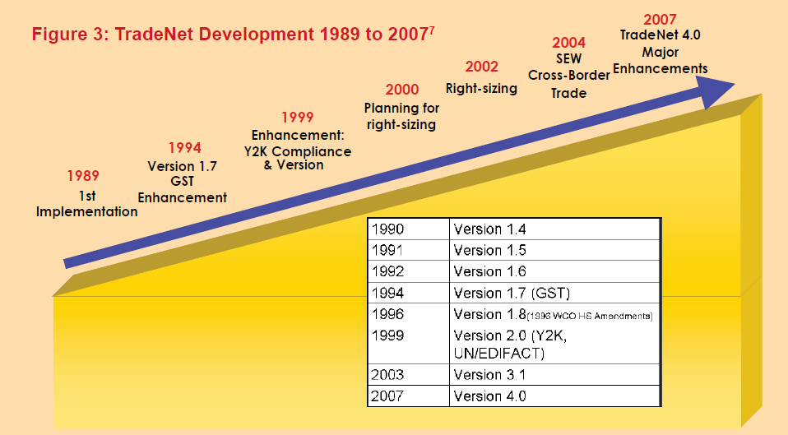
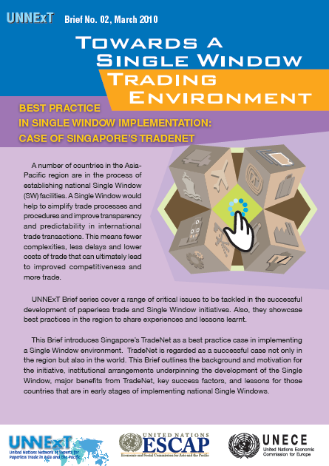
SW development in Singapore
Source: UNNExT Policy Brief 2 prepared by Jonathan Koh

Slide 28
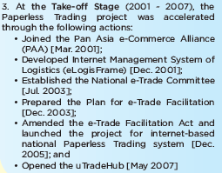
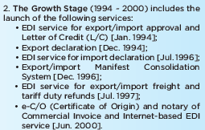
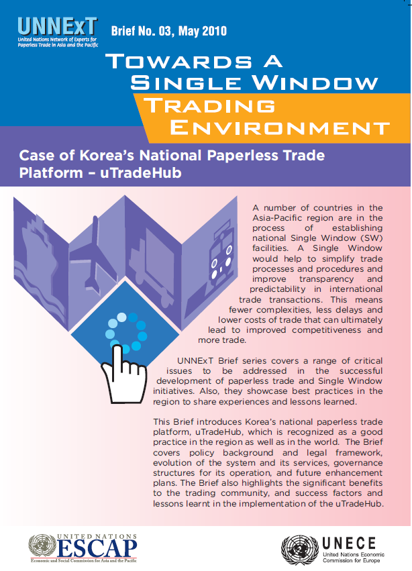
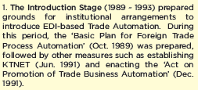
Korea’s uTradeHub
Source: UNNExT Policy Brief 3 prepared by Juyeon Ha

Slide 29
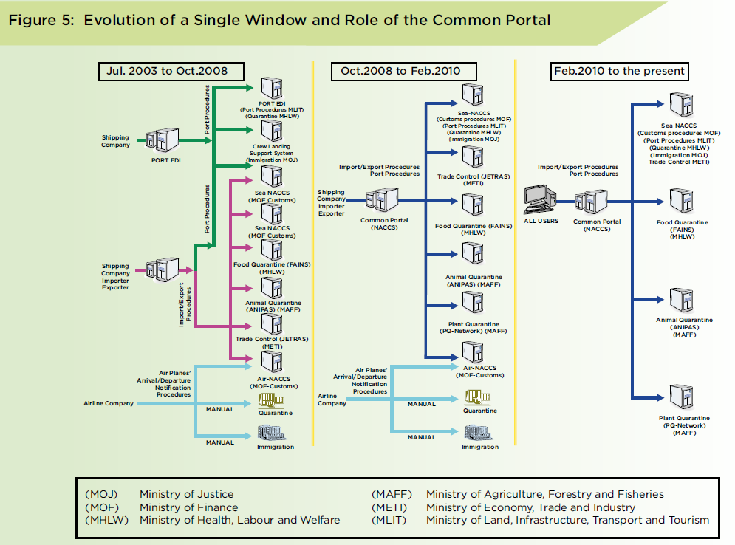
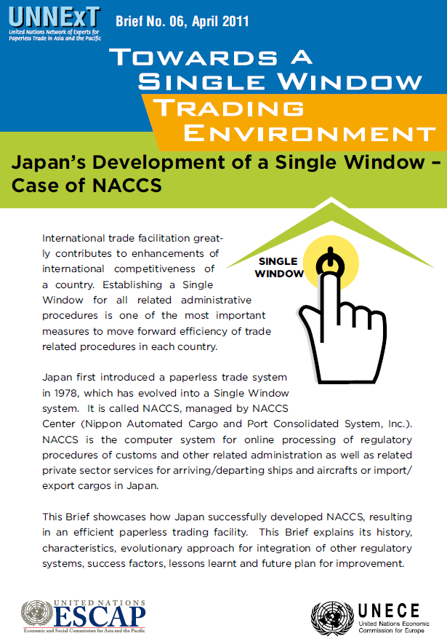
SW in Japan
Source: UNNExT Policy Brief 6 prepared by Takuya Sawafuji

Slide 30
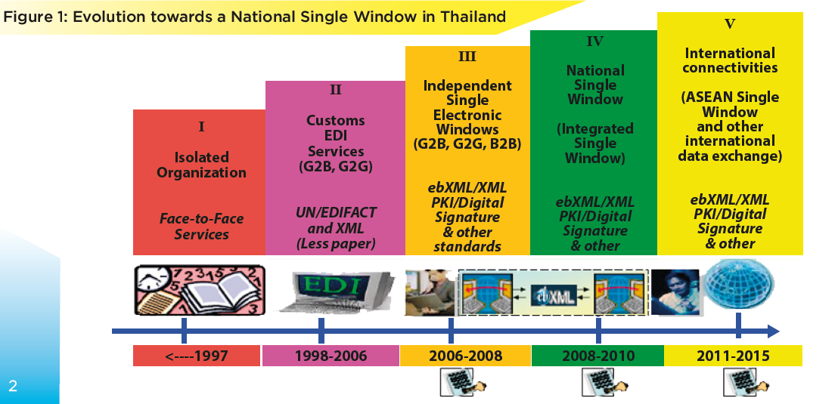

SW in Thailand
UNNExT Policy Brief 8 prepared by Sinmahat Kiatjanon

Slide 31
Requirements to Single Window Implementation
Stakeholder
Coordination
Legal
Framework
Political
Will
(Mandate)
Business
Model
Technical
Issues
Notes:
Implementing a Single Window demands several prerequisites. Implementing a Single Window is not simply developing an automation system. Rather, it is a process of creating an enabling environment for a Single Window to properly operate. The five core prerequisites are:
Political will with strategic mandate. For the success, you should have a strong political commitment at high-level. If such political commitment is aligned to national strategic mandate, it increases the chance of succcess.
Once you have political commitment, you have to coordinate stakeholders. Implementing a Single Window involves active participation of stakeholders from both public and private sectors. Unless stakeholders are properly coordinated, Single Window implementation can face great difficulty.
Implementing a Single Window also needs legal support. Unless there is clear legal basis and supportive legal provisions, a Single Window cannot be properly implemented and operated.
You have to also think about proper business model for implementation and operation of a Single Window. Because “one size cannot fit all,” you have to choose most suitable business model based on national requirements.
Implementing a Single Window demands to resolve issues of technical nature such as process simplification, data harmonization, and application of information and communication technology.

Slide 32
Investment and business model
In Singapore: “The direct capital cost of TradeNet’s development, i.e., contract cost to IBM and other sub
contractors was in excess of S$20 million in 1987. This does not include the costs incurred by various agencies in conceiving the project, developing requirements and specifications, managing contract or establishing SNS.” (Source: UNNExT Policy Brief 2).
In Thailand: “The cost of the THAI-NSW’s developments (phase 1 & phase 2) was about US$ 14 millions, excluding expenditures individually incurred by relevant government agencies and trading communities. All government agencies and traders can participate in the Single Window environment free of charge.” (Source: UNNExT Policy Brief 8).

Slide 33
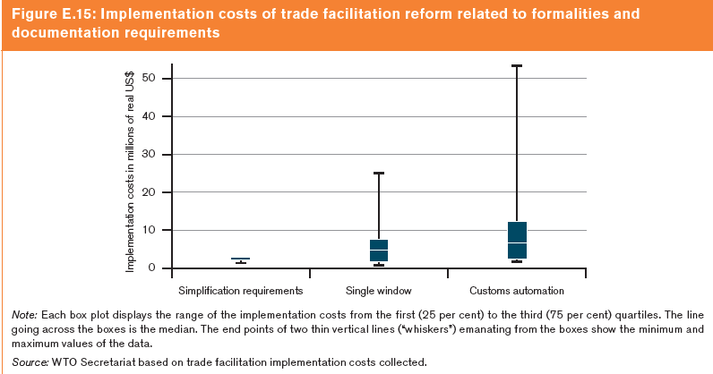
Inception costs
Source: WTO , World Trade Report 2015, page 122.

Slide 34
Challenges and Success Factors in Malaysia (1)
Main challenges
Success Factors
Key drivers (Lead agency and other government agencies) may not get the budget timely to put in place requirements to support the implementation of the NSW.
Many players involved and it requires efficient coordination.
Level of computerization of business processes differs from one organization/agency to another organization/agency and difference in data standard could lead to more complexity.
1. Political will and commitment in terms of national policy and financial support.
2a. Identify a strong Lead agency and ensure that all players have a common understanding on the objectives of the NSW.
2b. Establish relevant bodies (such as steering committee, task force/working groups ) to undertake specific roles and responsibilities.
3a. Relevant agencies need to carry out business process re-engineering to streamline their respective business processes.
3b. Identify the champion to coordinate the business process re-engineering activities carried out individual agency including adoption of international standard for data standardization and harmonization.
Source: Marainne Wong Mee Wan at the Asia-Pacific Trade Facilitation Forum 2014

Slide 35
Challenges and Success Factors in Malaysia…..cont.
Main challenges
Success Factors
Coping with changes to existing system is not an easy task.
Lacking ICT infrastructure particularly at remote locations could be an obstacle to the effectiveness of the NSW.
Establish efficient and effective change management policy and procedure.
Establish a strategic plan to address ICT infrastructure issues, if any.
Source: Marainne Wong Mee Wan at the Asia-Pacific Trade Facilitation Forum 2014

Slide 36
Thailand:
Ten Critical Success Components must be analyzed to understand the “as-is” and its bottlenecks, propose the “to-be”, reconcile and agree...
SW Vision and Political Will
Stakeholder Collaborative Platform
Governance & Finance Model
Business process analysis and improvement
Data Harmonization and document simplification
Application architecture design
Technology architecture design including
standards & technical interoperability
Legal Infrastructure
IT infrastructure & solutions design
Change adoption, operations, and sustainability
Strategic
Management
& Technical
IT Systems
Implementation
Operations
Source: Somnuk Keretho at the Asia-Pacific Trade Facilitation Forum 2013

Slide 37
Outline
Trade facilitation and paperless trade implementation in Asia and the Pacific: an overview
Lessons learnt in developing Single Windows in Asia-Pacific region
Framework Agreement on the Facilitation of Cross-Border Paperless Trade in Asia and the Pacific
ESCAP’s support in Single Window and paperless trade

Slide 38
State of implementation of “cross-border paperless trade” measures in Asia-Pacific economies (in %)

Slide 39
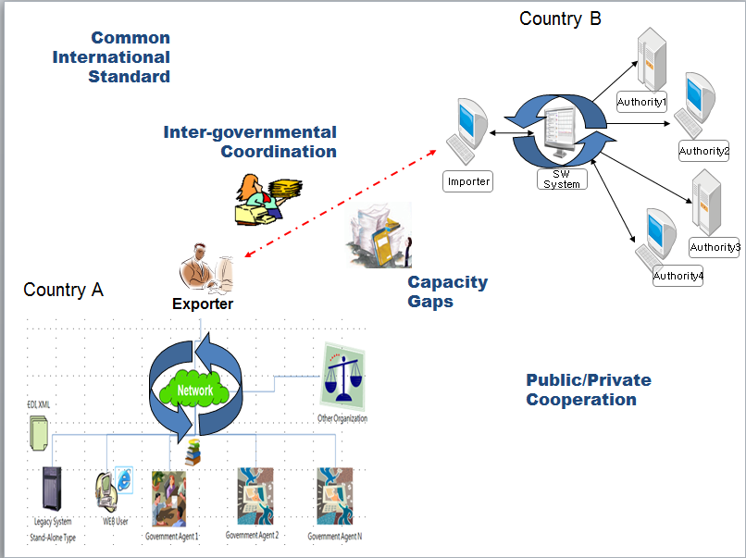
Challenges to moving forward on cross-border paperless trade
Adoption of common International Standards
Harmonization of legal frameworks
Capacity gaps among the parties (infrastructure & HR)
Cooperation between public and private sectors
Lack of intergovernmental coordination mechanism
Notes:
There are clearly many challenges to enabling cross-border paperless trade and I think this will need to be kept in mind during not only the drafting but also the implementation of the Section on Cross-border e-commerce in the China e-commerce law. Briefly these include:
- Adoption of common International Standards
- Harmonization of legal frameworks
- Capacity gaps among the parties (infrastructure & HR)
- Cooperation between public and private sectors
- Lack of intergovernmental coordination mechanism

Slide 40
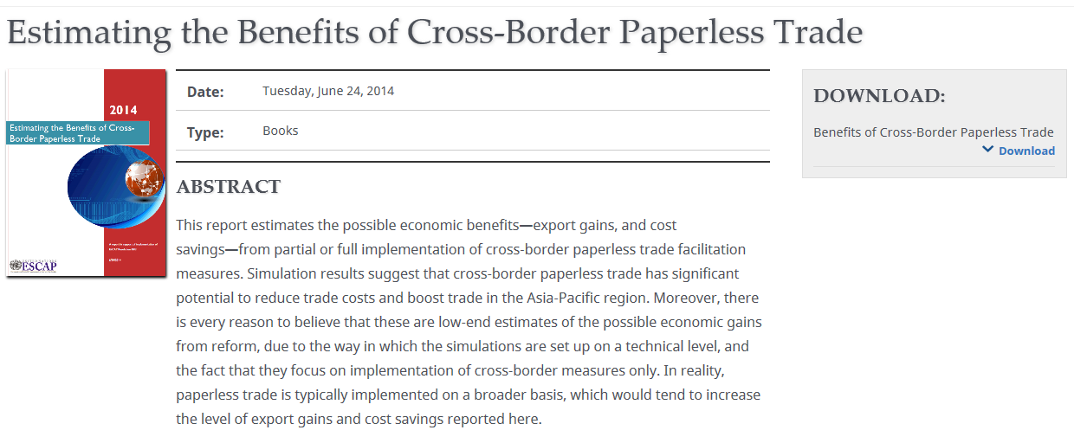
Benefits of
Cross-Border Paperless Trade
Annual regional export gains :
$36 bn (for partial implementation) to $257 bn (full implementation)
Export time reduction: 24% to 44%
Export cost reduction: 17% to 31%
Total direct cost savings across all trade: $1bn to $7bn annually
Source: http://www.unescap.org/resources/estimating-benefits-cross-border-paperless-trade
Notes:
This slides just show some of the benefits associated with enabling cross-border electronic exchange and legal recognition of electronic documents. They are quite substantial with export time reduction of over 25% in many cases.

Slide 41
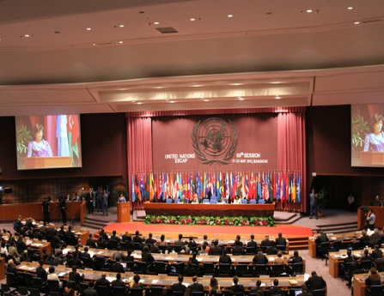
Framework Agreement on the Facilitation of Cross-Border Paperless Trade in Asia and the Pacific - Overview
  A new UN Treaty
  Open to interested (53) ESCAP member states (voluntary) to become parties
  Opened for signature on 1 October 2016 at UN Headquarters, New York
  Objective
  To facilitate cross-border paperless trade (data exchange) among willing ESCAP member states by providing a dedicated intergovernmental framework to develop legal and technical solutions
    Complementary to the WTO Trade Facilitation Agreement as well as (sub)regional efforts
  4 year step-by-step development process (ESCAP resolutions 68/3,70/6,72/4)
    Over 30 countries directly involved in finalizing the treaty text in March 2016
Adoption
by the Commission
Negotiation & Finalization
Expert Review &
Member Consultations
Regional
Study
2012
2013
2013 - 2016
19 May 2016
Notes:
The good news is that countries of the region now have an intergovernmental framework for countries to make progress on exchanging trade data and documents in a coordinated and harmonized manner. Indeed, ESCAP members have come together to develop a regional agreement called “Framework Agreement on Facilitation of Cross-Border Paperless Trade in Asia and the Pacific”. This agreement was finalized and adopted only 3 weeks ago in Bangkok at the 72nd ESCAP Commission session. It is a UN treaty that any interested ESCAP member states can become parties to. It will open for signature at the UN HQ in New York starting 1 October 2016.
The objective of the Framework Agreement is to facilitate cross-border paperless trade (data exchange) among willing ESCAP member states, by providing a dedicated intergovernmental framework to develop legal and technical solutions.
[SKIP]
The Framework Agreement was Developed through step by step Process based on official mandates over 5 years.
In 2012, a comprehensive regional study was done to assess current status of Asia and the Pacific and identify a most suitable solution for the region in enabling cross-border paperless trade.
In 2013, based on recommendation of the regional study on development a regional agreement, a series of expert review and member consultations at subregional levels were done to verify and improve a draft regional agreement.
During the period of late 2013 to early 2016, ESCAP member states, with the participation of officials and experts from over 25 member states, went through multiple round of negotiation of a draft regional agreement and finally finalized the text in March 2016. Then, the finalized text was adopted by the recent ESCAP Commission at its 72nd session in May 2016.

Slide 42
Framework Agreement on Facilitation of Cross-border Paperless Trade in Asia and the Pacific: Contents
Preamble
Articles 1 to 16: Substantive clauses
Article 1: Objective
Article 2: Scope
Article 3: Definitions
Article 4: Interpretation
Article 5: General principles
Article 6: National Policy Framework, Enabling Domestic Legal Environment and Paperless Trade Committee
Article 7: Facilitation of Cross-border Paperless Trade and Development of national Single Window(s)
Article 8: Cross-border Mutual Recognition of Trade-related Data and Documents in Electronic Form
Article 9: International Standards for Exchange of Trade-related Data and Documents in Electronic Form
Article 10: Relation with Other Legal Instruments Enabling Cross-Border Paperless Trade
Article 11: Institutional Arrangements
Article 12: Action Plan
Article 13: Pilot Projects and Sharing of Lessons Learned
Article 14: Capacity Building
Article 15: Implementation of the present Framework Agreement
Article 16: Other agreements in force
Articles 17 to 25: Final clauses

Slide 43
Framework Agreement on Facilitation of Cross-border Paperless Trade in Asia and the Pacific: Benefits
Region-wide multilateral intergovernmental platform
Builds upon existing bilateral/subregional initiatives; Supports WTO TFA implementation; Forster harmonization and minimize necessity for numerous bilateral/subregional intergovernmental approach;
Strong capacity building programme
Inclusive imitative, open to Asia-Pacific countries at all levels of development; Strong emphasis on knowledge sharing and CB/TA among parties
Pilot projects
Allow parties to adjust their systems before engaging in actual cross-border trade data exchange
Action Plan
Allow parties with different implementation level to set actions based on their respective readiness
Mutual recognition
Commit to the goal, while allowing flexibility in how to materialize the goal

Slide 44
Framework Agreement on Facilitation of Cross-border Paperless Trade in Asia and the Pacific: Key Provisions
Article 1: Objective
The objective of the present Framework Agreement is to promote cross-border paperless trade by enabling the exchange and mutual recognition of trade-related data and documents in electronic form and facilitating interoperability among national and subregional single windows and/or other paperless trade systems, for the purpose of making international trade transactions more efficient and transparent while improving regulatory compliance.
Article 5: General Principles
Article 8: Cross-border Mutual Recognition
Article 11: Institutional Arrangements
Article 12: Action Plan
Article 13: Pilot Projects and Sharing of Lessons Learned
Article 14: Capacity Building

Slide 45
Art. 5: General principles
Non-discrimination
of the use of Electronic communications
Functional Equivalence
Ⅰ
Ⅱ
Improving
transboundary trust environment
Ⅶ
Technological
neutrality
General
Principles
Ⅲ
Cooperation between the public and private sectors
Ⅵ
Promotion of
interoperability
Ⅳ
Ⅴ
Improved trade facilitation and regulatory compliance

Slide 46
Overview of provisions: Key provisions
Cross-border Mutual Recognition
Article 8
Key
Provisions
Article 14
Article 11
…
Institutional
Arrangements
Capacity
Building
Article 13
Article 12
…
Pilot Projects and Sharing of Lessons Learned
Action Plan

Slide 47
Outline
Trade facilitation and paperless trade implementation in Asia and the Pacific: an overview
Lessons learnt in developing Single Windows in Asia-Pacific region
Framework Agreement on the Facilitation of Cross-Border Paperless Trade in Asia and the Pacific
ESCAP’s support in Single Window and paperless trade

Slide 48
Trade Facilitation Programme in ESCAP
Legislative
Enabling paperless trade (Res. 68/3)
Interim Intergov. Steering Group on Cross-border Paperless Trade Facilitation (Res. 70/6)
Framework Agreement on Facilitation of Cross-border Paperless Trade in Asia and the Pacific (Res. 72/4)
Knowledge
Capacity
Building
Business Process Analysis
Single Window & Paperless Trade Implementation
Trade & Transport Facilitation Monitoring Mechanism
Agricultural & SME trade facilitation
WTO TFA implementation support
UNNExT Masterclass
ESCAP-WB Trade Cost Database
Paperless Trade Guides & Impact analyses
Global Trade Facilitation & Paperless Trade Implementation Survey
Trade Process Analysis Database

Slide 49

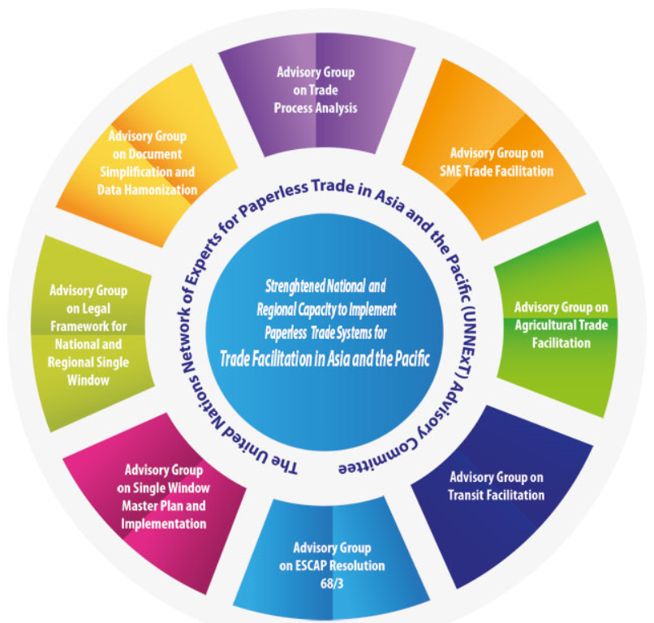


United Nations Network of Experts for Paperless Trade and Transport in Asia and the Pacific
“an ongoing community of knowledge and practice to facilitate the implementation of single window and paperless trade in the Asia-Pacific region ”
  Tools and guides development activities
  Advocacy and Technical Training Workshops
  Knowledge sharing and peer-to-peer support
www.unnext.unescap.org
49
Notes:
I would like to briefly introduce a regional expert network operated by ESCAP. It is called the United Nations Network of Experts for Paperless Trade and Transport in Asia and the Pacific, or UNNExT.
It is an ongoing community of knowledge and practice to facilitate the implementation of single window and paperless trade in the Asia-Pacific region.
As part of its programme, the UNExT conduct many capacity building activities, including tools and guides development and advocacy and technical training Workshops.
More details can be found at www.unnext.unescap.org as shown in the slide. You can register yourself to the Network by visiting this website, which is highly encouraged.

Slide 50




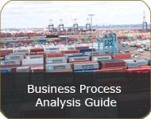

UNNExT Single Window Implementation Toolkit for Trade Facilitation
Notes:
Under UNNExT, a series of technical guides have been developed and used for capacity building events. The Single Window Implementation Toolkit consists of five guides – Business Process Analysis guide, Data harmonization guide, Guide for design of aligned trade forms, Single Window project implementation guide and Legal guide for electronic SW and paperless trade.
These guides are prepared based on international standards like UNCEFACT and World Customs Organization.
These guides have been used in capacity building training events.

Slide 51
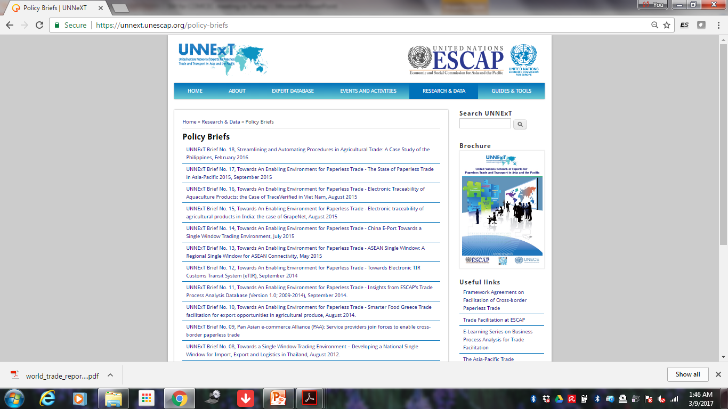
Policy briefs on single window and paperless trade

Slide 52
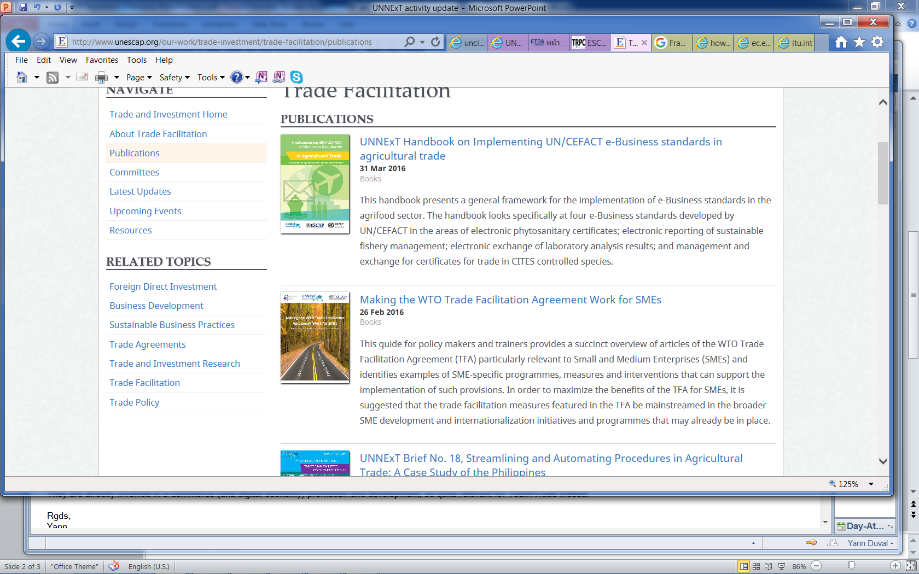
Current focus of UNNExT work [1]
Single window implementation
  Masterclass on Digital Customs and Single Window Implementation for Trade Facilitation planned with WCO and RoK Customs (19 - 28 Apr. 2017)
Cross-border paperless trade facilitation
  Development of implementation roadmap for the Framework Agreement on Facilitation of Cross-Border Paperless Trade; and related capacity building
Trade facilitation for SMEs
  in collaboration with International Trade Centre (ITC)

Slide 53
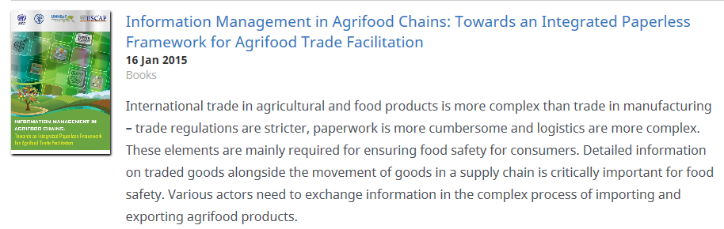
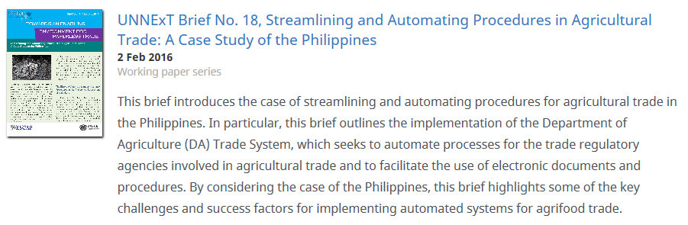
Current focus of UNNExT work [2]
Agricultural Paperless Trade Facilitation, including e-SPS / e-Phyto development and traceability systems
  On-going collaboration with UNECE UN/CEFACT, FAO and WTO

Slide 54

Current focus of UNNExT work [3]
Trade & Transport Facilitation Monitoring Mechanism (TTFMM)
  Extension of UNNExT Business Process Analysis Guide
  Implementation of TTFMM on-going in Bangladesh, Bhutan, Nepal
    In collaboration with Asian Development Bank
BPA? Analysis, including mapping,
timing and costing of a process
(e.g., moving goods from factory to
deck of ship)
Why? Necessary first step to improving a process
e-Single Window & Paperless Trading
Cross Border Data Harmonization & Exchange
National Data Harmonization
Documentation Simplification & Standardization
Process Simplification & Harmonization
Business Process Analysis

Slide 55
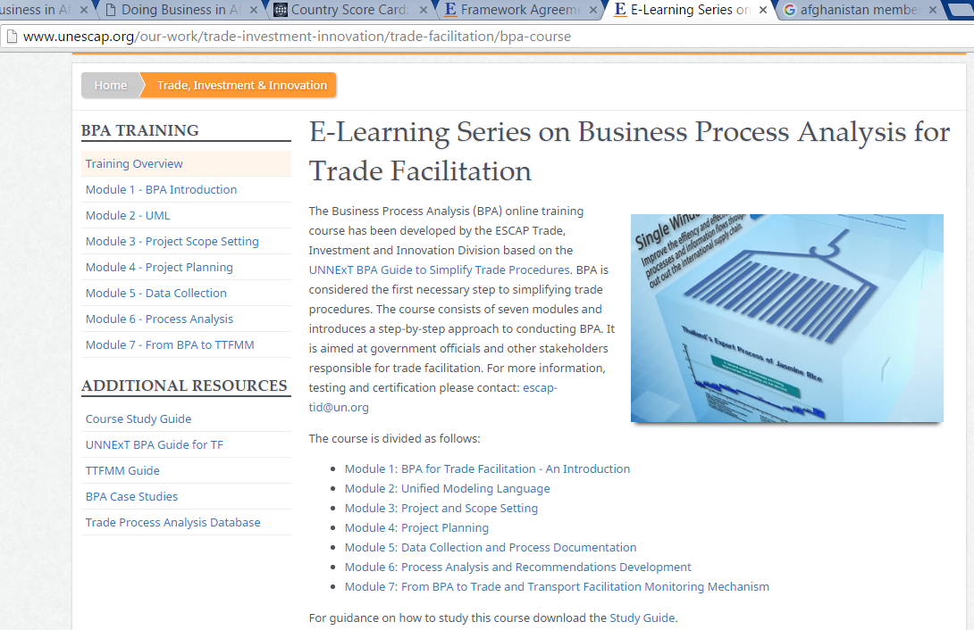
Course Certificate on BPA for TF (since Sep. 2016)
http://www.unescap.org/our-work/trade-investment-innovation/trade-facilitation/bpa-course

Slide 56
The second global survey on trade facilitation and paperless trade implementation
Objective:
  to collect relevant data and information on trade facilitation and paperless trade implementation from the countries world wide.
Expected outcome:
  useful information on TF and paperless trade implementation will be available to support the implementation of the WTO Trade Facilitation Agreement and regional initiative such as the Framework Agreement on Facilitation of Cross-border Paperless Trade in Asia and the Pacific
Time:
  January – July 2017
By whom?
  five UN regional commissions led by ESCAP, with support from other partners such as UNCTAD, International Trade Centre, OECD, Oceania Customs Organization and more.
  More organizations show keen interest to collaborate with the Survey. We welcome more partners.

Slide 57
To summarize
Any countries in Asia and the Pacific are encouraged to join the treaty on Framework Agreement on cross-border paperless trade – small economies and the least developed countries will certainly benefit from joining the treaty to align their efforts with regional and global standard. The treaty is not a privilege for more advanced economies.
National single window may start small and keep evolving, but need to be visionary: keeping interoperability and cross-border trade in mind.
Experiences of developing SW in Asia provide useful references for other countries. Case studies are documented by ESCAP/UNNExT.
Tools and guides on Single Window and paperless trade developed by ESCAP and its partners (especially the UNCEFACT Recommendations on SW) can be fully utilized by the countries.
The UNNExT community and experts can potentially support the countries to develop SW.
The global survey on TF and paperless trade will provide insightful data to support policy making and technical assistance. All experts are invited to contribute.

Slide 58
Thank you
www.unescap.org/our-work/trade-investment/trade-facilitation
unnext.unescap.org
http://communities.unescap.org/cross-border-paperless-trade-facilitation

