Slide 1
COMCEC Project Funding
Rules and Procedures at a Glance
Department of International Programs and Projects
pcm.comcec.org

Slide 2
COMCEC
STRATEGY
STRATEGIC OBJECTIVES
MEMBER DRIVEN
MECHANISM
OUTPUTS
COMCEC Project Funding
WORKING GROUPS
MEMBER COUNTRIES AND
OIC INSTITUTIONS
COMCEC Coordination Office
Department of International Programs and Projects
1

Slide 3
COMCEC Project Funding
Simple Rules
Clearly defined Financial Framework
Flexible Procedures
Backstopping by the CCO
Tech. Support by Development Bank of Turkey
COMCEC Coordination Office
Department of International Programs and Projects
2

Slide 4
Project Management Process (PCM)
IDEA
(initiation)
CCO
Backstopping
Evaluation
(closing)
Identification
(planning)
CCO
Backstopping
Monitoring
(&controlling)
Appraisal
DBT Support
DBT Support
Implementation
(execution)
COMCEC Coordination Office
Department of International Programs and Projects
3

Slide 5
Potential Project Owners
Member Countries (relevant ministries and other public institutions)
*registered to the Working Groups
*active participantion to the Working Groups *
OIC Institutions (operating in the field of economic and commercial cooperation)
COMCEC Coordination Office
Department of International Programs and Projects
4

Slide 6
Project Selection Ladder
SECTORAL THEMES
Promoting Multilateralism
(at least 3 Member States)
MULTILATERALISM
Trade Liberalization
Trade Facilitation
Trade Financing
Trade Promotion
OUTPUT AREAS
Expansion of trade among the member countries
STRATEGIC OBJECTIVE
Enhancing Mobility
Strengthening Solidarity
Improving Governance
PRINCIPLES
COMCEC Coordination Office
Department of International Programs and Projects
5

Slide 7
SECTORAL THEMES
Improving the Institutional Capacity of TPOs
Risk Mitigation in Trade Finance
Increasing awareness on the benefits of trade liberalization
COMCEC Coordination Office
Department of International Programs and Projects
6

Slide 8
Project Type
Research and analytical studies
Strategies, Guides, Roadmaps
E-Discussion
Community of Practice
Study visits
Trainings
Exchange programs among officials
Needs Assessments and Impact Analysis
Peer Assist
Conferences, Workshops
Focus Group
Knowledge Fair
Multi-Stakeholder Consultation
Expert Panel
see sample activity list…
TECHNICAL COOPERATION
CAPACITY BUILDING
COMCEC Coordination Office
Department of International Programs and Projects
7

Slide 9
The Mechanism
PROJECT
OWNERS
Application
CCO
Feedback
List of Successful
Projects
Financing
Operational and
Financial
Reporting
DEVELOPMENT BANK OF TURKEY
Program
Reporting
COMCEC Coordination Office
Department of International Programs and Projects
8

Slide 10
Grant Limits
Project Owner | Project Budget Lower Limit (USD) | Project Budget Upper Limit (USD) | Minimum Co-Finance Rates by the PO | CCO Grant Limits (USD)
Member Countries | 100.000 | 250.000 | %10 | 90.000-225.000
OIC Institutions | 50.000 | 100.000 | %25 | 37.500-75.000
COMCEC Coordination Office
Department of International Programs and Projects
9

Slide 11
Why COMCEC Project Funding?
Facilitate transforming ideas into reality
Help to project owners to have international project experience
Help to increase ability to work together
Improving capacity of project owner institutions
Totally grant
Co-finance: cash or in-kind contribution
COMCEC Coordination Office
Department of International Programs and Projects
10

Slide 12
First Call for Project Proposals
September 2nd, 2013 - First Call for Project Proposals
Great interest from countries and OIC Institutions
23 Member Countries and 3 OIC Institutions submitted project proposals
8 project proposals are selected for financing and completed in 2014.
COMCEC Coordination Office
Department of International Programs and Projects
11

Slide 13
2014 Projects
Capacity Building in Trade Institutions of the Central Asian Countries of COMCEC (Afghanistan)
Project Owner: Ministry of Commerce and Industries
Project Purpose: The aim of the project is to analyze, using survey and secondary data, how promotion of export potential and access to finance problems of SMEs in Afghanistan particularly dealing with the COMCEC member countries can be solved.
Status: Activities of the projects are implemented. Waiting for final report.
COMCEC Coordination Office
Department of International Programs and Projects
12

Slide 14
2014 Projects
International Seminar on Developing National& Regional Approaches to Enhancing Innovation Support Commercialization of R&D Results and Patents Among the Organization of Islamic Cooperation Member States(ICDT)
Project Owner: ICDT
Project Purpose: The purpose of the project is to increase capacity of participants and sharing this experience with other stakeholders through publishing and distributing analytical study report.
Status: The project is completed as of August 2014.
COMCEC Coordination Office
Department of International Programs and Projects
13

Slide 15
2014 Projects
SMEs in the Borderless Era, Shaping Opportunity in the Global Value Chain(Indonesia)
Project Owner: Ministry of Trade
Project Purpose: Main objectives of this project are to raise awareness in member countries on the internationalization of SMEs in the Global Value Chain (GVC), to encourage the internationalization of SMEs and as a result to promote international trade.
Status: The project is completed.
COMCEC Coordination Office
Department of International Programs and Projects
14

Slide 16
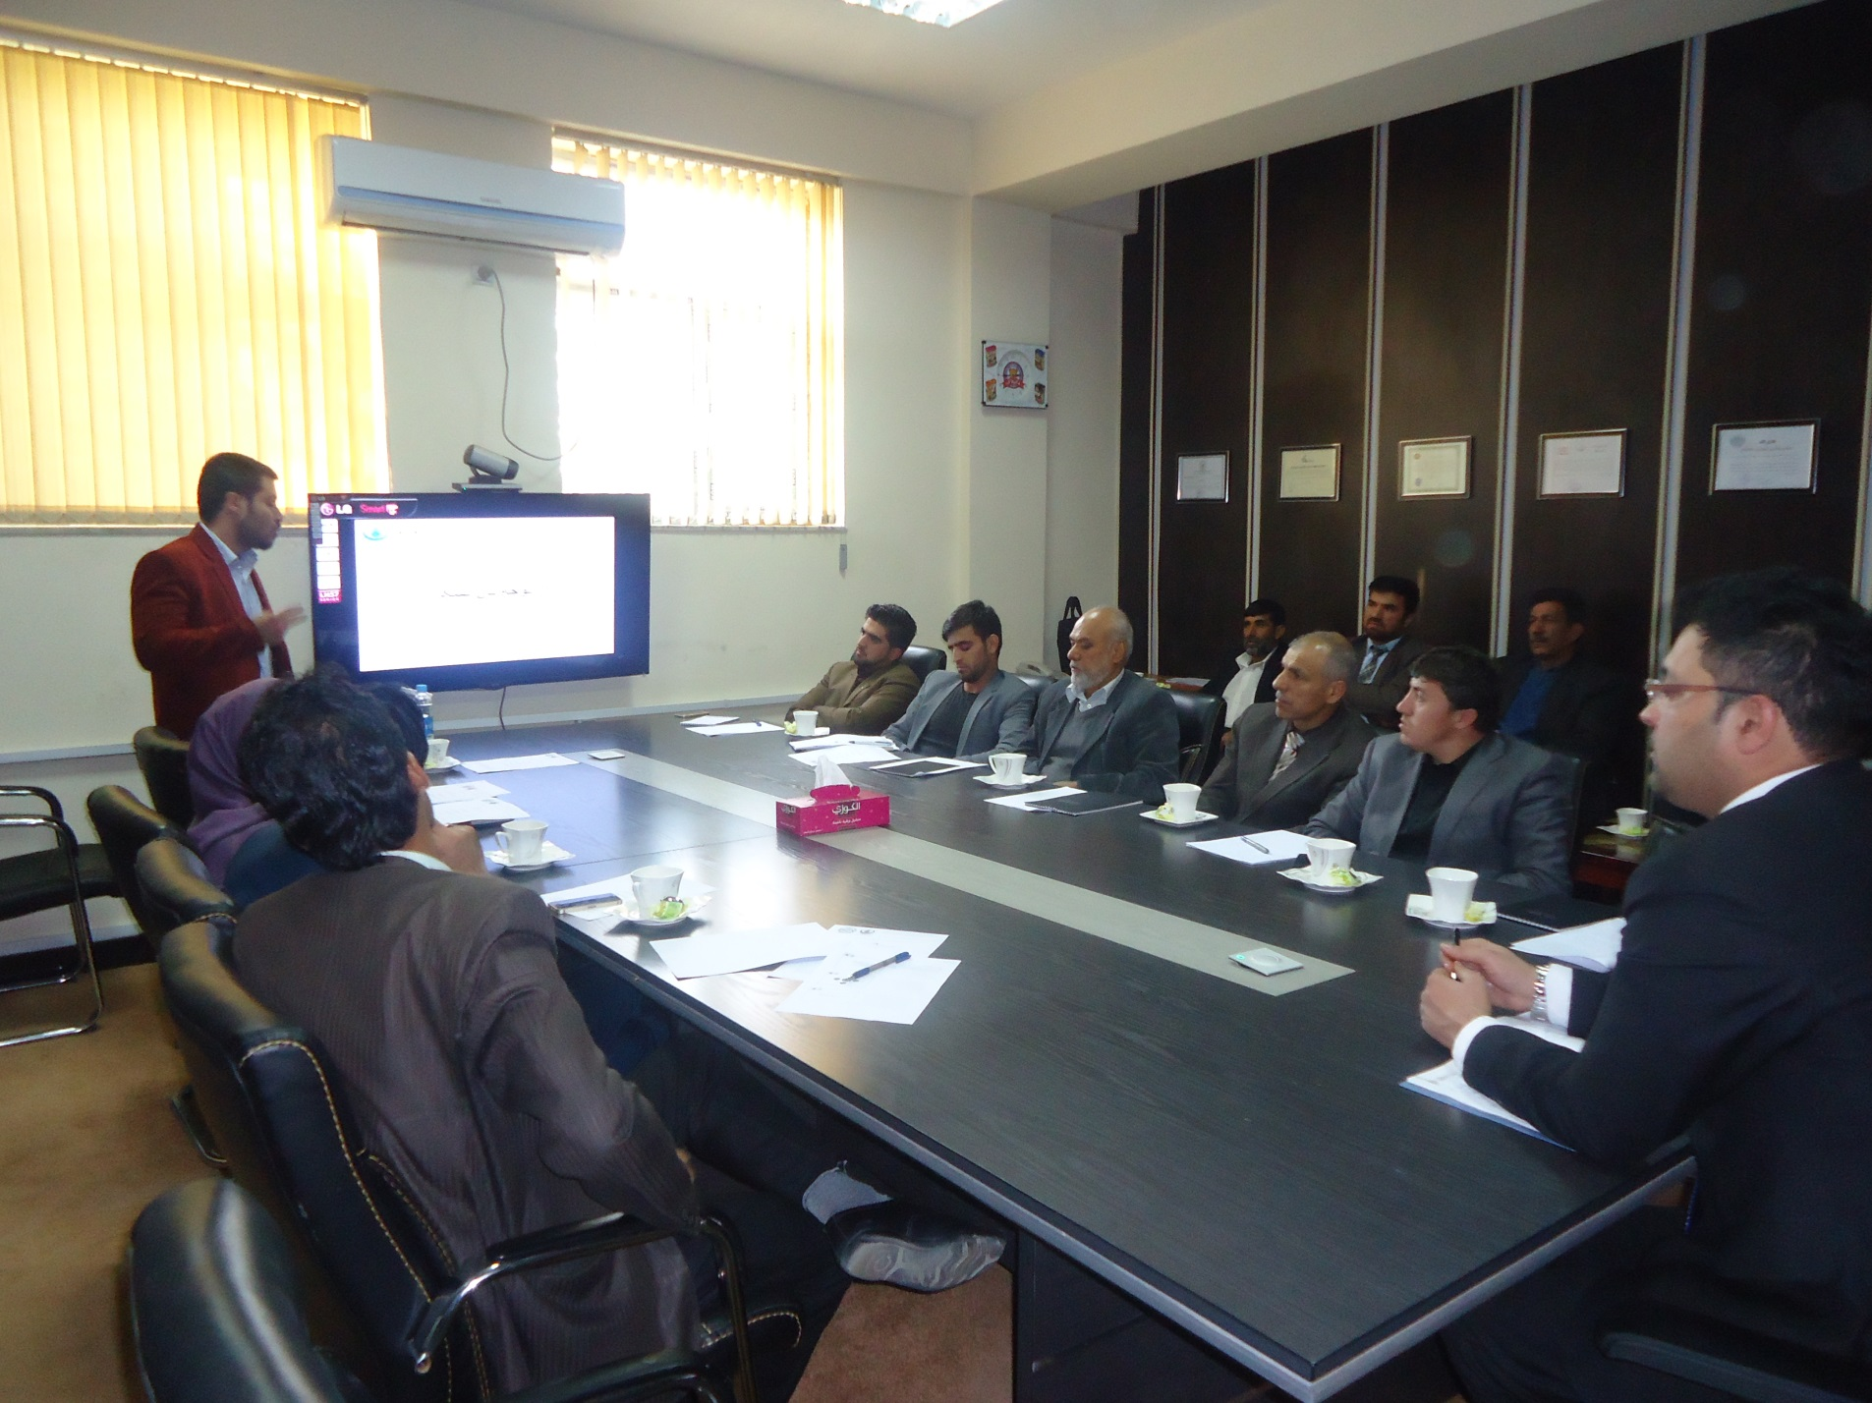
2014 Projects
Capacity Building in Trade Institutions of the Central Asian Countries of COMCEC (Afghanistan)
COMCEC Coordination Office
Department of International Programs and Projects
15

Slide 17
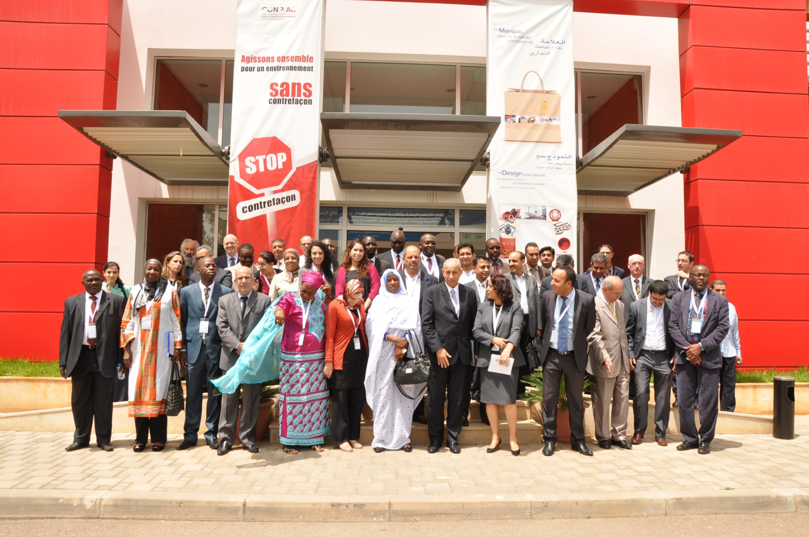
2014 Projects
International Seminar on Developing National& Regional Approaches to Enhancing Innovation Support Commercialization of R&D Results and Patents Among the Organization of Islamic Cooperation Member States(ICDT)
COMCEC Coordination Office
Department of International Programs and Projects
16

Slide 18
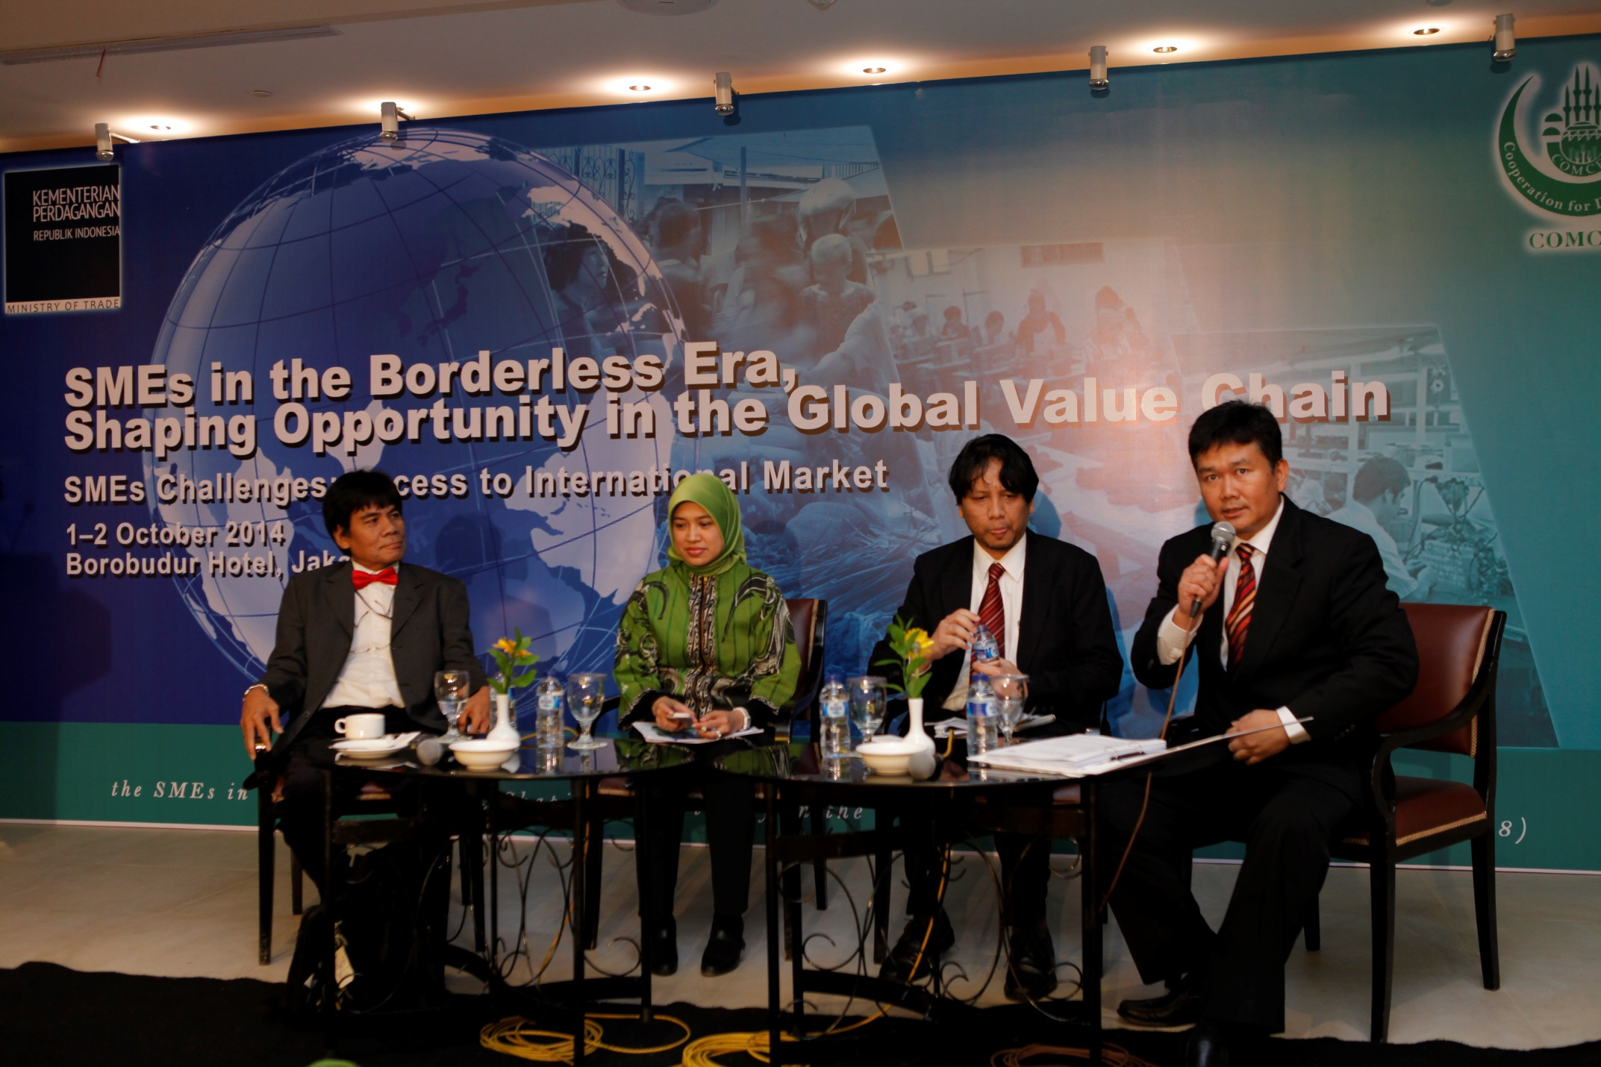
2014 Projects
SMEs in the Borderless Era, Shaping Opportunity in the Global Value Chain(Indonesia)
COMCEC Coordination Office
Department of International Programs and Projects
17

Slide 19
Second Call for Project Proposals
September 2014
Project submissions are over as of December 26th, 2014
COMCEC Coordination Office
Department of International Programs and Projects
18

Slide 20
The Second Call
62 project proposals are submitted
20 countries and 3 OIC Institutions submitted projects
17 projects are final-listed
3 projects are final-listed in the Trade Cooperation Area
COMCEC Coordination Office
Department of International Programs and Projects
19

Slide 21
2015 Projects
1- THE GAMBIA
Capacity-building and Institutional Strengthening of The Gambia Standards Bureau for the Adoption and Implementation of OIC/SMIIC Halal Standards and related Conformity Assessment
2- ITFC
Trade Facilitation Program for Central Asian Member Countries of OIC
3- QATAR
Access to Finance for SME and entrepreneurs in the OIC region; Opportunities and Challanges for the eentrepreneurs
COMCEC Coordination Office
Department of International Programs and Projects
20

Slide 22
The Second Call - What’s New?
Independent appraisal of project proposals
Upper limit for Project Coordinator’s and Project Expert’s fees
New Criteria! - Sectoral Themes of WG Meetings
Revised durations for project submission periods
COMCEC Coordination Office
Department of International Programs and Projects
19/21
21

Slide 23
Third Call for Project Proposals
September 2015
COMCEC Coordination Office
Department of International Programs and Projects
pcm.comcec.org

Slide 24
pcm.comcec.org pcm@comcec.org
Thank You
Department of International Programs and Projects

