Slide 1




COMCEC STRATEGY
Making Cooperation Work
For Building an Interdependent Islamic World
COMCEC
Trade OUTLOOK
2014
Trade Working Group 5thMeeting
March 26, 2015
Ankara, Turkey

Slide 2
OUTLINE
Recent Trends in Trade Between OIC Member States and the World
Recent Trends in Intra-OIC Trade
Effects of Steep Fall in Oil Prices on OIC Countries(MENAP Region)
Making Cooperation Work
COMCEC STRATEGY
For Building an Interdependent Islamic World
1

Slide 3
TRADE BETWEEN OIC and the WORLD
Making Cooperation Work
COMCEC STRATEGY
For Building an Interdependent Islamic World
1

Slide 4
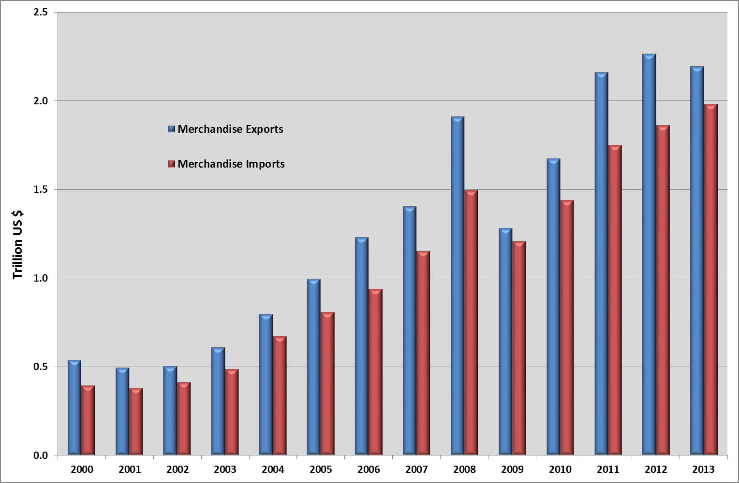
Total OIC exports fell by 3.1 per cent in 2013
Source: SESRIC
Making Cooperation Work
COMCEC STRATEGY
For Building an Interdependent Islamic World

Slide 5
Main Factors Accounting For The Weakness Of Total OIC Exports In 2013
The slow pace of world demand growth
Falling commodity prices
Ongoing political instability in the Middle East and oil supply disruptions
Making Cooperation Work
COMCEC STRATEGY
For Building an Interdependent Islamic World
1

Slide 6
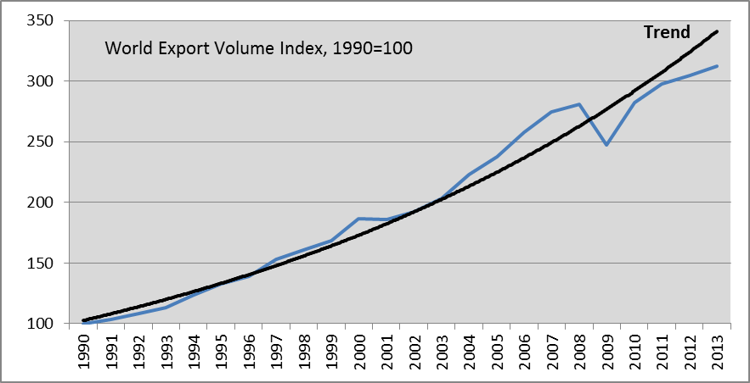
World trade growth remained sluggish in 2013
Source: WTO Database
Making Cooperation Work
COMCEC STRATEGY
For Building an Interdependent Islamic World
1

Slide 7
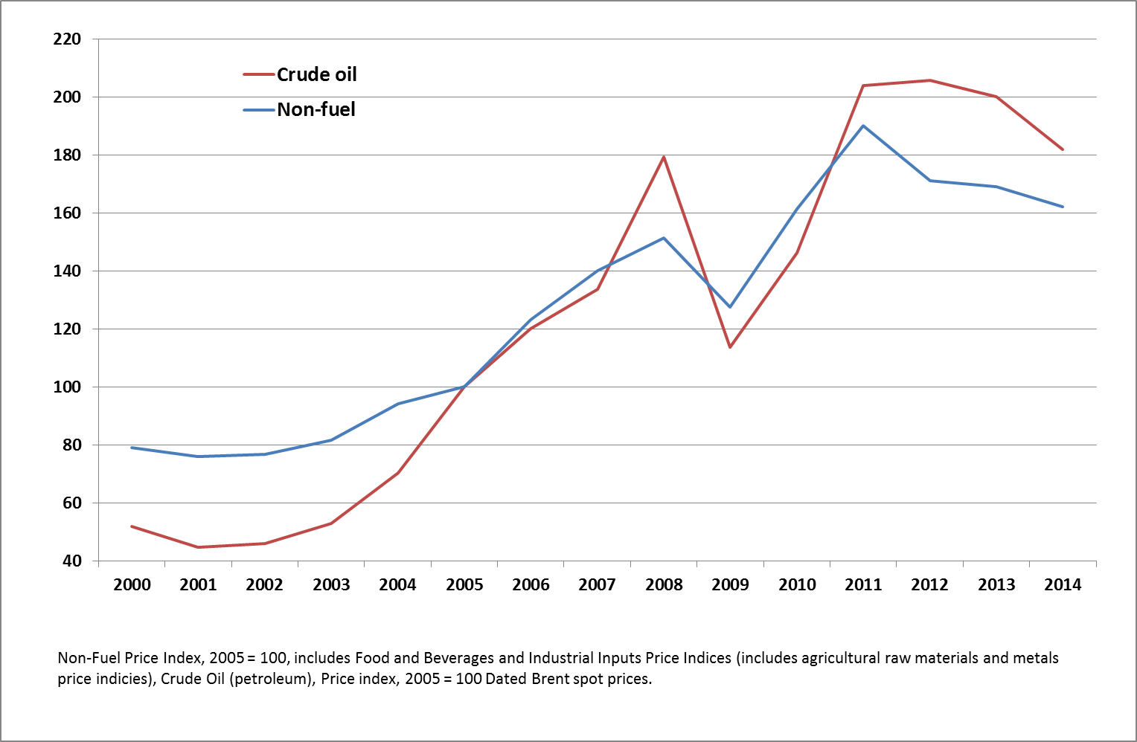
Falling Commodity Prices in 2013
Source: IMF Database
Making Cooperation Work
COMCEC STRATEGY
For Building an Interdependent Islamic World

Slide 8
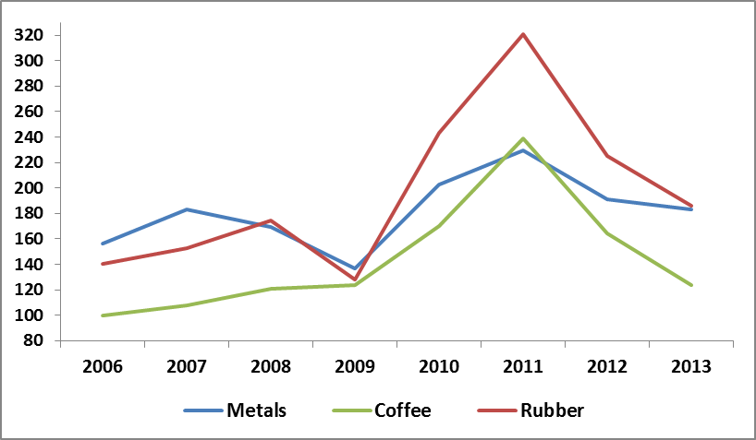
Prices of Selected Commodities Exported by the OIC Members
(2005=100)
Source: IMF Database
Making Cooperation Work
COMCEC STRATEGY
For Building an Interdependent Islamic World

Slide 9
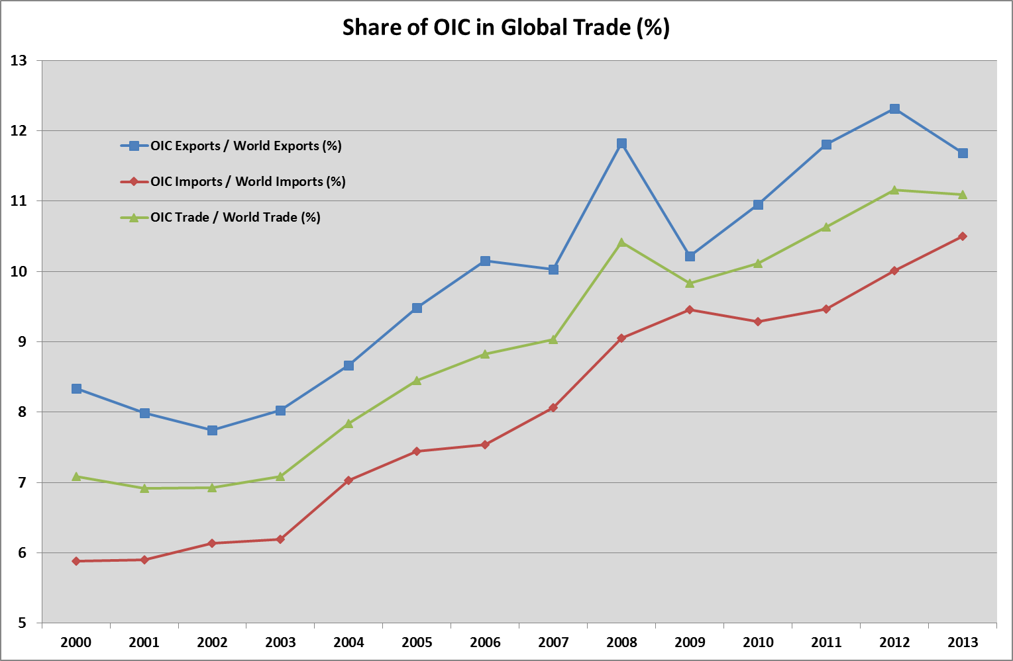
The share of OIC countries in global exports declined to 11.8 per cent in 2013
Source: SESRIC, WTO
Making Cooperation Work
COMCEC STRATEGY
For Building an Interdependent Islamic World

Slide 10
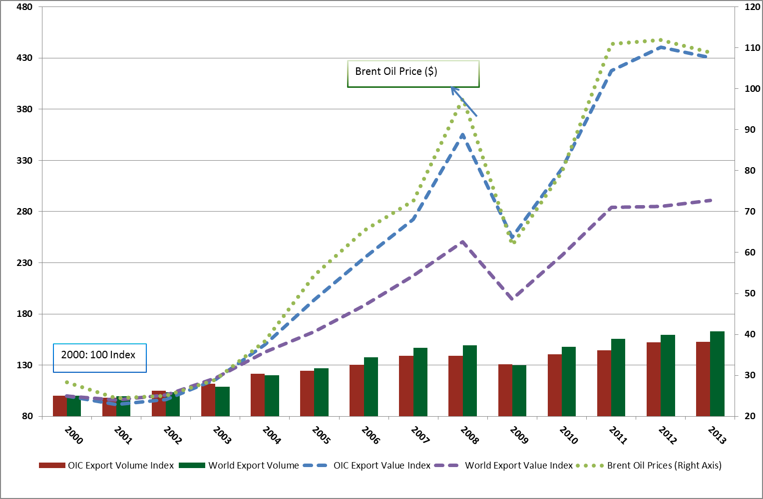
Share of OIC countries in global trade increased in value terms but not in volume terms
Source: UNCTADSTAT, IMF
Making Cooperation Work
COMCEC STRATEGY
For Building an Interdependent Islamic World

Slide 11
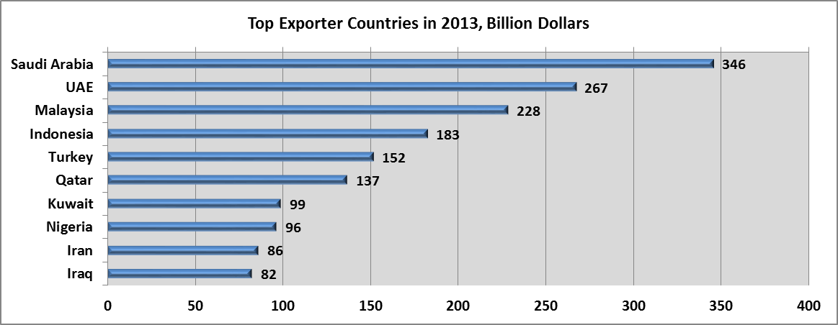
Top performers in total OIC exports in 2013
Source: SESRIC
Making Cooperation Work
COMCEC STRATEGY
For Building an Interdependent Islamic World

Slide 12
High country concentration in total OIC exports
Source: UNCTADSTAT
Making Cooperation Work
COMCEC STRATEGY
For Building an Interdependent Islamic World

Slide 13
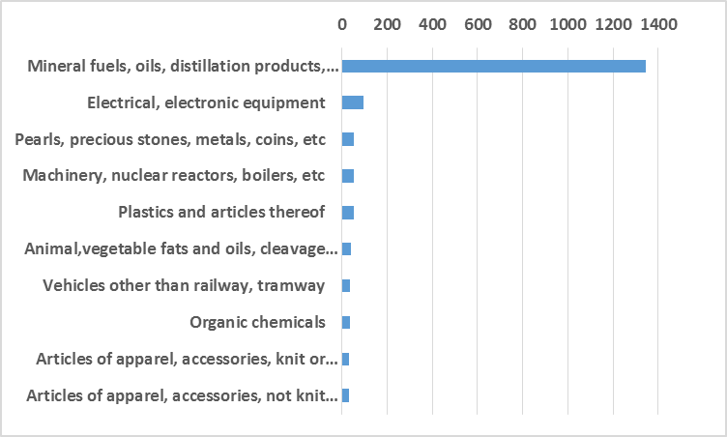
Dominance of mineral fuels and oils in total OIC exports
OIC Exports to World - Top 10 Items (2013, Billion $)
Source:ITC Trademap
Making Cooperation Work
COMCEC STRATEGY
For Building an Interdependent Islamic World

Slide 14
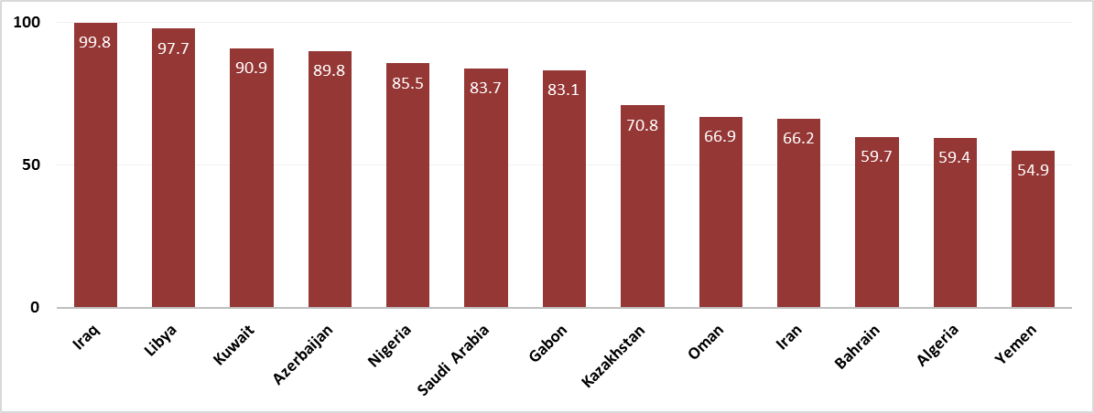
Share of Petroleum in Total Exports, 2013 (%)
Source: UN Comtrade
Making Cooperation Work
COMCEC STRATEGY
For Building an Interdependent Islamic World

Slide 15
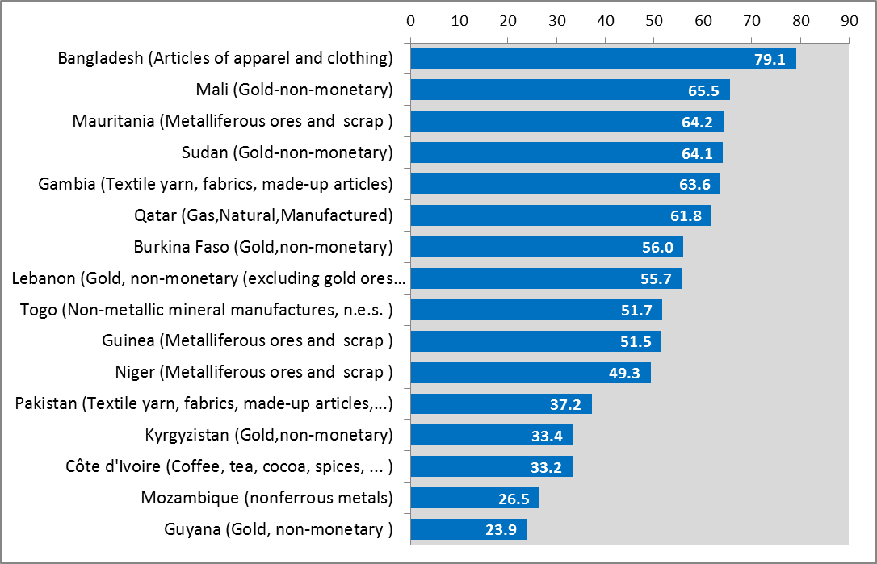
Share of Commodities in Total Exports, 2013 (%)
Source: UN Comtrade
Making Cooperation Work
COMCEC STRATEGY
For Building an Interdependent Islamic World

Slide 16
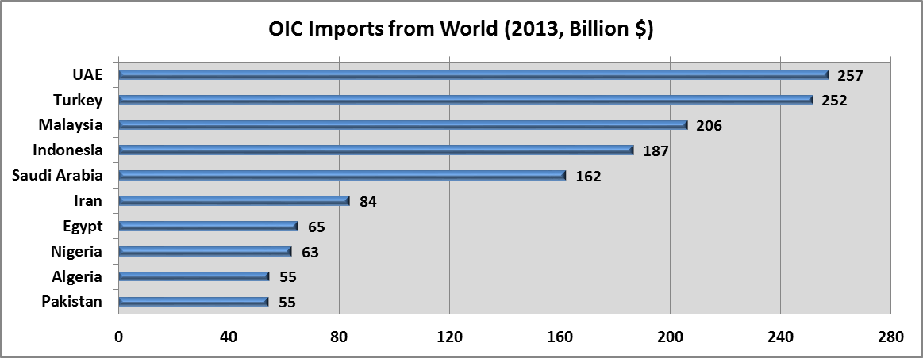
The total OIC imports dominated by the leading exporters in 2013
Source:SESRIC
Making Cooperation Work
COMCEC STRATEGY
For Building an Interdependent Islamic World

Slide 17
Total OIC imports originated mainly from developed countries
Source: UNCTADSTAT
Making Cooperation Work
COMCEC STRATEGY
For Building an Interdependent Islamic World

Slide 18
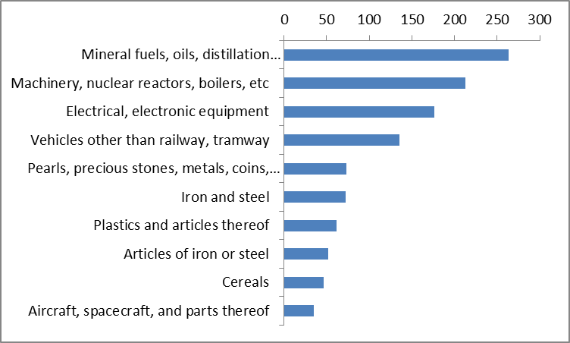
Product diversification of total OIC imports was higher
(2013, Billion $)
Source: ITC
Making Cooperation Work
COMCEC STRATEGY
For Building an Interdependent Islamic World

Slide 19
INTRA-OIC TRADE
Making Cooperation Work
COMCEC STRATEGY
For Building an Interdependent Islamic World

Slide 20
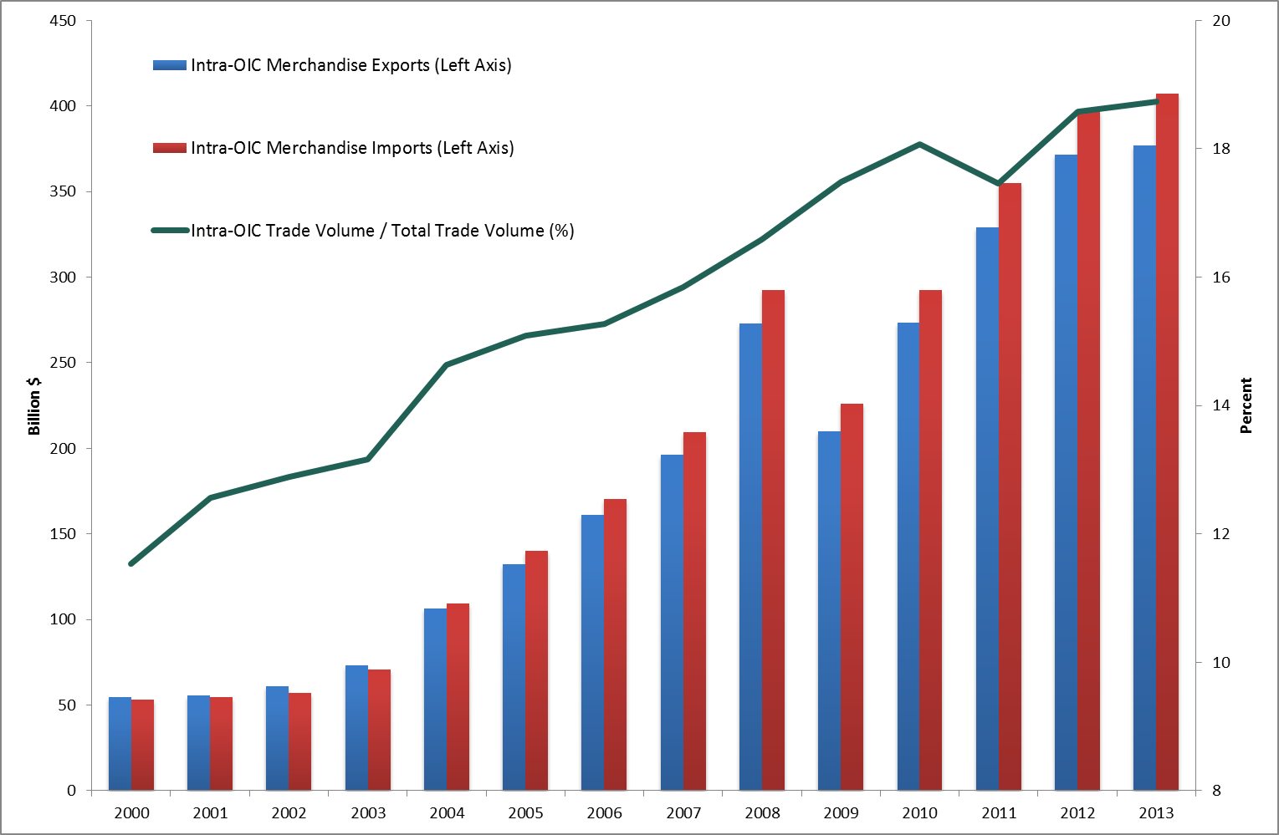
Share of intra-OIC trade peaked at 18.7 per cent in 2013
Source: SESRIC
Making Cooperation Work
COMCEC STRATEGY
For Building an Interdependent Islamic World

Slide 21
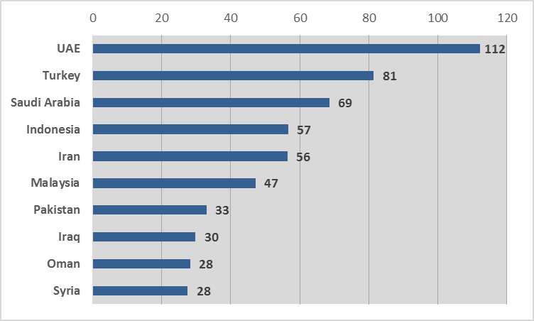
Major players in intra OIC trade in 2013
(Billion $)
Source:SESRIC
Making Cooperation Work
COMCEC STRATEGY
For Building an Interdependent Islamic World

Slide 22
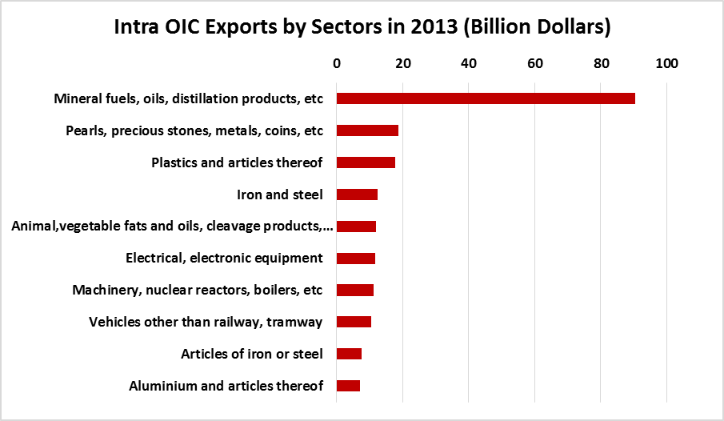
Intra-OIC exports concentrated on a few commoditites
Source: ITC Trademap
Making Cooperation Work
COMCEC STRATEGY
For Building an Interdependent Islamic World

Slide 23
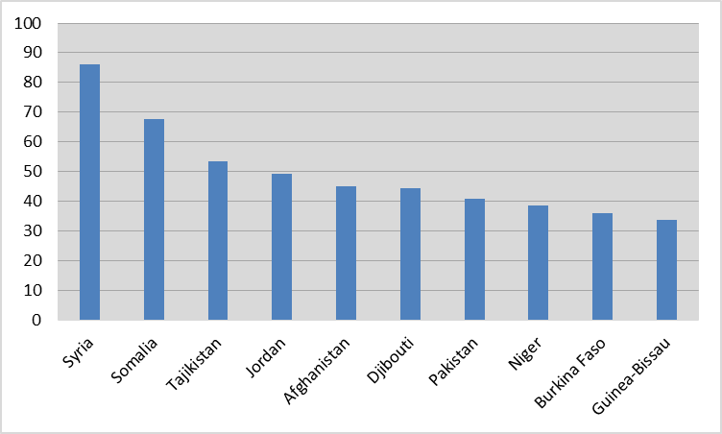
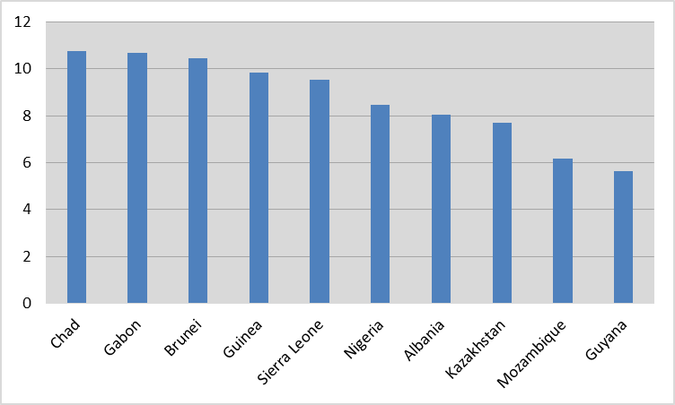
20 per cent intra-OIC trade target was surpassed by 30 Member States by 2013
Member States Having the Biggest Intra-OIC Trade Share (%)
Member States Having the Lowest Intra-OIC Trade Share (%)
Source:SESRIC
Making Cooperation Work
COMCEC STRATEGY
For Building an Interdependent Islamic World

Slide 24
EFFECTS OF STEEP FALL in OIL PRICES on OIC MEMBER STATES (MENAP REGION)
Source:SESRIC
Making Cooperation Work
COMCEC STRATEGY
For Building an Interdependent Islamic World

Slide 25
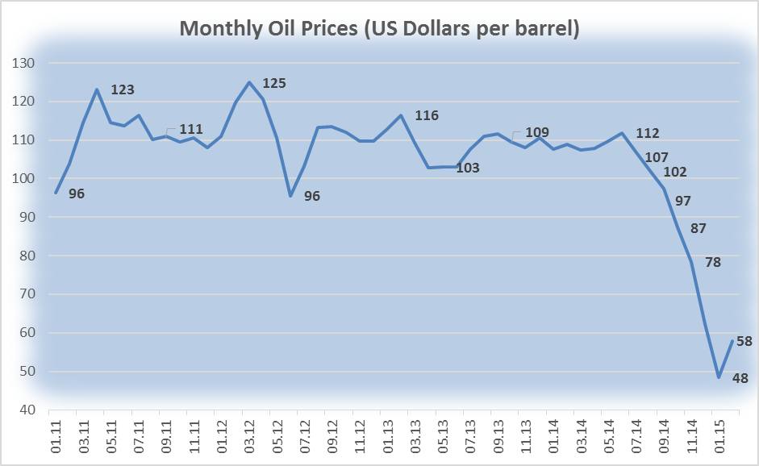
Oil prices fell from an average of 110 ($/pb) in the last three years to 48($/pb) in January 2015
Source: IMF Commodity Prices Database
Making Cooperation Work
COMCEC STRATEGY
For Building an Interdependent Islamic World

Slide 26
The steep decline in oil prices have been driven by both supply and demand factors along with the effects of monetary policies
ON THE DEMAND SIDE :
Weakening Oil Demand Especially from China, Japan and the Euro Area
ON THE SUPPLY SIDE
-Higher than-expected supply, particularly from the United States
-OPEC’s policy shift to maintain production and thus the market share
EFFECTS OF THE MONETARY POLICIES
Real interest rates
U.S. dollar appreciation
Making Cooperation Work
COMCEC STRATEGY
For Building an Interdependent Islamic World

Slide 27
Growth is expected to weaken in most countries except U.S in 2015
Making Cooperation Work
COMCEC STRATEGY
For Building an Interdependent Islamic World

Slide 28
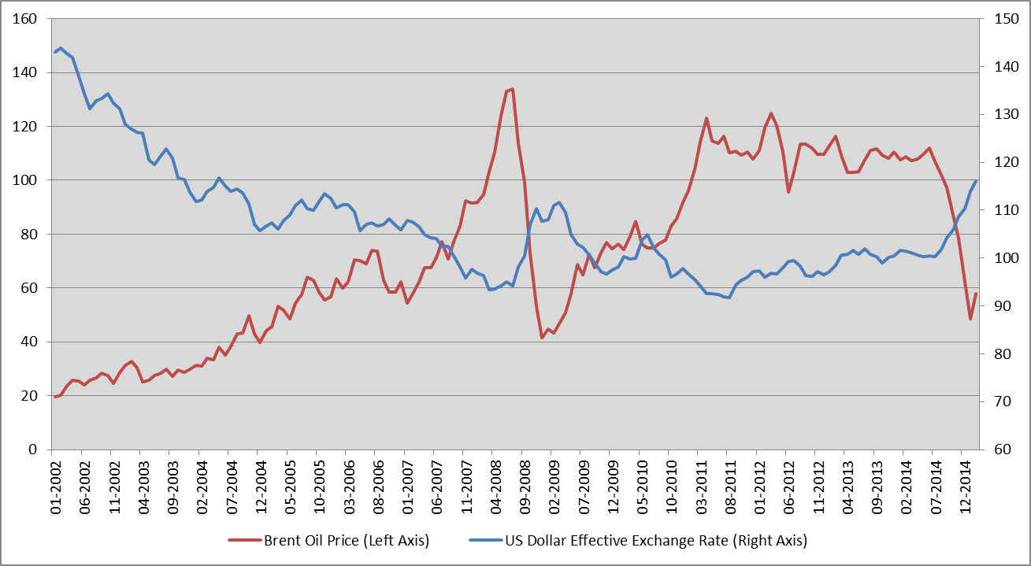
There is an inverse relation between US dollar effective exchange rate and the oil prices
Figure: US Dollar Effective Exchange Rates versus Brent Oil Prices
Source:FED,IMF
Making Cooperation Work
COMCEC STRATEGY
For Building an Interdependent Islamic World

Slide 29
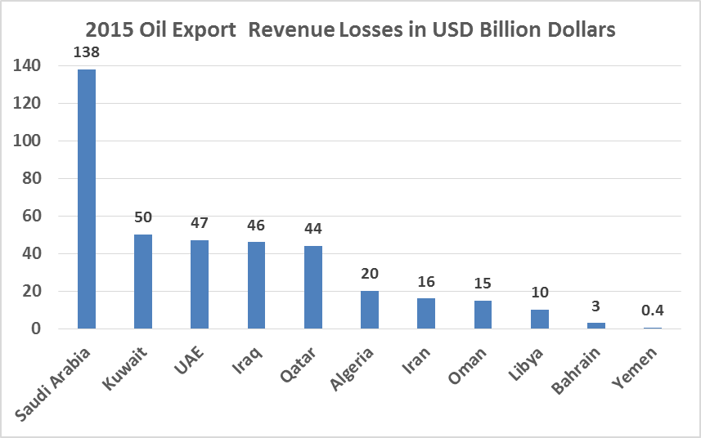
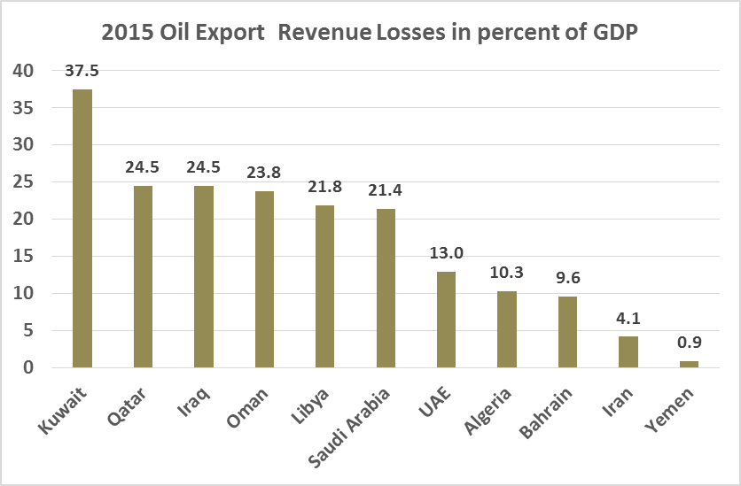
Kuwait, Qatar, Iraq, Oman, Libya, and Saudi Arabia are expected to be the most affected countries from the steep decline in oil prices
Figure: External Loss Estimates from Lower Oil Prices, 2015
Source:IMF Regional Economic Outlook 2015 January Update
Making Cooperation Work
COMCEC STRATEGY
For Building an Interdependent Islamic World

Slide 30
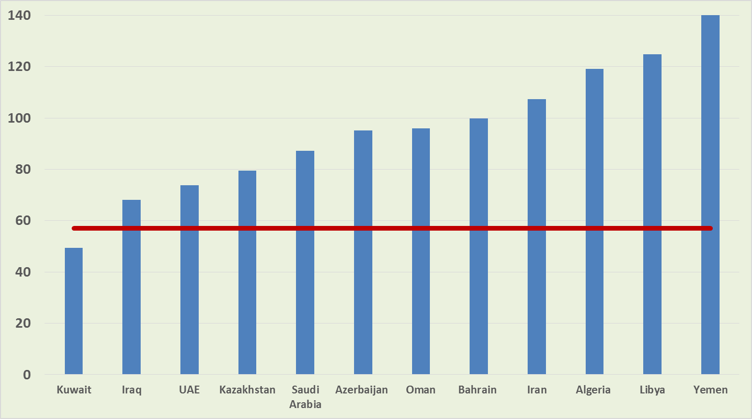
Most Oil Exporters need oil prices well above 57 dollars to balance their budgets
Figure: Fiscal Breakeven Oil Prices (U.S. Dollars per barrel)
2015 oil price estimate
Source: IMF Regional Economic Outlook, 2015 January Update
Making Cooperation Work
COMCEC STRATEGY
For Building an Interdependent Islamic World

Slide 31
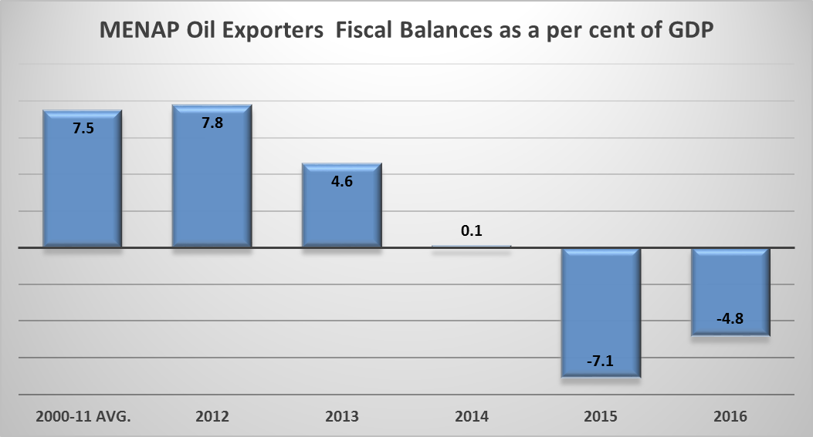
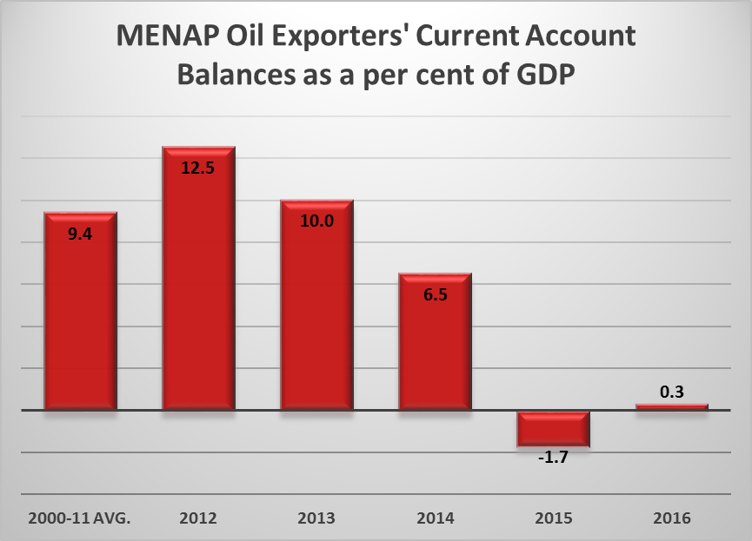
Sharp falls in oil prices are expected to lead to significant declines both in the fiscal balances and external balances in the MENAP region
Source: IMF Regional Economic Outlook, 2015 January Update
Note: Figures for 2015 and 2016 are estimates.
Note: MENAP Oil Exporters include :Algeria, Bahrain, Iran, Iraq, Kuwait, Libya, Oman, Qatar, Saudi Arabia, UAE and Yemen
MENAP Oil Importers include :Afghanistan, Djibouti, Egypt, Jordan, Lebanon, Mauitania, Morocco, Pakistan, Sudan, Syria and Tunisia.
Making Cooperation Work
COMCEC STRATEGY
For Building an Interdependent Islamic World

Slide 32
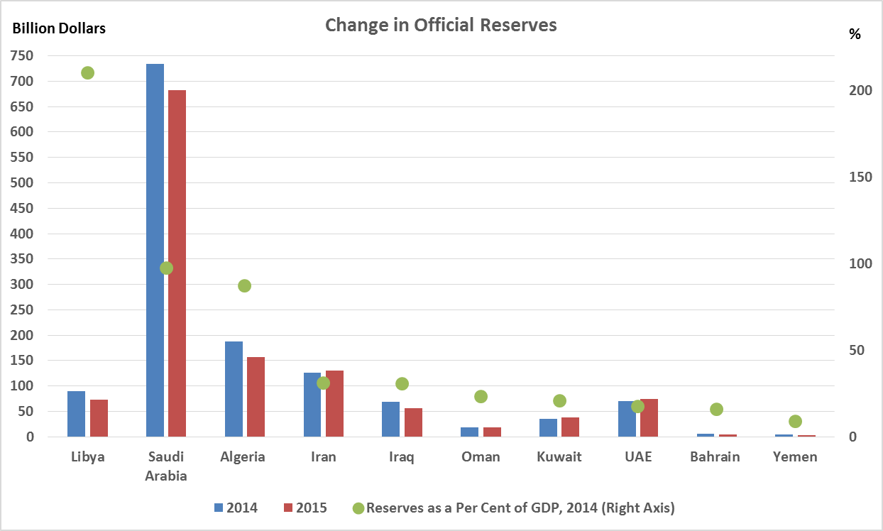
While Saudi Arabia and the Gulf states having significant reserves can sustain a lower oil price, Algeria, Iran, Iraq and Yemen are more vulnerable
Source: IMF Regional Economic Outlook, 2015 January Update
Making Cooperation Work
COMCEC STRATEGY
For Building an Interdependent Islamic World

Slide 33
Oil exporters need to diversify exports to reduce vulnerabilities due to oil price swings
Oil prices is expected to be volatile on the short term
Given the negative effects of oil price swings, Oil exporters will need to further diversify their economies
Making Cooperation Work
COMCEC STRATEGY
For Building an Interdependent Islamic World

Slide 34
COMCEC STRATEGY
Making Cooperation Work
For Building an Interdependent Islamic World
Thank You
Trade Working Group Meeting
March 26 th, 2015
Ankara, Turkey

