Slide 1
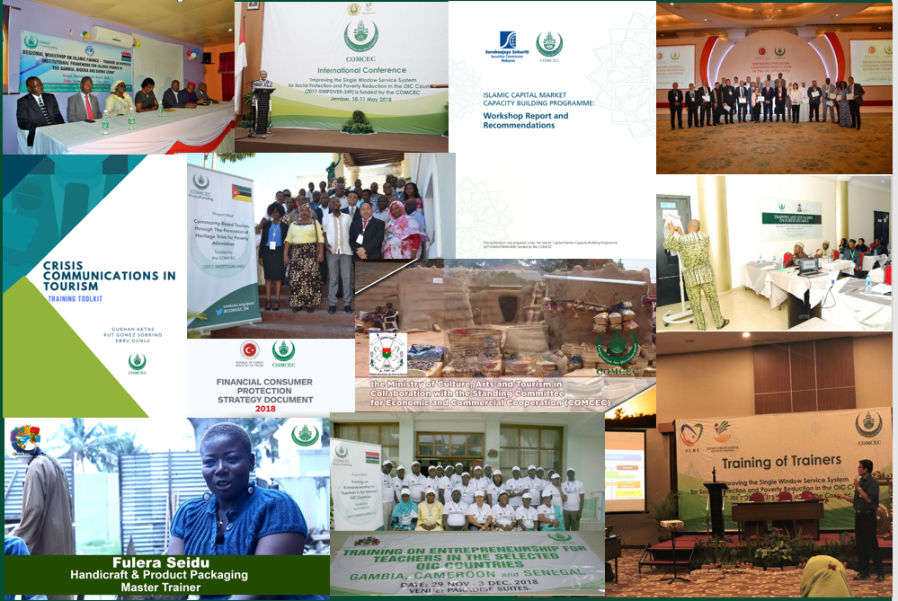
Eda AKÇA
Program Coordinator Department of Programs and Projects
COMCEC Financial Support Instruments

Slide 3
Background
COMCEC Ministerial Meetings and Extraordinary Islamic Summits
Project Owner
Ministry of National Economy of Palestine
Program Objectives
Assisting restoration efforts in cultural, historical and archeological infrastructure of Al-Quds
Building the human and institutional capacity of the sector
Emphasizing the importance of Al-Quds as well as its Palestinian-Arab identity

Slide 4
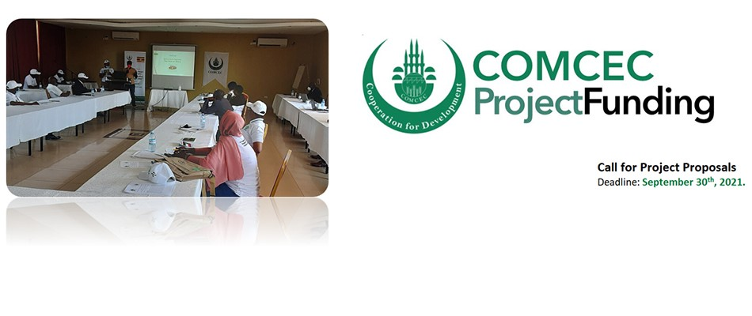
110 Projects from 29 Countries and 5 OIC institutions (2014-2021)
More than 50 countries as a beneficiary

Slide 5
COMCEC Project Funding (CPF)
WHAT?
A grant-based finance mechanism, was introduced by COMCEC Coordination Office in 2013 as a policy support instrument under the COMCEC Strategy
WHY?
Supporting implementation of policy recommendations adopted by COMCEC Ministerial Sessions
Increasing institutional and human capacity
Enhancing multilateral cooperation and solidarity among the member countries
HOW?
Financing projects in six cooperation areas;
* Agriculture * Financial Cooperation
* Trade * Transport and Communication
* Tourism * Poverty Alleviation

Slide 6
COMCEC Project Funding (CPF)
WHO CAN APPLY?
Government institutions of the OIC member countries which are registered to the relevant working group
OIC institutions operating in the field of economic and commercial cooperation
PROJECT TYPES
Activity-based Projects: Including training, seminar, workshop, study visit, publicity meeting and preparation of audio, visual and written promotion materials etc.

Slide 7
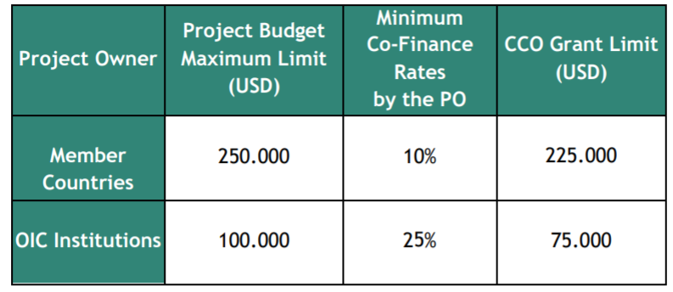
COMCEC Project Funding (CPF)
BUDGET LIMITS
TIMELINE of CALL for PROJECT PROPOSALS
Preliminary Application: September 1st-September 30th
Declaration of the Short-Listed Projects : Early November
Submission of the Final Project Proposals : End of November
Declaration of the Final-Listed Projects: Early January
Implementation Period: April 1st- December 31st
Project Management Information System

Slide 8
2021 Projects in Trade Area under the CPF
Project Title: Improve Food Import-Export Control System
Project Owner: Ministry of Economic Development- Maldives
Partner countries: Turkey and Malaysia
Project Purpose: One of the policy recommendations adopted in the 32nd COMCEC Ministerial Session in the field of trade is “Developing/Strengthening a National Quality Infrastructure”. In line with this policy recommendation, the project aims to harmonize food quality infrastructure with international systems and increase related human capacity to improve trade with other countries.
Activities: Study Visit and Training

Slide 9
2021 Projects in Trade Area under the CPF
Project Title: OIC/SMIIC Halal Foundation Training for Africa Region
Project Owner: SMIIC
Partner countries: Turkey, Morocco, Cameroon, Côte d'Ivoire, Gabon, Mali, Guinea, Niger, Burkina Faso, Algeria, Tunisia, Mauritania, Djibouti, Senegal
Project Purpose: In line with policy recommendations adopted in the 32nd COMCEC Ministerial Session “Strengthening SMIIC for the Adoption of Harmonized Standards for the Development of Quality Infrastructure in the OIC for Enhancing Intra-OIC Trade”, the project aims to train relevant experts in the Halal market, OIC/SMIIC Standards and Halal certification, adoption and implementation of standards and the use of OIC/SMIIC Halal Food standards.
Activities: Training

Slide 10
2021 Projects in Trade Area under the CPF
Project Title: Digital Transformation for Enhancing Trade Facilitation
Project Owner: ICCIA
Partner countries: Turkey, Pakistan, Egypt, Azerbaijan, Bangladesh, Burkina Faso, Cameroon, Djibouti, The Gambia, Guinea, Indonesia, Iran, Côte d’Ivoire, Kuwait , Mali,Niger, Oman, Qatar, Saudi Arabia, Somali, Sudan, Uganda, Chad, Senegal, Kirghizstan
Project Purpose: The project intends to create a vision among OIC chambers and set a digital transformation agenda to establish a strategic plan to guide the chambers in contributing to private sector development.
Activities: Workshop

Slide 11
2021 Projects in Trade Area under the CPF
Project Title: Developing Human Capital in OIC Countries for Technical Halal Auditing based on SMIIC Halal Certification System & Halal Quality Infrastructure
Project Owner: Ministry of Trade, Turkey
Partner countries: Pakistan, Kazakhstan, Kyrgyzstan, Nigeria
Project Purpose: The project aims to create an awareness on the importance of harmonized Halal standards and its positive to contribution to halal economy via conducting an international conference.
Activities: Training and Conference

Slide 12
De
Call for Project Proposals
Preliminary Submission starts on October 16th, 2021

Slide 13
COMCEC COVID Response (CCR)
WHAT?
A Grant-based Project Financing Mechanism
WHY?
To assist member states in their efforts to alleviate the negative effects of the COVID-19 Pandemic on member country economies
HOW?
Providing financial support to projects in the following types in six cooperation areas:
Direct Grant for purchasing machinery/equipment/service
Needs Assessment
Experience Sharing
Budget for Each Project: 100.000 USD (max.)

Slide 14
COMCEC COVID Response (CCR)
WHO CAN APPLY?
Government institutions of the OIC member countries which are registered to the WGs
FİRST CALL – 9 projects are being implemented in 2021 in Agriculture, Tourism and Trade cooperation areas.
SECOND CALL FOR PROJECT PROPOSALS
Preliminary Application: 16 October- 15 November 2021
Short-List: Mid-December 2021
Final Application: Mid-December 2021 to Mid-January 2022
Final-List: Mid-February 2022
Implementation: April-December 2022
Updates for the second call:
Extending the program to all cooperation areas
Policy recommendations regarding COVID-19

Slide 15
2021 Projects in Trade Area under the CCR
Project Title: Digital Transformation Of The Ministry Of Economy And Trade Lebanon
Project Owner: Ministry of Economy and Trade, Lebanon
Partner Type: Sharing Expertise (Visiting Expert)
Project Purpose: The project purpose is to increase institutional capacity on simplification and automation of trade procedures through the best practices and to gain experience and knowledge on e-commerce, e-export and consumer protection in the field of agriculture
Activities: Two experts will conduct a study visit to the two Ministries in Turkey

Slide 16
2021 Projects in Trade Area under the CCR
Project Title: Modernizing The Electronic Infrastructure Of The Ministry Of National Economy
Project Owner: Ministry of National Economy
Partner Type: Direct Grant
Project Purpose: The objective of the project is to keep providing services locally to the public all times without any delay during the pandemic
Activities: It is envisaged to purchase equipment for the newly established sub-directorates in different regions of Palestine due to the travel restrictions intensified during the COVID-19 period.

Slide 17
THANK YOU
cpf.comcec.org

