Slide 1
Kadir ALTINTOP
Program Coordinator
PROJECT MANAGEMENT TRAINING PROGRAM
GENERAL OVERVIEW
June, 30th 2022

Slide 2
Outline
Types of Projects
Main Program Actors
2

Slide 3
Outline
Types of Projects
Main Program Actors
3

Slide 4
1- Types of Projects
Direct Grant
Needs Assesment
Sharing Expertise
Visiting Expert
Training/Workshop
4

Slide 5
Direct Grant
For alleviating negative impacts of the pandemic, POs can purchase:
Machinery,
Equipment,
Service
For directly meeting the needs of final beneficiaries (institutions, SMEs, farmers etc.)
5

Slide 6
Needs Assesment
Studies assessing the harm imposed by the pandemic
A needs assessment report through local field visit, interviews, desk-based research, etc.
Proposing possible solutions and action plans regarding the pandemic impact on the selected sector and theme.
6

Slide 7
Sharing Expertise
Type One: Visiting Expert
A field visit program conducting by expert(s) from project owner country to host country
To share experiences for eliminating negative effects of the pandemic
Collecting information and data from host country for this purpose
Preparing a field report that describes the current situation of countries in the pandemic and provides recommendations for that.
7

Slide 8
Sharing Expertise
Type Two: Training/Workshop
Under the Training;
An educational activity to be held for improving personal and institutional capacity of participants
The activity includes theoretical and practical studies
Under the Workshop;
A meeting with a specific focus which brings together relevant experts, technical personnel and academicians from partner countries
In order to achieve some concrete results, facilitating discussions and hand-on-practices on a specific topic.
8

Slide 9
Outline
Types of Projects
Main Program Actors
9

Slide 10
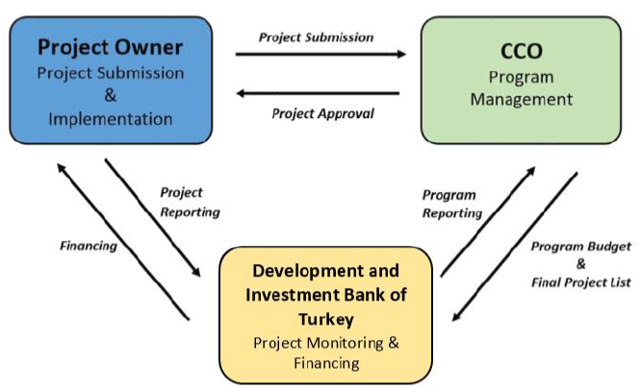
Main Actors
10

Slide 11
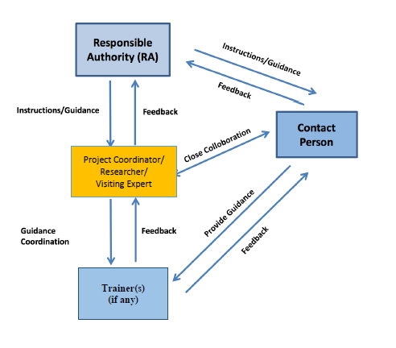
Distribution of Roles among Project Staff
11

Slide 12
Responsibilities of Responsible Authority (RA)
Main responsible actor for effective and timely implementation of project activities,
Performing administrative and technical management of project activities and personnel (Project Coordinator, Researcher, Trainer etc)
Checking and approving the relevant documents (Detailed Work Plan, progress reports, timesheets etc.) of the project in accordance with the requirements set forth in the Contract and Program Guidelines
Ensuring the accuracy of the information provided to the Bank and the CCO
Ensuring the submission of the relevant project documents in a timely manner
Developing and maintaining close cooperation with partner countries, the Bank and the CCO
Notifying the Bank and the CCO promptly on the difficulties encountered during the project implementation.
12

Slide 13
Responsibilities of Contact Person (CP)
Performing the administrative and technical management of project activities and supervising project personnel on behalf of the Responsible Authority
Ensuring smooth, effective and timely implementation of project activities
Checking the conformity and accuracy of the relevant documents (Detailed Work Plan, progress reports, timesheets etc) of the project in accordance with the requirements set forth in the Contract and Program Guidelines
Providing additional information, justification and/or documents on behalf of the Responsible Authority, if and when requested by the Bank
Attending project related meetings.
13

Slide 14
Other Project Staff
Researcher
Project Coordinator
Visiting Expert
Trainer
Project Coordinator
Visiting Expert
Trainer
14

Slide 15
THANK YOU
COMCEC COORDINATION OFFICE
ccr@comcec.org

