Slide 1
Eda AKÇA
Program Coordinator
PROJECT MANAGEMENT TRAINING PROGRAM
SHARING EXPERTISE PROJECTS
June, 30th 2022

Slide 2
Outline
Sharing Expertise
Responsibilities of Actors
Monitoring and Reporting
Online Monitoring System
Visibility
2

Slide 3
Outline
Sharing Expertise
Responsibilities of Actors
Monitoring and Reporting
Online Monitoring System
Visibility
3

Slide 4
Sharing Expertise
1- Responsibilities of Actors
CONTACT PERSON
Ensuring smooth implementation of the project activities
Supervising project personnel and checking the conformity of reports and documents on behalf of the Responsible Authority.
Working in close cooperation with the Bank and the CCO.
If necessary, providing additional information for the Bank and the CCO.
4

Slide 5
Sharing Expertise
1- Responsibilities of Actors
PROJECT COORDINATOR (SE projects including training/workshop act.)
Overall management of all project activities and coordination of the project partners and other relevant stakeholders.
Evaluating overall project performance and proposing corrective action whenever required.
Working in close cooperation with the Bank, the CCO and the Project Owner.
Drafting Detailed Work Plan (where necessary) and other reports along with supplementary documents and conveying them to the Responsible Authority before submitting them.
Preparing his/her own timesheets in every month.
Checking and sending training materials.
5

Slide 6
Sharing Expertise
1- Responsibilities of Actors
PROJECT COORDINATOR (Cont’d)
Extending official invitations to the partner countries.
Attending COMCEC events and other relevant international meetings.
6

Slide 7
Sharing Expertise
1- Responsibilities of Actors
TRAINER (SE projects including training activity)
Contributing to the preparation of the Detailed Work Plan and Activity Reports.
Preparing the content and program of the training in collaboration with the Project Coordinator.
Preparing the training materials.
Collecting and analysing data which is essential to preparation of training program.
Training relevant target groups on the specific subject(s) stated in the Project Fiche.
Preparing his/her own timesheets.
7

Slide 8
Sharing Expertise
1- Responsibilities of Actors
VISITING EXPERT
Overall management and coordination of all project activities.
Evaluating overall project performance and proposing corrective action whenever required.
Conducting the international field visit in accordance with the project fiche.
Documenting the all documents related with the international field visit.
Collecting and analysing data which is essential to preparation of the field report.
Submitting each section of field report to the Responsible Authority before sending them to the CCO for approval.
Editing and revising each section of field report by considering the comments and suggestions of the PO and the CCO.
8

Slide 9
Sharing Expertise
1- Responsibilities of Actors
VISITING EXPERT (Cont’d)
Preparing his/her disbursement request forms upon approval of relevant sections of the field report .
Ensuring that all the requirements of the project fiche are satisfied properly and on time.
Providing relevant information and documents to the Project Owner, the Bank and the CCO.
Communicating with the relevant parties for the field visit.
Attending COMCEC events and other relevant international meetings (where necessary) to present project activities and outcomes if requested by the CCO.
9

Slide 10
Outline
Sharing Expertise
Responsibilities of Actors
Monitoring and Reporting
Online Monitoring System
Visibility
10

Slide 11
Sharing Expertise
2- Monitoring and Reporting
SE Project incl. Training/Workshop act.
Detailed Work Plan
Monthly Progress Report
Activity Report
Project Completion Report
SE Project incl. Visiting Expert Act.
Revised Detailed Work Plan
Field Report (Draft/Final)
The Timesheets, Financial Progress Reports, and Disbursement Request Forms will be explained by the Bank tomorrow.
11

Slide 12
Sharing Expertise
2- Monitoring and Reporting
DETAILED WORK PLAN
Project activities and other preparatory works related to the activities will be presented in the Detailed Work Plan.
It will help to facilitate the time-management and following–up the activities.
Detailed Work Plan should be prepared and sent to the CCO after signing of the contract.
Trainer(s)/visiting expert(s) (if available) is supposed to contribute to the preparation of the Detailed Work Plan.
Before transfer of the payments, the Bank checks consistency of the financial reports with Detailed Work Plan
12

Slide 13
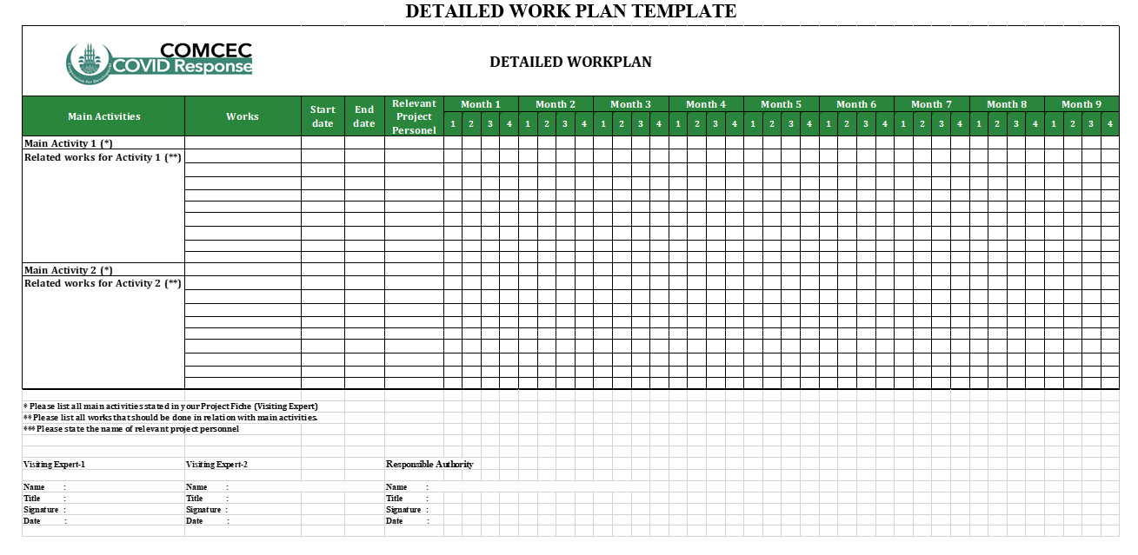
Sharing Expertise
13

Slide 14
Sharing Expertise
2- Monitoring and Reporting
MONTHLY PROGRESS REPORT
Monthly Progress Report shows the technical progress of Project.
Planned and completed works of the respective month are stated in the report.
It includes details about the problems encountered, the measures taken for the solution of these problems.
Planned works for the next month, alterations in project, visibility and goods and services purchased should be stated in the report.
All verifying documents (questionnaires, reports, training/workshop materials etc.) should be submitted as attachment of the report.
Payments to the Project Coordinator can only be made upon approval of the relevant Monthly Progress Report and Timesheet by the Bank and the CCO.
14

Slide 15
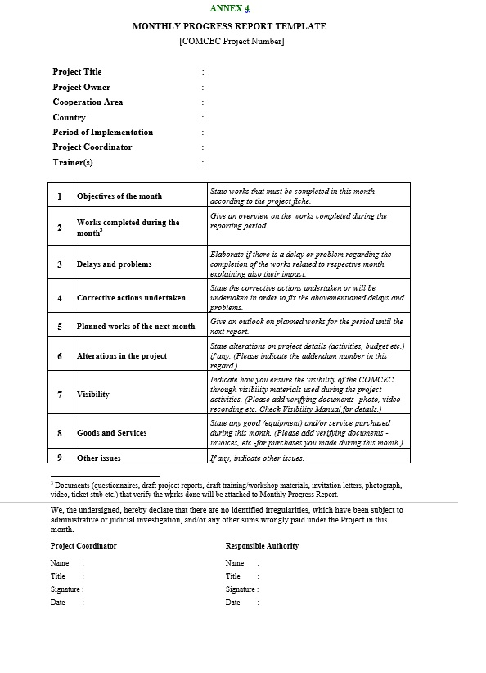
Sharing Expertise
15

Slide 16
Sharing Expertise
2- Monitoring and Reporting
ACTIVITY REPORT
The PO submits an Activity Report if a main activity is undertaken.
Activity Report shall be prepared by The Project Coordinator in collaboration with the Trainer (if available) and approved (checked and signed) by the Responsible Authority
Activity Report is the document that shows the works performed during each main activity as well as their evaluations.
Description, objective, outcomes, visibility and impact of the realized activity are stated along with the challenges that are faced during the implementation period.
Payments to the Trainer(s) can only be made upon approval of the relevant Activity Report and Timesheets.
16

Slide 17
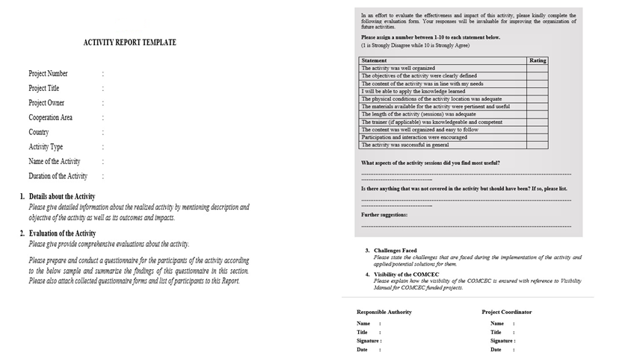
Sharing Expertise
17

Slide 18
Sharing Expertise
2- Monitoring and Reporting
PROJECT COMPLETION REPORT
PO submits a Project Completion Report within two weeks after all project activities are completed.
Project Completion Report shall be prepared by the Project Coordinator in collaboration with other project personnel (if available) and approved (checked and signed) by the Responsible Authority.
Project Completion Report summarizes all technical information about the implementation of the project.
Project Completion Report shall be prepared in line with the other financial and technical reports produced during the project implementation.
The impact and outcomes of the project shall be stated in the Project Completion Report.
Last payments will be done after approval of the Project Completion Reports.
18

Slide 19
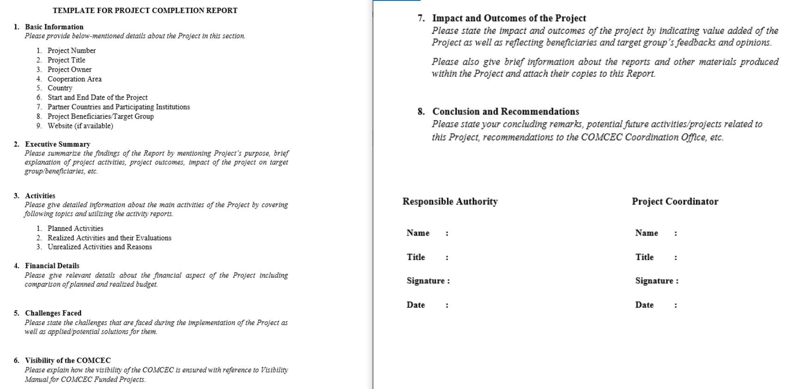
Sharing Expertise
19

Slide 20
Sharing Expertise
2- Monitoring and Reporting
FIELD REPORT
PO submits first section of the report before expert(s) travel to host country.
First section specifies the current situation of the selected sector/theme in PO country with related to the COVID-19 Pandemic.
List of institutions and interviewees along with questionnaire that will be used during the visit will also be submitted.
The PO can request 60% of the total budget after CCO approves the first section, list of institutions, list of interviewees and questionnaire.
PO submits second and third sections of the field report once expert(s)’ time has ended in the host country.
20

Slide 21
Sharing Expertise
2- Monitoring and Reporting
FIELD REPORT (Cont’d)
Second section of the field report states;
why host country was chosen by Project Owner.
the current situation in host country.
the successful practices of the host country in the selected topic
Third section of the report should focus on;
lessons learned, the results achieved, and benefits of the field visit.
experience of successful practices from host country.
recommendations for all member countries
conclusions.
PO can request remaining amount of the total budget after CCO approve the final version of the field report.
21

Slide 22
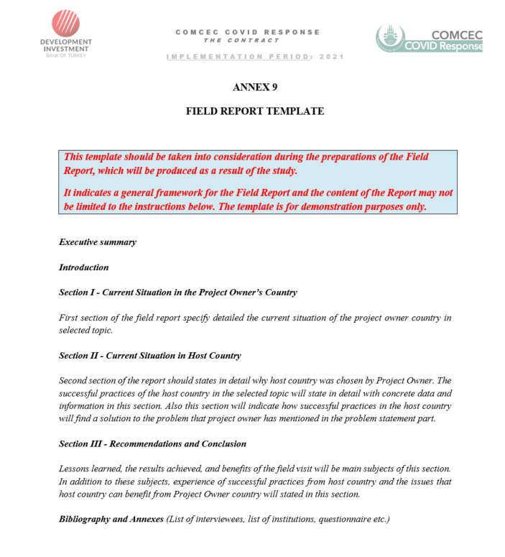
Sharing Expertise
22

Slide 23
Outline
Sharing Expertise
Responsibilities of Contact Person
Monitoring and Reporting
Online Monitoring System
Visibility
23

Slide 24
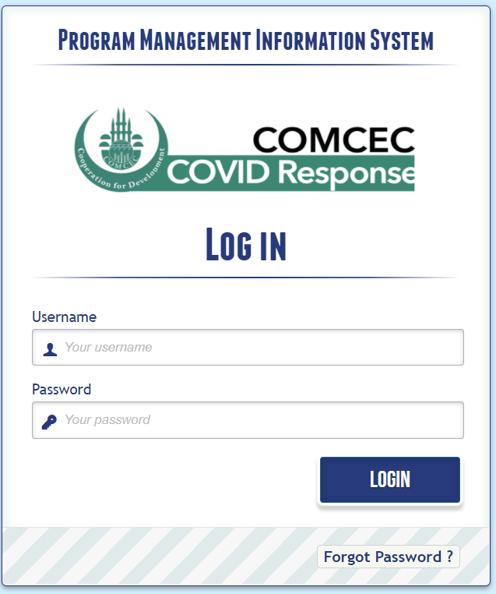
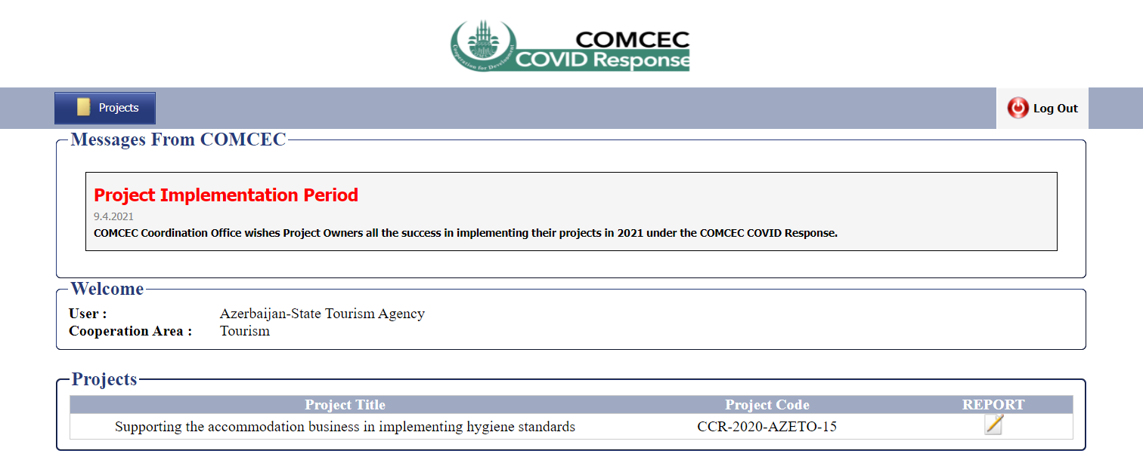
Sharing Expertise
3- Online Monitoring System
Login Page: http://ccr.comcec.org
For submitting reports click:
24

Slide 25
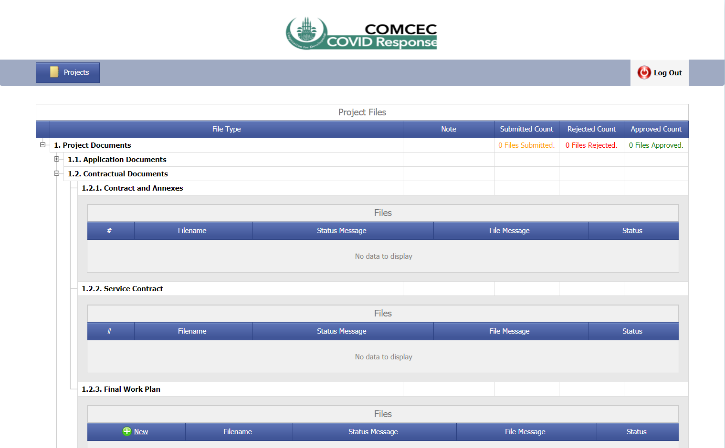
Sharing Expertise
3- Online Monitoring System
Click Here
25

Slide 26
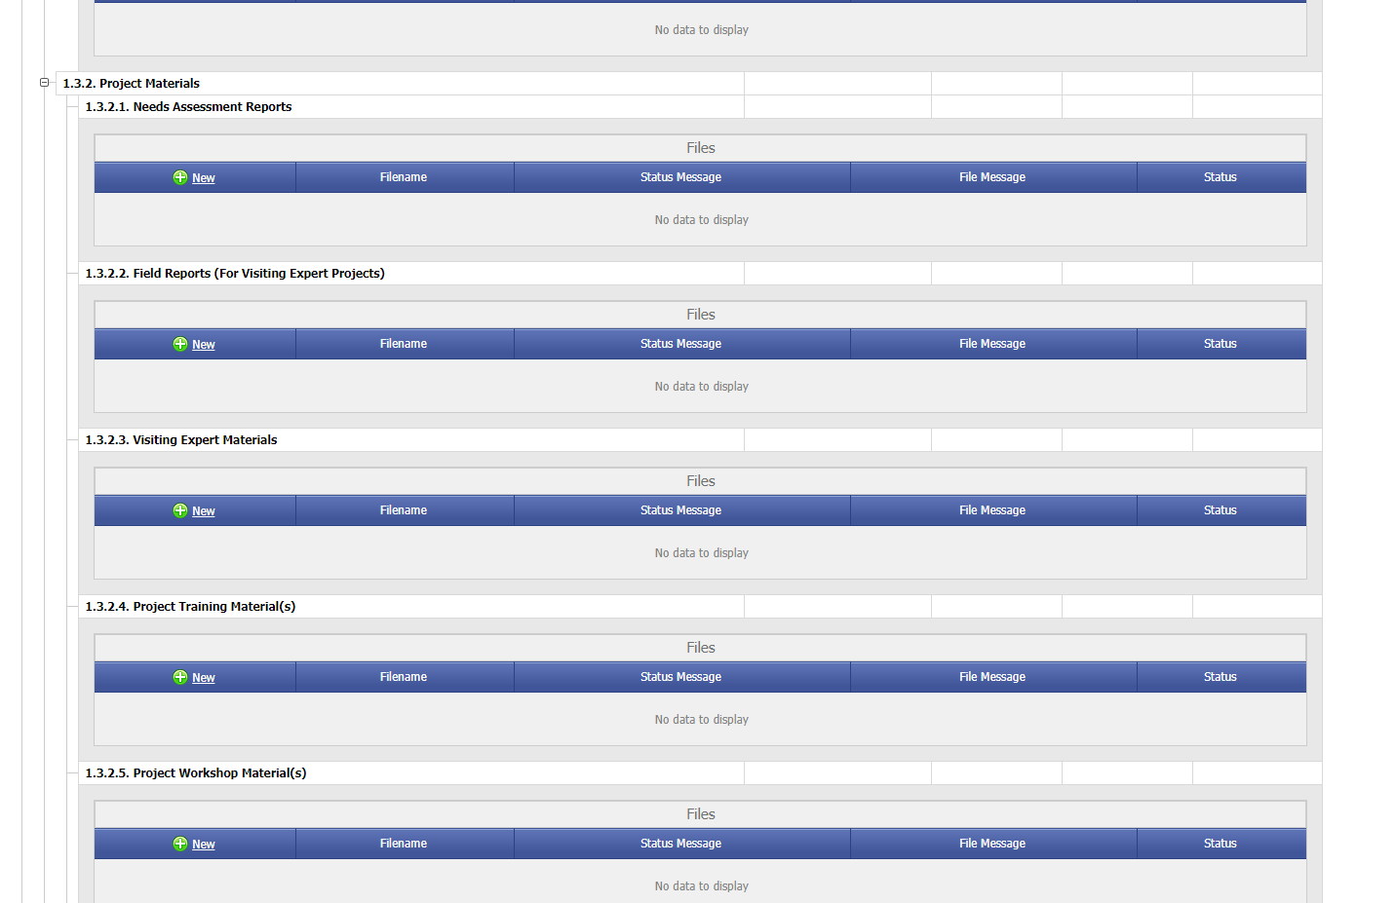
Sharing Expertise
3- Online Monitoring System
Submit Here
26

Slide 27
Outline
Sharing Expertise
Responsibilities of Actors
Monitoring and Reporting
Online Monitoring System
Visibility
27

Slide 28
Sharing Expertise
4- Visibility
The COMCEC Logo must be used in all training materials and field reports.
Various photos and video records (if available) should be taken during the activities in order to provide visibility of the project in different platforms.
The visibility materials must be in compliant with the samples demonstrated in this manual.
28

Slide 29
Sharing Expertise
THANK YOU
COMCEC COORDINATION OFFICE
ccr@comcec.org

