Slide 1

April 22nd, 2025
COMCEC PROJECT SUPPORT PROGRAMS
24th Meeting of COMCEC Agriculture Working Group
Ali ORUÇ
Expert
Department of Programs and Projects
COORDINATION
OFFICE
cpf@comcec.org

Slide 2

Outline
Overview of the COMCEC Project Support Programs
Objectives and Main Characteristics of the COMCEC Project Funding (CPF)
Project Preparation and Submission
  How to prepare a project proposal
  Online Project Submission
Timeline of Call for Project Proposals
Agriculture Projects under CPF in 2025
COORDINATION
OFFICE

Slide 3

1) Overview
COORDINATION
OFFICE

Slide 4
2) Objectives and Main Characteristics
WHAT?
A grant-based finance mechanism, was introduced by COMCEC Coordination Office in 2014 as a policy support instrument under the COMCEC Strategy
WHY?
Increasing institutional and human capacity
Supporting implementation of policy recommendations adopted by COMCEC Ministerial Sessions
Enhancing cooperation and solidarity among the member countries
WHO CAN APPLY?
Relevant public institution of a Member Country ( Registered to Relevant Working Group) or an OIC Institution/Organ operating in the field of economic and commercial cooperation
COORDINATION
OFFICE

Slide 5
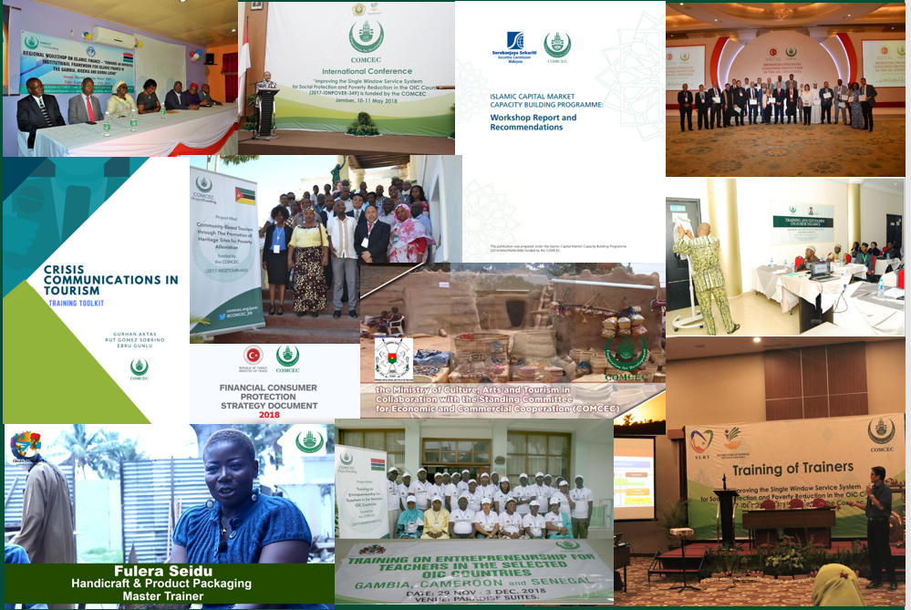
1) Overview
* 156 Projects from 29 Countries and 6 OIC institutions (35 Projects in Agriculture)
* Almost all member countries as a beneficiary
COORDINATION
OFFICE

Slide 6
2) Objectives and Main Characteristics
HOW?
Financing projects in eight cooperation areas;
* Agriculture * Financial Cooperation * Digital Transformation
* Trade * Tourism * Poverty Alleviation
* Transport and Communications * Small and Medium Enterprises
MAIN PROJECT TYPES
Training , Study Visit, Workshop, Conference and Seminar , Publicity Meetings and Preparation of Audio, Visual and Written Materials
Peer-to-Peer Experience Sharing
Needs Assessment
COORDINATION
OFFICE

Slide 7
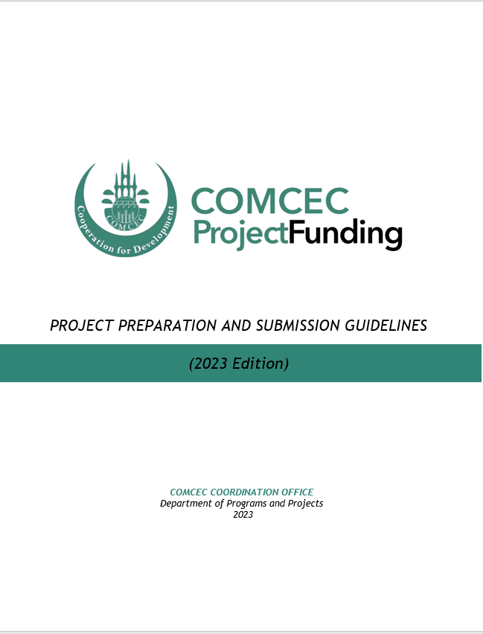
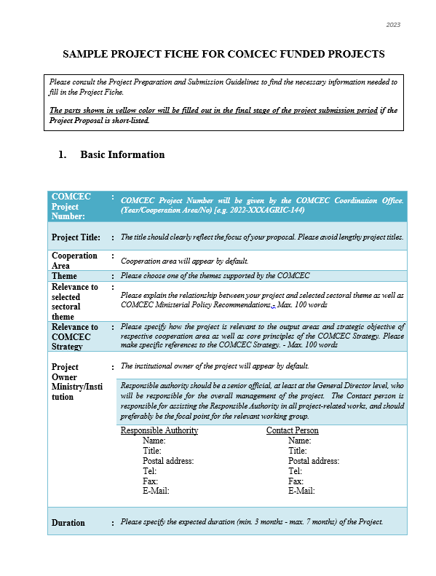
3) Project Preparation and Submission:
a) How to Prepare a Project Proposal
Review the reference documents on the Project Management Information System (https://project.comcec.org/) and Programs Website (https://programs.comcec.org/)
  Project Preparation and Submission Guidelines
  Sample Project Fiche
  Supported Themes
  COMCEC Strategy
Send the relevant documents to the interested national institutions/departments
Fill out the online project fiche through Project Management Information System
Feel free to consult with the CCO (cpf@comcec.org)
Project Preparation and Implementation Guidelines
Sample Project Fiche
COORDINATION
OFFICE

Slide 8
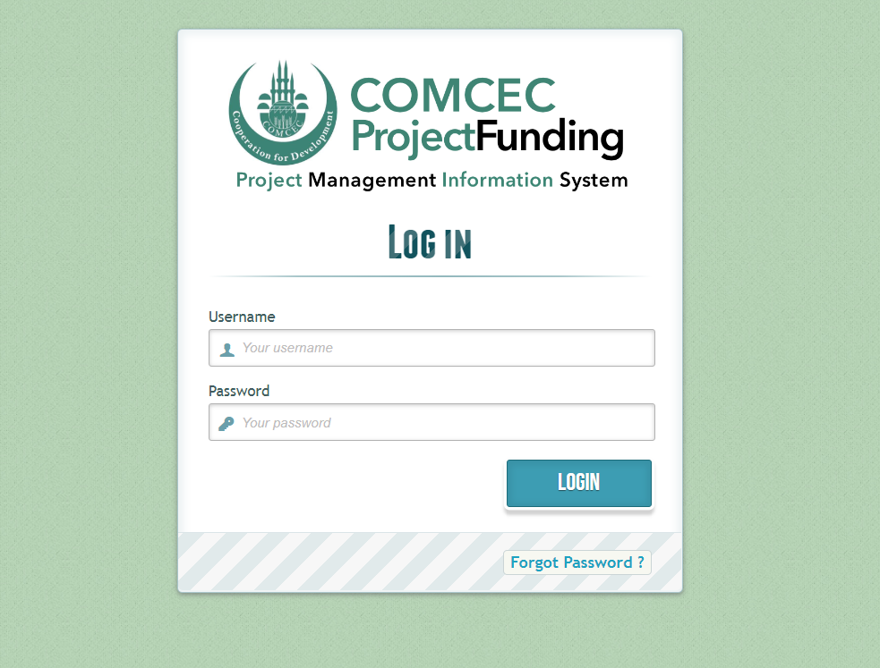
3) Project Preparation and Submission:
b) Online Project Submission
ONLINE PROJECT SUBMISSION: https://project.comcec.org/
The Username and Password are only provided to the sectoral focal points.
If you do not have username and password, please contact cpf@comcec.org.
Username and Password
COORDINATION
OFFICE

Slide 9
4) Timeline Cycle of the Project
13th Call for Project Proposals
Declaration of the Final List of Successful Project Proposals
Submission of the Final Version of Project Proposal by the Project Owner
Declaration of Short List
October 1st- 31st 2025
Early December 2025
End of December 2025
February-March 2026
April 2026
Finalization of Contract Procedures
Project Implementation Period
Organizing a Training Activity
April-December 2026
COORDINATION
OFFICE

Slide 10

5) Agriculture Projects under CPF in 2025
Project Title : Boosting Competitiveness of Azerbaijani Small Family Farms and SMEs by Adopting Climate-Resilient Agricultural Practices
Project Owner : Ministry of Agriculture
Project Partner : Türkiye
Project Activities : Study Visit for Experience Sharing
Project Purpose : Increasing capacities of small-scale agricultural enterprises in Azerbaijan on climate-resilient and low-emission practices.
AZERBAIJAN
COORDINATION
OFFICE

Slide 11

5) Agriculture Projects under CPF in 2025
Project Title : Capacity Building in Efficient Water Management and Agricultural Practices Resilient to the Effects of Climate Change for Market Gardening
Project Owner : Ministry of Agriculture
Project Partners : Morocco and IOFS
Project Activities : Study Visit and Training
Project Purpose : Increasing the capacities of stakeholders in market gardening sector within the context of the effects of climate change
BENIN
COORDINATION
OFFICE

Slide 12

5) Agriculture Projects under CPF in 2025
Project Title : Building capacities of Livestock technicians and smallholder livestock farmers on sustainable climate resilient and Innovative techniques
Project Owner : Ministry of Agriculture
Project Partners : Mauritania
Project Activities : Study Visit and Training
Project Purpose : Increasing technical capacity of different stakeholders on sustainable, climate resilient and innovative techniques in livestock production.
GAMBIA
COORDINATION
OFFICE

Slide 13

5) Agriculture Projects under CPF in 2025
Project Title : Development of dairy production to ensure sustainable food and nutritional security in Niger
Project Owner : Ministry of Agriculture
Project Partners : Türkiye
Project Activities : Study Visit and Training
Project Purpose : Increasing capacities of small scale producers on milk production and processing systems.
NIGER
COORDINATION
OFFICE

Slide 14

5) Agriculture Projects under CPF in 2025
Project Title : Enhancing the capabilities of farmers in some OIC countries by Expanding and Sustainability Using organic and organo-mineral fertilizers
Project Owner : Ministry of Agriculture and Land Reclamation
Project Partners : Sudan, Benin and IOFS
Project Activities : Study Visit, Training and Preparation of audio, visual and written promotional materials
Project Purpose : Enhancing the capacities of the target groups in organic and organic mineral fertilizer production techniques.
EGYPT
COORDINATION
OFFICE

Slide 15

5) Agriculture Projects under CPF in 2025
Project Title : Promoting Unconventional Water Resources to Enhance Agriculture Productivity in Water-Scarce OIC Member Countries
Project Owner : SESRIC
Project Partners : Chad, Niger, Senegal, Morocco, Saudi Arabia, Bangladesh and Türkiye
Project Activities : Training and Field Visit
Project Purpose : Promoting unconventional water resources practices to ensure water-secured agriculture practices.
SESRIC
COORDINATION
OFFICE

Slide 16
THANK YOU
cpf@comcec.org
COORDINATION
OFFICE
cpf@comcec.org

