Slide 1

April 21st, 2025
COMCEC PROJECT SUPPORT PROGRAMS
24th Meeting of COMCEC Tourism Working Group
Kadir ALTINTOP
Expert
Department of Programs and Projects
COMCEC
COORDINATION
OFFICE
cpf@comcec.org

Slide 2

Outline
Overview of the COMCEC Project Support Programs
Objectives and Main Characteristics of the COMCEC Project Funding (CPF)
Project Preparation and Submission
  How to prepare a project proposal
  Online Project Submission
Timeline Cycle of the Project
Tourism Projects under CPF in 2025
COMCEC
COORDINATION
OFFICE

Slide 3
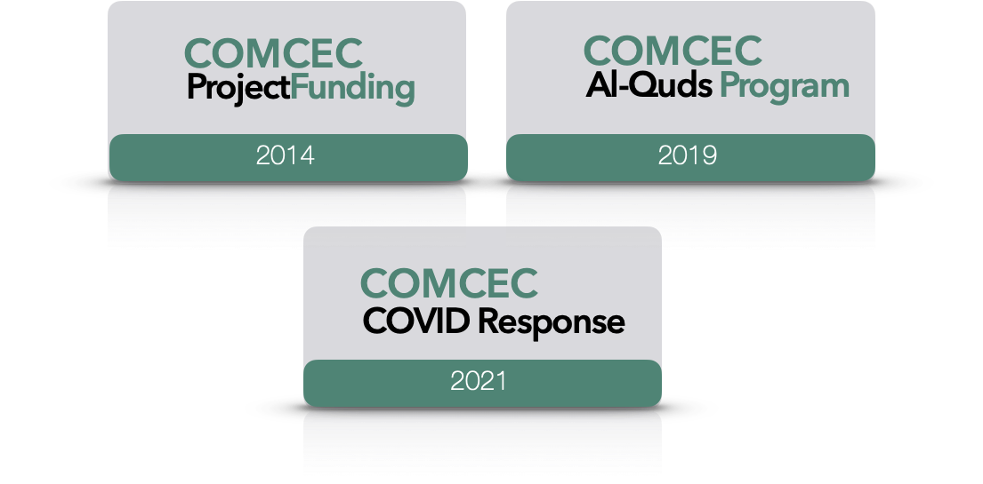
1) Overview
COMCEC
COORDINATION
OFFICE

Slide 4
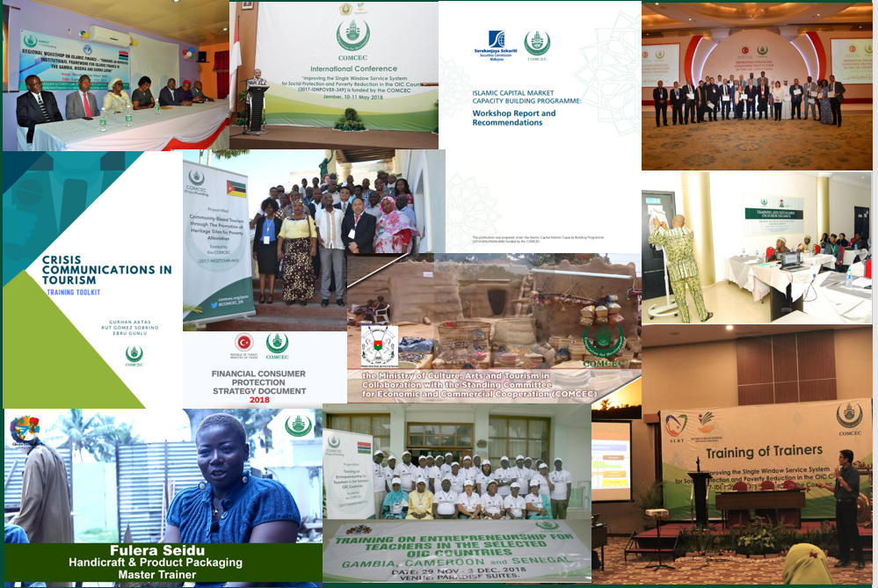
1) Overview
* More than 150 Projects from 30 Countries and 6 OIC institutions (30 Projects in Tourism)
* Almost all member countries as a beneficiary
COMCEC
COORDINATION
OFFICE

Slide 5
2) Objectives and Main Characteristics
WHAT?
A grant-based finance mechanism, was introduced by COMCEC Coordination Office in 2014 as a policy support instrument under the COMCEC Strategy
WHY?
Increasing institutional and human capacity
Supporting implementation of policy recommendations adopted by COMCEC Ministerial Sessions
Enhancing cooperation and solidarity among the member countries
WHO CAN APPLY?
Relevant public institution of a Member Country ( Registered to Relevant Working Group) or an OIC Institution/Organ operating in the field of economic and commercial cooperation
COMCEC
COORDINATION
OFFICE

Slide 6
2) Objectives and Main Characteristics
HOW?
Financing projects in seven cooperation areas;
* Agriculture * Financial Cooperation * Digital Transformation
* Trade * Tourism * Poverty Alleviation *SMEs
* Transport and Communications
MAIN PROJECT TYPES
Training , Study Visit, Workshop, Conference and Seminar , Publicity Meetings and Preparation of Audio, Visual and Written Materials
Peer-to-Peer Experience Sharing
Needs Assessment
Moreover, Opportunity to implement project individually
COMCEC
COORDINATION
OFFICE

Slide 7
2) Objectives and Main Characteristics
SUPPORTED THEMES IN TOURISM THIS YEAR
Promoting Entrepreneurship for Tourism Industry Competitiveness in the OIC Countries
Developing/Improving Financial Tools (i.e. Incentives) for Enhancing Women and Youth Entrepreneurship
Designing Guidance and Training Programs in order to Increase the Number of Entrepreneurs in the Tourism Sector
Developing Effective Strategies for Improving Tourism Entrepreneurship
Developing and Branding Gastronomy Tourism Destinations within OIC
Developing/Improving Local Farmers/Livestock Breeders Program with A Specific Focus on Gastronomy
Developing Programs and Initiatives on Culinary Techniques
Developing/Improving Strategic Development Plans and Marketing Strategies for Gastronomy Tourism
Improving the Quality and Sustainability of Heritage Tourism in OIC
COMCEC
COORDINATION
OFFICE

Slide 8
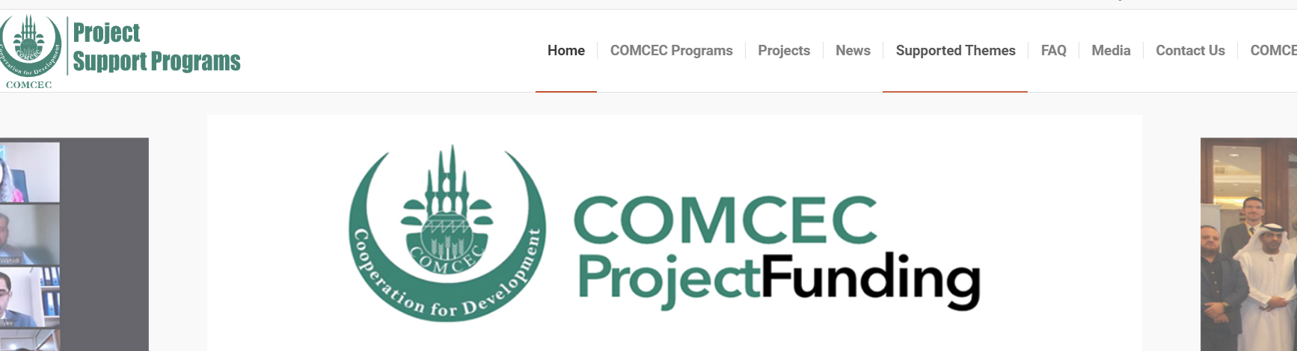
2) Objectives and Main Characteristics
SUPPORTED THEMES IN TOURISM THIS YEAR
https://programs.comcec.org/
Supported Themes
COMCEC
COORDINATION
OFFICE

Slide 9
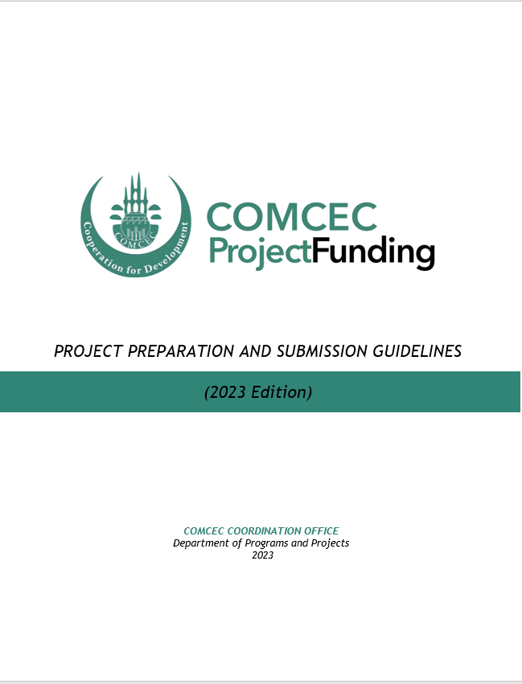
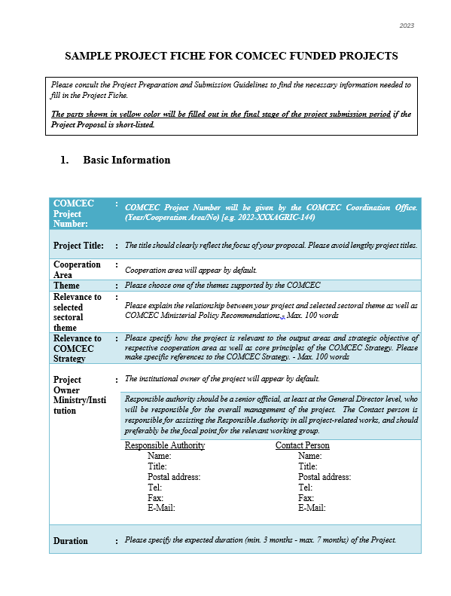
3) Project Preparation and Submission:
a) How to Prepare a Project Proposal
Review the reference documents on the Project Management Information System (https://project.comcec.org/) and Programs Website (https://programs.comcec.org/)
  Project Preparation and Submission Guidelines
  Sample Project Fiche
  Supported Themes
  COMCEC Strategy
Send the relevant documents to the interested national institutions/departments
Fill out the online project fiche through Project Management Information System
Feel free to consult with the CCO
Project Preparation and Implementation Guidelines
Sample Project Fiche
COMCEC
COORDINATION
OFFICE

Slide 10
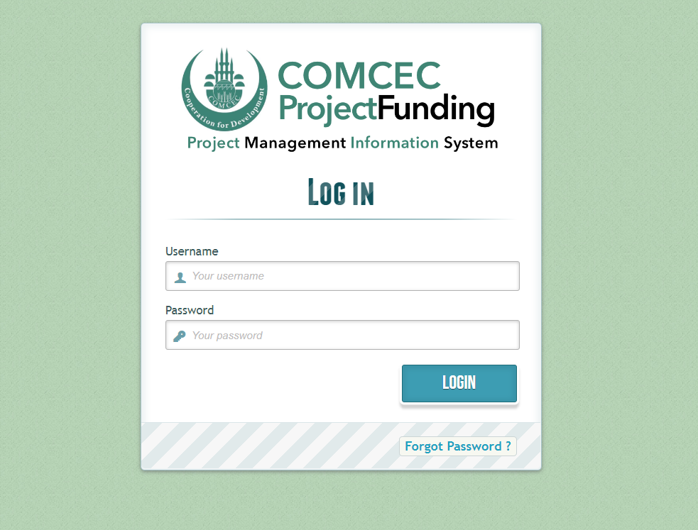
3) Project Preparation and Submission:
b) Online Project Submission
ONLINE PROJECT SUBMISSION: https://project.comcec.org/
The Username and Password are only provided to the sectoral focal points.
If you do not have username and password, please contact cpf@comcec.org.
Username and Password
COMCEC
COORDINATION
OFFICE

Slide 11
4) Timeline Cycle of the Project
Opening of 12nd Call for Project Proposals
Declaration of the Final List of Successful Project Proposals
Submission of the Final Version of Project Proposal by the Project Owner
Declaration of Short List
October, 1st- 31st 2024
Early December 2024
End of December 2024
February-March 2025
April 2025
Finalization of Contract Procedures
April-December 2025
Project Implementation Period
Organizing a Training Activity
COMCEC
COORDINATION
OFFICE

Slide 12
5) Tourism Projects under CPF in 2025
BURKINA FASO | Capacity Building of Stakeholders through Experience Sharing in Agrotourism Practices
BANGLADESH | Strategic Planning and Marketing Strategies for the Promotion of Gastronomy Tourism
INDONESIA | Empowering Sustainable Tourism: Integrating Blue, Green, Circular Economy into Tourism Operations
MALDIVES | Enhancing Maldivian Gastronomy Tourism by Increasing the Recognition of Traditional Cuisine
MALAYSIA | Reimagining Islamic Heritage Tourism: Best Practices and Critical Success Factors
UGANDA | Effective Management of Tourism Heritage SItes for Enhancing the Quality and Sustainability in Tourism
SESRIC | Promoting Gastronomy Tourism for the Destination Senegal
COMCEC
COORDINATION
OFFICE

Slide 13

Tourism Projects under CPF in 2025
Project Title : Capacity Building of Stakeholders through Experience Sharing in Agrotourism Practices
Project Owner : Ministry of Communication, Culture, Arts and Tourism
Project Partners : Morocco
Project Activities : Training and Study Visit
Project Purpose : Strengthening the connection between agriculture and livestock farming with tourism, diversifying the range of tourist products, and enhancing the appeal of agrotourism destinations
BURKINA FASO
COMCEC
COORDINATION
OFFICE

Slide 14

Tourism Projects under CPF in 2025
Project Title : Strategic Planning and Marketing Strategies for the Promotion of Gastronomy Tourism
Project Owner : Ministry of Civil Aviation and Tourism
Project Partners : Türkiye
Project Activities : Training
Project Purpose : To create comprehensive strategic plans and effective marketing strategies that position Bangladesh as a gastronomic tourism destination, generating sustainable economic opportunities for local communities while preserving traditional culinary heritage
BANGLADESH
COMCEC
COORDINATION
OFFICE

Slide 15

Tourism Projects under CPF in 2025
Project Title : Empowering Sustainable Tourism: Integrating Blue, Green, Circular Economy into Tourism Operations
Project Owner : Ministry of Tourism and Creative Economy
Project Partners : Türkiye
Project Activities : Workshop
Project Purpose : Strengthening the competitive and sustainable tourism industry through promoting resource efficiency, waste management, renewable energy, and circular economy models
INDONESIA
COMCEC
COORDINATION
OFFICE

Slide 16

Tourism Projects under CPF in 2025
Project Title : Enhancing Maldivian Gastronomy Tourism by Increasing the Recognition of Traditional Cuisine
Project Owner : Ministry of Tourism
Project Partners : -
Project Activities : Publicity Meeting and Prep. of Audio, Visual and Written Promotional Materials
Project Purpose : To enhance tourism competitiveness by promoting and branding Maldivian gastronomy through creating stronger links between tourism and local communities
MALDIVES
COMCEC
COORDINATION
OFFICE

Slide 17

Tourism Projects under CPF in 2025
Project Title : Reimagining Islamic Heritage Tourism: Best Practices and Critical Success Factors
Project Owner : Ministry of Tourism, Arts and Culture
Project Partners : Uzbekistan, Türkiye, Jordan and Mali
Project Activities : Workshop and Study Visit
Project Purpose : To identify the critical factors behind the successful practices in Islamic heritage tourism and raise awareness of tourism stakeholders to strengthen and increase recognition of Islamic heritage tourism
MALAYSIA
COMCEC
COORDINATION
OFFICE

Slide 18

Tourism Projects under CPF in 2025
Project Title : Effective Management of Tourism Heritage Sites for Enhancing the Quality and Sustainability in Tourism
Project Owner : Ministry of Tourism, Wildlife and Antiquities
Project Partners : The Gambia
Project Activities : Training
Project Purpose : Equipping prominent stakeholders in heritage tourism with effective and quality tourism management techniques and strengthening the tourism economy by protecting heritage resources and values
UGANDA
COMCEC
COORDINATION
OFFICE

Slide 19

Tourism Projects under CPF in 2025
Project Title : Promoting Gastronomy Tourism for the Destination Senegal
Project Owner : SESRIC
Project Partners : Türkiye, Morocco, Senegal, Uzbekistan, Malaysia, and ICDT
Project Activities : Training and Workshop
Project Purpose : To create a strong brand identity for Senegal in gastronomy tourism by equipping relevant stakeholders with essential marketing and management skills, and effective collaboration approaches
SESRIC
COMCEC
COORDINATION
OFFICE

Slide 20
THANK YOU
cpf@comcec.org
COMCEC
COORDINATION
OFFICE
cpf@comcec.org

