Slide 1
IsDB’s Experience in Enhancing and Sustaining Rural Accessibility
24th Meeting of the COMCEC Transport and Communications Working Group
24th April 2025

Slide 2
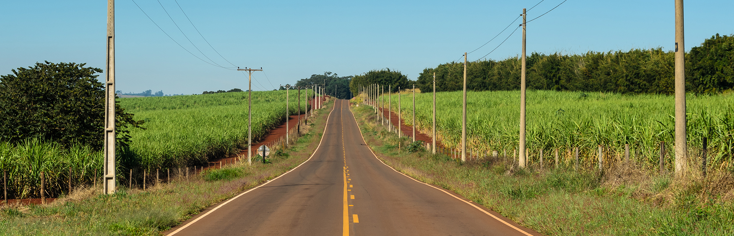
The Islamic Development Bank has played an important role in improving and sustaining rural accessibility through infrastructure projects that promote rural economic growth and resilience.
We deploy STI, provide technical assistance and partner to improve and sustain rural accessibility.

Slide 3
Key Facts about IsDB
Established in 1975 with HQ in Jeddah, KSA
Over 1,000 staff distributed across entities & regional hubs
A Unique Model of South-South Cooperation
Global MDB Membership: 57 Countries Spreading over 4 Continents
11 Regional Hubs
1 Centre of Excellence
EUROPE
Kazakhstan
Turkey
Morocco
KSA
(HQs)
Bangladesh
Egypt
UAE
ASIA
Senegal
Nigeria
Uganda
Malaysia
(CoE)
Suriname
AFRICA
Indonesia
LATIN AMERICA
Public Sector Financing
Public-Private Partnership
Capacity Development and Technical Cooperation
Reverse Linkages (South-South Cooperation)
Science Technology and Innovation

Slide 4
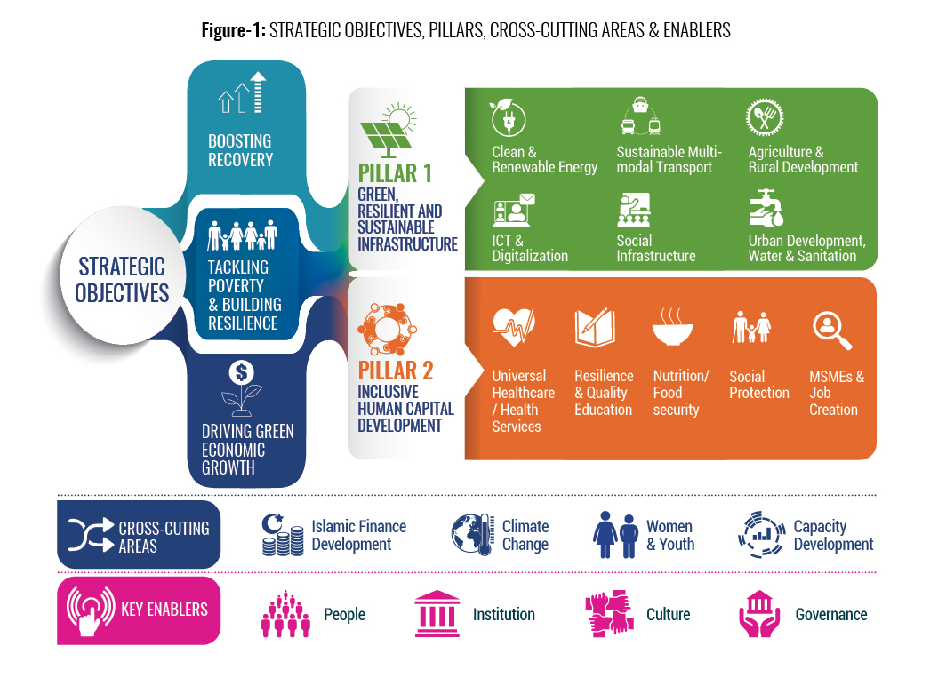
Strategic Objective & Focus Areas of IsDB (under Realigned Strategy 2023-2025)

Slide 5
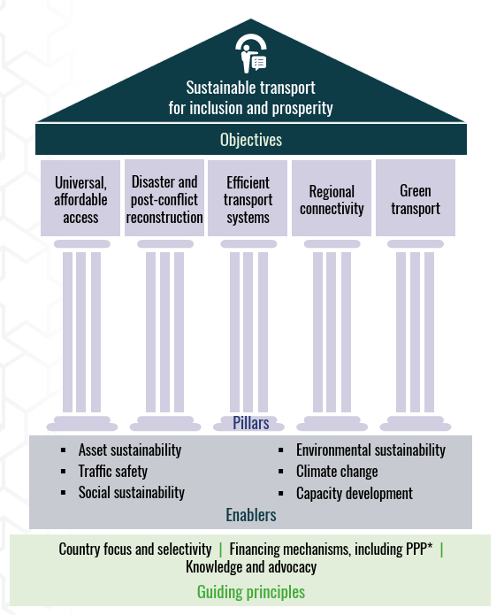
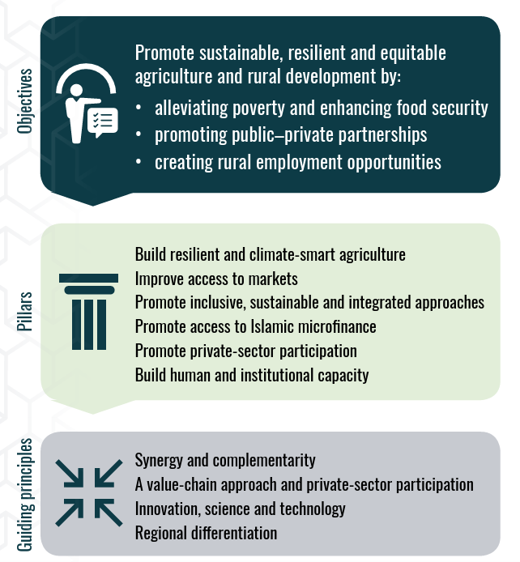
IsDB Sector Policy Framework
Transport
Agriculture & Rural Development

Slide 6
Project Cycle for the IsDB Project Financing
- Appraisal
- Negotiation
- Approval
- Signature
- Effectiveness
- Procurement
- Financial Mgt
- Disbursement
- Monitoring and Support
- Physical Closure
- Financial Closure
- Member Country Partnership Strategy
- Country Engagement Framework
- Country Programming
Conducting technical, economic, social and environmental assessments and preparing feasibility studies, engineering and technical designs, stakeholder engagement, etc
Country Strategy & Programming
Project Processing
Project Post Evaluation
Lessons Learned
Project Completion
Project Implementation

Slide 7
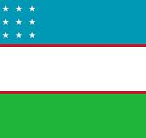
Example of Projects Financed by IsDB that Improved Rural Accessibility
Integrated Agric Development Project |  | Integrated Rural Development Project |  | Integrated Rural Development Project |  | Construction of Five Climate Resilient Bridges
 | Linking Farmers to Market Project |  | Bereket - Etrek Railway Project |  | Agro-Pastoral Development Project in the OMVG Region (Gambia, Guinea, Guinea Bissau, Senegal)
Increased agricultural trade which enhances farmers' livelihoods.
Increased access of beneficiaries to established irrigation land.
Increased access to amenities like health, education, and markets.
Increased earnings from a second job due to simple access to work opportunities.
Easy access to isolated villages and decreased rural transportation cost.
Integration of remote regions with economic activities, particularly tourism.
Increased regional integration e.g. Bereket - Etrek Railway Project and Agro-Pastoral Development Project in the OMVG

Slide 8
Innovation, Partnership, Capacity Building and Institutional Support
Technology Deployment Cooperation Program
South-south cooperation through Reverse linkage
Institutional Capacity Building

Slide 9
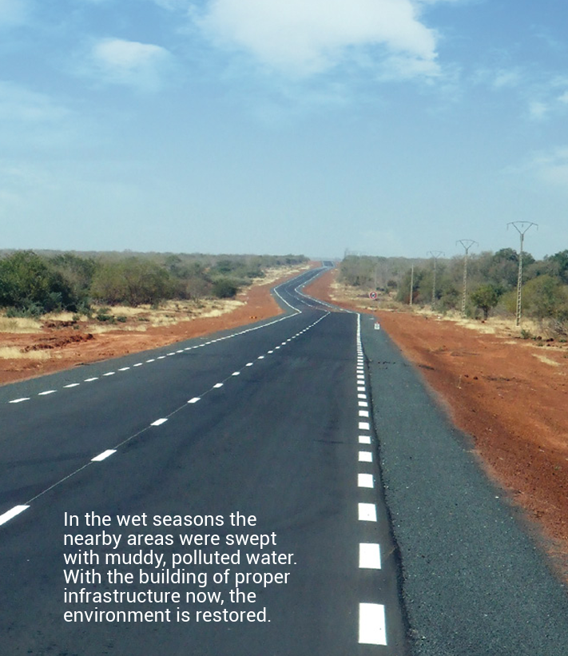
Selected Lessons Learned and Recommendation
Focus in designing rural road programs right from the start that generates high development impact and bankability projects.
Engage the local stakeholders better, considering disparities in regional development.
Promote cooperation through Reverse Linkage.

Slide 10
T hank Y ou!

