Slide 1

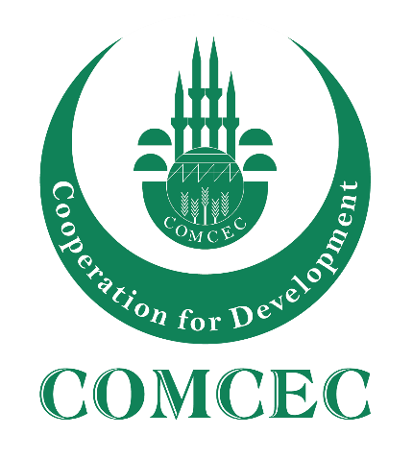
COMCEC STRATEGY
Making Cooperation Work
For Building an Interdependent Islamic World
COMCEC
TOURISM OUTLOOK
2025
Gurel CETIN, PhD
Comcec Coordination Offce
September, 2025

Slide 2
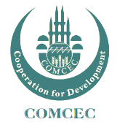
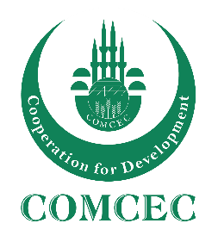
OUTLINE
The Importance of Tourism for Development
Tourism Trends
Overview of International Tourism in the World
International Tourism in the OIC Member Countries
Making Cooperation Work
Making Cooperation Work
COMCEC STRATEGY
COMCEC STRATEGY
1
For Building an Interdependent Islamic World
For Building an Interdependent Islamic World
1

Slide 3

The Importance of Tourism for Development
A remarkable socio-economic phenomena
A critical sector for both advanced and developing economies
Related to more than 185 supply-side economic activities, with direct and indirect effects
Making Cooperation Work
Making Cooperation Work
COMCEC STRATEGY
COMCEC STRATEGY
2
For Building an Interdependent Islamic World
For Building an Interdependent Islamic World

Slide 4
The Importance of Tourism for Development
8 % GDP
(Direct, Indirect and Induced)
1/11
JOBS
US $ 2 TRILLION IN EXPORTS
7%
OF WORLD’S TRADE
30 %
OF
SERVICES EXPORTS
Source: UNWTO Tourism Highlights, 2024 Edition
Making Cooperation Work
Making Cooperation Work
COMCEC STRATEGY
COMCEC STRATEGY
3
For Building an Interdependent Islamic World
For Building an Interdependent Islamic World

Slide 5
Key Tourism Trends
  Demographic changes
  Behavioral changes
  Advancements in technology
  Crises and risk management
  Sustainability
Making Cooperation Work
COMCEC STRATEGY
4
For Building an Interdependent Islamic World

Slide 6

Demographic Changes
Share of global population over the age of 60
8 %
12 %
21 %
1950
2013
2050
Active travelers
Security is important
Personalized services
Soft adventure for «feeling young»
Health, sport and wellness products
Making Cooperation Work
COMCEC STRATEGY
4
For Building an Interdependent Islamic World

Slide 7
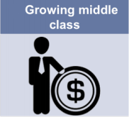
Demographic Changes
Middle Class Population
(in billion)
1.8
3.2
4.9
2009
2020
2030
The increase in average income results in a growing middle class
Emerging source markets
Making Cooperation Work
COMCEC STRATEGY
6
For Building an Interdependent Islamic World

Slide 8

Demographic Changes
Generation Y (Millennials)
50 % of all travelers by 2025
Technology is essential!!!
Generation Z (iGen – 6-25 ages)
Spend parents’ money faster
High level of involvement in digital trends
A more dynamic lifestyle
Source: Horwart HTL Tourism Megatrends, 2016
Making Cooperation Work
COMCEC STRATEGY
5
For Building an Interdependent Islamic World

Slide 9

Behavioral Changes
Increase in the share of emerging economies
14 cities are from the Middle East and Asia in the top 20 global destinations by international overnight visitors.
Emerging Destinations
58 % of Total Arrivals
2030
Source: Travelness, 2024
Making Cooperation Work
COMCEC STRATEGY
7
For Building an Interdependent Islamic World

Slide 10


  Advancements in Technology
Source: ITB World Travel Trends Report 2015-2016
Making Cooperation Work
COMCEC STRATEGY
8
For Building an Interdependent Islamic World

Slide 11

  Sharing Economy
Security
Taxing
Unfair Competition
Inflation
Gentrification
Making Cooperation Work
COMCEC STRATEGY
10
For Building an Interdependent Islamic World

Slide 12

  Digital Nomads
Remote Work (30%)
Extended Stays
Slow Tourism
Visa Issues
Flexible Infra-structure
Health services
Education Services
Accessibility
Making Cooperation Work
COMCEC STRATEGY
10
For Building an Interdependent Islamic World

Slide 13

  Artificial Intelligence
Personalization
Speed
Translation
Routing
Marketing - Nudging
Human Resources
Operations
GPDR issues
Making Cooperation Work
COMCEC STRATEGY
10
For Building an Interdependent Islamic World

Slide 14
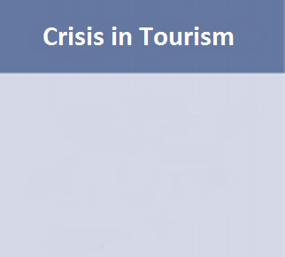
  Crises and Risk Management
Source: WTTC, 2016
Making Cooperation Work
COMCEC STRATEGY
10
For Building an Interdependent Islamic World

Slide 15

Sustainability
Tourism
Tourist Numbers
Sustainable Tourism
Environmental Concerns
Social Concerns
Economic Concerns
Economic Concerns
Sustainable Tourism is defined as:
« tourism that respects both local people and the traveler, cultural heritage and the environment»
Making Cooperation Work
COMCEC STRATEGY
11
For Building an Interdependent Islamic World

Slide 16
International Tourist Arrivals
Source: World Tourism Organization
Making Cooperation Work
Making Cooperation Work
COMCEC STRATEGY
COMCEC STRATEGY
12
For Building an Interdependent Islamic World
For Building an Interdependent Islamic World
8

Slide 17
  International Tourism- Market Share
Tourist Arrivals
Source: UNWTO, 2024a
Making Cooperation Work
Making Cooperation Work
COMCEC STRATEGY
COMCEC STRATEGY
13
For Building an Interdependent Islamic World
For Building an Interdependent Islamic World
10

Slide 18
International Tourism Receipts
Source: World Tourism Organization
Making Cooperation Work
Making Cooperation Work
COMCEC STRATEGY
COMCEC STRATEGY
14
For Building an Interdependent Islamic World
For Building an Interdependent Islamic World
8

Slide 19
International Tourism Market Share
Tourism Receipts
Source: UNWTO, 2025a
Making Cooperation Work
Making Cooperation Work
COMCEC STRATEGY
COMCEC STRATEGY
15
For Building an Interdependent Islamic World
For Building an Interdependent Islamic World
11

Slide 20
International Arrivals in the OIC Member Countries
(Millions)
Source: Adopted from UNWTO, 2025c (Last available data for OIC countries were used)
Making Cooperation Work
Making Cooperation Work
COMCEC STRATEGY
COMCEC STRATEGY
17
For Building an Interdependent Islamic World
For Building an Interdependent Islamic World
22

Slide 21
International Receipts in the OIC Member Countries
(Billion $)
Source: Adopted from UNWTO, 2025c (Last available data for OIC countries were used)
Making Cooperation Work
Making Cooperation Work
COMCEC STRATEGY
COMCEC STRATEGY
17
For Building an Interdependent Islamic World
For Building an Interdependent Islamic World
22

Slide 22
Tourist Arrivals in OIC Regions
(OIC-MENA, OIC-Asia, and OIC-Sub-Saharan Africa)
(Millions)
Source: Adopted from UNWTO, 2025c (Last available data for OIC countries were used)
Making Cooperation Work
Making Cooperation Work
COMCEC STRATEGY
COMCEC STRATEGY
18
For Building an Interdependent Islamic World
For Building an Interdependent Islamic World
22

Slide 23
Tourism Receipts in OIC Regions
(OIC-MENA, OIC-Asia, OIC-Sub-Saharan Africa)
(Billion $)
Source: Adopted from UNWTO, 2025c (Last available data for OIC countries were used)
Making Cooperation Work
Making Cooperation Work
COMCEC STRATEGY
COMCEC STRATEGY
19
For Building an Interdependent Islamic World
For Building an Interdependent Islamic World
23

Slide 24
Top 10 OIC Tourism Destinations in International Tourist Arrivals (2023)
(Thousands)
Source: Adopted from UNWTO, 2025c (Last available data for OIC countries were used)
Top-10 countries hosted 194 million international tourist in 2024.
Making Cooperation Work
Making Cooperation Work
COMCEC STRATEGY
COMCEC STRATEGY
20
For Building an Interdependent Islamic World
For Building an Interdependent Islamic World
16

Slide 25
Top 10 OIC Tourism Earners in International Tourism (2023)
(Billion $)
Source: Adopted from UNWTO, 2024c (Last available data for OIC countries were used)
Top-10 countries earned US$ 213 billion as international tourism receipts in 2024.
Making Cooperation Work
Making Cooperation Work
COMCEC STRATEGY
COMCEC STRATEGY
21
For Building an Interdependent Islamic World
For Building an Interdependent Islamic World
18

Slide 26
Recent Developments in the OIC Member Countries
Türkiye (4th), Saudi Arabia (11th), Malaysia (12th), Morocco (17th) and Egypt (20th) were ranked in the top 20 countries in terms of arrivals in the World.
Türkiye (5th), UAE (12th), Saudi Arabia (13th) and Malaysia (17th) were also ranked at top 20 list in terms of receipts in the World in 2024.
Gulf countries continued their extraordinary growth compared to pre-pandemic year of 2019. Egypt, and Iran are also back in business after the pandemic.
Making Cooperation Work
Making Cooperation Work
COMCEC STRATEGY
COMCEC STRATEGY
23
For Building an Interdependent Islamic World
For Building an Interdependent Islamic World
24

Slide 27
Recent Developments in the OIC Member Countries
OIC members in Asia such as Malaysia and Indonesia have suffered from the impacts of pandemic since 2020. They both recorded around 25% growth in 2024 yet still below their 2019 volume.
Uzbekistan recorded 50+% increase both in receipts and arrivals. Albania, and Kazakhstan continued their steady but impressive growth.
The Palestine Occupation have been effecting the neighbouring OIC countries such as Lebanon.
The visa regime of Western countries towards Russian citizens also affected the results.
Source: UNWTO
Making Cooperation Work
Making Cooperation Work
COMCEC STRATEGY
COMCEC STRATEGY
24
For Building an Interdependent Islamic World
For Building an Interdependent Islamic World
24

Slide 28
Tourism Opportunities and Challenges
for the OIC Member Countries
Opportunities
Natural Resources
Human Resources
Authenticity and novelty
Price competitiveness
Dynamism
Cultural Resources
Challenges
Insufficient Tourism Investment & Infrastructure
Low Tourism Service Quality
INSUFFICIENT MARKETING AND PROMOTION
Insufficient Image Building and Branding
POOR DESTINATION PLANNING & PRODUCT DEVELOPMENT
Travel Facilitation Problems
Safety and Security Related Problems
LACK OF TOURISM DIVERSIFICATION
Making Cooperation Work
Making Cooperation Work
COMCEC STRATEGY
COMCEC STRATEGY
28
For Building an Interdependent Islamic World
For Building an Interdependent Islamic World
30

Slide 29
COMCEC ANALYTICAL TOPICS (2025 – 2026)
Heritage Tourism (2025)
Climate Change (2026)
Making Cooperation Work
Making Cooperation Work
COMCEC STRATEGY
COMCEC STRATEGY
29
For Building an Interdependent Islamic World
For Building an Interdependent Islamic World
24

Slide 30
COMCEC STRATEGY
Making Cooperation Work
For Building an Interdependent Islamic World
THANK YOU
comcec@comcec.org
www.comcec.org
Gurel CETIN, PhD
Comcec Coordination Office
September, 2024

