Slide 1



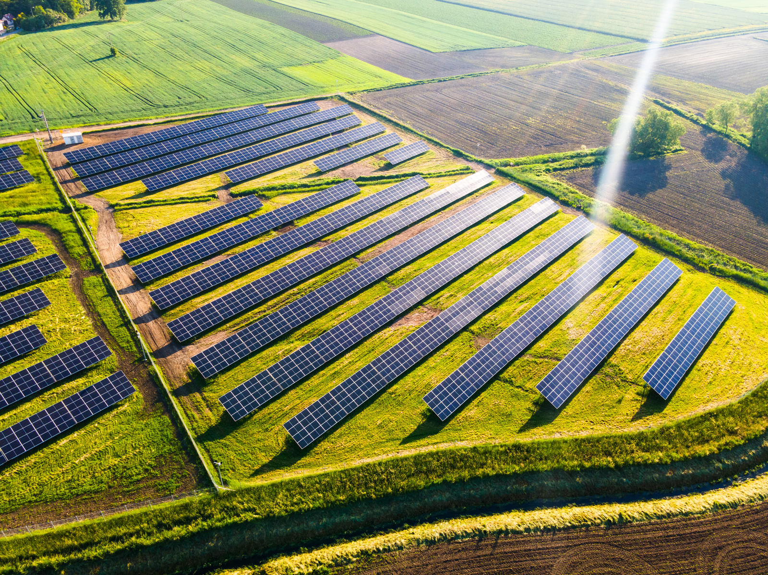
Promoting Sustainable and Environmentally Friendly Islamic Financial Instruments to Combat the Adverse Effects of Climate Change and Natural Disasters in the OIC Member Countries
Professor Mehmet Asutay
September 17, 2025
Researchers:
Dr. Mücahit Özdemir (Bursa Uludağ University)
Astrid Fionna Harningtyas (Durham University & Bank Indonesia)
Dr. Dalal Aassouli (Hamad Bin Khalifa University)
Dr. Ahmad Mohammad Barau (Bamokosi Integrated Services Ltd)
Rahmawati Rahayu (Durham University & Institut Teknologi Bandung)
Dr. Hüsnü Tekin (Economic Cooperation Organization)

Slide 2




Introduction
Aim & Focus
Theoretical Considerations
Methodology
Country Case Studies
Overview of the Study

Slide 3

The Aim & Focus of the Research Project
1 | Examine the development and practices of Islamic green finance instruments aimed at addressing climate change and natural disasters
2 | Examine global trends in Islamic sustainable finance and compare them to the performance of conventional markets
3 | Evaluate the best practices, current initiatives, risks and challenges in both OIC member countries and non-OIC countries
4 | Identify the key stakeholders and their roles in promoting collaboration for green finance advancement
5 | Offer policy recommendations to bolster the growth of the Islamic green finance market
6 | Develop a structured roadmap to accelerate sustainable finance adoption in OIC member countries

Slide 4
Rationalising Extended Stakeholder Governance (Ihsani Governance)
Why Islamic finance must respond to environmental degradation and climate risk and contribute to the islah process?

Slide 5
Chronic Crises through the Existing Economic System
Human crisis (refugees and immigration)
Ecological crisis and climate risk
Political crisis (political unrest and wars)
Economic crises
Health and welfare crises

Slide 6
Emergence of new moralities – Sustainability and ethical business and finance
Removal of ethics impoverished economics (Amartya Sen; A. Etzioni)
Produced a partial analysis
Return of morality - shaping the consequences of economic and financial activities (form vs substance)
From Friedman’s uncompromising position of firms for profits (1967) to the global moral condition of SDGs – a huge positive move
But how substantial is the sustainable development claims and the measures developed
Instrumental ethics/morality vs substantive morality
Islamic substantial morality – maqasid al Shari’ah as a methodology
Question remains:
Are we making the necessary disruption with Sustainable Development discourse or Islamic economics and finance through maqasid?

Slide 7

What should finance be for?
Islamic Moral Economy Condition
01
What is meaning of finance?
An Intermediary
02
“Finance is not about ‘making money’ per se. It is a ‘functional’ science in that it exists to support other goals – those of the society. The better aligned a society’s financial institutions are with its goals and ideals, the stronger and more successful the society will be.
Financial-Financing Difference
Financial: hegemony of finance over real economy
Financing: intermediary in real economic activity
“Finance is not, and should not be, merely a zero-sum game, but rather an adjunct to, and a means toward, a productive life.
Objective of Finance
(Shiller, 2012: 104)
(Shiller, 2012: 7)
03

Slide 8

Financial Decision Making – Changing Paradigm
Capitalist Solution – Efficiency Frontier
  The most efficient and highest return
  Screening based on financial return
  Y=f(Financial Performance)
Ethical + Efficiency Solution – Stage 1:
  Financial return - subject to
    Negative Screening (e.g. whether the investment has environmental degradation, human rights abuses etc)
    Y=f(Financial Performance + Negative Screening)
    Ethical Solution – Stage 2 – Equity Frontier – Islamic Moral Economy Solution
    Financial return - subject to
    Positive Screening (e.g. positive impact on the improvement of environmental conditions – such as green investment, impact investment, etc, prevention of human rights abuses)
    Y=f(Financial Performance + Negative Screening + Positive Screening)

Slide 9
Comparing Institutional Logics
Capitalist Institutional Logic – Neoclassical Paradigm
Determined by Enlightenment ontology, defining humans as homeconomicus:
Ethics and value-free decision making
Rational
Self-maximizing
Efficiency
Shareholder value maximisation
Capital accumulation
Islamic Institutional Logic/Iqtisad Paradigm
Determined by Islamic Ontology with a particular definition of human and their relationship with the larger ecology and ecosystem
Value-Ethics determines
Bounded rationality/constrained domain
Socio-tropic individual with social accountability in the hereafter – falah individual
Equity
Extended stakeholder governance/ihsani governance
Resource accessibility for empowerment and emancipation

Slide 10

Examples in the Differences of Institutional Logics: Efficiency Frontier vs Equity Frontier & Price Mechanism
Capitalism
Price determines everything, including resource accessibility
Efficiency – risk and return
Islamic Moral Economy
“It is not the prices that determine everything, but everything that determines prices” - Bourdieu (2005)
Permissibility and resource accessibility are determined by moral ontology
Equity and motive

Slide 11
Defining Iqtisad for Articulating Maqasid Methodology
Iqtisad as an Arabic word comes from the root of ‘qasd’ and qisd;
‘directing towards an objective’, ‘true path’, ‘in line with an aim’, ‘equable’ and ‘temperate’.
‘just share’ and hence ‘justice’.
iqtisad, relates
‘to giving the right of everything’,
‘to locate everything in its place’, and hence
‘establishing justice’.
Iqtisad aims to maintain the mizan (balance) through ihsan
Iqtisad relates to directing towards an objective:
Emancipation and empowerment of all the stakeholders
embeddedness in the social formation of the society.
Falah seeking individual through Ihsani/good society
Iqtisad aims to maintain the mizan (balance/equilibrium) through ihsan
stakeholding-centred development
So that the initial equation can be maintained.

Slide 12
Ontology of Islamic Moral Political Economy
Growth with Harmony
(tazkiyah)
Everyone and everything has a development path to reach their perfection
(rububiyah)
Methodology -virtue ethics
Maqasid al-Shari’ah
Well-being of all the stakeholders
Complementarity for Unity
(tawhid)
Just
(adalah & Ihsan)
Sustainable
(Mizan & Ihsan)
Imperative
(‘islah’ or melioration and reclamation/
RE-APPREPRIATION)
Everything is a trust and hence should be treated accordingly
(amanah)
The world created with a balance
(mizan)
Maqasid al-Shari’ah provides the necessary framework to assess the consequences against al-adl wal ihsan

Slide 13
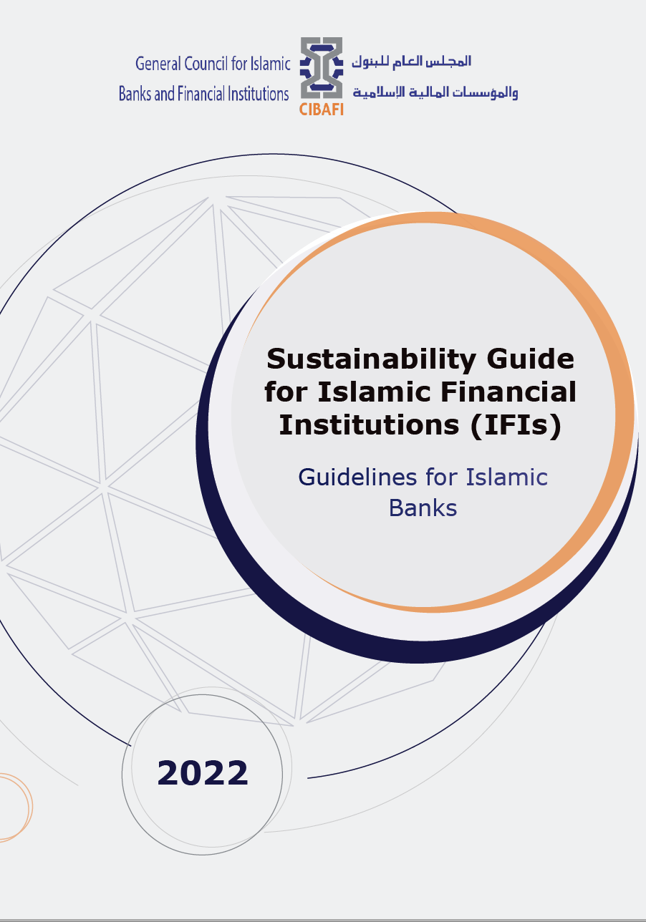
Definition of Islamic Sustainable Development –CIBAFI Guide
Recognising the complementary nature of all the stakeholders to reach unity (tawhid) within the Mizan (divine order/balance),
which requires the recognition and provision of an opportunity space for the development path for each stakeholder to reach their perfection (rububiyah),
where the growth of each stakeholder has to be in harmony with the other stakeholders’ (tazkiyah)
leading to inter-and-intra generational justice (adalah)
through the equilibrium based (ihsani) governance.
Asutay (2002)

Slide 14
Methodology of Islamic Finance & Investment Decision Making: Maqasid al-Shari’ah
Methodology of Islamic moral economy for Islamic finance aims to overcome dichotomy between form and substance by combining them within Islamic logic
Islamised Market Logic through Fiqhi (Form) Screening
(prohibitions) (intentions)
Riba
Gharar
Maysir
Sin industries
Over leverage (debt)
Moral (Substance) Screening (consequences)
Maqasid al-Shari’ah consequences – substantive morality of Islam
Emancipation and Empowerment of Human and Other Stakeholders
Islamic Logic
Substantive Morality
=
+

Slide 15


Climate Adaptation and Vulnerability Measurement:
ND-GAIN Scores for Global and OIC Countries (‘95-’23)
Metric | OIC Member Countries Average |  | Global Average
 | 1995 | 2023 | 1995 | 2023
Vulnerability | 0.492 | 0.465 | 0.457 | 0.433
Readiness | 0.290 | 0.327 | 0.358 | 0.403
The ND-GAIN index measures vulnerability across six sectors (food, water, health, ecosystems, habitat, and infrastructure) and readiness through economic, governance, social readiness to climate impacts.
In terms of performance, OIC member countries are lag behind the global average for both vulnerability and readiness in 1995 and 2023.
Nevertheless, both vulnerability and readiness in 2023 are improved for OIC member countries, narrowing the gap with the global average.
Some progress are made such as in water resource management, health infrastructure, and ecosystem protection sectors, indicating reduced exposure and increased adaptive capacities. However, higher climate vulnerability in OIC Member Countries highlights more climate exposure and structural sensitivity to climate shocks.

Slide 16

The Role of Islamic Green Finance in Addressing Climate Risk
Islamic finance plays important role as alternative avenue to address climate change and implement DRR strategies. The instruments are not only ethically grounded but are also aligned with the principles of sustainability, social justice, and risk-sharing, which are essential for long-term resilience.
Some commonly used instruments: Green Sukuk, Zakah, Takaful and Waqf, with some potential use of Islamic crowdfunding platforms, Islamic microfinance institutions.
Comparative Advantages of Islamic Financial Tools over Conventional Green Finance on DRR Strategies

Slide 17


Challenges and Opportunities to Advance Islamic Finance in Addressing Climate Risk
Challenges
Opportunities
Regulatory gaps and policy uncertainty
Limited market awareness and capacity
Limited bankable green projects and climate data
Higher risk perceptions and limited investor base
Sharia harmonization issues
Growing demand for ethical and climate-friendly investments
Expansion of green sukuk and innovative Islamic instruments
International support and collaboration
Alignment with global standards and investor attraction
Addressing climate risks through Islamic finance innovation

Slide 18

Islamic Financial Instruments aligned with DRR Strategies

Slide 19


Methodology
Critical review of existing body of knowledge
Data Collection & Analysis
Synthesis
Primary Data
Secondary Data
Semi structured interviews with stakeholders in selected countries for case studies:
Financial regulators and policymakers (Ministry of Finance, Central Banks, Financial Services Authority)
National Climate Agencies
Bankers and industry players including people from takaful industry
Islamic social finance agencies
Standard-setting bodies (IFSB)
Climate and Natural Disaster focused NGOs
Databases
Regulatory reports
Policy documents
Standard-setting bodies regulations
Industry and financial institutions reports
Case Studies
Incentive mechanisms
Best practices: Lessons learned
Country-specific policy recommendations
Strategic roadmap for broader OIC members context

Slide 20
Country Case Studies
OIC Member Countries
Azerbaijan
Indonesia
Nigeria
Qatar
Non-OIC Member Country
United Kingdom
Country | Group | IF Dev. Level | Income Group | ND-Gain Index* | Vulnerability* | Readiness**
Azerbaijan | Asian | Low | Upper Middle | 86 (Moderate) | 80 (Moderate) | 100 (Moderate)
Indonesia | Asian | Moderate | Lower Middle | 98 (Moderate) | 97 (Moderate) | 106 (Moderate)
Nigeria | African | Moderate | Low | 157 (Severe) | 126 (Moderate) | 173 (Not Ready)
Qatar | Arab | Developed | Upper | 37 (Strong-Moderate) | 34 (Mild-Moderate) | 48 (Ready-Moderate)
United Kingdom | Non-OIC | Moderate | Upper | 8 (Strong) | 6 (Very mild) | 13 (Ready)
Note: *out of 187 countries, ** out of 192 countries; IF: Islamic Finance

Slide 21
Country Case Studies
Azerbaijan | High reliance on carbon intensive sectors, particularly energy and agriculture sectors, shared by other emerging countries International collaboration has supported the development of climate-smart agriculture and energy reform Hosted the COP 29 which intensified climate commitments The banking sector green financing has resolved to finance $1.2 billion green projects through international collaboration, PPP and green bond issuances
Indonesia | Largest Muslim economy and a member of the Group of Twenty (G20) Facing both transition and physical risks according to IMF assessment The Government and financial authorities have strengthened legal and regulatory reforms to support sustainable finance Stands as a leader in green finance and the first to issue sovereign green sukuk in 2018 Steady growth in green sukuk market, particularly sovereign green sukuk issuance
Nigeria | Several climate risk initiatives have taken place such as the establishment of the National Council on Climate Change (NCCC), the National Agency for the Great Green Wall (NAGGW), the Agro-Climatic Resilience in Semi-Arid Landscape (ACReSAL), the Climate Action Africa (CAA) and Thrive Agric’s Sustainable Agriculture Program Potential use of Islamic green finance instruments to mobilize climate finance
Qatar | Interconnection with the Qatar National Vision 2030 which includes environmental protection, given challenging environmental and climatic characteristics Several measures have taken place to increase the renewable energy power supply The corporate green sukuk issuance has started to grow supported by Sustainable Bond and Sukuk framework by the authority
United Kingdom | Non-Muslim majority country serving as the centre for the Islamic finance industry in the western hemisphere and issuing sovereign sukuk A global climate finance and actions leader, as a first country to establish government climate initiatives and national emission targets in 2008 Committed to support the financing for developing countries climate transition First country to publish green finance strategy in 2019 The London Stock Exchange pioneered green bond issuance The financial authorities have led global efforts in climate risk integration into financial sector policies

Slide 22



Overview of the Study
The Role of Green Islamic Finance Combat the Adverse Effects of Climate Change and Natural Disasters
Green Finance Initiatives: Global Perspectives
Case Studies
Policy Recommendations and Roadmap
Green finance and SDG
Current global trends in green finance
Different funding models of green projects
Global challenges in the green finance project execution
The role of key stakeholders
Lessons learnt for OIC countries
Islamic finance and climate risks and natural disasters financing opportunities
Islamic finance instruments for climate risk and natural disasters mitigation
Comparative performance of Islamic and conventional green finance
Islamic financial development and sustainable development progress in OIC Countries
Challenges and opportunities for green Islamic finance in OIC Countries
Assessing the country risk for climate and natural disasters
The trajectory of Islamic finance: institutionalization, legal and regulatory framework, and financial standing with particular reference to climate risk mitigation and natural disaster preparedness
Islamic financing provisions for climate risk mitigation and natural disasters preparedness: institutions, products and offerings
Incentive mechanisms to develop Islamic financing responses
Best practices: lessons learned
Country-specific policy recommendations
Short-term recommendations based on the result findings
Long-term structural recommendations

Slide 23
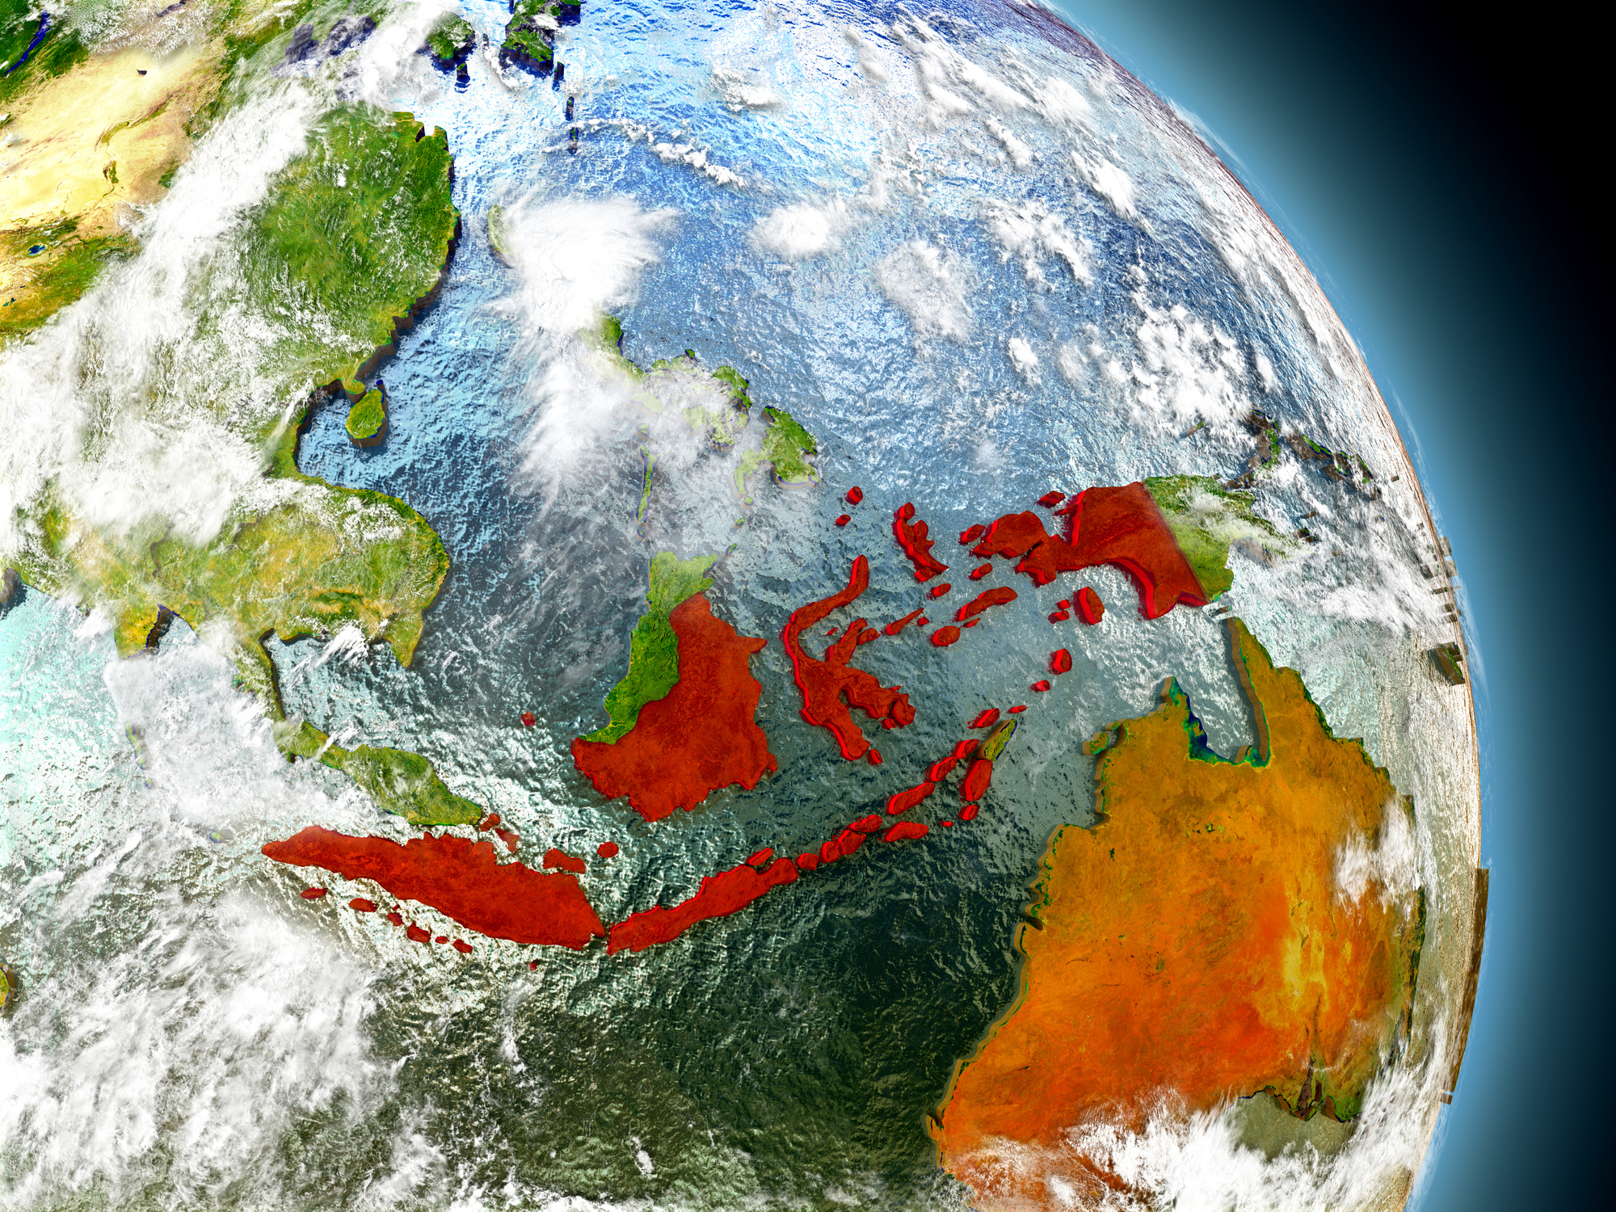
CASE STUDY:
INDONESIA
Country-specific Climate Risks & Resilience
Climate-related Disaster
Vulnerable Sector
Resilience Measures & Adaptation Tools
Policy Framework
Islamic Green Finance in Indonesia
Islamic Finance Trajectory: Institutional Framework & Market
Regulatory Landscape & Incentives
Best Practices
Policy Recommendations

Slide 24
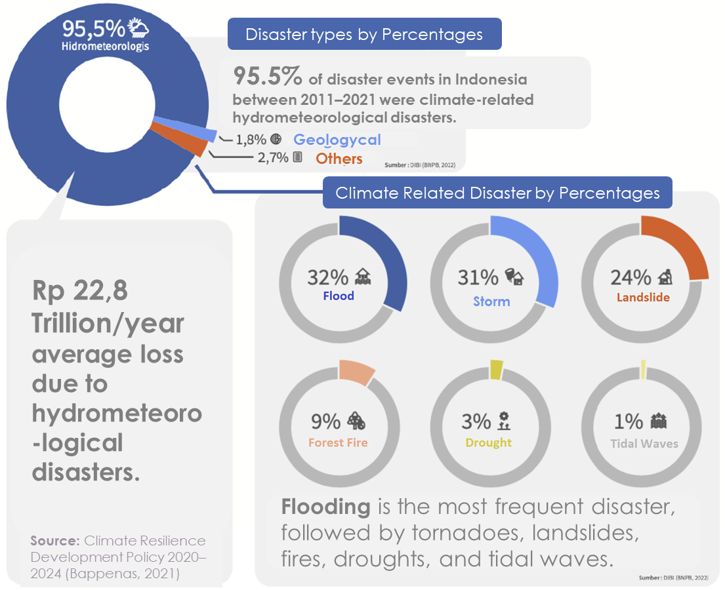
Disaster Profile in Indonesia
One of the world’s most disaster-prone countries
Faces both climate and geophysical risks
400+ disaster events (2020–2025), >43 million people affected
Annual events: floods, storms, landslides, droughts
Java, Sumatra, Sulawesi: high-impact zones

Slide 25


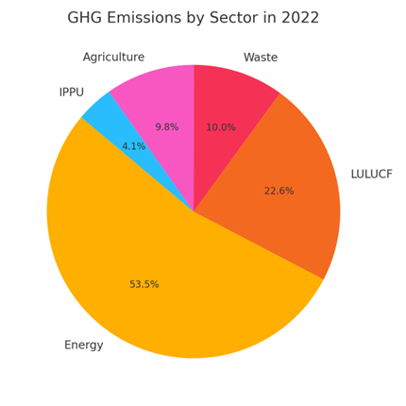

GHG Emission
In 2022, Indonesia's greenhouse gas (GHG) emissions were dominated by the energy sector, contributing 53.5% of total emissions, largely driven by coal-fired power and transportation. The LULUCF sector (Land Use, Land Use Change, and Forestry) followed at 22.6%, reflecting deforestation and peatland degradation. Other significant contributors included waste (10.0%), agriculture (9.8%), and industrial processes (IPPU, 4.1%).
Highlighting the need for targeted mitigation in energy transition, sustainable land management, and circular economy initiatives.

Slide 26
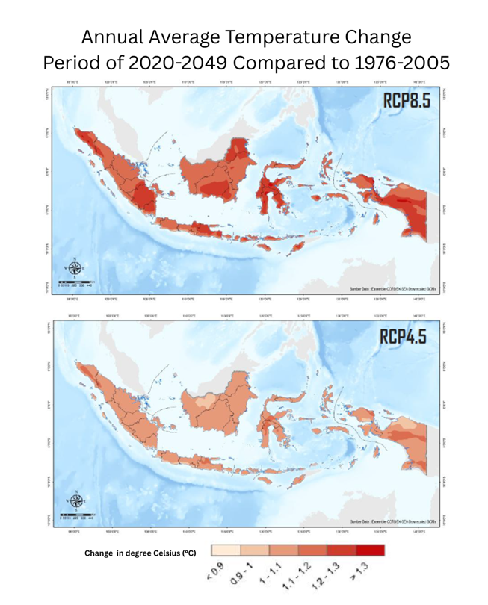

Indonesia is expected to experience a significant rise in average annual temperatures:
RCP8.5 scenario
(high emissions)
+1.5°C to +2.5°C, particularly in Java, Kalimantan, Sulawesi, and Papua.
Climate Change
Projection
RCP4.5 scenario
(moderate emissions)
Temperature rise :
+1.0°C to +1.5°C
across most regions.
Source : BMKG, 2025

Slide 27
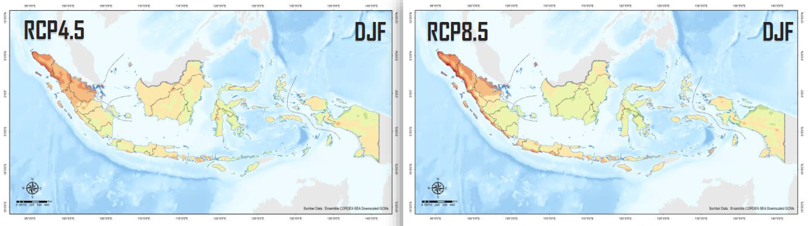

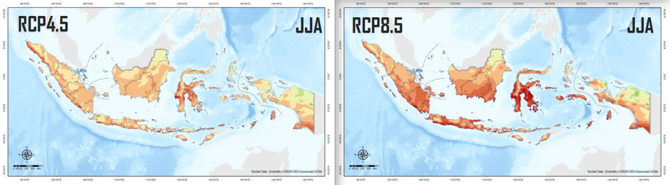
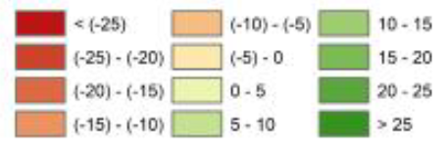
Seasonal Rainfall Projection
RCP 8.5 Scenario
(High Emission)
  Greater variability, with significant drying during JJA, increasing drought potential
  Risk of more intense wet seasons in some areas, increasing flood potential
RCP 4.5 Scenario
(Moderate Emission)
Projected changes in seasonal rainfall for the period 2020–2046 relative to 1976–2005
Percent Change (%):
  Minor decrease during wet season (DJF)
  Some reduction during dry season (JJA), especially in southern Sumatra, Java, Sulawesi, and Nusa Tenggaral
Source : BMKG, 2025
Climate compounding risks: more frequent floods + heatwaves + disease outbreaks

Slide 28

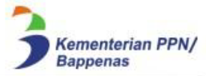






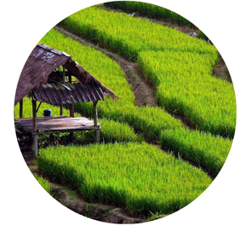



Vulnerable Sector
Source :
Health and Disease
Water Availability
  Climate change disrupts rainfall distribution and river flows, causing more frequent droughts and water shortages, especially in eastern Indonesia (e.g., NTT).
  Many regions already face water stress due to population growth and competing demands from agriculture and industry.
  Reservoirs and groundwater systems are increasingly vulnerable to seasonal variability.
Coastal and Marine
  Rising temperatures and humidity increase the spread of vector-borne diseases such as dengue fever and malaria.
  Heat stress and air pollution exacerbate respiratory and cardiovascular illnesses, especially in urban poor populations.
  Health systems in rural areas have limited capacity to respond to climate-induced health threats.
Agriculture
  High risk from sea-level rise, coastal erosion, and saltwater intrusion, threatening fisheries, tourism, and infrastructure.
  Over 42 million Indonesians live in coastal areas, many with low adaptive capacity.
  Climate impacts are worsened by mangrove loss and rapid coastal development.
  Highly exposed to floods, droughts, and shifting rainfall patterns, affecting crop yields and food security.
  Smallholder farmers, who make up the majority, often lack access to climate information, insurance, and adaptive technologies.

Slide 29
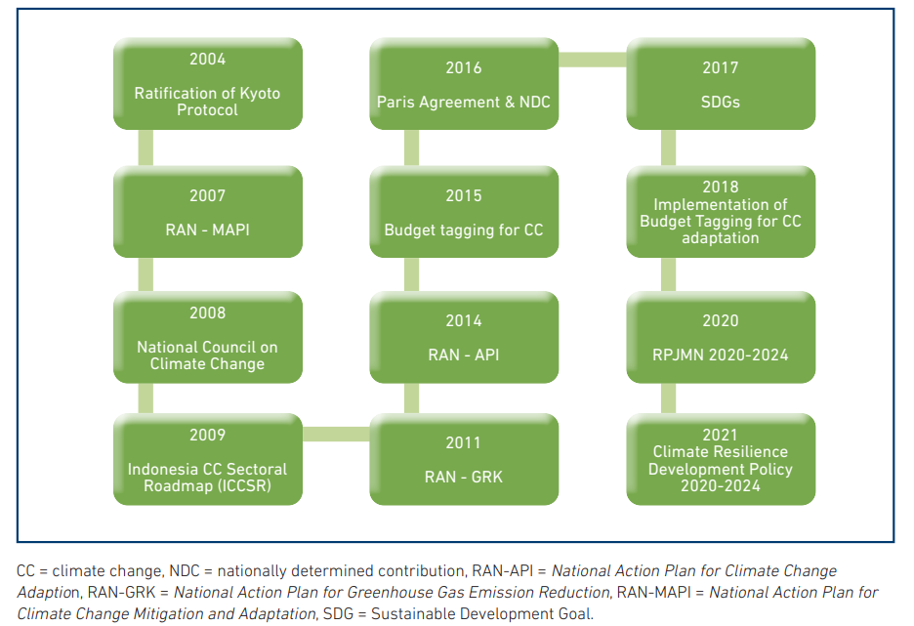
Indonesia Policy Milestone
Source : Zen and Saputra (2023)

Slide 30
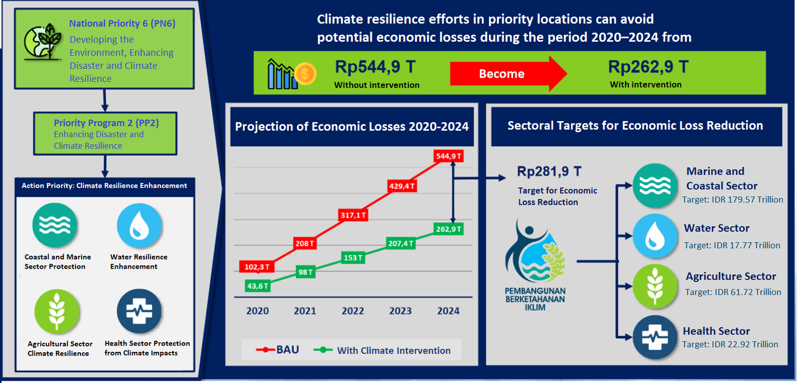


Policy Framework
Climate Resilience Development Policy (CRDP) 2020–2045
Source: National Development Planning Agency
  Mainstreaming climate resilience into infrastructure and spatial planning
  Strengthening local climate governance
  Expanding nature-based solutions
  Scaling up adaptation finance and public-private partnerships
  Enhancing risk and data systems for planning and accountability
Future Direction (RPJMN 2025–2029)
Supported by:
Development Partners

Slide 31









Adaptation Measures and Tools
National-Level Measures
Community-Based Tools
Infrastructure & Nature-Based Solutions
Financial and Institutional Tools
  RAN-API: National Adaptation Plan integrating climate resilience into all sectors
  Climate Budget Tagging (CBT): Tracks climate-related spending in national & regional budgets
  SIDIK: Indonesia Climate Vulnerability Index used for planning and prioritizing adaptation areas
  InaRISK: Public platform for disaster risk assessment and early warning
  ProKlim (Program Kampung Iklim): Local adaptation and mitigation program targeting urban and rural communities with over 3,000 registered villages
  Eco-village & Climate Villages: Integrates water harvesting, organic farming, and waste management
  Flood control infrastructure (e.g., river normalization in Jakarta)
  Mangrove and peatland restoration for coastal protection and carbon storage
  Climate-resilient farming practices using drought-resistant crops and micro-irrigation
  green budgeting, carbon pricing, and disaster risk financing
  Disaster Risk Financing: Insurance schemes and contingency funds at national and subnational levels
  Climate Resilience Indicators embedded in RPJMN targets
  Development Partner Support: ADB, JICA, USAID, UNDP supporting data, finance, and technical capacity

Slide 32





Islamic Finance Trajectory: Institutional Arrangement
Islamic Financial Stability Regulatory & Supervisory Landscape
Financial Sector Omnibus Law No. 4 of 2023
Monetary
Payment System
Resolution & Deposit insurance
Microprudential
Fiscal
Macroprudential
Sharia Banking Committee
Financial System Stability Committee
Financial Stability
Islamic Financial Sector
Sustainable Finance Committee
Banking
Takaful
Capital market & money market
Coordination for sustainable finance strategies, policies and programs
Optimization of policies
Development of databases and infrastructure
Development of sustainable taxonomy
Sharia Governance

Slide 33


Islamic Finance Trajectory: Industry Development
Islamic Finance and Banking Development
Jan 2025:
14
Islamic Commercial Banks
Asset Market Share (2023)
Banking Market Share (2024)
19
Islamic Windows
174
Islamic Rural Banks
Source: OJK (2024)
Data source: OJK (2025)

Slide 34
Islamic Finance Trajectory: Industry Development
Asset Growth
Deposit Growth
Islamic Banking Performance Compared to Conventional Banking
Financing Contract
Financing Growth
Data source: OJK

Slide 35
Islamic Finance Trajectory: Industry Development
Islamic Finance Assets Composition
Sovereign Sukuk plays a pivotal role in supporting the IF industry development.
Islamic banking, as the predominant sector within the IF industry, holds significant potential to contribute toward climate goals achievements.
Invest in green sukuk
Bank
Increase green financing
NDC Indonesia
Transform debtors to be more sustainable or greener
Note: As of 2023, OJK (2024)

Slide 36
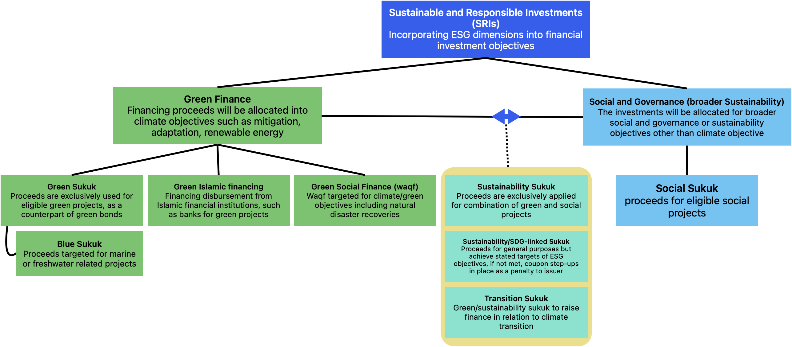

Islamic Green Finance in Indonesia: Market Development
Green Islamic Financial Instruments

Slide 37
Islamic Green Finance in Indonesia: Sovereign Sukuk
Green Sukuk Market Development
Indonesian Sukuk Issuance (USD million)
Green sovereign sukuk account for a small share of Indonesia’s total sukuk issuance – but show a growing trend, signaling strong future potential.
The Wakalah contract is the most commonly used structure in both domestic and international green sukuk issued by the Government.
Data source: LSEG Workspace

Slide 38
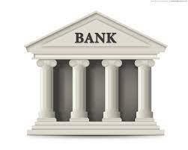

Islamic Green Finance in Indonesia: Sovereign Sukuk
Indonesian Green Sukuk Issuance Milestones (2018-2025)
Domestic Wholesale Green Sukuk
Global Market Issuance
Domestic Retail Green Sukuk
Cumulative issuance at IDR 22.22 trillion or around USD 1.35 billion from 2022 to 2023.
Tenors are around 6-7 years.
Yield around 6.625%.
Targeted institutional investors, typically through auctions.
Cumulative issuance at USD 7.7 billion from 2018 to Mid 2025.
Tenors are varied. From 5 to 30 years, diversified gradually.
Yield around 2.3% to 5.5% depends on the maturity.
Cumulative issuance at IDR 44.6 trillion or around USD 2.7 billion from 2019 to Mid 2025.
Tenors are typically 2 or 4 years.
Yield around 4.8% to 6.6%.
▪️ Global Issuance:
Strong interest from European (36%) and Asian (37%) investors
Institutional investors dominated participation
▪️ Domestic wholesale investors: Banks held a major share (72%) in wholesale green sukuk
▪️ Domestic retail Investors:
Generation X & Baby Boomers: 70%
Millennials: 25% → Reflects rising interest in ethical & Shariah-compliant investments among younger generations
2023 Issuance

Slide 39
Islamic Green Finance in Indonesia: Sovereign Sukuk
2018-2025 Green Sukuk Issuance
SNI Serie at Global Market
(Cumulative Issuance: USD 7.7 billion)
March 2018
USD 1.25 billion
Tenor: 5 years
Yield: 3.75%
Aqd: Wakala bil istithmar
June 2020
USD 750 million
Tenor: 5 years
Yield: 2.3%
Aqd: Hybrid
May 2022
USD 1.5 billion
Tenor: 10 years
Yield: 4.7%
Aqd: Wakala bil istithmar
July 2024
USD 600 million Tenor: 30 years Yield: 5.5% Aqd: Wakala bil istithmar
1st Issuance
2nd Issuance
3rd Issuance
4th Issuance
5th Issuance
6th Issuance
7th Issuance
8th Issuance
February 2019
USD 750 million
Tenor: 5.5 years
Yield: 3.9%
Aqd: Wakala bil istithmar
June 2021
USD 750 million
Tenor: 30 years
Yield: 3.55%
Aqd: Hybrid
November 2023
USD 1.0 billion
Tenor: 10 years
Yield: 5.6%
Aqd: Wakala bil istithmar
July 2025
USD 1.1 billion
Tenor: 30 years
Yield: 5.5%
Aqd: Wakala
Domestic Retail Green Sukuk – Saving Sukuk (IDR 44.6 trillion or USD 2.7 billion)
Domestic Wholesale Green Sukuk (IDR 22.22 trillion or USD 1.35 billion)
November 2019
IDR 1.46 trillion
Tenor: 2 years
Yield: 6.75% (floating with floor)
Aqd: Wakala bil istithmar
November 2021
IDR 5 trillion
Tenor: 2 years
Yield: 4.8% (floating with floor)
Aqd: Wakala bil istithmar
November 2022
IDR 10 trillion
Tenor: 2 years
Yield: 6.15% (floating with floor)
Aqd: Wakala bil istithmar
May 2023
IDR 3.3 trillion
Tenor: 4 years
Yield: 6.4% (floating with floor)
Aqd: Wakala bil istithmar
June 2024
IDR 5.08 trillion
Tenor: 4 years
Yield: 6.55% (floating with floor)
Aqd: Wakala bil istithmar
April 2025
IDR 4 trillion
Tenor: 4 years
Yield: 6.6% (floating with floor)
Aqd: Wakala
1st Issuance
2nd Issuance
3rd Issuance
4th Issuance
5th Issuance
6th Issuance
7th Issuance
8th Issuance
9th Issuance
10th Issuance
11th Issuance
November 2020
IDR 5.42 trillion
Tenor: 2 years
Yield: 5.5% (floating with floor)
Aqd: Wakala bil istithmar
September 2022
IDR 6.73 trillion
Tenor: 7 years
Yield: 6.625% p.a (fixed)
Aqd: Ijarah
Jan-Dec 2023
IDR 15.49 trillion
Tenor: 6 years
Yield: 6.625% p.a (fixed)
November 2023
IDR 5.5 trillion
Tenor: 4 years
Yield: 6.5% (floating with floor)
Aqd: Wakala bil istithmar
December 2024
IDR 4.84 trillion
Tenor: 4 years
Yield: 6.5% (floating with floor)
Aqd: Wakala bil istithmar

Slide 40

Islamic Green Finance in Indonesia: Regulatory Incentives
Contribution of Regulators and Economic Sectors in Green Transition
Climate Risks
Macro-financial Stability against the threat of systemic risk from climate change
NDC Indonesia
Reduction in Carbon Emission from Real Sector
Catalytic Enabler
Green Fiscal Policies
Green Business Practices and Green Consumptions
Green Financing
Green Financial Policies
Policies and Practices
Regulators and Economic Sectors
Government
(Ministry of Finance)
Corporate
MSME
Household
Bank & Financial Institutions
Bank Indonesia
OJK
Transformation
Risk Manage-ment
Financing
Business
Source: BI (2023), modified
40

Slide 41
Islamic Green Finance in Indonesia: Regulatory Incentives
Regulatory Landscape to Promote Green Finance
Ministry of Finance
Fiscal Authority
OJK
Microprudential Authority
Bank Indonesia
Macroprudential Authority
Green sukuk issuance: leader in the industry which addressing the climate finance needs across ministries to support country’s climate goals. Targeting both global and domestic markets.
Green Bond and Sukuk Framework: established in 2018 to support the green sovereign instrument issuance, highlighting the importance of compliance to international standards.
Sustainable Finance Roadmaps:
  Phase I 2015-2019
  Phase II 2021-2025
Regulatory Framework on Sustainable Finance and Disclosure:
  51/POJK.03/2017
  60/POJK.04/2017
Green and Sustainable Finance Taxonomies:
  Indonesia Green Taxonomy 1.0
  Sustainable Finance Taxonomy (2.0)
Climate Risk Integration and Carbon Trading
Sectoral Roadmap
  Islamic banking sector
Green Macroprudential Policies:
  Green Loan-to-Value
  Green macroprudential inclusive financing ratio
  Macroprudential liquidity incentives policy
  Green calculator
Other central bank green initiatives
  Reserve management
  Monetary operation
  Green building practices
  SME empowerment
  Researches

Slide 42

Islamic Green Finance in Indonesia: Regulatory Incentives
Role of Incentives
Ministry of Finance
Fiscal Authority
OJK
Microprudential Authority
Bank Indonesia
Macroprudential Authority
Market Leadership, Fiscal and Targeted Incentives
Financial Sectoral Incentives
Macroprudential Policy Incentives
Open to share best practices and insights with corporate issuers
50% discount on the listing fee for green bonds
(IDX KEP-00038/BEI/05-2020)
2019: Green LTV for green properties 100% and green down payments for electric vehicles at 0%
S
S
S
Tax incentives to promote conducive instruments for sustainable sectors
(Govt Regulation No. 78 of 2019 and MOF Regulation No. 96 of 2022)
25% first time issuers of green bond transactions in the capital market
(OJK Decree of 2018)
2022: Macroprudential Inclusive Financing Ratio to encourage banks increasing their financing to MSME and green financing.
S
S
D
2023: Macroprudential Liquidity Incentive Policy by reducing reserve requirements by 50 bps for banks that provide green mortgages and EV ownership loans
Capacity building, Sustainable Finance Awards and Other
(OJK Regulation No. 51/POJK.03/2017)
S
Various incentives for the use of electric vehicle: tax holiday for new EV manufacturing plant, lower EV taxes for consumers and subsidies for EV purchasing, lift of car access restrictions
S
D
2022: Publish a report on the study of business models for development of green MSME
D
Supply of Green Financing
Demand of Green Financing

Slide 43
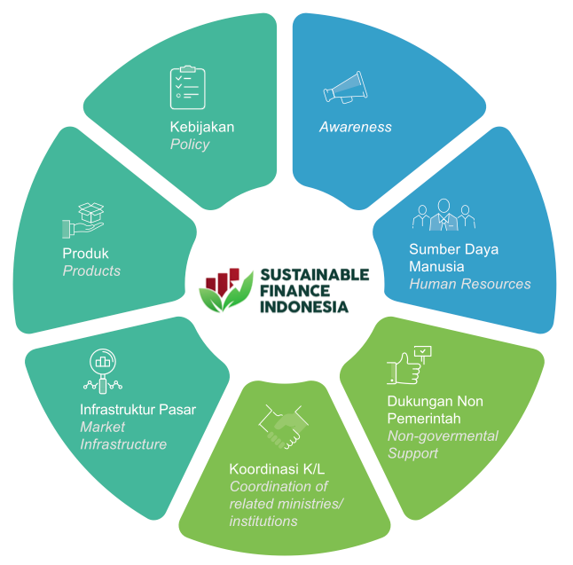
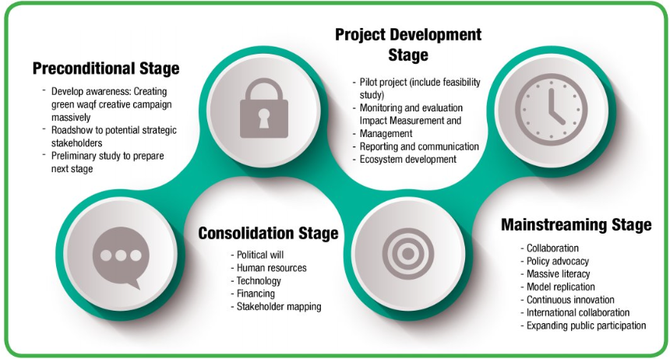
Islamic Green Finance in Indonesia: Best Practices
Best Practices: Lessons Learned
Green Waqf Framework
(BWI & UNDP, 2022)
Waqf Forest
Berbagi Listrik Project
Satu Wakaf Indonesia
Source: OJK (2021)

Slide 44
Islamic Green Finance in Indonesia: Policy Recommendations
Country-specific Recommendations
Problems
Policy Recommendations
Limited green and sustainability sukuk offerings (supply)
Further unlocking corporate sukuk market potentials
Diversification of Islamic financing contracts and sukuk models
Lack of understanding in investors and issuers
Increasing capacity building and literacy for issuers and investors
Enhancing regulatory collaborations
Promoting innovative financing models
Leveraging technological innovation

Slide 45

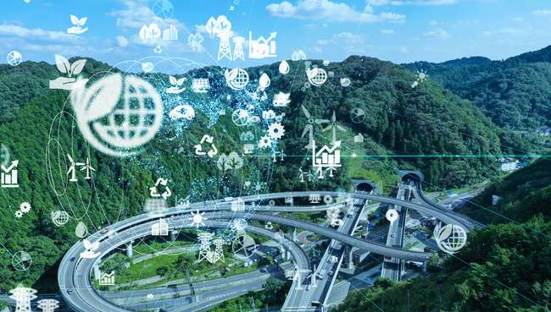


CASE STUDY
NIGERIA
Country-specific Climate Risks & Resilience
Climate Disaster Profile
GHG Emission & Climate Change Projection
Vulnerable Sector
Key Policy Milestones
Islamic Green Finance in Nigeria
Market Development: Sovereign Sukuk
Regulatory Landscape & Incentives
Policy Recommendations
Best Practices

Slide 46

Disaster Profile in Nigeria
Accumulative Frequency & Affected Population from Natural Disasters (2000-2025)
Nigeria is ranked severely vulnerable to climate induced disasters - ND-GAIN Index
Faces both climate and geophysical risks
101+ disaster events (2000–2025), >35 million people affected
Annual events: floods, storms, Epidemic, landslides, droughts
North-East, North-West, North Central: high-impact zones
National Bureau of Statistics and World Bank estimate average yearly Economic Impact of natural disaster to be in the range: US$6–7 billion.
Natural Disaster | Frequency | Affected People
Flood | 43 | 16,140,433
Epidemic | 50 | 406,921
Drought | 1 | 19,110,398
Storm | 5 | 19,007
Mass Movement (wet) | 2 | 300
Total | 101 | 35,677,059
Epidemic is the most frequent Natural Disaster followed by Flood, Storm, Mass Movement (wet) and Drought.
Drought, though less frequent has the highest impact

Slide 47

GHG Emission
GHG Emissions by Sector in 2022
In 2022, Nigeria's greenhouse gas (GHG) emissions were dominated by the LUCF (Land Use Change and Forestry) which accounts for 54.55%, reflecting deforestation and land degradation, followed by the Energy sector accounting for 27.67%, largely driven by Fossil Oil-fired power and transportation. Other significant contributing sectors are:
Agriculture (12.66%)
Industrial Process (4.76%)
Bunker Fuels (0.37%)
Highlighting the need for targeted mitigation in sustainable land management, energy transition and circular economy initiatives.

Slide 48
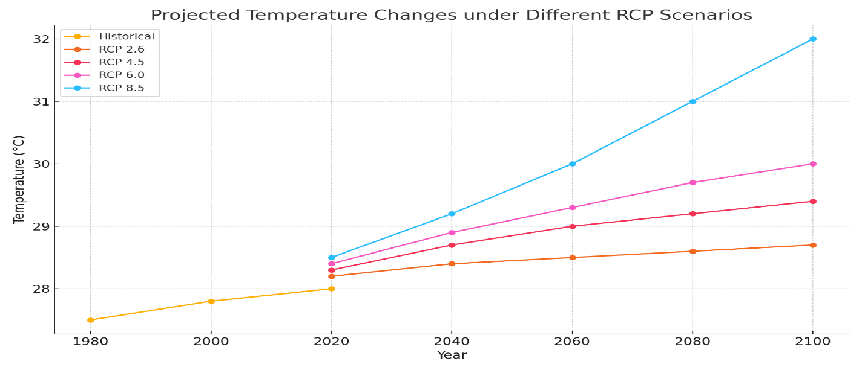
Climate Change
Projection
Source : World Bank CCKP (2021)
Projections under RCP8.5 consistently indicate significant warming across all regions of Nigeria.
Temperatures across Nigeria are expected to increase by 2.9°C to as much as 5.7°C by end of the century

Slide 49
Projected Average Precipitation in Nigeria (Baseline period, 1986 - 2005)
Climate Change
Projection
Source : World Bank CCKP (2021)
Under RCP 2.6 and RCP 6.0, annual average precipitation is expected to remain similar to historical observations
Under RCP8.5, precipitation will decrease most drastically
However, rainfall is expected to decrease significantly in the northern areas and increase in the south and along the coast

Slide 50




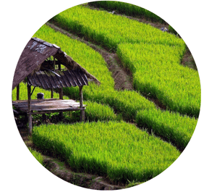
Vulnerable Sector
Health and Disease
Water Availability
  In the north, rising temperatures and desertification could exacerbate existing problems related to water supply and food security, which are already major challenges in the region
Coastal and Marine
  Rising temperatures and humidity increase the spread of vector-borne diseases such as dengue fever and malaria.
  Floods also spread water borne disease resulting into epidemic
  Health systems have limited capacity to respond to climate-induced health threats.
Agriculture
  In the south, coastal areas and river basins are exposed to flooding, resulting in loss of life and damage to infrastructure.
  Rising sea levels are also threatening the Nigerian coast, particularly Lagos, with erosion, salinization of land and flooding
  Nigeria has about 853 km of coastline with low adaptive capacity.
  Highly exposed to floods, droughts, and shifting rainfall patterns, affecting crop yields and food security.
  Smallholder farmers, who make up the majority, often lack access to climate information, insurance, and adaptive technologies.

Slide 51
The Government of Nigeria has responded to the adverse impacts of climate change in many ways.
Nigeria’s Significant Policy Milestones
At the International Level:
No | Policy Initiative
1 | Nigeria is a party to the United Nations Framework Convention on Climate Change (UNFCCC, 1992)
2 | Nigeria is a signatory to both the Kyoto Protocol and the Paris Agreement (FME(2020)).
3 | Nigeria subscribes to the Sendai Framework for Disaster Risk Reduction (UNDRR, 2015)
4 | Nigeria subscribes to United Nations Sustainable Development Goals (SDGs) for accelerated national development (FME (2020))
These policy frameworks provide a robust approach and structure for mainstreaming adaptation across all spheres of governance.
(Okeke, 2023)
At the National Level:
No | Policy Initiative
1 | the Nationally Determined Contribution document (NDC)
2 | the National Adaptation Plan (NAP) Framework
3 | the National Adaptation Strategy and Plan of Action on Climate Change for Nigeria (NASPA-CCN)
4 | Climate Change Policy Response and Strategy (NCCPRS),
5 | Climate Change Act (CCA) 2021
6 | National Climate Change Policy for Nigeria 2021 – 2030
7 | the National Action Plan on Gender and Climate Change for Nigeria (NAPGCC).
Source : Zen and Saputra (2023)

Slide 52
Islamic Finance Trajectory: Institutional Arrangement
Islamic Financial Stability Regulatory & Supervisory Landscape
Legal Framework: Bank and Other Financial Institutions Act (BOFIA) 2020, Central Bank of Nigeria Act (CBN) 2007, National Insurance Commission (NAICOM) Act1 997, Investment and Securities Act (ISA) 2007, Nigerian Deposit Insurance Act (NDIC) 2006 and Pension Commission Act (PENCOM) 2014
Key Regulators in the Financial Sector are:
Central Bank of Nigeria
Nigerian Deposit Insurance Corporation
National Insurance Commission
Securities and Exchange Commission
Pension Commission
Financial Regulation Advisory Council of Experts (FRACE)
Issues Regulatory and Supervisory Frameworks for Islamic Banks
Issues Takaful guidelines for Deposits protection
Issues Takaful guidelines for Takaful Operators
Issues guidelines on Sukuk and Islamic Mutual Funds
Issues guidelines on Fund 6 (non-interest Funds) to Pension Fund
Administrators to serve the interest of investors who are interested in Shari’ah compliant investments
The Shari’ah Board for the Financial Sector

Slide 53
Islamic Finance Trajectory: Industry Development
Islamic Finance and Banking Development
Jan 2025:
6
Islamic Banks
Asset Market Share (2023)
Banking Market Share (2024)
1
Islamic Window
6
Islamic Microfinance Banks
Source: CBN (2024, WAMI (2024))

Slide 54
Islamic Finance Trajectory: Industry Development
Asset Growth
Deposit Growth
Islamic Banking Performance Compared to Conventional Banking
Financing Growth
Data source: CBN(2024)

Slide 55
Islamic Finance Trajectory: Industry Development
Islamic Finance Assets Composition

Slide 56
Islamic Green Finance in Nigeria: Sukuk Market Development
Sukuk Market Development
Nigeria Sukuk Issuance (USD million)
No Sovereign Green Sukuk were issued in Nigeria.
  Some sovereign sukuk were not labelled ‘green’ but the proceedings were used for erosion rehabilitation.
2 Corporate Green Sukuk totalling about USD1.8 million were issued for renewal energy project.
7 Sovereign Sukuk for road projects were issued.
2 Sovereign Green bond totalling USD 15 million were issued.
Green Sukuk account for a very small share of Sukuk issuance in Nigeria.
The Ijarah Contract was the dominant contract used in structuring the Sovereign Sukuk and the Corporate Green Sukuk.
Data source: DMO

Slide 57
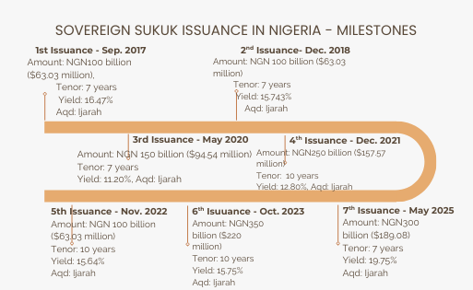
Islamic Green Finance in Nigeria: Sovereign Sukuk Issuance
2017-2025 Sovereign Sukuk Issuance
7 Sovereign Sukuk Issued amounting to USD 877.36 million

Slide 58

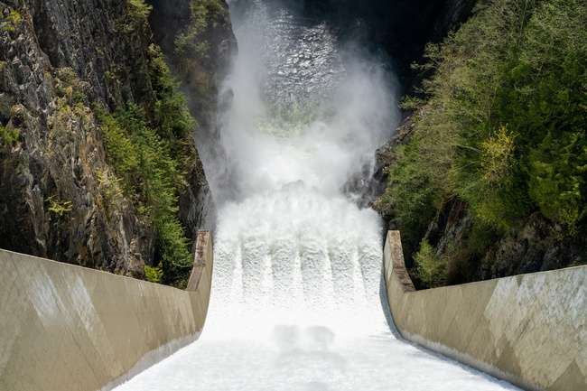

Islamic Green Finance in Nigeria: Regulatory and Industry Players Incentives
Regulatory Landscape to Promote Green Finance
Ministry of Finance
Fiscal Authority
Central Bank of Nigeria
Other Industry Players
Green Funding: Nigerian government has implemented several fiscal incentives to encourage green funding:
  These incentives are embedded in various legislative frameworks e.g. Electricity Act, Industrial Development (Income Tax Relief) Act, VAT Act.
Green Bond Framework: issued in 2017 to support the green sovereign instrument issuance.
Sustainable Banking Principles:
  Issued in 2012.
  to deliver positive development impacts to society while protecting communities and the environment in which financial institutions and their clients operate.
Anchors the Nigeria Incentive-Based Risk Sharing System for Agricultural Lending (NIRSAL) for sustainable Agricultural funding
Climate Risk Integration into Regulatory and Supervisory Frameworks
Collaboration between Nigerian Exchange Group (NGX) and the Luxembourg Stock Exchange (LuxSE) – facilitated cross-listing and trading of green bonds.
In 2016, Africa Guarantee Fund (AGF) introduced a Green Guarantee Facility geared towards increasing financing for climate change mitigation and adaptation projects.

Slide 59
Islamic Green Finance in Nigeria: Best Practices
Best Practices: Lessons Learned
Best Practice | Brief Description
Climate Change Act, 2021 (“CCA”) | legal framework that enables the mobilization and management of funds for climate action
Climate Budgeting | climate budgeting is effectively analyzed using the BudgIT where budget for the preservation of the environment and subsequent projects related to climate action are thoroughly assessed
Green Finance and Carbon Markets | The carbon market is a private sector led innovative initiative in climate change where the Nigerian Exchange Group (NGX) developed a robust carbon market, which would incentivize the preservation of forests and the restoration of degraded lands
Climate Risk Management | The CBN has issued principles and sector guidance for the banking sector that incorporate elements of climate risk in the overall ESG approach for risk management
The Securities & Exchange Commission (SEC) Nigerian Sustainable Finance Principles, 2021 (“NSFP”) | The NSFP provides key principles on sustainable finance to improve economic prosperity and competitiveness while contributing to protecting and restoring ecological systems
The Nigerian Stock Exchange Sustainable Disclosure Guidelines, 2018 | The Guidelines contain provisions for sustainability reporting and disclosure by companies listed on the Nigerian Exchange which encompasses economic, environmental, social and governance factors
Nigeria Green Tagging Banking Review | The Nigeria Green Tagging Banking Review offers guidance on developing a robust monitoring and disclosure framework for financial institutions to accurately and transparently report their green financial footprint to the Nigerian Central Bank and other financial regulators.
The Nigerian Green Bonds Market Development Programme | a collaborative initiative which was launched by NGX in 2016 to foster green finance and promote sustainable investments in Nigeria, with the goal of developing a vibrant non-sovereign green bond market
Reporting Framework for Financial Institutions to Report on Green Financing | This is a framework for financial institutions to identify, tag and report on their green financial position

Slide 60
Islamic Green Finance in Nigeria: Policy Recommendations
Country-specific Recommendations
Challenges | Policy Recommendations
Limited Awareness and Public Education on Green Finance | The Federal Ministry of Finance, the Federal Ministry of Environment, Federal Ministry of Information and other relevant agencies of government should organize sensitization campaign and roadshows on the viability of green Islamic finance as a credible alternative for raising green finance.
Lack of Regulatory Framework for Green Sukuk | The financial regulatory bodies in Nigeria: the CBN, the SEC in conjunction with the Debt Management Office (DMO) should collaborate and develop a robust green sukuk framework that will address the challenges in order to unlock the potentials of green sukuk for climate change financing
Lack of adequate Green Shari’ah-Compliant Products | The CBN, should have incentive mechanism to incentivize Islamic banks to embrace green finance so that the Islamic banks can develop innovative and tailor-made green Islamic financial products that meet the specific needs of Nigerian investors and green projects.
Shallow Secondary Market for Green Sukuk | The key regulators in the financial sector in Nigeria should provide an enabling environment to develop domestic green sukuk markets by employing a developmental framework that is similar to the one used for developing the conventional bond markets.
Lack of Institutionalized Islamic Social Finance | In order to actualize the potentials of Islamic Social Finance for green financing, the Federal government should come up with a framework for institutionalizing Islamic Social Finance in Nigeria
Lack of Syndicated Green Financing Framework | The CBN should come up with a syndicated green financing framework that will enable Islamic banks to leverage the syndicated green financing option

Slide 61

CASE STUDY
QATAR
Country-specific Climate Risks and Resilience
Climate Profile
GHG Emission
Islamic Green Finance in Qatar
Regulatory Landscape & Incentives
Policy Recommendations
Best Practices

Slide 62
Country-specific Climate Risk and Resilience Profile
Country-Specific Climate Risks
Resilience Profile
▪︎ Highly susceptible to climate-related hazards.
▪︎ Highest per capita greenhouse gas (GHG) emissions.
▪︎ Physical risks:
  ∙ Extreme Heat
  ∙ Coastal Flooding
  ∙ Water Scarcity
  ∙ Desertification
▪︎ Transition risks:
  ∙ Economic Diversification Pressure
  ∙ Regulatory and Market Risks
  ∙ Social Risks
▪︎ Qatar scores high on adaptation readiness.
▪︎ Robust infrastructure and financial capacity to implement resilience measures.
▪︎ The country’s National Environment and Climate Change Strategy (2021) outlines plans for emissions reduction, renewable energy adoption, and enhanced biodiversity.

Slide 63
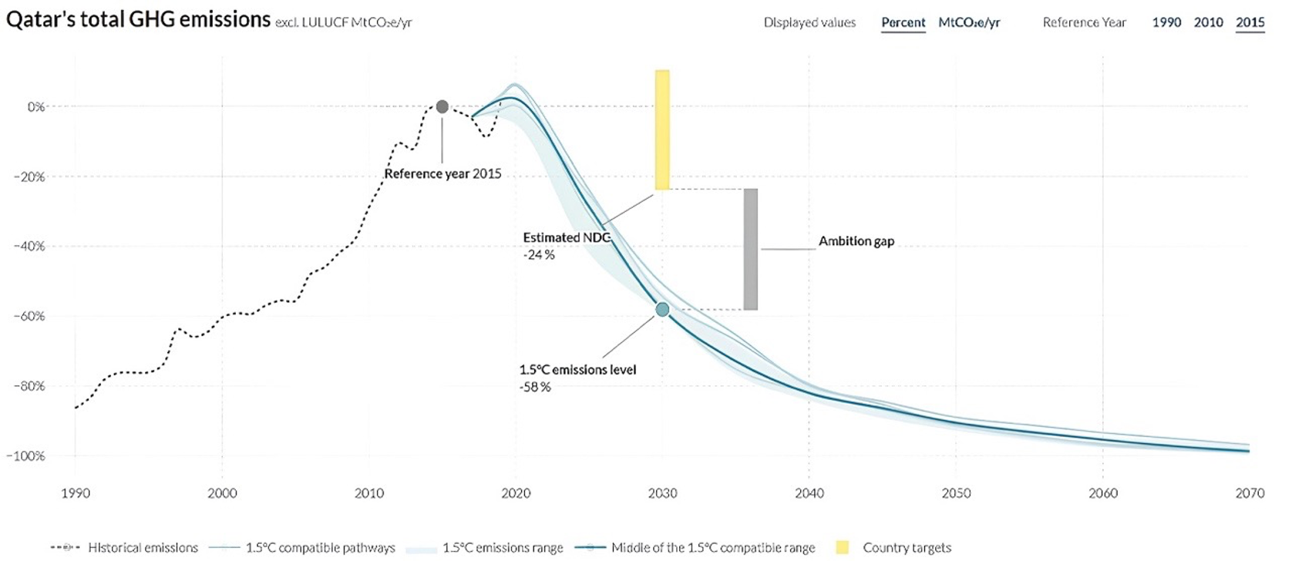
GHG Emission
Qatar’s Greenhouse Emissions Pathway Compared to 1.5°C Compatibility Target

Slide 64
Islamic Finance Trajectory: Regulatory Framework
Regulatory Framework
Qatar National Vision 2030
Third National Development Strategy
Third Strategic Plan for Financial Sector development
Digital Assets Framework
Digital Banks Framework
National Environment and Climate Change Strategy

Slide 65
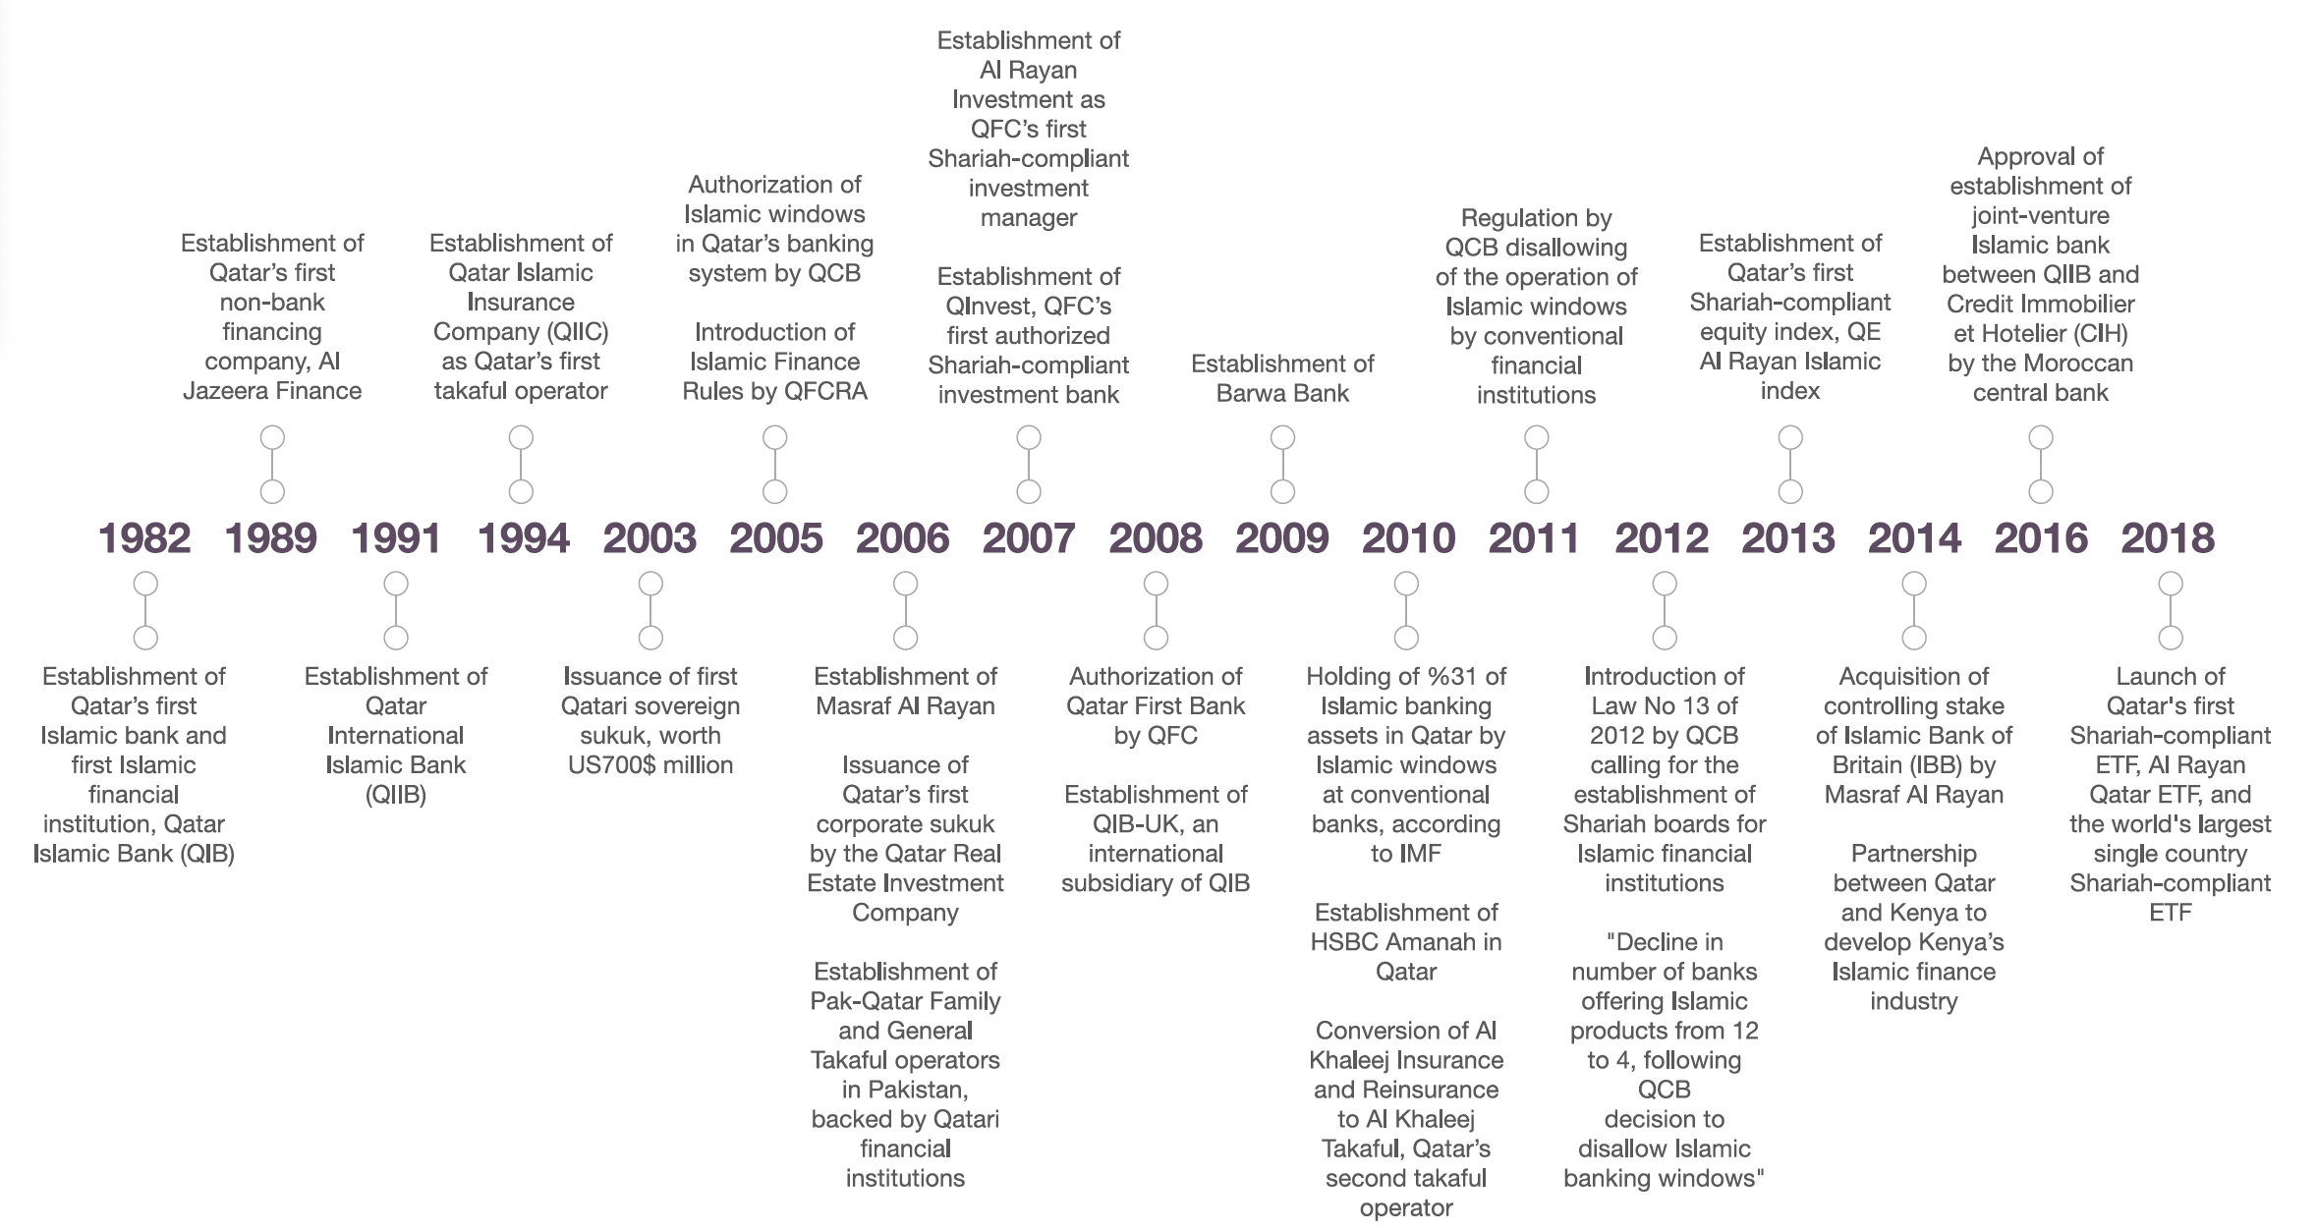
Islamic Finance Trajectory: Industry Landscape
Islamic Financial Landscape
Source: Qatar Islamic Finance report 2018

Slide 66
Islamic Green Finance in Qatar: Islamic Green Financial Landscape
Islamic Green Financial Landscape
Macroprudential Incentives
Microprudential Incentives
Product-Level and Market Incentives
Fiscal Incentives
Market Development through Sovereign Leadership
Ambitious Strategies
Product Innovation
QCB has embedded sustainability into its regulatory oversight
Launch of comprehensive frameworks and guidelines that align with international best practices.
Third Strategic Plan for Financial Sector development.
QCB’s Sustainable Finance Framework, introduced in 2025.
New Regulatory Framework for Digital Banks.
QFC’s Sustainable Sukuk and Bonds Framework in 2022.
Green and sustainable banking products such as green loans, sustainable deposits, green mortgage and real estate financing, sustainability-linked Murabaha facilities, etc.
Sustainability embedded into the governance and operational structures of several IFIs.
Competitive tax policies and government-backed initiatives that encourage sustainable investment.
Incentive Mechanisms
to Develop Islamic
Financing Responses
Detailed guidelines for sustainability risk management and disclosure issued by QCB and QFCRA.
frameworks and products that support green and sustainable finance launched by several IFIs.

Slide 67
Islamic Green Finance in Qatar: Best Practices
Best Practices and Lessons Learned
Best Practices
Lessons learned
▪︎ Ecosystem for Sustainable/Green Finance in Qatar:
Qatar’s sustainable finance ecosystem is anchored by a collaborative effort between regulators, financial institutions, and policymakers.
▪︎ Taxonomies and Regulation on Green/Sustainable Bonds and Sukuk:
While Qatar does not yet have a unified or dedicated national taxonomy for sustainable finance as of 2025, the country has made notable progress toward aligning with international practices through regulatory frameworks and guidance.
▪︎ Green Macroprudential Policies:
Qatar’s macroprudential approach to green finance is evident in the requirements imposed by the QCB framework.
▪︎ Initiatives Promoting Transparent Green/Sustainability Reporting:
The QCB Sustainable Finance Framework requires financial institutions to adopt clear procedures for impact evaluation, reporting, and external verification of sustainable finance activities.
▪︎ Integration of Islamic Finance and Sustainability:
Qatar’s regulatory framework explicitly integrates Islamic finance with sustainability criteria, leveraging Shariah-compliant instruments as a core part of the country’s sustainable development strategy.
▪︎ Macroprudential Innovation:
Linking credit terms to sustainability performance targets aligns financial sector incentives with national climate goals, supporting both investment mobilization and systemic resilience.
▪︎ Commitment to Transparency:
Mandatory impact reporting and third-party verification are best practices that ensure accountability and build trust in the market.
▪︎ Ecosystem Collaboration:
Strong coordination between regulators, financial institutions, and policymakers has created a supportive environment for sustainable finance innovation and growth.

Slide 68
Islamic Green Finance in Qatar: Policy Recommendations
Country-specific Policy Recommendations
Policy Recommendations
Integrate Climate Adaptation and Mitigation into Islamic Finance Strategies.
Develop and Incentivize Green and Resilience-Linked Islamic Financial Products.
Enhance Regulatory and Supervisory Frameworks for Sustainable Finance.
Foster Public-Private Partnerships and Cross-Sectoral Collaboration.
Implement Fiscal, Macroprudential, and Microprudential Incentives.
Build Capacity and Raise Awareness.
Monitor, Evaluate, and Report Impact.

Slide 69

CASE STUDY
AZERBAIJAN
Country-specific Climate Risks and Resilience
Climate Profile
Climate Change Context
Islamic Green Finance in Azerbaijan
Islamic Finance Trajectory
Incentive Mechanisms
Best Practices
Policy Recommendations

Slide 70
Disaster Profile in Azerbaijan
Past Disasters (EM-DAT) (1970 - 2021)
Accumulative Frequency & Affected Population from Natural Disasters (2000-2025)
 | Number of Events (Events) | Number of Deaths (People) | Number of Affected (People) | Number of Damaged (USD, millions)
Drought | 1 |  |  | 100.0
Floods | 7 | 19 | 1,840,300 | 96.2
Earthquake | 5 | 33 | 734,971 | 15.0
Azerbaijan faces multiple climate hazards—droughts, floods, strong winds, heatwaves, landslides, and forest fires—posing risks to agriculture, water resources, and urban areas.
From 1970–2021, 13 major disasters were recorded: 7 floods, 5 earthquakes, and 1 drought, with floods being the most frequent and damaging.
Water resources have declined by ~15% in two decades, and the Caspian Sea level has dropped over 2 meters, disrupting ecosystems and coastal economies.
Average annual disaster losses equal ~2.7% of GDP, with floods and droughts identified as the costliest hazards, highlighting urgent adaptation needs.
Climate change impacts—rising temperatures, reduced precipitation, and sea-level fluctuations—are intensifying stress on agriculture, ecosystems, and public health.
Average Annual Loss (AAL), Current
 | USD, Millions | % GDP
Drought | 720.5 | 1.4
Floods | 52 | 0.1
Earthquake | 513.3 | 1.0
Biological | 53.4 | 0.1
Multihazards | 1,389.2 | 2.7
Epidemic is the most frequent Natural Disaster followed by Flood, Storm, Mass Movement (wet) and Drought.
Drought, though less frequent has the highest impact

Slide 71
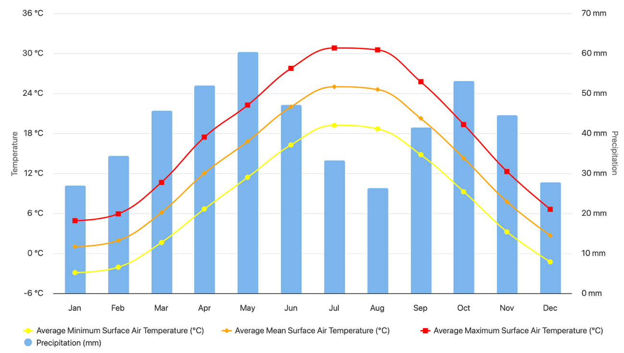
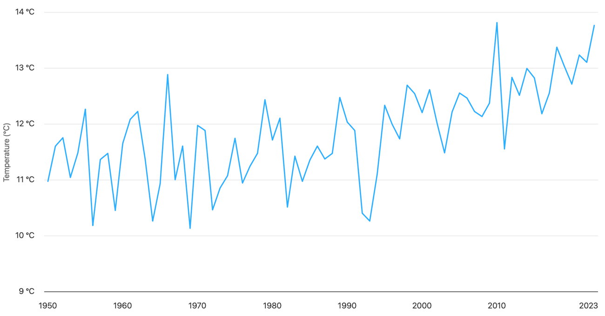
Observed Seasonal Cycle: Azerbaijan 1991-2020
Climate Change
Context
Observed Timeseries of Annual Average Mean Surface Air Temperature – Azerbaijan: 1950-2023

Slide 72
Islamic Finance Trajectory: Policy Landscape
Trajectory of Islamic Finance Landscape
📌 Gradual exploration since 2000s, starting with Islamic banking windows.
🏦 International Bank of Azerbaijan pioneered mudarabah, musharakah, ijara, and sukuk before closing its Islamic unit in 2015.
⚖️ Key challenges: low awareness, limited regulation, and dominance of conventional banking.
🤝 Central Bank & government engaging with IsDB, Al Baraka, and drafting sukuk legislation.
💹 Sukuk issuance & test-phase Islamic bank license mark steps toward financial inclusion.
Azerbaijan is gradually integrating Islamic finance into its financial system, with sukuk issuance and regulatory reforms marking key steps toward broader financial inclusion.

Slide 73
Islamic Green Finance in Azerbaijan: Incentive Mechanisms
Incentive Mechanisms for Islamic Finance and Green Finance
📑 2024–2026 strategy calls for legal framework on sukuk & Shariah-compliant products
🧪 CBA’s regulatory sandbox enables testing of sukuk, Shariah lending & micro-takaful
🏦 Local bank applied in 2024 to offer Islamic banking; sukuk first, full banking in 3–5 years
💹 Sukuk issuance seen as key to mobilize funds for infrastructure & SMEs
🌍 Global partnerships with IsDB, Al Baraka & IBFIM align with best practices
Islamic finance is emerging as a strategic tool in Azerbaijan to diversify investment, expand financial inclusion, and align with global best practices through sukuk, regulatory reforms, and international partnerships.

Slide 74
Islamic Green Finance in Azerbaijan: Best Practices
Best Practices: Lessons Learned
Best Practice | Brief Description
Hosting COP29 | Positioned Azerbaijan as a global leader in climate action, attracting investment and partnerships for green technologies while accelerating national green finance initiatives.
Green Finance Taxonomy | Developed by the Central Bank to guide investors and institutions in identifying and supporting environmentally sustainable projects.
National Adaptation Plan (NAP, 2024) | Provides a structured, phased framework for resilience in water, agriculture, and ecosystems, aligning climate governance with Azerbaijan’s 2030 development priorities.
Institutional Climate Governance | Led by the Ministry of Ecology and Natural Resources and coordinated through the State Commission on Climate Change to ensure national ownership and global alignment.
MSME Green Transition (via KOBİA) | Supports small businesses with funding, tools, and resources to adopt sustainable practices and green technologies, driving inclusive economic transformation.

Slide 75
Islamic Green Finance in Azerbaijan: Policy Recommendations
Country-specific Recommendations
Recommendation | Description | Implementation Challenges
Introduce Green Sukuk for Climate-Resilient Infrastructure | Pilot sukuk to finance renewable energy, resilient infrastructure, and irrigation aligned with global green standards. | Requires project pipeline, certification processes, and strong investor outreach.
Accelerate Regulation and Licensing for Islamic Banking | Develop regulatory framework and licensing for Islamic banks, supported by training and stakeholder consultations. | Legal gaps, lack of expertise, and slow regulatory adaptation may delay progress.
Integrate Islamic Microfinance & Takaful for SMEs and Farmers | Provide qard al-hasan, murabaha-based green credit, and micro-takaful for rural resilience and climate adaptation. | Limited awareness, affordability, and institutional capacity to scale such products.
Use Regulatory Sandbox to Pilot Islamic Green Finance | Test sukuk crowdfunding, digital takaful, and blockchain tracking of green finance in a controlled environment. | Scaling from pilots to nationwide adoption may face regulatory and market barriers.
Establish National Islamic Green Finance Facility | Create blended finance pool linking sukuk, IsDB support, and public funds to finance adaptation priorities. | Mobilising consistent funding and ensuring transparency in fund allocation.
Promote Regional Cooperation on Islamic Climate Finance | Partner with OIC countries on sukuk issuances, takaful pools, and Shariah-compliant green research. | Coordination complexity, differing legal systems, and geopolitical risks.

Slide 76

CASE STUDY:
UNITED KINGDOM
Country-specific Climate Risks and Resilience
Climate Profile
Green Finance Practice Reference
Green Finance Development
Integration of Islamic Finance within Green Finance
Best Practices

Slide 77
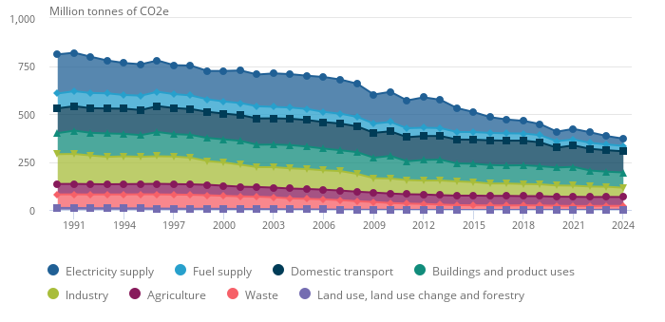
Country Profile for Climate and Natural Disasters Risk
Top Emitting CO2 in National Communication Sectors on a Territorial Basis: UK 1990 to 2024 (Provisional)
UK was a major emitter during the Industrial Revolution, now contributes only 1% of global GHG emissions.
By 2022, emissions has dropped 48-54% since 1990 supported by strong climate transition initiatives.
Economic costs predicted from 1.1% to 7.4% of GDP by 2100 under current policies.
The overall trends confirm that decarbonisation is achievable and economically sound.
Accumulative Frequency & Affected Population from Natural Disasters (2000-2025)
Climate Resilience
UK is recognized as one of the most climate resilient countries.
Based on 2023 ND-GAIN, the UK’s climate resilience ranks 8th out of 187 countries, reflecting low climate vulnerability and strong climate readiness.
INFORM Risk Index 2023 places UK in very low-risk category supported by strong institutional and infrastructure capacity.
The most significant reduction comes from the electricity supply sector, reflecting the UK’s shift away from coal-fired power to renewable and natural gas.
UK climate projections show significant changes this century, even under moderate emissions. By 2041–2060, the UK is expected to warm by 1.5–2.0°C above the 1981–2000 baseline, with wetter winters, drier summers, and sea-level rise between 3–37 cm.
Epidemic is the most frequent Natural Disaster followed by Flood, Storm, Mass Movement (wet) and Drought.
Drought, though less frequent has the highest impact

Slide 78
Green Finance Practice Reference
Financial Sector Governance & Regulation
Ambitious Climate Targets & Achievements
The UK maintains a net-zero goal by 2050, underpinned by strong policies and climate finance commitments. The latest target: reduce GHG emission to 81% by 2035.
The UK was also the first nation to establish government climate initiatives and national emission targets under the 2008 Climate Change Act and the 2019 Green Finance Strategy.
The UK has achieved 50% GHG emission reduction between 1990 and 2022.
The UK’s financial sector, among the largest globally, has emerged as a leader in sustainable and green finance.
Financial sector authorities in the UK have integrated climate considerations into policy actions, including prudential regulations and country-level risk assessments.
The UK’s institutional framework benefits from clear delineation of responsibilities:
The Trajectory of Green Finance in the UK
HM Treasury
Bank of England
FCA
Ministry of Finance
Strategic direction on sustainable finance
Market conduct & transparency
Strong interagency collaboration
Fiscal policy
Macro & micro-prudential regulation & supervision
Policy & Regulatory Framework for Green Finance & Climate Resilience
Financial Regulatory Initiatives & Assets
Climate Stress Testing and Risk Analytics
UK Emissions Trading Scheme
Market & Industry Initiatives, inc. Islamic Finance & Green integration
Government Strategy and Green Bonds
Green Taxonomy & Standards
Monetary Policy & Greening Central Banking

Slide 79

Green Finance Practice Reference: Integration of Islamic Finance
Integration of Islamic Finance within the Green Finance Ecosystem
The Islamic finance sector in the UK operates under the same regulatory regime as conventional financial institutions.
Islamic financial institutions are required to comply with standard financial regulations and are also responsible for their Shariah governance.
The UK authorities have taken steps to accommodate Islamic finance within the legal and regulatory system, through adjusting tax laws to ensure equal treatment and establishing the Alternative Liquidity Facility (ALF) in 2021.
The UK is home to five Islamic banks, all with GCC ownership.
According to the latest Islamic Finance Development Indicator (IFDI) by LSEG, UK ranks high in Islamic finance knowledge and sustainability metrics, indicating strong alignment between UK’s Islamic finance initiatives and ESG goals.
📌 The UK has positioned itself as a global leader in climate finance and sustainable investment.
🏦 The London Stock Exchange (LSE) serves as a key venue for green bonds and Sukuk listings. It is the third-largest listing venue for US-dollar Sukuk globally, hosting about 35% of global outstanding USD-denominated Sukuk.
Collaborative efforts between the LSEG, the IsDB, and the ICMA have led to the development of practical guidance on Sustainable Sukuk issuance in April 2024.
🤝 The initiative, rooted in partnerships fostered by the High-Level Working Group on Green Sukuk (HLWG), demonstrates the UK's capacity to serve as a global platform for Islamic finance and climate-aligned finance.

Slide 80
Green Finance Practice Reference: Best Practices
Best Practices: Lessons Learned
UK regulators have taken a principles-based approach guided by strategic direction, favouring disclosure, market guidance, and collaboration over prescriptive mandates such as green lending quotas or differentiated capital charges.
Strong Legal Commitments
Regulatory Clarity and Integration
Strong Stakeholder Engagement
Market Development through Sovereign Leadership
Transparency and Reporting
Global Collaboration
Climate Change Act
National Climate Plan
Financial Sector Policies
COP26 hosting in 2021.
Co-chairing international coalitions and member of climate global forums.
Climate risk integration into supervisory frameworks, not silos.
Supported by inter-agency coordination.
MULTI-DIMENSIONAL AND
INTEGRATED APPROACH
Addressing climate risk is not only an environmental necessity, but a core component of safeguarding economic stability and sustainable development.
Annual UK Green Financing Allocation Report.
Climate disclosures requirement for companies.
Wider stakeholders’ collaboration to support NDC achievement.
Encourage greater public engagement through 2025 Public Participation Strategy.
Green bond market development supported by strong liquidity.

Slide 81
Policy Recommendations & Roadmap
Specific Policy Recommendations: Advanced & Emerging
Key Building Blocks
Roadmap
General Policy Recommendations
Paradigm Shift

Slide 82
Key Building Blocks for Policy Recommendation Development
Legal & Regulatory Frameworks
Product & Market Development
Capacity Building, Awareness & Confidence
Incentives Mechanism & Collaboration
Market Infrastructure & Impact Monitoring
Market-driven innovation, product diversification, and clear frameworks for new green Islamic instruments are necessary to meet climate and DRR financing demands and attract private investment.
Strengthening the market infrastructure and leveraging technology will establish credibility, increase investor trust, and facilitate wider access to sustainable Islamic finance.
Wide-reaching efforts are needed to raise understanding among all stakeholders and build the technical capacity for designing, promoting, and monitoring green financial products.
OIC countries require harmonised, transparent, and enforceable regulations that support green Islamic finance, officially recognising climate-related risks and DRR, alongside sustainable investment goals.
Policy incentives combined with active collaboration among states, industries, and international partners are crucial to driving large-scale climate-aligned and DRR investments.

Slide 83
Key Building Blocks for Policy Recommendation Development
Legal & Regulatory Frameworks | Product & Market Development | Capacity Building, Awareness & Confidence | Incentives Mechanism & Collaboration | Market Infrastructure & Impact Monitoring
Enhancing regulatory and supervisory frameworks for sustainable finance Improving regulatory framework for green sukuk Integrating climate financing into national plans | Further Unlocking Corporate Sukuk Market Potential Diversification Of Islamic Financing Contracts And Sukuk Models Promoting Innovative Financing Models Innovating Adequate Green Shari’ah-Compliant Products Introducing The Syndicated Green Financing Framework Developing And Incentivising Green And Resilience-Linked Islamic Financial Products Reconsidering The Role Of Islamic Social Financial Instruments In DRR And Climate Resilience Financing Developing policies to strengthen the role of takaful and re-takaful for DRR in OIC Member Countries Establishing a dedicated Islamic finance disaster risk and climate resilience fund as well as sukuk-based platforms | Increasing Capacity Building and Literacy for Issuers and Investors Raising Awareness and Enhancing Public Education Boosting investor confidence by increasing transparency, improving disclosure, and enabling independent verification of green credentials Building Capacity and Raising Awareness through collaboration | Implementing Fiscal, Macroprudential, and Microprudential Incentives Developing Incentive Mechanism/Collaborative Efforts Fostering Public-Private Partnerships and Cross-Sectoral Collaboration: | Developing and promoting the shallow secondary market for Green Sukuk Monitoring, evaluating, and reporting impact Leveraging technological innovation Reevaluating the Role of Islamic Social Financial Instruments in Funding Climate Resilience and Disaster Risk Reduction

Slide 84
Policy Recommendations: Advanced Countries or Progressive Development of Green Finance
Action | Responsible Stakeholders | Timeline
Integrate climate stress testing into prudential supervision and regulation for both Islamic and conventional financial institutions, embedding climate risks and DRR into policy frameworks, aligned with the international standards and global best practices (particularly for macroprudential polices) | Central Banks and Financial Supervisory Authorities, IMF, and World Bank | Short-Medium Term (1-3 years)
Diversify Islamic green instruments beyond plain-vanilla green sukuk, introducing blue sukuk, sustainability-linked sukuk, transition sukuk, and hybrid structures while broadening the investor base globally, particularly targeting ethical and responsible investment funds. | Ministries of Finance, Capital Market Authorities, Islamic financial institutions | Medium Term (3-5 years)
Lead harmonization of green taxonomies, disclosure frameworks, and certification standards across the OIC, aligning with global norms and mitigating green washing while reflecting Islamic finance principles and increasing market integrity. This could set benchmarks for emerging markets. | OIC Secretariat, IsDB, National Regulators | Medium Term (3-5 years)
Develop a green finance framework to unlock the potential of financing mobilization from Islamic social finance market (such as zakat and waqf). | OIC Secretariat, IsDB, National Regulators | Medium Term (3-5 years)
Integrate digital innovation in green finance ecosystems, including Islamic green finance development and AI-driven climate risk analytics, to improve efficiency, transparency, and investor outreach. | FinTech Companies, Capital Market Authorities, Central Banks, Islamic financial institutions | Medium Term (3-5 years)
Leverage sovereign wealth funds to co-finance large-scale renewable energy and climate-resilient infrastructure, crowding in private capital and directed to align with NDC target. | Sovereign Wealth Funds, Related Ministries | Medium-Long Term (3 – 5+ years)
Lead to build global market infrastructure, particularly in climate risk and DRR related standardized data, in collaboration with international organizations as well as increase or optimize participation in global climate and DRR initiatives to provide more balanced and comprehensive views of Islamic countries circumstances. | IsDB, IFSB and National Regulators, other global climate data repositories (EMDAT, IMF) and global climate forums (NGFS), UNDRR | Medium-Long Term (3 – 5+ years)
Promote public–private partnerships (PPP) to finance large-scale green infrastructure and clean energy projects, blending sovereign leadership with private sector innovation and capital. | Ministries of Finance, PPP Units, Private Sectors, MDBs | Medium-Long Term (3 – 5+ years)
Develop cross-border Islamic green investment platforms and marketplaces to improve greenium effect, market liquidity, reduce transaction costs, and enhance market visibility. | Regional Development Banks, IILM, IIFM, Stock Exchanges, Financial Centres, National Regulators | Long Term (5+ years)

Slide 85
Policy Recommendations: Emerging Countries or Nascent Development of Green Finance
Action | Responsible Stakeholders | Timeline
Introduce enabling regulations for green sukuk issuance, including tax incentives, reduced issuance costs, and simplified Shariah approval processes. | Ministries of Finance, Capital Market Authorities | Short Term (1-2 years)
Build institutional capacity through targeted training for regulators, issuers, and investors on climate risk and DRR assessments, sustainable finance instruments, and Islamic finance innovation. | Central Banks, Financial Supervisory Authorities, IMF, World Bank | Short Term (1-2 years)
Enhance public and market awareness on climate risks and DRR as well as the value of Islamic green finance, and the potential greenium benefits through national campaigns, media outreach, and stakeholder dialogues. | Ministries of Finance and Environment, Financial Regulators, Industry Associations, Islamic financial institutions | Short-Medium Term (1-3 years)
Establish green project preparation facilities to create pipelines of bankable projects eligible for Islamic green finance, supported by MDBs and technical assistance providers. | Related Ministries, MDBs, IsDB | Short-Medium Term (1-3 years)
Implement blended finance frameworks combining concessional funds, guarantees, and private capital to de-risk climate investments and to finance DRR strategies. | MDBs, Islamic financial institutions, Development Agencies | Short-Medium Term (1-3 years)
Encourage digital innovation in green finance, such as mobile-based green investment platforms, blockchain-based project tracking, and AI tools for project monitoring and verification. | FinTech Startups, Capital Market Authorities | Short-Medium Term (1-3 years)
Mobilize Islamic social finance (zakat, waqf, qard hasan) for community-level adaptation projects, particularly in rural and climate and natural disasters vulnerable regions. | Religious Councils, NGOs, Regional Authorities, Social Finance Platforms | Medium Term (3-5 years)
Promote public–private partnerships (PPP) for renewable energy, water resilience, climate and natural disasters-resilient infrastructure projects to leverage both domestic and foreign capital. | Ministry of Planning, PPP Units, Ministry of Finance, MDBs, Private sector | Medium Term (3-5 years)

Slide 86
Roadmap for Islamic financial instruments development
Phase 1
FOUNDATION
1-3 years
Phase 2
EXPANSION
3 - 5 years
Phase 3
INTEGRATION
5+ years
  Mainstream climate risk considerations in policy settings
  Develop or adapt green taxonomies
  Launch public awareness campaign
  Pilot sovereign and corporate green sukuk issuances
  Establish central repositories for climate data
  Introduce digital innovation pilots
  Initiate small-scale PPP
  Develop strategies for Islamic social financial supporting environment
  Expand the range of Islamic green financial instruments
  Scale up capacity building and public awareness campaigns
  Introduce macroprudential incentives
  Develop green sukuk certification
  Establish OIC green finance platforms
  Implement climate disclosure requirements
  Expand digital innovation
  Scale up PPP frameworks
  Scale up Islamic social financial instruments' implementation
  Fully integrate climate risk considerations
  Position Islamic green finance as a mainstream investment class
  Maintain and improve capacity building and public awareness campaigns
  Foster deep linkages between Islamic social finance and commercial green finance
  Institutionalize policy review mechanisms within OIC
  Foster partnership of OIC and global financial centres
  Establish fully integrated digital ecosystem for Islamic green finance
  Build long-term PPP pipelines
  Fully integrate Islamic social finance into financial system
Establish the legal, regulatory, and market groundwork
Scale market participation, diversify instruments, and integrate climate risk
Fully embed climate risk and sustainability

Slide 87
General Policy Recommendations for the OIC Countries
Increase Public Awareness on the Growing Impact of Climate Risk to Foster Climate Action and Transition to a Low-Carbon and Climate Resilient Economy
Scale Up the Role of Multilateral Development Banks in Supporting Sustainable Finance in OIC Countries
Integrate Climate and DRR Considerations into Global Islamic Financial Sector Policy Frameworks and Monitor Progress
Strengthen Domestic Inter-agency Collaboration among Governments, Central Banks, and Financial Regulators
Harmonise Green Taxonomy Frameworks with Consideration for Islamic Finance Specificities, Supported by Robust Market Infrastructure
Unlocking the Potential of Islamic Finance, including Green Sukuk and Islamic Social Financial Instruments, and Promoting Shariah-compliant Innovative Financing and Public-Private Partnership Models
Ensure Adequate Standardised Data Availability and Develop Frameworks to Support Informed Policy Making
Enhance Market Transparency through the Adopting a Global Disclosure Framework
Promote International Collaboration through the OIC Forum
Leverage Islamic Social Finance and Digital Innovation to Support Climate Action and DRR

Slide 88





Islamic Moral Political Economy Paradigm Shift-based Policy Recommendation for the OIC Member Countries
Recalibrating the Relationship between Human, Society, Economy and Ecology
Islamic moral and political economy framework to guide public policy and the institutional logics of Islamic finance.
This involves decoupling public policy and regulations, as well as governance related to Islamic finance, from the conventional finance-based institutional logics that shape the regulatory and governance environment OIC Member Countries.
Moving away from traditional financial institutional logic by overcoming imposed regulations on Islamic finance
Emphasising risk sharing and equity-based financing, thus reducing debt-based financing
Controlling the debt creation and consumerism as major sources of climate risk
Maintaining the mizan (balanced order) to produce positive outcomes in environmental sustainability

Slide 89



Thank You

