Slide 1


25th Meeting of the COMCEC Tourism Working Group
Date : September 15–16, 2025
Venue : Ankara, Türkiye
Theme :
Improving the Quality and Sustainability of Heritage Tourism in OIC Countries:
The Experience of Burkina Faso
Presentation by : Monique ILBOUDO/OUEDRAOGO
Director General of Tourism of Burkina Faso

Slide 2
Main Points
Burkina Faso : A Mosaic of Exceptional Heritage
Strategy for Quality and Sustainability
Challenges and Responses
Outlook

Slide 3
1. Burkina Faso : A Mosaic of Exceptional Heritage
UNESCO World Heritage Sites : Loropéni Ruins, Iron Metallurgy Sites, Royal Court of Tiébélé, W-Arly- Pendjari Complex
National Heritage : Sudanese-style mosques, natural sculptural sites
Intangible Heritage : Balafon, FESPACO, SIAO, National Culture Week

Slide 4
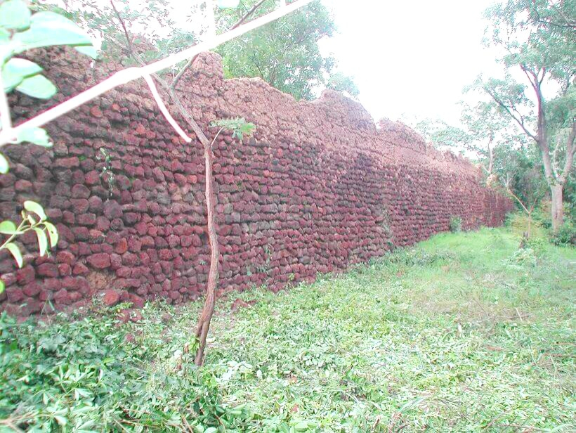
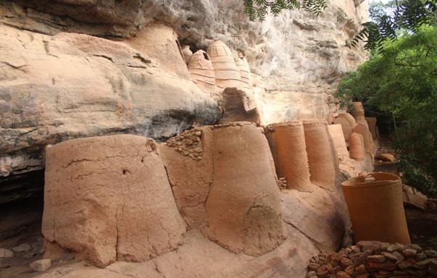
Ruins of Loropeni and Niansogoni Village

Slide 5
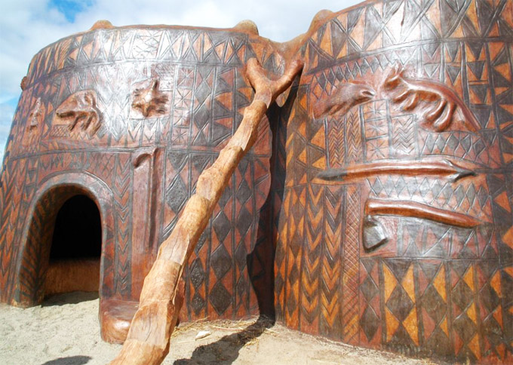
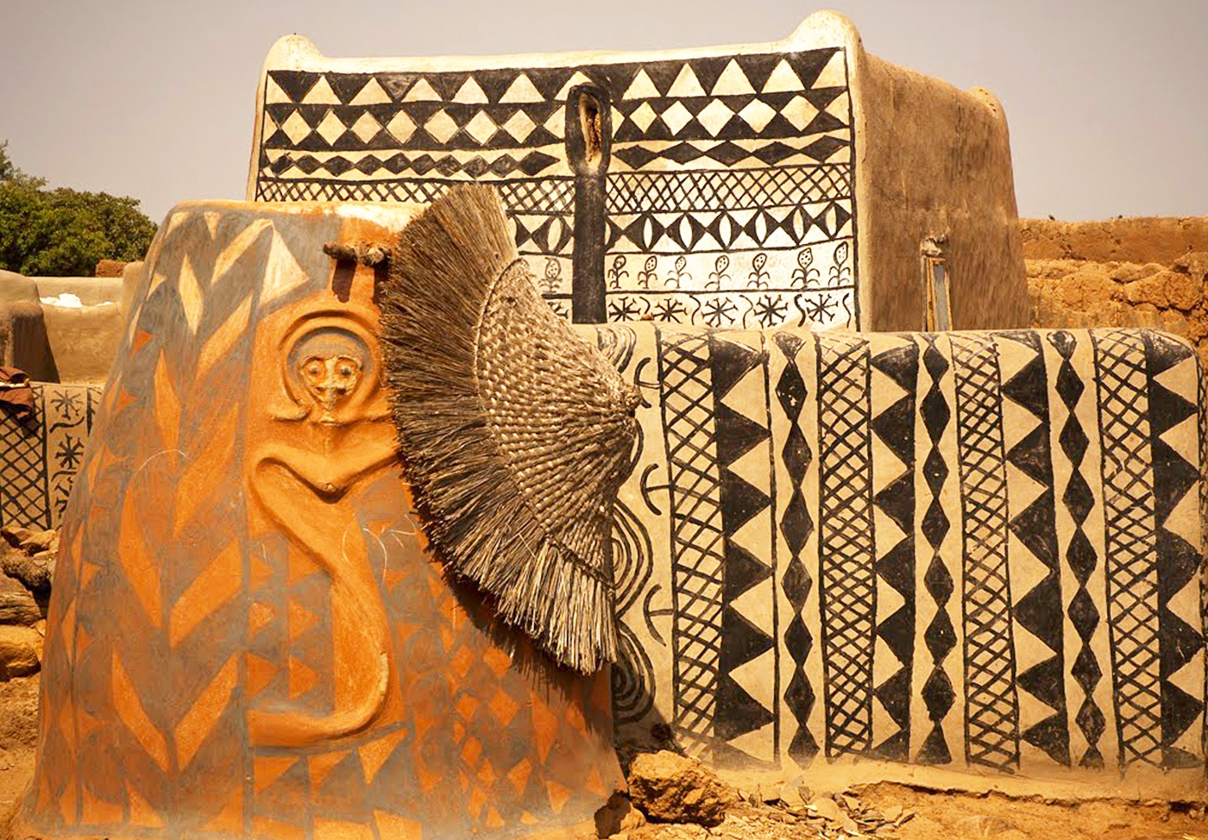
Royal Court of Tiébélé

Slide 6
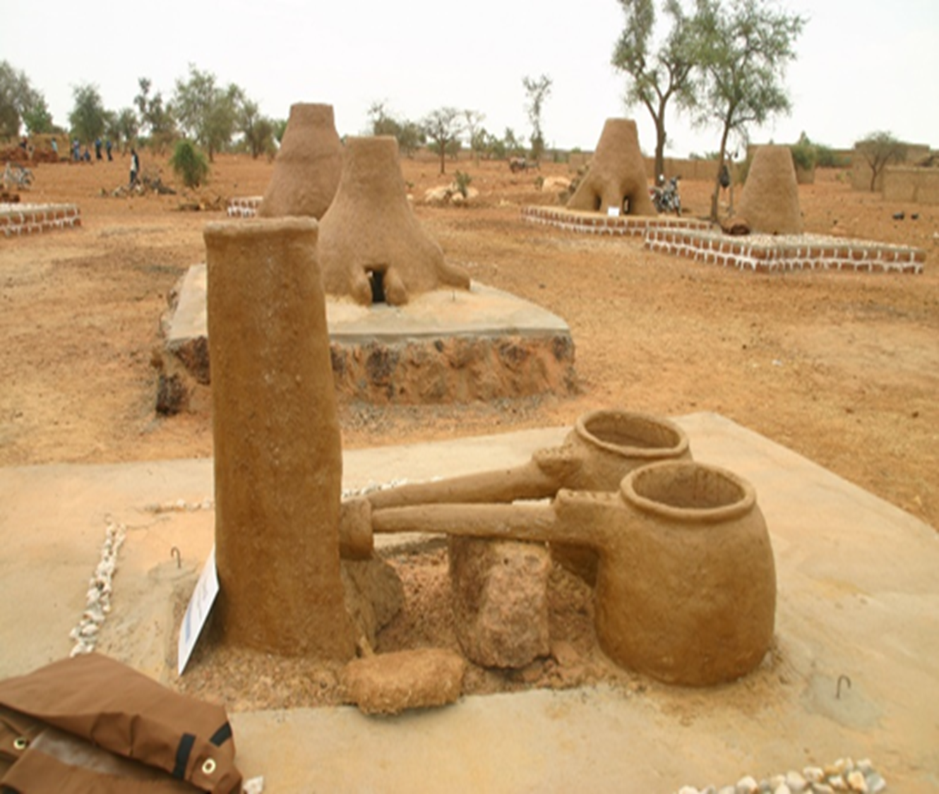
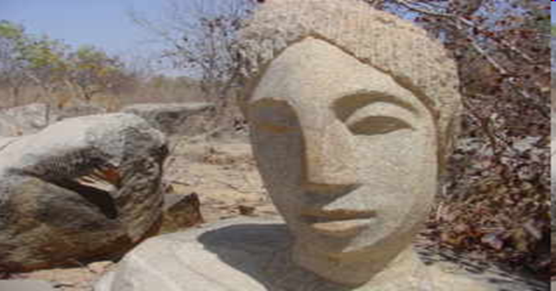
Iron Metallurgy Sites and Laongo natural sculptural sites

Slide 7
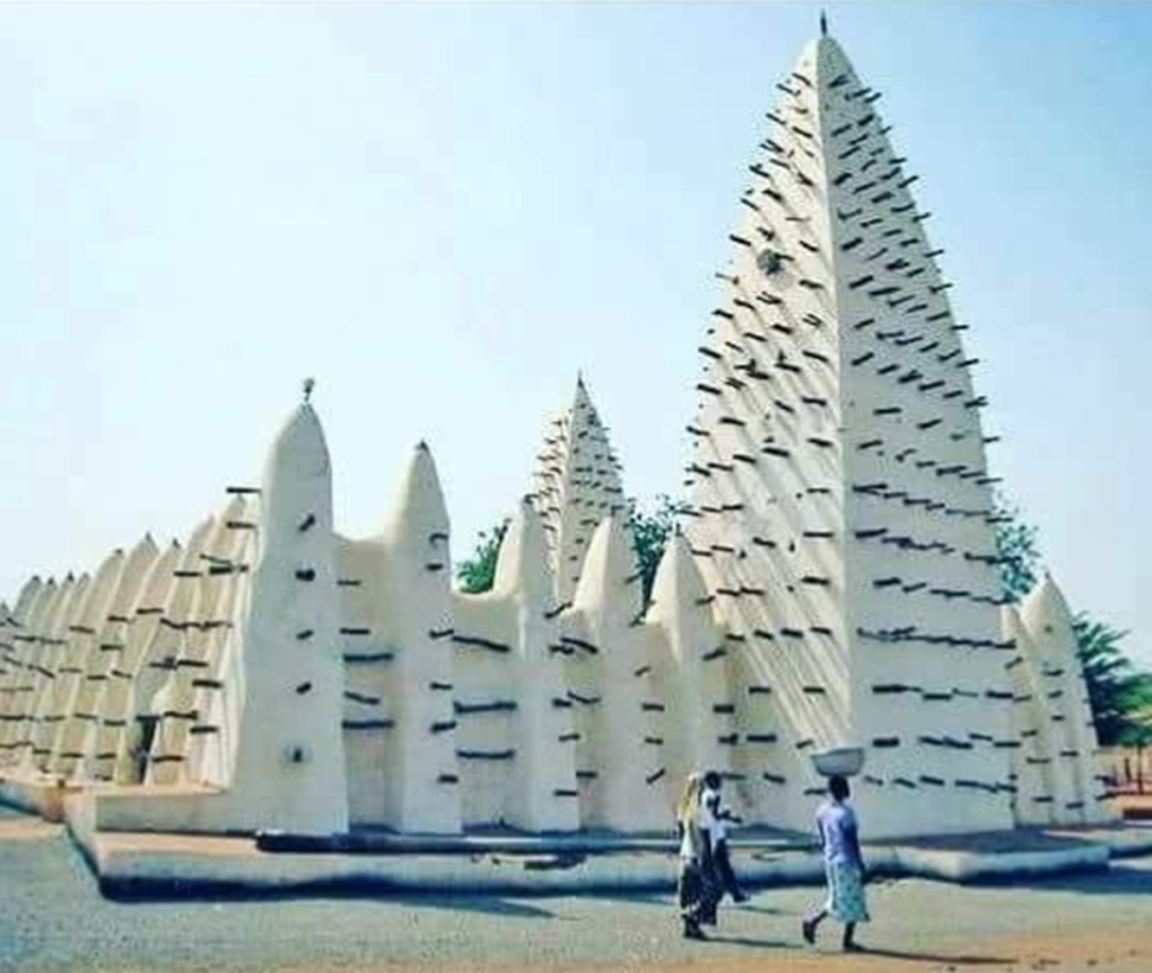
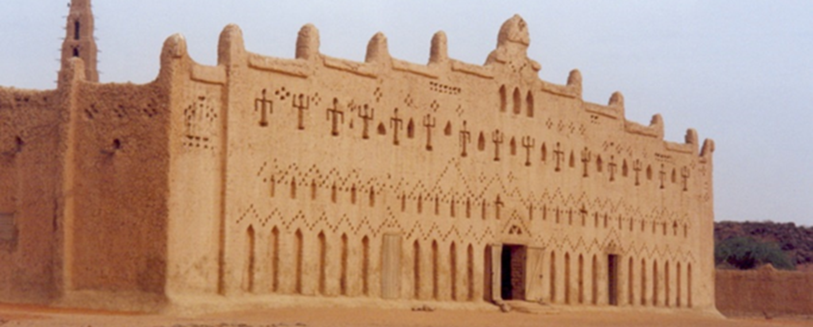
Mosque of Dioulassoba and Mosque of Bani

Slide 8
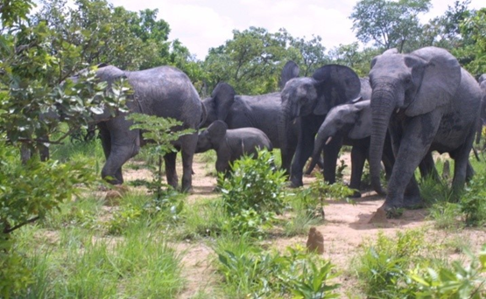
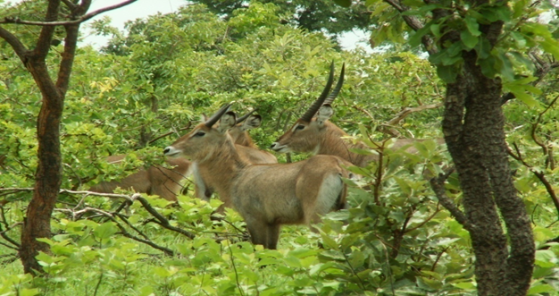
W-Arly, Pendjari Complex

Slide 9
2. Strategy for Quality and Sustainability
Community involvement : Village camps, local guides, revenue sharing
Institutional framework : National strategies, 2021 Tourism Law, UNESCO site management plans
Professionalization : Training guides, eco-friendly hotels, artisan support
Respectful tourism : Thematic itineraries, raising awareness among visitors about responsible behaviour

Slide 10
3. Challenges and Responses
Security : Resilience, secure hubs, domestic and regional tourism
Financing : Public–private partnerships, innovative financing, partner support
Legal securization of heritage : consultations for agreement with local communities.
Scarcity of basic material for renovation : adaptation measures and sustainable practices inspired by traditional knowledge.

Slide 11
4. Outlook
👉 Heritage tourism = hope and development
👉 Achievements = political will + community commitment
👉 Future vision : stronger OIC cooperation for peace and prosperity

Slide 12
Thank you for your kind attention

