Slide 1

Supporting the Development of thematic loans, Bonds and sukuk in emerging markets
Dr Riccardo Ambrosini
Climate Finance
Financial Institutions Group, Middle East and Central Asia
Ankara, 17 September 2025

Slide 2
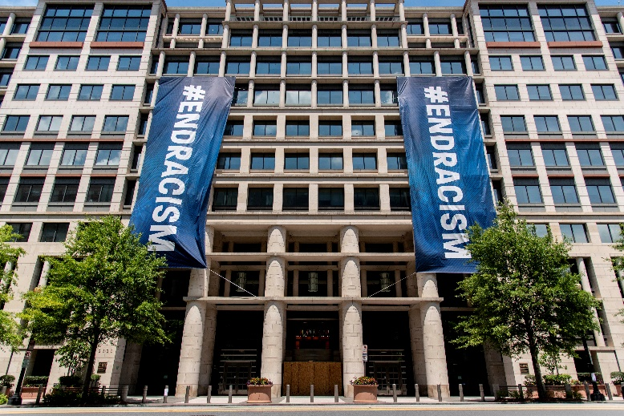

Who is the International Finance Corporation?
IFC is a member of the World Bank Group with a mission to promote development through investment in private sector
Owned by 185 member countries and has an AAA credit rating
Provides debt and equity investments and resource mobilization for the private sector in emerging markets for over 60 year.
Global presence in almost 100 countries and working with over 2,000 private sector clients
International Development Association
International Bank for Reconstruction and Development
International Finance Corporation
Multilateral Investment Guarantee Agency
International Centre for Settlement of Investment Disputes
Loans and grants to governments of developing countries
Loans to governments of middle-income countries
Debt and equity investments and advisory services to private sector in developing countries
Guarantees of foreign direct investment’s non-commercial risks
Conciliation and arbitration of investment disputes
2

Slide 3
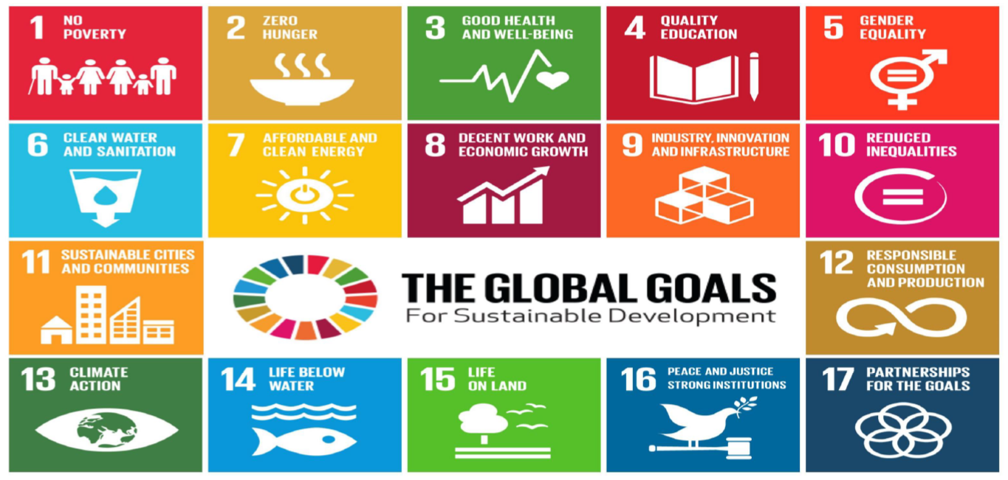
SDG - the compass of global development
Footer
3
Notes:
ABC AS alone is 5.0

Slide 4

Green & climate-smart transition presents huge investment opportunities
    IFC study found that 21 countries* in EM account for 89% share of EM GHG emissions, and need US$23 trillion investment in climate finance by 2030 (this hasn’t included financing needs for Climate Smart Agriculture and Adaptation)
    This presents the single largest growth opportunity for banks in EM – Could grow the share of green lending portfolio from 7% to 30% by 2030, increasing profitability and gaining market share
    “Green Banking” will enable outperformance by successful banks – not just by better managing environmental risks, but by being at the forefront of trillions of dollars of new business related to climate lending
 | Financing Source
Total Market Opportunity | Banks | Capital Markets
US$ 23 Trillion | US$ 13 Trillion | US$ 10 Trillion
East Asia and Pacific
US$ 16,046 Billion
Latin America and the Caribbean
US$ 2,640 Billion
South Asia
US$ 2,234 Billion
Europe and Central Asia
US$ 665 Billion
Sub-Saharan Africa
US$ 783 Billion
Middle East and North Africa
US$ 265 Billion
Buildings
US$ 16,334 Billion
Transport
US$ 3,699 Billion
Renewables
US$ 1,765 Billion
Electric transmission
and distribution
US$ 413 Billion
Industrial Energy Efficiency
US$ 307 Billion
Waste
US$ 115 Billion
US$23T
2030
Forecast of
Bank lending
2016
7%
30%
Bank loans
Bank lending
for climate
US$22 Trillion
US$44.5 Trillion
Source: IFC Report and G20 Input Paper Raising US$23 Trillion – Greening Banks and Capital Markets for Growth. An IFC report that analyzes the level of bank and capital markets financing required to finance the NDCs. Adding climate smart agriculture and adaptation investment needs, SSA financing demand will be likely 1 trillion USD.
4
Notes:
ABC AS alone is 5.0

Slide 5
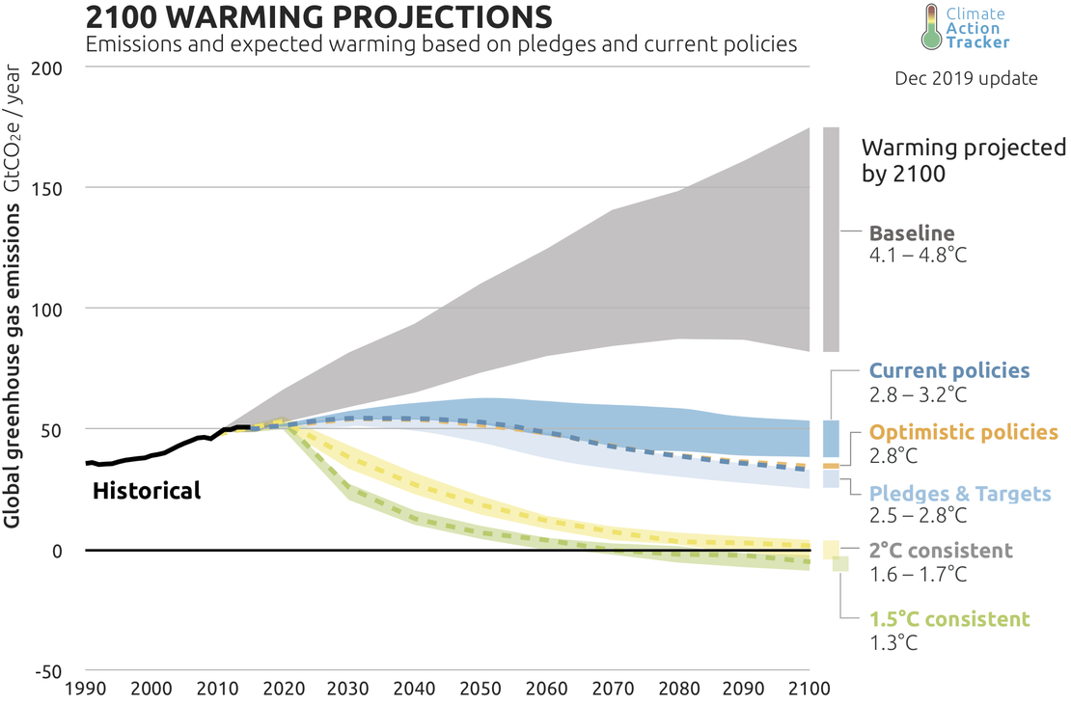
Renewed focus on Paris Agreement alignment
Emissions need to decline by 7.6% per year
The aim of the Paris Agreement is to limit global warming
  to well below 2 °C above pre-industrial times
  to pursue efforts to limit the increase to 1.5°C
  to strengthen countries' ability to deal with the impacts of climate change and support them in their efforts
Between 2020 and 2030 global emissions should decrease by 7.6% per year to achieve the 1.5 °C scenario
By 2050, global emissions would have to decline by about 60%
5
Notes:
ABC AS alone is 5.0

Slide 6
Sustainable Finance – What is What?
CLIMATE CHANGE MITIGATION
FUNDING
INSTRUMENTS
ENVIRONMENTAL
LOW CARBON
(SDGs 6,7,11,12,14,15)
CLIMATE
CLIMATE CHANGE ADAPTATION
Based on Use of Proceeds: loans with climate components, loans and bonds/sukuk
GREEN
BIODIVERSITY
BLUE FINANCE (OCEANS & WATER)
SUSTAINABLE FINANCE
OTHER ENVIRONMENTAL
Based on Targets: Sustainability-linked Bonds/Sukuk and Sustainability-linked Loans
SOCIAL
(SDGs 1,2,3,4,5,10)
GOVERNANCE / OTHER SDGs
(SDGs 8,9,11,16)
6
Notes:
ABC AS alone is 5.0

Slide 7
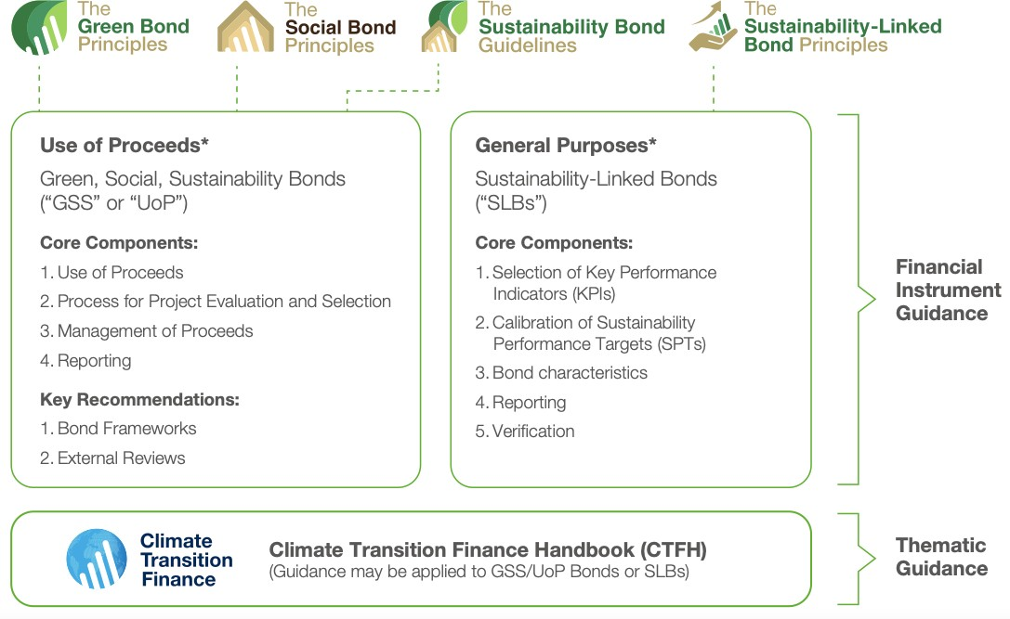
Thematic Loans, Bonds and sukuk: The architecture of the “Principles”
7

Slide 8
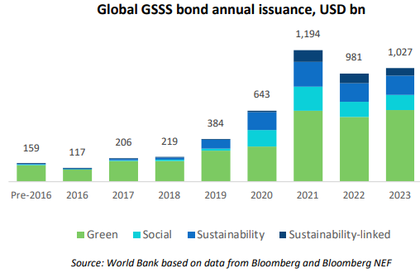
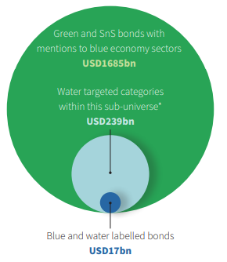
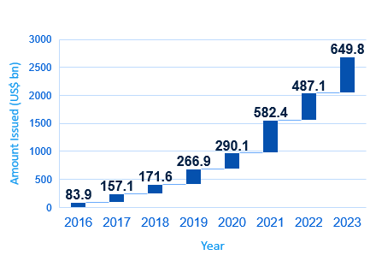
EM Sustainable Bond Markets in the Global Context
Sustainable Bond Market Evolution
The global green bond market has exceeded USD 4.9 trillion in cumulative issuance (US$ billion, incl. 2023)
Blue bonds emerge as a subset of green bonds and draw attention to water and marine protection issues
Sustainable bond market grows rapidly (US$ billion), with green bonds accounting for the largest market share
Source: Climate Bonds Initiative; Bloomberg L.P.; Environmental Finance Magazine; and IFC analysis.
8

Slide 9
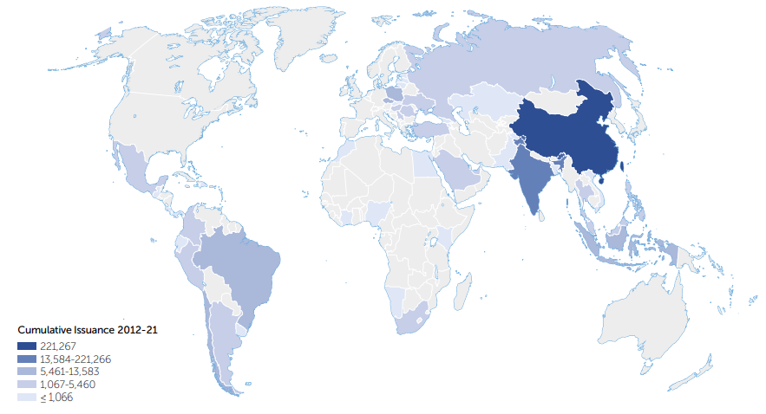
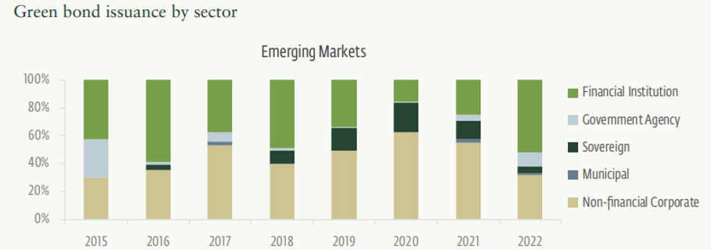

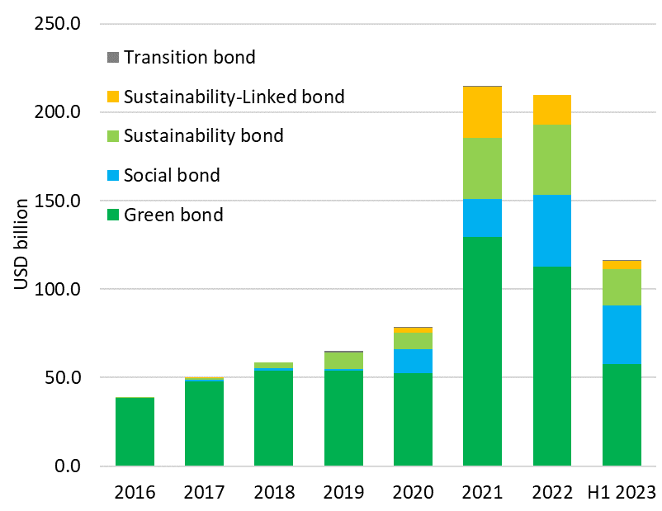
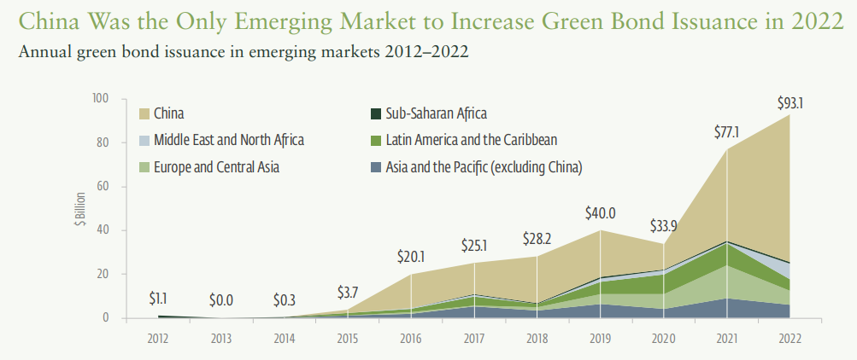
Green, Social, Sustainability and Sustainability-linked in Emerging Markets
2012-2021 Cumulative Green Bond Issuances by Region
Green Bond issuance driven by FIs in 2022
Creating green bond markets:
sustainable finance policies and frameworks;
green bond issuance momentum;
capital market development;
governance and political stability.
9
Source: Emerging Markets Green Bond Report 2021 and 2023, Environmental Finance (June 2023)

Slide 10
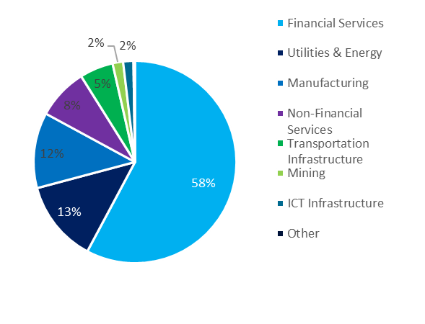
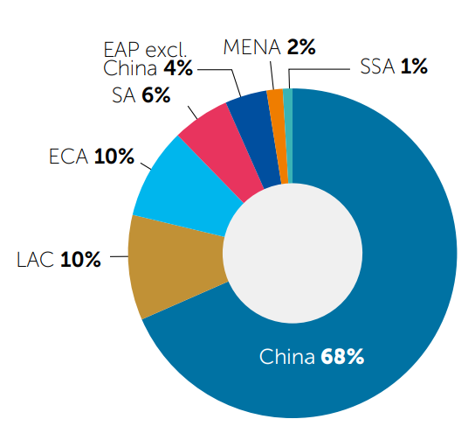
Green, Social, Sustainability and Sustainability-linked in Emerging Markets
2012-2021 Cumulative Green Bond Issuances by Region
2022 GSS issuance by Issuer types
The financial sector leads the non-sovereign bond/sukuk issuances. Issuance by FIs increased from $334 billion in 2021 to $370 billion in 2022
In EM real economy issuers represent around 57% sustainable bonds by # of bonds and 41% by value of bonds.
The MENA region only accounts for about 2% of total GSS bond/sukuk issuances
Source: CBI, March 2022
Source: Emerging Markets Green Bond Report 2021
10

Slide 11
What is IFC’s role in the Sustainable Bond Market?
Lender
Investor
IFC channels investments through financial intermediaries to support climate or social-related credit lines.
IFC typically acts as an anchor investor for first-time issuers
Green loans
IFC’s roles in the Sustainable Bond Market
IFC offers two sustainable bond programs:
Green Bond Program
Social Bond Program
Issuer
Work with Regulators
IFC supports capital market regulators in the development of national sustainable bond frameworks
Provider of Technical Assistance and Advisory Services
Mobilizer
Emerging Green One (EGO) Bond Fund
Real Economy Green Investment Opportunity (REGIO) Bond Fund
Green Bond Technical Assistance Facility
Contributor to Market Development
Chairs the Executive Committee of the Green, Social and Sustainability-Linked Bond Principles
11

Slide 12

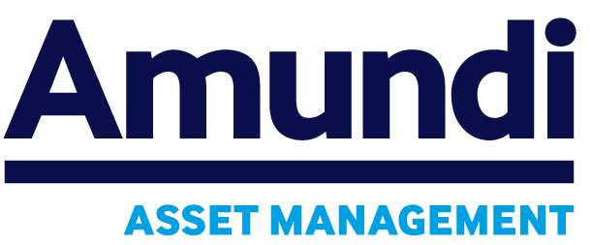

IFC as an issuer and investor in green bonds
IFC is a pioneer in the green bond market and one of the largest global issuers of green bonds.
In 2014, IFC became the first international investor in an EM green bond when it subscribed to a US$50 million equivalent Indian Rupee green bond issued by Yes Bank, which became the first EM cross border green bond issuance.
IFC has issued 172 green bonds in 20 currencies for US$10.4 billion. In Feb 2013, IFC issued a US$1.0 billion green bond, the largest issued at that time by any entity and the first liquid benchmark green issue that helped main-stream green bonds as a market instrument.
In partnership with Amundi, IFC has set-up the world’s largest green bond fund with a US$2 billion investment strategy to support green bonds issued by banks active in EMs.
In partnership with HSBC, IFC created the first global green bond fund with a US$500 million size targeting “real economy” issuers in EM (REGIO).
12

