Slide 1

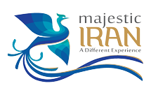
The 25 Meeting of the COMCEC Tourism Working Group
15-16 September 2025 ;Ankara
“Improving the Quality of Heritage Tourism in Islamic Countries OIC”
Islamic Republic of Iran
Ministry of Cultural Heritage, Tourism and Handicrafts)MCTH(
www.visitiran.ir

Slide 2
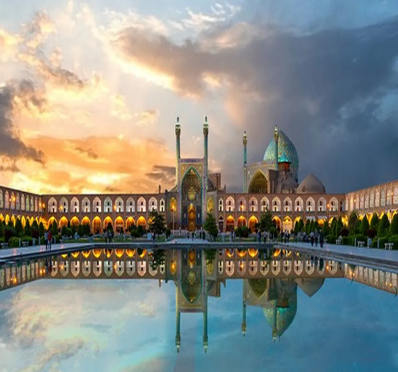
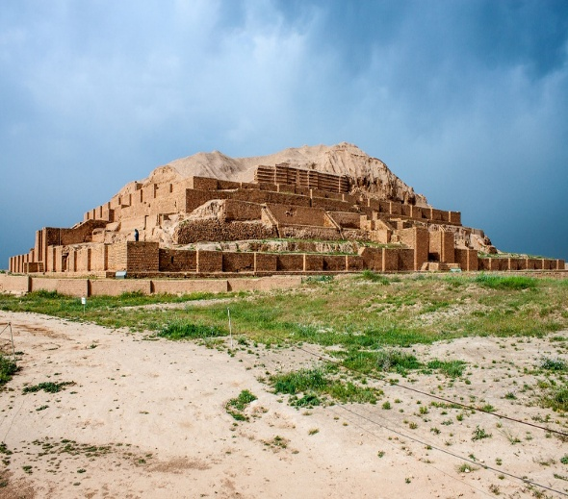
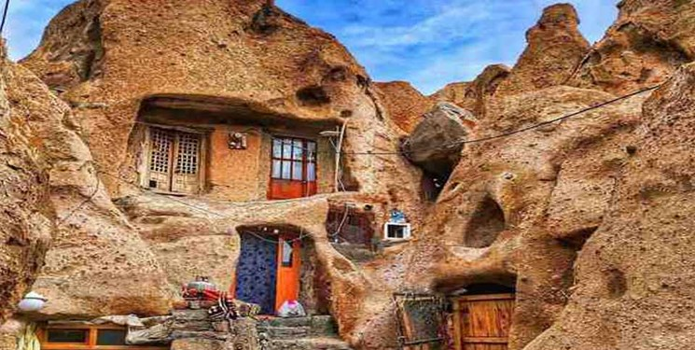
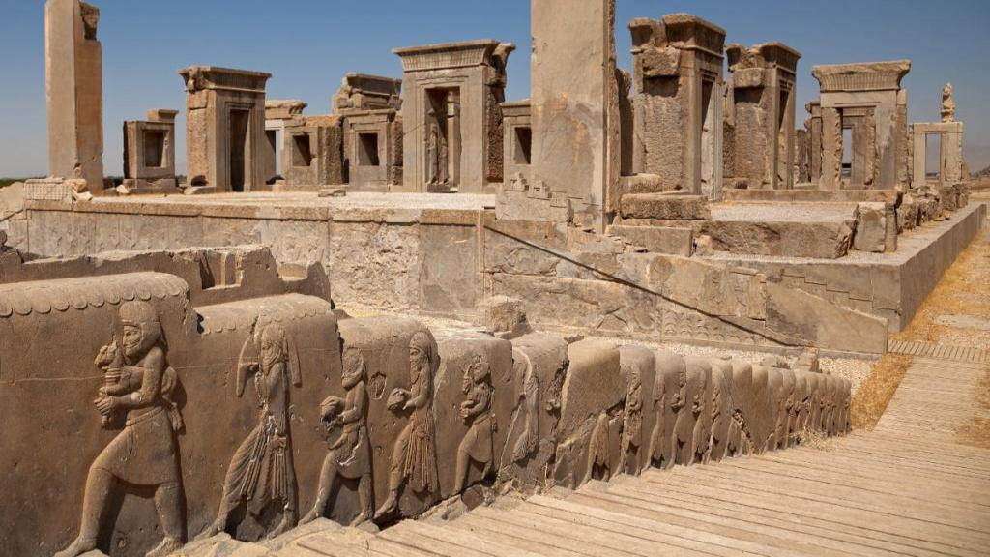
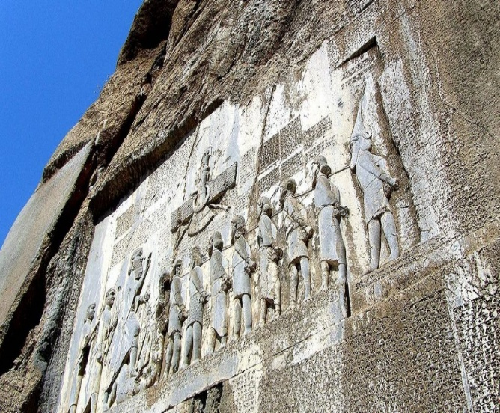
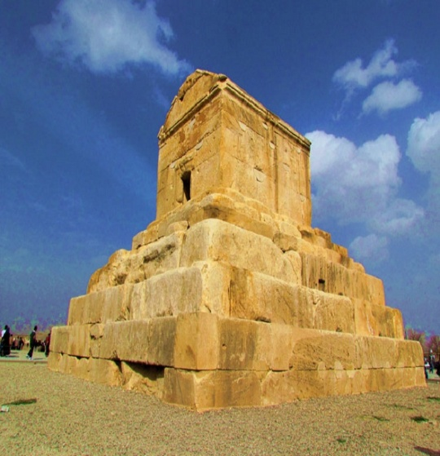
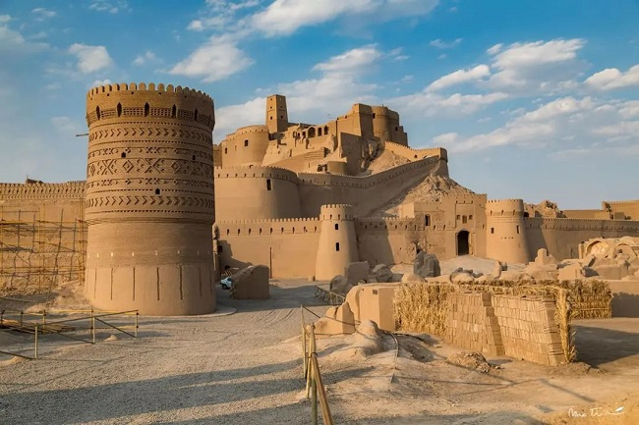
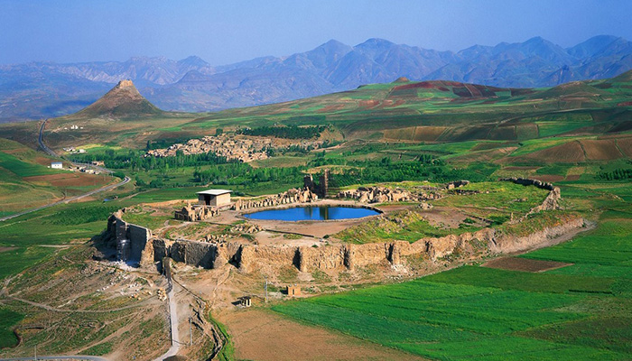
Islamic Republic of Iran
Ministry of Cultural Heritage, Tourism and Handicrafts)MCTH(
www.visitiran.ir

Slide 3
Iran, with its rich and diverse tourism heritage, has steadily strengthened its position as a cultural and heritage-based destination in recent years.
This growing interest reflects the country’s unique potential to offer authentic experiences to international visitors.
In this context, revisiting tourism strategies and placing greater emphasis on sustainability has become a strategic necessity—especially among OIC member countries that share deep cultural and historical ties and can collectively advance sustainable heritage tourism through regional collaboration.
4
www.visitiran.ir
www.visitiran.ir

Slide 4


The trend of inbound foreign tourist arrivals and annual percentage changes
www.visitiran.ir

Slide 5
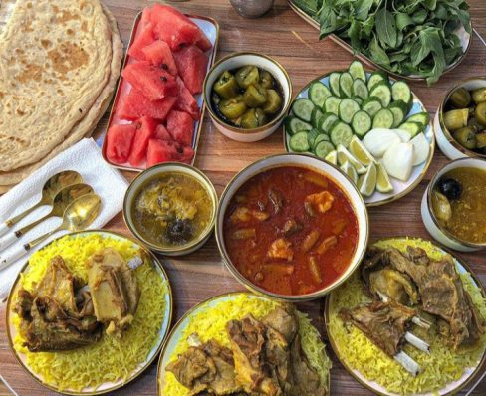
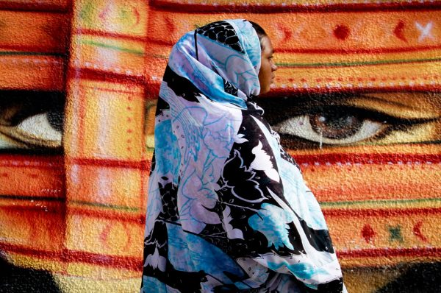
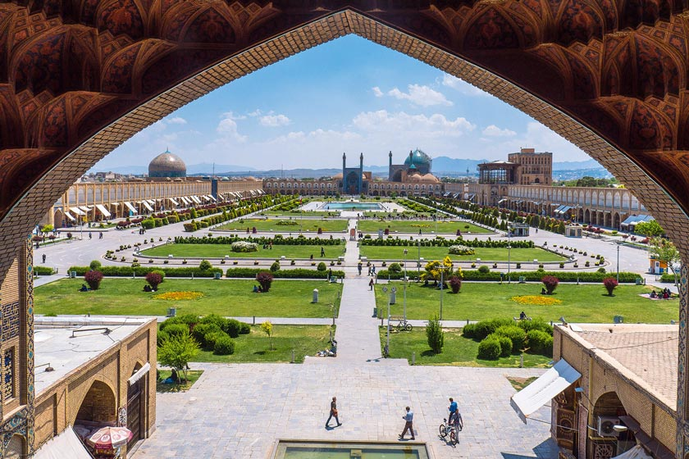
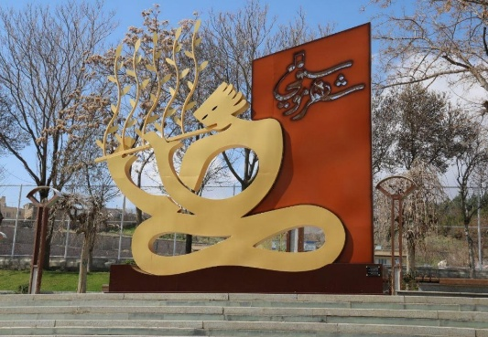
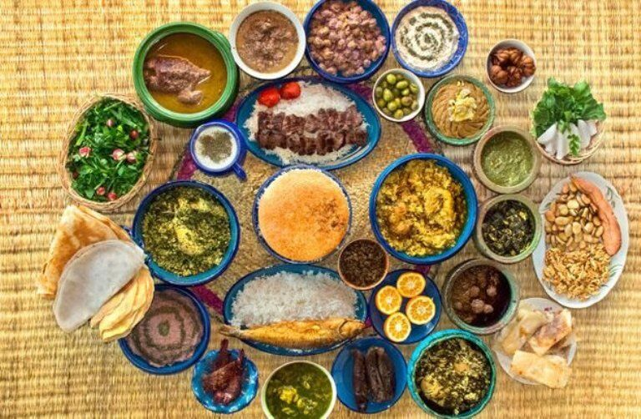
1
2
3
4
5
UNESCO’s Creative Cities
Kermanshah
The CreativeCity Of gastronomy (2021)
Bandar Abbas
city of “Crafts and Folk Art” (2019)
Isfahan
Creative City of Crafts and Folk Art (2015)
Sanandaj
city of “Music” (2019)
Rasht
The Creative City Of gastronomy (2015)
Iran’s Heritage Tourism Potential
Iran ranks among the top 10 countries globally with 29 UNESCO World Heritage Sites
Recognized for intangible cultural heritage such as Nowruz, traditional music, and crafts
Five Iranian cities (Isfahan, Rasht, Bandar Abbas, Sanandaj, Kermanshah) are part of UNESCO’s Creative Cities Network
Diverse attractions: deserts, forests, bazaars, Persian gardens
Strong potential for regional cooperation among OIC member states in promoting sustainable heritage tourism
2
Islamic Republic of Iran
Ministry of Cultural Heritage, Tourism and Handicrafts)MCTH(
www.visitiran.ir

Slide 6
29 Iranian tangible Heritage Sites Listed by UNESCO
Tchogha Zanbil (1979)
Persepolis (1979)
Meidan Emam, Esfahan (1979)
Takht-e Soleyman (2003)
Pasargadae (2004)
Bam and its Cultural Landscape(2004)
Soltaniyeh (2005)
Bisotun (2006)
Armenian Monastic Ensembles of Iran (2008)
Shushtar Historical Hydraulic System (2009)
Sheikh Safi al-din Khanegah and Shrine Ensemble in Ardabil (2010)
Tabriz Historic Bazaar Complex(2010)
The Persian Garden (2011)
13. The Persian Garden (2011)
14. Masjed-e Jame of Isfahan (2012)
15. Gonbad-e Qabus (2012)
16. Golestan Palace (2013)
17. Shahr-i Sokhta (2014)
18. Cultural Landscape of Maymand(2015)
19. Susa (2015)
20. The Persian Qanat (2016)
21. Lut Desert (2016)
22. Historic City of Yazd (2017)
23. Sassanid Archaeological Landscape of Fars Region (2018)
24. Hyrcanian Forests
25. Cultural Landscape of Hawraman/Uramanat
Trans-Iranian Railway
27.
28.
29.
a wide range of various types of properties from samples of urban engineering and architecture to Bazaars, buildings, etc.
www.visitiran.ir

Slide 7
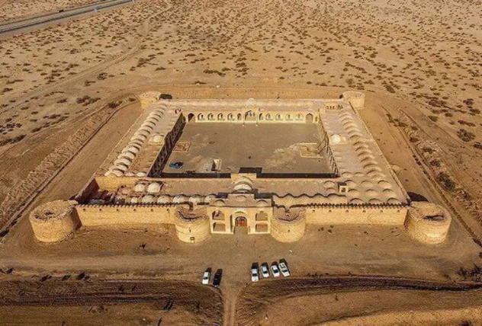
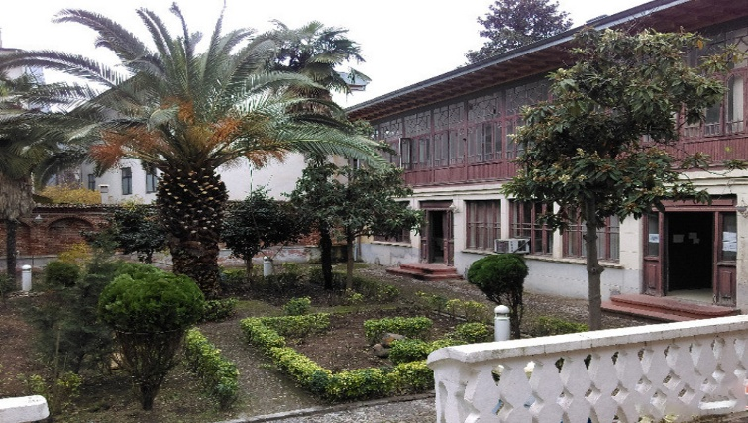
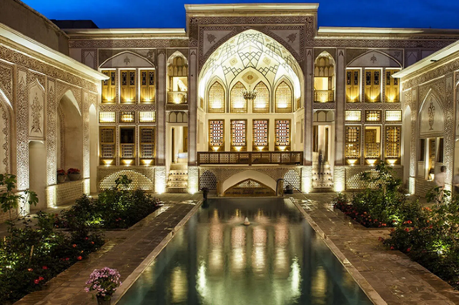
Adaptive Reuse of Historic Buildings in Iran
Qom
Dirgchin Caravanserai
One of the oldest caravanserais in Iran, located along the Silk Road, is currently being used as a cultural and tourism center.
This historic house, after restoration, has been transformed into a cultural and artistic center, hosting local exhibitions and art events.
This house, while preserving the authenticity of Iranian architecture, has been transformed into a luxury eco-lodge and stands as a successful example of cultural and economic reuse.
-Iran has shifted from passive preservation to active reuse of historic houses and caravanserais.
-Restored sites now serve as eco-lodges, cultural centers, and tourism hubs, supporting heritage and local development.
-Caravanserais along ancient trade routes play a vital role in sustainable tourism.
-The approach encourages private investment and adds value to heritage asset

Slide 8
Toward Sustainable Heritage Preservation in Rural Areas
Adaptive reuse of historic buildings via private sector investment for tourism and hospitality
Organizing local festivals to revive and safeguard intangible cultural heritage
Registering indigenous events in the national tourism calendar to ensure visibility and preservation
Successful examples: Kandovan (rock-cut architecture) and Palangan (stepped village with living traditions)

Slide 9
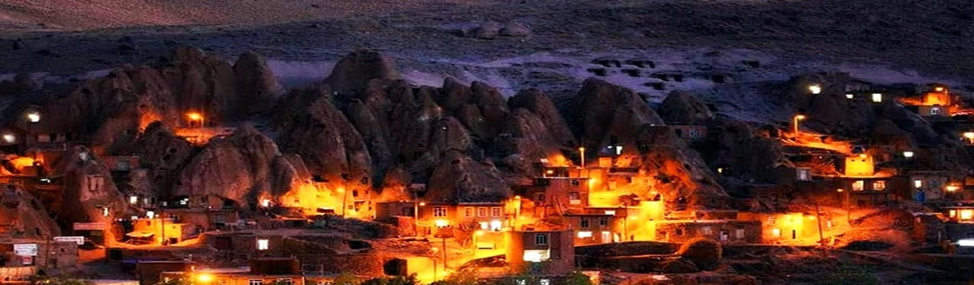
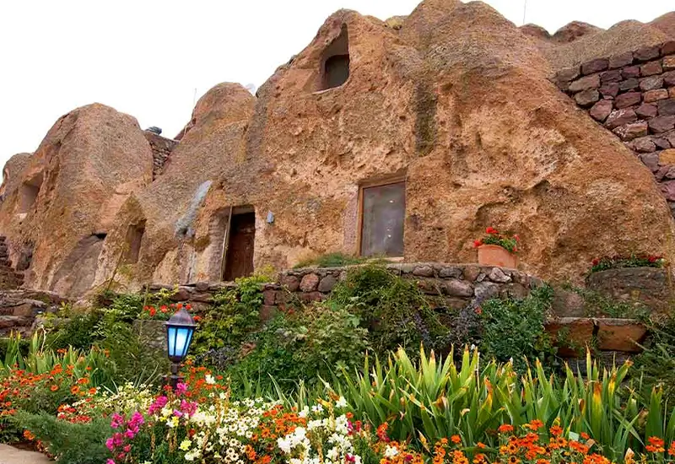
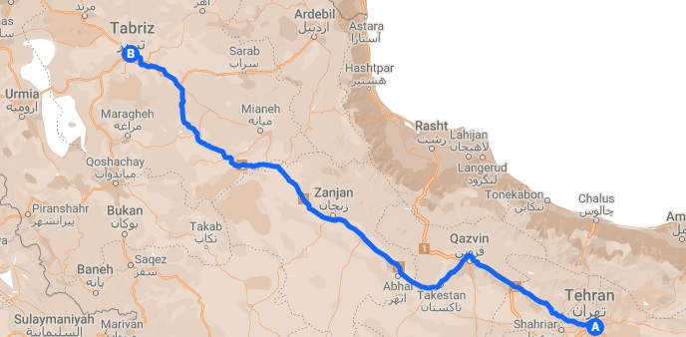
Kandovan Village – A Living Heritag
Unique rock-cut architecture at Mount Sahand
One of the few actively inhabited heritage sites worldwide
A remarkable example of human–nature harmony
Candidate for UNESCO World Heritage inscription
Strong potential for sustainable, experience-based tourism
is known as a rocky village and it is 3,000 years old.

Slide 10
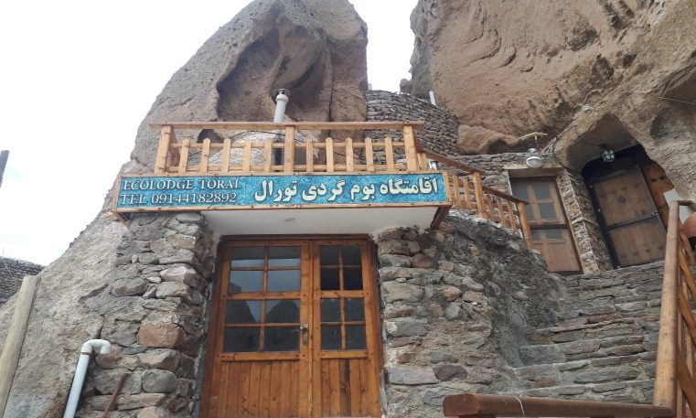
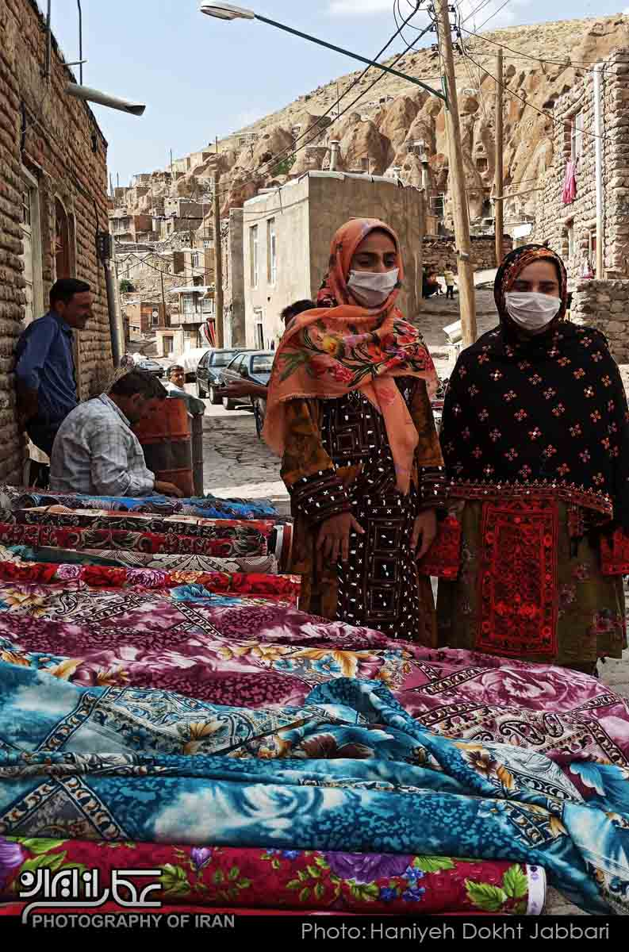
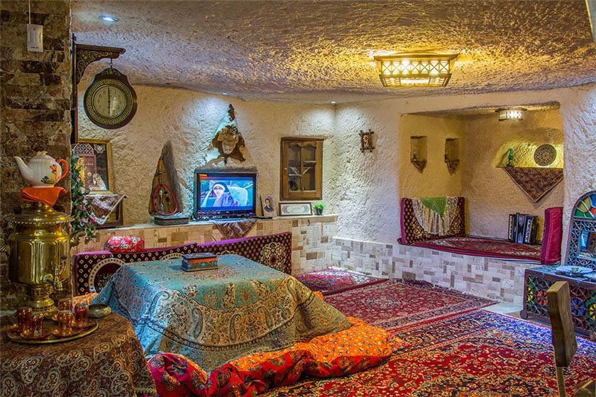
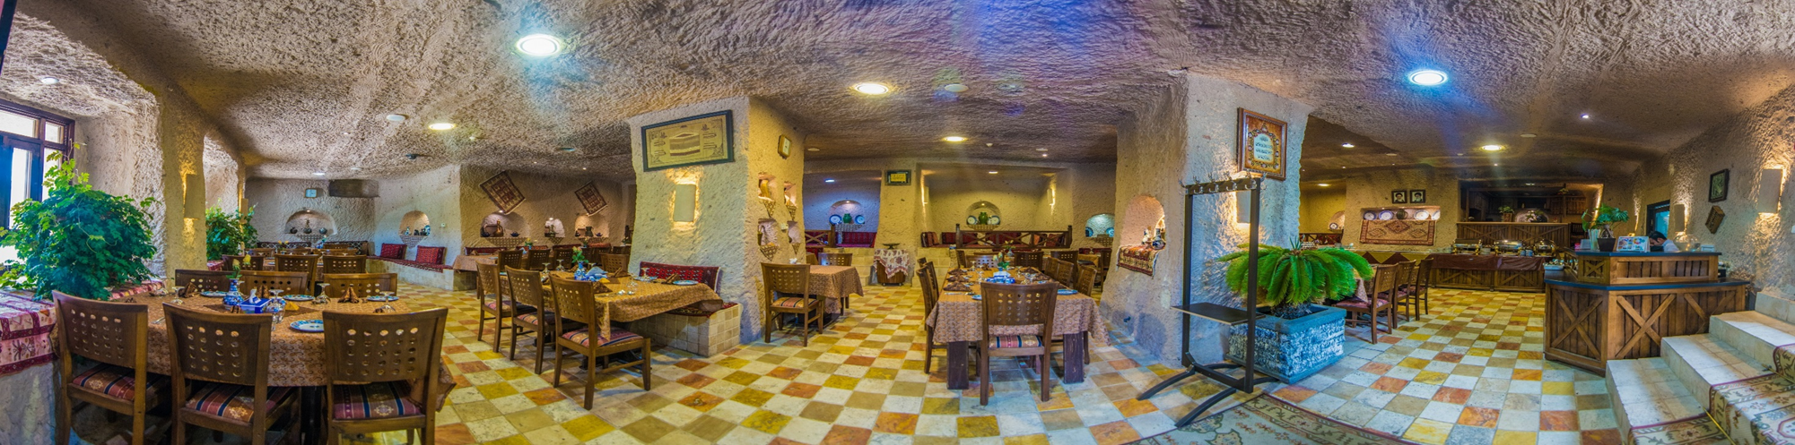
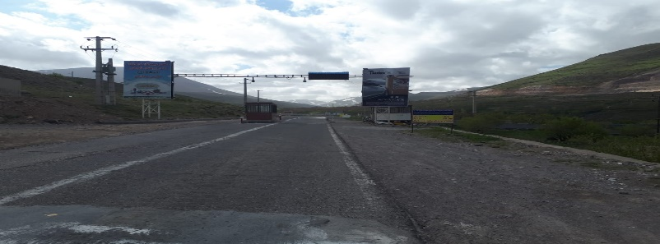
The main business of the villagers is tourism
30 eco-lodges
1 boutique hotel
150 handicraft workshops and shops
1 local bazaar with about 20 shops
1 traditional host
11 restaurants
Creating job opportunities for women and the elderly
Holding training course to instruct hand made things like needlework for women
Eco- lodge
Women's employment
restaurant
Village tolls

Slide 11
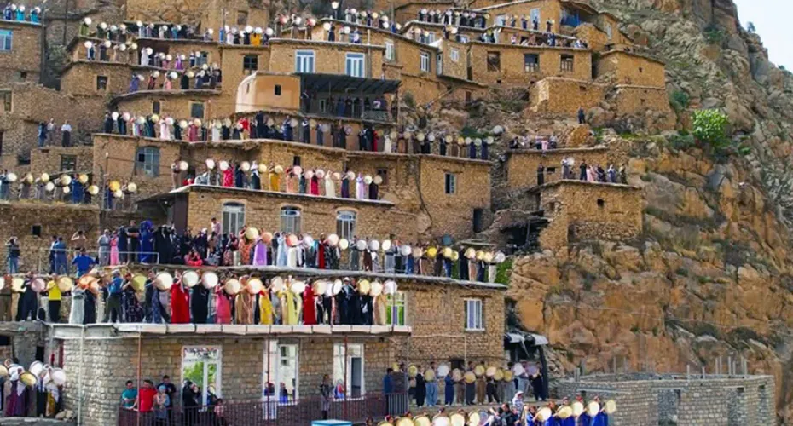
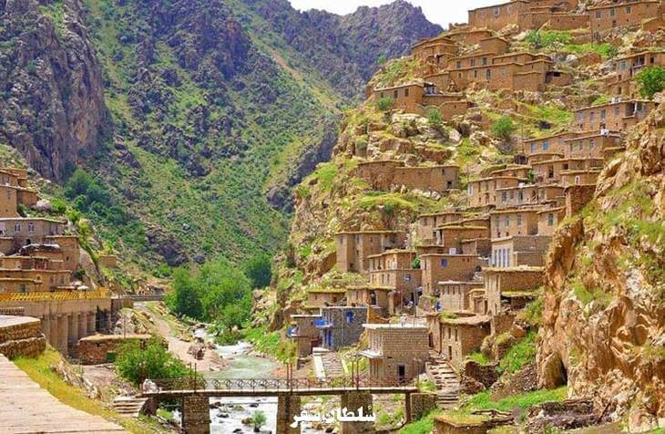
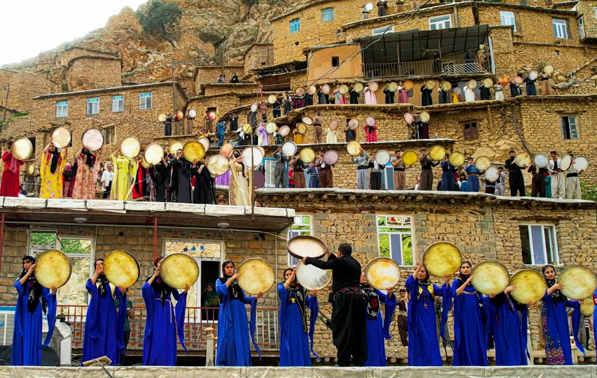
Palangan Village: A Living Heritage in the Heart of Kurdistan
•Palangan is one of the oldest villages in Kurdistan, with roots dating back to pre-Islamic times.
• Known for its stepped stone architecture and location in Tangivar Valley, it reflects authentic mountain life.
• The village hosts vibrant cultural events, including traditional festivals like Hezar Daf and fire-lit Nowruz celebrations.
• Restoration efforts have preserved its heritage while promoting tourism and local engagement.

Slide 12
Recommendations
🏛️ Legal Framework for Responsible Reuse
Establish clear regulations for private-sector involvement in restoring and reusing heritage buildings.
🌱 Infrastructure Development in Rural Areas
Invest in tourism infrastructure while preserving local architecture and cultural identity.
🎭 Promotion of Intangible Heritage Events
Encourage registration of local festivals and rituals in the national tourism calendar.
🌐 Regional Collaboration Among OIC Members
Create a UNESCO-linked heritage network for shared learning and joint initiatives.
👥 Community Training & Empowerment
Provide education and tools for local communities to manage and benefit from heritage tourism.
💡 Use of Digital Technologies
Apply virtual reality, interactive maps, and online platforms to showcase heritage globally.
Establishing a UNESCO-registered heritage tourism network among member countries
including :
-heritage roads and sites,
-registered villages,
- intangible heritage such as historic houses.
www.visitiran.ir
Islamic Republic of Iran
Ministry of Cultural Heritage, Tourism and Handicrafts)MCTH(

Slide 13
Thank you for your attention.
Islamic Republic of Iran
Ministry of Cultural Heritage, Tourism and Handicrafts)MCTH(
www.visitiran.ir

