Slide 1

Housing and Social Policy in Azerbaijan
Speech & Presentation
2025

Slide 2



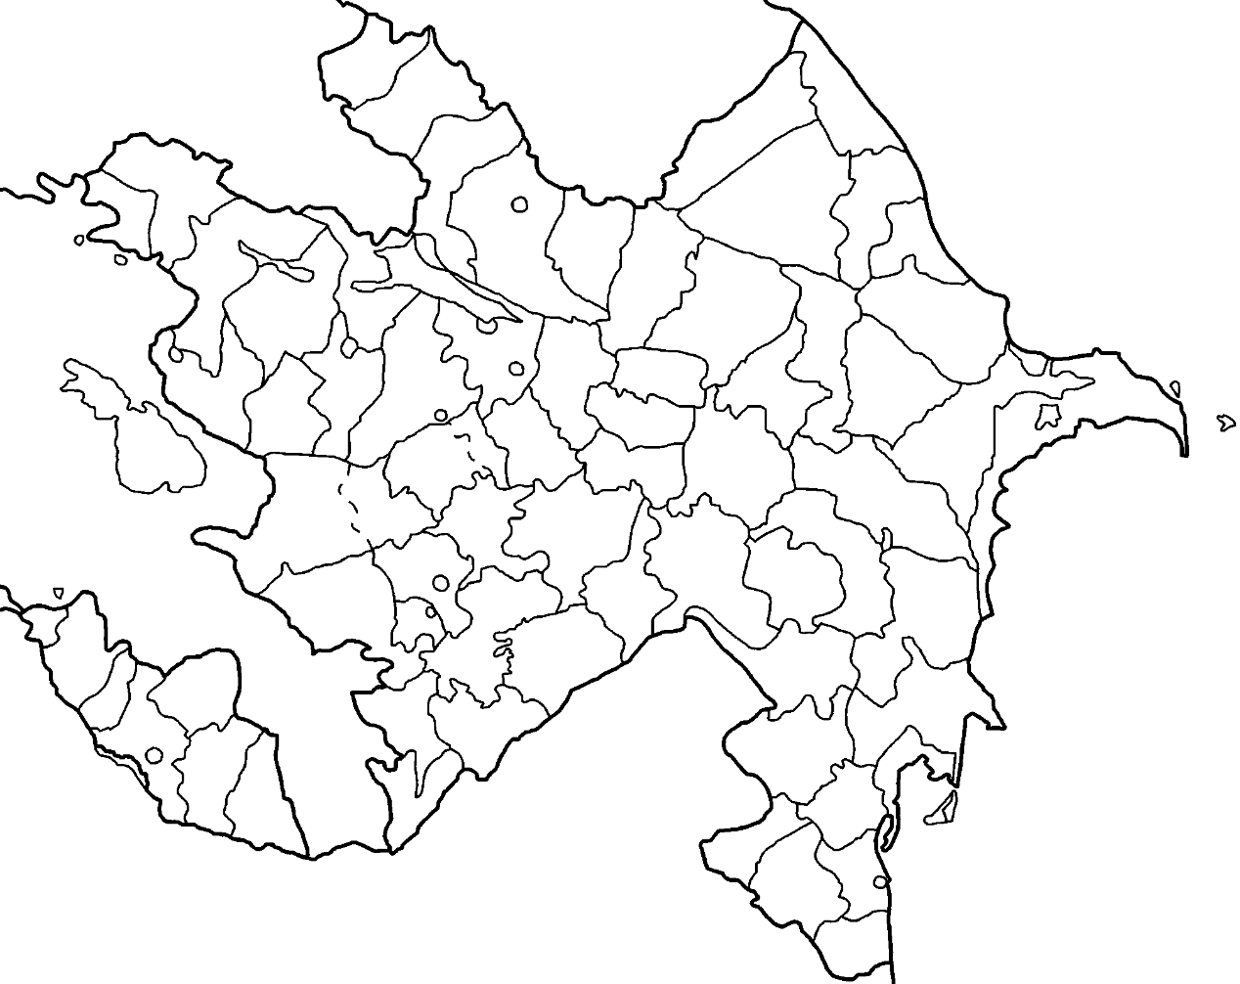
Population: 10,250,000
Introducing Azerbaijan
49%
51%
Children (0-14): 22%
Working age (15-64): 70%
Elderly (65+): 8%
2

Slide 3




Housing Support Decrees in Azerbaijan
Decree № 569 – 20 June 2014
Decree № 2449 – 25 January 2021
Decree № 2871 – 25 August 2021
Decree № 492s (Cabinet of Ministers) – 16 August 2021

Slide 4







Entitlement to Housing Provision
Martyrs Families
People with War-Caused Disabilities
People with visual impairments
Persons with disabilities in connection with the liquidation of the consequences of the accident
at the Chernobyl NPP
Persons who have been awarded the title of ‘Hero of the Patriotic War’ of the Republic of
Azerbaijan (after the death of the person, their family members)
Children deprived of prenatal care

Slide 5
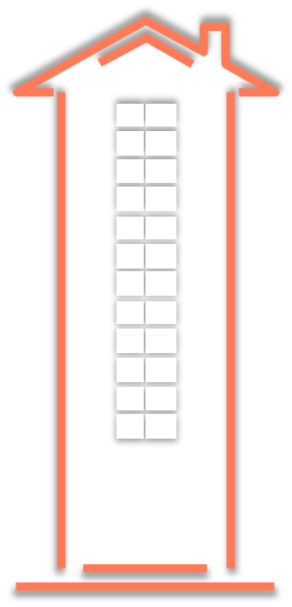

Housing Provision Over Time
Housing Security for Martyrs Families & People with War-Caused Disabilities
4 278
4 016
6 800
Up to
16 000
2014-2020
2021-2024
Until now
5

Slide 6


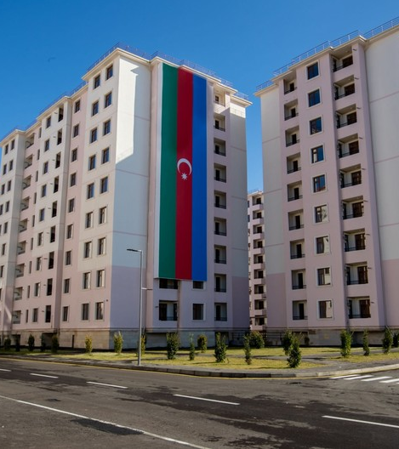


Newly Opened Housing Complexes (2021-2024)
Baku - 6
Lankaran - 1
Absheron - 2
Mingachevir - 1
Samukh - 1
Ganja - 1
In general: 11

Slide 7






Housing for Vulnerable Groups (2021-2025)
Construction of social housing for martyrs families
Provided 2367
Construction of social housing for People with War-Caused Disabilities
Provided 2821
Construction of social housing for visually impaired citizens (2015)
Provided 720
Construction of social housing for Persons with disabilities in connection with the liquidation
of the consequences of the accident at the Chernobyl NPP
Provided 609
Construction of social housing for Children deprived of perental care
Provided 283

Slide 8

Future Plans
Legal amendments to define categories of socially vulnerable citizens
Expansion of social rental housing programs for low-income families
Inclusion of long-serving military personnel into support programs
Prevention of misuse through 10-year restriction on resale and mortgage
Strengthening fairness and sustainability in housing policies
8

Slide 9
Thank you for your attention!

