Slide 1
THE 25th MEETING OF THE COMCEC TOURISM WORKING GROUP| September 15-16, 2025, Ankara
IMPROVING THE QUALITY AND SUSTAINABILITY OF HERITAGE TOURISM IN OIC COUNTRIES
HOLISTIC CONSERVATION, SUSTAINABILITY AND TOURISM
IN HISTORIC ENVIRONMENTS
Prof.Dr.Özlem Karakul
Member of Tangible Cultural Heritage Expertise Committee of the Turkish National Commission for UNESCO
Selcuk University
Notes:
Dear members of THE COMCEC TOURISM WORKING GROUP, in my presentation today, I would like to present a holistic approach to the conservation of historic environments, considering tangible and intangible heritage and their relation with sustainability and tourism from a UNESCO perspective.

Slide 2
PRESERVING EUROPEAN RURAL CULTURE AND HERITAGE
IMPROVING THE QUALITY AND SUSTAINABILITY OF HERITAGE TOURISM IN OIC COUNTRIES
THE 25th MEETING OF THE COMCEC TOURISM WORKING GROUP
The Council of Europe's Framework Convention on the Value of Cultural Heritage for Society (Faro Convention),2005
TO PROMOTE A WIDER UNDERSTANDING OF HERITAGE AND ITS RELATIONSHIP WITH COMMUNITIES AND SOCIETY
the sustainable development of rural communities,
reinforcing people’s sense of belonging and identity
their shared responsibility for preserving rural culture and heritage.
HOLISTIC CONSERVATION, SUSTAINABILITY AND TOURISMT
PRESERVING AND VALUING BOTH THE TANGIBLE AND INTANGIBLE CULTURAL HERITAGE
and maintaining cultural vitality in rural areas would be an asset for the future.
Adopting appropriate long-term policies for the sustainable development of rural areas and creating conditions for heritage-based activities such as rural tourism, artisanal crafts and sustainable agriculture could provide viable solutions.
Notes:
Promoting a broader understanding of heritage and its relationship to communities while preserving both tangible and intangible cultural heritage is one of the goals highlighted in the Council of Europe's Framework Convention on the Value of Cultural Heritage for Society (Faro Convention), 2005(twothousandfive).

Slide 3
PRESERVING EUROPEAN RURAL CULTURE AND HERITAGE
IMPROVING THE QUALITY AND SUSTAINABILITY OF HERITAGE TOURISM IN OIC COUNTRIES
THE 25th MEETING OF THE COMCEC TOURISM WORKING GROUP
The Council of Europe's Framework Convention on the Value of Cultural Heritage for Society (Faro Convention),2005
HERITAGE BECOMES A KEY PART OF A LOCAL ECONOMIC DEVELOPMENT MODEL BASED ON
SUSTAINABILITY
A DYNAMIC APPROACH
integrates cultural heritage into sustainable development and the improvement of the quality of life of local communities.
INCLUSIVE APPROACH
heritage as a living resource shaped by human experiences, stories and traditions.
COMMUNITY-CENTRED APPROACH
moving away from a state-led model to one where local communities are actively engaged in heritage management.
HOLISTIC CONSERVATION, SUSTAINABILITY AND TOURISMT
Notes:
With a focus on heritage as a vital component of a sustainable local economic development model, the Convention proposed three strategies: community-centered, inclusive, and dynamic approaches.

Slide 4
PRESERVING EUROPEAN RURAL CULTURE AND HERITAGE
IMPROVING THE QUALITY AND SUSTAINABILITY OF HERITAGE TOURISM IN OIC COUNTRIES
THE 25th MEETING OF THE COMCEC TOURISM WORKING GROUP
TRADITIONAL SKILLS AND INTANGIBLE HERITAGE
Traditional craftsmanship is perhaps the most tangible manifestation of intangible cultural heritage.
Its preservation aims to ensure that the knowledge and skills associated with traditional artisanry
are passed on to future generations, so that crafts continue to be produced within their communities,
providing livelihoods for their makers and reflecting creativity.
HOLISTIC CONSERVATION, SUSTAINABILITY AND TOURISMT
CULTURAL HERITAGE TRANSMISSION: ROLE OF WOMEN AND YOUTH IN RURAL AREAS
Women and youth play complementary roles in safeguarding rural heritage. Women often act as custodians of traditional crafts, agricultural knowledge and culinary practices, anchoring them in the local economy and community identity.
Notes:
two important topics in relation to the connections between rural settlements and sustainability are TRADITIONAL SKILLS AND INTANGIBLE HERITAGE and CULTURAL HERITAGE TRANSMISSION.

Slide 5
PRESERVING EUROPEAN RURAL CULTURE AND HERITAGE
IMPROVING THE QUALITY AND SUSTAINABILITY OF HERITAGE TOURISM IN OIC COUNTRIES
THE 25th MEETING OF THE COMCEC TOURISM WORKING GROUP
UNESCO CONVENTION CONCERNING THE PROTECTION OF THE WORLD CULTURAL AND NATURAL HERITAGE| 1972
CULTURAL HERITAGE
monuments: architectural works, works of monumental sculpture and painting, elements or structures of an archaeological nature, inscriptions, cave dwellings and combinations of features
groups of buildings: groups of separate or connected buildings which, because of their architecture, their homogeneity or their place in the landscape
sites: works of man or the combined works of nature and man, and areas including archaeological sites
HOLISTIC CONSERVATION, SUSTAINABILITY AND TOURISMT
NATURAL HERITAGE
Notes:
As you know, in the UNESCO Convention 1972 (nineteenseventytwo), cultural heritage and natural heritage are defined mainly within the framework of tangible cultural heritage.

Slide 6
PRESERVING EUROPEAN RURAL CULTURE AND HERITAGE
IMPROVING THE QUALITY AND SUSTAINABILITY OF HERITAGE TOURISM IN OIC COUNTRIES
THE 25th MEETING OF THE COMCEC TOURISM WORKING GROUP
UNESCO CONVENTION FOR THE SAFEGUARDING OF THE INTANGIBLE CULTURAL HERITAGE| 2003
INTANGIBLE CULTURAL HERITAGE
the practices, representations, expressions, knowledge, skills – as well as the instruments, objects, artefacts and cultural spaces associated therewith – that communities, groups and, in some cases, individuals recognize as part of their cultural heritage.
oral traditions and expressions, including language as a vehicle of the intangible cultural heritage;
(b) performing arts;
(c) social practices, rituals and festive events;
(d) knowledge and practices concerning nature and the universe;
(e) traditional craftsmanship.
HOLISTIC CONSERVATION, SUSTAINABILITY AND TOURISMT
SAFEGUARDING
identification, documentation, research, preservation, protection, promotion, enhancement, transmission, particularly through formal and non-formal education, as well as the revitalization of the various aspects of such heritage.
Notes:
6. In the Convention 2003(twothousandthree), INTANGIBLE CULTURAL HERITAGE is defined as the practices, representations, expressions, knowledge, skills. Traditional craftsmanship is one of the domains reflected by intangible heritage.

Slide 7
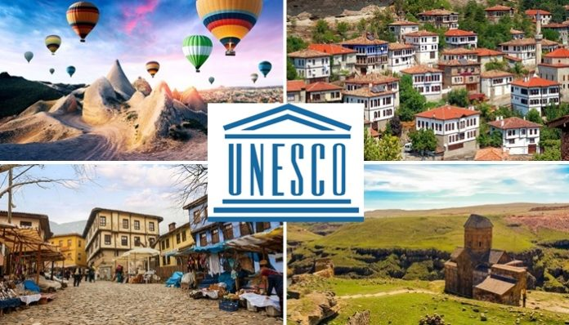
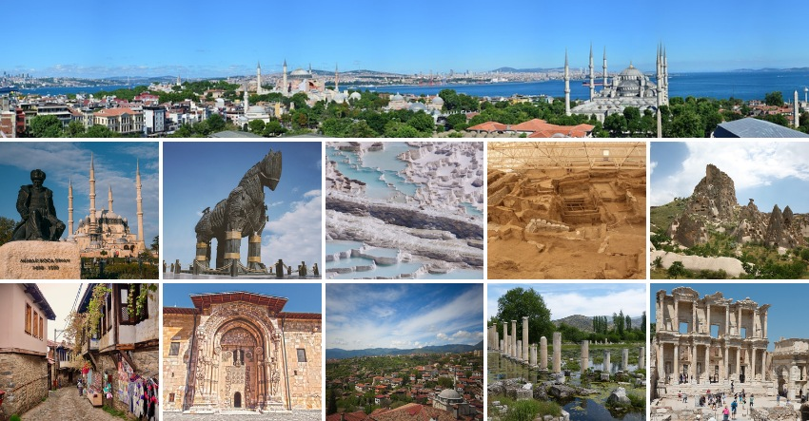
Türkiye has 22 elements on the World Heritage List and 79 on the Tentative List.

Slide 8
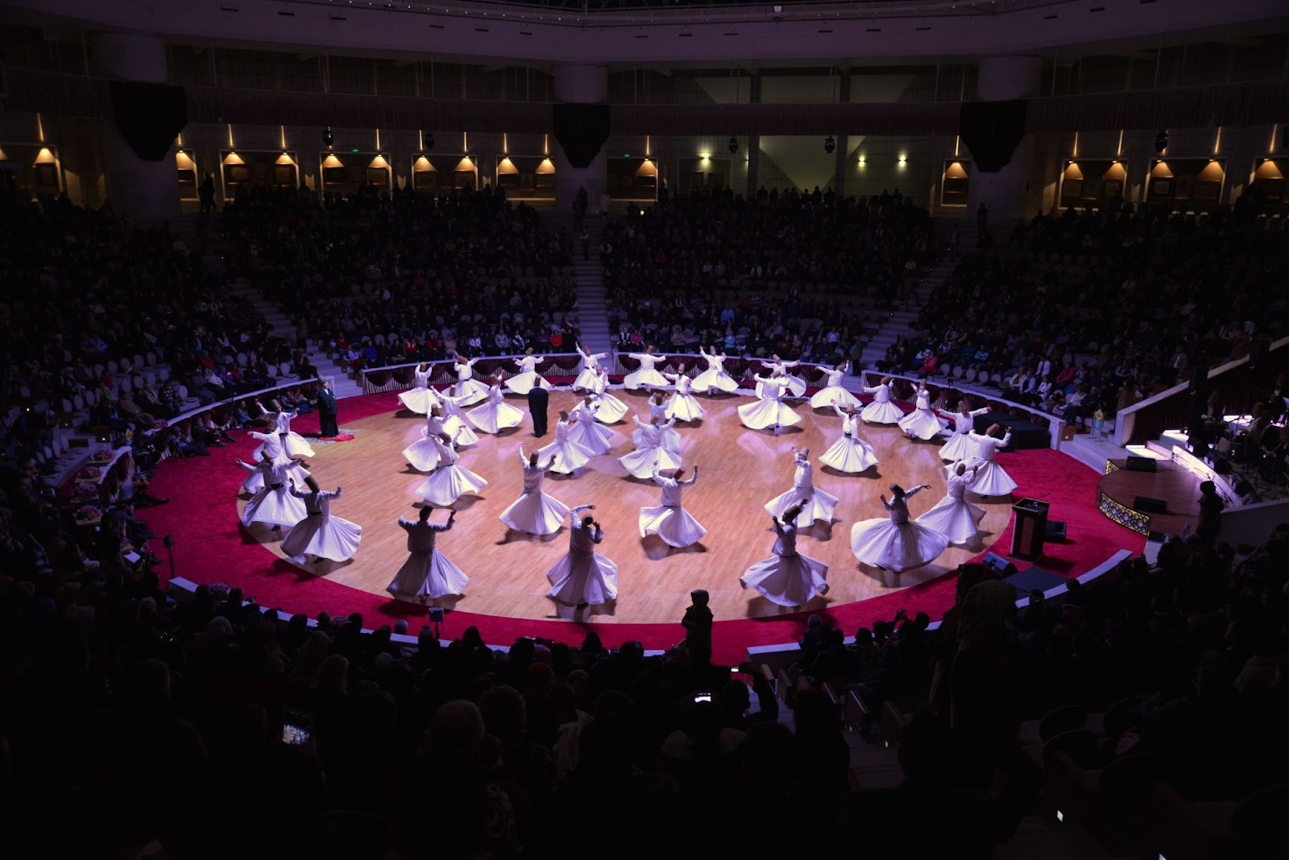
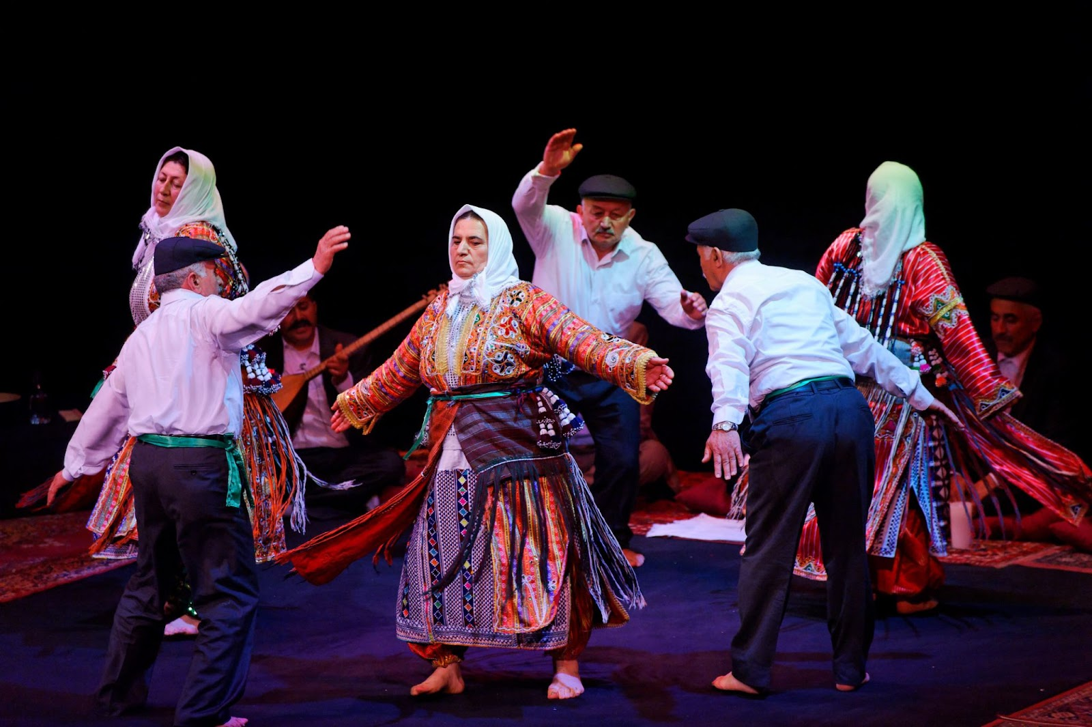

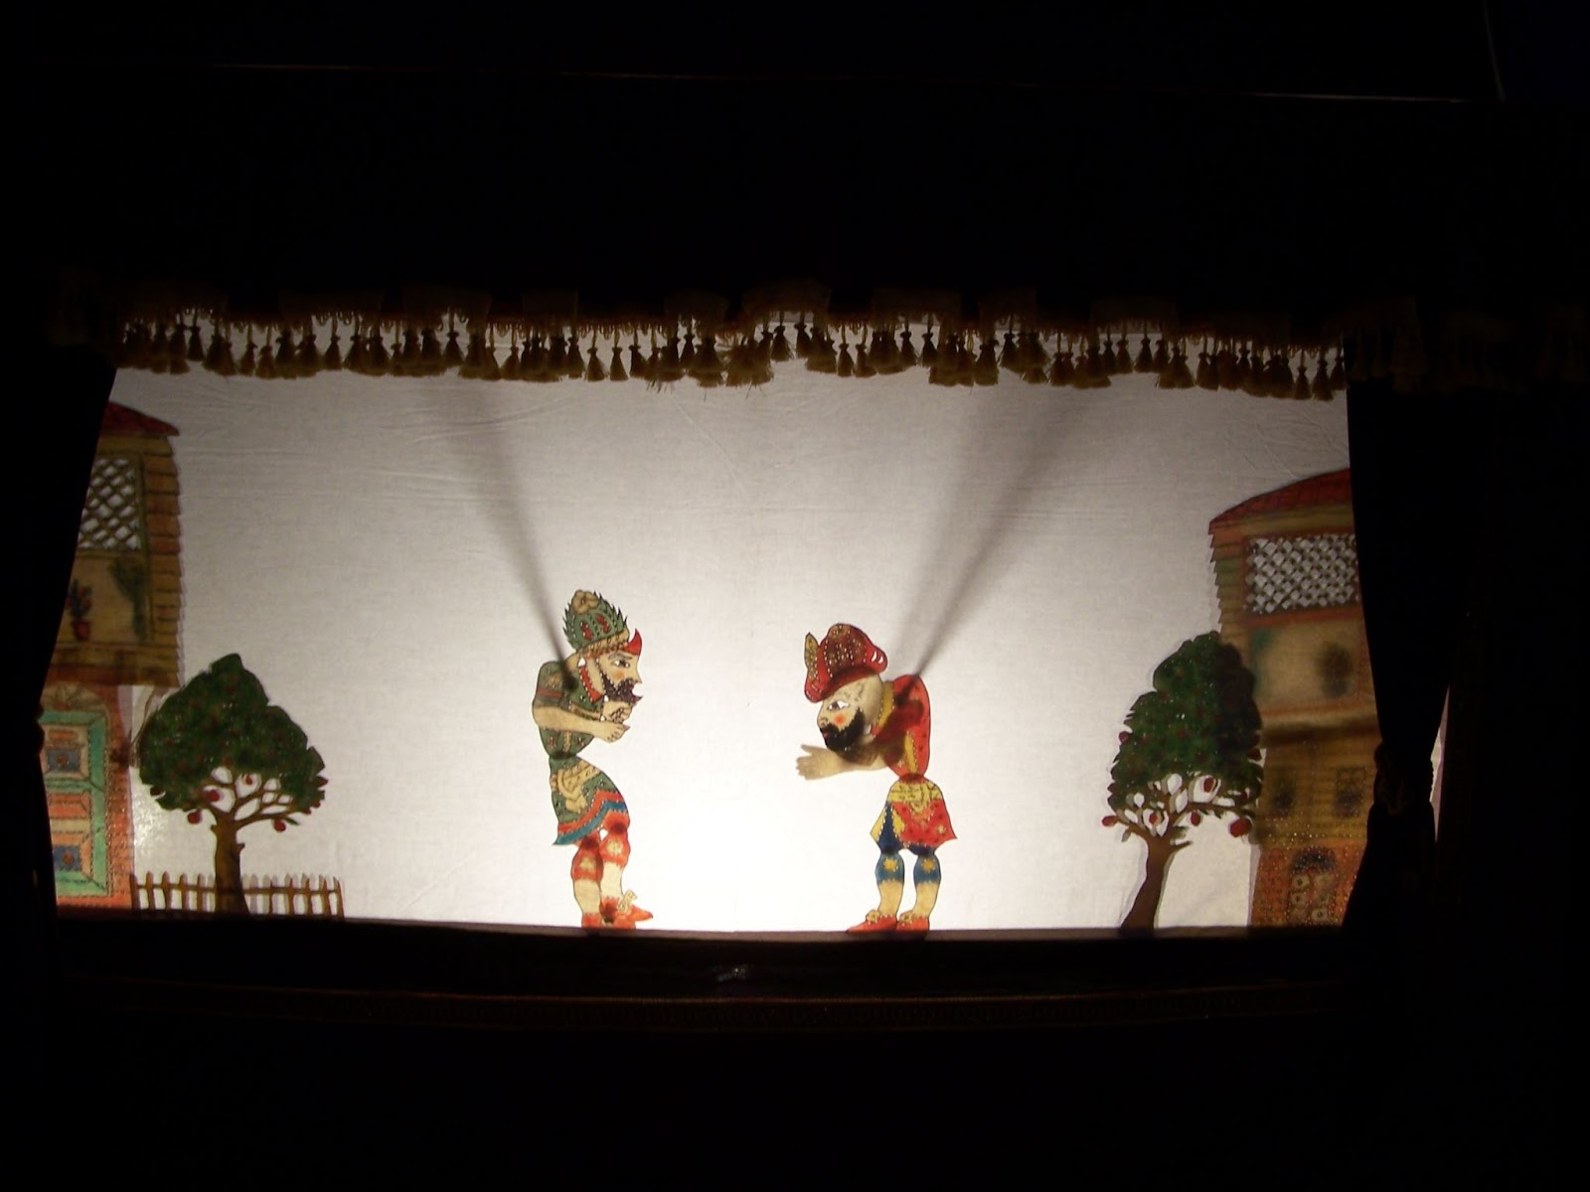
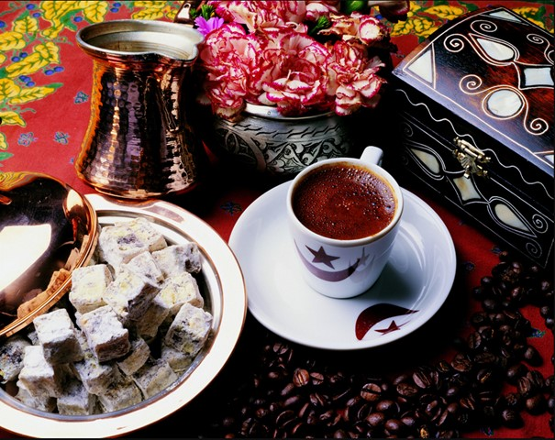
Türkiye has 31 elements on the Lists of Intangible Cultural Heritage. Representative List of the Intangible Cultural Heritage of Humanity, List of Intangible Cultural Heritage in Need of Urgent Safeguarding

Slide 9
PRESERVING EUROPEAN RURAL CULTURE AND HERITAGE
IMPROVING THE QUALITY AND SUSTAINABILITY OF HERITAGE TOURISM IN OIC COUNTRIES
THE 25th MEETING OF THE COMCEC TOURISM WORKING GROUP
CULTURAL
NATURAL
TANGIBLE
INTANGIBLE
HERITAGE
THE 1972 UNESCO CONVENTION CONCERNING THE PROTECTION OF THE WORLD CULTURAL AND NATURAL HERITAGE
HOLISTIC CONSERVATION, SUSTAINABILITY AND TOURISMT
CULTURAL HERITAGE
THE 2003 UNESCO CONVENTION FOR THE SAFEGUARDING OF THE INTANGIBLE CULTURAL HERITAGE
Notes:
In short, the definition of heritage has evolved from cultural and natural heritage to tangible and intangible heritage from the 72nd(seventytwo) Convention to the 2003(twothousandthree) Convention.

Slide 10
PRESERVING EUROPEAN RURAL CULTURE AND HERITAGE
IMPROVING THE QUALITY AND SUSTAINABILITY OF HERITAGE TOURISM IN OIC COUNTRIES
THE 25th MEETING OF THE COMCEC TOURISM WORKING GROUP
HISTORIC ENVIRONMENTS
LIVING COMPLEX ORGANISMS- ENTITIES
UNDERSTANDING WHOLE= UNDERSTANDING COMPONENTS
ENTITY OF TANGIBLE AND INTANGIBLE VALUES
HISTORIC ENVIRONMENTS
HOLISTIC CONSERVATION, SUSTAINABILITY AND TOURISMT
KURAMSAL ÇERÇEVE
HOLISTIC CONSERVATION
BÜTÜNCÜL KORUMA
Notes:
Historical environments, which can be considered as living complex organisms, can be defined as a whole consisting of the interrelations of tangible and intangible values.

Slide 11
PRESERVING EUROPEAN RURAL CULTURE AND HERITAGE
IMPROVING THE QUALITY AND SUSTAINABILITY OF HERITAGE TOURISM IN OIC COUNTRIES
THE 25th MEETING OF THE COMCEC TOURISM WORKING GROUP
TANGIBLE VALUES
INTANGIBLE VALUES
NATURAL STRUCTURE
BUILT ENVIRONMENT
CULTURAL PRACTICES
CULTURAL EXPRESSIONS
HOLISTIC CONSERVATION, SUSTAINABILITY AND TOURISMT
KURAMSAL ÇERÇEVE
HISTORIC ENVIRONMENTS
HOLISTIC CONSERVATION
BÜTÜNCÜL KORUMA
PRODUCTS OF INTERRELATIONS OF TANGIBLE AND INTANGIBLE VALUES
Notes:
While the tangible values ​ consist of natural structures and built environments, intangible values ​​include cultural practices and cultural expressions.

Slide 12
PRESERVING EUROPEAN RURAL CULTURE AND HERITAGE
IMPROVING THE QUALITY AND SUSTAINABILITY OF HERITAGE TOURISM IN OIC COUNTRIES
THE 25th MEETING OF THE COMCEC TOURISM WORKING GROUP
INTERRELATIONS
TANGIBLE AND INTANGIBLE VALUES
UNDERSTANDING
EVALUATING
INTERPRETING
SUSTAINING
HOLISTIC CONSERVATION
HOLISTIC CONSERVATION, SUSTAINABILITY AND TOURISMT
DEĞERLENDİRME
Notes:
Holistic conservation is a complex process based on understanding, evaluating, interpreting and sustaining the interactions of these values.

Slide 13
PRESERVING EUROPEAN RURAL CULTURE AND HERITAGE
IMPROVING THE QUALITY AND SUSTAINABILITY OF HERITAGE TOURISM IN OIC COUNTRIES
THE 25th MEETING OF THE COMCEC TOURISM WORKING GROUP
interrelations | processes
contexts to discuss the relations and change tangible and intangible values
CONSERVATION
a problem of the dissonancy in the handling of two processes
the transmission process of intangible values
the transformation process of historic environments
HOLISTIC CONSERVATION, SUSTAINABILITY AND TOURISMT
Notes:
In holistic approach, the interactions ​​should be evaluated in different processes considering the transmission process of intangible values ​​​​in the transformation process of historical environments.

Slide 14
PRESERVING EUROPEAN RURAL CULTURE AND HERITAGE
IMPROVING THE QUALITY AND SUSTAINABILITY OF HERITAGE TOURISM IN OIC COUNTRIES
THE 25th MEETING OF THE COMCEC TOURISM WORKING GROUP
SUSTAINABLE DEVELOPMENT
«a development that meets the needs of the present generation without compromising the abilities of future generations to meet their own needs»(United Nations World Commission on Environment and Development in 1987)
«the importance of cultural diversity and the need for a more holistic and integrated approach to sustainable development ” (Hangzhou Declaration )
HOLISTIC CONSERVATION, SUSTAINABILITY AND TOURISMT
Notes:
The term „sustainable development‟ is defined as “a development that meets the
needs of the present generation without compromising the abilities of future generations
to meet their own needs” by the United Nations World Commission on Environment
and Development in 1987 (nineteeneightyseven). In Hangzhou Declaration issued, the importance of cultural diversity and the need for a more holistic and integrated approach to sustainable development were emphasized.

Slide 15
PRESERVING EUROPEAN RURAL CULTURE AND HERITAGE
IMPROVING THE QUALITY AND SUSTAINABILITY OF HERITAGE TOURISM IN OIC COUNTRIES
THE 25th MEETING OF THE COMCEC TOURISM WORKING GROUP
ASPECTS OF SUSTAINABILITY
environmental | socio-cultural | socio-economic
to respect nature, to benefit of natural and climatic resources, to reduce pollution and waste materials, to contribute to human health and welfare and to reduce natural hazards effects | the cultural landscape, to transfer construction cultures, to enhance creativity, to recognize intangible values, to encourage social cohesion | support autonomy, to promote local activities, to optimize construction efforts, to extend building's lifetime, to save resources
HOLISTIC CONSERVATION, SUSTAINABILITY AND TOURISMT
VERSUS Project (Correia et al., 2014: 26).

Slide 16
PRESERVING EUROPEAN RURAL CULTURE AND HERITAGE
IMPROVING THE QUALITY AND SUSTAINABILITY OF HERITAGE TOURISM IN OIC COUNTRIES
THE 25th MEETING OF THE COMCEC TOURISM WORKING GROUP
SUSTAINABLE DEVELOPMENT-CULTURE
CULTURE| a significant issue in sustainable development (UNESCO, 2015)
INTANGIBLE CULTURAL HERITAGE as a mainspring of cultural diversity and a guarantee of sustainable development
THE CONSERVATION OF CULTURAL HERITAGE
a significant issue in sustainable development
the reuse of historic buildings,
revitalization of historic environments,
the increase in the number of the restored buildings increasing property values,
the creation of jobs related to local building craftsmanship
the creation of jobs related to tourism
HOLISTIC CONSERVATION, SUSTAINABILITY AND TOURISMT
Notes:
UNESCO underlines that culture needs to be considered as a significant issue in
sustainable development. UNESCO Conventions, have underscored the importance of intangible cultural heritage as a mainspring of cultural diversity and a guarantee of sustainable development.

Slide 17
PRESERVING EUROPEAN RURAL CULTURE AND HERITAGE
IMPROVING THE QUALITY AND SUSTAINABILITY OF HERITAGE TOURISM IN OIC COUNTRIES
THE 25th MEETING OF THE COMCEC TOURISM WORKING GROUP
International Documents on Conservation of Traditional Craftsmanship
TRADITIONAL CRAFTSMANSHIPS
A DOMAIN INTANGIBLE CULTURAL HERITAGE REFLECTS
HOLISTIC CONSERVATION, SUSTAINABILITY AND TOURISMT
UNESCO Convention for the Safeguarding of the Intangible Cultural Heritage, 2003
THE CONSERVATION OF TRADITIONAL CRAFTSMANSHIP
ACCURATE DOCUMENTATION
THE CONTINUITY OF PRACTICE
TRANSMISSION BETWEEN GENERATIONS
Notes:
“Traditional craftsmanship” is determined as one of the domains in which intangible cultural heritage. its conservation necessitates accurate documentation, the continuity of practice and its transmission between generations.

Slide 18
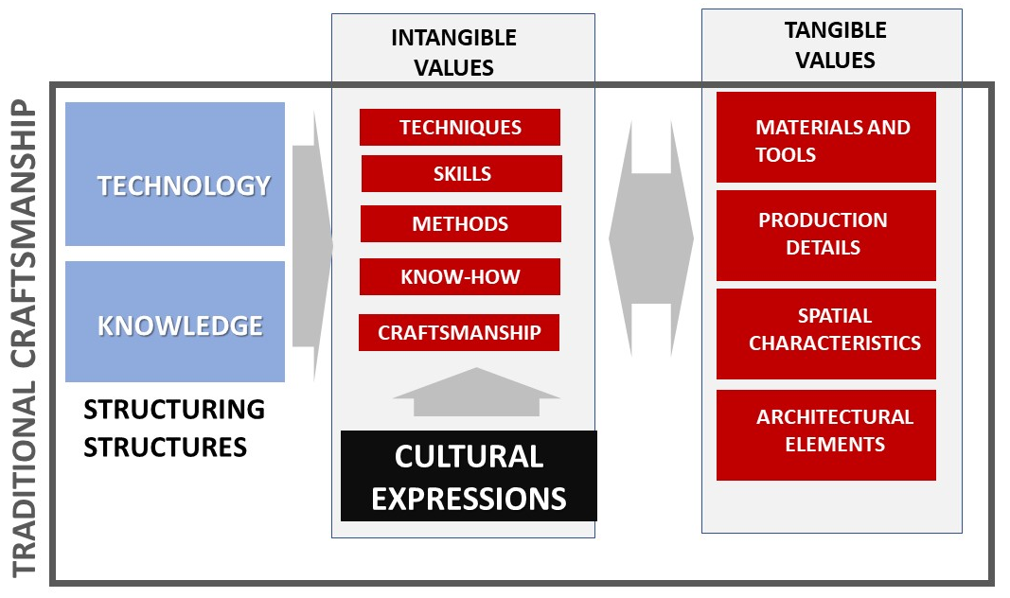
PRESERVING EUROPEAN RURAL CULTURE AND HERITAGE
IMPROVING THE QUALITY AND SUSTAINABILITY OF HERITAGE TOURISM IN OIC COUNTRIES
THE 25th MEETING OF THE COMCEC TOURISM WORKING GROUP
    HOLISTIC APPROACH ON TRADITIONAL CRAFTSMANSHIP
HOLISTIC CONSERVATION, SUSTAINABILITY AND TOURISMT
KARAKUL, Ö., 2022, Traditional Craftsmanship in Architecture, Conservation and Technology, Craft, Technology and Design, Tarkko Oksala, Tufan Orel, Arto Mutanen, Mervi Friman, Jaana Lamberg & Merja Hintsa (Eds.), Häme University of Applied Sciences.
Notes:
This graphic shows the tangible and intangible value components and interactions of traditional crafts within the framework of a holistic approach.

Slide 19
PRESERVING EUROPEAN RURAL CULTURE AND HERITAGE
IMPROVING THE QUALITY AND SUSTAINABILITY OF HERITAGE TOURISM IN OIC COUNTRIES
THE 25th MEETING OF THE COMCEC TOURISM WORKING GROUP
SUSTAINABILITY-TRADITIONAL CRAFTSMANSHIP
AUTHENTICITY | learning process, production process, materials, design, people and place” (ICCROM, 2004, 22).
CREATIVITY| the learning process of know-how and traditional methods in crafts by master-apprentice relationship and evaluating the traditional learning process of crafts as a source of inspiration through the production of new in the present (ICCROM, 2004, 24).
HOLISTIC CONSERVATION, SUSTAINABILITY AND TOURISMT
Notes:
The most significant qualities to be considered for sustainability is the “authenticity” and
“creativity” in interrelations between tangible and intangible values.

Slide 20
PRESERVING EUROPEAN RURAL CULTURE AND HERITAGE
IMPROVING THE QUALITY AND SUSTAINABILITY OF HERITAGE TOURISM IN OIC COUNTRIES
THE 25th MEETING OF THE COMCEC TOURISM WORKING GROUP
TRADITIONAL CRAFTSMANSHIPS
the product of a complex process through which craftsmen use their skills and know-how and express their creativity
Traditional craftsmanship related to building culture| Building Crafts | stone masonry, timber frame system, mud-brick masonry, stone, wood, metal, glazed tile, glass, wall painting craftsmanship
Traditional craftsmanship related to living culture | stone, wood, metal, glazed tile, glass craftsmanship, carpet-making, rug-making, cloth-weaving, writing, tile-making, ceramics and pottery, embroidery, leather manufacture, musical instrument-making, copper work, basket-making, felt-making, weaving
HOLISTIC CONSERVATION, SUSTAINABILITY AND TOURISMT
Notes:
Traditional craftsmanship can mainly be grouped into two: one related to building culture and related to living culture.

Slide 21
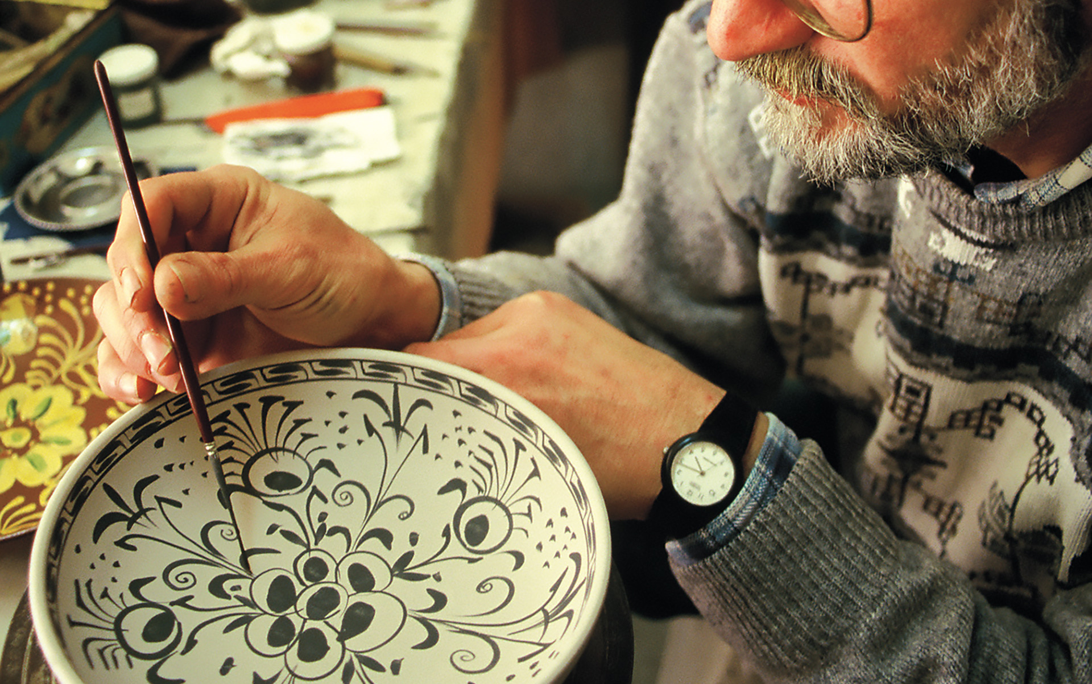
PRESERVING EUROPEAN RURAL CULTURE AND HERITAGE
IMPROVING THE QUALITY AND SUSTAINABILITY OF HERITAGE TOURISM IN OIC COUNTRIES
THE 25th MEETING OF THE COMCEC TOURISM WORKING GROUP
HOLISTIC CONSERVATION, SUSTAINABILITY AND TOURISMT
Traditional craftsmanship of glazed tile- Çini making
Notes:
In this slide you see the work of a glazed-tile craftsman.

Slide 22
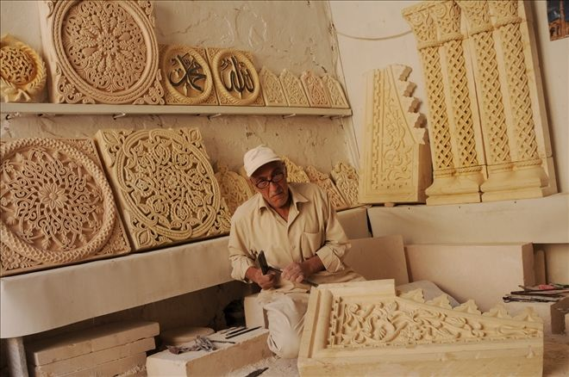
PRESERVING EUROPEAN RURAL CULTURE AND HERITAGE
IMPROVING THE QUALITY AND SUSTAINABILITY OF HERITAGE TOURISM IN OIC COUNTRIES
THE 25th MEETING OF THE COMCEC TOURISM WORKING GROUP
HOLISTIC CONSERVATION, SUSTAINABILITY AND TOURISMT
Traditional stone craftsmanship in Mardin
Notes:
In this slide you see the work of a traditional stone craftsman.

Slide 23
PRESERVING EUROPEAN RURAL CULTURE AND HERITAGE
IMPROVING THE QUALITY AND SUSTAINABILITY OF HERITAGE TOURISM IN OIC COUNTRIES
THE 25th MEETING OF THE COMCEC TOURISM WORKING GROUP
  TRANSFORMATION PROCESS- TRADITIONAL CRAFTSMANSHIP
tourism
migration
the rising technological, economic and cultural interactions
TRANSFORMATION PROCESS OF HISTORIC ENVIRONMENTS
HOLISTIC CONSERVATION, SUSTAINABILITY AND TOURISMT
CHANGE İN LIVING CULTURE | the cultural practices and their relations with tangible features, mainly, spatial characteristics and architectural elements and the related furniture and craft products used in daily life.
CHANGE IN BUILDING CULTURE, technology, knowledge | the implementation process of traditional building crafts, particularly, know-how, skills, tools and materials used
Notes:
Interrelations between values in living and building culture have considerably changed under the effects of tourism, migration throughout the transformation process of historic environments.

Slide 24
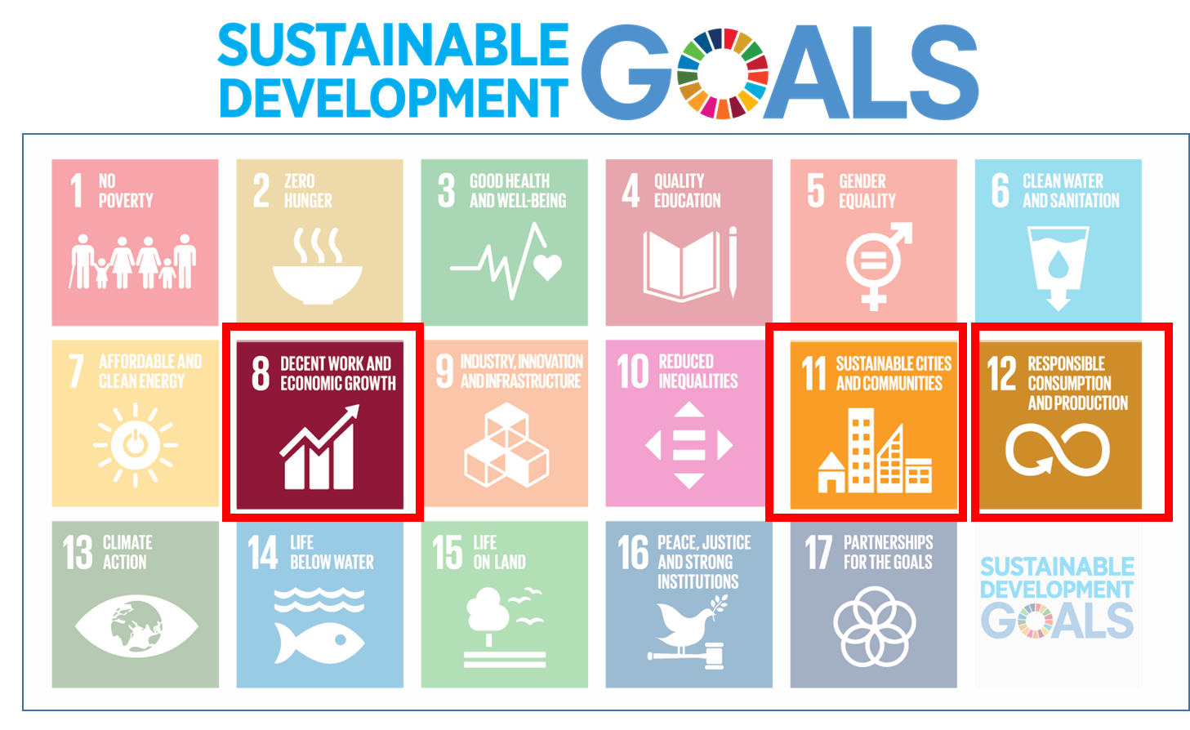
PRESERVING EUROPEAN RURAL CULTURE AND HERITAGE
IMPROVING THE QUALITY AND SUSTAINABILITY OF HERITAGE TOURISM IN OIC COUNTRIES
THE 25th MEETING OF THE COMCEC TOURISM WORKING GROUP
  SUSTAINABLE DEVELOPMENT- CONSERVATION OF TRADITIONAL CRAFTSMANSHIP
GOAL 8 | “promote sustained, inclusive and sustainable economic growth full and productive employment and decent work for all”,
GOAL 11 | “make cities and human settlements inclusive, safe, resilient and sustainable”,
GOAL 12| “ensure sustainable consumption and production patterns”,
HOLISTIC CONSERVATION, SUSTAINABILITY AND TOURISMT
THE CONTINUITY OF LOCAL BUILDING TRADITION AND CRAFT PRODUCTION PROCESS|
sustainable development in historic environments throughout the rapid change process and the development of tourism.
Notes:
Considering Sustainable Development goals with the traditional craftsmanship, the continuity of local building tradition is especially significant for providing sustainable development in historic environments throughout the rapid change process.

Slide 25
PRESERVING EUROPEAN RURAL CULTURE AND HERITAGE
IMPROVING THE QUALITY AND SUSTAINABILITY OF HERITAGE TOURISM IN OIC COUNTRIES
THE 25th MEETING OF THE COMCEC TOURISM WORKING GROUP
INTANGIBLE CULTURAL HERITAGE- SUSTAINABLE DEVELOPMENT
UNESCO (2015). Intangible Cultural Heritage and Sustainable Development, Kit of the Convention for the Safeguarding of the Intangible Cultural Heritage
SUSTAINABLE DEVELOPMENT | INCLUSIVE ECONOMIC DEVELOPMENT
TRADITIONAL CRAFTSMANSHIP| A Critical Role For Providing The Economic Development In Historic Environments within The Developments of Tourism.
CULTURAL TOURISM| regenerate local cultural practices and traditional craftsmanship according to the needs of tourists.
HOLISTIC CONSERVATION, SUSTAINABILITY AND TOURISMT
Notes:
Focusing on traditional craftsmanship as emphasized within the UNESCO Kit in 2015 (two thousand fifteen) sustainable development depends on inclusive economic development, and traditional craftsmanship gains a critical role.

Slide 26
PRESERVING EUROPEAN RURAL CULTURE AND HERITAGE
IMPROVING THE QUALITY AND SUSTAINABILITY OF HERITAGE TOURISM IN OIC COUNTRIES
THE 25th MEETING OF THE COMCEC TOURISM WORKING GROUP
HOLISTIC CONSERVATION| TOURISM
Tourism creates new cultural, technological, and economic interactions in historical environments, leading to significant changes in the lifestyle and value systems of local communities.
Most residents prefer to engage in tourism-related activities, which they see as a new source of livelihood, thereby abandoning some cultural practices they have traditionally maintained.
While tourism promotes awareness of the need to protect the physical environment and structures among local communities, it also leads to changes and disruptions in lifestyles, value systems, and the practice of local cultural traditions.
For the proper management and sustainability of tourism, it is important to develop comprehensive approaches to the protection of tangible and intangible cultural heritage.
In this context, it is important to document and protect structures and environments, along with the cultural practices and narratives they contain, taking into account their authenticity and integrity.
HOLISTIC CONSERVATION, SUSTAINABILITY AND TOURISMT
Notes:
Here, you see some issues related to the relations between holistic conservation and tourism.

Slide 27
PRESERVING EUROPEAN RURAL CULTURE AND HERITAGE
IMPROVING THE QUALITY AND SUSTAINABILITY OF HERITAGE TOURISM IN OIC COUNTRIES
THE 25th MEETING OF THE COMCEC TOURISM WORKING GROUP
HOLISTIC CONSERVATION
Mutual interactions between tangible and intangible heritage elements in historic environments
DOCUMENTATION-UNDERSTANDING-EVALUATION-SUSTAINABILITY
MANAGEMENT OF TOURISM IN HISTORIC ENVIRONMENT
Evaluation and control of effects of tourism on holistic conservation
HOLISTIC CONSERVATION, SUSTAINABILITY AND TOURISMT
GİRİŞ
Notes:
Management of tourism need to evaluate and control of tourism on holistic conservation.

Slide 28
PRESERVING EUROPEAN RURAL CULTURE AND HERITAGE
IMPROVING THE QUALITY AND SUSTAINABILITY OF HERITAGE TOURISM IN OIC COUNTRIES
THE 25th MEETING OF THE COMCEC TOURISM WORKING GROUP
  EFFECTS OF TOURISM ON TRADITIONAL CRAFTSMANSHIP AND SUSTAINABLE DEVELOPMENT
THE ACCURATE MANAGEMENT OF TOURISM | to contribute cultural, economic and environmental dimensions of sustainable development (UNITED NATIONS, 2012).
the importance of the promotion of investment in especially sustainable tourism, specifically, ecotourism and cultural tourism
inclusive economic development and job opportunities for local people, creating small medium-sized enterprises
the significance of the integrated and holistic approaches to planning and building activities including the participation of local people in decision-making, supporting local authorities
HOLISTIC CONSERVATION, SUSTAINABILITY AND TOURISMT
Notes:
Here you see effects of tourism on traditional craftsmanship and sustainable development.

Slide 29
PRESERVING EUROPEAN RURAL CULTURE AND HERITAGE
IMPROVING THE QUALITY AND SUSTAINABILITY OF HERITAGE TOURISM IN OIC COUNTRIES
THE 25th MEETING OF THE COMCEC TOURISM WORKING GROUP
INTANGIBLE CULTURAL HERITAGE- SUSTAINABLE DEVELOPMENT | UNESCO, 2015
SUSTAINABLE DEVELOPMENT | INCLUSIVE ECONOMIC DEVELOPMENT
TRADITIONAL CRAFTSMANSHIP| A Critical Role For Providing The Economic Development In Historic Environments within The Developments of Tourism.
CULTURAL TOURISM| regenerate local cultural practices and traditional craftsmanship according to the needs of tourists.
HOLISTIC CONSERVATION, SUSTAINABILITY AND TOURISMT

Slide 30
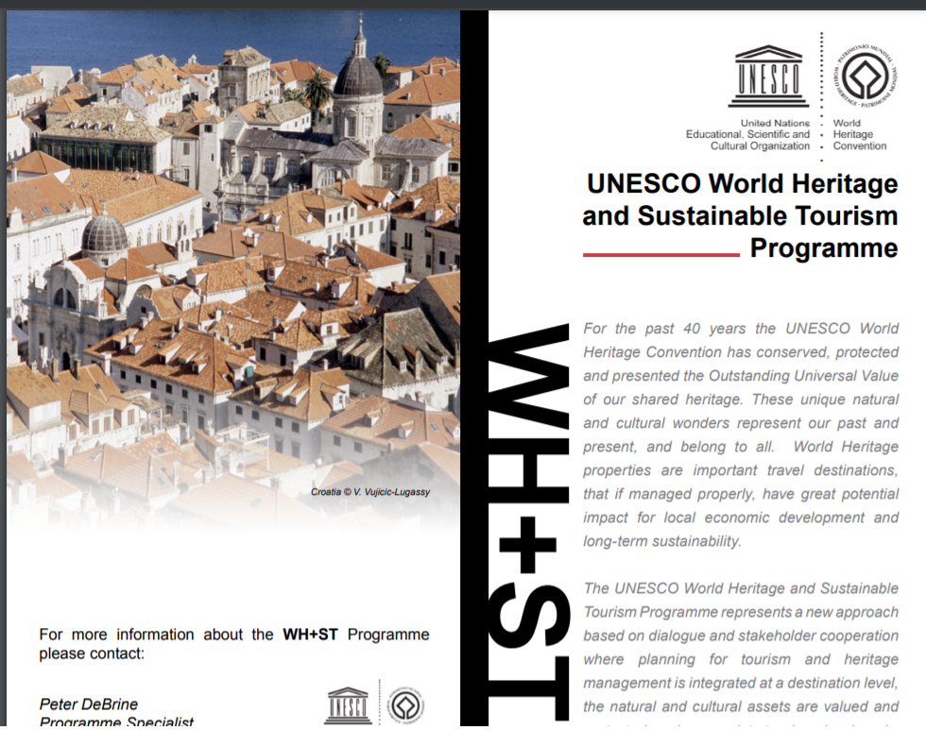
PRESERVING EUROPEAN RURAL CULTURE AND HERITAGE
IMPROVING THE QUALITY AND SUSTAINABILITY OF HERITAGE TOURISM IN OIC COUNTRIES
THE 25th MEETING OF THE COMCEC TOURISM WORKING GROUP
HOLISTIC CONSERVATION, SUSTAINABILITY AND TOURISMT
The UNESCO World Heritage and Sustainable Tourism Programme represents a new approach based on dialogue and stakeholder cooperation where planning for tourism and heritage management is integrated at a destination level, the natural and cultural assets are valued and protected, and appropriate tourism developed.
https://whc.unesco.org/uploads/activities/documents/activity-669-7.pdf
Notes:
I would like to tell you about UNESCO's tourism and cultural heritage programs.

Slide 31
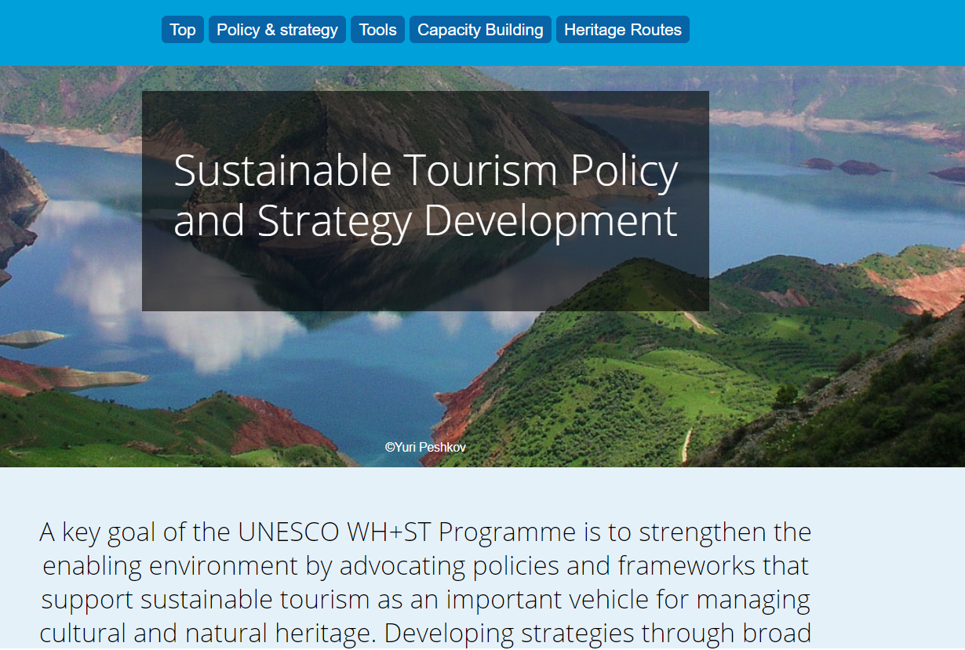
PRESERVING EUROPEAN RURAL CULTURE AND HERITAGE
IMPROVING THE QUALITY AND SUSTAINABILITY OF HERITAGE TOURISM IN OIC COUNTRIES
THE 25th MEETING OF THE COMCEC TOURISM WORKING GROUP
UNESCO WORLD HERITAGE Sustainable Tourism Policy and Strategy Development
A key goal of the UNESCO WH+ST Programme is to strengthen the enabling environment by advocating policies and frameworks that support sustainable tourism as an important vehicle for managing cultural and natural heritage. Developing strategies through broad stakeholder engagement for the planning, development and management of sustainable tourism that follows a destination approach and focuses on empowering local communities is central to UNESCO’s approach.
HOLISTIC CONSERVATION, SUSTAINABILITY AND TOURISMT
https://whc.unesco.org/en/tourism/

Slide 32
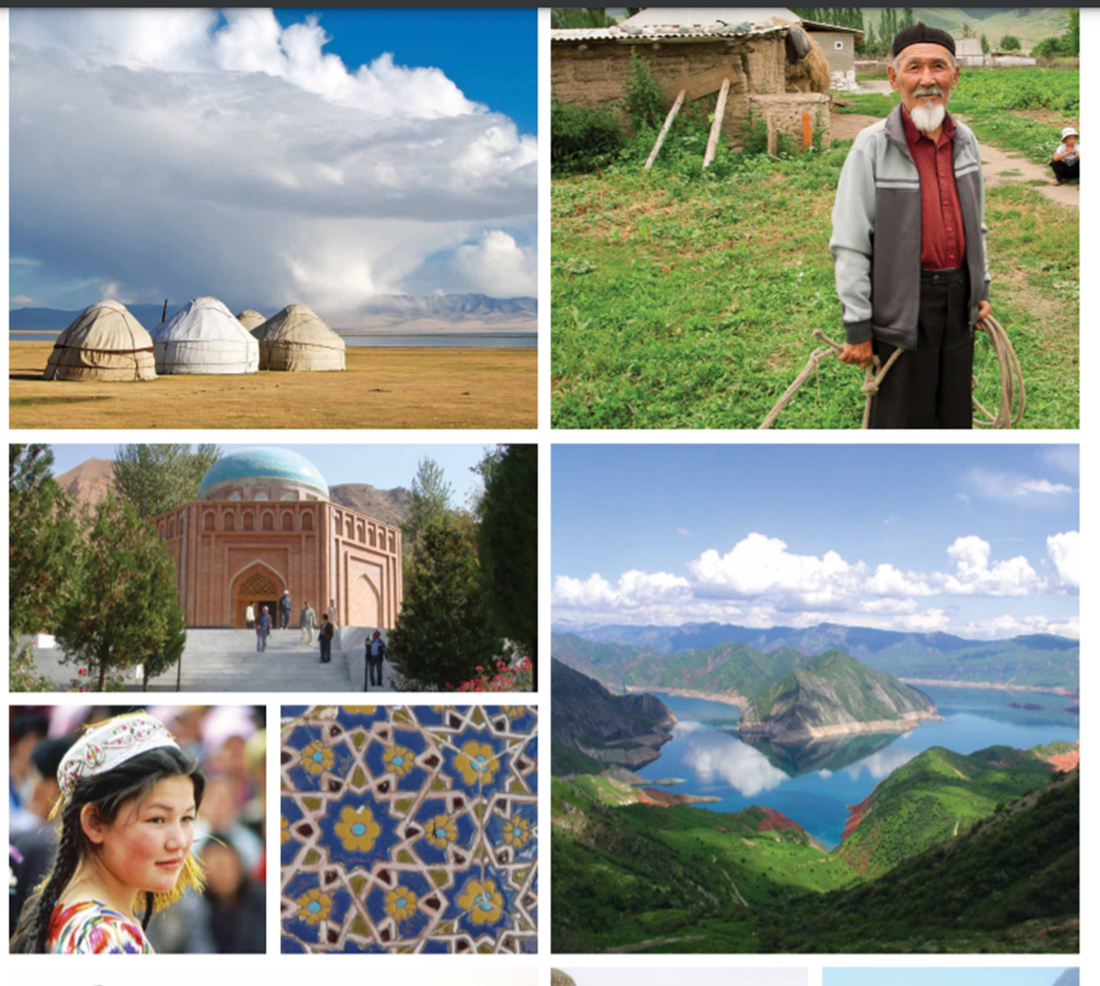
PRESERVING EUROPEAN RURAL CULTURE AND HERITAGE
IMPROVING THE QUALITY AND SUSTAINABILITY OF HERITAGE TOURISM IN OIC COUNTRIES
THE 25th MEETING OF THE COMCEC TOURISM WORKING GROUP
The Silk Road Heritage Corridors Project
Acclaimed as the ‘greatest route in the history of mankind’, the ancient Silk Road formed the first bridge between the East and the West and was an important vehicle for trade between the ancient empires of China, Central and Western Asia, the Indian sub-continent, and Rome. The Silk Road was more than just trade routes, it symbolised the multiple benefits arising from cultural exchange. As a result, countless historic and cultural sites remain along the network of famous routes.
Today these routes, or ‘heritage corridors’ as they have been identified by the United Nations Educational, Scientific and Cultural Organization (UNESCO), have the potential to offer economic benefits to local communities and cross cultural exchange through tourism development. The Silk Road’s exceptional cultural and living heritage creates incredible opportunities for tourism.
HOLISTIC CONSERVATION, SUSTAINABILITY AND TOURISMT
In recent years a team of experts at UNESCO, ICOMOS and UCL, have conducted ground-breaking research into the Silk Road’s sites and routes as part of the transnational Silk Roads World Heritage Serial Nomination project.

Slide 33
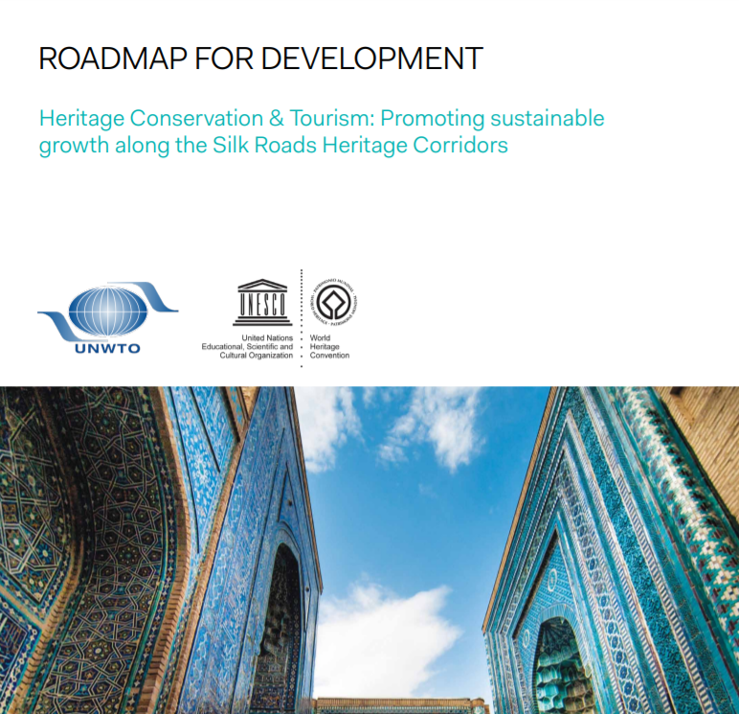
PRESERVING EUROPEAN RURAL CULTURE AND HERITAGE
IMPROVING THE QUALITY AND SUSTAINABILITY OF HERITAGE TOURISM IN OIC COUNTRIES
THE 25th MEETING OF THE COMCEC TOURISM WORKING GROUP
Heritage Conservation & Tourism: Promoting sustainable growth along the Silk Roads Heritage Corridors
Heritage Conservation & Tourism: Promoting sustainable growth along the Silk Roads Heritage Corridors
This Roadmap lays the foundation for developing a comprehensive and sustainable Silk Roads Heritage Corridors Tourism Strategy. It focuses on two heritage corridors crossing five countries: China, Kazakhstan, Kyrgyzstan, Tajikistan and Uzbekistan, which form the basis of a serial nomination that will be considered for inscription to the UNESCO World Heritage List in 2014. The strategy addresses the overarching principles of sustainable growth, community development, heritage management and conservation.
HOLISTIC CONSERVATION, SUSTAINABILITY AND TOURISMT

Slide 34
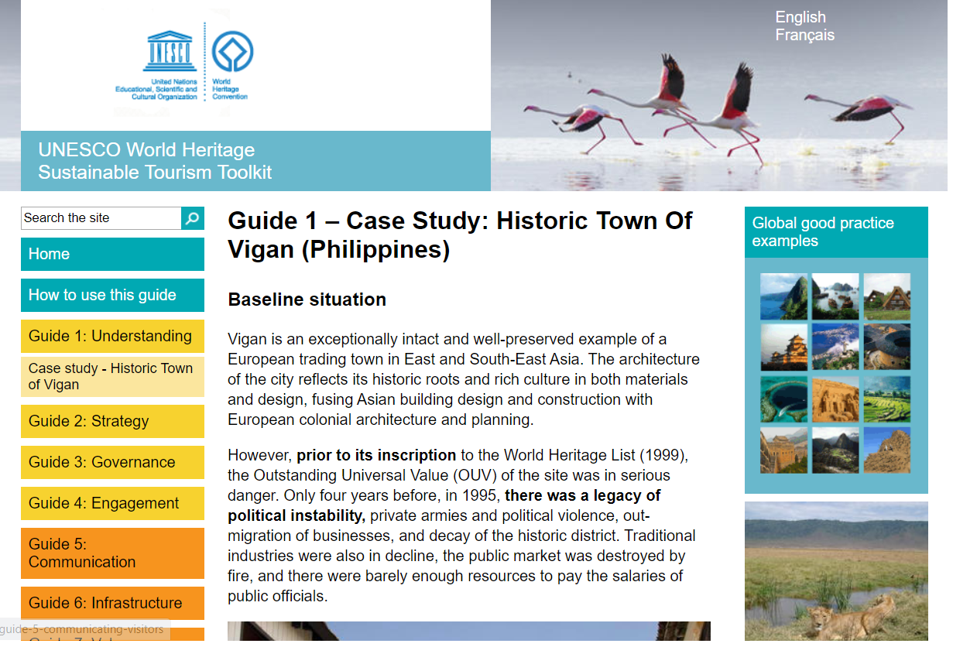
PRESERVING EUROPEAN RURAL CULTURE AND HERITAGE
IMPROVING THE QUALITY AND SUSTAINABILITY OF HERITAGE TOURISM IN OIC COUNTRIES
THE 25th MEETING OF THE COMCEC TOURISM WORKING GROUP
Sustainable Tourism Toolkit
UNESCO World Heritage
Sustainable planning and management of tourism is one of the most pressing challenges concerning the future of the World Heritage Convention today and is the focus of the UNESCO World Heritage and Sustainable Tourism Programme.
These 'How To' guides for World Heritage Site managers and other key stakeholders will enable a growing number of World Heritage Site communities to make positive changes to the way they pro-actively manage tourism.
HOLISTIC CONSERVATION, SUSTAINABILITY AND TOURISMT
http://whc.unesco.org/sustainabletourismtoolkit/how-use-guide

Slide 35
PRESERVING EUROPEAN RURAL CULTURE AND HERITAGE
IMPROVING THE QUALITY AND SUSTAINABILITY OF HERITAGE TOURISM IN OIC COUNTRIES
THE 25th MEETING OF THE COMCEC TOURISM WORKING GROUP
FOLKLORIZATION-DECONTEXTUALIZATION-INTANGIBLE CULTURAL HERITAGE
UNESCO's primary concern is that new forms do not violate the integrity of the original “pure” and “authentic” intangible cultural heritage context. The UNESCO report from the Vietnam meeting refers to this as the problem of decontextualization (UNESCO and EHHCAP, 2008).
Tourism can change both the context and the content of tradition.Hmong traditional clothing is being altered to meet tourists' expectations.
Tourists' desires are prioritized over the needs of the Hmong people.A step further is the staging of traditions for tourists.
In tourism research literature, this is called “staged authenticity” (MacCannell, 1973).In some parts of India, ceremonies where local couples marry more than thirty times just for tourists | commercialization
HOLISTIC CONSERVATION, SUSTAINABILITY AND TOURISMT
Notes:
Here I would like to talk about decontextualization, which is an important problem in the relationship between tourism and intangible cultural heritage.

Slide 36
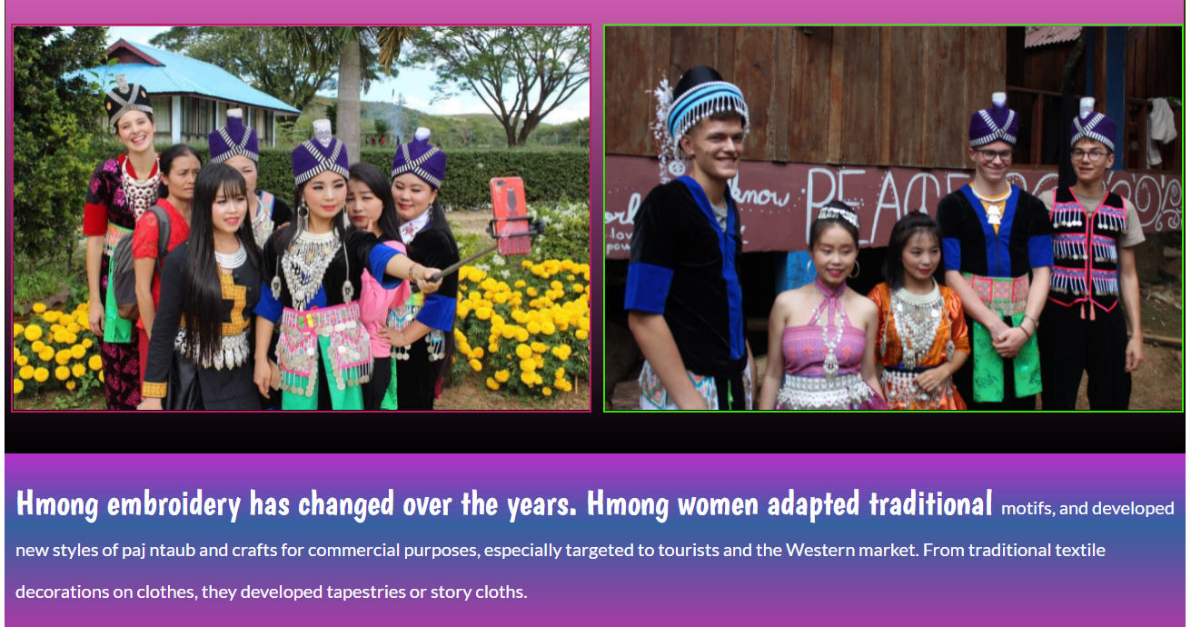
Notes:
55 / 5.000
local people wear traditional clothes for tourists

Slide 37
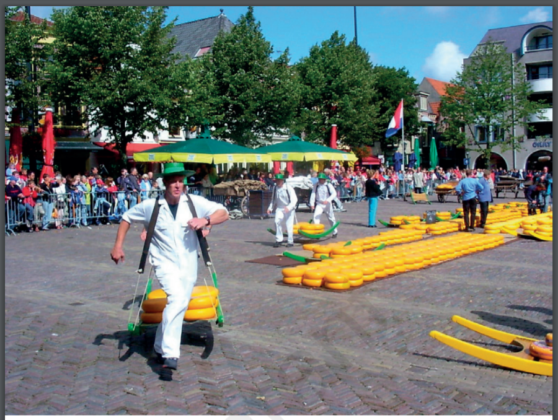
Alkmaar'ın peynir pazarı: turistler için kültürel kitle eğlencesi
Notes:
The cheese market is used as an entertainment area for tourists

Slide 38
PRESERVING EUROPEAN RURAL CULTURE AND HERITAGE
IMPROVING THE QUALITY AND SUSTAINABILITY OF HERITAGE TOURISM IN OIC COUNTRIES
THE 25th MEETING OF THE COMCEC TOURISM WORKING GROUP
DISCUSSION AND CONCLUSIONS
    Traditional craftsmanship gains a critical role for providing sustainable development in historic environments concerning the inclusive economic development, sustainable cities, sustainable production patterns
    Traditional craftsmanship is affected positively or negatively with regard to the different management policies of tourism developed by countries directly affecting the sustainable development of historic environments.
    The accurate management of tourism contributes to the sustainable development of environments increasing the implementation of craft products to afford the increasing demand for tourists on traditional craftsmanship.
    Tourism also accelerates the conservation and restoration activities in historic environments providing the continuity of the activities of local building masters using local building materials, techniques and tools and making environments sustainable
    the demand of cultural tourists on handmade products produced by traditional techniques and materials, accelerates the production process of the products of local traditional craftsmanship.
HOLISTIC CONSERVATION, SUSTAINABILITY AND TOURISMT

