Slide 1



Decent Housing for the Poor in the OIC Member Countries
Presented by: Republic of Albania
25th COMCEC Poverty Alleviation Working Group
15–16 September 2025, Ankara

Slide 2
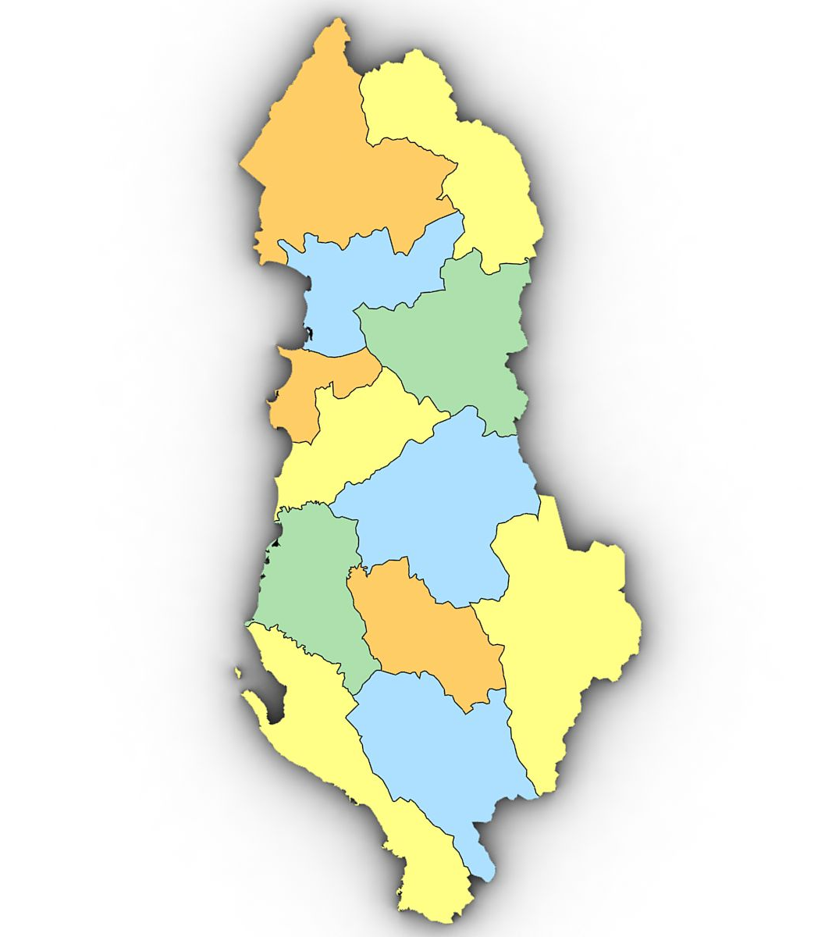
Albania: Population and housing challenges
Population: Around 2.4 million people.
Rural presence: About 35% live in rural areas with limited access to basic services.
Migration trends: Significant movement from rural to urban areas, driven by poor housing and underdeveloped infrastructure in rural regions.
Housing disparities: Clear differences in housing quality between urban and rural areas.
Urban challenges: Population growth pressures leading to informal settlements and housing shortages.
Rural challenges: Depopulation, aging communities, and many homes left uninhabited.

Slide 3
Housing Institutional and strategic framework
Legal & Strategic Framework | Institutional Framework
Law No. 22/2018 on Social Housing – defines programs, eligibility, and responsibilities. | Ministry of Economy, Culture, and Innovation.– leads housing policy for vulnerable groups.
National Housing Strategy (2016–2025) – strategic goals for expanding housing access. | Municipalities – manage social housing registries, construction, allocation, and monitoring
 | Donors & Civil Society – support implementation, outreach, and funding.

Slide 4
Housing programs and instruments
Low-Cost Housing Program (LCH)
Social Rental Housing
Specialized Housing Program
Temporary Shelter Program
Housing Adaptation and Improvement Program
Housing Area Development Program

Slide 5
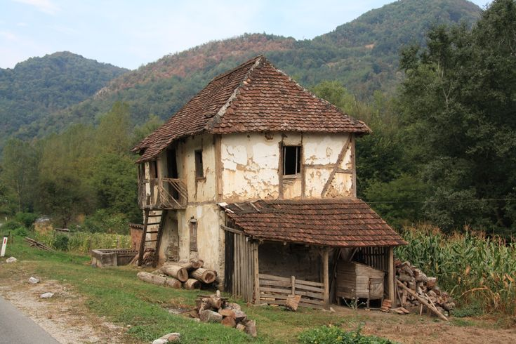
Rural housing challenges
Poor infrastructure in remote areas
Informal housing and lack of ownership titles
Limited local capacity and funding
Aging population and rural emigration

Slide 6
Vulnerable groups supported in Albania
Families living in poverty or extreme poverty, based on verified income thresholds.
Roma and Egyptian minorities, who often face systemic exclusion and housing insecurity.
Female-headed households, especially those with dependent children or without formal employment.
Persons with disabilities, requiring adapted housing solutions and priority allocation.
Orphans and children without parental care, supported through institutional and community-based housing.
Elderly persons without family support, at risk of homelessness or substandard living conditions.

Slide 7

Eligibility criteria for housing support
Access to housing assistance in Albania is regulated by Law No. 22/2018 on Social Housing and supporting municipal regulations. Eligibility is determined based on the following criteria:
Verified low-income status, often assessed through social assistance databases and income declarations.
Lack of adequate housing, including homelessness, unsafe dwellings, or overcrowding.
Belonging to a vulnerable category, as officially recognized by law or municipal policy.
Municipal residency, usually requiring continuous residence for at least one year.
Registration in the Social Housing Registry

Slide 8
National social housing program – achievements & priorities
Key Achievements (2018–2024): Implemented 6 national social housing schemes, creating over 117,800 m² of public social housing stock through municipal transfers or financial equivalent.
Reached 35,800 households (≈ 130,000 individuals): including 22,840 households under social housing and 12,960 under reconstruction programs.
2025 Program Highlights:Covers 1,253 vulnerable families across 35 municipalities,.
Program launched in July–August 2025, with a two-year implementation period. Supports , new social housing units, informal settlement upgrades, and temporary housing installations.

Slide 9
Remaining Challenges:
High demand from vulnerable groups exceeds current supply.
Informal settlements and lack of legal ownership continue to hinder access to housing.
Rural areas face added barriers due to infrastructure and demographic decline.

Slide 10
Future priorities and key measures
Improve coordination between the central government and municipalities to plan, implement, and monitor housing programs more effectively.
Increase support for rural areas, including building houses and upgrading local infrastructure (roads, water, electricity).
Encourage partnerships with the private sector to build more affordable housing.
Improve targeting and communication with vulnerable groups, using outreach by social services and awareness campaigns.
Strengthen cooperation with international partners and donors to access more funding and share best practices.

Slide 11
Thank You

