Slide 1



Developing/Improving Export Strategies in the OIC Member Countries: Bangladesh’s Experience
Md Akram Ali
Ministry of Commerce, Bangladesh

Slide 2
Presentation Overview
Bangladesh’s Export and OIC
Strategies Adopted by Bangladesh to Export Development
Challenges Faced by Bangladesh
Lesson for OIC Member Countries

Slide 3
Bangladesh’s Export & OIC
OIC’s role in strengthening economic and trade cooperation among member states
Bangladesh has benefited through
  Trade opportunities in OIC countries
  Knowledge sharing, training, and investment flows
  Collaboration under COMCEC programs
Export-led growth is central to Bangladesh’s economic development

Slide 4
Bangladesh’s Export Growth: An Overview
RMG (Ready-Made Garments) is the backbone (≈82% of exports)
Contribution: >87% of total foreign exchange earnings
Continuous reforms to develop exports
Figures in billion dollar
Year | Total Exports | RMG Exports | Share (%)
2020–21 | 38.76 | 31.46 | 81.17
2021–22 | 52.08 | 42.61 | 81.82
2022–23 | 46.43 | 38.14 | 82.15
2023–24 | 44.47 | 36.15 | 81.29
2024–25 | 48.28 | 39.35 | 81.50
Source: NBR

Slide 5
Bilateral Trade with OIC Countries
Bangladesh’s exports are concentrated in the UK, USA and EU (approximately 80%)
However, OIC markets are important partners for Bangladesh
Exports to OIC (FY 2024–25): US$ 2.3 billion
OIC world imports remain >US$ 2.4 trillion (Source: ITC Trade Map)(potential for Bangladesh to expand its share)
Top export products: knitwear, woven garments, jute, footwear, pharmaceuticals, frozen foods, etc.

Slide 6
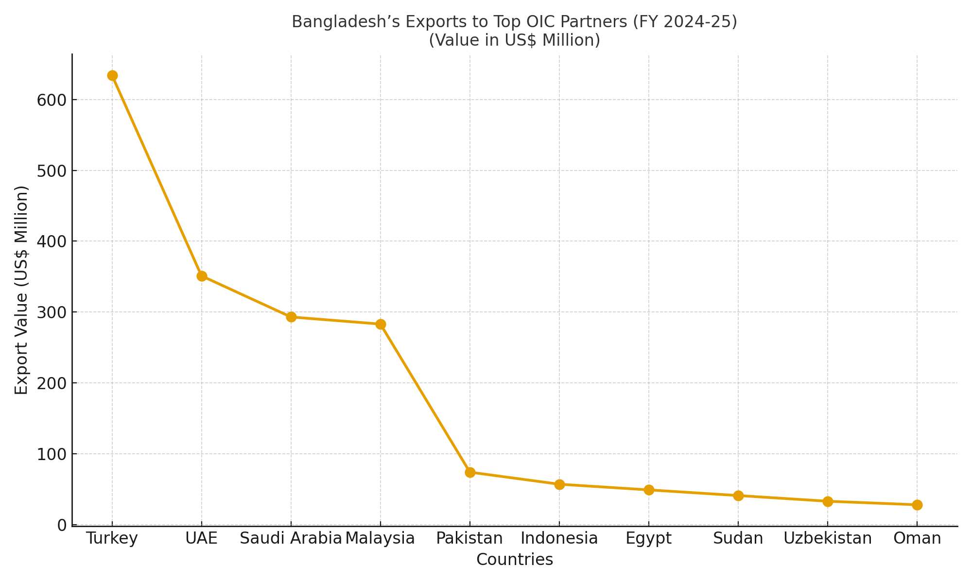
Major Export Partners in OIC

Slide 7
Export Strategies Bangladesh Adopted
National export policy & targets
  Adopted multi-year Export Policy (Export Policy 2024–27) with explicit export targets and measures to create an export-friendly environment
  Policy framed in light of challenges from Least Developed Country (LDC) graduation
  Emphasis on a long-term strategic vision, including preparing for the 4IR and Vision 2041
Export-Oriented Industrial Policy
  Focuses on labor-intensive industries
  Policies encouraged private sector investment and prioritized export-led growth

Slide 8
Export Strategies Adopted
Build on an RMG-led engine while upgrading value chain
  Competitive labor costs, Trade privileges such as GSP and strong partnerships with international buyers
  Sustain and upgrade the RMG sector (improve compliance and move to higher-value and Man-Made Fibre (MMF) garments
  Support for Micro, Small and Medium Enterprises (MSME) and backward-linkages (fabrics and input suppliers)
Diversification Efforts
  Other tradable sectors, i.e., pharmaceuticals, leather & leather goods, ceramics, jute & jute products, agro-processed goods, shipbuilding, etc.
  Identification of priority exportable non-traditional items, such as vegetables, handicrafts and medical equipment and providing necessary incentives

Slide 9
Export Strategies Adopted
Diversification Efforts
  Other tradable sectors, i.e., pharmaceuticals, leather & leather goods, ceramics, jute & jute products, agro-processed goods, shipbuilding, etc.
  Identification of priority exportable non-traditional items, such as vegetables, handicrafts and medical equipment and providing necessary incentives for their development

Slide 10
Export Strategies Adopted
Trade Policy Reforms
  Duty drawbacks, bonded warehouses facilities and tax holidays
  EPZs and SEZs were established to provide infrastructure, simplify regulations, and attract export oriented FDI
Capacity Building & Skills Development
  Workforce training, skill development program and compliance with labour rights and safety regulations

Slide 11
Export Strategies Adopted
Trade Facilitation and Logistics Upgrade
  Port modernisation (Chattogram port & Bay Terminal improvements through 4 different PPP Model Projects)
  Development of Payra Port and Matarbari Deep Sea ports and inland container depots to lower turnaround time and transport cost
Green and Sustainable exports (New Priority)
  Encourage green/energy-efficient manufacturing and low-carbon logistics (to meet buyer requirements and access green value chains)

Slide 12
Export Strategies Adopted
Trade negotiations for FTA/EPA
Bangladesh National Single Window (NSW) for trade facilitation and integrating customs issues online _NBR
One Stop Service (OSS) & 1st Investment Summit_BIDA

Slide 13
Challenges Faced
Dependence on RMG (≈82% of exports)
Limited diversification in other sectors
Infrastructure bottlenecks (ports, logistics, power)
Compliance pressure: labor rights & environment standards
Low value addition (concentration in low-cost manufacturing)

Slide 14
Lessons for OIC Member States
Sectoral focus: Identify comparative advantage sectors (like RMG for Bangladesh)
Trade diplomacy: Active engagement in bilateral and multilateral trade negotiations
Supportive Trade Policies: incentives, tariff reforms, FDI attraction
Capacity building: Skills development and technology upgrading
Diversification: Both in products and export destinations
Sustainability: Adopting green practices to secure long-term market access

Slide 15
Final Note
Bangladesh’s export success is the result of long-term strategy + strong policy support + private sector engagement
Encountering existing challenges concerning export development and getting strong cooperation from OIC member states would greatly benefit Bangladesh in coming days

Slide 16


