Slide 1

September 22nd, 2025
COMCEC PROJECT SUPPORT PROGRAMS
25th Meeting of COMCEC Trade Working Group
Eda AKÇA
Program Coordinator
Department of Programs and Projects
COMCEC
COORDINATION
OFFICE
cpf@comcec.org
Notes:
Thank you Mr. Chairman, Distinguished delegates and dear participants, my name is Eda AKÇA, I am expert at COMCEC Coordination Office. I am mainly responsible for running of projects under COMCEC Project Support Programs. Today, it is my pleasure to provide you with a comprehensive overview of the COMCEC Project Support Programs, with a particular focus on the COMCEC Project Funding as we called it (CPF).

Slide 2

Outline
Overview of the COMCEC Project Support Programs
Objectives and Main Characteristics of the COMCEC Project Funding (CPF)
Project Preparation and Submission
  How to prepare a project proposal
  Online Project Submission
Timeline of Call for Project Proposals
Trade Projects under CPF in 2025
COMCEC
COORDINATION
OFFICE
Notes:
This is the outline of my presentation. In my presentation, I will begin with general information about the COMCEC Project Support Programs and then move on to the objectives and key features of CPF. Afterwards, I will explain how projects can be prepared and submitted, and share the program’s timeline. To conclude, I will give a brief update on the trade projects supported under CPF this year.

Slide 3
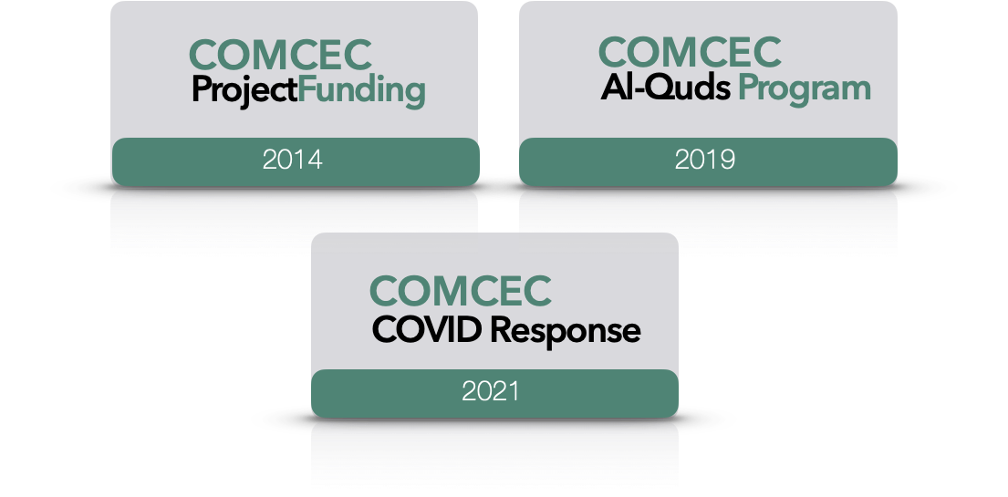
1) Overview
COMCEC
COORDINATION
OFFICE
Notes:
As COMCEC Coordination Office, we currently manage two distinct grant programs: namely COMCEC Project Funding (CPF) and COMCEC Al-Quds Program. The main objective of these grant programs is to realize the policy recommendations taken in the Ministerial sessions as well as working group and to support the project ideas of the member countries and OIC institutions.
I think many of you are already familiar with the COMCEC Project Funding. COMCEC Project Funding is the first grant program started by the COMCEC in 2014 as one of the implementation instruments of the COMCEC Strategy. Over the years, CPF has become one of the most significant and well-utilized mechanisms, enabling Member States to implement projects directly aligned with COMCEC’s policy priorities.
When it comes to COMCEC Al-Quds program, this program has been initiated based on the decisions taken in the previous COMCEC ministerial meetings as well as extraordinary islamic summits. This program aims at improving the capacity of Al-Quds considering the specific economic needs of the region as well as institutional and human capacity of the relevant stakeholders. The program was earlier focused on destination development and management as well as community-based tourism in Al-Quds. As of 2022, the scope of program has been developed by extending capacity building in e-learning, e-commerce, micro finance, SME development, entrepreneurship fields. To date, twenty projects have been successfully completed under this program, and 8 more are currently under implementation in 2025, in close cooperation with Palestinian authorities.
Let me now turn to the details of the COMCEC Project Funding.

Slide 4
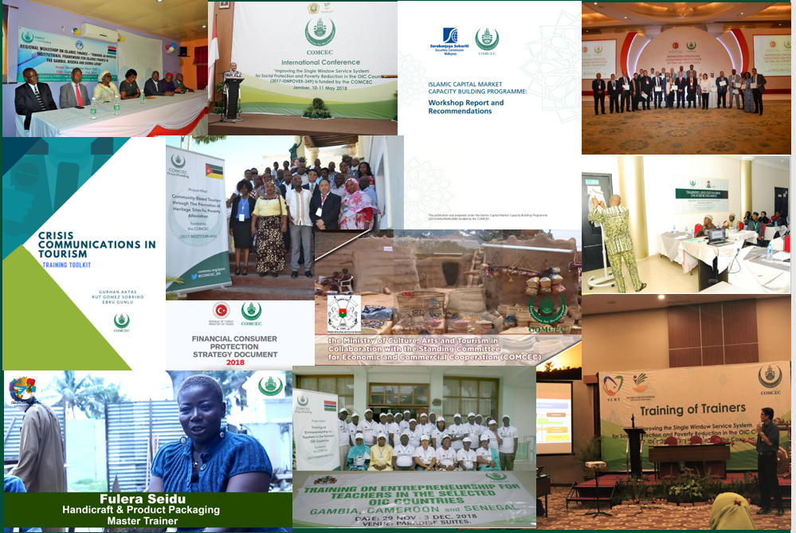
1) Overview
* 156 Projects from 29 Countries and 6 OIC institutions (33 Projects in Trade)
* All member countries as a beneficiary
COMCEC
COORDINATION
OFFICE
Notes:
Since its inception in 2014, CPF has supported 156 projects implemented by 29 Member States and 6 OIC institutions. Importantly, almost all OIC Member States have taken part in CPF either as project owners or beneficiaries.
In the trade sector in particular, 33 projects have been carried out.

Slide 5
2) Objectives and Main Characteristics
WHAT?
A grant-based finance mechanism, was introduced by COMCEC Coordination Office in 2014 as a policy support instrument under the COMCEC Strategy
WHY?
Increasing institutional and human capacity
Supporting implementation of policy recommendations adopted by COMCEC Ministerial Sessions
Enhancing cooperation and solidarity among the member countries
WHO CAN APPLY?
Relevant public institution of a Member Country ( Registered to Relevant Working Group) or an OIC Institution/Organ operating in the field of economic and commercial cooperation
COMCEC
COORDINATION
OFFICE
Notes:
As the oldest and most traditional grant-based financing mechanism of COMCEC, CPF primarily aims to:
Support the implementation of policy recommendations endorsed at COMCEC Ministerial Sessions.
Enhance institutional and human capacity across Member States.
Strengthen cooperation and solidarity among OIC members.
As an important rule, only government institutions of OIC Member States registered in the relevant Working Groups are eligible to submit project proposals under CPF.

Slide 6
2) Objectives and Main Characteristics
HOW?
Financing projects in eight main areas;
* Agriculture * Financial Cooperation * Digital Transformation
* Trade * Tourism * Poverty Alleviation
* Transport and Communications *Small and Medium Enterprises (SME’s)
MAIN PROJECT TYPES
Training , Study Visit, Workshop, Conference and Seminar , Publicity Meetings and Preparation of Audio, Visual and Written Materials
Peer-to-Peer Experience Sharing
Needs Assessment
COMCEC
COORDINATION
OFFICE
Notes:
As you can see from the screen, we are supporting soft type projects under the eight cooperation areas.
* Agriculture * Financial Cooperation
* Trade * Transport and Communications
Tourism * Poverty Alleviation * Digital Transformation *SMEs
Based on the resolutions of the COMCEC Ministerial Sessions, we also included Small and Medium Entreprises Area last year, as one of the supported areas under the COMCEC Project Funding. So, the Member Countries can submit their project proposals in this area.
We mainly support activity-based projects under this program. These projects include the activities such as training, seminar, workshop, study visit and publicity meeting etc. Furthermore, with the 2023 implementation year, we added two new project types. These are peer to peer experience sharing and needs assessment.
Also, I would like to remind again that Member Countries also have the option to implement projects independently, without partners based on the Project types.

Slide 7
2) Objectives and Main Characteristics
SUPPORTED THEMES IN TRADE THIS YEAR
Supporting E-Commerce Know-How Transfer Programs among the OIC Member Countries
Improving E-Commerce Capacities of the SMEs through Effective Usage of ICT Tools
Establishing/Developing Comprehensive National E-Commerce Strategies
Developing/Improving Web-Based Platforms for Providing Information about E-Commerce Regulations and Applications
Encouraging Youth and Women Entrepreneurship in the E-Commerce Industry
Improving Quality Infrastructure in the OIC Member Countries
Enhancing International Collaboration of National Quality Infrastructure (NQI) Institutions Particularly Specialized in the Metrology Field
Harmonizing Standards and Regulations in alignment with International Standards such as ISO, IEC and SMIIC
Strengthening NQI Institutions’ Capacity with a view to Enhancing Their Technical and Operational Capabilities
Conducting Metrological Studies at the OIC Level, Particularly for the Trade of Halal Products
Enhancing Capacities of SMEs in terms of Compliance with Quality Standards
Integrating Quality Management Principles into Educational Curricula at All Levels
Improving Consumer Protection Regulation on Standards and Safety
Developing/Strengthening a Periodic Assessment System to Evaluate the Alignment of Harmonized Standards, and Related Initiatives
Developing/Improving Export Strategies in the OIC Member Countries
COMCEC
COORDINATION
OFFICE
Notes:
Projects are supported only under pre-determined annual themes, which are formulated based on previous policy recommendations and aligned with the upcoming year’s agenda.
For the Trade sector this year, themes include: E-commerce, Quality Infrastructure , Harmonizing Standards and Regulations in alignment with International Standards
Please note that these themes will be updated for the 2026 implementation period. The 13th Call for Project Proposals, to be issued in October, will reflect these new themes.

Slide 8
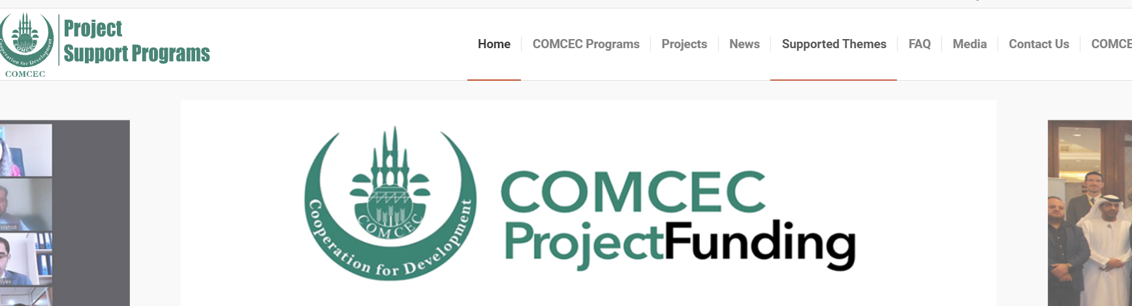
2) Objectives and Main Characteristics
SUPPORTED THEMES IN TRADE THIS YEAR
https://programs.comcec.org/
Supported Themes
COMCEC
COORDINATION
OFFICE
Notes:
You can access the list of supported themes at program.comcec.org. As I mentioned earlier, the themes will be renewed for this call period.

Slide 9
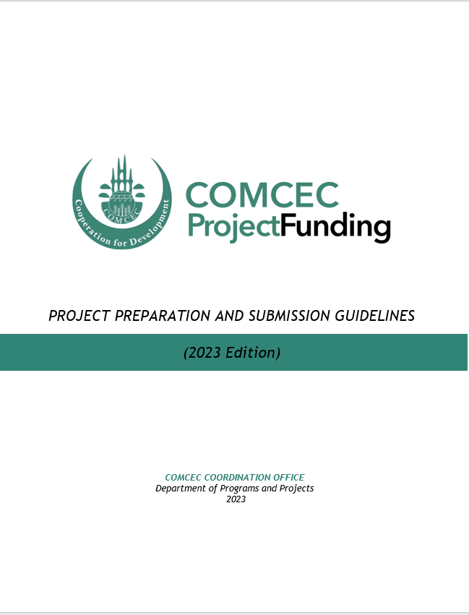
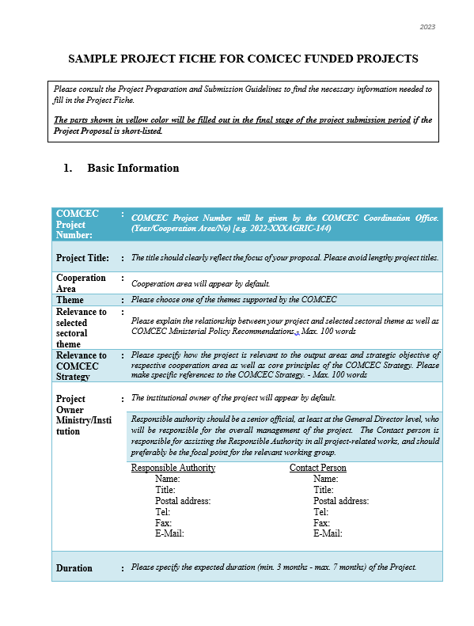
3) Project Preparation and Submission:
a) How to Prepare a Project Proposal
Review the reference documents on the Project Management Information System (https://project.comcec.org/) and Programs Website (https://programs.comcec.org/)
  Project Preparation and Submission Guidelines
  Sample Project Fiche
  Supported Themes
  COMCEC Strategy
Send the relevant documents to the interested national institutions/departments
Fill out the online project fiche through Project Management Information System
Feel free to consult with the CCO
Project Preparation and Implementation Guidelines
Sample Project Fiche
COMCEC
COORDINATION
OFFICE
Notes:
In this section, I would like to give important information about how to prepare and submit project proposal. Before submitting a proposal, we highly advise you to carefully review CPF’s reference documents such as the Project Preparation and Submission Guidelines and the Sample Project Fiche. These documents can be easily accessed through our online system. You can also reach the COMCEC Strategy and Supported Themes through the Programs Website. As an important development, I would like to express that we take into account this “Entering Data into the COMCEC Policy Follow-Up System” issue while evaluating the project proposals with the other critical points stated in the Preparation and Submission Guidelines.
The project fiche is submitted by the focal point in the relevant institution registered to the online system. The focal institution in question (usually Ministries of Trade in the field of trade) can share CPF's reference documents with other institutions so that they can submit their project proposals. After completion of mentioned internal-institution process of project proposals, you need to fill-out and submit the online project fiche through Project Management Information System.

Slide 10
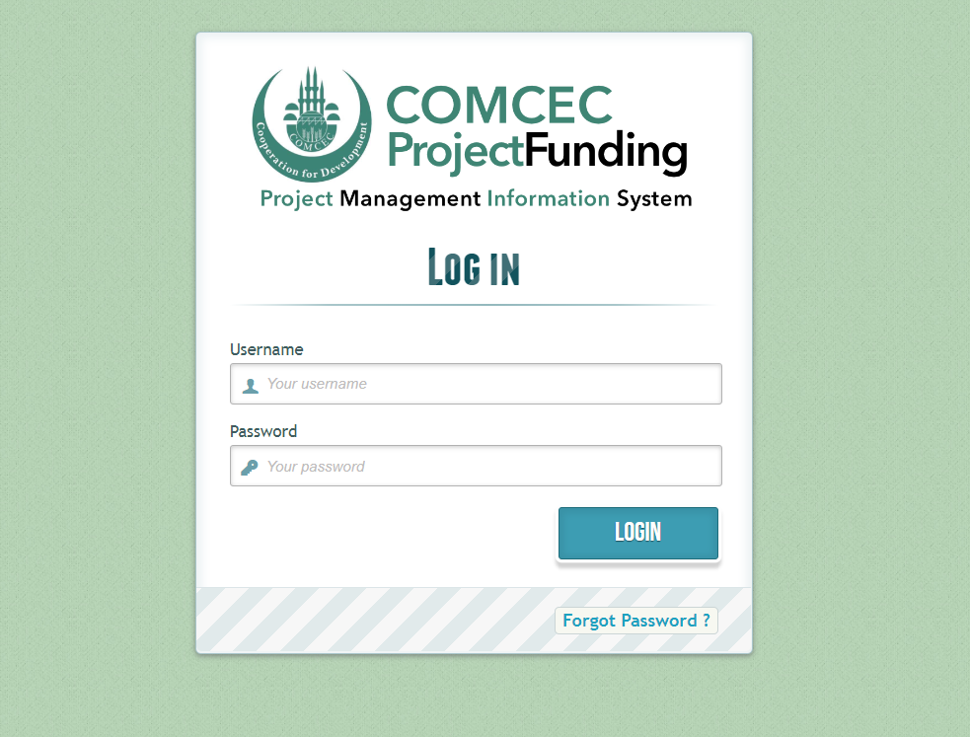
3) Project Preparation and Submission:
b) Online Project Submission
ONLINE PROJECT SUBMISSION: https://project.comcec.org/
The Username and Password are only provided to the sectoral focal points.
If you do not have username and password, please contact cpf@comcec.org.
Username and Password
COMCEC
COORDINATION
OFFICE
Notes:
You can access to our Project Management Information System through project.comcec.org. In this respect, you are expected to submit your projects through using username and password that we provided for our focal points. If focal points do not yet have login credentials, they are kindly requested to contact us.

Slide 11
4) Timeline Cycle of the Project
13th Call for Project Proposals
Declaration of the Final List of Successful Project Proposals
Submission of the Final Version of Project Proposal by the Project Owner
Declaration of Short List
October 1st- 31st 2025
Early December 2025
End of December 2025
February-March 2026
April 2026
Finalization of Contract Procedures
Project Implementation Period
Organizing a Training Activity
April-December 2026
COMCEC
COORDINATION
OFFICE
Notes:
By considering the Thirteenth Call for Project Proposals which will be started in October, the timeline of Call is presenting for project submission and implementation. According to this timeline, you have the opportunity to submit your project proposals in the October.
After the receiving project proposals and completion of the first evaluation process by our side, we will announce the short-list of the project in early December and the shortlisted project owners are expected to submit more detailed project proposals, with CVs of the human resources, details budget etc. by the end of December.
After the finalization of submission and evaluation by the CCO, the Final List of Successful Project Proposals will be published in February. In April, COMCEC Coordination Office and the Development and Investment Bank of Türkiye will coordinate with the project owners to finalize contract procedures and deliver training sessions for project implementation.
From April until the end of the respective year, the projects will be implemented and all the procedures will be finalized inshallah.

Slide 12

5) Trade Projects under CPF in 2025
Project Title : Enhancing Slaughterhouse Standards for Halal and Food Safety Compliance
Project Owner : Ministry of Trade
Project Partners : Türkiye and SMIIC
Project Activities : Study Visit and Training
Project Purpose : To strengthen slaughterhouse operations by implementing Halal and food safety standards, ensuring compliance with international regulations (ISO, SMIIC), and enhancing the capacity of industry stakeholders.
INDONESIA
COMCEC
COORDINATION
OFFICE
Notes:
Now, I would like to give you brief information about the trade projects supported under the COMCEC Project Funding this year.
The first project is being implemented by Indoneasia with the partnership of Türkiye and SMIIC. Through this project, it is aimed at strengthening slaughterhouse operations by implementing Halal and food safety standards, ensuring compliance with international regulations.
Up to now, a study visit has been conducted to Türkiye to learn best practices in Halal and food safety standards. Afterwards, with the gaining experiences from visit, a training activity will be organized in order to strengthen slaughterhouse operations by implementing Halal and food safety standards.

Slide 13

5) Trade Projects under CPF in 2025
Project Title : Enhancing the Capacity of Metrology Laboratories for Improved Quality Infrastructure
Project Owner : SMIIC
Project Partners : Türkiye, Uganda and Sudan
Project Activities : Training and Workshop
Project Purpose : To enhance the technical and operational capabilities of National Quality Infrastructure (NQI) institutions in Sudan and Uganda through targeted theoretical and practical training programs.
SMIIC
COMCEC
COORDINATION
OFFICE
Notes:
The second project has been implemented by SMIIC with the partnership of Uganda, Sudan and Türkiye. This project focused on enhancing the technical and operational capabilities of National Quality Infrastructure (NQI) institutions in Sudan and Uganda through targeted theoretical and practical training programs
In this context, a comprehensive training was conducted with the participation of Sudanese and Turkish officials in Uganda. Subsequently, to enhance the effectiveness of the training, a workshop will be held in Türkiye to present good practice examples

Slide 14
THANK YOU
cpf@comcec.org
COMCEC
COORDINATION
OFFICE
cpf@comcec.org
Notes:
This is the end of my presentation. I hope it was informative for all. Thank you for your interest and patience. You may communicate with us cpf@comcec.org. Thank you.

