Slide 1


DEVELOPING/IMPROVING EXPORT STRATEGIES IN THE OIC MEMBER COUNTRIES
﻿MaIn Challenges and Success Factors In DevelopIng/ImprovIng Export StrategIes In the OIC Member CountrIes
THE 25TH MEETING OF THE COMCEC TRADE WORKING GROUP
September 23, 2025
Zeynep ÖKTEM, MSc, Consultant

Slide 2
OVERVIEW OF THE PRESENTATION
1
Challenges
2
Road Map for Effective NES
3
Guiding Principles and Recommended Practices
4
Policy Recommendations

Slide 3

1. CHALLENGES

Slide 4

Challenges
Heavy reliance on imports of strategic goods which increases risks of price and supply fluctuations alongside instability from volatile export revenues.
Volatility of export revenues directly transmitting to growth variability through large fluctuations disrupting economic stability.
Increasing protectionist measures in traditional markets that compounds external shocks and fluctuations.
Geopolitical tensions, environmental challenges, and technological disruptions exposing structural weaknesses in export-led growth models.

Slide 5

Challenges
Need for enhanced stakeholder coordination and stronger public–private partnership to ensure long-term sustainability and competitiveness.
Unharmonized quality infrastructure policies limiting SMEs and MSMEs in meeting international requirements such as ISO and Halal certification.
Variations in halal standards at the international level creating barriers to trade and consumer confidence.
Limited trade literacy constraining many countries, especially developing and emerging ones, from fully integrating into global markets and reducing export capacity.

Slide 6

Challenges
Budgetary constraints limiting SMEs and MSMEs from investing in trade-related training, restricting their ability to participate in global value chains.
Limited R&D investment, poor academia-industry collaboration, and insufficient financial support constraining companies’ innovation and high-tech development, limiting countries’ engagement in advanced sectors.
Rapid digital technology evolution creating a skills mismatch, with shortages of professionals in AI, data science, cybersecurity, and blockchain.
Structural constraints, including ISO or halal certification requirements, limiting SMEs and MSMEs’ credibility and integration into international markets.

Slide 7

Challenges
Limited financial resources restricting SMEs and MSMEs from establishing and maintaining international connections.
Low digital literacy and insufficient digital infrastructure constraining adoption of e-commerce platforms and digital trade facilitation tools
Inadequate digital infrastructure and high licensing fees limiting SMEs and MSMEs’ participation in global value chains and export expansion.
Limited compliance with new green trade regulations which revealed inherent vulnerabilities in many economies.

Slide 8
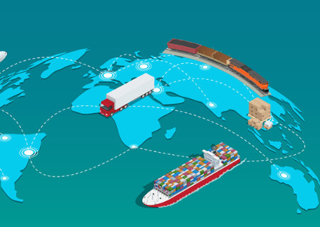
Challenges
Emerging climate-related regulations requiring companies to integrate sustainability across supply chains, increasing costs, compliance burdens, and competitive pressures.
High digitalization infrastructure costs placing a disproportionate burden on SMEs, reducing competitiveness and limiting efficient participation in international trade.
Paper-based and fragmented systems causing delays, higher overheads, and increased risk of errors and fraud, while low transparency and data security concerns discouraging SMEs from adopting digital solutions.

Slide 9

2. ROAD MAP FOR EFFECTIVE NES

Slide 10

Common Components of Effective NES
A data-based, sector-specific identification process
Strong institutional capacity and clear coordination mechanisms
Affordable financial and technical assistance support to SMEs and MSMEs
Digitalization and technological integration
Clear monitoring and independent evaluation

Slide 11

3. GUIDING PRINCIPLES & RECOMMENDED PRINCIPLES

Slide 12
Guiding Framework for OIC Countries
Phase | Guiding Principle | Recommended Good Practices
Identification | Evidence-based needs assessment | Regular competitiveness reports; target market analyses using ITC/UNCTAD data
 | Clear prioritization of sectors and markets | Sector-specific roadmaps; leveraging opportunities from FTAs and regional integration
 | Public-private sector collaboration | Exporter advisory councils; stakeholder mapping and inclusive consultation

Slide 13
Guiding Framework for OIC Countries
Phase | Guiding Principle | Recommended Good Practices
Implementation | Strengthening institutional and human capacity | Establishment of export academies; continuous training for SMEs and trade officials
 | Well-defined coordination mechanisms | Creation of National Export Committees; clear division between lead and supporting institutions
 | Accessible financial and technical support | Export credit and insurance agencies; SME supports funds and grants
 | Digitalization and technology integration | Single Window customs systems; AI-driven market analysis; development of e-commerce infrastructure

Slide 14
Guiding Framework for OIC Countries
Phase | Guiding Principle | Recommended Good Practices
Monitoring | Regular monitoring and transparent reporting | Annual NES progress reports; digital dashboards for real-time tracking
 | Independent evaluation mechanisms | External assessments by ITC/UNCTAD; mid-term evaluations with recommendations
Cross-cutting | Sustainability and ethical trade principles | Green product incentives; compliance with social and labor standards
 | Awareness raising and knowledge sharing | Export information portals; national and regional awareness campaigns

Slide 15

4. POLICY RECOMMENDATIONS

Slide 16
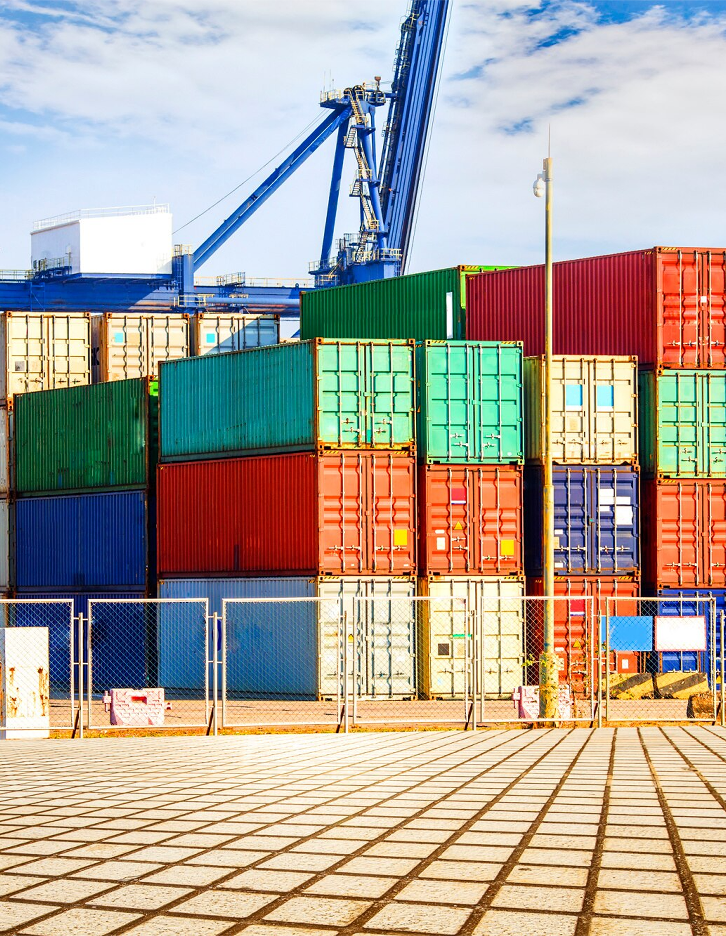

Policy Recommendations
Developing and implementing a comprehensive export framework within OIC Member Countries, for trade facilitation, which streamlines cross-border processes, reduces transaction costs, and enhances the efficiency of export and import operations
Organizing strategic regional planning activities such as seminars, with the specialists from OIC Member Countries
Encouraging technical knowledge transfer through direct information/document sharing, trainings, workshops, personnel exchange programs in the field of trade

Slide 17

Policy Recommendations
Setting-up dedicated task forces including experts from government, the private sector, civil society and academia for planning comprehensive export framework
Developing structured collaboration mechanisms such as public–private dialogue platforms, sector-specific working groups, and policy advisory councils
Utilization of services provided by SMIIC to facilitate trade by harmonizing quality infrastructure

Slide 18

Policy Recommendations
Making use of IFHAB services for mutual recognition of halal certificates by developing and maintaining Multilateral Recognition Arrangement (MRA) among the national halal accreditation bodies of the Member Countries
Publishing and circulating policy briefs, newsletters, and guidance notes to OIC Member Countries’ Ministries, accreditation bodies, and halal certification authorities
Raising awareness and strengthening knowledge of exporters and marketing professionals about international market trends, compliance requirements, and risk management especially in less developed OIC Member Countries

Slide 19
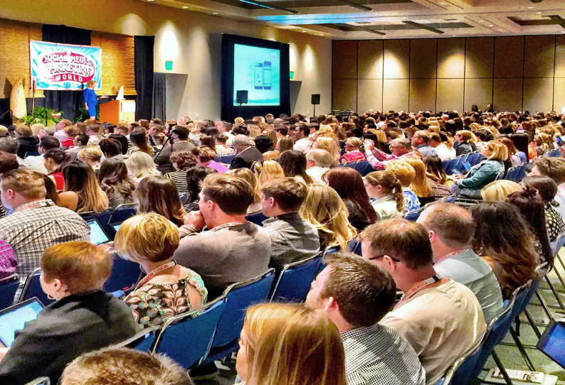
Policy Recommendations
Promoting usage of social media marketing, product display on global e-commerce platforms, and successful international marketing to improve the competitiveness of companies and business skills of trade and marketing staff
Supporting public awareness campaigns – via media, trade fairs, regional trips, and sectoral conferences – to foster greater visibility of export opportunities and success stories
Developing/implementing targeted innovation policies and R&D incentive programs especially for emerging technologies

Slide 20

Policy Recommendations
Providing innovation grants and tax incentives to high-tech firms
Developing/establishing technology transfer centers, science parks, incubators, and innovation hubs through public-private partnerships for innovative entrepreneurs, start-ups and SMEs
Developing dedicated financial and export funding mechanisms to support internationalization of SMEs and MSMEs

Slide 21

Policy Recommendations
Supporting SMEs and MSMEs to improve their credibility in overseas markets through subsidizing certification fees and providing consultation services among others
Developing targeted financial and technical assistance programs to support firms, particularly in developing countries, in achieving compliance with new climate-related trade standards
Promoting green certification programs through tax incentives for green production and green technologies

Slide 22

Policy Recommendations
Developing/Implementing trade policies in favor of environmental friendliness by simplifying the burden of standards, aligning environmental requirements across regions of OIC Member Countries and reducing non-tariff obstacles related to sustainability compliance.
Promoting digital and paperless trade platforms, with a focus on adoption of National Single Window (NSW) platforms, through adopting legislation and regulations that provide legal recognition of electronic documents, e-signatures, and digital certificates.
Developing robust data security, cybersecurity, and privacy laws outlining the roles and responsibilities of public administrations and private users in Single Window applications
Providing a legal basis for regional interoperability which allows cross-border recognition of electronic certificates of origin, sanitary and phytosanitary (SPS) documents, and other trade-related licenses.

Slide 23



THANK YOU
Do you have any questions?
info@utrlab.com
(0312) 210 16 07
http://www.utrlab.com/

