Slide 1


DEVELOPING/IMPROVING EXPORT STRATEGIES IN THE OIC MEMBER COUNTRIES
﻿DRAFT RESEARCH REPORT
THE 25TH MEETING OF THE COMCEC TRADE WORKING GROUP
September 22, 2025
Zeynep ÖKTEM, MSc, Consultant

Slide 2
OVERVIEW OF THE PRESENTATION
1
General Overview of the Report & Introduction
2
Conceptual Framework
3
Export Strategy Development
4
Good Practices from Leading Countries

Slide 3

1. GENERAL OVERVIEW & INTRODUCTION

Slide 4

General Overview of the Report
Introduction
Conceptual Framework; Global, Regional and Local Trends
Export Strategy Development
Mapping of Good Practices
Guiding Principles and Recommended Practices
Conclusion & Policy Recommendations
Annex; Analysis of Survey Results
References

Slide 5

Introductory Chapter
A comprehensive overview of the report, outlining its main objectives, scope, and significance.
It explains the research methodology and introduces the conceptual framework that supports the analysis.

Slide 6

Aim & Scope of the Study
Prepare a Guideline that will act as a comprehensive guide for the OIC Member Countries.
Outline the step‑by‑step process for assessing, planning and executing an export strategy and the tools, resources and legal frameworks required for success.
Provide a comprehensive approach to examine the current export trends and strategies including NES’s different elements and some insight into how this affects the OIC Member Countries’ export capacity through desk-top research, surveys, interviews and field visits.
Prepare guiding principles and recommendations for the OIC Member Countries will also be prepared for an effective NES.
Elaborate on emerging challenges in the development and implementation of export strategies and sets out benchmarks and recommended good practices.

Slide 7

Significance of the Study
Necessity for the regulatory and supervisory issues in trade and export activities due to movement towards a digitalizing world.
Tremendous growth of E-commerce with the penetration of artificial intelligence and its applications.
Development of actionable policy suggestions for regional and international cooperation among OIC Member Countries and beyond.
Increasing importance of environmental awareness and aligning export strategies with sustainable development principles, i.e. green production and green trade.

Slide 8

Research Methodology
Multi-layered research design that combines both qualitative and quantitative techniques to generate evidence-based findings and recommendations.
Desk-based literature review
Structured online survey
Field visits
Interviews

Slide 9
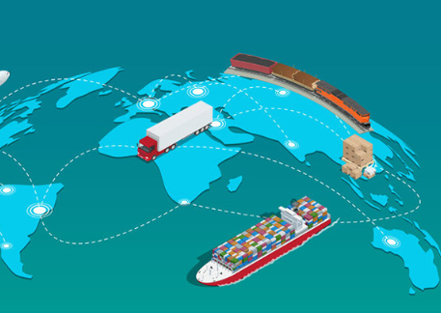
Case Country Selection Criteria
Selection based on a set of criteria in a transparent manner to ensure both analytical robustness and comparability of the analysis.
Balanced selection, includes four OIC Member Countries and two non-OIC countries with fair representation of both intra-regional and cross-regional benchmarking.
Selection based on geographical diversity; different levels of GDP, product and market diversity.
Categorizing countries by their strategic strengths, structural weaknesses, and prospective opportunities.

Slide 10
Brief Analysis of Case Countries
Dependency on hydrocarbon exports (~95% of export revenue), recent reforms to diversify the economy, successful NES applications.
Large labor force, agricultural commodities, restrictions on unprocessed raw material exports, focus on value addition.Vision documents, structured policy papers
Strong commitment to industrial modernization; important growth programmes like “Made in China 2025”; leadership in smart manufacturing, e-commerce integrated with AI platforms.
Azerbaijan
Egypt (field visit)
Netherlands (non‑OIC):
Nigeria
Indonesia (field visit)
China (non‑OIC):
Strategic geographic location; dependency on oil & gas; various strategic policies to efforts to strengthen exports, agriculture and rural economy.
Growing population; strategic location at the Cairo‑Suez route; mix of agriculture, textiles, chemicals; natural resources and non‑oil sectors.
Policies interms of Frameworks, high export volumes; strong agricultural sector; re‑exports, dependency on critical raw materials.

Slide 11

2. CONCEPTUAL FRAMEWORK

Slide 12

Global Trade Environment and Trends
Global trade is significantly influenced by a range of disruptive events, such as the Financial Crisis of 2007–2008, the outbreak of COVID‑19.
Governmental responses through instruments such as tariffs, non‑tariff measures, export controls, and investment restrictions are imposing substantial constraints on the flow of goods.
The weakening of the multilateral framework is expected to have possible contraction in global trade volumes, GDP declines in developed economies and losses due to trade restrictions.

Slide 13
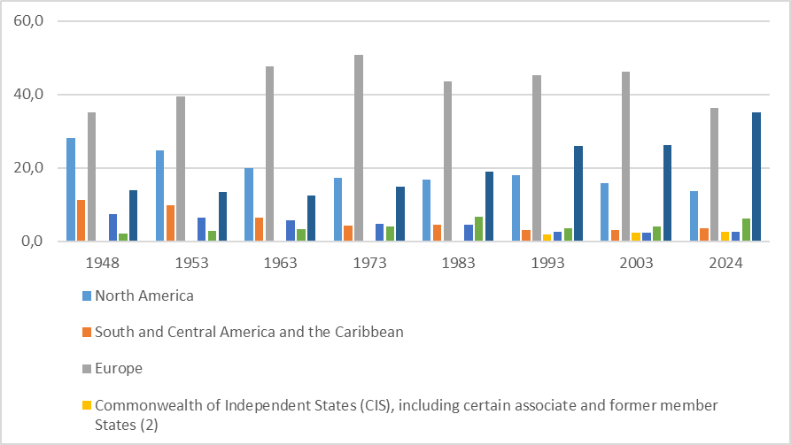
Global Trade Environment and Trends
Europe’s (grey bar) long-standing dominance has slowed in recent years. While EU regulations support sustainable trade, excessive or overly stringent measures risk undermining the EU’s openness and reducing its attractiveness as a trading partner. The growing digitalization and the green transition, represents both a challenge and an opportunity for the European economy.
Asia (dark blue bar) stands out consistent export growth due to intraregional trade, with China. The export boom reflects geographical dispersion of production: relocating to assemby works to lower-wage economies, while more advanced Asian economies focus on producing high value-added components and capital goods. Digitalization has emerged as another significant driver of Asia’s economic performance.
North America (blue bar)comprising the United States and Canada—has experienced a steady decline in export performance over recent decades. Geopolitical dynamics are increasingly reshaping North American supply chains, with the United States adopting a more inward-looking trade posture characterized by rising tariffs and import restrictions.

Slide 14

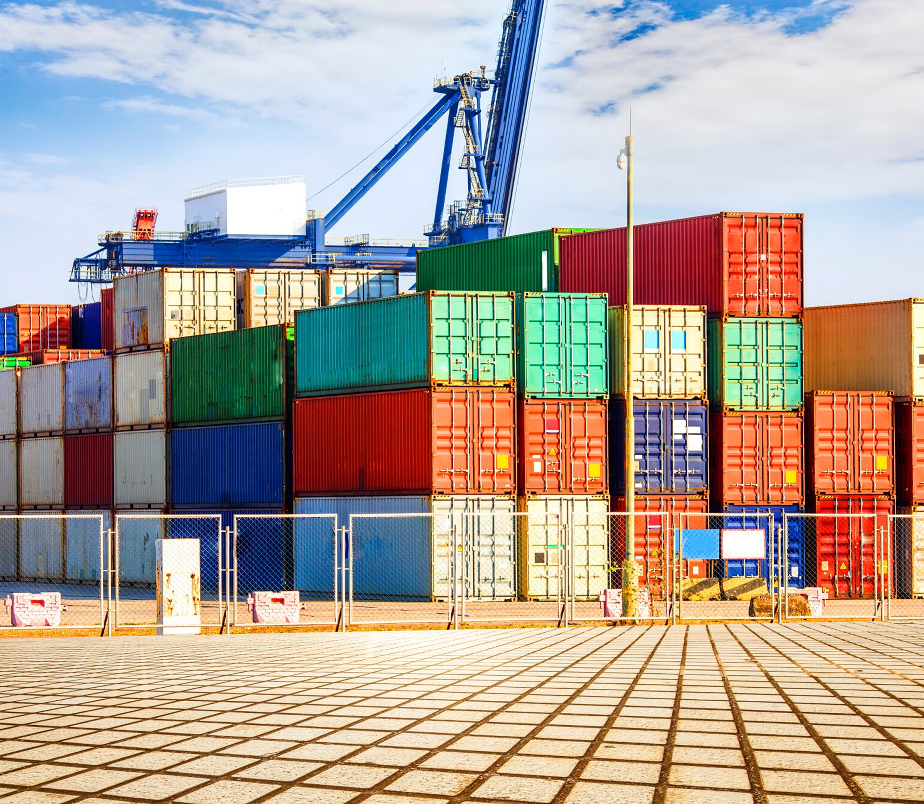
Current Situation in Global Trade Environment
WTO Global Trade Outlook and Statistics (GTOS) report in April 2025:
Trade policy developments—including a partial de-escalation of U.S.–China tensions alongside the imposition of higher U.S. tariffs on steel and aluminum—have alternately moderated and exacerbated global trade forecasts.
The WTO projects a contraction of 0.2% in the volume of world merchandise trade for 2025, reflecting the cumulative effects of tariff increases and persistent uncertainty, followed by a modest recovery with 2.5% growth projected for 2026.
North America is expected to bear the steepest losses, with exports expected to decline by 12.6%.
Under a downside scenario, the reinstatement of suspended “reciprocal” tariffs and the wider spread of policy uncertainty—compounded by unresolved bilateral negotiations—could push global merchandise trade into a further 1.5% decline.

Slide 15
Trade Environment in OIC Member Countries and Trends
Members of the OIC possess both the strategic capacity and moral authority to influence global economic outcomes.
Represent nearly 25% of global population and endowed with vast natural resources—holding approximately 65% of the world’s crude oil and around 60% of natural gas reserves.
Accounts for 14.5% of global production, 10.5% of exports, 9.7% of FDI inflows.
Intra-OIC trade:
Increased from 19.16% (2023) to 20.36% (2024).
COVID-19: mild contraction, but slower growth by 2023, below historical 4.3% average.
2025 growth forecast is 4.2% – still below trajectory.
Intra-OIC trade, though increasing, continues to be behind global averages. In 2023 global trade fell by 5.1%, OIC exports dropped more sharply than imports.
Challenges: lack of diversification, competitiveness gaps, inflationary pressures, increased vulnerabilities due to export-import balance.

Slide 16
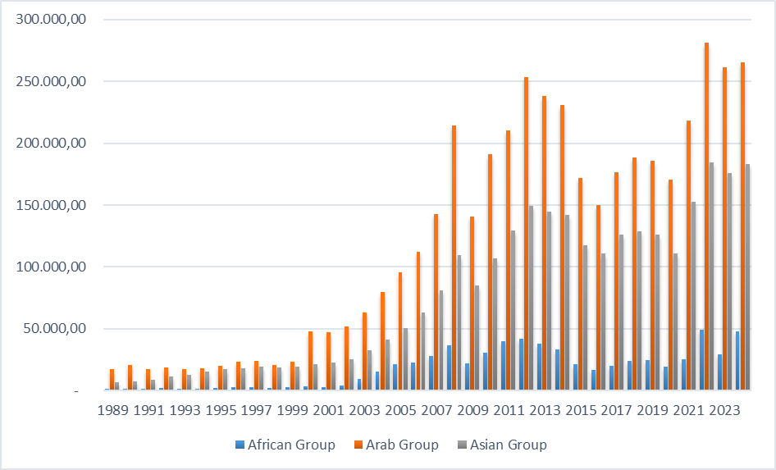
Trade Environment in OIC Member Countries and Trends
The Arab Group’s export performance demonstrates steady growth, with visible fluctuations due to the volatility of energy markets. Their exports surge while international oil prices are high and have even exceeded the exports of the Asian Group in some years.
The trend of the Asian Group has been quite robust and stable over the period, but its domination becomes more observable in the years after. This fact can be explained as the strong export capacity of large OIC Asian economies like Malaysia, Indonesia, Azerbaijan and Türkiye, shows more diversified production structures and stronger integration into global value chains.
African block is invariably smaller, though there is some increase over time.

Slide 17
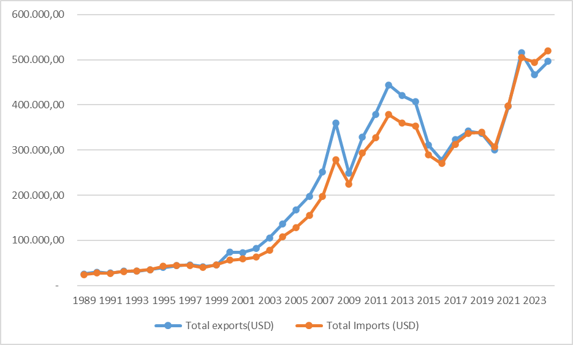
Trade Environment in OIC Member Countries and Trends
02
Figure shows that intra-OIC trade is more import driven, highlighting a persistent trade gap within OIC economies.
Limitations to the trade potential in the region, as non-tariff barriers, insufficient transit infrastructure and heavy custom procedures. However:
  The Trade Preferential System among OIC Member States (TPS-OIC) enables Member Countries to benefit from preferential tariffs to boost trade.
  Analytical and data-based policy advice provided by SESRIC and COMCEC has become essential to the displacement of policy formulation based on evidence.
Intra OIC Export- Import Volume between 1989-2024

Slide 18
Export-Led Growth and National Export Strategy (NES)
Export-led growth has driven increased consumption in advanced economies while simultaneously fostering investment and industrialization in developing countries.
The broader outcomes of this process:
significant reductions in poverty,
the facilitation of rapid urbanization,
the generation of employment opportunities,
notable improvements in living standards

Slide 19
Export-Led Growth and National Export Strategy (NES)
Export competitiveness = ability of a country to produce, distribute, and sell goods and services as effectively or more efficiently than international competitors
Openness & global integration → economic growth, enabling job creation and poverty reduction → stronger resilience and long-term development.
Countries that have benefited most from export have pursued comprehensive export policies and regulatory reforms designed to foster business-friendly environments and enhance export capacity.
Historical success stories: Republic of Korea and Chinese Taipei in the 1960s; Southeast Asian countries such as Thailand, Malaysia and Singapore in the 1970s; China in the 1980s, and Central and South American countries in 1990s, such as Chile

Slide 20

Institutional Framework- Export Strategy
Institutional reinforcing framework can contribute significantly toward improving a country’s export performance .
Well-designed export framework would focus on the promotion of the export-oriented sectors and simplify the process for exporters to address bureaucratic red tape.
The active participation and endorsement of all stakeholders, particularly the private sector, is essential in order to strike the right balance and ensure sustainability.

Slide 21
Institutional Framework- Export Strategy
Most of the export-oriented countries have adopted long-term frameworks, programmes, strategies, policy or vision documents that articulate their aspirations for political and economic sovereignity.
There is no universal blueprint for building an export strategy, certain core elements are widely recognized as contributing to export success when integrated into the formulation process.
As a good example of such a framework, the NES outlines targeted actions for policymakers,institutions and enterprises to overcome constraints and capitalize on opportunities to support resilient value chains and foster inclusive, digital, and greener trade.

Slide 22

National Export Strategy (NES)
As indicated by ITC, the governments must adopt a holistic perspective that ensures policies, laws, and regulations are sequenced and harmonized to create a mutually reinforcing framework for competitiveness and export success.
  NES can trigger transformative change through a whole-of-country effort in support of sustainable economic growth. NES sometimes called a "strategy of strategies”.
  NES can provide guidance on how to overcome developing supply-side capacities in terms of ;
    quality, value addition,
    diversification,
    technology and skills to align national productivity with international market opportunities

Slide 23

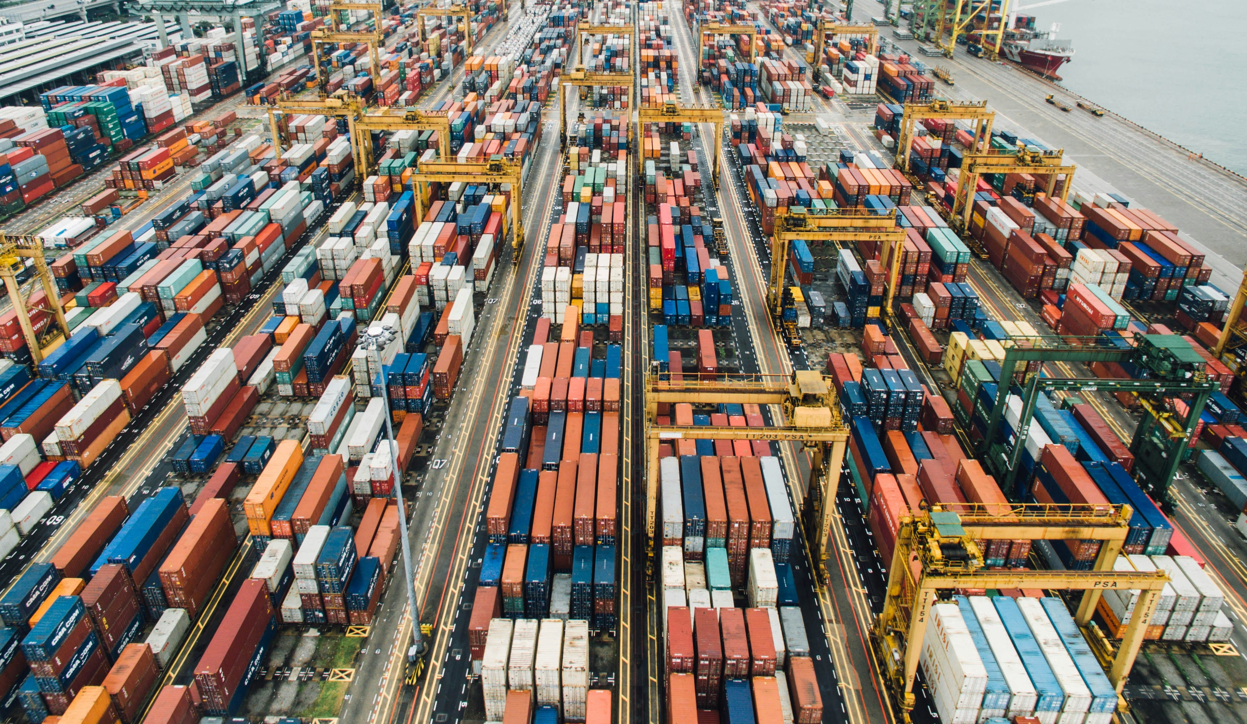
National Export Strategy (NES)
Fosters the diversification of export products and markets.
Encourages competitiveness of SMEs at home and abroad.
Promotes investment by pinpointing growth sectors.
Strengthens public-private partnerships to mount trade development offensives.
Sets up frameworks for implementation, monitoring results.
Aims to enhance living standards and income levels by expanding export capacities, creating jobs, and reducing imports.

Slide 24
Digitalization in Trade
Trade digitalization is not only key to facilitating domestic trade, but also as a support driver of goals such as ensuring seamless cross-border transactions.
Digital trade significantly reduces transaction costs and strengthens the resilience of global supply chains.
The integration of advanced technologies such as Big Data analytics, Artificial Intelligence (AI), and blockchain further enhance efficiency, transparency, and risk management capacities within trade processes.
Paperless trade includes systems such as automated customs procedures, electronic single windows, electronic submission of customs declarations, issuance of import and export permits, electronic application and issuance of preferential certificates of origin, and e-payment of customs duties and fees.

Slide 25
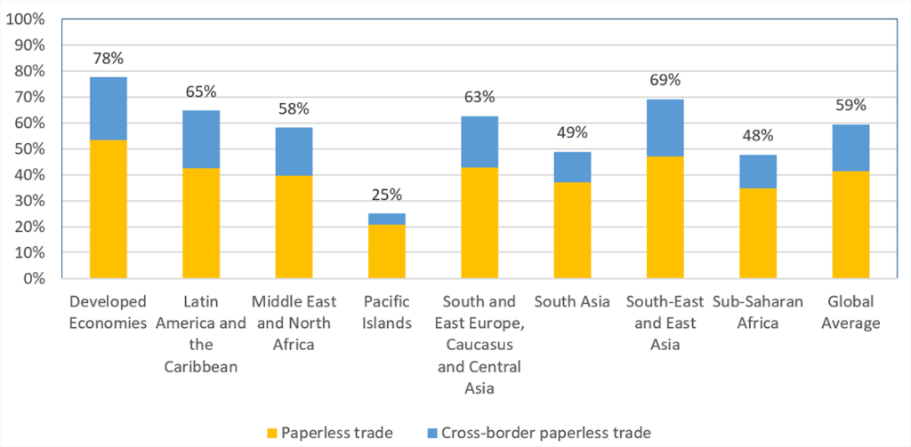
Digitalization in Trade
Developed economies employ digital trade features in approximately 80% of their trade operations.
At the country level, the Netherlands and New Zealand are leaders, with digitalization rates of 96%, followed by Australia, Belgium, the Republic of Korea, and Singapore at 93%.

Slide 26

Free Trade Agreements
The National Export Strategy (NES) can be further enhanced through the implementation of Free Trade Agreements (FTAs).
FTAs define the tariffs, taxes, and duties that nations apply to imports and exports.
FTAs key aim is to diminish or abolish trade obstacles, thus enabling increased market access and invigorating international commerce.
FTAs function as a crucial aid in exporting diversification and enhancing global competitiveness for domestic industries to limit trade costs and foster a stable environment for trade.

Slide 27
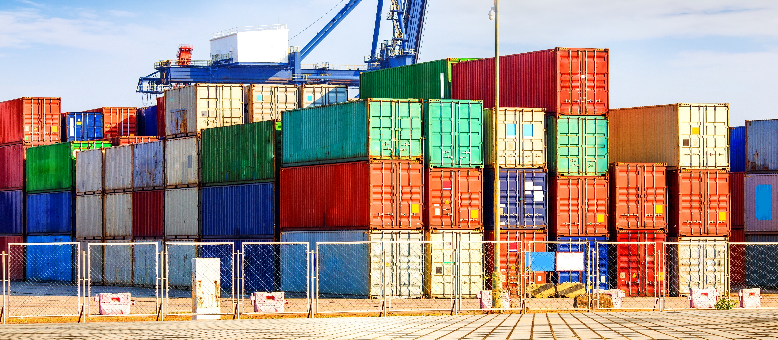
3. EXPORT STRATEGY DEVELOPMENT

Slide 28

The Design of NES
The National Export Strategy (NES) is a fundamental policy tool for sustainable economic growth, trade diversification and increased competitiveness.
A well-designed NES allows countries to transform their comparative advantages into competitive advantages and to create a roadmap aligned with long-term development goals.
NES is participatory, requires public-private dialogue, collaboration with international institutions and market based decision-making.
NES must be a “living strategy”, flexible and adaptable to global fluctuations, digital transformation, and new Technologies.

Slide 29
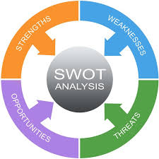
The development and implementation process of NES
Identification Phase to determine a country's current export structure and priorities
Assessing the Current Export Structure (Gap and Need Assessment) The traditional approach involves the use of SWOT analysis to guide strategy development.
Identifying Export Markets and Priority Countries
Prioritizing sectors aligned with target markets ensures the efficient use of resources.
Establishing strong partnerships between the public and the private sector and inclusion of non-governmental organizations

Slide 30

The development and implementation process of NES
Implementation Phase with the strategic alignment of the lead agency.
Developing institutional capacity with Human Resources and Institutional Structure
Identifying Coordination Mechanisms by establishing monitoring and steering committees and technical advisory groups
Establishing a Communicating the Strategy to ensure broad awareness and stakeholder engagement thru media, websites, dissemination events
Implementation Plan and Performance Criteria by defining key performance indicators (KPI) are essential for measuring the success of the strategy.
Developing Financial and Technical Support mechanisms with export credit institutions like EXIMBANKs

Slide 31
The development and implementation process of NES
Monitoring Phase through transparent and regular monitoring, evaluation, and reporting mechanisms.
Monitoring: AI-based dashboards enable real-time tracking of export flows, identification of bottlenecks, and forecasting of market trends.
Evaluation: Periodic independent evaluations demonstrate the extent to which targets are being achieved. Evaluations conducted by international organizations such as the ITC increase credibility.
Reporting: NES progress reports should be published annually and made publicly available. This enhances both accountability and stakeholder trust.

Slide 32
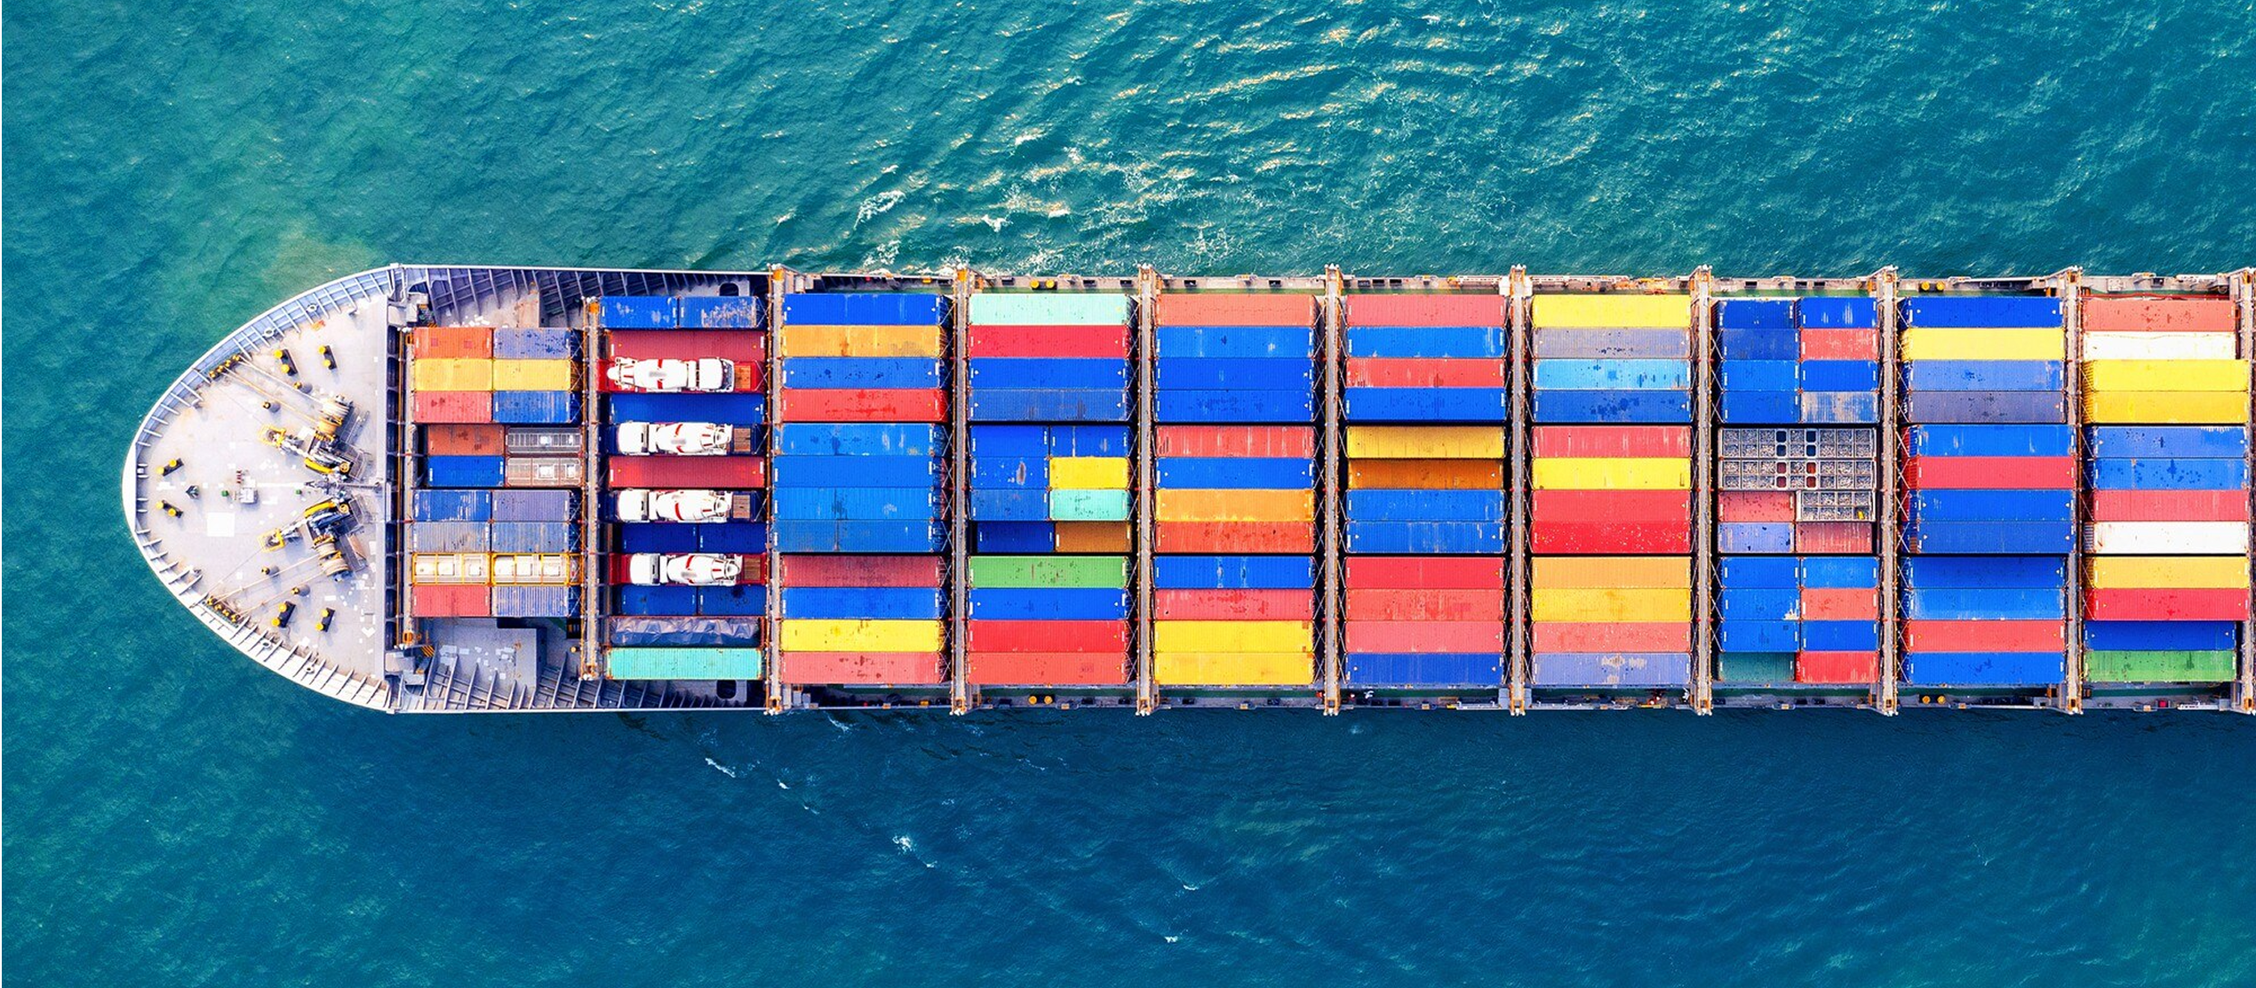
4. GOOD PRACTICES FROM LEADING COUNTRIES

Slide 33
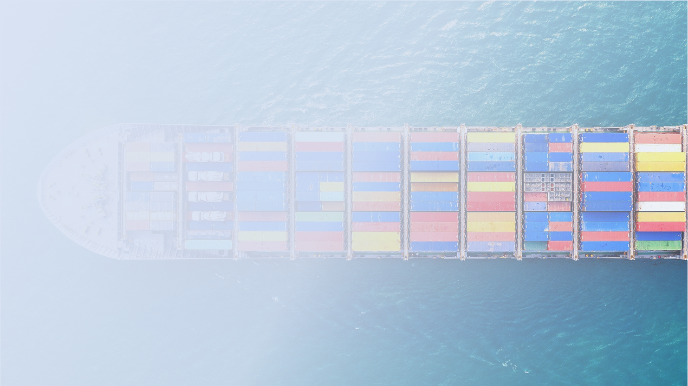

Outlook of Current Trade Environment and Trends in OIC Member Countries
Good Practices from Leading Countries
Germany’s Strategy Paper outlined four key strategic priorities: strengthening coordination among export promotion actors and placing greater emphasis on cooperation through organizations such as the OECD to uphold transparent rules governing international competition. (Identification / Developing Partnerships)
Denmark’s VITUS Programme is designed to support SMEs.. While results varied, the majority of firms enrolled in VITUS secured their first export sale within the 12-month programme period. (Implementation / Financial and Technical Support)
The Japan External Trade Organization (JETRO) has developed a service known as JETRO File, which provides free access to reports covering 62 countries. JETRO File had registered approximately 38,000 users, with the homepage receiving an average of 16,000 visits per month—suggesting that each user accessed the system about once every two months. (Implementation / Financial and Technical Support)
Spain’s Master’s Degree Programme in Export Promotion, administered by ICEX Spain Trade and Investment, combines academic study with extensive practical training. ICEX has trained more than 6,500 professionals, who now work in multinational companies, as entrepreneurs, senior government officials, or staff of multilateral organizations. (Implementation/ Human Resources and Institutional Structure)

Slide 34
Outlook of Current Trade Environment and Trends in OIC Member Countries
Good Practices from Leading Countries
Denmark applies a set of key performance indicators (KPIs) to assess the effectiveness of its Trade Council staff. This indicator is based on feedback from companies that have utilized the Council’s services. The target value is set at a minimum of 72 %, the achieved result was 82 %, shows strong level of client satisfaction and effectiveness. (Implementation / Performance Criteria)
The GREAT Britain & Northern Ireland Campaign serves as the UK’s flagship international communications programme to strengthen the UK’s global reputation and stimulate economic growth. The initiative has successfully showcased the UK’s strengths across 164 countries, generating returns of approximately £7 billion for the national economy. (Implementation / Communicating the Strategy)
Norwegian Trade Council (NTC) monitors all Trade Promotion Organization (TPO) activities under a single set of measurement principles, while assessing the quality and impact of each service. NTC seeks to capture customer perceptions through surveys conducted by the external consultancy Gallup. (Monitoring)

Slide 35



THANK YOU
Do you have any questions?
info@utrlab.com
(0312) 210 16 07
http://www.utrlab.com/

