Slide 1


Draft Guide on Decent Housing for the Poor in the
OIC Member Countries - Policy Recommendations
Prof. Ali Hepşen - Dr. Levent Sümer
Istanbul University – Boğaziçi University
September 2025

Slide 2
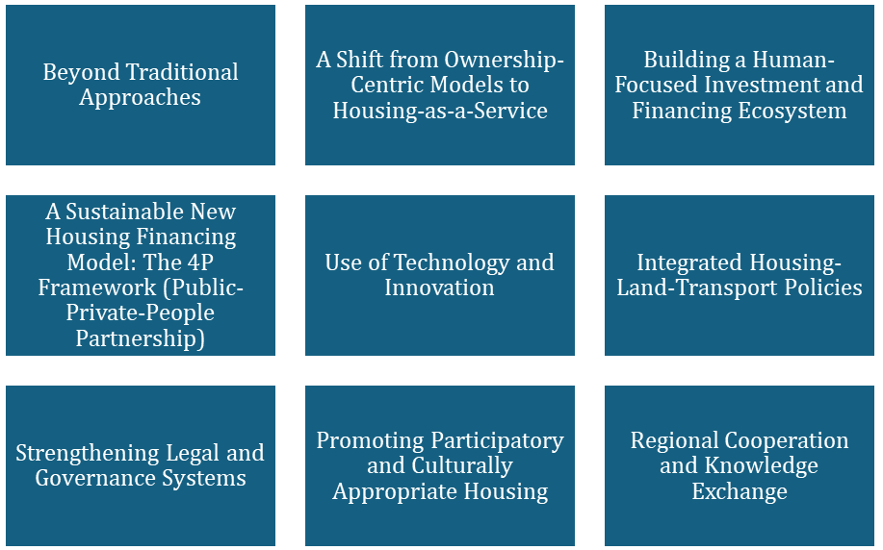
GUIDED PRINCIPLES

Slide 3
4P Housing Model
4P Housing Model
Affordability without Debt Dependence
Collective Investment Mechanisms
Decentralized Management
Value Preservation and Circularity
Derived from Sümer, 2024

Slide 4
Implementation of 4P Housing Model
Tool/Mechanism | Function | Implementation in OIC Context
Housing Development Fund (HDF) | Mobilizes blended finance (public, private, donor, waqf) for large-scale housing. | Can be capitalized via Islamic finance instruments (e.g., Sukuk, Zakat, Waqf)
Land Contribution by the State | Lowers development costs by making serviced land available | Applicable in countries with high public land holdings
Construction Cooperatives | Enables people to co-develop and manage housing | Aligns with communal traditions and religious values
Rent-to-Own Programs | Gradual ownership without upfront loans | Ideal for informal workers and younger households
Shared Equity Model | Ownership shared between the fund and the household, reducing the initial cost | State exits gradually as income rises

Slide 5
POLICIES
Policy Recommendation 1: Adopting Future-Proof and Integrated Housing Strategies through addressing urbanization challenges, demographic shifts, climate risks, and housing price fluctuations
Rationale: Many Member Countries have made progress through short- and medium-term programs, yet recurring crises show the importance of embedding foresight into housing policy. International examples, such as Singapore’s integrated planning, demonstrate the value of aligning housing provision with transport, employment, and social services.
Future-proofing policies will ensure resilience, stability, and affordability for future generations. Therefore, there is a need for designing full-fledged strategies. These strategies should be implemented through strong institutional frameworks that ensure coherence across ministries, municipalities, and private stakeholders.

Slide 6
POLICIES
Policy Recommendation 2: Strengthening Housing Resilience through Rehabilitation and Innovative Construction through upgrading existing stock while promoting innovative technologies such as modular, prefabricated, and climate-adapted construction
Rationale: Rehabilitating existing stock is often more cost-effective and socially inclusive than demolition. At the same time, modular and innovative construction can reduce costs and timelines, making housing provision more efficient. Combining rehabilitation with modern construction technologies allows governments to scale housing delivery while respecting cultural heritage and community structures.
These approaches can deliver faster, safer, and more affordable housing solutions, particularly in disaster-prone regions.

Slide 7
POLICIES
Policy Recommendation 3: Adopting Flexible and Data-Driven Housing Regulations including rent control, land use zoning, loan-to-value ratios, to improve credibility, fairness, and efficiency in housing systems
Rationale: Static regulations risk creating market distortions. Data-driven and adaptive frameworks allow policymakers to balance tenant protection with investment incentives.
In this respect, developing tailored regulations to market dynamics and demographic situation could improve credibility, fairness, and efficiency in housing systems.

Slide 8
POLICIES
Policy Recommendation 4: Embedding Social Dimensions and Inclusive Governance to reflect cultural traditions, family structures, and community networks on Housing Programs
Rationale: Housing projects that overlook cultural and social realities or exclude communities from decision-making often face resistance, low uptake, and limited impact. By engaging communities as active partners in planning, financing, and implementation, housing initiatives can ensure that dignity, aspirations, and collective ownership are respected.
International experiences with participatory housing upgrading show that when cultural needs are integrated and people are treated as equal stakeholders, solutions become more legitimate, inclusive, and sustainable.

Slide 9
POLICIES
Policy Recommendation 5: Expanding Affordable Rental Options and Mobilizing Vacant Housing, including tax relief, rental guarantees, or targeted penalties for long-term vacancy
Rationale: Homeownership remains a priority across OIC societies, yet a growing share of youth, migrants, and the poor segment of society require secure and affordable rental options. Expanding rental housing diversifies tenure, stabilizes markets, and enhances mobility.
Mobilizing vacant units provides a cost-efficient way to expand supply in central urban areas. Options such as tax relief, rental guarantees, or targeted penalties for long-term vacancy can help unlock supply.

Slide 10
POLICIES
Policy Recommendation 6: Improving Housing Access for the Poorest through Targeted State-Led Programs that combine tailored subsidies, cross-subsidized developments, or outright public provision
Rationale: The poorest households are often unable to access housing through financial instruments or market channels. State-led interventions remain essential to meet their needs, as demonstrated by large-scale programs in several Member Countries. A state-led approach ensures that housing is treated as a social right rather than a purely market commodity, guaranteeing provision to groups otherwise excluded from private initiatives.
By prioritizing the poorest households through targeted subsidies, cross-subsidized developments, or outright public provision, governments can reduce inequality, stabilize urban populations, and prevent the deepening of slums. While fiscal costs may be high, the long-term social returns—healthier citizens, stronger communities, and reduced urban unrest—make state-led affordable housing a cornerstone of equitable housing policy.

Slide 11
POLICIES
Policy Recommendation 7: Diversifying Housing Finance through Islamic Financing Instruments including Murabaha, Ijarah, Sukuk and Collective Models
Rationale: Conventional mortgages are often inaccessible due to high costs or individual preferences. Diversifying financial tools ensures affordability, resilience, and cultural alignment with Member States’ needs.
Murabaha, ijarah, sukuk instruments as well as cooperative models are important mechanisms for broadening inclusion and reducing risks

Slide 12
POLICIES
Policy Recommendation 8: Building Stable and Inclusive Housing Investment Ecosystems through instruments such as Real Estate Investment Trust (REITs), Real Estate Investment Fund (REIFs), and sukuk-backed housing bonds, linked to pension and savings funds.
Rationale: Stable investment frameworks reduce dependence on short-term bank lending and mitigate speculative volatility. Long-term, inclusive investment ecosystems channel institutional capital into housing while allowing citizens to build wealth through indirect or fractional ownership.
This strengthens both affordability and the financial sector’s resilience.

Slide 13
SUMMARY
Rethink Finance: Develop non-interest-based financing, expand Islamic housing finance, and create secondary mortgage markets.
Promote Rental Markets: Establish legal frameworks for secure renting, develop social rental housing, and introduce rent-to-own schemes.
Establish/Strengthen Institutions: Establish or strengthen central housing institutions for policy creation and implementation.

Slide 14
SUMMARY
Ensure Planning: Ensure access to serviced land, implement balanced land management, and integrate housing with job centers and public transport.
Build Green and Inclusive: Mandate climate-resilient building codes, incentivize sustainable construction, and prioritize disadvantaged groups (youth, women, refugees).
Foster Cooperation: Create knowledge-sharing platforms and regional financing mechanisms within the OIC.

Slide 15


Thank You
Dr. Levent Sümer & Prof. Ali Hepşen
levent.sumer@boun.edu.tr
ali.hepsen@istanbul.edu.tr

