Slide 1
THE 25th MEETING OF THE COMCEC
TRADE WORKING GROUP
Country Presentation
22-23 September 2025
Ankara

Slide 2
Outline
The Global Economy and Turkish Economy
Action Tools and Policies Regarding Merchandise Exports
Action Tools and Policies Regarding Services Exports
Trade Diplomacy
Free Zones

Slide 3
The Global Economy and Turkish Economy
Current Trends and Outlook

Slide 4
Developments in the Global Economy
Uncertainties surrounding trade policy are weighing down expectations for global merchandise trade volume and global growth.
Global Goods Trade Volume Forecasts
(Annual % Change)
Global Growth
(Annual % Change)
Source: WTO
Source: IMF

Slide 5
Developments in the Turkish Economy
Despite global uncertainties and weak external demand conditions, the Turkish economy grew by 4.8% in the second quarter of 2025, reaching an annualized GDP of 1.474 trillion dollars.
Current Prices GDP (Billions of Dollars)
Period | Growth Rate
2003-2024 | 5.4%
2020 | 1.8%
2021 | 11.8%
2022 | 5.4%
2023 | 5.0%
2024 | 3.3%
2025-First Quarter | 2.3%
2025-Second Quarter | 4.8%
Source: TURKSTAT, *Quarterly data for 2025 has been annualized.

Slide 6
The Historic Increase in Our Exports
Our exports of goods and services have increased sevenfold over the past 22 years.
Increased 7.2 times over 22 years
Increased 8.2 times over 22 years
Source: Ministry of Trade, Turkish Statistical Institute (TÜİK), Central Bank of the Republic of Turkey (TCMB)
STS: Special Trade System (before 2013)
GTS: General Trade System (after 2013)

Slide 7

Exports by Region and Main Items
Exports by Country Groups (2024)
Top 5 Items with the Largest Share in Exports
Motor vehicles - 32.4 Billion Dollars
Boilers, machines, mechanical devices, and tools - 25.6 Billion Dollars
Mineral fuels, mineral oils -16.6 Billion Dollars
Electrical machinery and equipment -16.5 Billion Dollars
Precious stones, precious metals, pearls -13.0 Billion Dollars
Other Europe (Excluding EU 27)
40.1 Billion Dollars
EU (27)
108.5 Billion Dollars
North Amerika
18.1 Billion Dollars
Other Asia
20.8 Billion Dollars
North Africa
14.4 Billion Dollars
Near and Middle East
43.6 Billion Dollars
Central America and the Caribbean
2.8 Billion Dollars
Other Africa
7.1 Billion Dollars
South America
2.9 Billion Dollars
Australia and New Zealand
1.3 Billion Dollars
Source: Ministry of Trade Republic of Türkiye, TURKSTAT

Slide 8
January-August 2025 Foreign Trade Data
In January-August 2025, export was recorded at 178.1 billion dollars, an increase of 4.34% compared to the same period of the previous year.
Period (Million Dollars) |  | Export | Import | Foreign Trade Balance | Export/Import (%)
January-August | 2024 | 170,705 | 225,518 | -54,813 | 75.69
 | 2025 | 178,112 | 238,183 | -60,071 | 74.78
 | Change | 4.34% | 5.62% | 9.59% | -0.91*
* Represents the percentage point difference.
Source: Ministry of Trade, TURKSTAT, Central Bank of the Republic of Türkiye (CBRT)

Slide 9
Current Account Balance
A significant decline has been recorded in our external financing needs.
Annualized Current Account Deficit (Million Dollars)
Source: CBRT, TURKSTAT

Slide 10
MTP 2026-2028
Under the MTP, at the end of the period;
An increase in national income to 1.886 trillion dollars;
per capita income to 20,987 dollars;
exports to 308.5 billion dollars;
travel revenues to 68.2 billion dollars;
and employment to 35,130 persons.
A decline of the current account deficit to 18.5 billion dollars,
the unemployment rate to 7.8 percent,
and inflation to 8.0 percent is targeted.
Source: Republic Of Türkiye Presidency of Strategy and Budget (MTP)

Slide 11
Action Tools and Policies Regarding Merchandise Exports

Slide 12
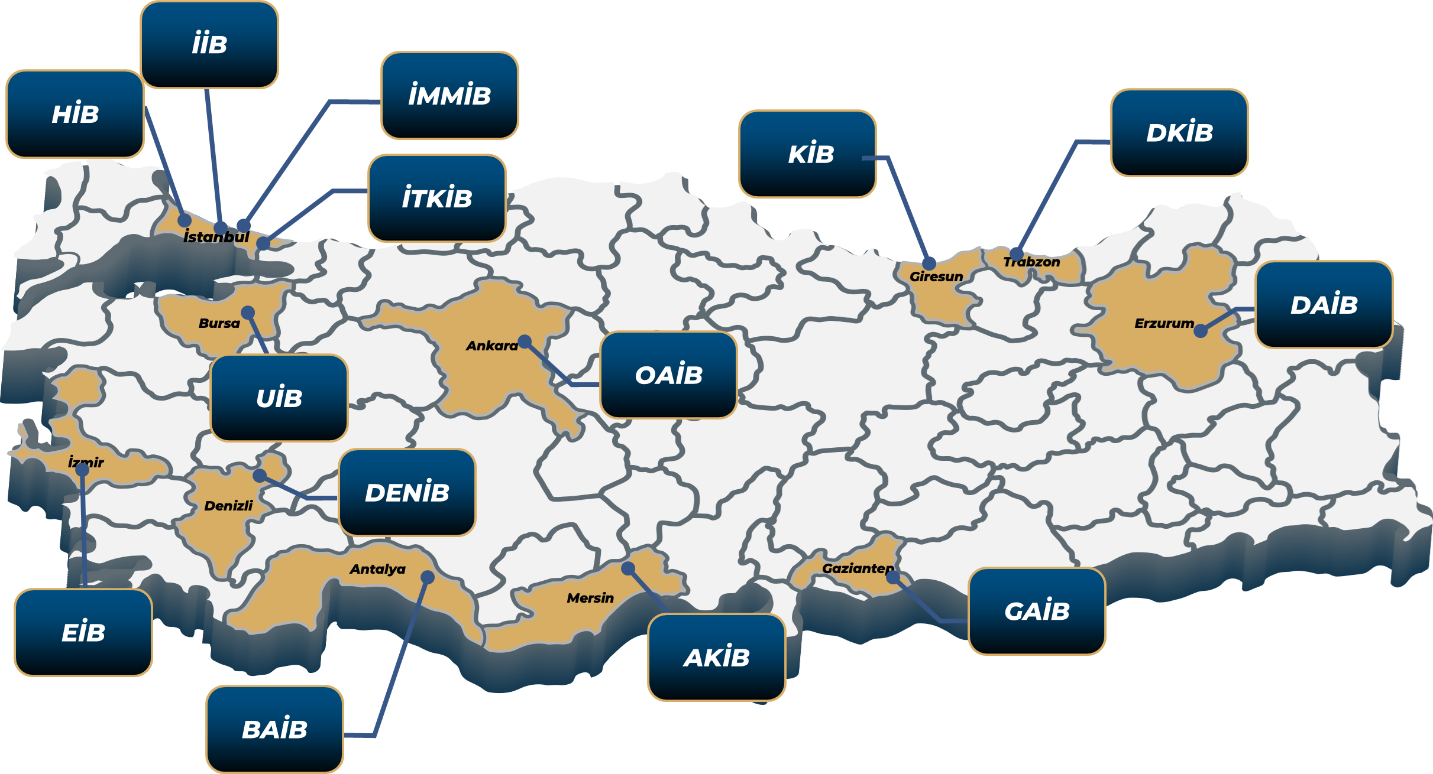
Türkiye Exporters Assembly and Exporters Associations
The institutional structure supporting our exporters plays a pivotal role in translating Türkiye’s export vision into concrete results.
Exporters Associations possess legal entity and operate with a special budget, with the primary aim of increasing exports both qualitatively and quantitatively, promoting foreign trade in line with export strategies.
This structure enables sector-based organization of exporters and contributes to the effective, inclusive, and broad-based implementation of foreign trade policies.
There are currently 61 Exporters' Associations operating under 14 General Secretariats.

Slide 13


Strategies and Policies Implemented to Enhance Merchandise Exports
Trade Fairs, Trade Delegations, EXPO
To expand exports through product and market diversification, increase the share of high-tech, high-value, brand- and innovation-led goods, and deepen Türkiye’s role in global value chains, we encourage our exporters’ participation in trade fairs, delegations, and bilateral business meetings.
Export Academy
Training and information activities are being consolidated under an institutional and academic framework to develop a well-equipped workforce in export expertise.
The Easy Export Platform
Through the AI-powered Easy Export Platform (KİP), companies can access—in one place—all the information they need, including target-market recommendations, potential importer data, and sectoral and country analyses.
Easy Export Platform For E-Commerce (E-KIP)
To consolidate all information our exporters need throughout the e-export process on a single platform.
Together with an AI-powered Smart E-Export Bot, to facilitate exporters’ selection of the right products, pricing, and global marketplaces.
THE EASY EXPORT PLATFORM

Slide 14
TARGET
Export Diversification Policies
While safeguarding our position in traditional export markets, we are developing market diversification strategies to expand access to new markets with high demand potential and strategic significance.
Faraway Countries Strategy
Strategy to Develop Exports with Member States of the Organization of Islamic Cooperation (OIC)
Target Countries in Exports
The Faraway Countries Strategy aims to develop trade with countries outside our immediate geography in order to enhance market diversity by increasing our exports.
Analysis identified 18 target markets: USA, Australia, Brazil, China, Indonesia, the Philippines, South Africa, South Korea, India, Japan, Canada, Malaysia, Mexico, Nigeria, Pakistan, Chile, Thailand, and Vietnam.
Based on analysis and consultations a total of 328 actions have been devised.
Goal: raise Türkiye’s average export range to the global average and reach $50 billion in exports to these 18 markets by 2028.
This Strategy has been launched, focusing especially on Gulf countries where trade is concentrated.
Through this strategy: The current 26% share of OIC countries in our exports is targeted to rise to 30% by 2028.
Promising export sectors and product groups have been identified, and—under the action plan—mechanisms and tools have been put in place to secure Turkish products’ access to these markets.
In line with the objectives of minimizing the potential impact of contraction in our traditional markets and guiding our exporters toward alternative markets, new target countries are identified each year based on multi-factor analyses of trade, diplomacy, and macroeconomic conditions.
As a result of comprehensive and objective analyses by our Ministry, 55 countries have been identified as Target Countries in Exports in 2025.

Slide 15



Export Financing
As the Ministry of Trade, we are working resolutely with all relevant institutions—chiefly Türk Eximbank, Türk Ticaret Bankası, and İGE A.Ş.—to diversify financing instruments for our exporters and improve their accessibility
Türk Eximbank, Türkiye’s official export credit agency, plays a complementary role by offering a wide array of export financing and insurance services.
By the end of 2024, the Bank has provided a record-high level of support totaling USD 48.7 billion.
2025 Target: USD 52 billion
Functioning as a public-private partnership, İGE A.Ş aims to improve exporters’ access to financing by providing guarantee mechanisms that reduce collateral requirements and enhance creditworthiness.
Currently, against the utilization of exporter loans totaling TRY 189,1 billion, guarantee support amounting to TRY 165,2 billion has been provided.
2025 Target: TRY 160 billion in loan guarantees
Having recently commenced operations, Türk Ticaret Bankası (TTB) aims to offer a broad suite of services—from meeting financing needs and lowering costs, to intermediating foreign trade transactions, developing SME-specific solutions, and supporting green transition projects.
In 2025, TTB aims to provide a total of TRY 75 billion in financing to exporters, expand to 11 branches, and raise the number of exporters using its loans to 1,000.

Slide 16
Action Tools and Policies Regarding Services Exports

Slide 17










Services Trade
Global Situation and Türkiye’s Share
Türkiye's Services Exports (Billion USD)
Global GDP’s 2/3 and employment’s 50% consist of service sectors.
(World Bank)
In Türkiye, 2/3 of the GDP and employment consist of service sectors, in line with other developed countries.
More than three-quarters of foreign direct investment in advanced economies flows into the services sectors.
Global service exports constitute 26.4% of international trade. (WTO)
Türkiye’s share in global exports of services realized as 1.32% in 2024.
Türkiye’s service exports have increased eightfold in 22 years, while it is worth 117 billion USD in 2024 compared to 14 billion USD in 2002.
Thus, the balance of services recorded a surplus of USD 61.4 billion in 2024. (5th in the World)
Tourism and logistics&transportation services are predominant sectors in Turkish service exports with 61 and 41 billion USD export revenues respectively.

Slide 18


Action Tools and Policies Regarding Services Exports
Trade Delegations/Buying Missions and Services Trade Fairs, Information-sharing Meetings
Trade delegations in which Turkish service providers visit potential buyers and their associations abroad.
Buying missions in which foreign service buyers visit Turkish service providers and sectoral associations.
International trade fairs in service sectors where Turkish service providers meet potential and former service buyers abroad.
National participation organisations in commercially important fairs in order to benefit from advantages of participating together, e.g., Turkish info-stands, interactive booths or experience zones.
Individual firm participations in international trade fairs in service sectors when there are few Turkish participants.
Conferences and courses including global and national developments related to trade in services.
Meetings with shareholders, including sectoral associations and companies, in order to guide the services sector in line with current affairs, economic and sectoral outlook.

Slide 19
Trade Diplomacy

Slide 20
Trade Diplomacy
Trade Diplomacy: An Effective Tool for Export Strategies
Türkiye’s Trade Diplomacy Instruments
Builds trust
Strengthens bilateral and multilateral economic relations/cooperation
Enhances market access through trade agreements
Creates enabling environment for exporters
An Extensive FTA Network (24 in force)
Strong diplomatic representation abroad (230 commercial counselors/attachés on 115 countries, 168 cities)
Participating actively in regional and international organizations
Joint Economic Commissions and business forums
Utilizing diplomatic channels to address trade disputes
Notes:
Trade is based on trust. Just as firms need to trust each in order to trade, the same goes for governments and trade diplomacy builds trust.
Trade diplomacy strengthens cooperation. Stronger diplomatic ties translate into stronger economic cooperation, which directly supports exporters. For example: let’s say you want to focus on increasing your exports to LDCs. You can make your exporters life easier by helping the LDC establish single window systems.
The most impactful outcome one can achive through trade diplomacy is an FTA. Yes, agreements are a process of give and take and there are a lot of things to consider before even thinking about negotiating one but keep in mind, a balanced FTA is always a win-win.
Türkiye actively uses trade diplomacy instruments to expand exports. Free Trade Agreements with priority markets open doors for Turkish goods and services. Trade counselors and attachés support companies on the ground, helping them navigate local markets. At the same time, Türkiye leverages regional and global platforms to influence rules and standards. Joint economic commissions and business forums create opportunities for Turkish exporters, while diplomatic channels ensure that potential trade disputes are addressed constructively.

Slide 21
Free Zones in Türkiye

Slide 22
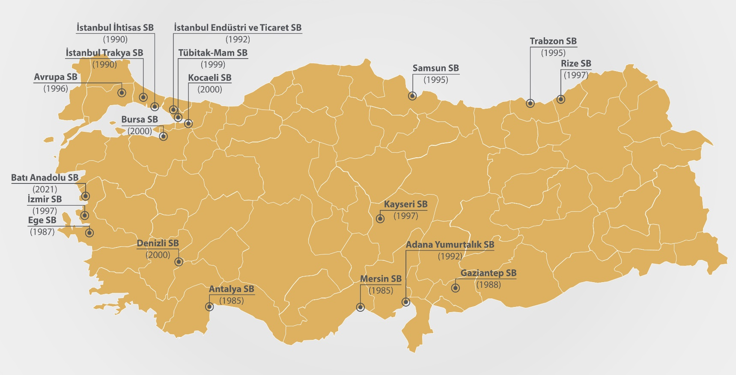
Main Objectives Of Turkish Free Zones
Location of Free Zones
  Promoting export oriented investment and production
  Accelerating foreign direct investment and technology transfer
  Directing enterprises towards export
  Developing international trade
Main Objectives

Slide 23



Key Indicators of Free Zones (2024)
19
10,42%
2.091
74,2%
Free Zones
(26,000 acres)
Share of hi-tech commodities in total sales
96,000+
12
Firms
(545 Foreign)
Share of exports in total sales
Employment
Billion $
Export

Slide 24
Export Performance (2002-2024)

Slide 25
Destination of Exports (2024)
By Countries
Main export destinations by countries
By Country Groups

