Slide 1
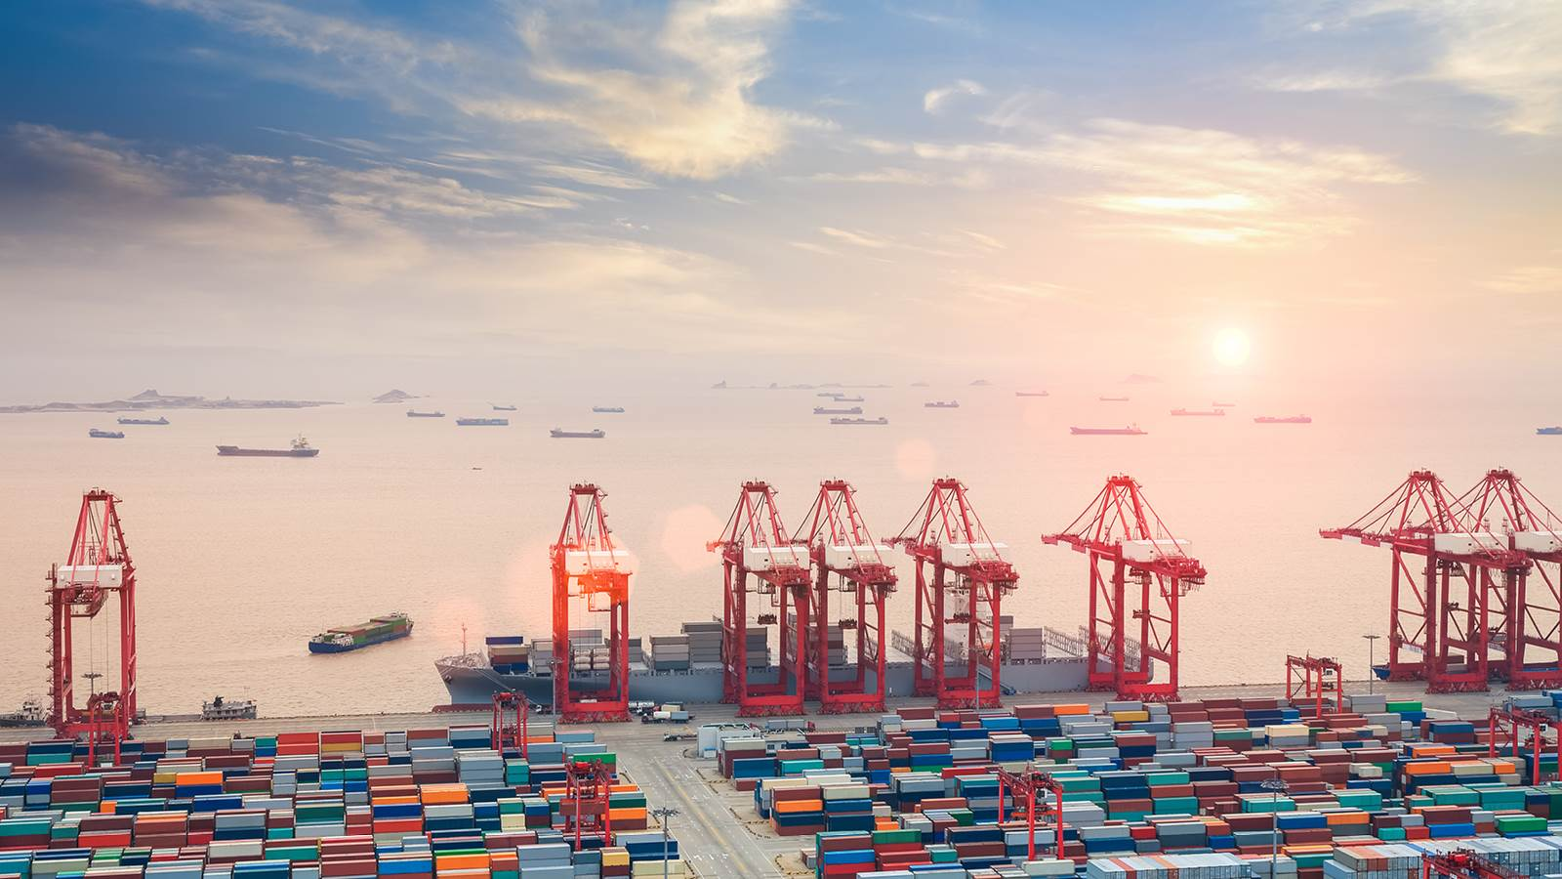


Supporting trade expansion
Dr Kenza Le Mentec
Institute for Training and Technical Cooperation
25TH MEETING OF THE COMCEC TRADE WORKING GROUP
(September 22 -23, 2025, Ankara, Türkiye)

Slide 2

WTO
What is it?
The World Trade Organization - a rules-based organization set up by governments to administer multilateral trade agreements (MTAs) and perform a number of other important functions
Established on 1 January 1995; incorporating the GATT which existed from 1 January 1948 - 31 December 1994
Membership: keeps on changing, but recent figure is 166 Members, 22 acceding. Consensus-based decision-making
Secretariat: around 650 people; different backgrounds and nationalities. Headed by a Director-General, Dr Ngozi Okonjo-Iweala. Offices in Geneva. No field offices.
Budget: 205 million Swiss francs

Slide 3






















What remains to be done?
22 ongoing accessions, plus ….
(By application date)
Lebanese Republic
Bosnia &
Herzegovina
Bhutan
Sao Tomé & Principe
Somalia
Iran
Bahamas
Syrian
Arab Rep.
Libya
Iraq
Serbia
Belarus
Sudan
-Uzbekistan
Algeria
Azerbaijan
Andorra
Ethiopia
Equatorial
Guinea
Curaçao
Turkmenistan
South Sudan
2022
1987
1993
1996
1997
1999
2001
2003
2004
2005
1994
2007
2105
2017
2020

Slide 4
WTO
Main functions
Administering and implementing the multilateral
and plurilateral trade agreements
Forum for multilateral trade negotiations
Dispute settlement
Overseeing national trade policy
Co-operation with other international organizations. IMF and the World Bank (coherence in global economic policy-making)
Technical Assistance and training
Art. III
WTO Agr.

Slide 5
The WTO Agreements
WTO Agreement
(Marrakesh Agreement Establishing the WTO and its Annexes)
Annex 1
Annex 2
Annex 3
Annex 4
1A
1B
1C
General Agreement on Trade in Services and Annexes
Agreement on Trade Related Aspects of Intellectual Property Rights
Understanding on Rules and Procedures Governing the Settlement of Disputes
Trade Policy Review Mechanism
Plurilateral Trade Agreements
Multilateral Agreements on Trade in Goods
Ministerial Declarations and Decisions

Slide 6
Annex 1A
Multilateral agreements on trade in Goods
GATT 1994 (General Agreement on Tariffs and Trade)
Understandings
Marrakesh Protocol
Agreements on:
1A
Multilateral
trade agreement
on trade in goods
Agriculture
Customs valuation
Sanitary and phytosanitary measures
Preshipment inspection
Textiles and clothing
Rules of origin
Technical barriers to trade
Import licensing
Goods
Trade-related investment measures (TRIMS)
Subsidies and countervailing measures
Safeguards
Antidumping
Trade Facilitation Agreement

Slide 7
WTO
Ministerial Conferences
Singapore (1996), Geneva (1998), Seattle (1999)
Doha (2001) - Doha Development Agenda (New Round of Trade Negotiations)
Cancun (September 2003)
Hong-Kong, China (December 2005)
Geneva, 30 November - 2 December 2009
Geneva, 15-17 December 2011
Bali, Indonesia – December 2013
Nairobi, Kenya – December 2015
Buenos Aires, Argentina – December 2017
Geneva (MC12) – June 2022
Abu Dhabi (MC13) – February 2024
Cameroon MC14 – 26 – 29 March 2026

Slide 8
Supporting effective trade policies
What avenues for OIC Members?
Accession process: Trade Policy Reform promoting sustained export growth
Trade Policy Review Mechanism
WTO Trade Monitoring Exercise
Transparency/notifications
Online resources (ePing, Rules of Origin Facilitator, AG-IMS, eGPA, etc.)
WTO Technical assistance programme
Specific technical assistance and capacity building programmes (STDF, EIF and TFAF)
Implementation of Investment Facilitation for Development Agreement (needs assessments)

Slide 9
Trade Policy Review Mechanism (TPRM)
WTO has many objectives, among which:
NON-DISCRIMINATION
PREDICTABILITY
TRANSPARENCY
At the WTO, Members agree that TRANSPARENCY is enhanced mainly through the TPRM, and also through notifications and the trade monitoring exercise.

Slide 10

TPRM is not
  a basis for enforcement
  for dispute settlement
  to impose new policy commitments

Slide 11
TPRM
Benefits
WTO
Only time all trade-related policies examined
Examples for other Members
Equality of treatment
Domestic constraints on trade policy explained

Slide 12
TPRM
Benefits
Members
Domestic policy development
Inter-agency cooperation
Technical cooperation needs
Coherence among policies
Coherence between:
  Policy and law
  Law and practice

Slide 13
Frequency of reviews
Frequency based on share of world trade (imports and exports of goods and services)
Top 4 – every 3 years: EU, United States, China, Japan
Next 16 – every 5 years
Other Members – every 7 years
Notes:
Frequency changed from 2019

Slide 14
Basis for review
Annex 3, pragraph C(v)
1. Government report
Policy statement by Government
  Up to the authorities
  Shorter
2. WTO Secretariat report
Secretariat responsibility
  Up to the Secretariat
  Longer
Two reports are complementary

Slide 15
Government Report
POLICY STATEMENT
FORWARD LOOKING
AVOID REPEATING THE CONTENT OF THE SECRETARIAT REPORT
INDICATE FUTURE DIRECTION OF KEY TRADE AND TRADE-RELATED POLICIES.
10-15 pages

Slide 16
Secretariat Report
SECRETARIAT REPORT SEEKS TO:
REVIEW MAIN TRENDS AND DEVELOPMENTS SINCE PREVIOUS REVIEW (OR SINCE ACCESSION TO THE WTO);
EVALUATE TRADE AND TRADE-RELATED POLICIES AND MEASURES;
TPR PROCESS HELPS PREPARE MEMBER UNDER REVIEW FOR TPRB MEETING.

Slide 17
Sections of the Secretariat report
1. Economic Environment
2. Trade and investment policy framework
3. Trade policies practices by measure
4. Trade policies in selected sectors

Slide 18
Participating WTO Members | Latest TPR | Executive Summary
Jordan | 27-29 September 2023 | s446_sum_e.pdf
Indonesia | 9-11 December 2020 | s401_sum_e.pdf
Uganda | 20-22 March 2019 | s384_sum_e.pdf
Pakistan | 30 March - 1 April 2022 | s424_sum_e.pdf
Bahrain | 24-26 November 2021 | s419_sum_e.pdf
Brunei-Darussalam | 27-29 November 2924 | s464_sum_e.pdf
Bangladesh | 3-5 April 2019 | s385_sum_e.pdf
Tajikistan | 6 -8 December 2021 | s399_sum_e.pdf
Türkiye | 13-15 November 2023 | s439_sum_e.pdf
Chad (CEMAC) | 20-22 September | s445_sum_e.pdf
Togo (WAEMU) | 25-27 October 2017 | s362-00_sum_e.pdf
Tunisia | 13-15 July 2016 | s341_sum_e.pdf
KSA | 3-5 March 2021 | s407_sum_e.pdf
Senegal(WAEMU) | 25-27 October 2017 | s362-00_sum_e.pdf
Sierra Leone | 15 and 17 April 2025 | s470_sum_e.pdf
Oman | 17-19 November 2021 | s418_sum_e.pdf
Qatar | 6- 8 April 2021 | s408_sum_e.pdf
Kazakhstan | 25-27 September 2024 | s459_sum_e.pdf
Kuwait | 7-9 February 2012 | s258_sum_e.pdf
Malaysia | 8 – 10 February 2023 | s436_sum_e.pdf
Egypt | 20-22 February 2018 | s367_sum_e.pdf
Morocco | 22 -24 April 2024 | s453_sum_e.pdf
Mozambique | 1-3 July 2024 | s456_sum_e.pdf

Slide 19
The WTO Trade Monitoring Exercise
Origin - 2008-2009 Global Financial Crisis - WTO Trade Monitoring Exercise launched in early 2009 to provide WTO Members and Observers with regular updates on all trade and trade-related measures implemented in the context of the crisis.
Also in early 2009, G20 Leaders mandated the WTO, together with other international bodies, to monitor and report publicly on G20 adherence to resisting protectionism and promoting global trade and investment.
2 Trade Monitoring reports are circulated per year (previously 4) - 1 WTO-wide report and 1 G20 reports – in cooperation with OECD and UNCTAD.
Considerable media coverage given the unique nature of the reports/products.
Further information is available at the WTO Trade Monitoring webpage: https://www.wto.org/english/tratop_e/tpr_e/trade_monitoring_e.htm

Slide 20
The WTO Trade Monitoring Exercise
The only regular and cross-cutting transparency exercise within the multilateral trading system. It has systemic and political importance.
Providing regular snapshots of the latest trends in the implementation of new trade and trade-related measures and on developments in the trade policy-making.
Inclusive platform for a multilateral peer review of trade issues in general, and trade policies in particular. A transparency exercise, NOT a legal exercise.
Information in the reports – factual, derived from multiple sources, including notifications – is verified by Members. Important stakeholder relationship.
Further information is available at the WTO Trade Monitoring webpage: https://www.wto.org/english/tratop_e/tpr_e/trade_monitoring_e.htm

Slide 21
Issues covered in the Reports
Recent economic and trade developments
Sanitary and Phytosanitary (SPS) measures
Technical Barriers to Trade (TBT) measures
Trade concerns
Policy developments in Agriculture, Services, IP
Selected trade policy issues
Transparency of trade policies
Topical/analytical boxes
Notes:
The information contained in the Trade Monitoring Reports comes from different sources:
Contributions from other WTO bodies (SPS, TBT, etc.)
Trade and trade-related measures:
found by WTO Secretariat and sent to Delegations for VERIFICATION
communicated to the Secretariat directly by Delegations

Slide 22
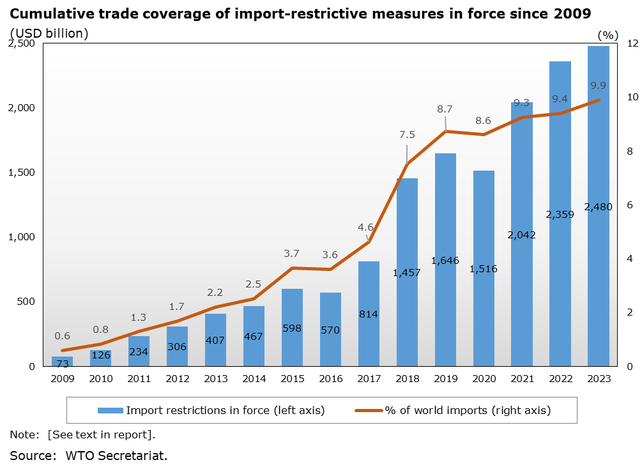
Example of information in Reports

Slide 23
Examples of measures
Goods - Liberalizing
Angola, 1/1/16: Temporary elimination on import tariffs on horse mackerel fish, under an import quota of 90,000 tonnes
Source: Presidential Decree No. 20/16 (January 2016)
Trade Remedies
Dominican Republic, 28/1/16: Initiation on 28 January 2016 of anti-dumping investigation on imports of corrugated or deformed steel rods and bars for concrete reinforcement from China.
Provisional and definitive duties imposed on 11 July 2016 and 25 January 2017, respectively.
Source: WTO document G/ADP/N/300/DOM, 16 October 2017
Services
Benin, 17/02/20: Benin's Agency for the Promotion of Investments and Exports launched a new online platform allowing all regulatory processes required to open a business to be conducted digitally, at lower costs and more promptly.
Source: https://cio-mag.com/le-benin-lance-sa-plateforme-de-creation-dentreprise-en-ligne/
IP
Chile, 2/4/22: INAPI contributed to the elaboration of the public domain patent report on technologies to combat COVID-19.
Source: https://www.inapi.cl/sala-de-prensa/detalle-noticia/oficinas-de-prosur-publican-informe-de-tecnologias-de-dominio-publico-para-enfrentar-efectos-de-crisis-sanitaria

Slide 24
Trade measures are publicly available
Trade Monitoring Database
(Goods, Services, IP measures)
http://tmdb.wto.org

Slide 25
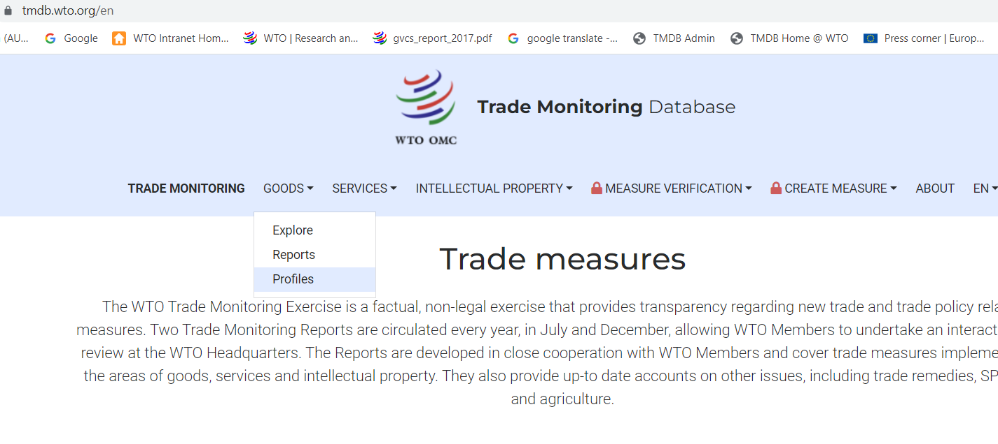

Slide 26
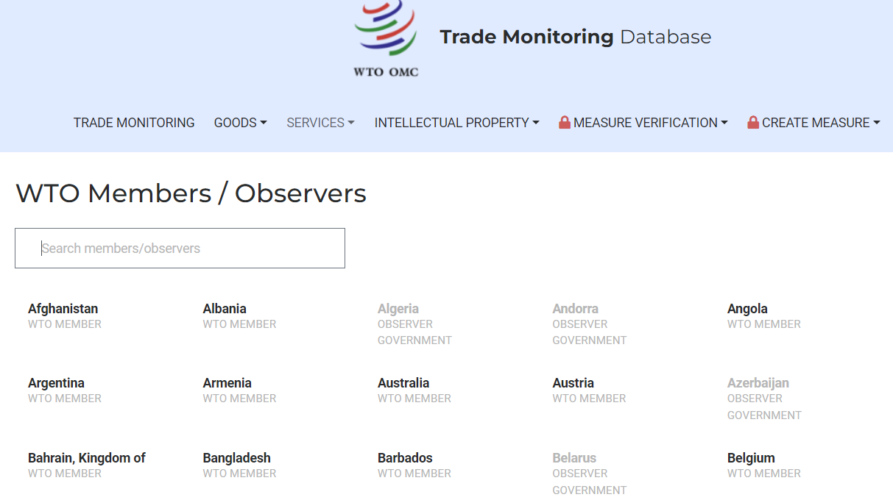
Bahrain

Slide 27
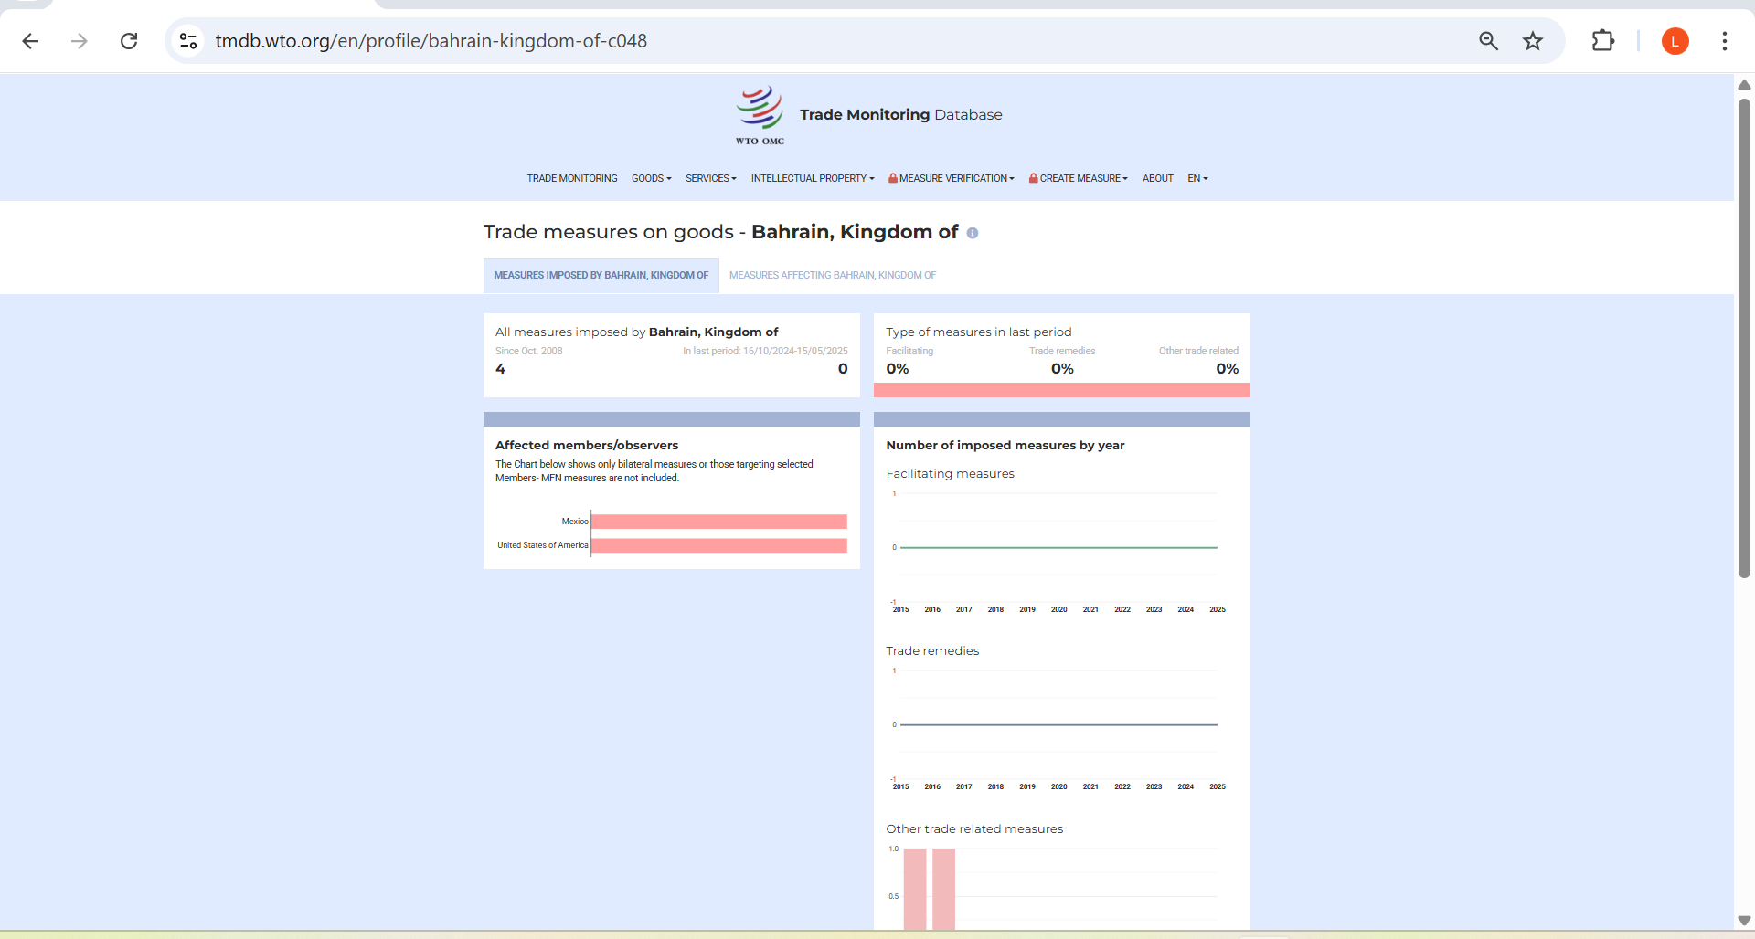

Slide 28
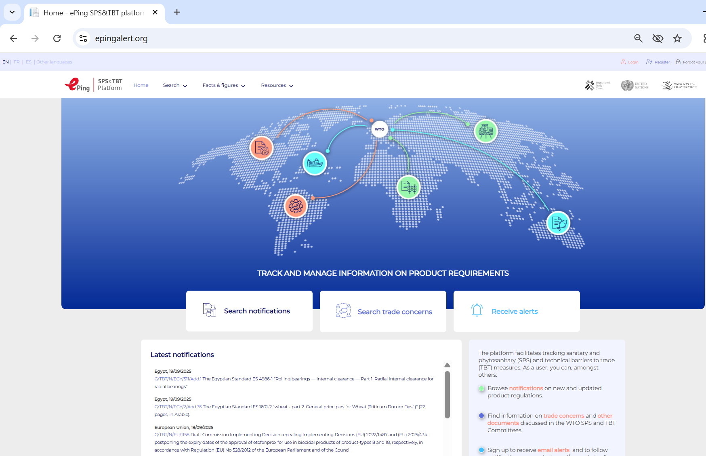
ePing
https://www.epingalert.org/

Slide 29
Rules of Origin Facilitator
https://findrulesoforigin.org/

Slide 30
Rules of Origin Facilitator
https://findrulesoforigin.org/

Slide 31
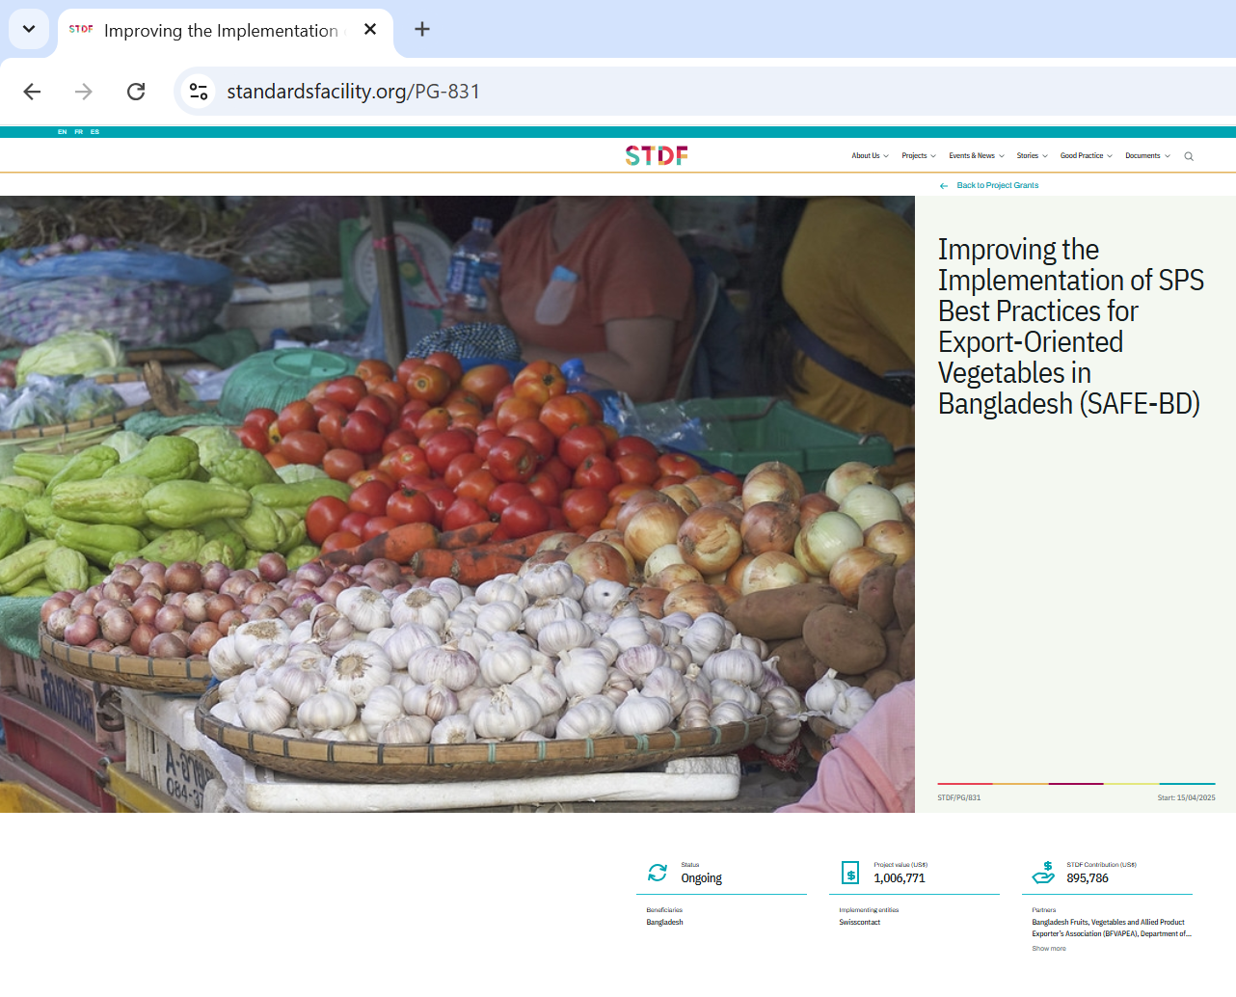
Standards and Trade Development Facility
https://standardsfacility.org/

Slide 32
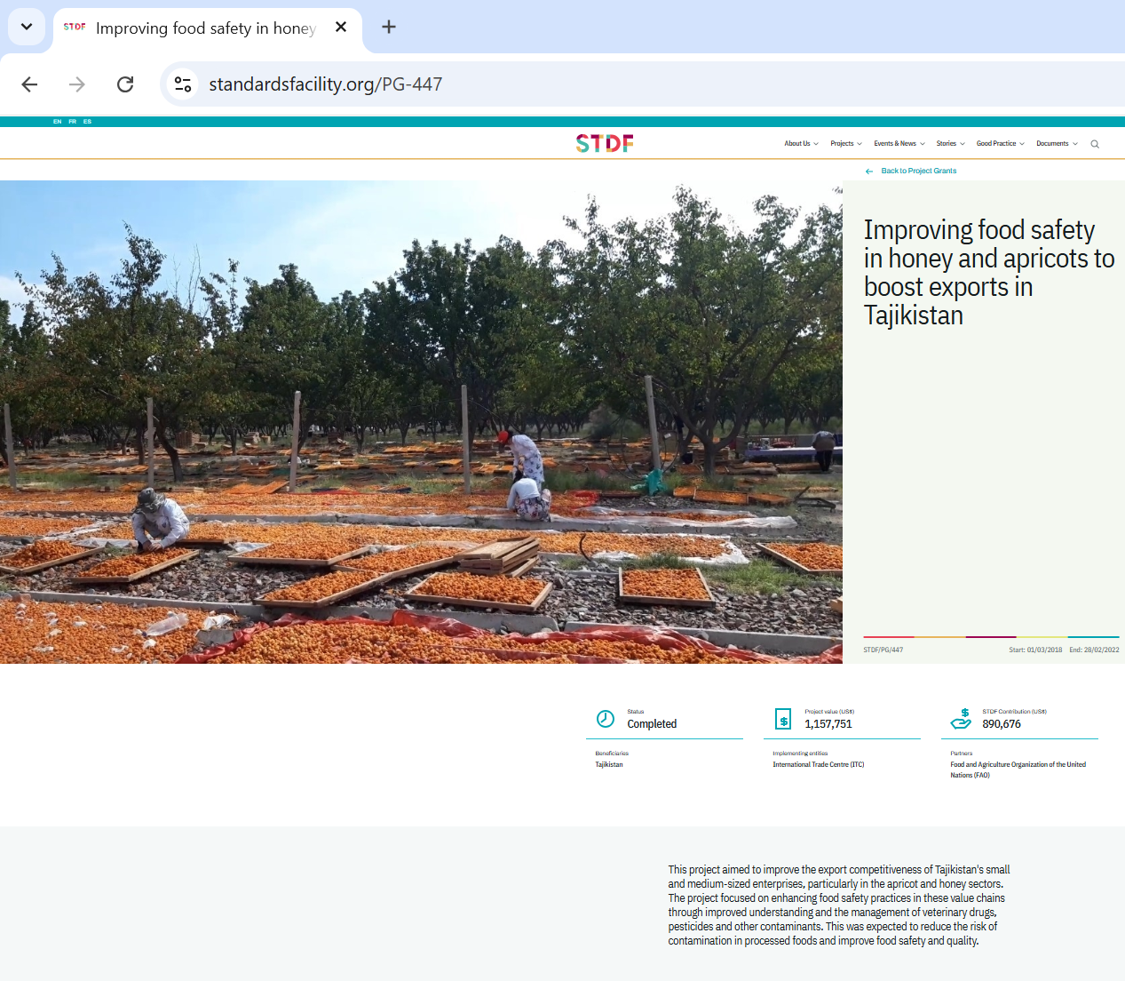
Standards and Trade Development Facility
https://standardsfacility.org/

Slide 33
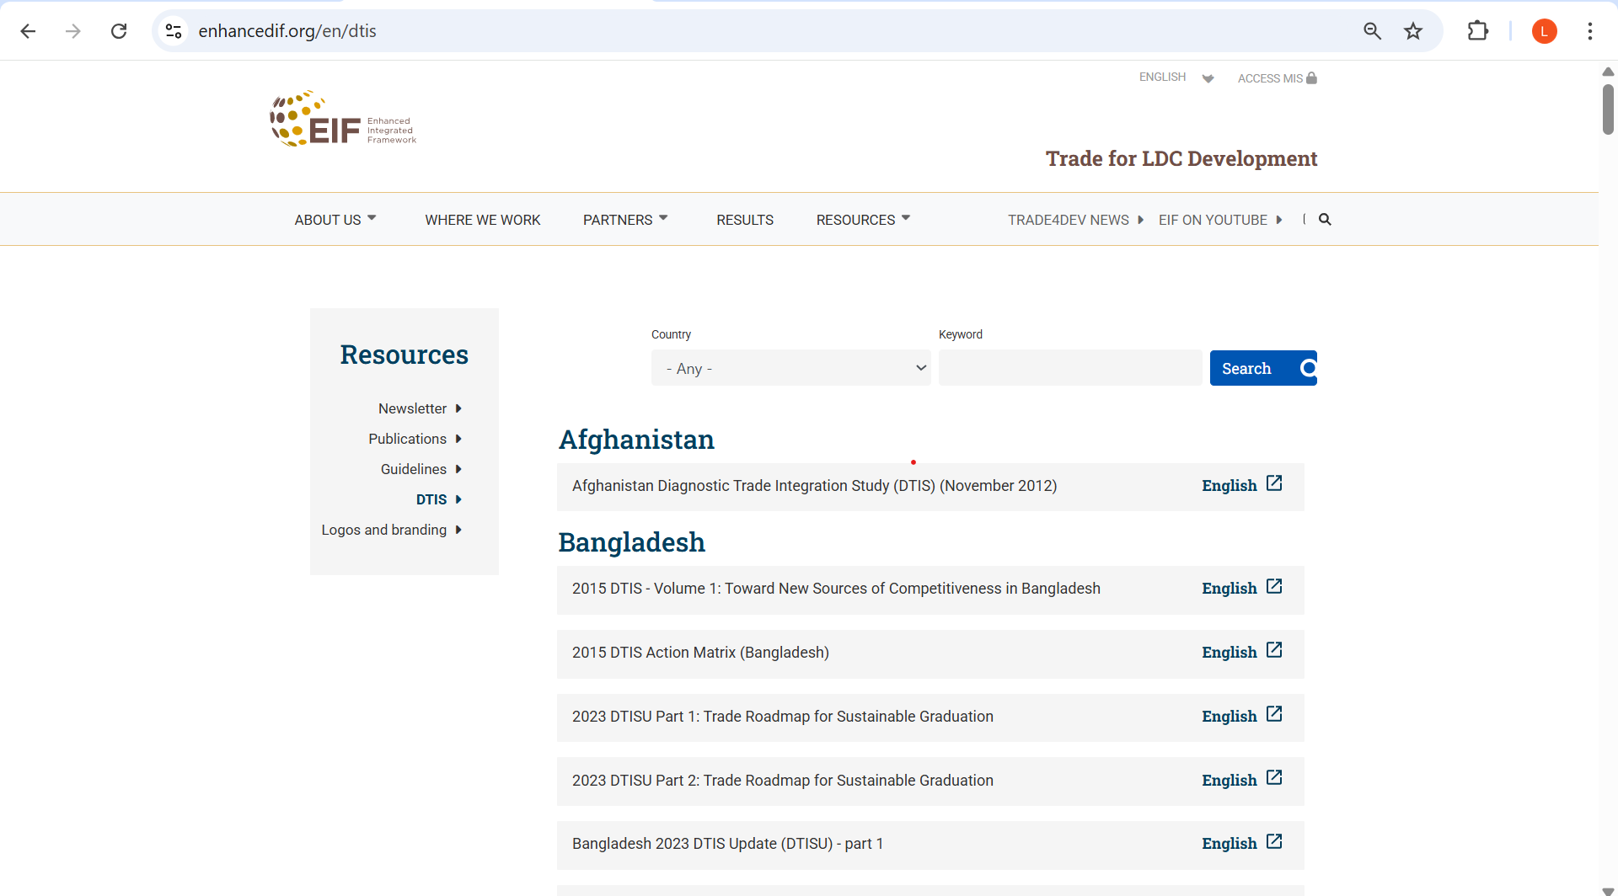
Enhanced Integrated Framework
Diagnostic Trade Integration Studies (DTIS)
https://www.enhancedif.org/en

Slide 34
Thank you.

