Slide 1



25th meeting of COMCEC agriculture Working Group
22-23 SEPTEMBER 2025
COUNTRY PRESENTATION
BY
FATOU JAMMEH TOURAY
DPS – PP & comcec focal point
The gambia

Slide 2
PRESENTATION OUTLINE
INTRODUCTION
GAMBIA SMALL-SCALE PRODUCERS PROFILE
Small ruminants PRODUCTION ENHANCEMENT FOR smallholder farmers
General CHALLENGES
Government INITIATIVES
OPPORTUNITIES FOR GROWTH
CONCLUSION AND RECOMMENDATION

Slide 3
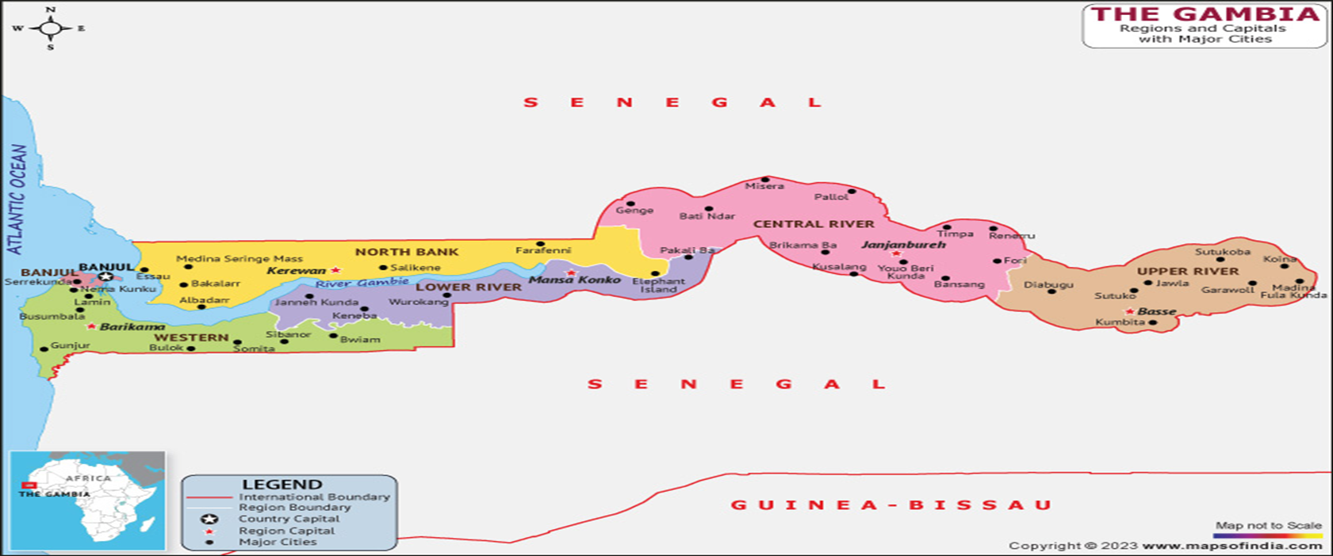
INTRODUCTION
The Gambia, one of the smallest country in main land Africa is situated at latitude 13 degrees, 27’ North and Longitude 16 degrees 34’ West and located on the estuary of the River Gambia, 26 nautical miles away from the Atlantic Ocean.
The Gambia is also known as the “Smiling Coast of Africa”.
Agriculture serves as the backbone of The Gambia's economy, with a substantial segment of the population depending on it for their livelihoods.
The sector contributes approximately 20-30% to the country's GDP and employs over 70% of the population, either directly or indirectly.
Most rural households rely heavily on agriculture for subsistence, income generation, and overall economic stability.

Slide 4
Introduction Cont...
The main agricultural activities in the Gambia, mainly by Small – Scale producers include:
Crop production: Focused on:
  Groundnuts (peanuts) – the main cash crop
  Cashew Nuts – also cash crop and gaining prominence
  Millet, sorghum, maize, and rice – mainly staple foods.
  Rice is the main staple crop with (an average of 8 tons per hectare for commercial farms and around 2.5 tons per hectare for farmer managed plots)
Horticulture: Increasingly important, with vegetables (onions, tomatoes) and fruits (mangoes, citrus) grown mainly by women.
Livestock: Cattle, sheep, goats, and poultry are raised primarily for local consumption.
Fisheries: A growing sector, both inland and marine, with increasing export potential.

Slide 5
GAMBIA SMALL-SCALE PRODUCERS PROFILE
Demographics:
The vast majority of Small - Scale Agriculture producers are family-run operations.
Characterized by small landholdings, often less than two hectares.
Many are women, who play a crucial role in cultivation and processing
Most women are also into Community Gardening to produce vegetables for both economic and nutrition
Economic Contribution:
Account for over 70% of agricultural output.
Are the primary providers of food for the domestic market.
Their success is directly linked to rural development by providing jobs and promoting economic activity in communities.
Small-scale agriculture is vital to The Gambia’s economy, supporting many livelihoods across the country.

Slide 6
SMALL-SCALE COMMUNITY GARDENS PROFILE CONT.
Average size per Garden – 5 ha. Fenced with water facilities.
Cold storage facilities and Agro-logistic centers to curb post harvest losses in vegetable and fruit production.
Average number of women per Garden is 75
Most non functional gardens have problems with the water infrastructure
These women and youth are provided with inputs ranging from quality seeds, garden tools and fertilizer.
NO | REGION | STATUS OF GARDEN
 |  | FUNCTIONAL | NON - FUNCTIONAL
1 | CRR/N | 28 | 8
2 | CRR/S | 47 | 12
3 | LRR | 64 | 22
4 | URBAN | 7 | -
5 | NBR | 57 | 33
6 | WCR | 113 | 28
7 | URR | 58 | 25
 | TOTAL | 374 | 128

Slide 7
Small ruminants PRODUCTION ENHANCEMENT FOR smallholder farmers.
The first ever small ruminant production Enhancement Project being implemented in the Gambia for smallholder ruminant breeders and Fatteners; targeting women and youth.
Infrastructural development for both production and health is at the center of this project’s activities.
A large ruminant production enhancement proposal has jus been submitted by the GOTG to IsDB for funding.
BREEDING SCHEMES: 30
FATTENING SCHEMES: 30
SMALL RUMINANT MARKETS: 10
VETERINARY DRUG OUTLETS: 15
COMMUNITY PASTURES: 20
INDIVIDUAL PASTURES: 21
SOLAR POWERED ANIMAL WATERING FACILITIES: 21
MEAT STALLS WITH REFRIGRATION: 10
MILK COLLECTION AND PRESERVATION CENTRES: 3
MINI DAIRIES: 2
SLAUGHTER FACILITIES: 10

Slide 8
Small ruminants PRODUCTION ENHANCEMENT FOR smallholder farmers CONT.
280 Poultry schemes supported across the country
180 layer schemes and 100 broiler schemes
Matching grants for SMEs, Farmer Organizations and Individuals to boost production and productivity across different value chains.(GIRAV and ROOTS)
Matching grants specifically for women and youth (ROOTS)
Equipped the Central Veterinary Laboratory of the Gambia
Construction of Farmer Demonstration Training Centre with animal pens and a 6ha pasture field
Model Animal Pens a 8ha pasture field for the Gambia’s genetic improvement center.
Islamic microfinance credit facility across all regions of the country
USD 3 Million is disbursed to 2 MFIs for livestock farmers to access loans through the Sharia model

Slide 9
General CHALLENGES
Despite its importance, The Gambia faces several challenges in its agriculture sector.
Declining soil fertility,
Pest infestations,
Unsustainable farming practices,
Customary land systems (Which restrict expansion and investment).
Irregular rainfall
Inadequate access to credit, extension services, and modern inputs (e.g., fertilizers, machinery)
In adequate rural roads limited productivity and threatened food and nutrition security.

Slide 10
General CHALLENGES CONT.
Agriculture is mainly rain-fed and relies on smallholder, subsistence farming, with limited diversification.
Many rural farmers lack adequate knowledge and skills in good agricultural practices and climate-resilient techniques, which restricts them from producing surplus for sale.
Post-harvest losses are a significant issue, caused by poor storage facilities, the absence of processing practices, low value addition, and limited market access beyond the districts.
These losses reduce farmers’ income and hinder overall agricultural development.

Slide 11
Government INITIATIVES
The Government of The Gambia (GoTG) and its partners have instituted several initiatives including:
Recovery Focused National Development Plan (2023–2027): Emphasized agriculture as a key sector for inclusive growth and poverty reduction.
Aligned its policies with AU 2003 Maputo and KAMPALA declarations.
ROOTS Project-Targeting climate resilience, access to markets, empowering women and youths in vegetable and rice schemes
The Gambia Agriculture and Food Security project (GAFSP) – Structure food demand to assure institutional markets and improve smallholder farmer productivity.

Slide 12
Government INITIATIVES CONT.
Strengthened Research and Agricultural Extension Systems through NARI, DoA, DLS, DoCD, DoP etc
Transformation of the Agribusiness Unit of the Department of Agriculture to the Department of Cooperative Development to better coordinate like-minded SHFs
All agricultural projects target 80% women, 25% youth, and 10% persons with disability (reflecting the national average)
Agroecology Project-Targeting integrated and sustainable agricultural practices.
Gambia Inclusive and Resilient Agricultural Value Chain Development Project (GIRAV) It focuses on supporting smallholder farmers, improving sustainable farming practices, and increasing market access.
REWARD – Gambia project focusing on the Rice Value Chain
Small Ruminant Production Enhancement Project

Slide 13
Government INITIATIVES CONT.
GAMIRSAL PROJECT: The project development objective is to increase access to lending from Financial Institutions (FIs) to actors in agricultural value chains. The project specific objectives are : i) increase access of FIs to risk mitigating instruments to crowd in investments in the agricultural sector;
ii) improve FIs' knowledge of the agricultural sector and skills in analyzing, financing, and managing agricultural project portfolios, including climate risk mainstreaming in investment portfolio; and iii) improve skills of agriculture value chains' actors in business governance

Slide 14
OPPORTUNITIES FOR GROWTH
In this light, there are several opportunities for economic growth and collaboration with China and other developing countries. These include:
Value addition: Agro-processing industries (for groundnuts, fruits, vegetables and cereals)
Export potential: Especially in organic and fair-trade products.
Tourism-agriculture linkage: Supplying hotels and restaurants with local produce.

Slide 15
OPPORTUNITIES FOR GROWTH CONT.
Technology and innovation: Mobile platforms for market access, digital extension services.
Machinery and equipment development for the Gambian condition
Climate-smart agriculture: Conservation farming, improved irrigation systems, and drought-tolerant crops.
Capacity building in project and cooperative management, Management information systems, on hands training on modern production techniques in agriculture, Community Governance, Irrigation Infrastructure Maintenance and Management

Slide 16
CONCLUSION AND RECOMMENDATION
The path forward for agricultural economic development in The Gambia includes:
Strengthening Capacity of Small-Scale Producers on climate smart and innovative agricultural techniques.
Scaling up investment in agri-infrastructure and value chains.
Enhancing more research and innovation.
Promoting inclusive participation, especially of women and youth.
Encouraging public-private partnerships.
Provide Climate Resilience seeds for both crops and animals.
Facilitate access to affordable finance
Timely access to quality inputs

Slide 17
CONCLUSION AND RECOMMENDATION
Reduce cost of production.
Encourage and build capacity on organic farming.
Develop policies to promote access to land by smallholder farmers especially youth and women.
Create market opportunities.
Mechanize to suit their land capacity.
Build capacities on sustainable feed production and storage techniques.
Provide climate resilience storage facilities.
Improve water management in the face of erratic rains.
Encourage rain water harvesting.

Slide 18
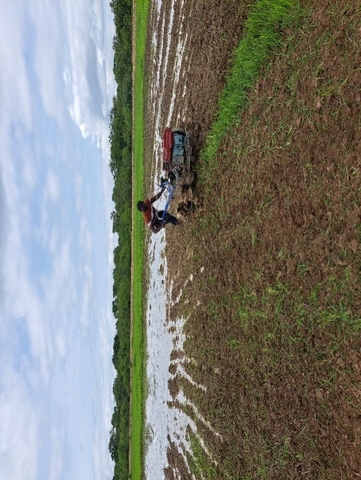
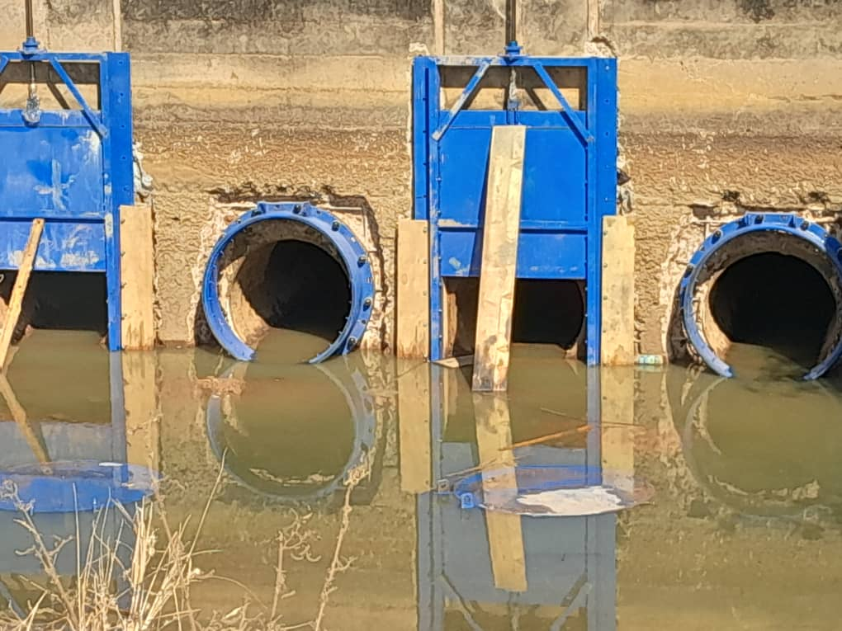
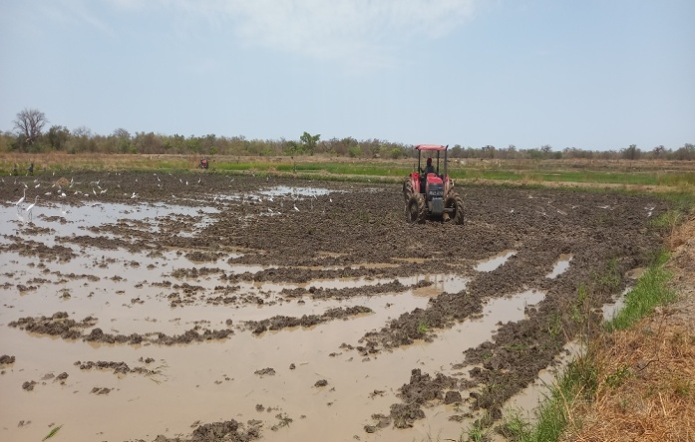
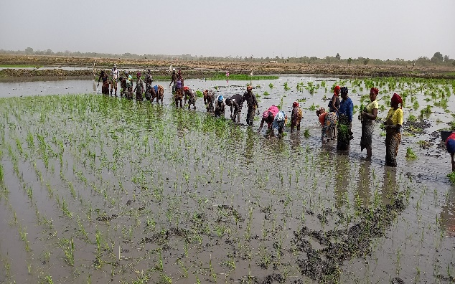
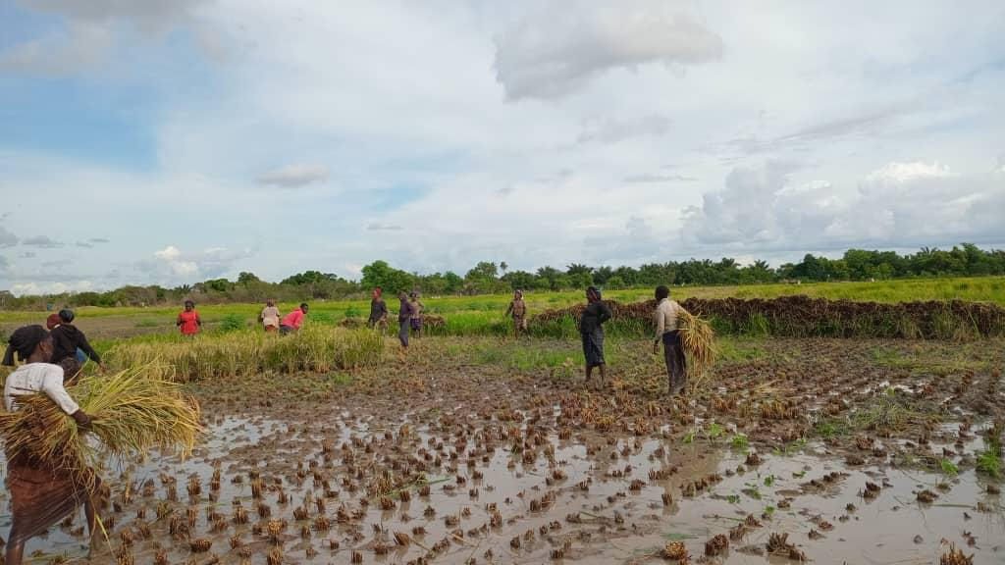
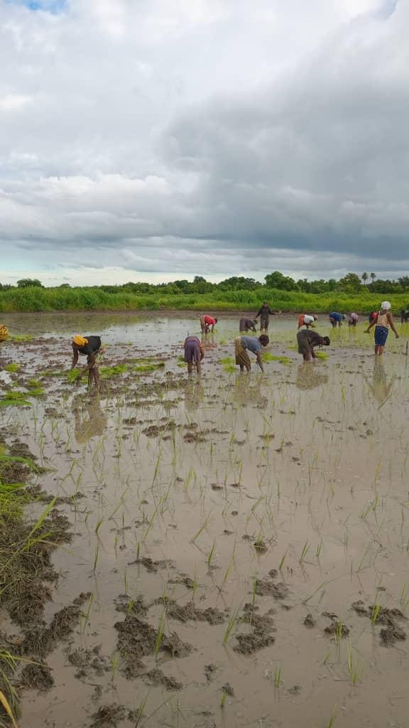
PICTORIAL OF SMALL – SCALE RICE PRODUCTION

Slide 19
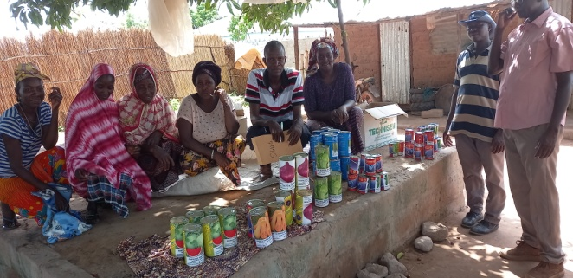
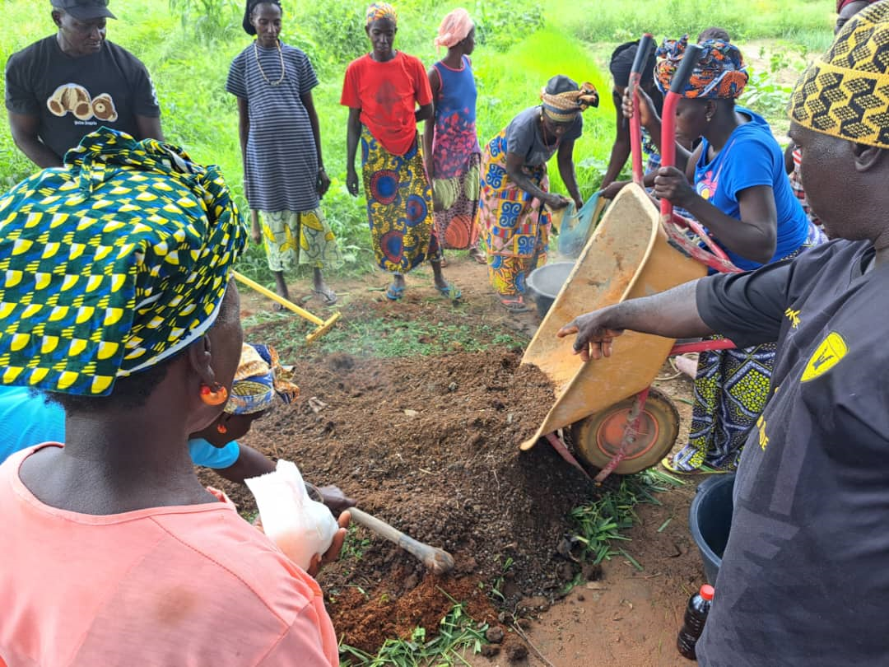
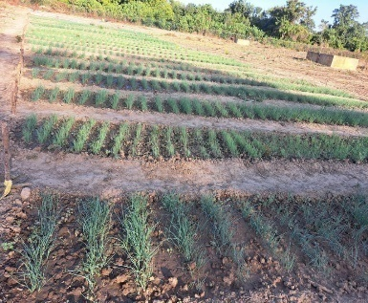
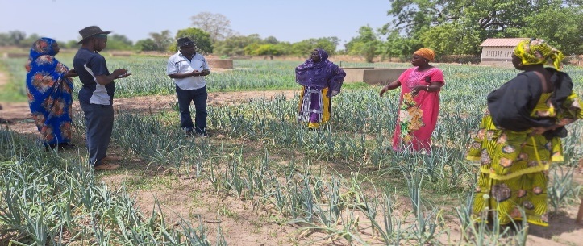
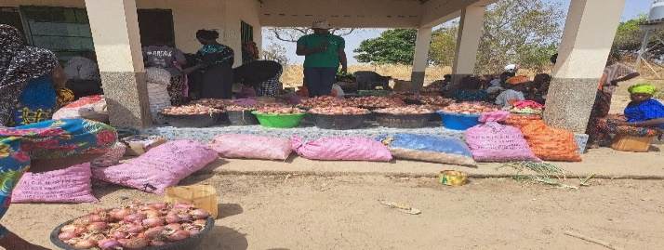
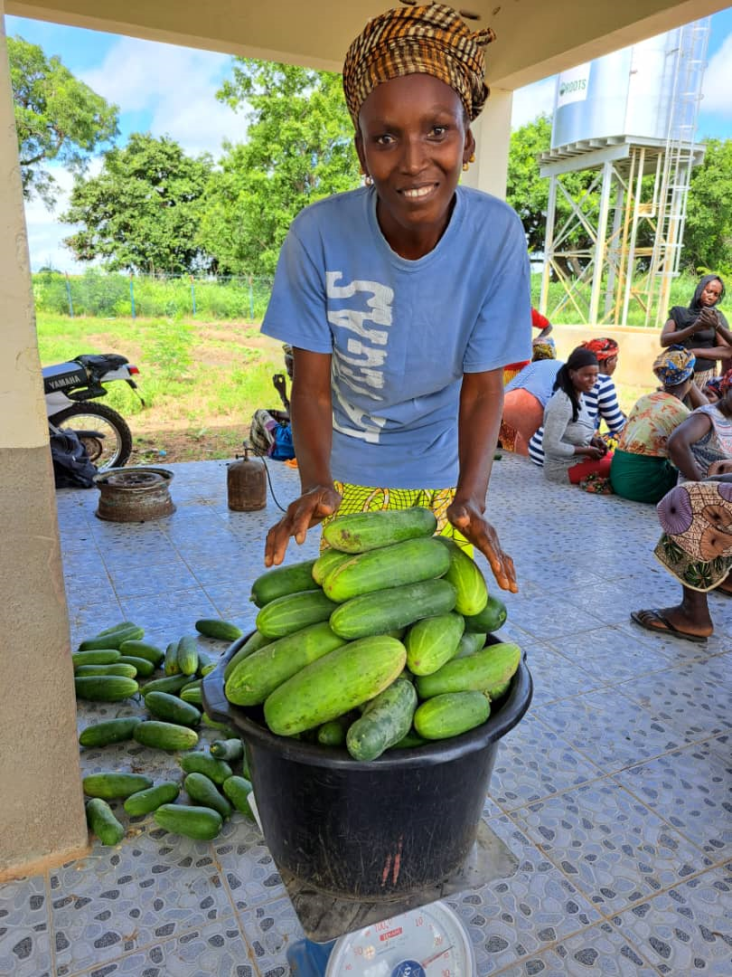
PICTORIAL OF SMALL – SCALE VEGETABLE PRODUCTION

Slide 20


