Slide 1


TPS-OIC
Current Status and Recent Developments
Gürkan Polat
Director-CCO
October 1, 2025

Slide 2
Background
TPS-OIC in a Nutshell
1980’s: The idea for establishing a trade preferential system among the member states -
The most important project of the COMCEC in the field of trade for fostering intra-OIC trade
Objective: to promote intra-OIC trade through exchange of trade preferences among the Member Countries
1
2
3
The necessary basis for enhancing intra-OIC trade and advanced trade arrangements
The negotiations were held under the Trade Negotiating Committee (TNC), established and supervised by the COMCEC.
4
5
6
TNC Secretariat: COMCEC Coordination Office and ICDT
Notes:
Following the entry into force of the Framework Agreement, the COMCEC established the Trade Negotiating Committee (TNC) in 2003. The main function of the TNC is to embark on negotiations for achieving the objectives of the Framework Agreement
The Committee shall also be responsible, on behalf of the COMCEC, for
reviewing the application of the Agreement
monitoring the implementation of the results of the negotiations,
carrying out consultations,
making recommendations and suggesting decisions as required

Slide 3
Timeline
Basic principles (Declaration of Intent) was adopted by COMCEC
The required number of 10 ratifying states for the entry into force of the Framework Agreement was reached
Ministerial declaration of the COMCEC for the launching of the First Round of TPS-OIC Negotiations.
First Round of Negotiations (Antalya round, 4 meetings) producing the Preferential Tariffs Scheme (PRETAS)
Ministerial Declaration for the launching of the Second Round of Negotiations.
The Framework Agreement was adopted by the COMCEC
1990
2003
2006
1988
2002
2004-2005
Notes:
COMCEC adopted Basic principles (Declaration of Intent) that should guide the efforts for the establishment of a trade preferential system in 1988
İn 1990 The Framework Agreement was adopted by the COMCEC, and presented to the signature and ratification by the Member States.
In 2002 The required number of 10 ratifying states for the entry into force of the Framework Agreement was reached.
In 2003,

Slide 4
Timeline
Ministerial Declaration for submitting the Rules of Origin for signing and ratification, and adopting the date of January 1st, 2009 for the operationalization of the System
The required number of 10 ratifying states for the entry into force of the PRETAS was reached.
The required number of 10 ratifying states for the entry into force of the Rules of Origin was reached.
The required number of at least 10 member states that have both ratified all the three agreements and submitted their concessions lists was reached.
Second Round of Trade negotiations (Ankara Round, 4 meetings) producing the TPS-OIC Rules of Origin.
The Effectuation of TPS-OIC
July 1st, 2022
2007
2011
2006-2007
2010
2014

Slide 5
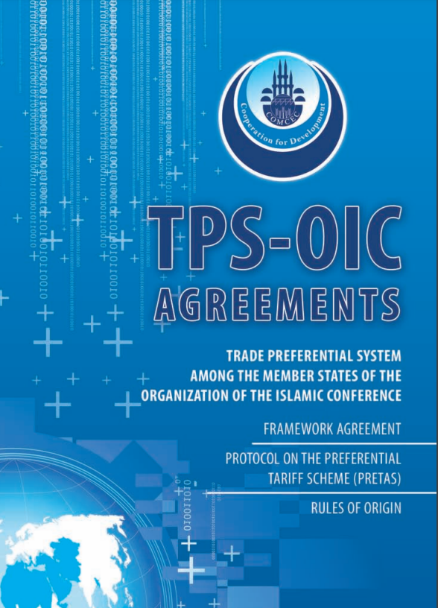
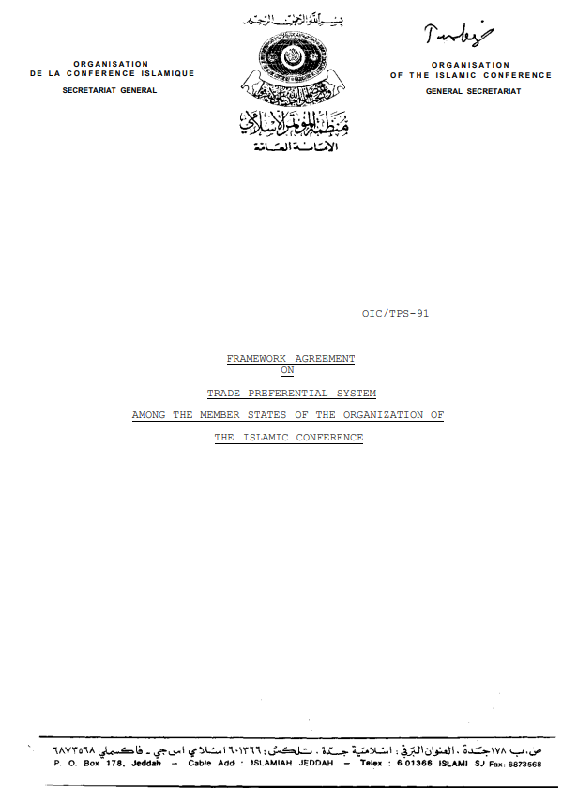
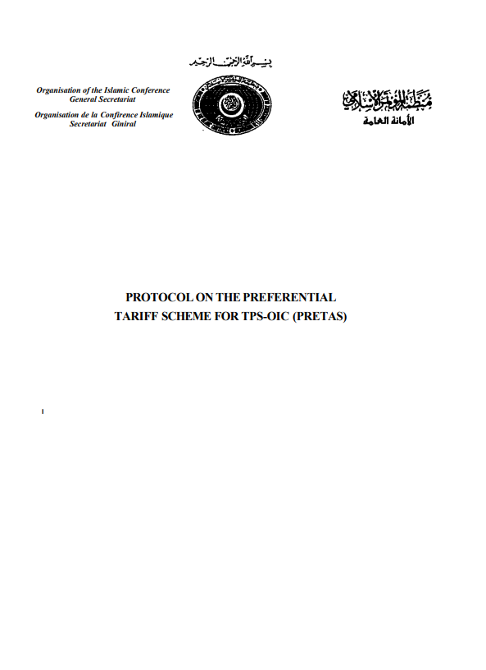
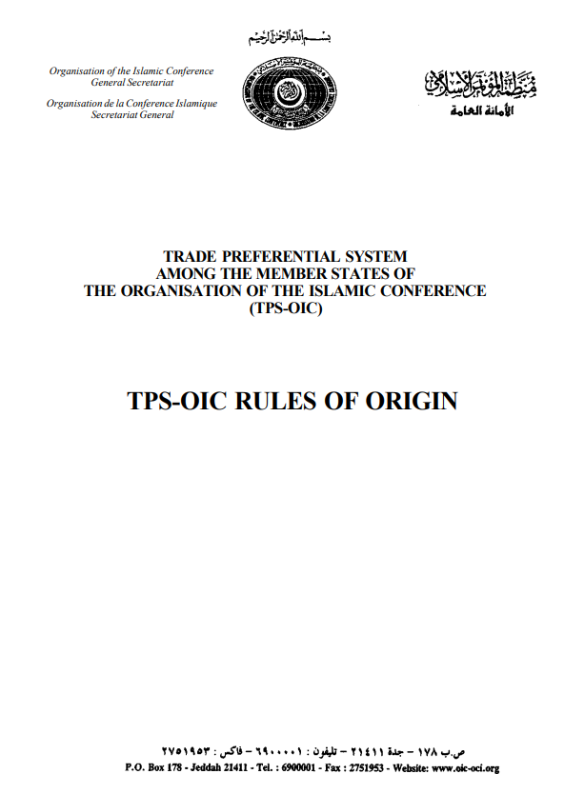
Basic Documents
The Protocol on Preferential Tariff Scheme (PRETAS)
The Framework Agreement
The Rules of Origin
Sets out the general rules and principles for the negotiations towards the establishment of the TPS-OIC - 2002
Applied for the identification of the origin of products eligible for preferential concessions under the TPS-OIC-2011
Lays out the concrete reduction rates in tariffs in accordance with a time-table for implementation -2010
Notes:
TPS-OIC is based on three agreements:
The Framework Agreement,
The Protocol on Preferential Tariff Scheme (PRETAS)
The Rules of Origin
As the basic legal document of the TPS-OIC, the Framework Agreement sets out the general rules and principles for the negotiations towards the establishment of the TPS-OIC and entered into force in 2002.
At the end of the first round, the TNC agreed on the PRETAS. The PRETAS complements the Framework Agreement by laying out the concrete reduction rates in tariffs in accordance with a time-table for implementation and entered into force in February 2010.
The Rules of Origin, which will be applied for the identification of the origin of products eligible for preferential concessions under the TPS-OIC, entered into force in August 2011.

Slide 6

The Framework Agreement
Signed by 42 Member Countries
Ratified by 32 Member Countries
Number of the Member Countries Signing and Ratifying Three Agreements of the TPS-OIC
PRETAS
Signed by 33 Member Countries
Ratified by 18 Member Countries
The Rules of Origin
Signed by 32 Member Countries
Ratified by 18 Member Countries

Slide 7



BACKGROUND
Successful Implementation of TPS-OIC
Fulfillment of two conditions at the same time
Signing and ratifying all three TPS-OIC Agreements
Submission of concession lists to the TNC Secretariat
Printing the TPS-OIC Certificate of Origin documents
Successful implementation of the System
Conveying specimen impressions of stamps to the TNC Secretariat
Completing the necessary internal legislative and administrative measures
Notes:
In order to make the TPS-OIC operational OIC Member Countries have to fulfill two conditions at the same time:
Firstly Member Countries have to sign and ratify the three Agreements of TPS-OIC
«Signing is the first step for a Member State in the way of adopting the Agreement. An official of a Member State, specifically authorized for signing the Agreement, could sign the Agreement, the original copy of which is placed at the OIC General Secretariat, Jeddah. It could be signed either in Jeddah or during the annual meetings of the COMCEC.»
« The second step is the ratification process, which is more complex and time-consuming compared to the first step and depends on the internal procedure of each Member State for ratification, such as approval by the parliament, by the cabinet etc. The ratifying Member State is to send its instrument of ratification, i.e. the document proving the ratification to the General Secretariat of the OIC.
2. Secondly Member Countries have to submit the list of concessions to the TNC Secretariat undertaken by ICDT and CCO
For successful implementation of the System, the Member Countries are required to undertake some internal measures, such as;
1.printing the TPS-OIC Certificate of Origin documents,
2.conveying specimen impressions of stamps to the TNC Secretariat and
3.completing the necessary internal legislative and administrative measures.
After the completion of these measures, the System becomes fully operational

Slide 8
Current List of Participating States of the System
(As of November 1st, 2025)
Pakistan
Türkiye
Saudi Arabia
Oman
Qatar
Bangladesh
Iran
Jordan
Malaysia
Morocco
Kuwait
Bahrain
United Arab Emirates

Slide 9
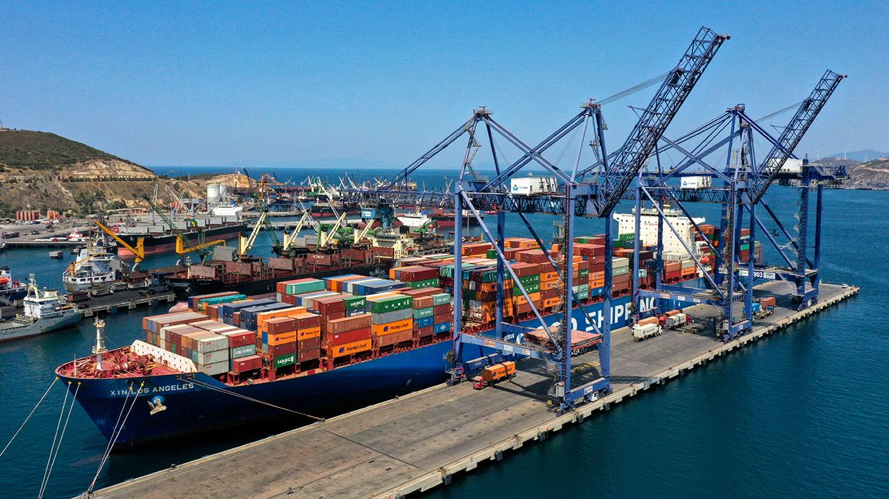
Current Status &
Recent Developments
37th COMCEC: Determination of July 1st, 2022 as the cut-off date for the effectuation of the TPS-OIC
Circulation of relevant documents to the TPS-OIC Participating States
Operationalization of TPS-OIC as of July 1st 2022
Formation of TPS-OIC online communication platform among the TPS-OIC Participating States
(tps-oic@comcec.org)
Notes:
As you kindly recall, the 37th Session of the COMCEC endorsed the decisions of the TNC Meeting held on 1-2 June 2021, in particular the determination of July 1st, 2022 as the cut-off date for the effectuation of the System, and requested the concerned member states to complete the necessary internal procedures and other preparations until that date.
As the co-secretariat of the TNC, relevant documents (the lists of authorized bodies, their sample of stamps and signs, and concession lists) of other participating states have been communicated to the CCO. Then, the CCO conveyed all these documents to all TPS-OIC Participating States through diplomatic channels.
Afterwards, in compliance with the relevant decisions/resolutions of the TNC and the COMCEC Ministerial Sessions, full implementation of the Preferential Trade has been started and the System has become operational as of July 1st 2022.
COMCEC Coordination Office established an online communication platform to better communicate with the TPS-OIC Focal Points. The Latest developments concerning the System is communicated to all TPS-OIC Participatings States through this platform along with the diplomatic channels.

Slide 10
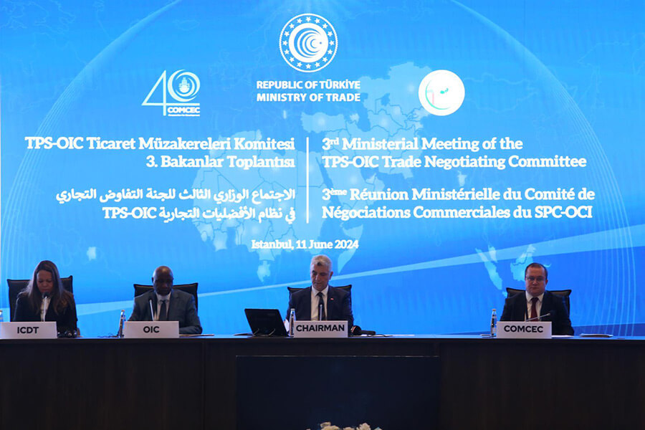
Current Status &
Recent Developments
A TNC Meeting on the margins of 38th COMCEC Ministerial Session in 2022
Ministerial Breakfast Meeting for TPS-OIC was held on the margins of 38th COMCEC Session.
Virtual TNC Meetings on 6-7 June and 20 November, 2023
Ministerial Working Breakfast on TPS-OIC as a side event of 39th COMCEC Ministerial Session on 4 December 2023, İstanbul
The Third TPS-OIC TNC Meeting at Ministerial Level in İstanbul (10-11 June 2024)
Notes:
After operationalization of the System, there has some operational issues to be addressed.
In this regard, a series of TNC Meetings were convened between 2022 and 2023.
Also 2 (two) Ministerial Breakfast Meetings were organized, where the Honorable Ministers reiterated the importance of increasing intra-OIC trade particularly through full implementation of TPS-OIC and indicated their willingness to extend the scope of TPS-OIC.
Within this framework, as you are well aware, H.E. Mr. Ömer BOLAT, the Trade Minister of the Republic of Türkiye, proposed to hold a meeting at the Ministerial level in Türkiye in 2024 to initiate new rounds of negotiations to expand the scope of TPS-OIC.
The Third TPS-OIC TNC Meeting was held at the Ministerial level in İstanbul on 10-11 June 2024 to initiate a new round for expanding the scope of the System.

Slide 11
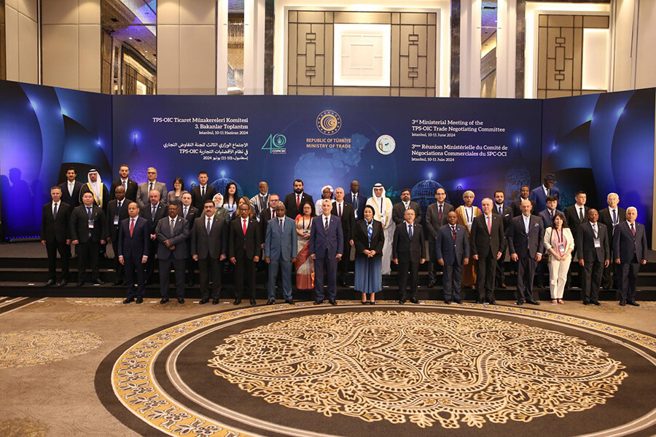
Current Status &
Recent Developments
The 3rd TPS-OIC TNC Meeting at Ministerial Level in İstanbul to expand the scope of the TPS-OIC (10-11 June 2024)
Adoption of İstabul Ministerial Declaration
Initial Discussion on Draft Working plan on TPS-OIC
Preparation on a Study on benefits, challenges and potential of the TPS-OIC
A legal explanatory note on the date of the entry into force of the TPS-OIC Agreements
Notes:
During the Meeting, it was underlined that the smooth implementation of the TPS-OIC is a priority for all the Participating States. Furthermore, Honorable Ministers adopted İstanbul Ministerial Declaration.
The Ministers and Heads of Delegations of OIC Member States attending to the said Meeting took note of the initial discussions on a draft “Work Plan for Potential Expansion of TPS-OIC” presented by the Republic of Türkiye. They also tasked the relevant authorities to continue the engagement under TNC.
During the Meeting, the TNC Secretariat was instructed to conduct a study on the benefits, challenges, and potentials of the TPS-OIC, in cooperation with the interested OIC Institutions, by taking into consideration international best practices.
Furthermore, regarding the potential expansion of the TPS-OIC, TNC Secretariat was also assigned to prepare, in consultation with the OIC General Secretariat, a legal explanatory note on the date of entry into force of the TPS-OIC Agreements.
In this regard, TNC Secretariat fulfilled the tasks and circulated the concerned documents in three languages (Arabic, English and French) to the all OIC Member Countries through diplomatic channels before the 40th COMCEC Ministerial Session.

Slide 12

Current Status &
Recent Developments
40th COMCEC Session requested on the continuation of technical reviews in 2025 for the potential expansion of TPS-OIC through broader product coverage and the inclusion of new disciplines.
Welcomed the convening of the Hon. Ministers and Vice-Ministers on 4 November 2024, on the margin of the 40th COMCEC Session, for deliberations on the OIC trade agenda, with a particular focus on TPS-OIC.
41st Follow-up Committee Meeting of COMCEC welcomed the offer of the Republic of Türkiye to host a TNC Meeting on 9 September 2025
Additional TNC Meeting on 10 September 2025 with the attendance of the TPS-OIC Participating States to discuss exclusively the implementation issues
Notes:
On the other hand, 40th Session of COMCEC was successfully held on 2-5 November 2024 in İstanbul.
The 40th Session welcomed the decisions adopted at the TNC Meeting, hosted by Türkiye in 2024, and requested the continuation of technical reviews in 2025. These reviews aim to explore the potential expansion of TPS-OIC through broader product coverage and the inclusion of new disciplines.
Recalling the relevant resolutions of the 40th Session of the COMCEC, the Committee welcomed the offer of the Republic of Türkiye to host a TNC Meeting to elaborate on the potential expansion of TPS-OIC and called upon the MCs, which have signed and ratified the TPS-OIC Framework Agreement to actively participate in this meeting as well as invited other Member States which are not party to the Framework Agreement to participate in the meeting as observers.
The Committee also welcomed the offer of the Republic of Türkiye to host an additional TNC Meeting with the attendance of the Participating States which have already submitted their concession lists to discuss exclusively the implementation issues and called upon the relevant Participating States to actively participate in this meeting.
However, in consultation with the host authority, the Ministry of Trade of the Republic of Türkiye, the said TNC Meeting was postponed to today and we are here now!. We hope that this Meeting will make the best use of this opportunity and deliver fruitful outcomes.

Slide 13
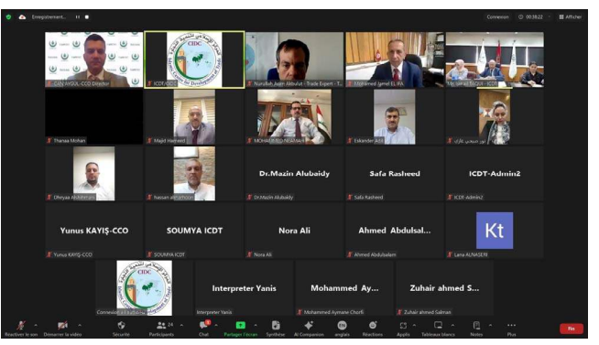
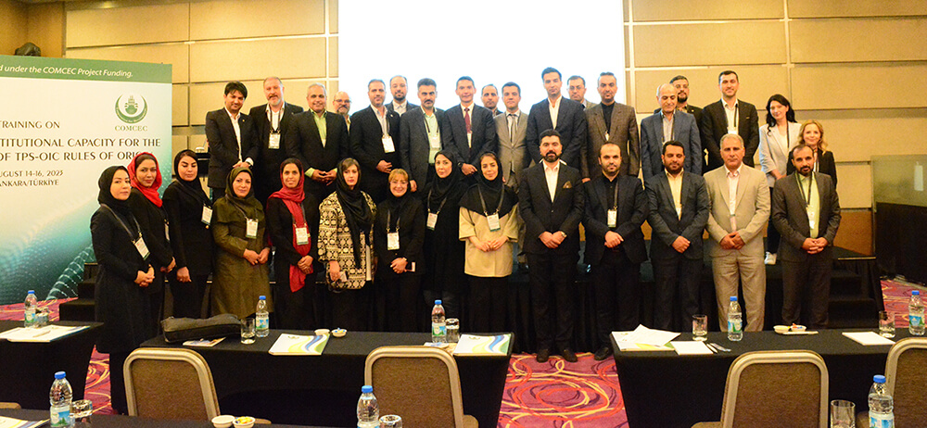
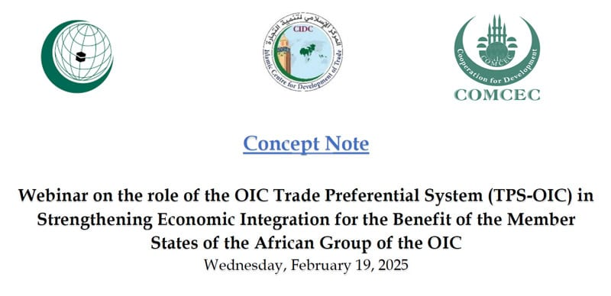
Awareness Raising Activities on TPS-OIC
TPS-OIC Workshops and Trainings
Indonesia, Sudan, the Gambia, Mauritania, Somalia, Surinam, Iran
An Awareness Raising Workshop for the benefit of Arab countries in the accession process to the TPS-OIC (2024)
A Webinar on the Role of the TPS-OIC in Enhancing Economic Integration for the Benefit of the Member States of the OIC African Group (2025)
CCO and ICDT are always ready for the awareness-raising workshops on the TPS-OIC and its impact on the private sectors in the interested Member Countries.

Slide 14

THANK YOU FOR YOUR ATTENTION
COMCEC Coordination Office
www.comcec.org
comcec@comcec.org
tps-oic@comcec.org

