Slide 1
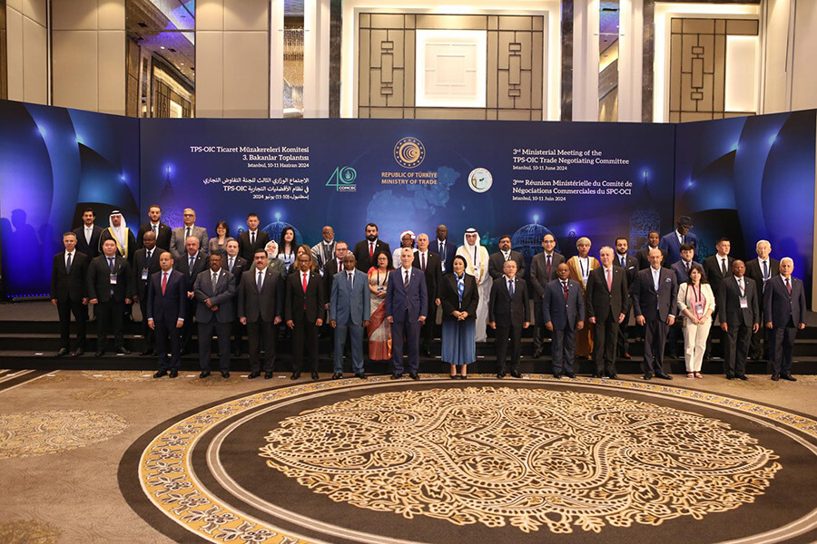



Opportunities & Challenges
of the Potential Expansion of TPS-OIC
Mr. Ismail TAQUI
Islamic Center for Development of Trade (ICDT)
Ankara,1-2 octobre 2025

Slide 2
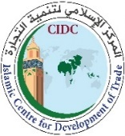
Outline
Introduction: General Context
State of Play of Trade and Investments in the OIC Zone
A Review of the TPS-OIC Tariff Preferences.
Opportunities for the Potential Expansion of the TPS-OIC
Key Challenges to the Potential Expansion of the TPS-OIC
Conclusion: Towards a Win-Win TPS-OIC

Slide 3

Introduction: General Context
The theory of economic integration (Hungarian economist Béla Balassa, 1961)
Explains the different stages of regional integration: Free trade area, Customs union, Common market, Economic union, Political integration.
Regional Trade Agreements (RTAs) are therefore considered as progressive instruments of integration, aimed at strengthening economic and political cooperation.
The TPS-OIC is a process launched in the 1980s as a first step towards the creation of an Islamic common market in accordance with Article 1 (paragraph 9) of the OIC Constitutive Charter.
A political choice consistent with the theory of regional economic integration, reflected in the establishment of RTAs as instruments to accelerate the economic development of countries.
New tariffs from the United States of America represent an incentive to strengthen market integration in the OIC region and to compensate for market share losses and counteract disruptions to trade flows.

Slide 4
State of Play of Trade and Investments in the OIC Zone
The OIC Ten-Year Plan of Action aims to increase intra-OIC trade to 25% by the end of 2025 (20.36% in 2024).
30 OIC countries have achieved the 25% intra-OIC trade target set in the OIC-2025 Programme of Action.
The international economic situation has not been conducive to achieving the 25% target. The OIC has therefore adopted a new 2026–2035 Action Plan to promote intra-OIC trade and investment.

Slide 5
State of Play of Trade and Investments in the OIC Zone
Medium and high value-added products are playing an increasingly important role in intra-OIC trade.
Manufactured goods, machinery, transport equipment and chemical products represent 53% of trade.
Fuels and inedible raw materials now represent only 26% of trade
The objective of the OIC's actions is to develop value chains and reduce dependence on raw materials.

Slide 6
State of Play of Trade and Investments in the OIC Zone
The major players in intra-OIC trade are concentrated in the two Arab and Asian groups.
Nigeria is the only country that has expanded its trade with OIC member states.
The TPS-OIC promotes the inclusion of Member States in the trade and economic dynamics of the OIC region.

Slide 7

State of Play of Trade and Investments in the OIC Zone
FDI flows to OIC countries in 2023: $150 billion, (+34.1% compared to 2014).
The share of OIC countries in global FDI flows: 11.3% in 2023, compared to 8% in 2014.
The evolution of foreign investment flows in the OIC region is strongly impacted by: Geopolitical tensions, climate change, instability of supply chains and restrictive regulatory frameworks.
The TPS-OIC is key a factor in attracting FDI

Slide 8

Review of the TPS-OIC Tariff Preferences
Tariff dismantling diagram: 2 tracks
(Articles 3, 4, 5 and 6 of PRETAS)
Normal track
Fast track
Voluntary accelerated process

Slide 9

Review of the TPS-OIC Tariff Preferences
Normal Track
Tariff dismantling diagram based on the 2003 MFN rate
Rules of Origin
Accumulation of origin
Fully-obtained
7% of all HS lines in the country, with a reduction over 4 years (PVD) and 6 years (PMA):
Rates between 15% and 25% at 15%;
Rates between 10% and 15% at 10%;
Rates below 10% are exempt from the rate reduction.
Countries with more than 90% of tariff lines having customs duties of 10% or less need to cover only 1% of their HS tariff lines.
40% of local added value for developing countries and 30% for LDCs
Trade defense measures must comply with WTO rules Article VI: Dumping and Subsidies and Article XIX: Safeguards of GATT 1994
Rates above 25% to 25%;

Slide 10

Review of the TPS-OIC tariff preferences
Voluntary accelerated process (Fast Track): principle of variable geometry
Negative list must not exceed:
Article 4 of PRETAS
25% of all Harmonized System tariff lines, in addition to tariff lines at ≤10%, for developing countries whose average tariff rate is ≥20%.
25% of all tariff lines of the Harmonized System plus tariff lines ⩽10%, for developing countries with an average tariff ⩾ 20%.
15% of all HS tariff lines for developing countries with an average tariff below 15%.
30% of all HS tariff lines for LDCs.
Countries willing to offer additional concessions may do so on a ‘fast track’ basis, provided reciprocity is maintained.
The dismantling concerns the 50% increase in the preferential margin over 5 tranches (7 tranches for LDCs), for all products.
Negative list

Slide 11

Review of the TPS-OIC Tariff Preferences
Does the TPS-OIC require simplification and modernization in order to align with the new generation of Regional Trade Agreements?

Slide 12


Review of the TPS-OIC Tariff Preferences
.. the aspects that can be improved
Insufficient tariff preferences
The rules of origin are no
longer adapted to the evolving
international context.
The OIC Regional Agreements cover more than 80% of tariff lines, while the TPS-OIC covers only 7% of tariff lines .
Tariff preferences are limited to 10%, while several OIC countries have MFN tariffs of less than 5%, such as the countries of GCC.
The TPS-OIC establishes only general rules of origin, whereas new-generation agreements lay down specific rules tailored to individual sectors and products.
Limited provisions for promotion
of trade
Membership in Regional Economic
Communities
The TPS-OIC is limited to trade in goods, whereas modern trade agreements generally encompass a broader range of disciplines, including services, investment, and intellectual property.
The TPS-OIC does not address the issue of membership in the TPS-OIC of member countries of certain regional communities.

Slide 13

Review of the TPS-OIC Tariff Preferences
The TPS-OIC includes legal provisions that allow periodic evaluation and revision
Article 2 § 9 of the TPS-OIC Framework Agreement provides for periodic evaluation and revision, in order to broaden its scope of application and improve its functioning.
Article 2 § 6 of the TPS-OIC Framework Agreement reflects the evolving nature of the TPS-OIC.
Article 10 of PRETAS on the revision of the protocol.
Article 32 §1 of the Rules of Origin Protocol provides for periodic review.
The Declaration of Intent on the Establishment of the System, adopted in 1988, explicitly provided for the System’s progressive expansion (§1.iii).

Slide 14

Review of the TPS-OIC Tariff Preferences
Compliance of the TPS-OIC with Multilateral Arrangements
Compatibility with the provisions of WTO Agreements concerning the waiver of the Most-Favoured-Nation (MFN) principle:
Enabling Clause from the 1979 Tokyo Round Agreements:: Developing countries may create preferential trade arrangements without extending them to developed countries..
Article 24 of the GATT (1994) provides the international legal framework authorizing the establishment of free trade areas and customs unions, subject to strict conditions designed to safeguard the balance of the multilateral trading system.
.. TPS-OIC, in the international context
TPS-OIC and Regional Agreements
Preservation of the achievements of bilateral or regional agreements among Member States or with third parties outside the OIC, in accordance with Article 2 of the Framework Agreement (paragraphs 11, 12, and 13):

Slide 15

Opportunities for the Potential Expansion of the TPS-OIC
Expanded access to international markets
Ability to export to larger markets without customs barriers.
Promotion of products with comparative advantage (agriculture, textiles, crafts, digital services, etc.).
4. Economic diversification
Reducing dependence on a limited number of export products.
Development of new sectors (industry, services, blue economy, renewable energy).
.. Growth opportunities
2. Stimulation of foreign investment
Investors are attracted to countries integrated into free trade zones.
Relocation of industries or creation of regional production sectors.
5. Improving local competitiveness
Exposure of companies to stronger competition, encouraging innovation and cost reduction.
Adoption of international standards that enhance product quality.
3. Transfer of technologies and know-how
Local businesses can benefit from partnerships with multinationals.
Improving productivity and competitiveness.
6. Regional integration and value chains
Participation in global and regional value chains.
Strengthening South-South cooperation.

Slide 16


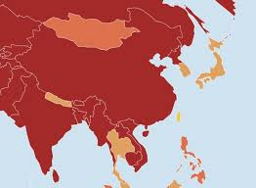

Opportunities for the Potential Expansion of the TPS-OIC
TPS-OIC : a vector of complementarity and balanced co-development between the 3 major OIC regions
Africa
Arab Region
Southeast Asia
Natural resources
Human resources
Growing markets
Fertile Investment Land
Infrastructure experience
Industrial and technological dynamism
Competitive workforce
Energy
Financial resources
Service sector
Labor market
Logistics hubs

Slide 17

Opportunities for the Potential Expansion of the TPS-OIC
Potential growth sectors
Agriculture
Agri-food
Manufacturing
Infrastructure / Corridors
Transportation-Logistics
Blue Economy
Healthcare Equipment and Pharmaceuticals
Tourism
ITC
Professional Services
Intra-OIC export potential: $22 bn.
The products with greatest export potential from OIC to OIC are Precious metals, Plastics & rubber, and Machinery, electricity. Precious metals shows the largest absolute difference between potential and actual exports in value terms, leaving room to realize additional exports worth $22 bn.

Slide 18
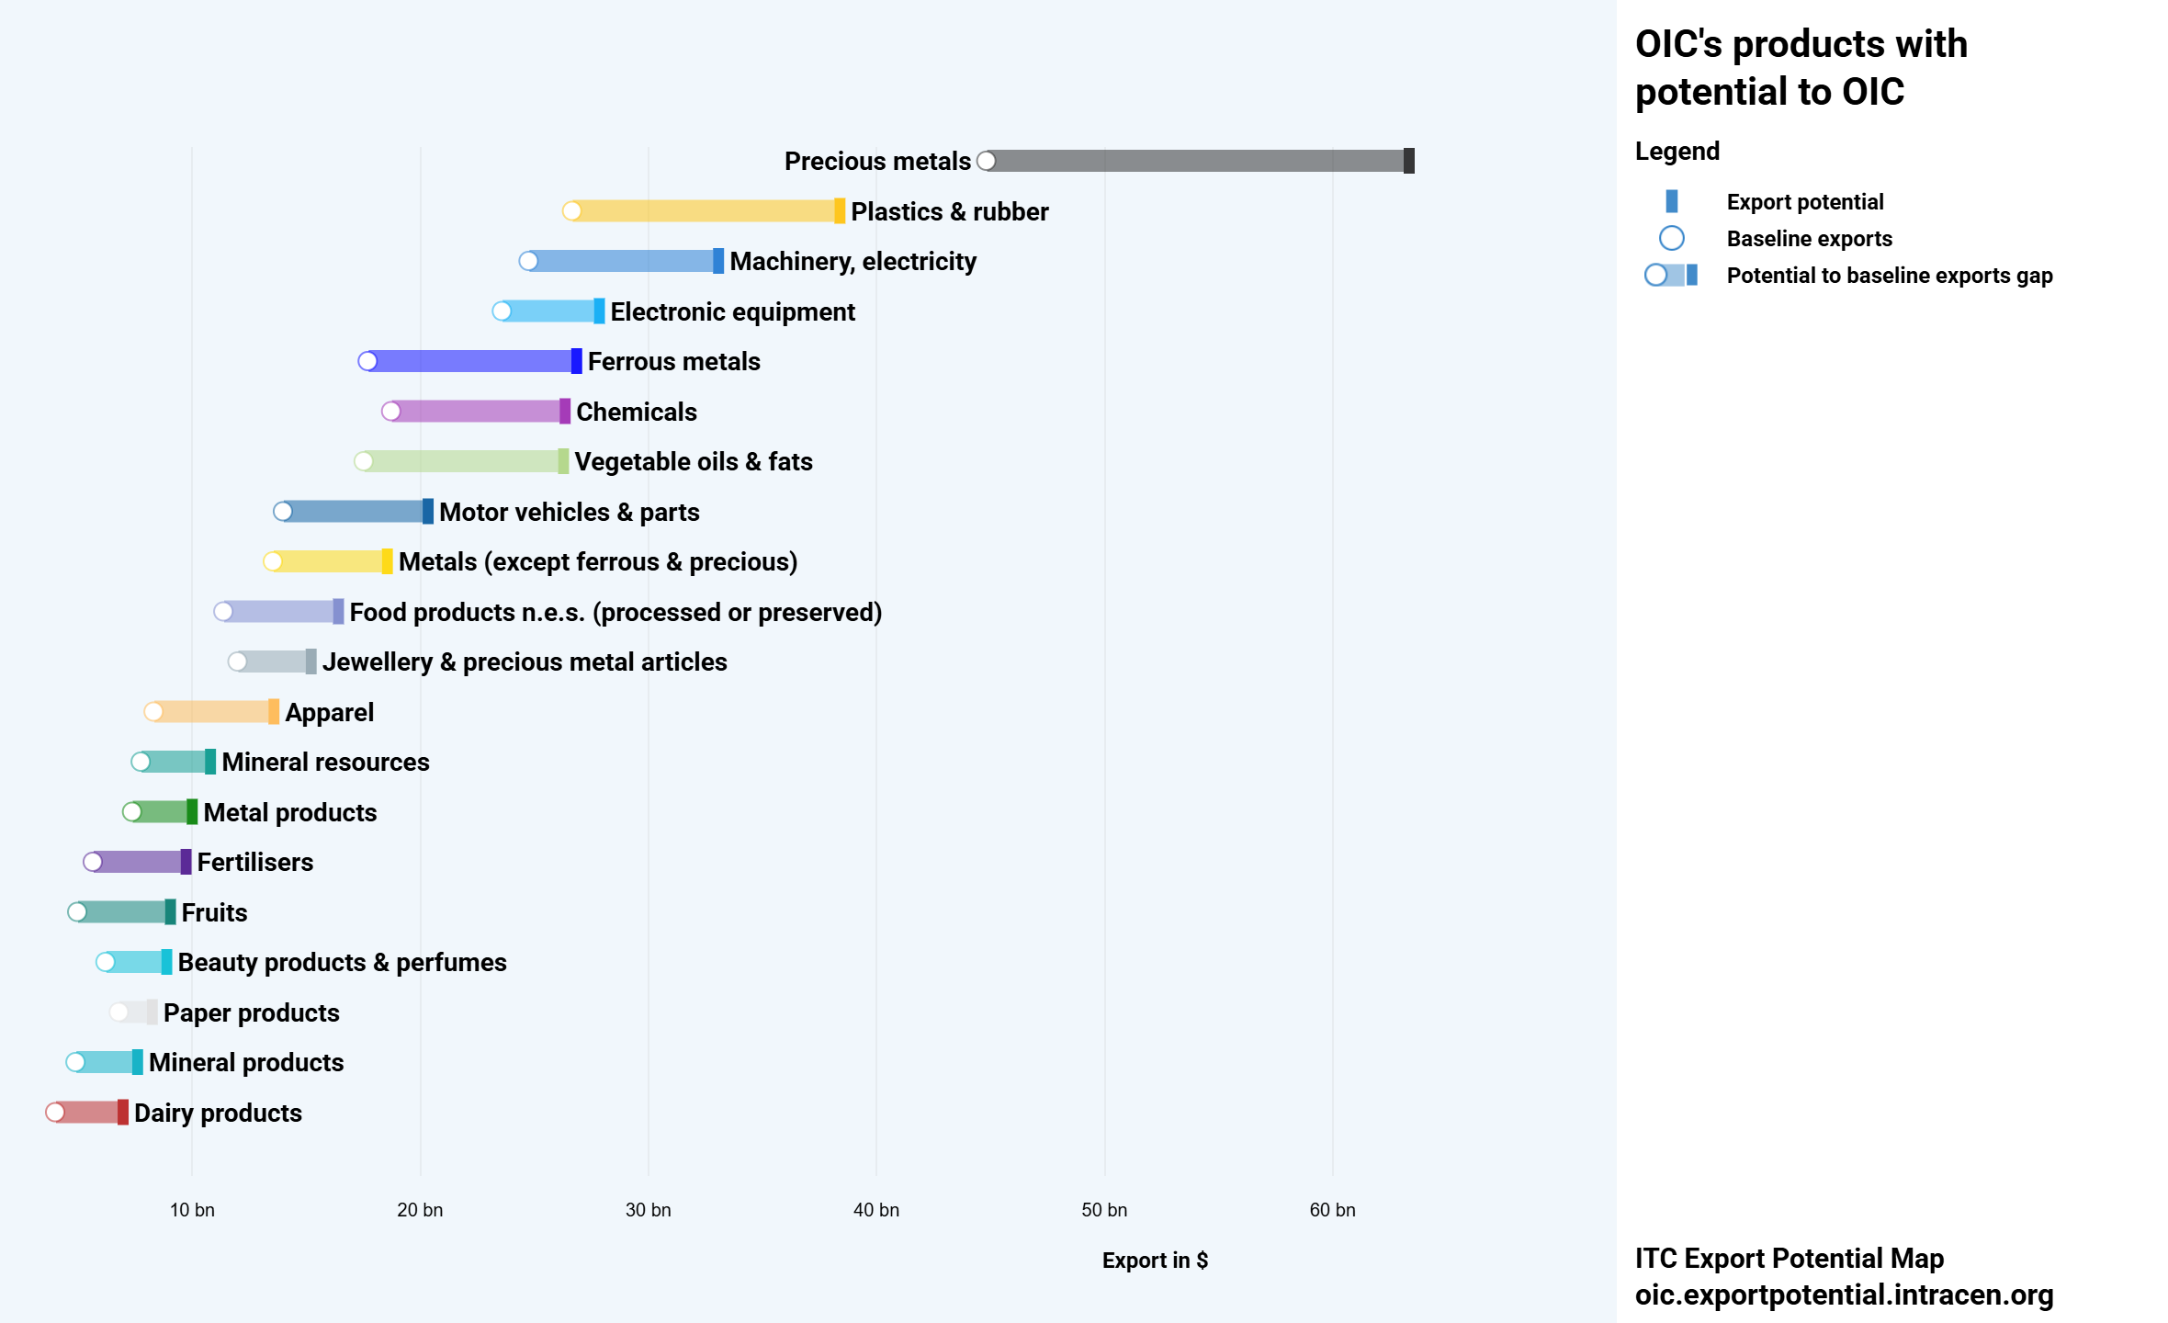
Opportunities for the Potential Expansion of the TPS-OIC
The TPS-OIC is a main tool for capturing the intra-OIC export potential

Slide 19
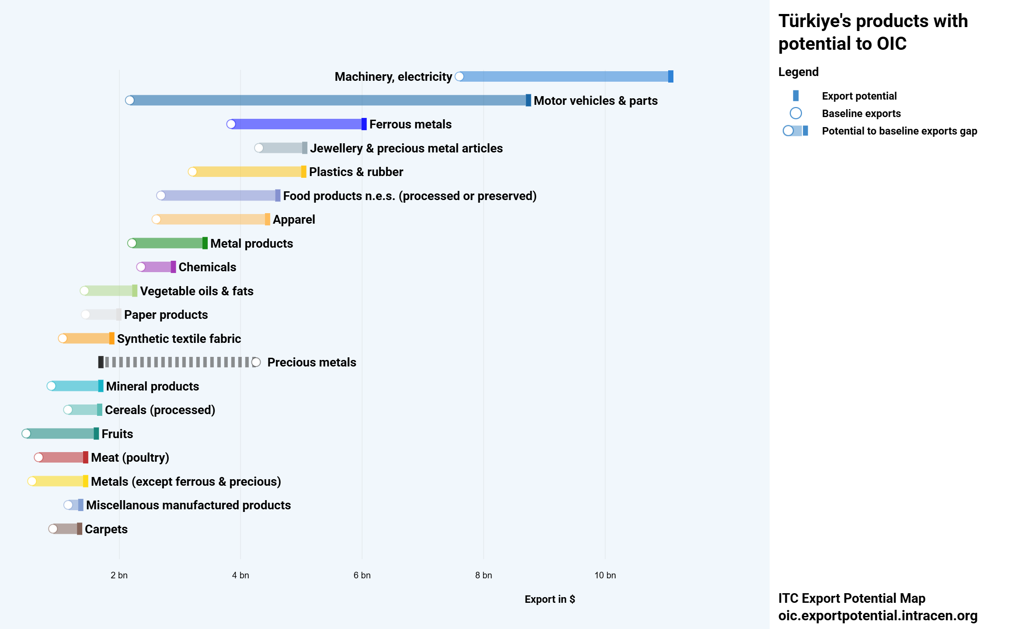

Opportunities for the Potential Expansion of the TPS-OIC
Example of potential by country (Türkiye)

Slide 20
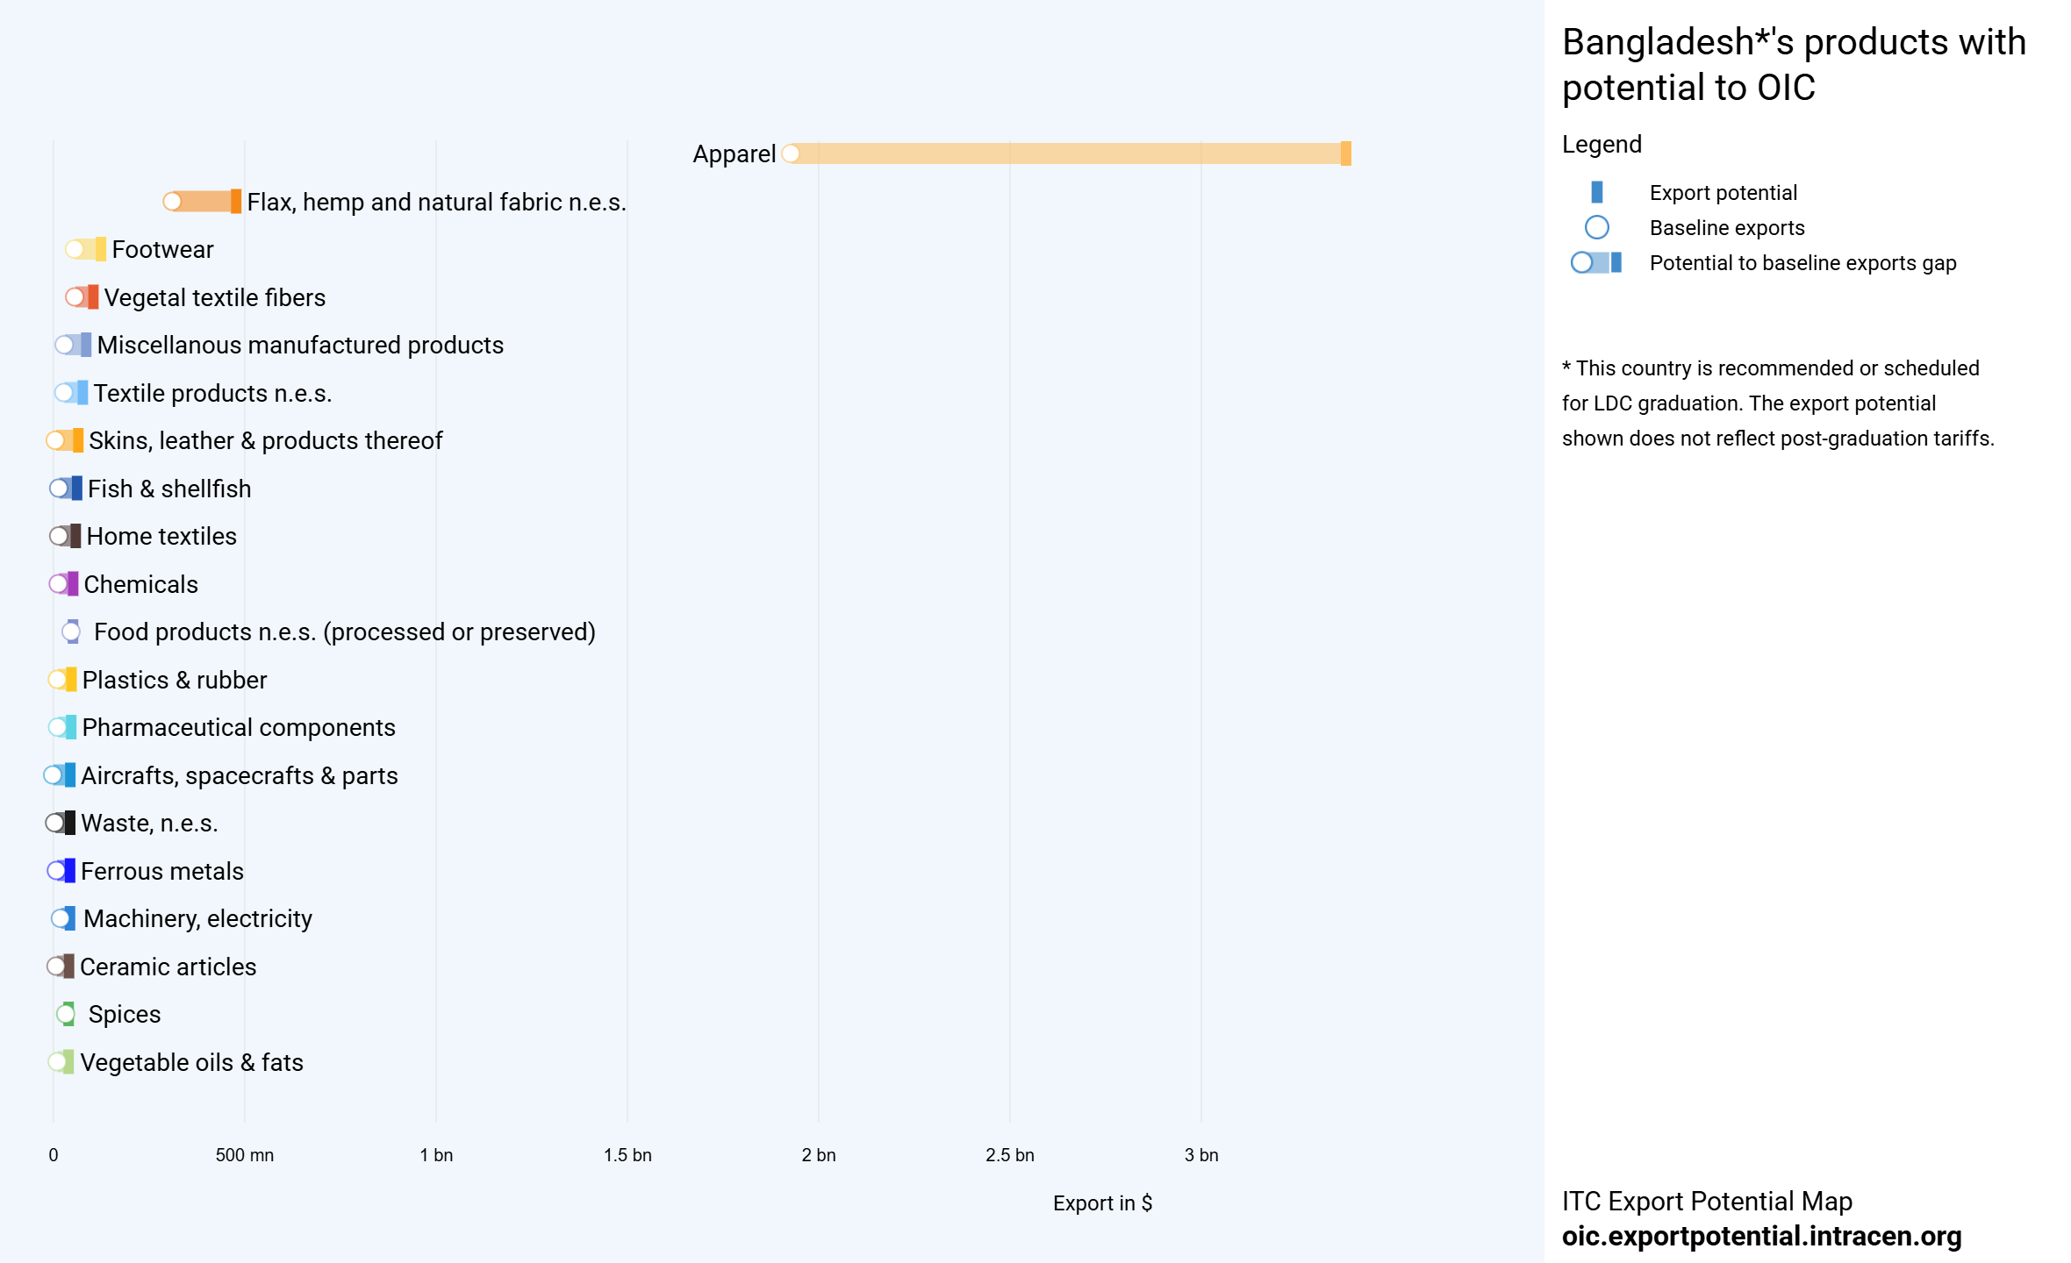
Opportunities for the Potential Expansion of the TPS-OIC
Example of potential by country (Bangladesh)

Slide 21
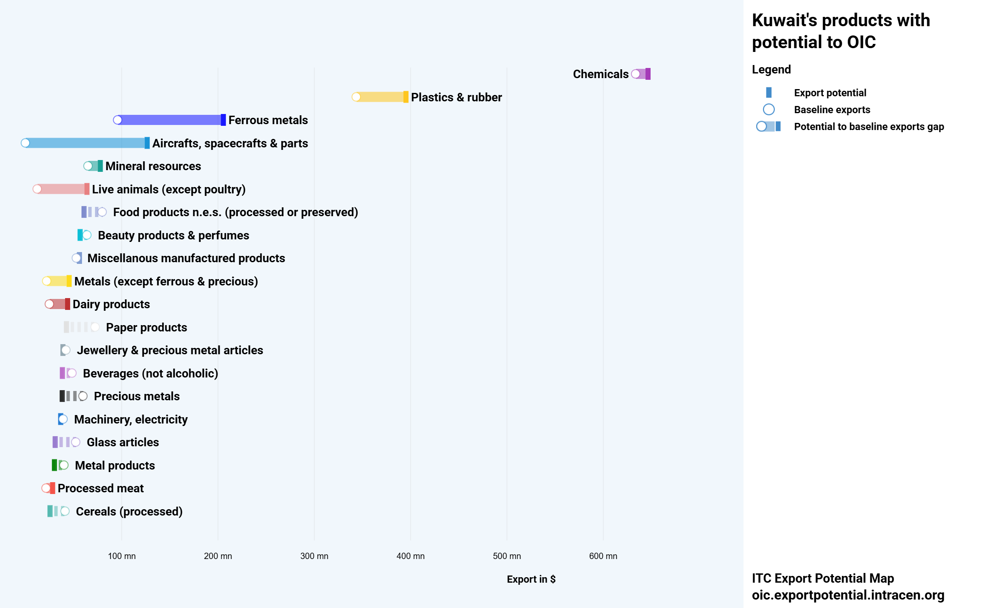
Opportunities for the Potential Expansion of the TPS-OIC
Example of potential by country (Kuwait)

Slide 22
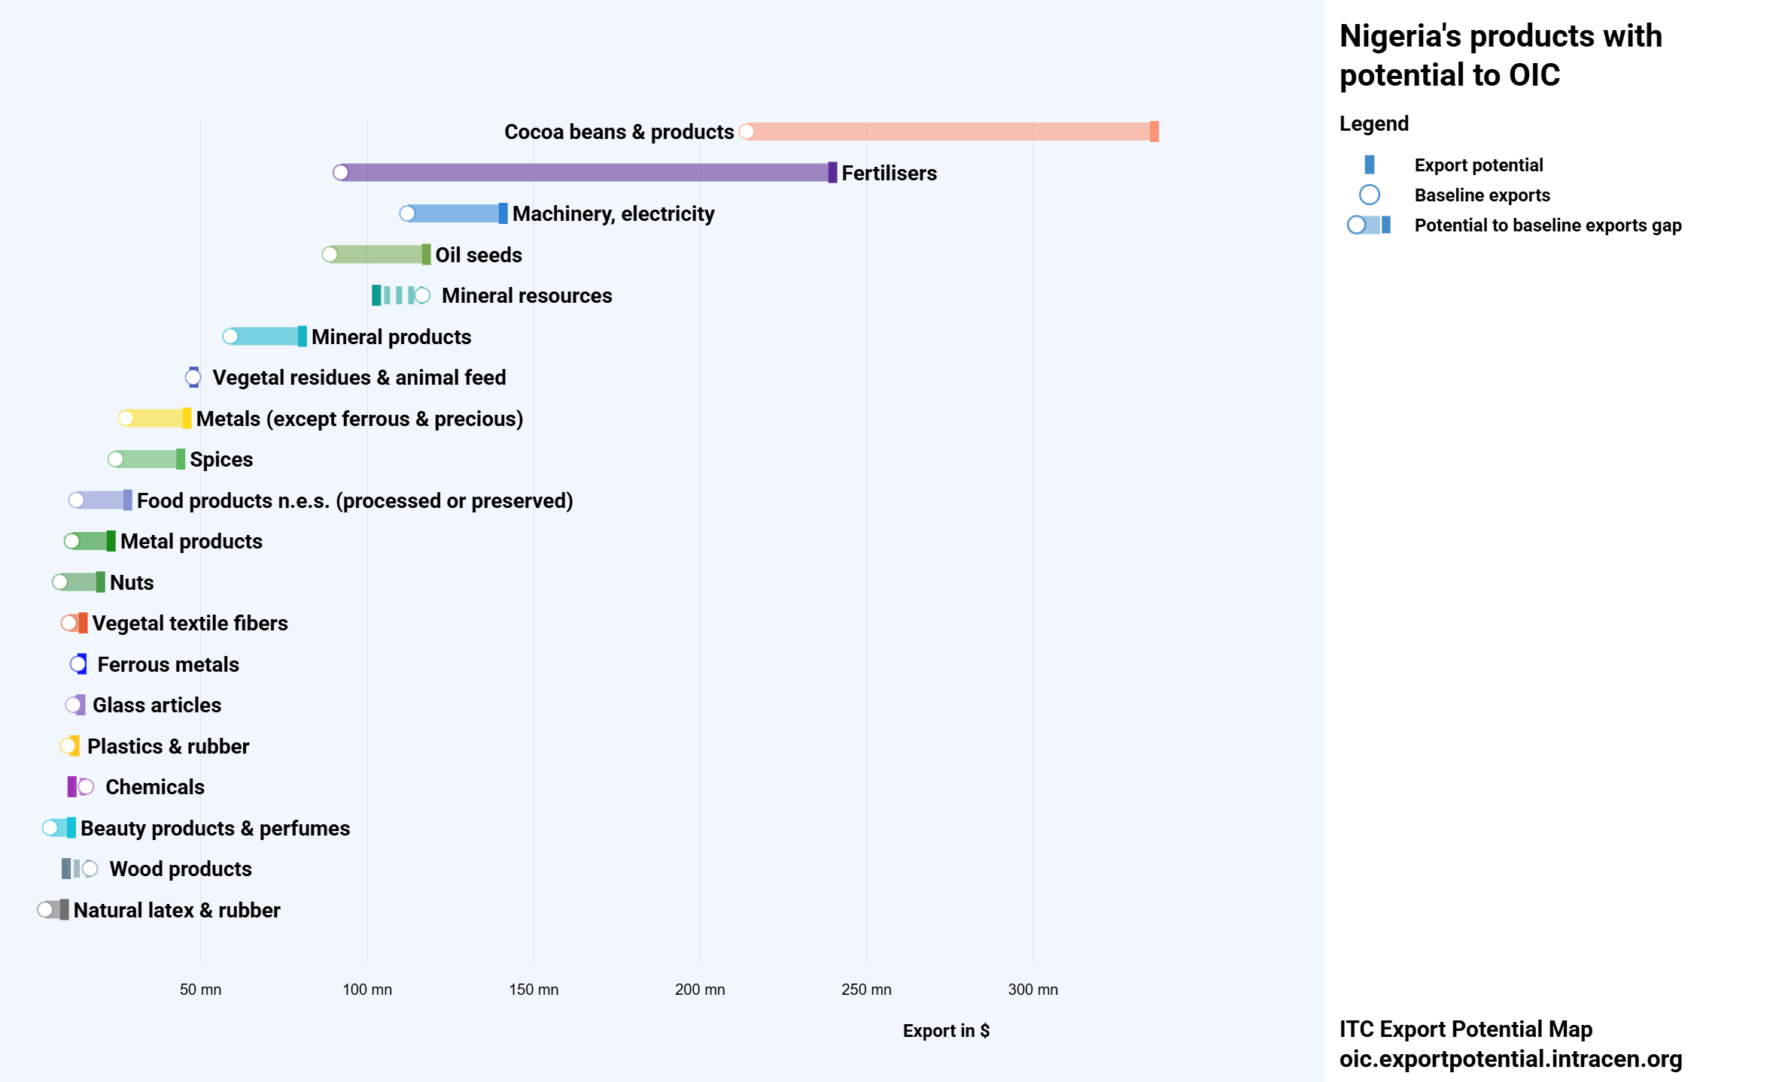
Opportunities for the Potential Expansion of the TPS-OIC
Example of potential by country (Nigeria)

Slide 23

Key Challenges to the Potential Expansion of the TPS-OIC
Regional Economic Disparities
Divergent Interests
Strategic economic priorities and interests vary among countries, complicating the opportunities for compromise and consensus needed to advance the TPS-OIC.
Regulatory constraints and standards
The revised TPS-OIC may include new rules of origin, technical, health, environmental or intellectual property standards. Compliance with these standards can be costly and difficult for member countries.
The economies of the OIC member states display great diversity in terms of size, level of development and industrial sectors, making the negotiations and revision of the TPS-OIC complex.
Concerns about market protection
Socio-economic Realities of LDCs
The TPS-OIC must be part of a global approach ensuring a balance between the opening and protection of national markets.
LDCs have limited resources and institutional capacities to effectively implement the TPS-OIC commitments.
Negotiation Management and Monitoring
Negotiations and implementation require institutional, legal and statistical capacities that some countries do not always have.
Loss of customs revenue
Reducing or eliminating customs duties deprives states of an important source of public revenue, especially for LDCs dependent on import duties.

Slide 24


Key Challenges to the Potential Expansion of the TPS-OIC
Concerns related to regional commitments and those within the framework of the OIC: 4 customs unions in force and others in the process of being established such as the Arab Customs Union, 13 regional free trade zones, plus the Global System of Trade Preferences (GSTP)
Countries must seek solutions to facilitate the accession of member countries of Regional Economic Communities to the TPS-OIC (case of ECOWAS and CEMAC)

Slide 25

Conclusion: Towards a Win-Win TPS-OIC
Capitalize on the achievements of the TPS-OIC to stimulate intra-OIC trade and develop the integration of OIC markets.
Adopt a flexible and differentiated approach to negotiations, taking into account the levels of development of each member country..
Open up to international best practices in new-generation agreements.
Promote the sharing of intra-OIC experiences in negotiations, highlighting pioneering countries in the field of free trade.
Establish renewed and ambitious technical and financial support mechanisms for the negotiations and implementation of the TPS-OIC.

Slide 26
Useful Links
https://oic.tradehelpdesk.org/
https://exportpotential.intracen.org
https://icdt-cidc.org/fr/knowledge-center/studies-research/
https://icdt-cidc.org/fr/knowledge-center/studies-research/

Slide 27

شكرا على انتباهكم
MERCI POUR VOTRE ATTENTION
THANK YOU FOR YOUR KIND ATTENTION
icdt@icdt-oic.org
للمزيد من المعلومات
Pour plus d’information:
For more information:

