Slide 1



April 8th, 2026
Actors and Responsibilities
Muhammed Ziya SARI
Program Coordinator
Programs and Projects Department
COMCEC
COORDINATION
OFFICE
cpf.comcec.org

Slide 2
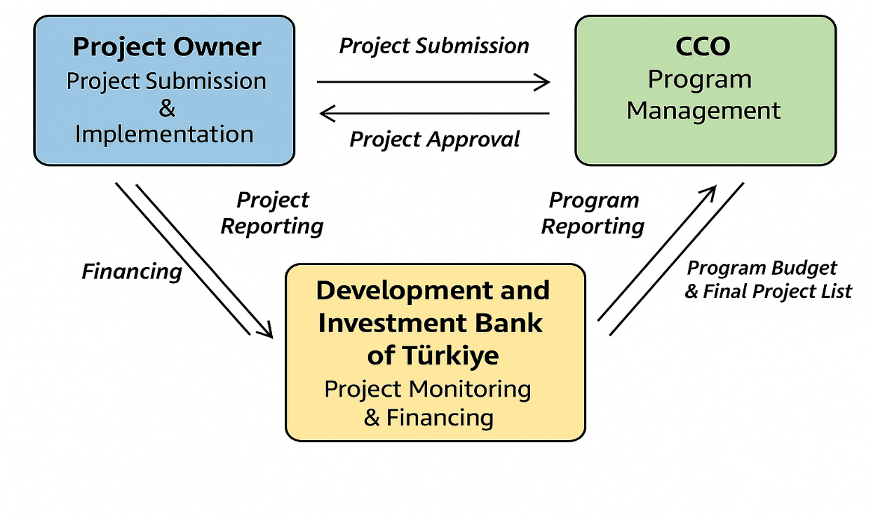


Overview
2
2

Slide 3
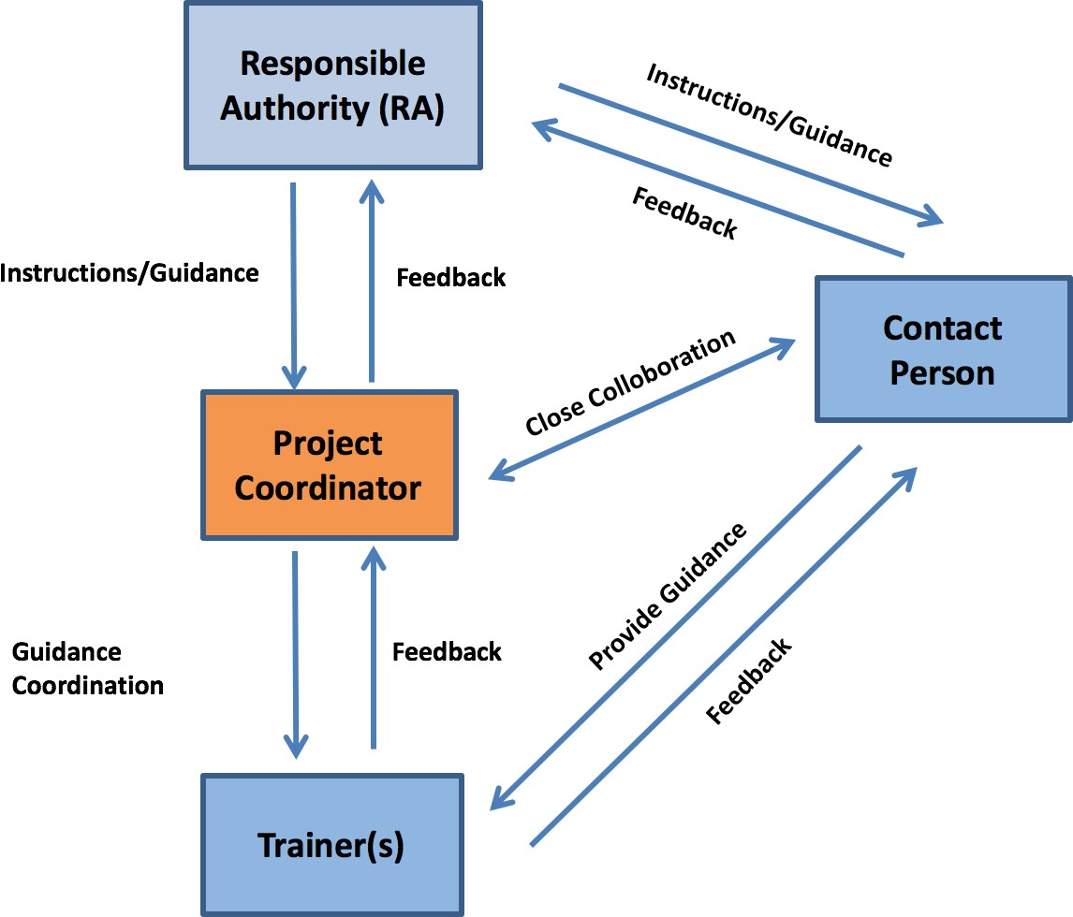
Distribution of Roles among Project Owner Agents
3

Slide 4


Responsible Authority
To supervise the implementation of all activities properly
To develop and maintain close cooperation with partner Countries
Implementation
To check and approve the conformity of progress reports, timesheets, supplementary documents including invoices, activity reports, project completion report and other documents with the requirements set forth in the Contract and Program Implementation Guidelines
To ensure submission of progress reports, timesheets, supplementary
Monitoring & Reporting
documents including invoices, Project Completion Report and other documents to the Bank
To ensure the accuracy of the information presented in the reports to the Bank and the CCO as well as to create conditions for the Bank to check this information at the Project Owner’s subordinate.
4

Slide 5



Contact Person
To ensure effective and timely implementation of project activities
To supervise the technical implementation of the all activities
To oversee project coordinator in terms of, inter alia, preparing technical documents according to the order and schedule stated in the Contract
Attending project related meetings
Performing the administrative and technical management of project activities
Implementation
To check the conformity of financial progress reports including invoices, monthly progress reports, detailed work plan, timesheets, project completion report and other documents
To check the accuracy of the information presented in progress reports as well as other supplementary documents such as invoices
Supervising project coordinator in terms of, inter alia, preparing technical documents according to the order and schedule stated in the Contract
Providing additional information, justification and/or documents on behalf of the Responsible Authority, if and when requested by the Bank
Monitoring & Reporting
5

Slide 6
Project Coordinator
Preparing the Detailed Work Plan and sending itto the Bank within two weeks after signing the contract
Conducting strategic and financial relations with the Project Owner, the Bank and the CCO
Overall management and coordination of all project activities in communication with the Bank and the CCO
Supporting the Contact Person and Trainer(s) (where available) in all project related works
Informing the Contact Person regarding all correspondences with the CCO and Bank.
Developing and maintaining close cooperation with relevant officials involved in the project and other
beneficiary organizations
Checking and sending training materials that are prepared by Trainer(s) to the CCO and the Bank in line with the time-frame presented in Program Implementation Guidelines
Performing necessary office management tasks including filing
Taking reasonable precautions to avoid unwanted injury toward to employees and third parties
Complying with the health and safety law, regulations, ordinance in order to create a safe working environment
Attending COMCEC events and other relevant international meetings (where necessary), to present project activities and outcomes
Implementation
6

Slide 7
Project Coordinator
Providing relevant information and documents to the Bank and the CCO
Evaluating overall project performance and proposing corrective action if and whenever required
Drafting progress reports along with supplementary documents, Activity Reports, Project Completion Report and conveying them to the Responsible Authority to be submitted to the Bank
Preparing his/her own timesheet in every month and convey them to the Responsible Authority to be submitted to the Bank
Monitoring & Reporting
7

Slide 8


Trainer
Contributing to the preparation of the Detailed Work Plan.
Collecting and analyzing data which is essential to the preparation of training program through study visits, interviews, etc.
Preparing the content and program of the training in collaboration with the Project Coordinator
Preparing the training materials in line with the time-frame presented in Program Implementation Guidelines and the Detailed Work Plan
Sending the training materials to the Project Coordinator to be later submitted
to the CCO and the Bank
Training relevant target groups on the specific subject(s) stated in the Project Fiche
Implementation
Following the rules and procedures stated in the CPF Project Implementation Guidelines, Visibility Manual and the Contract.
Preparing his/her own timesheet and convey them to the Responsible Authority to be later submitted to the Bank
Monitoring & Reporting
8

Slide 9
Key Researcher
Overall management and coordination of all project activities in communication with the PO, the Bank, the CCO and other relevant stakeholders.
Conducting local field visit(s) (where necessary) in accordance with the project fiche for needs assessment
Documenting local field visit(s) with photos, list of interviewees and letters of acceptance signed by interviewees, tickets, vouchers etc.
Collecting and analyzing data, which is essential to preparation of the needs assessment report through local field visit, interviews, desk-based research, etc.
Preparing the disbursement request forms and conveying them to the PO to be later submitted to the Bank and the CCO.
Sending drafts of the needs assessment report to the Responsible Authority for approval and submission to the CCO.
Editing and revising the needs assessment report (where necessary) by considering the comments and suggestions of the PO and the CCO.
Ensuring that all requirements stated in the project fiche is satisfied properly and on time.
Implementation
9

Slide 10

Key Researcher
Drafting Detailed Work Plan with Annotated Outline (before signing the Service Contract) and progress reports along with supplementary documents, and conveying them to the Responsible Authority to be submitted to the CCO and the Bank.
Evaluating overall project performance and proposing corrective action whenever required.
Supervising all the project personnel (if any) to ensure the successful implementation of the project and preparation of high quality needs assessment report.
Providing relevant information and documents to the Project Owner, the Bank and the CCO.
Monitoring & Reporting
10

Slide 11
Technical Expert(s)
Overall management and coordination of all project activities in communication with the PO, the Bank, the CCO and other relevant stakeholders.
Conducting the international field visit in accordance with the project fiche.
Documenting the international field visit via letter of acceptance, questionnaire, photos, list of interviewees and approval letter signed by the interviewees, travel tickets and other similar documents.
Collecting and analyzing data, which is essential to preparation of the needs assessment report through local field visit, interviews, desk-based research, etc.
Submitting each section of field study report to the Responsible Authority for assessment to be later sent the CCO for approval.
Editing and revising each section of field study report by considering the comments and suggestions of the PO and the CCO.
Ensuring that all the requirements of the project fiche are satisfied properly and on time.
Implementation
11

Slide 12
Technical Expert(s)
Drafting Detailed Work Plan with Annotated Outline (before signing the Service Contract) and progress reports along with supplementary documents, and conveying them to the Responsible Authority to be submitted to the CCO and the Bank.
Evaluating overall project performance and proposing corrective action whenever required.
Preparing his/her Financial Progress Reports upon approval of relevant sections of the field study report by CCO and conveying them to the PO to be later submitted to the Bank and the CCO.
Providing relevant information and documents to the Project Owner, the Bank and the CCO.
Monitoring & Reporting
12

Slide 13


THANKYOU
cpf.comcec.org cpf@comcec.org
COMCEC
COORDINATION
OFFICE

