Slide 1

The Development of Securities Crowdfunding Industry in Indonesia
Presented at
25th Meeting of the COMCEC Financial Cooperation Working Group
"Potential of Crowdfunding for Economic Development in the OIC Member Countries"
April 22, 2026
Noviyanto Utomo
Deputy Director of Securities Crowdfunding Supervision
Department of Securities Institution Supervision

Slide 2
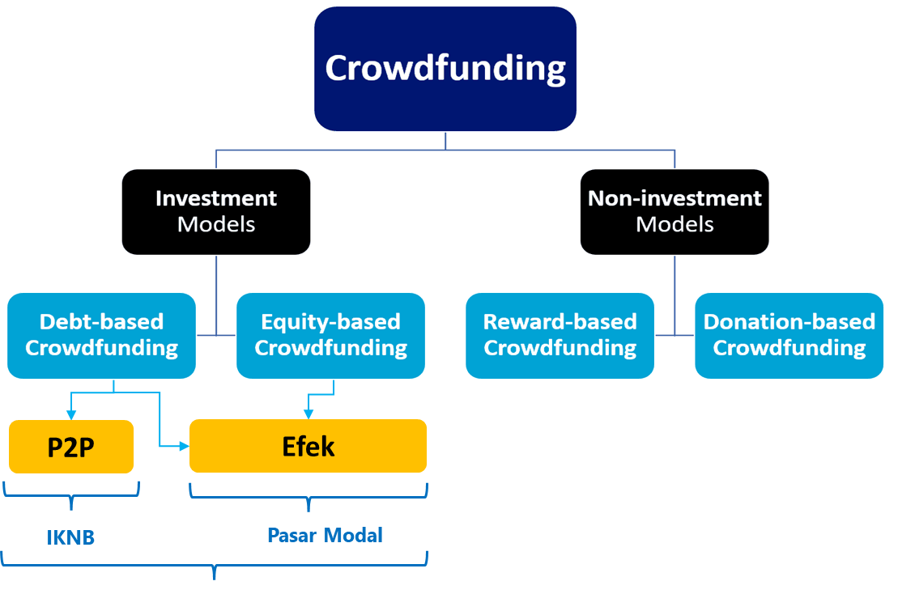
Types of Crowdfunding
Securities
NBFI
Capital Market
Regulate & Supervise by Indonesia FSA (OJK)
As is international best practice, such as FCA UK, US SEC, FSC Korea regulate and supervise investment crowdfunding
Notes:
NBFI: Non Bank Financial Intitution

Slide 3

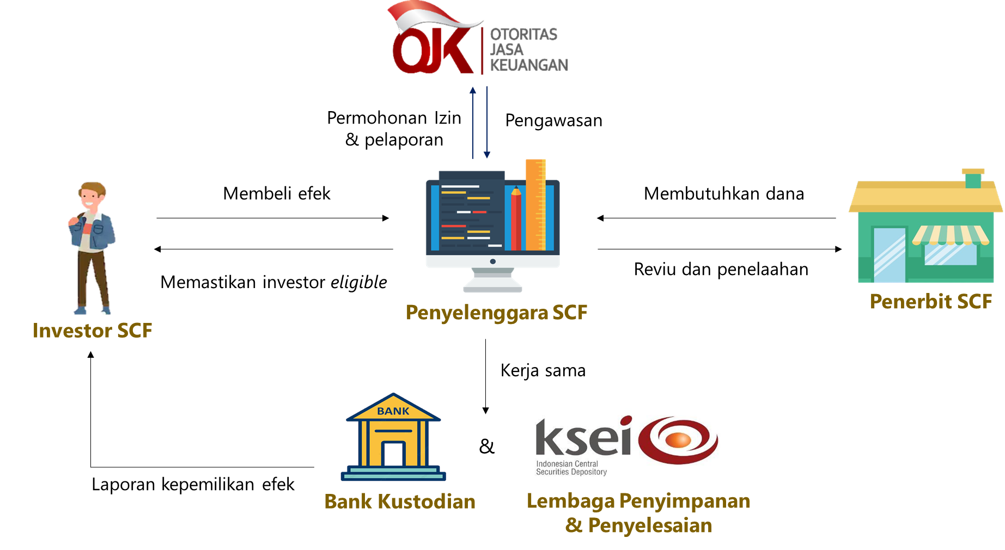





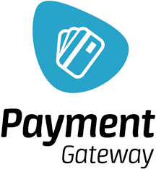
Related Parties of SCF
Licensing Application & Reporting
Supervision
Issuers
Buy Securities
Need Funding
Ensuring Eligible Investor
Review & Validating
SCF Platform
Third Parties
Credit Information Management Agency
Cooperation
KYC & e-signature Provider
Securities Ownership Report
Provider Payment Gateaway
&
Notes:
This slide shows technical workflow between the Investor, SCF Platform, Issuer, and third-party institutions such as KSEI (Depository), Custodian Banks, and credit information agencies

Slide 4
Regulatory Framework
2018
2020
2025
Equity Crowdfunding (ECF)
Securities Crowdfunding (SCF)
Issuance of POJK 17/2025
Clause:
POJK 37/2018 concerning Information Technology-Based Crowdfunding Services through Share Offerings (Equity Crowdfunding).
Facilitates start-ups and MSMEs in obtaining funds through the issuance of shares in the capital market.
Clause:
POJK 57/2020 concerning Information Technology-Based Securities Offerings through Crowdfunding Services.
POJK 16/2021 concerning Amendments to POJK 57/2020.
Facilitates start-ups and MSMEs in obtaining funds through the issuance of shares/bonds/sukuk in the capital market because not all MSMEs are established as Limited Liability Companies (PT).
POJK 57/2020 concerning Information Technology-Based Securities Offerings through Crowdfunding Services
POJK 16/2021 concerning Amendments to POJK 57/2020
are revoked and replaced by POJK 17/2025
Notes:
This slide shows technical workflow between the Investor, SCF Platform, Issuer, and third-party institutions such as KSEI (Depository), Custodian Banks, and credit information agencies

Slide 5
Background of Regulatory Changes
The quality of the Securities Crowdfunding (SCF) industry requires enhancement due to insufficient levels of compliance and corporate governance among Platforms.
Key Requirements for Improvement:
Industry Quality: Enhancing capital requirements, corporate governance, and transparency.
Protection: Increasing legal protection for both business operators (Issuers) and investors.
Legal Framework: Establishing a more comprehensive legal basis and reference for the licensing and supervision of SCF activities.
Regulatory Alignment: Adjusting existing provisions to align with the mandates of the Financial Sector Omnibus Law (UU P2SK).
Mandate of the Financial Sector Omnibus Law (UU P2SK)
Based on Chapter V, Articles 69A and 69B Paragraph (4) of the UU P2SK:
OJK Authority: OJK regulates the maximum funding limits and investor requirements for SCF.
Licensing: SCF Platforms are mandatory required to obtain a business license from OJK.
LJK Approvals: Platforms that are already Financial Service Institutions (LJK) licensed by OJK must obtain additional OJK approval.
Secondary Market: OJK has the authority to exempt share transfers via deed for secondary market trading on SCF platforms.
Transparency: Platform must ensure the completeness, adequacy, objectivity, and clarity of Issuer documents while upholding the Principle of Transparency.
Exclusivity: Issuers are prohibited from issuing securities through more than one Platform.
These improvements are accommodated in POJK 17/2025, which replaces and repeals POJK 57/2020 and POJK 16/2021.

Slide 6
Development of the Securities Crowdfunding Industry
No | Platform | Number of Issuers | Value of Securities | Number of Investors
1 | Shafiq | 101 | 669.776.028.356 | 50.478
2 | Bizhare | 164 | 266.483.840.000 | 43.454
3 | LBS Urun Dana | 82 | 263.659.249.650 | 17.821
4 | ICX | 43 | 217.954.010.000 | 25.411
5 | Danamart | 48 | 130.731.136.896 | 1.726
6 | Santara | 50 | 93.098.677.000 | 43.837
7 | Crowddana | 36 | 90.192.000.000 | 10.072
8 | Fundex | 33 | 74.540.200.000 | 1.603
9 | Ekuid | 19 | 40.453.000.000 | 639
10 | Urun RI | 15 | 20.688.146.001 | 654
11 | Danasaham | 2 | 10.500.000.000 | 2
12 | Prodana | 1 | 10.000.000.000 | 1
13 | Vestora | 6 | 7.689.600.000 | 62
14 | Fulusme | 5 | 2.252.050.000 | 19
15 | Visiku | 4 | 1.516.600.000 | 111
16 | SFUND | 1 | 560.000.000 | 14
17 | Aindo | 1 | 500.000.000 | 1
18 | Udana | 0 | - | -
Total |  | 611 | 1.900.594.537.903 | 195.905
The industry has shown a strategic role in the Capital Market with significant growth in participants and fund collection.
The following 5 Platforms are the parties with the largest securities issuance value:
Shafiq, Rp 669 billion, 35,2%
Bizhare, Rp 266 billion, 14%
LBS Urun Dana, Rp 263 billion, 13,9%
ICX, Rp 217 billion, 11,5%
Danamart, Rp 130 billion, 6,9%
* Data as of April 1, 2026

Slide 7
Development of the Securities Crowdfunding Industry (cont.)
Total Issuers
Value of Securities
Number of Investors
Overall, the crowdfunding industry in Indonesia shows a continued positive growth trend from 2018 to early 2026.
Nevertheless, the growth rate is decelerating as the industry enters a stabilization phase.

Slide 8
Strategies and Action to Improve Quality and Supervision
of SCF Industry
Key Revisions in POJK 17/2025:
Minimum Capital
Increased to IDR 25 Billion.
Minimum Equity
Mandatory minimum equity of IDR 5 Billion at all times (to be implemented over a 3-year transition period).
Governance
Strengthening Due Diligence for Issuers and oversight of affiliated parties.
Liquidity
Enhancing the liquidity of securities.
Performance Metrics
Mandatory use of an investment success rate ratio for all Platforms.
Implementation of APOLO for reporting and the development of SCFNet (integrated platform) by KSEI for data integration and public transparency.

Slide 9

Distribution of Issuers in Indonesia
Kalimantan
Sulawesi
Issuer | 3 (0,70%)
Asset | Rp9.59 Billion (0,93%)
Issuer | 0
Asset | Rp0
Maluku dan Papua
Sumatra
Issuer | 1 (0,23%)
Asset | Rp5.36 Billion (0,62%)
Issuer | 25 (5.81%)
Asset | Rp63.64 Billion (5,62%)
Jawa*
Issuer | 392 (91,16%)
Asset | Rp928.42 Billion (90,68%)
Bali, NTB, dan NTT
Issuer | 9 (2,09%)
Asset | Rp15.91 Billion (1.55%)
*Include Issuer at DKI Jakarta
Issuer: 194 (45.12%), Asset value Rp488.42 Billion (47.70%)
Source: KSEI as of March, 31, 2026

Slide 10
Distribution of Investors in Indonesia
Kalimantan
Sulawesi
Investor | 5,34%
Asset | Rp43.61 Billion (4,31%)
Investor | 3,34%
Asset | Rp17.11 Billion (1,69%)
Maluku dan Papua
Sumatra
Investor | 0,82%
Asset | Rp6.04 Billion (0,60%)
Investor | 14,61%
Asset | Rp110.23 Billion (10,90%)
Jawa*
Investor | 73,21%
Asset | Rp819.55 Billion (81,06%)
Bali, NTB, dan NTT
*Include Investor of DKI Jakarta
SID: 19,21%, Asset value Rp394.26 Billion (38.99%)
Investor | 2,69%
Asset | Rp14,52 Billion (1,44%)
Source: KSEI as of March, 31, 2026

Slide 11
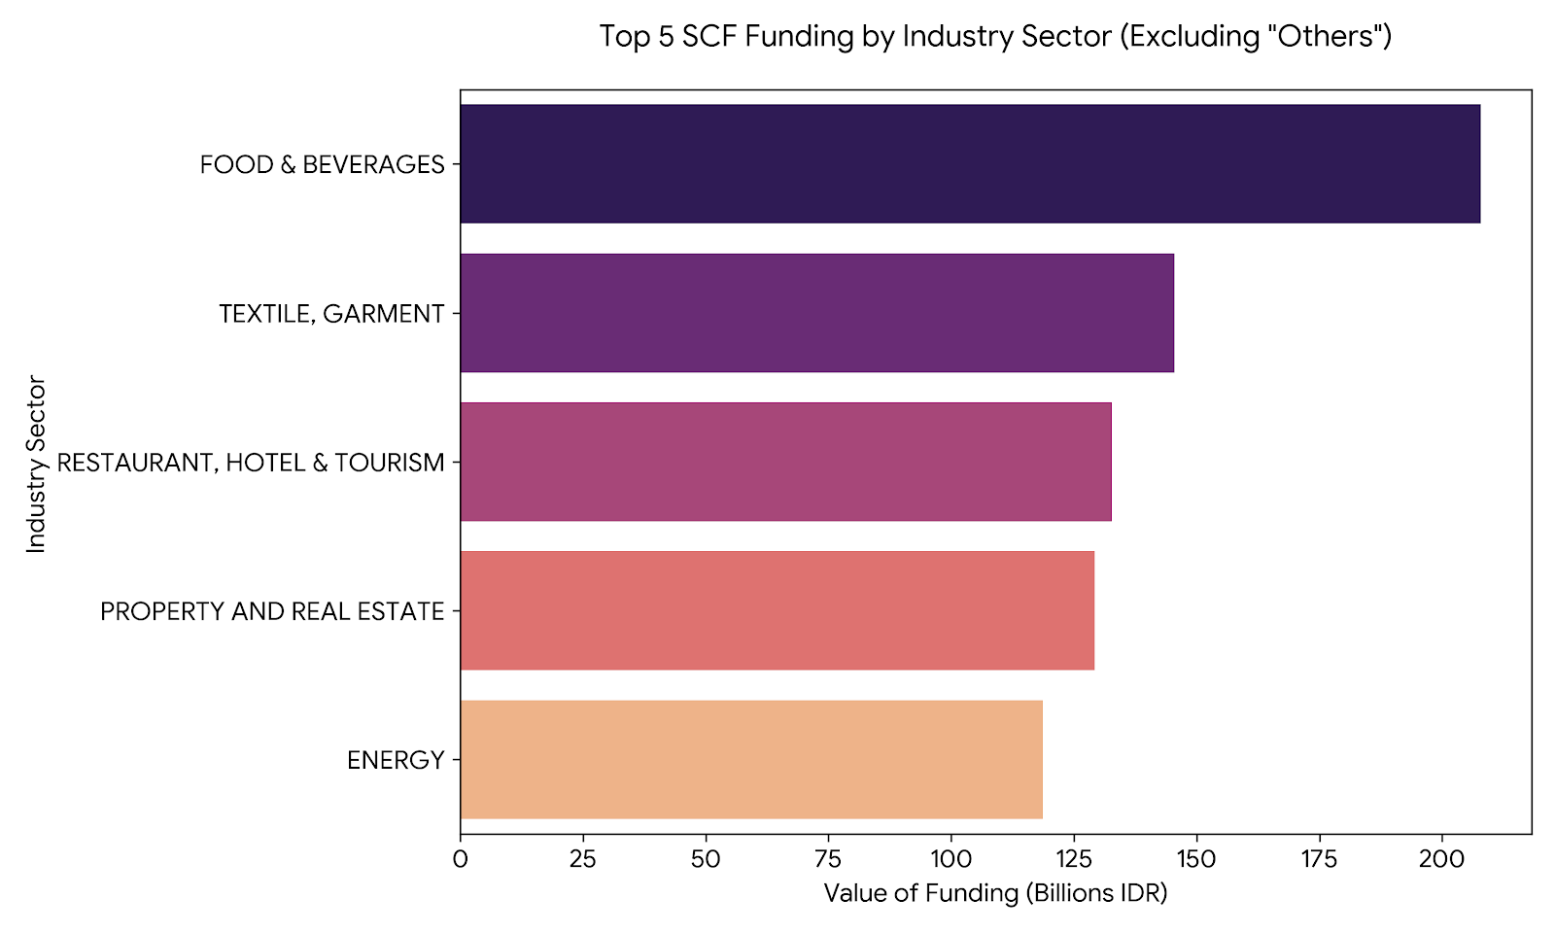
Data of Industry Sector
Key Observations from the Data
Consumer-Facing Dominance
Retail-adjacent sectors like Food & Beverages, Textiles, and Tourism dominate the funding landscape, highlighting where current investor appetite is concentrated.
Heavy Tailing: There are 45 total categories in the data, but the majority of the capital is heavily concentrated in these top 5 sectors.

Slide 12








Success Story of Issuer
Creative Industry (Film) funding various film projects
PT Dinamika Selaras Bersama
Film Project “Glenn Fredly The Movie”
Equity
Funding 735.500.000
98 Investors
Reached approximately 97,588 audience
PT Sinema Selaras Bersama
Film “Soul Reaper “ and “Blood Sacrifice”
Equity
Funding 1.255.000.000
106 Investors
Soul Reaper garnered around 400,000 audience
Blood Sacrifice reached 50,388 audience
PT Aster Sinema Selaras
3 Film Project Aster Adhya Pictures (Romeo's Broken Promise, Bones Upon Bones, and The Hole)
Equity
Funding 7.758.500.000
318 Investors
Bones Upon Bones reached 36,874 audience in the first 3 days of release
PT Dwi Danamitra Kavita
Film Harlot's Prayer
Bond
Funding 5.000.000.000
17 Investors
655,725 audience after 34 days

Slide 13
The Role of SCFNet in Resolving Industry Issues
Issues | Resolution of SCFNet
 | SCFNet acts as a reliable, independent, and integrated public information source, serving as a backup in case of Platform system failures.
 | SCFNet provides detailed data on offering stages, education materials, and investment success ratios based on dividend payments and default data.
 | Centralized information on problematic parties to assist Platform in risk mitigation
Data Integration and Reliability
Transparency and Education
Early Warning System
of Bad Actors/Perpetrator

Slide 14
The Role of SCFNet in Resolving Industry Issues (cont.)
Issues | Resolution of SCFNet
 | Mandatory use of Investor Fund Accounts (RDN) and escrow per offering to prevent fund misappropriation and increase transaction efficiency for small-value distributions.
 | SCFNet allows OJK and Platform to track cross-platform investment limits and enforce issuance ceilings.
Fund Management
(Escrow & Investor Accounts)
Monitoring and
Compliance

Slide 15

Thank You

