Slide 1



April 8th, 2026
Reporting and Monitoring
Ali ORUÇ
Expert
COMCEC
COORDINATION
OFFICE
programs.comcec.org

Slide 2



Outline
Importance of Reporting and Monitoring
Detailed Work Plan
Monthly Progress Report
Activity Report
Project Completion Report
Additional Reports for new Project Types:
Needs Assessment and Peer-to-Peer Experience Sharing
COMCEC
2
COORDINATION
OFFICE

Slide 3

Importance of Reporting and Monitoring
Observation of the physical and financial progress and following-up the results obtained, the collection and measurement of the information regarding the project.
Monitoring will be done via reporting as well as side-visits in the COMCEC Project Funding.
Reporting aims to measure how much of the project activities are completed.
Also, it aims to determine the achievements and problems during the implementation of the project.
COMCEC
3
COORDINATION
OFFICE

Slide 4
Importance of Reporting and Monitoring
Corrective actions can be taken for problems and risks with the help of reporting.
The CCO and Bank could inform the Project Owner for timely decisions to support implementation.
Funds will be transferred following the reporting of the progress in the project (such as time-sheets, progress reports).
COMCEC
4
COORDINATION
OFFICE

Slide 5
Detailed Work Plan
Project activities and other preparatory works related to the activities will be presented in the Detailed Work Plan.
It will help to facilitate the time-management and following–up the activities.
It will be prepared by the Project Coordinator (PC sends Detailed Work Plan to the Bank within two weeks after signing service contract).
Trainer(s) (if available) is supposed to contribute to the preparation of the Detailed Work Plan.
Before transfer of the payments, the Bank checks the timesheets by considering Detailed Work Plan
COMCEC
5
COORDINATION
OFFICE

Slide 6
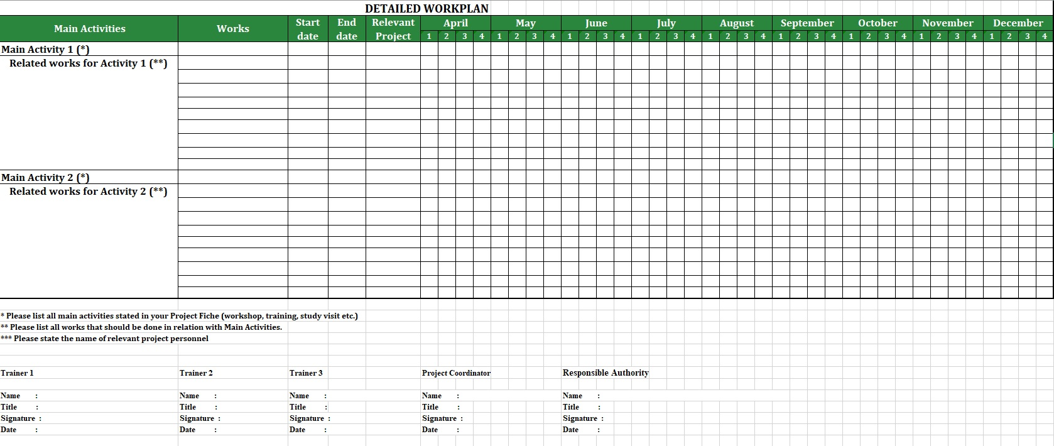
COMCEC
6
COORDINATION
OFFICE

Slide 7
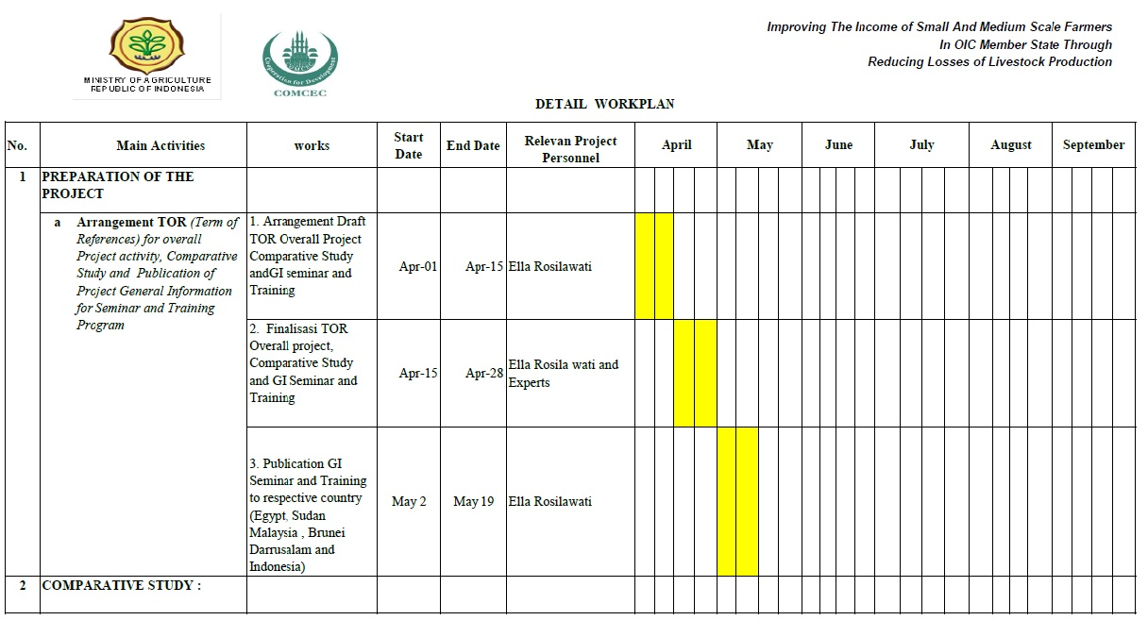
COMCEC
7
COORDINATION
OFFICE

Slide 8
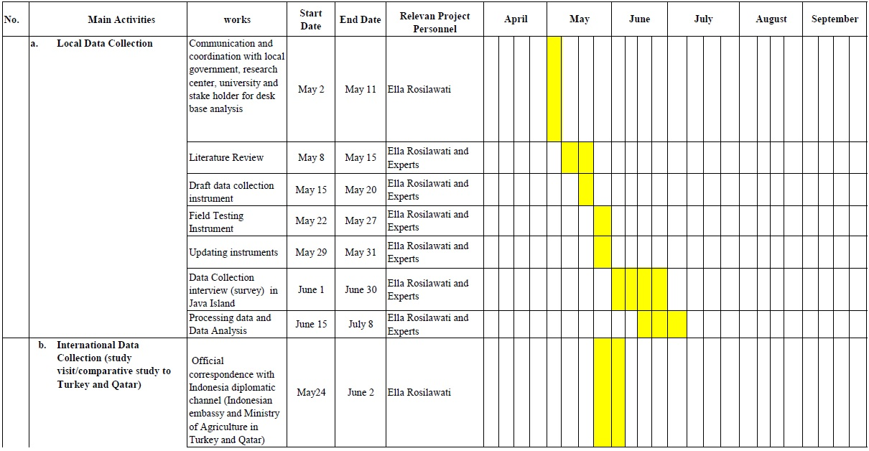
COMCEC
8
COORDINATION
OFFICE

Slide 9
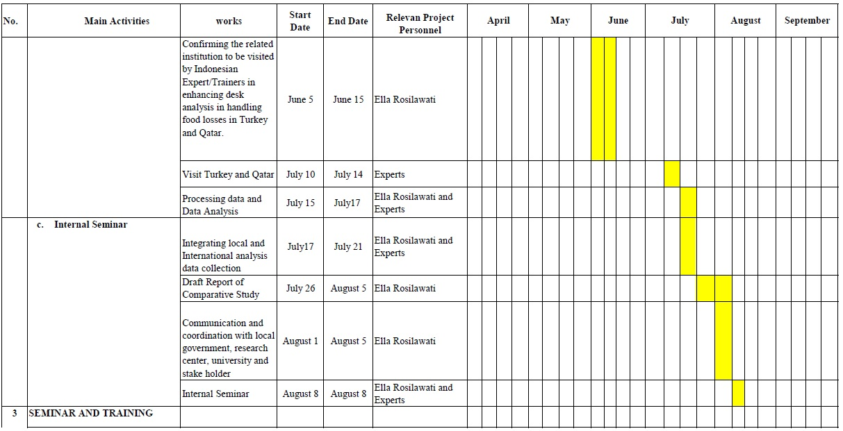
COMCEC
9
COORDINATION
OFFICE

Slide 10
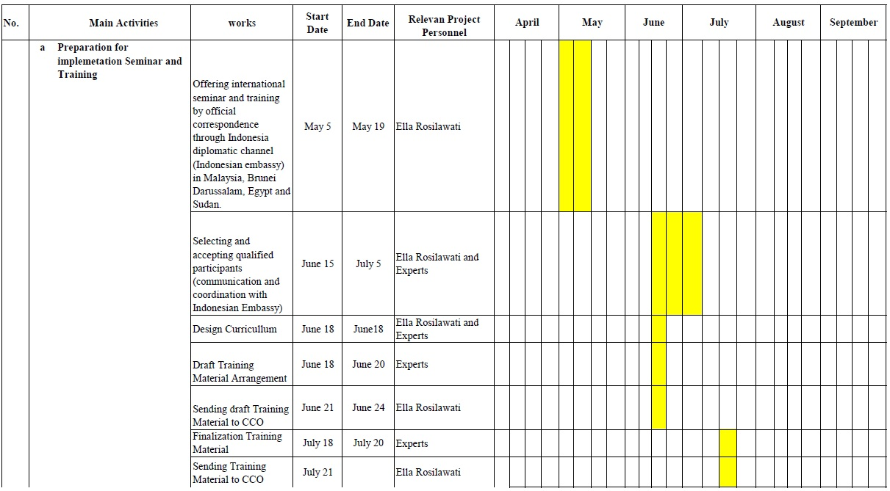
COMCEC
10
COORDINATION
OFFICE

Slide 11
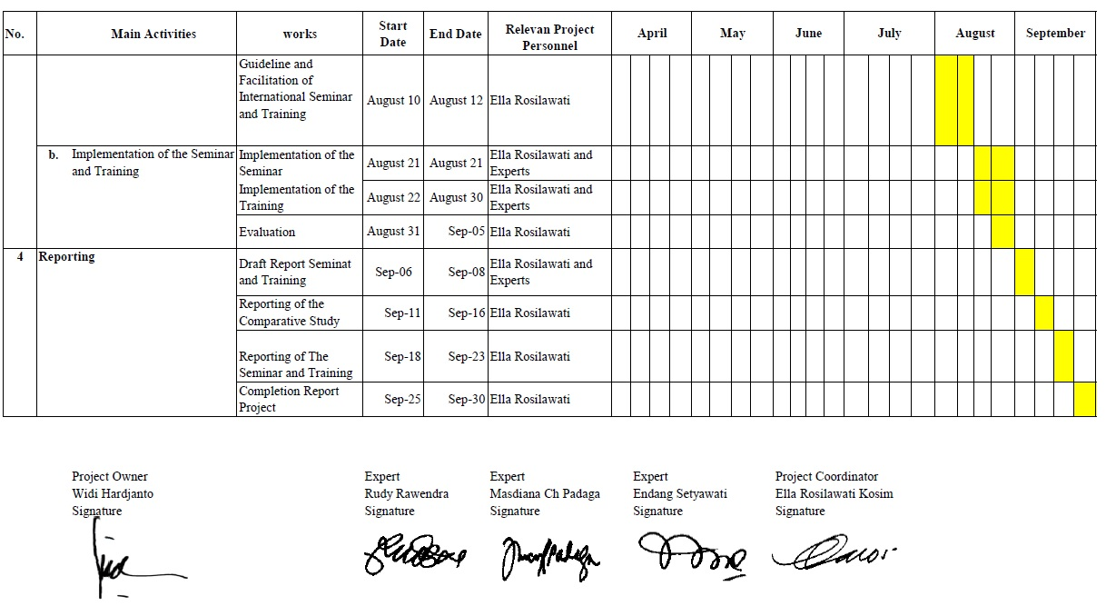
COMCEC
11
COORDINATION
OFFICE

Slide 12

Monthly Progress Report
Monthly Progress Report summarizes the technical progress of the project activities in the respective month.
It also includes details such as the problems encountered, the measures taken, and preparations for the next month.
The Bank and the CCO follow the progress regarding the project activities through Monthly Progress Report.
In case of any problem, report enables the CCO and Bank to intervene timely.
COMCEC
12
COORDINATION
OFFICE

Slide 13
Monthly Progress Report
Monthly Progress Report is prepared and signed by the Project Coordinator and Responsible Authority
Contact Person checks the Monthly Progress Reports
Payments are made based on the Monthly Progress Reports
COMCEC
13
COORDINATION
OFFICE

Slide 14
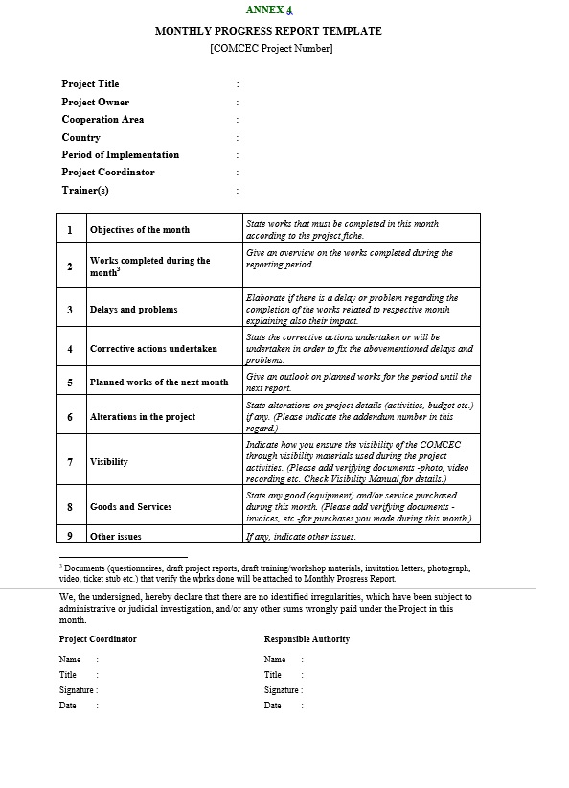
COMCEC
14
COORDINATION
OFFICE

Slide 15
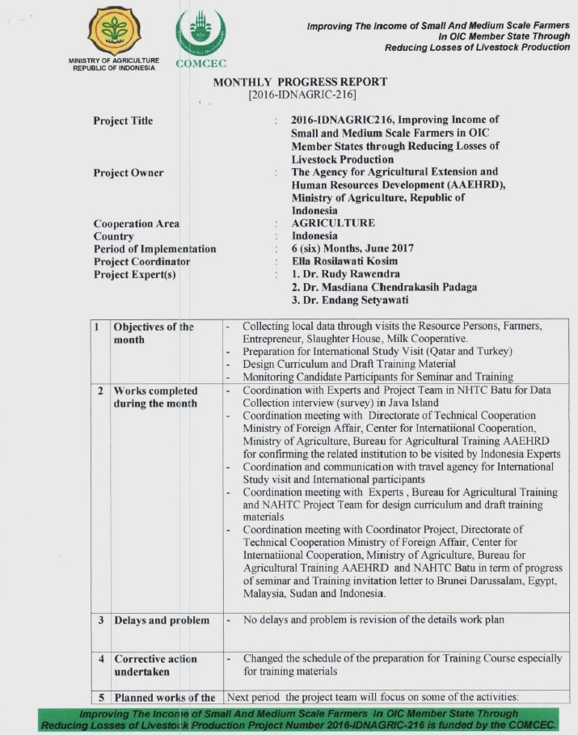
COMCEC
15
COORDINATION
OFFICE

Slide 16
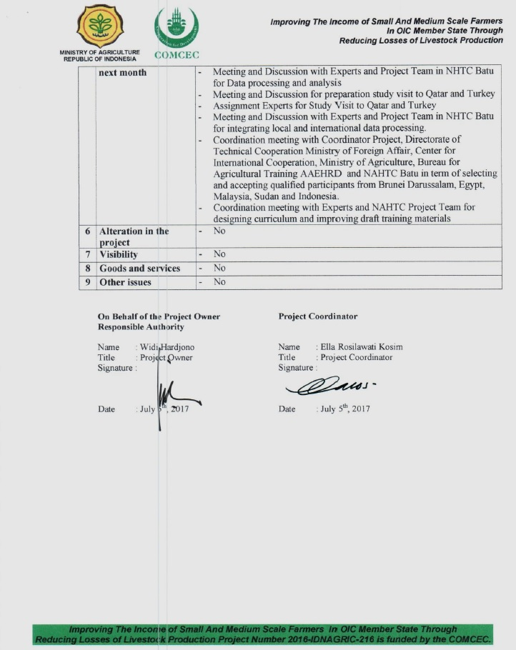
COMCEC
16
COORDINATION
OFFICE

Slide 17
Activity Report
Activity Reports are to be prepared for the activities such as Training, Workshop, Seminar and Study Visit within two weeks after one of the activity is successfully completed and sent to the CCO for approval.
Aim of the Activity Report is to evaluate the success of the activity.
Activity Reports also provide input for the Project Completion Report.
Project Coordinator is responsible for drafting Activity Reports
Trainer(s) is/are responsible for contributing to the preparation of the Activity Reports ( if available).
COMCEC
17
COORDINATION
OFFICE

Slide 18
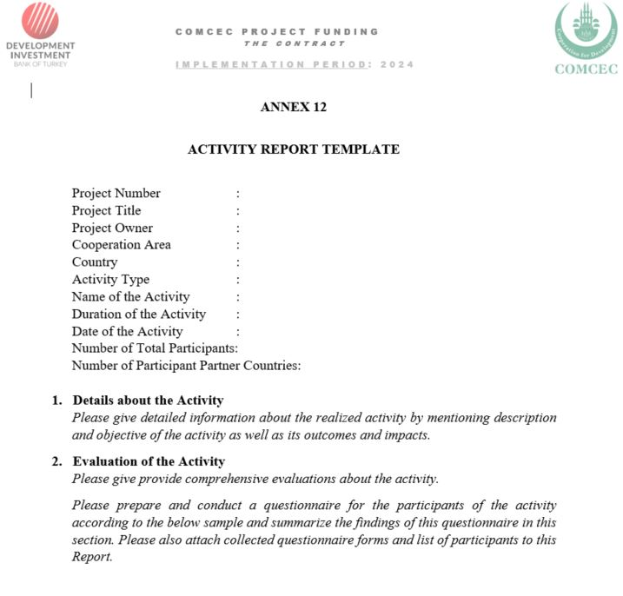
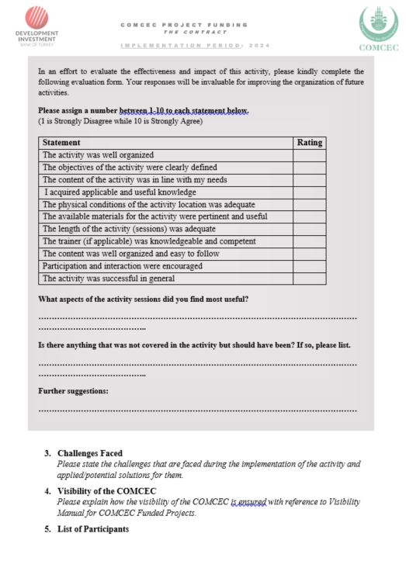
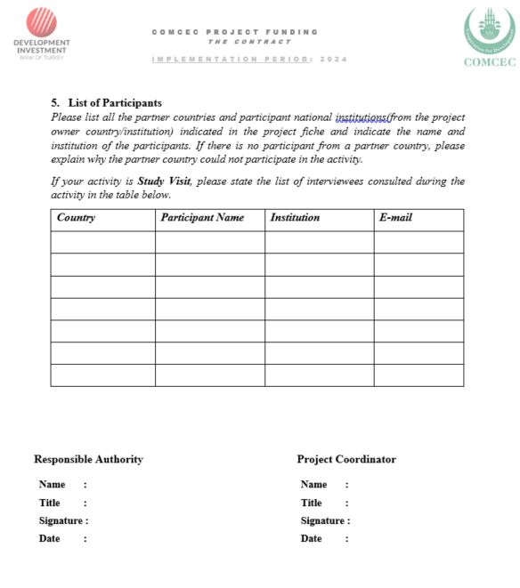
COMCEC
18
COORDINATION
OFFICE

Slide 19
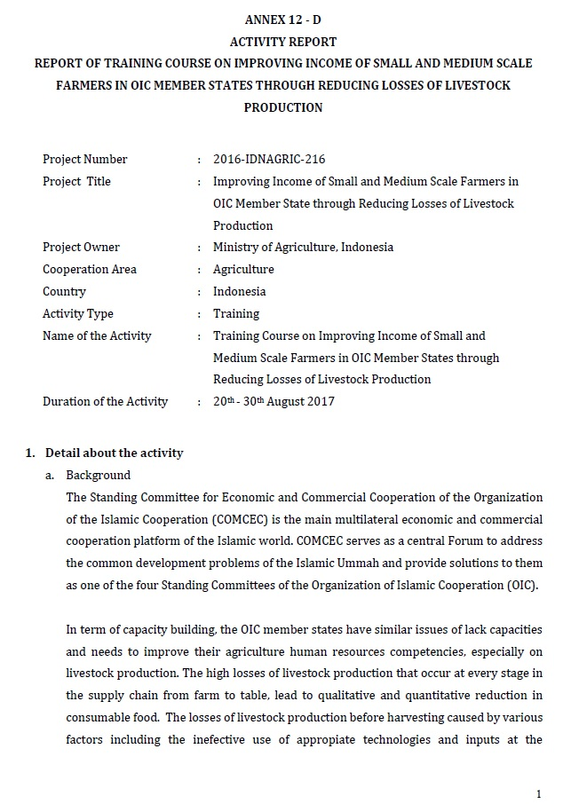
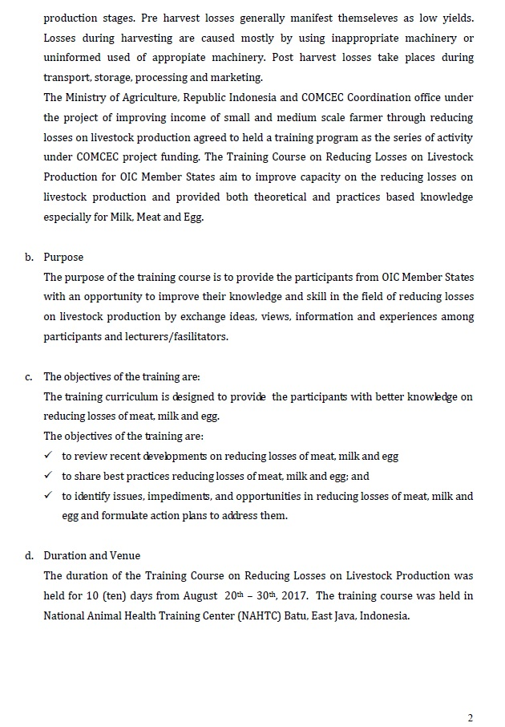
COMCEC
19
COORDINATION
OFFICE

Slide 20
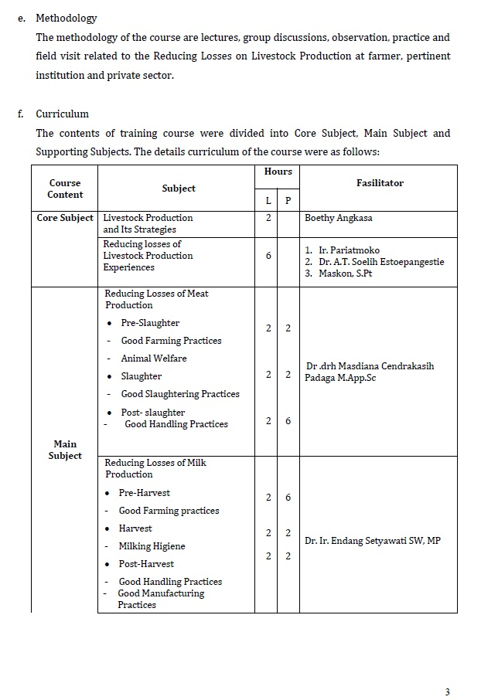
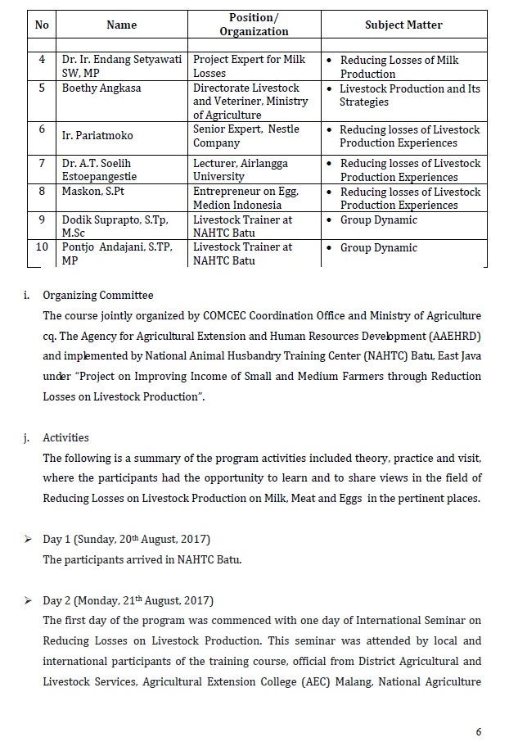
COMCEC
20
COORDINATION
OFFICE

Slide 21
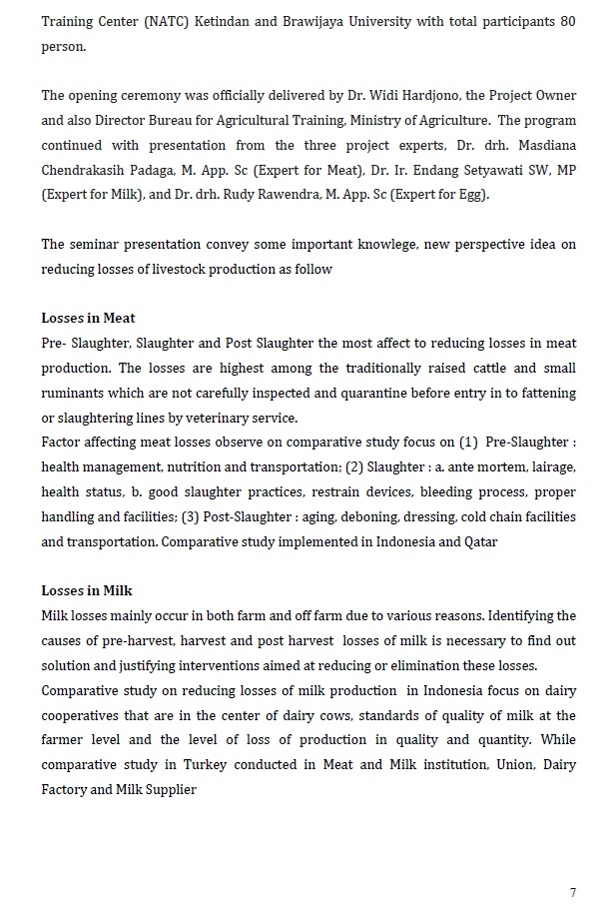
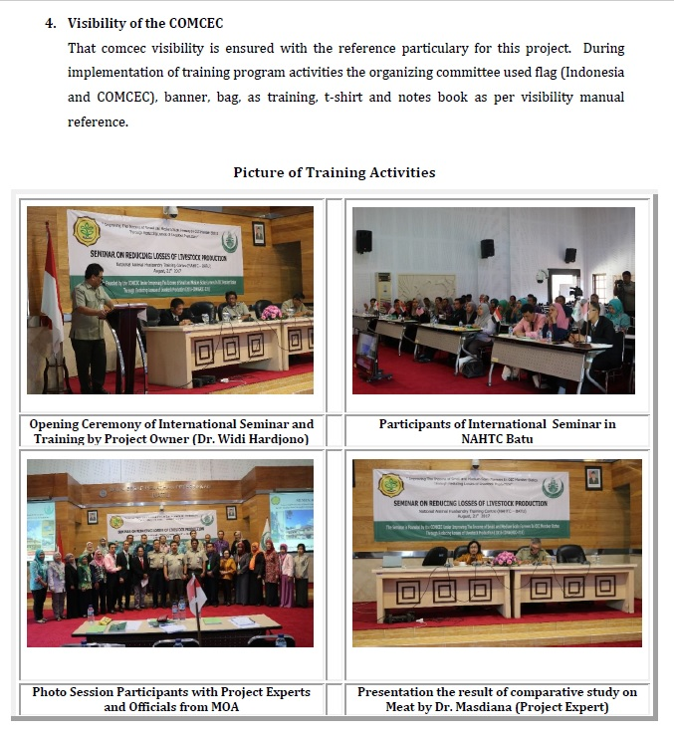
COMCEC
21
COORDINATION
OFFICE

Slide 22
Project Completion Report
The Project Completion Report is a closing report that provides general information on project activities, outputs and financial aspects. It aims to provide comprehensive information for third parties.
The Project Completion Report is prepared within two weeks after all activities are successfully completed and sent to the CCO for approval.
It is prepared and signed by the Project Coordinator and signed by the Responsible Authority.
Project Coordinator is responsible for drafting Project Completion Report
Contact Person checks the Project Completion Report
Last payments will be done after approval of the Project Completion Reports.
COMCEC
22
COORDINATION
OFFICE

Slide 23
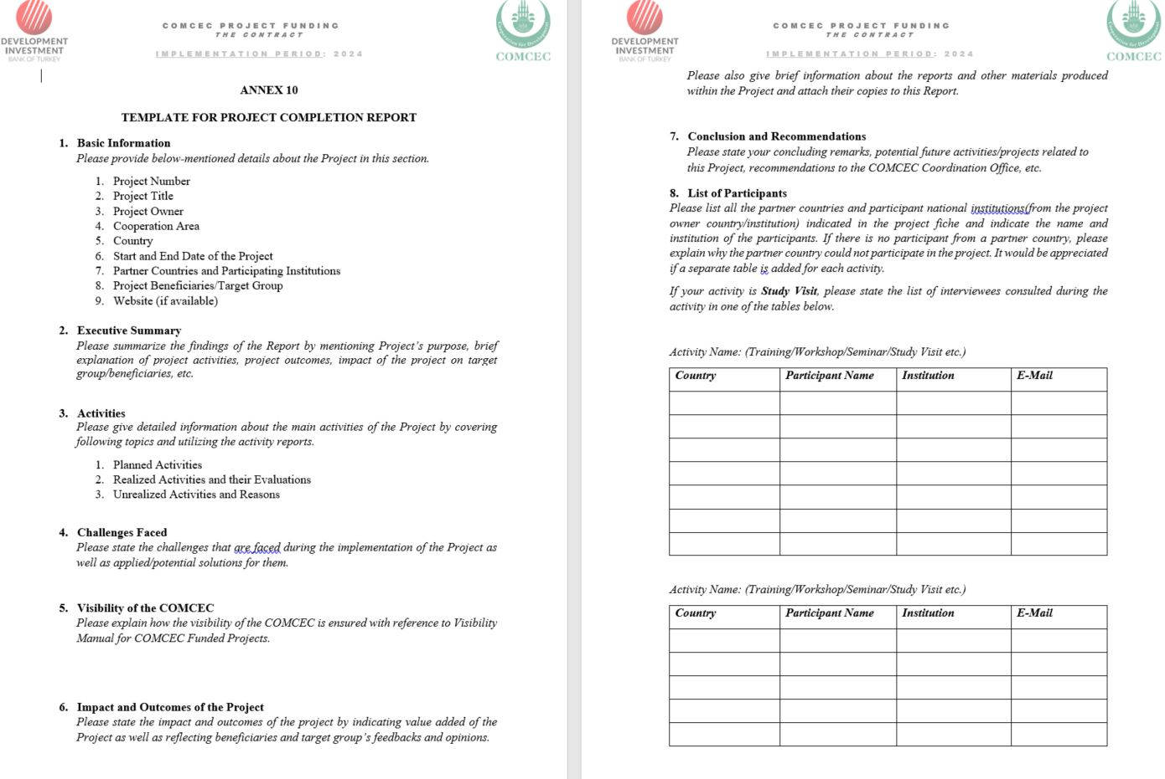
COMCEC
23
COORDINATION
OFFICE

Slide 24
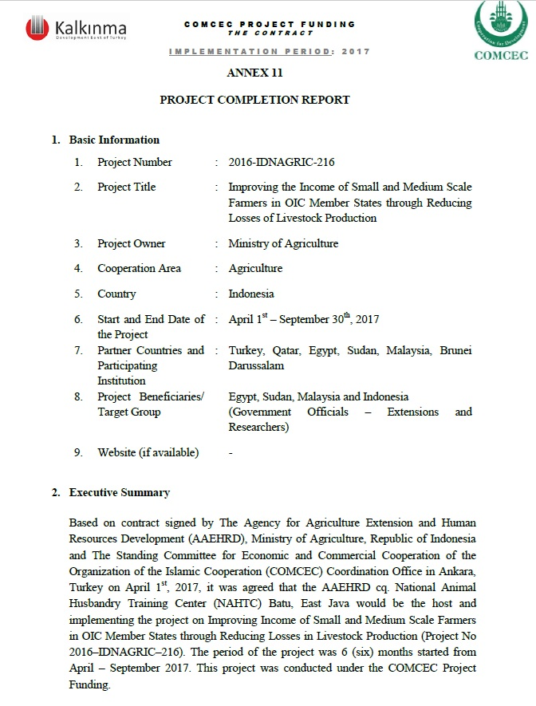
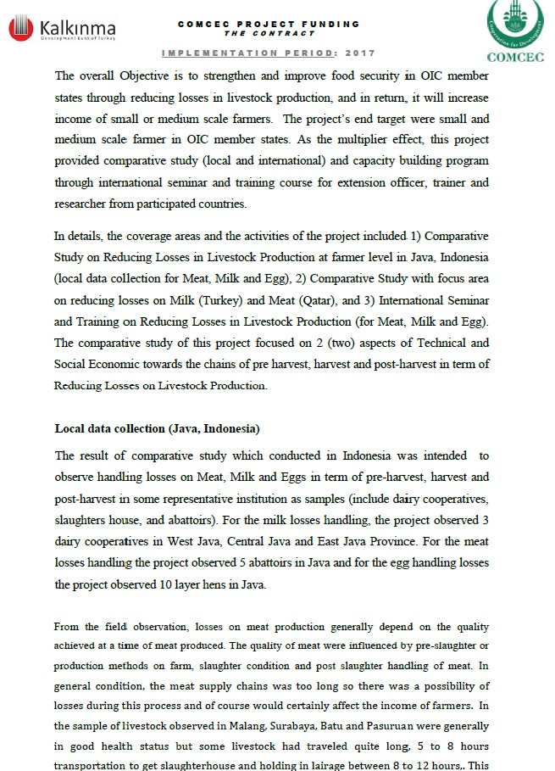
COMCEC
24
COORDINATION
OFFICE

Slide 25
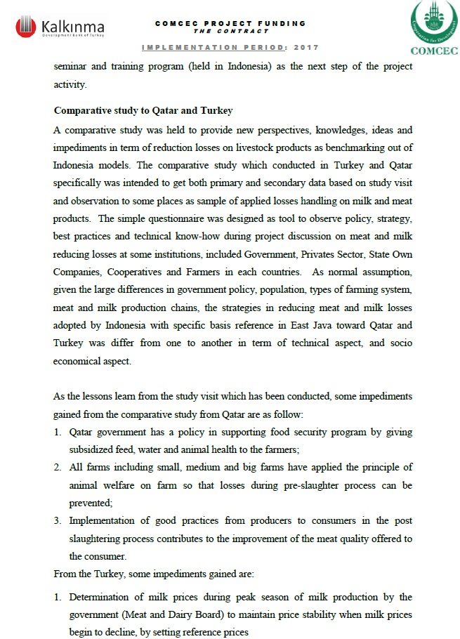
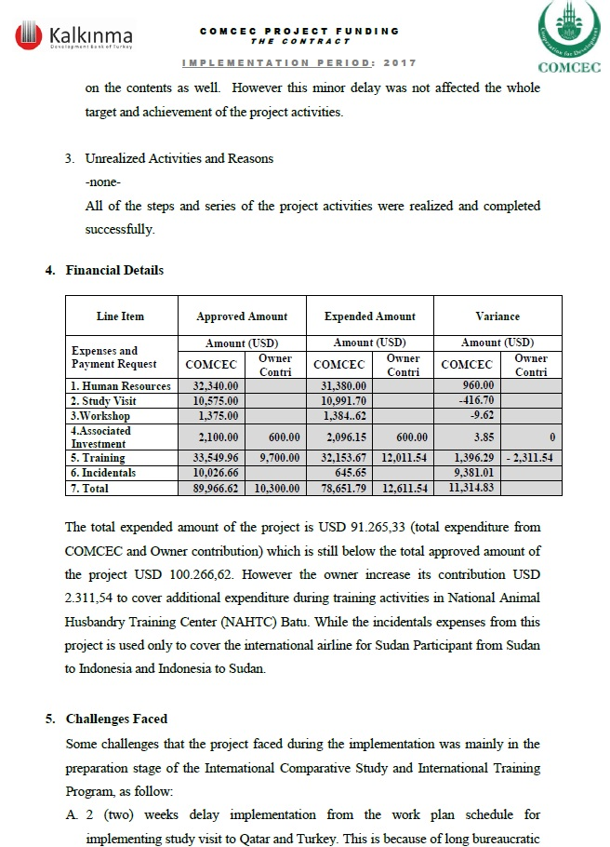

COMCEC
25
COORDINATION
OFFICE

Slide 26
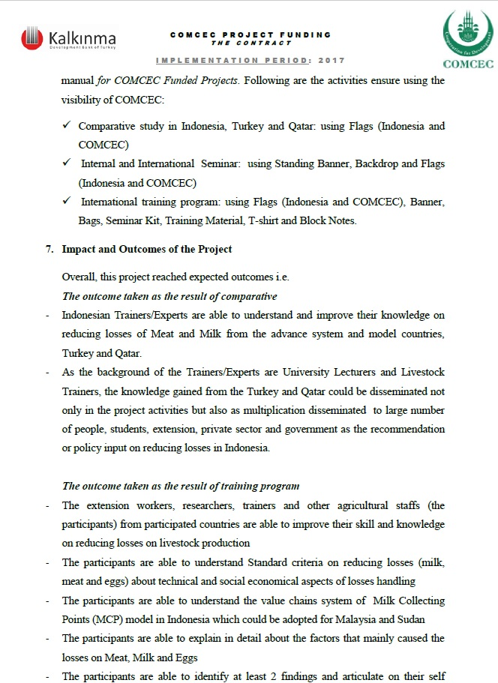
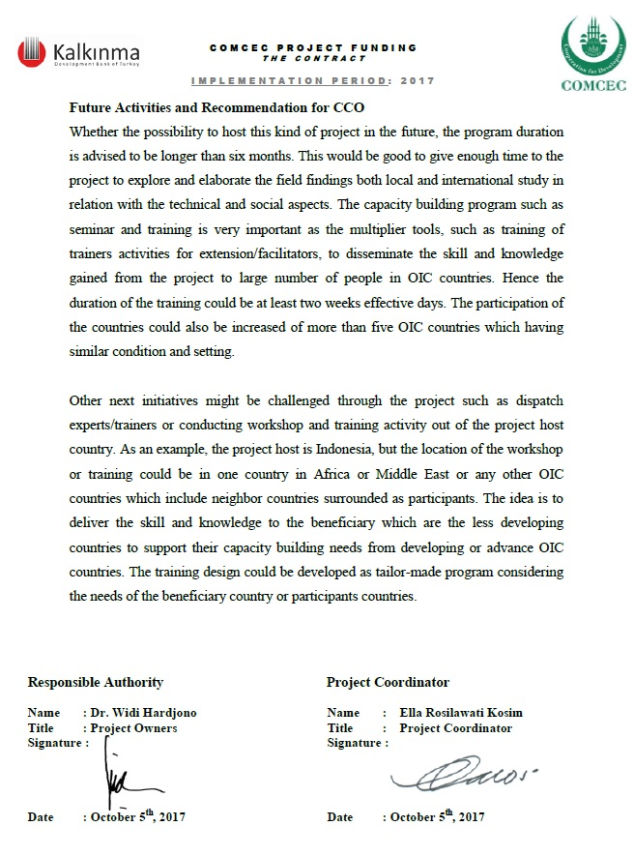

COMCEC
26
COORDINATION
OFFICE

Slide 27
Needs Assessment Report
Special Reports for Needs Assessment Projects
Assess needs of the PO Member Country and propose solutions to overcome the challenges and requirements of the member country in the related sector.
PO submits two drafts of the Needs Assessment Report in line with the template.
Section I - Assessing the Current Situation
Section II - Gathering and Analyzing Data
Section III - Making Decisions and Recommendations
COMCEC
27
COORDINATION
OFFICE

Slide 28
Field Study Report
Special Reports for Peer-to-Peer Experience Sharing Projects
In Peer-to-Peer Experience Sharing activities, the PO submits Field Study Report for reflecting the knowledge and experience acquired during the activity.
                Submit the 1st Section of the Field Study Report, (current situation of PO Country) before the visit
                Submit 2nd and 3rd sections after the activity (current situation in the host country and recommendations)
COMCEC
28
COORDINATION
OFFICE

Slide 29

THANKYOu
cpf.comcec.org
cpf@comcec.org
COMCEC
COORDINATION
OFFICE

