Slide 1

April 8th, 2026
Critical Issues for Successful Implementation
Eda AKÇA
Program Coordinator
Programs and Projects Department
COMCEC Coordination Office

Slide 2

What is Critical?
Following the Rules
Effective Communication
Good Logistical Issues and Deadlines
National Ownership
2

Slide 3
1
Following the Rules
Project Implementation Guidelines
Visibility Manual
3

Slide 4
Project Implementation
Guidelines
Following the Rules
Project Implementation Guidelines is the main document detailing the rules and procedures of the COMCEC Project Funding
Includes information about responsibilities of actors and project personnel, institutional structure, implementation and financing procedures, monitoring etc.
Please read the Program Implementation Guidelines whenever needed during the project implementation.
4

Slide 5
Project Implementation
Guidelines
Following the Rules
Sections to consider;
About the payments (see article 10. Payments - page 22 )
About irregularities and noncompliance (see article 9. Noncompliance and Related Santcions - page 21 )
About the monitoring and evaluation (see article 8. Reporting and Monitoring - page 17)
About the transfers between budget items (see article 8.8. Addendum Form - page 20 )
5

Slide 6
Visibility Manual
Following the Rules
Visibility Manual aims to raise the awareness of specific or general audience about the COMCEC and COMCEC funded projects.
The Manual mainly covers the written and visual identity of the COMCEC.
Setting out requirements and guidelines for briefings, written materials, press conferences, presentations, flyers, flags, invitations, signs, commemorative plaques and all other tools used to highlight COMCEC support.
6

Slide 7
Visibility Manual
Following the Rules
The COMCEC Logo must be used in all COMCEC- funded activities in line with the rules cited in this manual.
All visibility materials must be in English. POs can use the local language, Arabic and French in addition to English.
Graphics and wording of the visibility material must be visible, legible and clear at all times.
The visibility materials must be in compliant with the samples demonstrated in this manual.
7

Slide 8
Visibility Manual
Following the Rules
Progress Reports sent by the POs must include photographs and videos demonstrating visibility materials used during project activities. Photographs and videos must also show visibility material on equipment purchased under the project (if available).
Documents (analytical studies, brochures, flyers, CD, DVD, press release etc.) published under a COMCEC-funded project must include the following statement
"This [material] was prepared under the COMCEC Project Funding" on their cover (Section VI).
8

Slide 9
Visibility Manual
Following the Rules
Every study (needs assessment reports, field study reports, situation analyses, policy recommendations, etc.) and web site prepared under a COMCEC funded project must include the following statement;
" Views and opinions expressed in the report are solely those of the
author(s) and do not represent the official views of the COMCEC Coordination Office or the Member States of the Organization of Islamic Cooperation.[…] (Section I, article k) "
9

Slide 10

COMCEC Logo
https://www.comcec.org/comcec-logo/
10

Slide 11
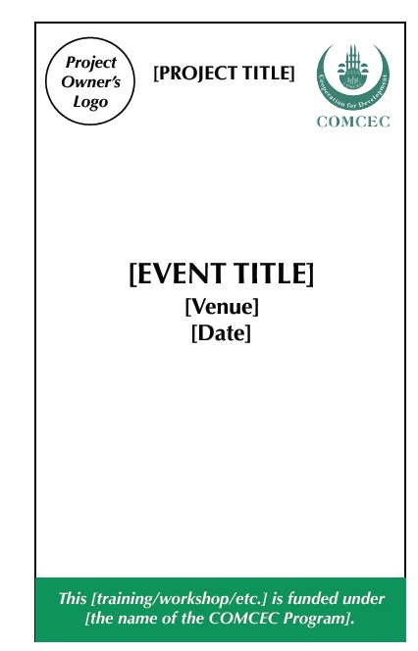
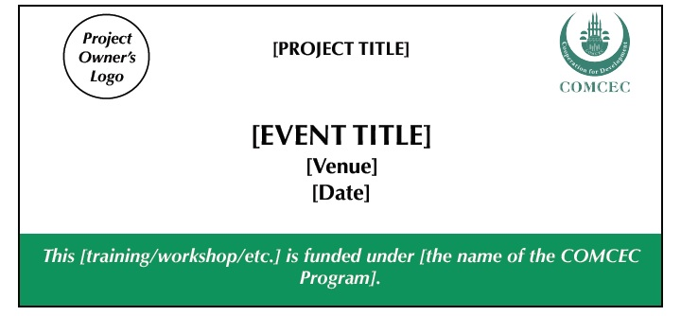
Banner Samples
11

Slide 12
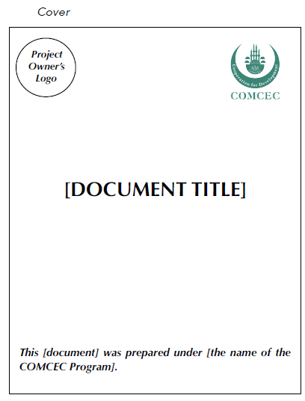
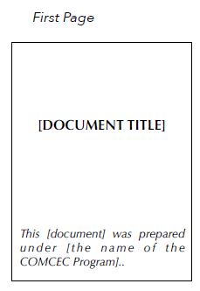
Document Samples
12

Slide 13
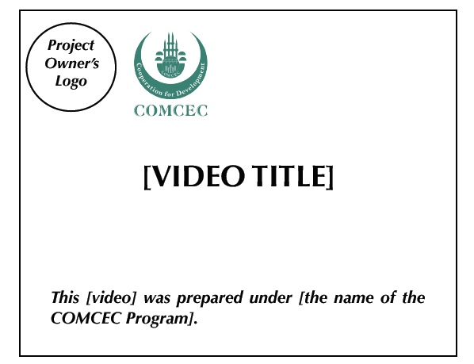
Video
13

Slide 14
2
Effective
Communication
14

Slide 15
Effective Communication
Selection and communication with partner countries
Success of the Project Implementation
Realization of Expected Outcomes
Right after your project starts;
Inform your partner (official letters and bilateral talks)
Share the details of the activities and tell your expectations from your partners
Prior notification has benefits:
Duration of internal procedures of partner countries
Participation of right people
Institutions to be visited and persons to be interviewed
15

Slide 16
Effective Communication
Inform CCO with related to the preparations of project activities
Simply CC cpf@comcec.org in your communication with partner countries
Convey soft copies of official letters to CCO via e-mail
16

Slide 17
Effective Communication
When informed on time, CCO can facilitate communication among partner countries and hence avoid potential problems beforehand
17

Slide 18
3
Logistical Issues and Deadlines
18

Slide 19
Logistical Issues
Preparing and sending the invitation letters to prospective participants at least one month before project activities
Addressing passport and visa issues in a timely manner
Reserving flight tickets and accommodation beforehand
Arrangement of local transfers in advance
19

Slide 20

Keeping Up With the Deadlines
Of critical importance for planning and executing the project activities on time and properly
Deadlines are determined in
Project Implementation Guidelines
Contract
Detailed Work Plan
Deadlines in the Detailed Work Plan :
Start and end dates of the main activities
Start and end dates of the related works for the main activities
Any delay in an activity or reporting may cause:
delay of payments
delay of project completion (extension of project duration)
20

Slide 21
Keeping Up With the Deadlines
Project Implementation Guidelines
Detailed Work Plan: First Month
Progress Reports: Every Month Except First Month
Official Invitation Letters: At least one month before the event
First Draft of Training Materials: At least one month before the date of the training program
Final Version of Training Materials: At least two weeks before the date of the training program.
21
Notes:
.

Slide 22
4
National Ownership
22

Slide 23
National Ownership
Ownership by the Ministries and Other Institutions of Project Owner Countries
Working in Harmony (responsible authority, contact person, project personnel and institutions of project owner countries)
Swift completion of reporting and signing procedures
Opportunity to cooperate with the Islamic world
23

Slide 24
programs.comcec.org
THANK you
cpf@comcec.org

