Slide 1



www.lc-oic.org
TH
26
MEETING OF THE COMCEC
POVERTY ALLEVIATION WORKING GROUP
Preventing the Skill Mismatch in the Labor Markets of the OIC Member States
© OIC Labour Centre. All rights reserved.
Notes:
Add here also the title of presentat

Slide 2

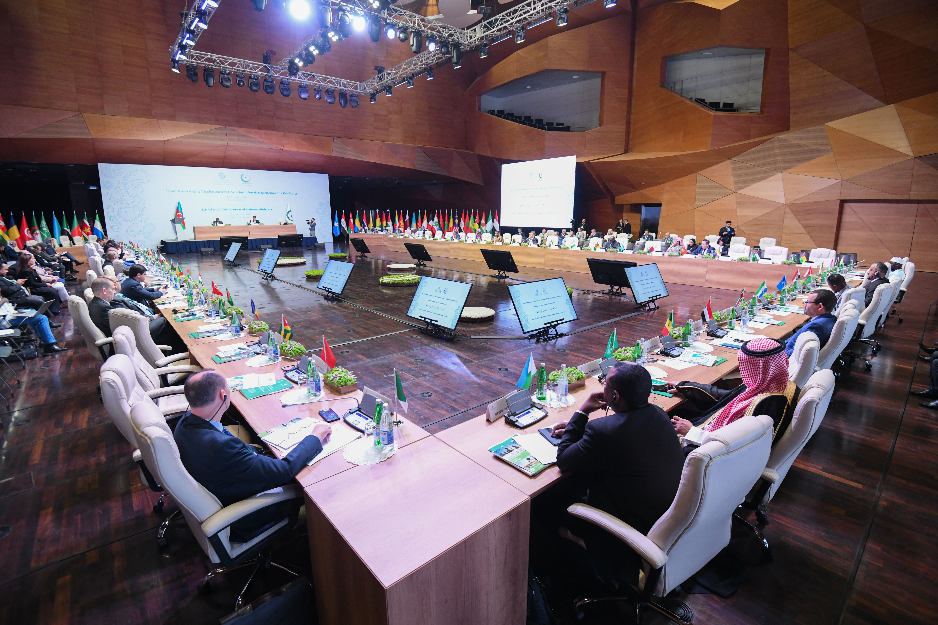

ABOUT US
As a specialized Institution of the OIC, the Centre operates in accordance with the provisions outlined in its Statute.
The OIC Labour Centre serves as an intergovernmental institution aimed at enhancing labour conditions, promoting employment opportunities, and fostering social protection systems across its Member States. It emphasizes the crucial need to ensure decent work, sustainable social protection, and poverty reduction within OIC Member States, in alignment with the objectives of the OIC Charter.
Our Vision
Our Mission
The OIC Labour Centre envisions inclusive, fair, and resilient labour markets across Member States, built on decent work for all and strengthened by effective social protection. It advances cooperation, international labour principles, and policy innovation—promoting men and women equality, social inclusion, skills recognition, and fair labour mobility to support shared prosperity and social justice.
Our mission is to consolidate and empower socio-economic development. The goal of the Centre is to enhance labour conditions, promote equitable employment opportunities, and foster sustainable social protection systems across OIC Member States, ensuring decent work, poverty reduction, and socio-economic development in alignment with the principles of the OIC Charter.
© OIC Labour Centre. All rights reserved.

Slide 3









SKILLS MISMATCH IN OIC MEMBER STATES
With a total population of 2.1 billion, the OIC faces a 62% skills mismatch rate which is significantly higher than the 43% in developed countries.
With only 16.2% of the workforce classified as high-skilled, OIC Member States exhibit a significant deficit, compared to 44.9% in other developing countries.
44.9%
16.2%
Source: OIC Labour Market Report 2025
© OIC Labour Centre. All rights reserved.

Slide 4



SKILLS MISMATCH IN OIC MEMBER STATES
While providing 21.5% of the world’s labour force, the high mismatch prevents the OIC Member States from translating its massive human capital into global competitiveness.
Despite a 55.5% Employment-to-Population Ratio (EPR) (ap. 1.17 billion), over half of these active workers (about 583 million) are in roles that do not align with their qualifications.
© OIC Labour Centre. All rights reserved.

Slide 5

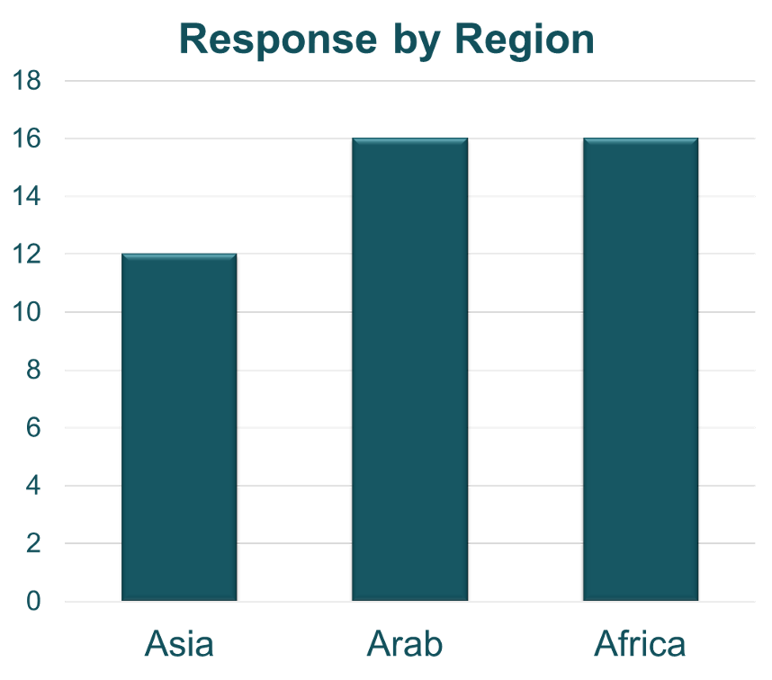

LABOUR MARKET SURVEY
Purpose
To conduct labour market needs and capacity assessment to identify priorities, skills gaps, and key challenges across OIC Member States, and to inform targeted programmes and policy interventions.
Responses by Country Groups
The survey was administered in English, Arabic, and French and collected responses from senior officials of Ministries of Labour across 44 OIC Member States.
Number of
responses
from Countries
© OIC Labour Centre. All rights reserved.

Slide 6

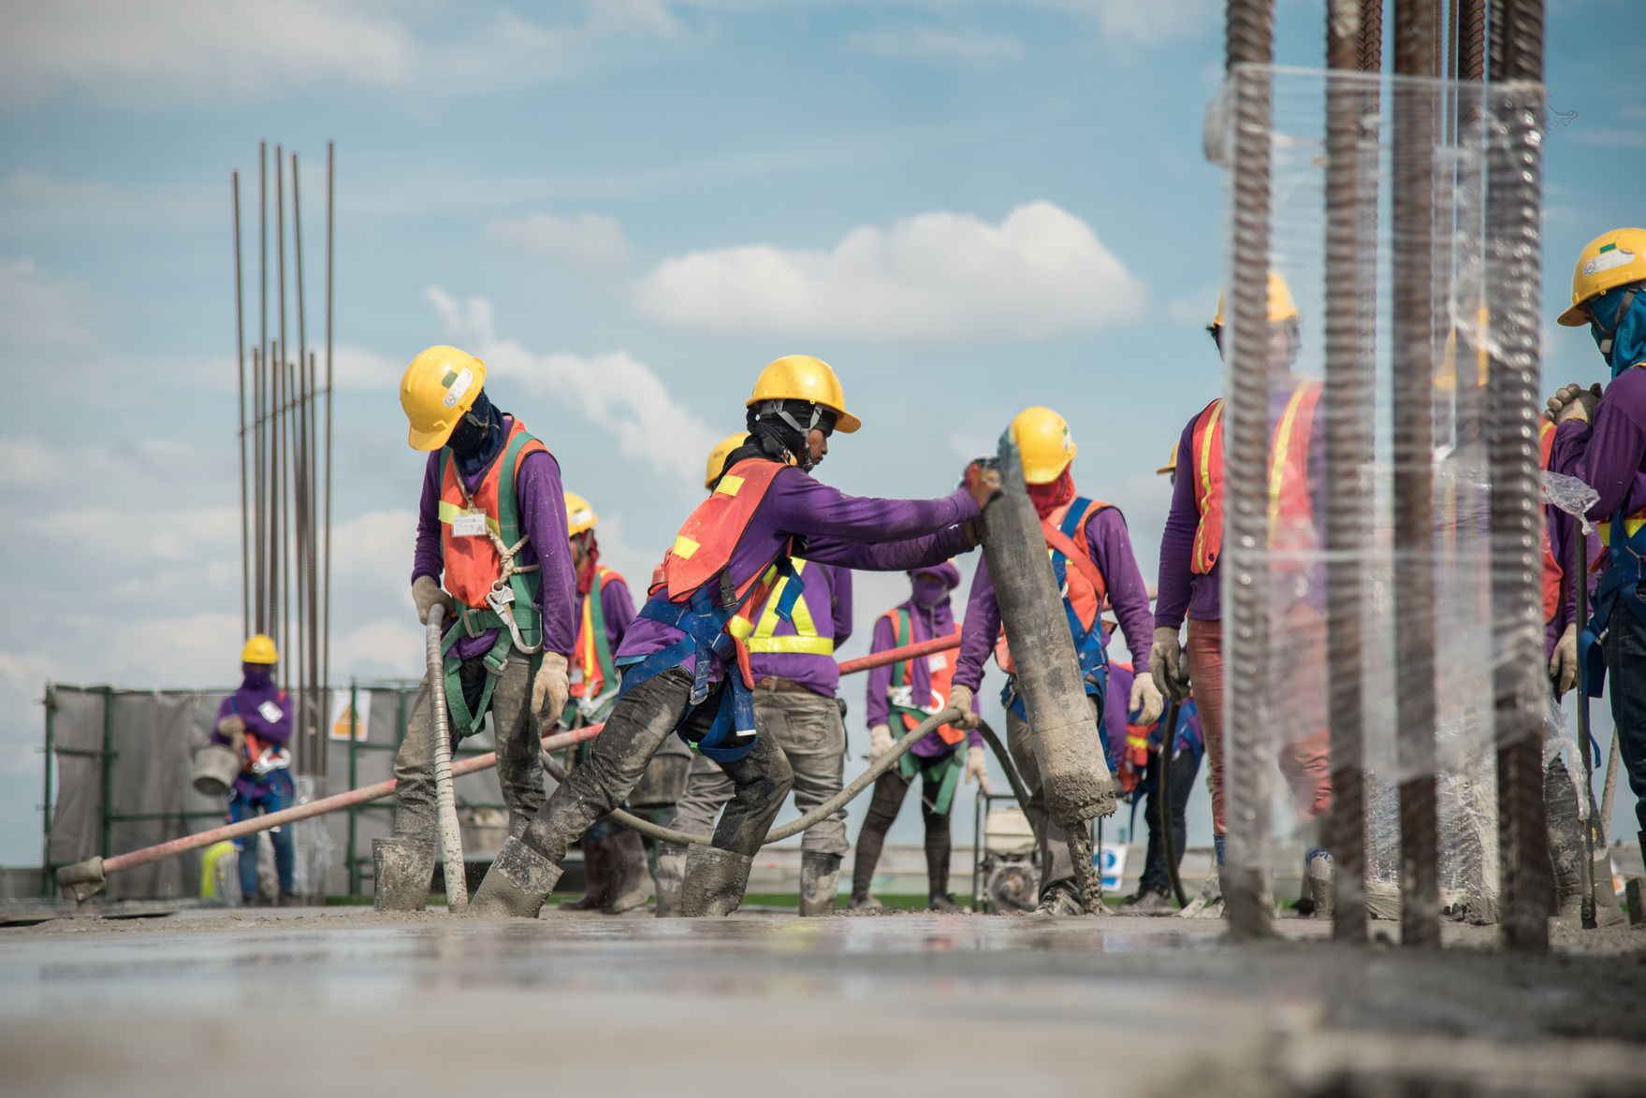

CURRENT STATE OF
LABOUR MARKET
Low Supply of Skilled Workforce and Oversupply of Unskilled Workforce
Systemic imbalance in workforce structure
Skills mismatch deemed as the top driver
of labour shortages
© OIC Labour Centre. All rights reserved.

Slide 7







EXTENT OF SKILLS MISMATCH
25 out of 44 respondents report significant skills mismatch and only 2
(Kuwait and Guinea)
reported no skills mismatch.
Most Affected Member States are Palestine, Jordan, Morocco
(OIC Labour Market Report 2025)
Identified as a top labour market challenge and the most difficult one to address
(OIC Labour Market Strategy 2025)
© OIC Labour Centre. All rights reserved.

Slide 8


MISSING SKILLS IN WORKFORCE
1
4
Technology Use
Planning & Organising
AI Literacy
2
5
Communication
3
6
Problem Solving
Initiative & Enterprise
© OIC Labour Centre. All rights reserved.

Slide 9




ONGOING MITIGATIONS
Increasing Vocational Training Programs
Strengthening Public-Private Partnerships
Encouraging Reskilling & Upskilling Initiatives
Providing Scholarships for Education in Key Sectors
© OIC Labour Centre. All rights reserved.
Notes:
(by rank)

Slide 10




RECOMMENDATIONS
Strengthen Education–Employer Partnerships
Enhance/ Establish Skills Forecasting & Labour Market Analysis Systems
Provide Continuous Reskilling/Upskilling Support
Reforming Educational Curriculum
Develop Career Guidance Systems
© OIC Labour Centre. All rights reserved.
Notes:
(by rank)

Slide 11









FUTURE OF WORK
Technology, AI & Digital Services
Emerging Demand
Renewable Energy
Top
Growing
Sectors
Healthcare & Biotech
Green Industries
Manufacturing & Automation
© OIC Labour Centre. All rights reserved.
Notes:
(by rank)

Slide 12

FUTURE OF WORK
1
Emerging Demand
AI and Automation
2
Digitalization
3
Key Drivers
37 out of 44 respondents indicated that they do not feel ready for the Future of Work, while only 7 countries
reported readiness.
Green Transition
© OIC Labour Centre. All rights reserved.
© OIC Labour Centre. All rights reserved.

Slide 13







INTERVENTIONS REQUIRED
FOR THE FUTURE WORKFORCE
Integrating AI & Digital Skills Into Curriculum
Strengthening Public-Private Partnerships
Expanding Vocational Training Systems
Improving Digital Infrastructure
Promoting STEM Education
© OIC Labour Centre. All rights reserved.

Slide 14





Where Countries See the Role of
OIC LABOUR
CENTRE
Policy Design Support
Carry Out Capacity Building Programs
Initiate Knowledge Transfer Across Member States
Conduct Labour Market Research & Skills Mapping
© OIC Labour Centre. All rights reserved.

Slide 15

“
Looking
Ahead:
The OIC Labour Centre remains committed to addressing skills mismatch by strengthening labour market systems, enhancing workforce skills, and promoting inclusive and sustainable employment across the OIC Member States. We look forward to continued collaboration with Member States and also invite COMCEC and other OIC institutions to partner in advancing practical, demand-driven solutions.
What’s next for us?
“
© OIC Labour Centre. All rights reserved.

Slide 16
THANK YOU
© OIC Labour Centre. All rights reserved.

Slide 17




www.lc-OIC.org
OICLabourCentre
OIC Labour Centre
in
OIC Labour Centre

