Slide 1

April 21th, 2026
COMCEC PROJECT SUPPORT PROGRAMS
26th Meeting of COMCEC Poverty Alleviation Working Group
Hasan Yenigül
Program Coordinator
Department of Programs and Projects
COORDINATION
OFFICE
cpf@comcec.org

Slide 2
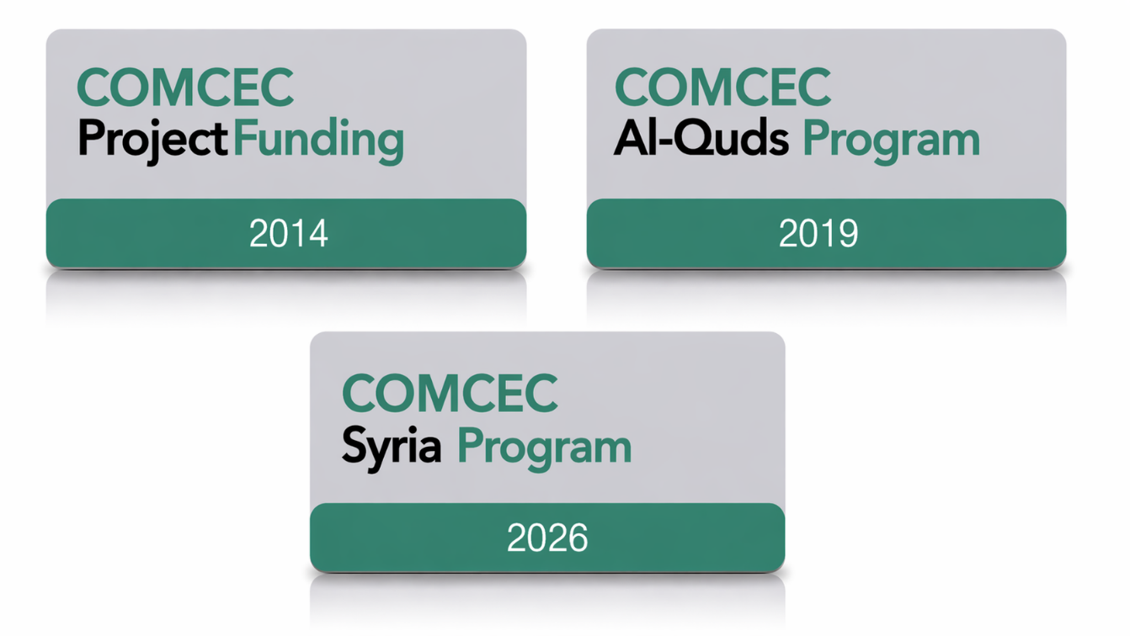
1) Overview
COORDINATION
OFFICE

Slide 3


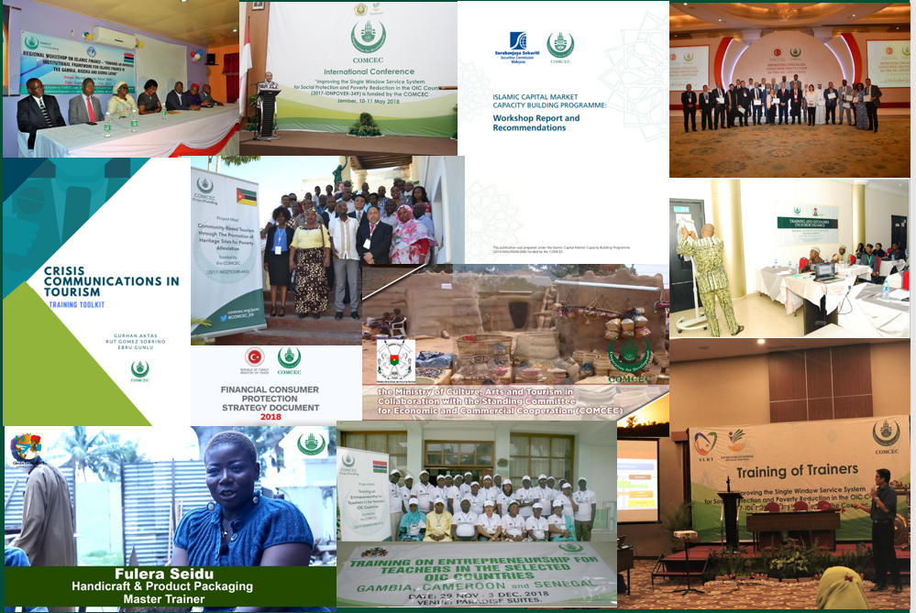
178 Projects from 32 Countries and 6 OIC institutions (29 Projects in Poverty Alleviation)
Almost all member countries as a beneficiary
COORDINATION
OFFICE

Slide 4
2) Objectives and Main Characteristics
WHAT?
A grant-based finance mechanism, was introduced by COMCEC Coordination Office in 2014 as a policy support instrument under the COMCEC Strategy
WHY?
Increasing institutional and human capacity
Supporting implementation of policy recommendations adopted by COMCEC Ministerial Sessions
Enhancing cooperation and solidarity among the member countries
WHO CAN APPLY?
Relevant public institution of a Member Country ( Registered to Relevant Working Group) or an OIC Institution/Organ operating in the field of economic and commercial cooperation
COORDINATION
OFFICE

Slide 5
2) Objectives and Main Characteristics
HOW?
Financing projects in eight cooperation areas;
Agriculture
Financial Cooperation
Digital Transformation
Trade
Tourism
Poverty Alleviation
Transport and Communications
Small and Medium Enterprises
MAIN PROJECT TYPES
Training , Study Visit, Workshop, Conference and Seminar , Publicity Meetings and Preparation of Audio, Visual and Written Materials
Peer-to-Peer Experience Sharing
Needs Assessment
COORDINATION
OFFICE

Slide 6
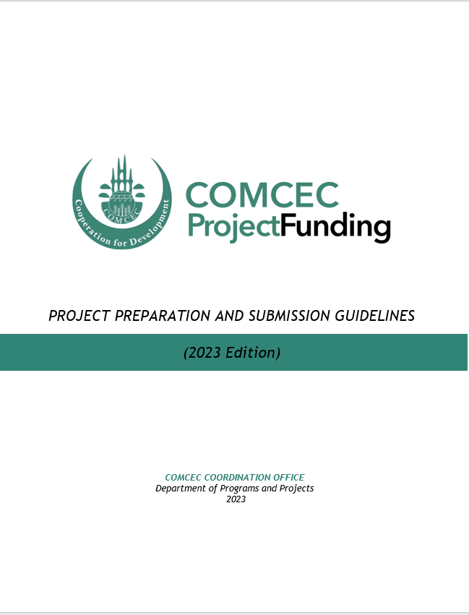
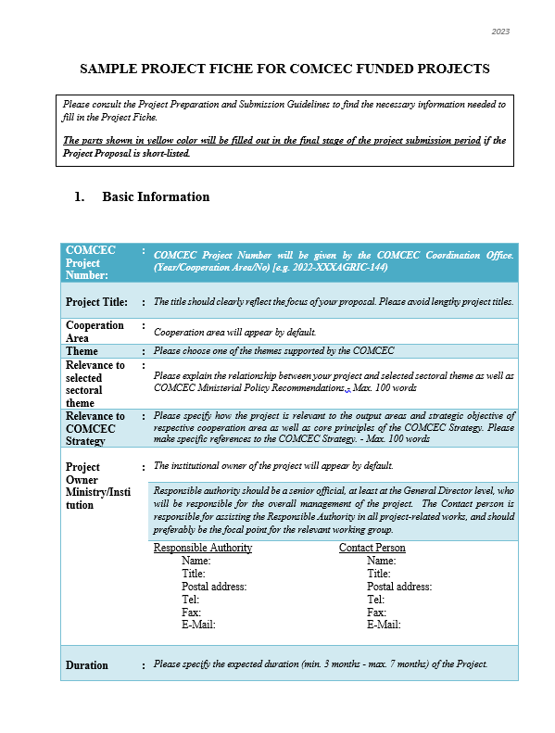
3) Project Preparation and Submission:
a) How to Prepare a Project Proposal
Review the reference documents on the Project Management Information System (https://project.comcec.org/) and Programs Website (https://programs.comcec.org/)
  Project Preparation and Submission Guidelines
  Sample Project Fiche
  Supported Themes
  COMCEC Strategy
Send the relevant documents to the interested national institutions/departments
Fill out the online project fiche through Project Management Information System
Feel free to consult with the CCO (cpf@comcec.org)
Project Preparation and Submission Guidelines
Sample Project Fiche
COORDINATION
OFFICE

Slide 7
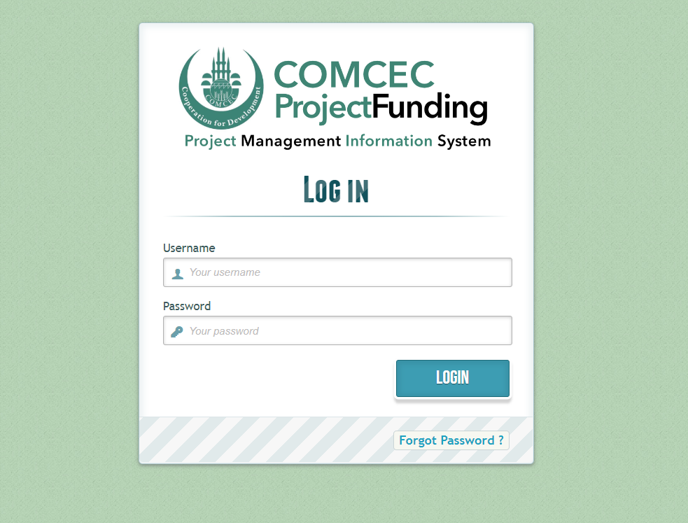
3) Project Preparation and Submission:
b) Online Project Submission
ONLINE PROJECT SUBMISSION: https://project.comcec.org/
The Username and Password are only provided to the sectoral focal points.
If you do not have username and password, please contact cpf@comcec.org.
Username and Password
COORDINATION
OFFICE

Slide 8
4) Timeline Cycle of the Project
14th Call for Project Proposals
Declaration of the Final List of Successful Project Proposals
Submission of the Final Version of Project Proposal by the Project Owner
Declaration of Short List
October 1st- 31st 2026
Early December 2026
End of December 2026
February-March 2027
April 2027
Finalization of Contract Procedures
Project Implementation Period
Organizing a Training Activity
April-December 2027
COORDINATION
OFFICE

Slide 9

5) Projects under Poverty Alleviation in 2026
Project Title : Closing the Gap: Strengthen Industry Driven TVET through Strategic Partnership to Boost Employment in OIC Countries
Project Owner : Ministry of Education of Malaysia
Project Partners : Iraq, Jordan, The Gambia, Nigeria, Pakistan, SESRIC
Project Activities : Online Training, Workshop
Project Purpose : The project aims at strengthening TVET systems in OIC member countries by leveraging Malaysia’s expertise to address skill mismatches, enhance workforce readiness, and improve labour market integration. Through the project activities, it fosters institutional capacity building and sustainable TVET development across the OIC member countries
COORDINATION
OFFICE

Slide 10

5) Projects under Poverty Alleviation in 2026
Project Title : Mobilizing Capital for Affordable Housing: A Masterclass on REITs, REIFs and Housing Sukuk
Project Owner : Federal Ministry of Finance of Nigeria
Project Partners : Malaysia, Türkiye
Project Activities : Workshop
Project Purpose : To equip capital market and housing sector professionals with the technical expertise to structure, launch, and manage real estate investment trusts, real estate investment funds, and sukuk bonds specifically designed to finance affordable housing in Nigeria. While learning the experiences of partner countries on modern housing finance instruments, Nigeria contributes its own local expertise and insights.
COORDINATION
OFFICE

Slide 11

5) Projects under Poverty Alleviation in 2026
Project Title : Foresight Skills Lab (FSL): Bridging Today’s Skills with Tomorrow’s Jobs
Project Owner : Ministry of Planning of Pakistan
Project Partners : Malaysia, OIC Labor Centre
Project Activities : Study Visit, Training
Project Purpose : By fostering cross-country exchange of skills-forecasting methodologies, the project is designed with the purpose of equipping policymakers and TVET planners with forecasting tools, and pilot forecasts that inform curricula, training programs and employment policies to meet the future demands of the labour market.
COORDINATION
OFFICE

Slide 12

5) Projects under Poverty Alleviation in 2026
Project Title : Experience Sharing on Islamic Financial Instruments for the Provision of Social Housing
Project Partners : Bangladesh, Malaysia, Egypt
Project Activities : Workshop
Project Purpose : The project aims to strengthen institutional and human capacity for pro-poor housing by integrating Islamic financial interventions into housing policy, planning, and delivery. It enhances the ability of public institutions and financial actors to scale affordable, equitable, and sustainable housing through Islamic financial instruments.
COORDINATION
OFFICE

Slide 13
THANK YOU
cpf@comcec.org
COORDINATION
OFFICE
cpf@comcec.org

