Slide 1

April 22nd, 2026
COMCEC PROJECT SUPPORT PROGRAMS
25th Meeting of COMCEC Financial Cooperation Working Group
Ramazan GÖRGEÇ
Expert
Department of Programs and Projects
COMCEC
COORDINATION
OFFICE
cpf@comcec.org

Slide 2

Outline
Overview of the COMCEC Project Support Programs
Objectives and Main Characteristics of the COMCEC Project Funding (CPF)
Project Preparation and Submission
  How to prepare a project proposal
  Online Project Submission
Timeline Cycle of the Project
Financial Cooperation Projects under CPF in 2026
COMCEC
COORDINATION
OFFICE

Slide 3
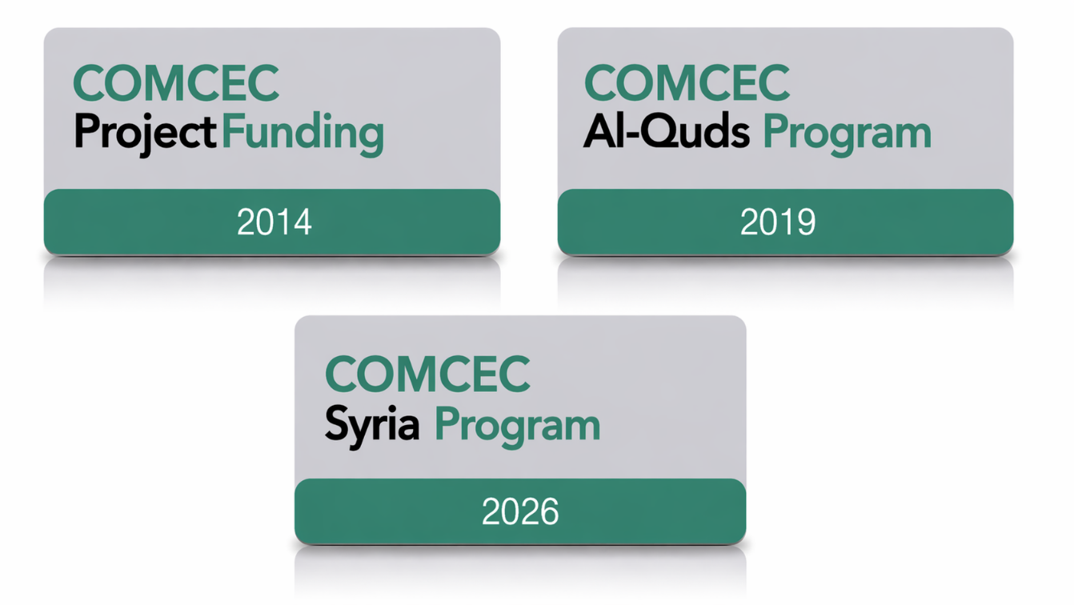
1) Overview
COMCEC
COORDINATION
OFFICE

Slide 4
2) Objectives and Main Characteristics
WHAT?
A grant-based finance mechanism, was introduced by COMCEC Coordination Office in 2014 as a policy support instrument under the COMCEC Strategy
WHY?
Increasing institutional and human capacity
Supporting implementation of policy recommendations adopted by COMCEC Ministerial Sessions
Enhancing cooperation and solidarity among the member countries
WHO CAN APPLY?
Relevant public institution of a Member Country ( Registered to Relevant Working Group) or an OIC Institution/Organ operating in the field of economic and commercial cooperation
COMCEC
COORDINATION
OFFICE

Slide 5
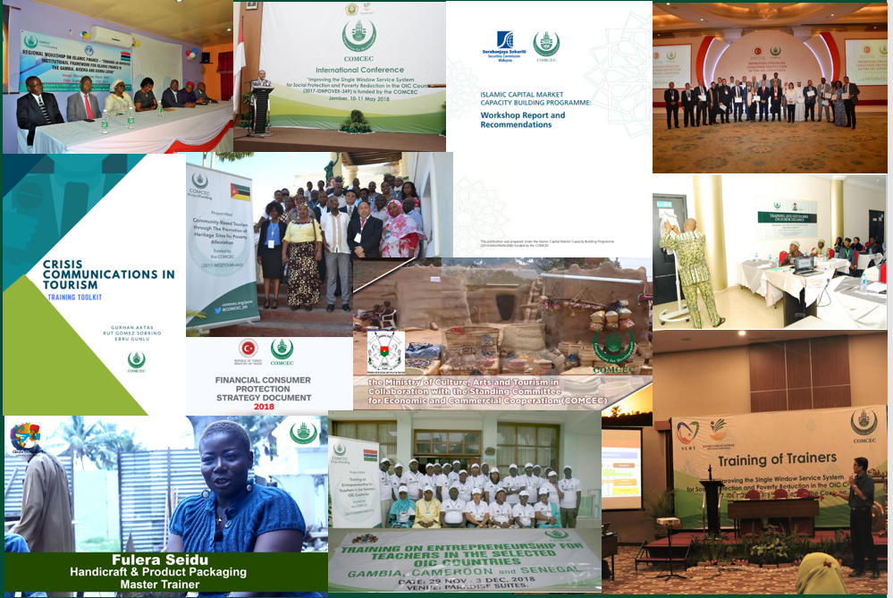
2) Objectives and Main Characteristics
* More than 178 Projects from 32 Countries and 6 OIC institutions (17 Projects in Financial Cooperation)
* Almost all member countries as a beneficiary
COMCEC
COORDINATION
OFFICE

Slide 6
2) Objectives and Main Characteristics
HOW?
Financing projects in eight cooperation areas;
* Agriculture * Financial Cooperation * Digital Transformation
* Trade * Tourism * Poverty Alleviation *SMEs
* Transport and Communications
MAIN PROJECT TYPES
Training , Study Visit, Workshop, Conference and Seminar , Publicity Meetings and Preparation of Audio, Visual and Written Materials
Peer-to-Peer Experience Sharing
Needs Assessment
Moreover, Opportunity to implement project individually
COMCEC
COORDINATION
OFFICE

Slide 7
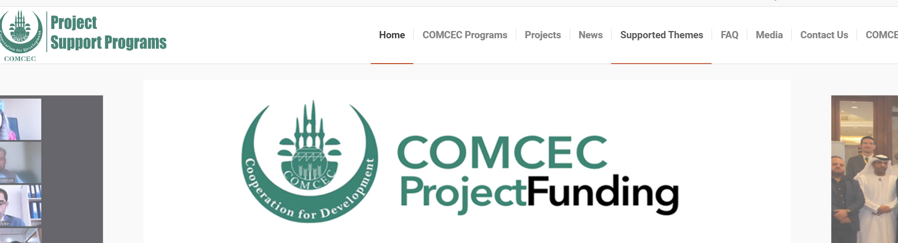
2) Objectives and Main Characteristics
SUPPORTED THEMES IN FINANCIAL COOPERATION https://programs.comcec.org/
Supported Themes
COMCEC
COORDINATION
OFFICE

Slide 8
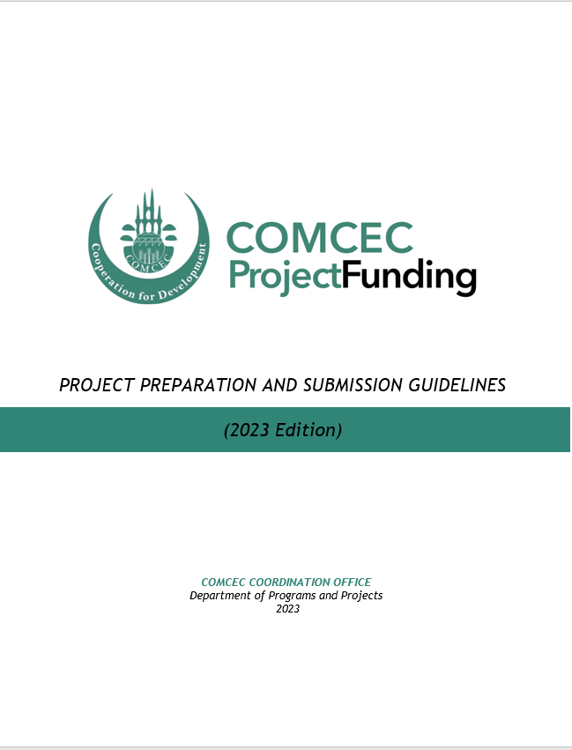
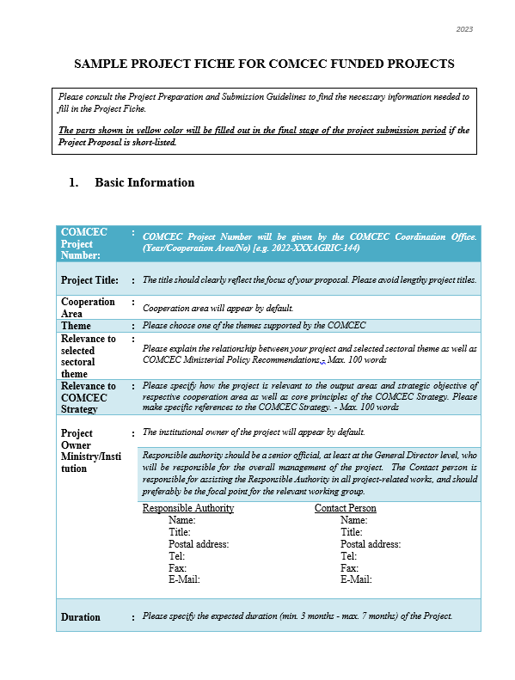
3) Project Preparation and Submission:
a) How to Prepare a Project Proposal
Review the reference documents on the Project Management Information System (https://project.comcec.org/) and Programs Website (https://programs.comcec.org/)
  Project Preparation and Submission Guidelines
  Sample Project Fiche
  Supported Themes
  COMCEC Strategy
Send the relevant documents to the interested national institutions/departments
Fill out the online project fiche through Project Management Information System
Feel free to consult with the CCO
Project Preparation and Implementation Guidelines
Sample Project Fiche
COMCEC
COORDINATION
OFFICE

Slide 9
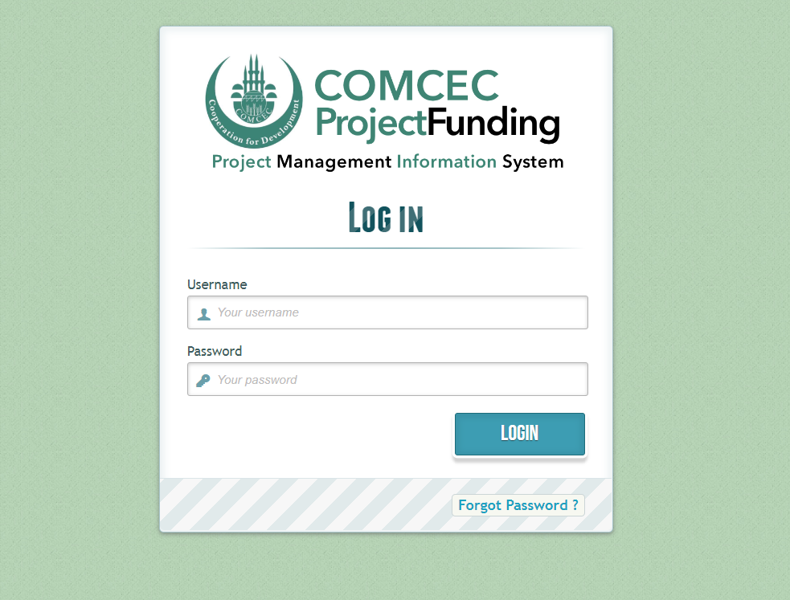
3) Project Preparation and Submission:
b) Online Project Submission
ONLINE PROJECT SUBMISSION: https://project.comcec.org/
The Username and Password are only provided to the sectoral focal points.
If you do not have username and password, please contact cpf@comcec.org.
Username and Password
COMCEC
COORDINATION
OFFICE

Slide 10
4) Timeline Cycle of the Project
Opening of 14th Call for Project Proposals
Declaration of the Final List of Successful Project Proposals
Submission of the Final Version of Project Proposal by the Project Owner
Declaration of Short List
October, 1st- 31st 2026
Early December 2026
End of December 2026
February-March 2027
April 2027
Finalization of Contract Procedures
April-December 2027
Project Implementation Period
Organizing a Training Activity
COMCEC
COORDINATION
OFFICE

Slide 11

5) Finance Projects under CPF in 2026
Project Title : Capacity Building in Green Sukuk and Islamic Microfinance in The Gambia
Project Owner : Ministry of Finance and Economic Affairs
Project Activities : Training
Project Purpose : Enhancing the technical knowledge and practical skills of public officials and financial sector practitioners in designing, regulating, and implementing Green Sukuk and Islamic microfinance instruments.
GAMBIA
COMCEC
COORDINATION
OFFICE

Slide 12

5) Finance Projects under CPF in 2026
Project Title : Utilizing Islamic Social Finance Instruments as a Powerful Alternatives for Climate Resilience
Project Owner : Ministry of Finance (INCEIF)
Project Activities : Training and Workshop
Project Purpose : Strengthening the capacity of partner countries to design and implement Islamic Social Finance (ISF) instruments for climate resilience and sustainable growth.
MALAYSIA
COMCEC
COORDINATION
OFFICE

Slide 13

5) Finance Projects under CPF in 2026
Project Title : Enhancing Professionals Cybersecurity Capabilities in Digital Payment Systems in Uganda
Project Owner : Ministry of Finance
Project Activities : Study Visit and Training
Project Purpose : Enhancing the operational cybersecurity capabilities of participants by equipping them with knowledge, skills and tools required to protect Information Systems, networks and digital payment platforms.
UGANDA
COMCEC
COORDINATION
OFFICE

Slide 14
THANK YOU
cpf@comcec.org
COMCEC
COORDINATION
OFFICE
cpf@comcec.org

