Slide 1
“DESIGNING INTEGRATED MULTIMODAL TRANSPORT SYSTEMS IN OIC MEMBER COUNTRIES: EXPERIENCES/ PERSPECTIVES OF UGANDA” A presentation at the 26th Meeting of the COMCEC Transport and Communication Working Group (TCWG) on 20th April 2026. Presented By: Katushabe Winstone, FCILT Commissioner Transport Regulation & Safety / Chief Licensing Officer Ministry of Works and Transport - Republic of Uganda

Slide 2
PRESENTATION OUTLINE
Uganda’s Transport Context
Importance of the Transport Corridors
National Policy and Institutional Framework
Key Corridors and Multimodal Nodes
Corridor Governance and Trade Facilitation
Major Investments in Multimodal Transport
Key Challenges
Policy Lessons and Recommendations
Key Takeaways from Uganda’s Experience

Slide 3

UGANDA’S TRANSPORT CONTEXT
Uganda is located in the East African Region and her transport system comprises road, rail, inland water and air transport, hence supporting domestic mobility and regional trade.
National strategies promote integration of these modes to develop a seamless multimodal transport system.
However, the system remains heavily road-dependent leading to high transport costs and congestion.
As a landlocked Country, Uganda relies on regional corridors for
access to international markets.
Government policies therefore focus on diversifying transport
modes & strengthening corridor governance to support
trade and economic growth.

Slide 4

IMPORTANCE OF THE TRANSPORT CORRIDORS
The Transport corridors have three (3) major roles:
Provide the infrastructure and logistics capacity to facilitate the movement of both imports and exports, making them crucial to national and regional trade facilitation.
Promote Cross-border trade, regional cooperation and economic integration.
Serve as market development channels, connecting production areas in the hinterland with regional and international markets through seaports.

Slide 5
NATIONAL POLICY AND INSTITUTIONAL FRAMEWORK
Uganda’s multimodal transport development is guided by Vision 2040, NDP IV, and the National Integrated Transport Master Plan.
These frameworks recognize transport infrastructure as a key driver of economic growth and regional trade.
Ministry of Works & Transport leads policy development, implementation and sector coordination.
Key institutions supporting the sector include MoFPED, NPA, URA,
URC, and UCAA, responsible for financing, planning, customs,
rail, and aviation services.
At the regional level, corridor governance is coordinated
through the East African Community (EAC) and corridor bodies
such as NCTTCA and CCTTFA.

Slide 6
KEY CORRIDORS AND MULTIMODAL NODES
Uganda’s trade logistics system is organized around regional transport corridors linking the country to international seaports.
The Northern Corridor connects Kampala to the Port of Mombasa and is the main route for Uganda’s imports and exports.
The Central Corridor provides an alternative route linking Uganda to the Port of Dar es Salaam via Lake Victoria.
To support these corridors, Key multimodal logistics nodes have been
developed. these include; Mukono ICD, Gulu Logistics Hub, Port
Bell and Jinja terminals, Entebbe International Airport a few
but to mention.
These facilities support efficient cargo transfer between road, rail,
inland water and air transport systems.

Slide 7
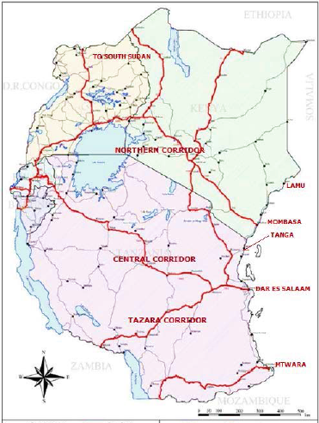
EAST AFRICAN TRANSPORT CORRIDORS

Slide 8
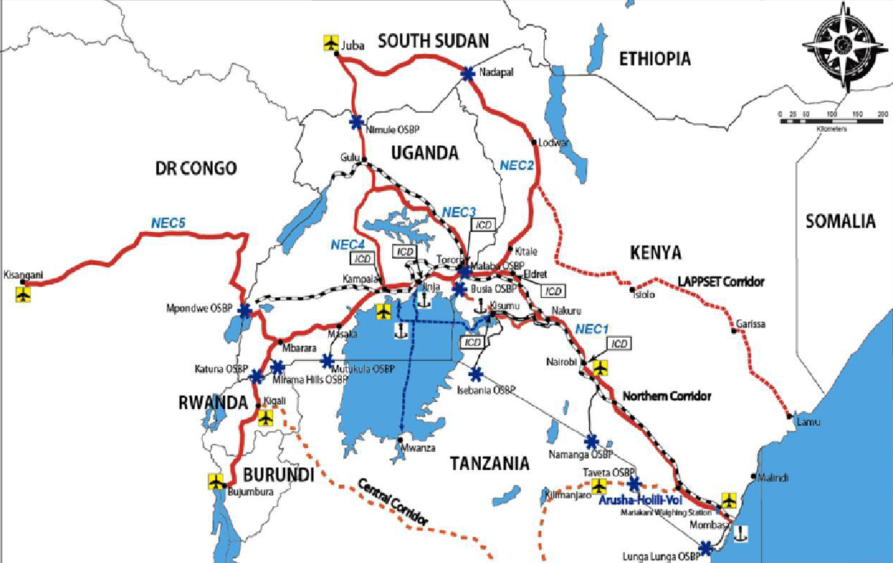
NORTHERN CORRIDOR TRANSPORT NETWORK

Slide 9
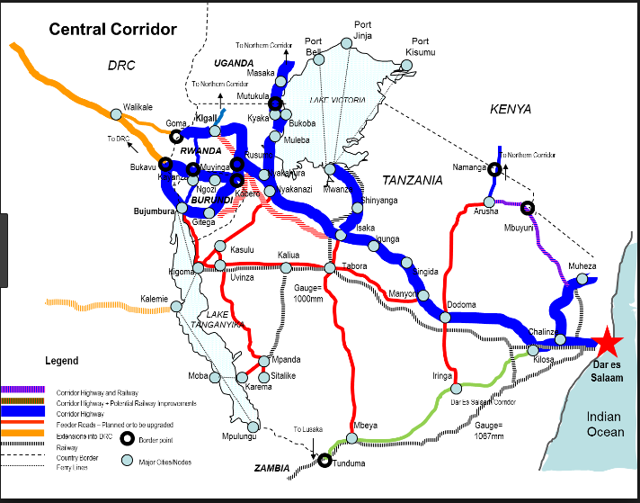
CENTRAL CORRIDOR TRANSPORT NETWORK

Slide 10
CORRIDOR GOVERNANCE AND TRADE FACILITATION
At the regional level, corridor governance is coordinated through the EAC and corridor institutions (NCTTCA & CCTTFA), established through multilateral agreements among member countries served by the corridors.
NCTTCA member states include: Burundi, DR Congo, Kenya, Rwanda, South Sudan and Uganda served by the Port of Mombasa.
CCTTFA member states include: Burundi, DR Congo, Rwanda, Tanzania and Uganda served by the port of Dar-es-Salaam.
Both the Central and Northern Corridors operate under a regional
public sector governance framework, where the Council of
Ministers responsible for Transport in the Member States
provides overall policy direction and oversight.

Slide 11
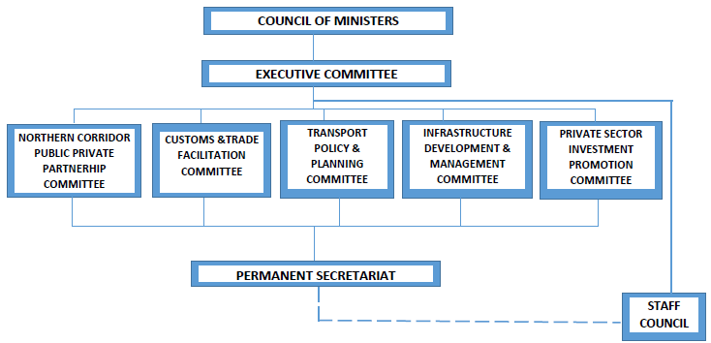
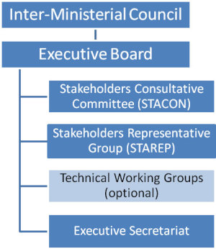
PROPOSED DECENTRALISATION OF MVR SERVICES AND OTHER
Institutional Structure of the Northern Corridor
Institutional Structure of Central Corridor

Slide 12

CORRIDOR GOVERNANCE AND TRADE FACILITATION ……CONT’D
One Stop Border Posts (OSBPs) to enable joint customs and immigration processing, thus reducing border delays. OSBPs include; Mutukula, Busia, Malaba, Elegu, Mirama Hills, and Katuna.
Uganda has implemented several reforms to improve corridor governance and trade facilitation. These include;
The EAC Single Customs Territory (SCT) to allow goods to be cleared at the final destination, improving transit efficiency.
Digital systems such as the Uganda Electronic Single Window, Regional Cargo Tracking System, and corridor monitoring systems to enhance transparency and cargo tracking.

Slide 13
MAJOR INVESTMENTS IN MULTIMODAL TRANSPORT
Malaba–Kampala Standard Gauge Railway development.
Rehabilitation of metre gauge railway network.
Development of logistics hubs and dry ports.
Kampala–Jinja Expressway construction.
Expansion of Entebbe International Airport.
Development of Kabalega Airport
Development of Bukasa Port on Lake Victoria (Civil works to commence soon)

Slide 14
KEY CHALLENGES
Limited development of multimodal transport systems, resulting in overdependence on road transport.
Infrastructure constraints and limited financing, which slow the upgrading of transport infrastructure and logistics facilities.
Port congestion and complex cargo clearance procedures, leading to delays at seaports, border posts, and inland terminals.
Operational inefficiencies along corridors, including regulatory
checkpoints and deterioration of road infrastructure due to heavy
freight traffic.
Limited digital integration and information sharing, including
ICT system downtime and weak performance monitoring
mechanisms.

Slide 15
POLICY LESSONS AND RECOMMENDATIONS
Policy Lessons and Recommendations
1. Policy Lessons and Recommendations
The SMART Corridor approach, supported by the African Union and regional corridor institutions, promotes the use of Intelligent Transport Systems (ITS) to improve safety, efficiency and reliability of transport corridors. Key elements include:
Maintaining high-quality corridor infrastructure while enhancing safety and operational efficiency.
Real-time monitoring of traffic and cargo movements to improve logistics coordination and corridor performance.
Promoting paperless trade through digital customs clearance and logistics documentation.

Slide 16
POLICY LESSONS AND RECOMMENDATIONS
Policy Lessons and Recommendations Cont’d…
Implementing trade facilitation tools, including National Single Windows, One Stop Border Posts, Coordinated Border Management, and electronic cargo tracking systems.
Establishing legal frameworks that recognize electronic documentation and digital trade systems.
Promotion of rail and inland water transport investments
Integrate climate resilience in transport infrastructure.

Slide 17
KEY TAKEAWAYS FROM UGANDA’S EXPERIENCE
Integration of road, rail, inland water and air transport (multimodal transport) improves logistics efficiency and reduces trade costs.
Regional institutions and coordinated policies help streamline cross-border trade and transport operations.
Tools such as Electronic Single Windows, Cargo Tracking Systems and One Stop Border Posts reduce delays and improve transparency.
Logistics nodes (Dry ports, inland ports, logistics hubs and airport
Cargo facilities) support multimodal transport operations.
Collaboration among corridor countries helps address
infrastructure gaps and operational bottlenecks.

Slide 18
For God and My Country
Thank You

