Slide 1
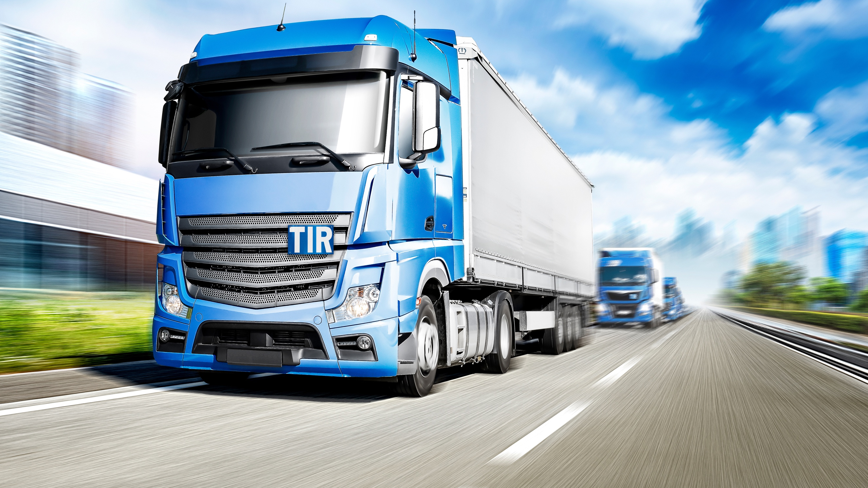
IRU’s Experience in Designing Integrated Multimodal Transport Systems
Erman EREKE
IRU General Delegate to the Middle East and Region
erman.ereke@iru.org

Slide 2
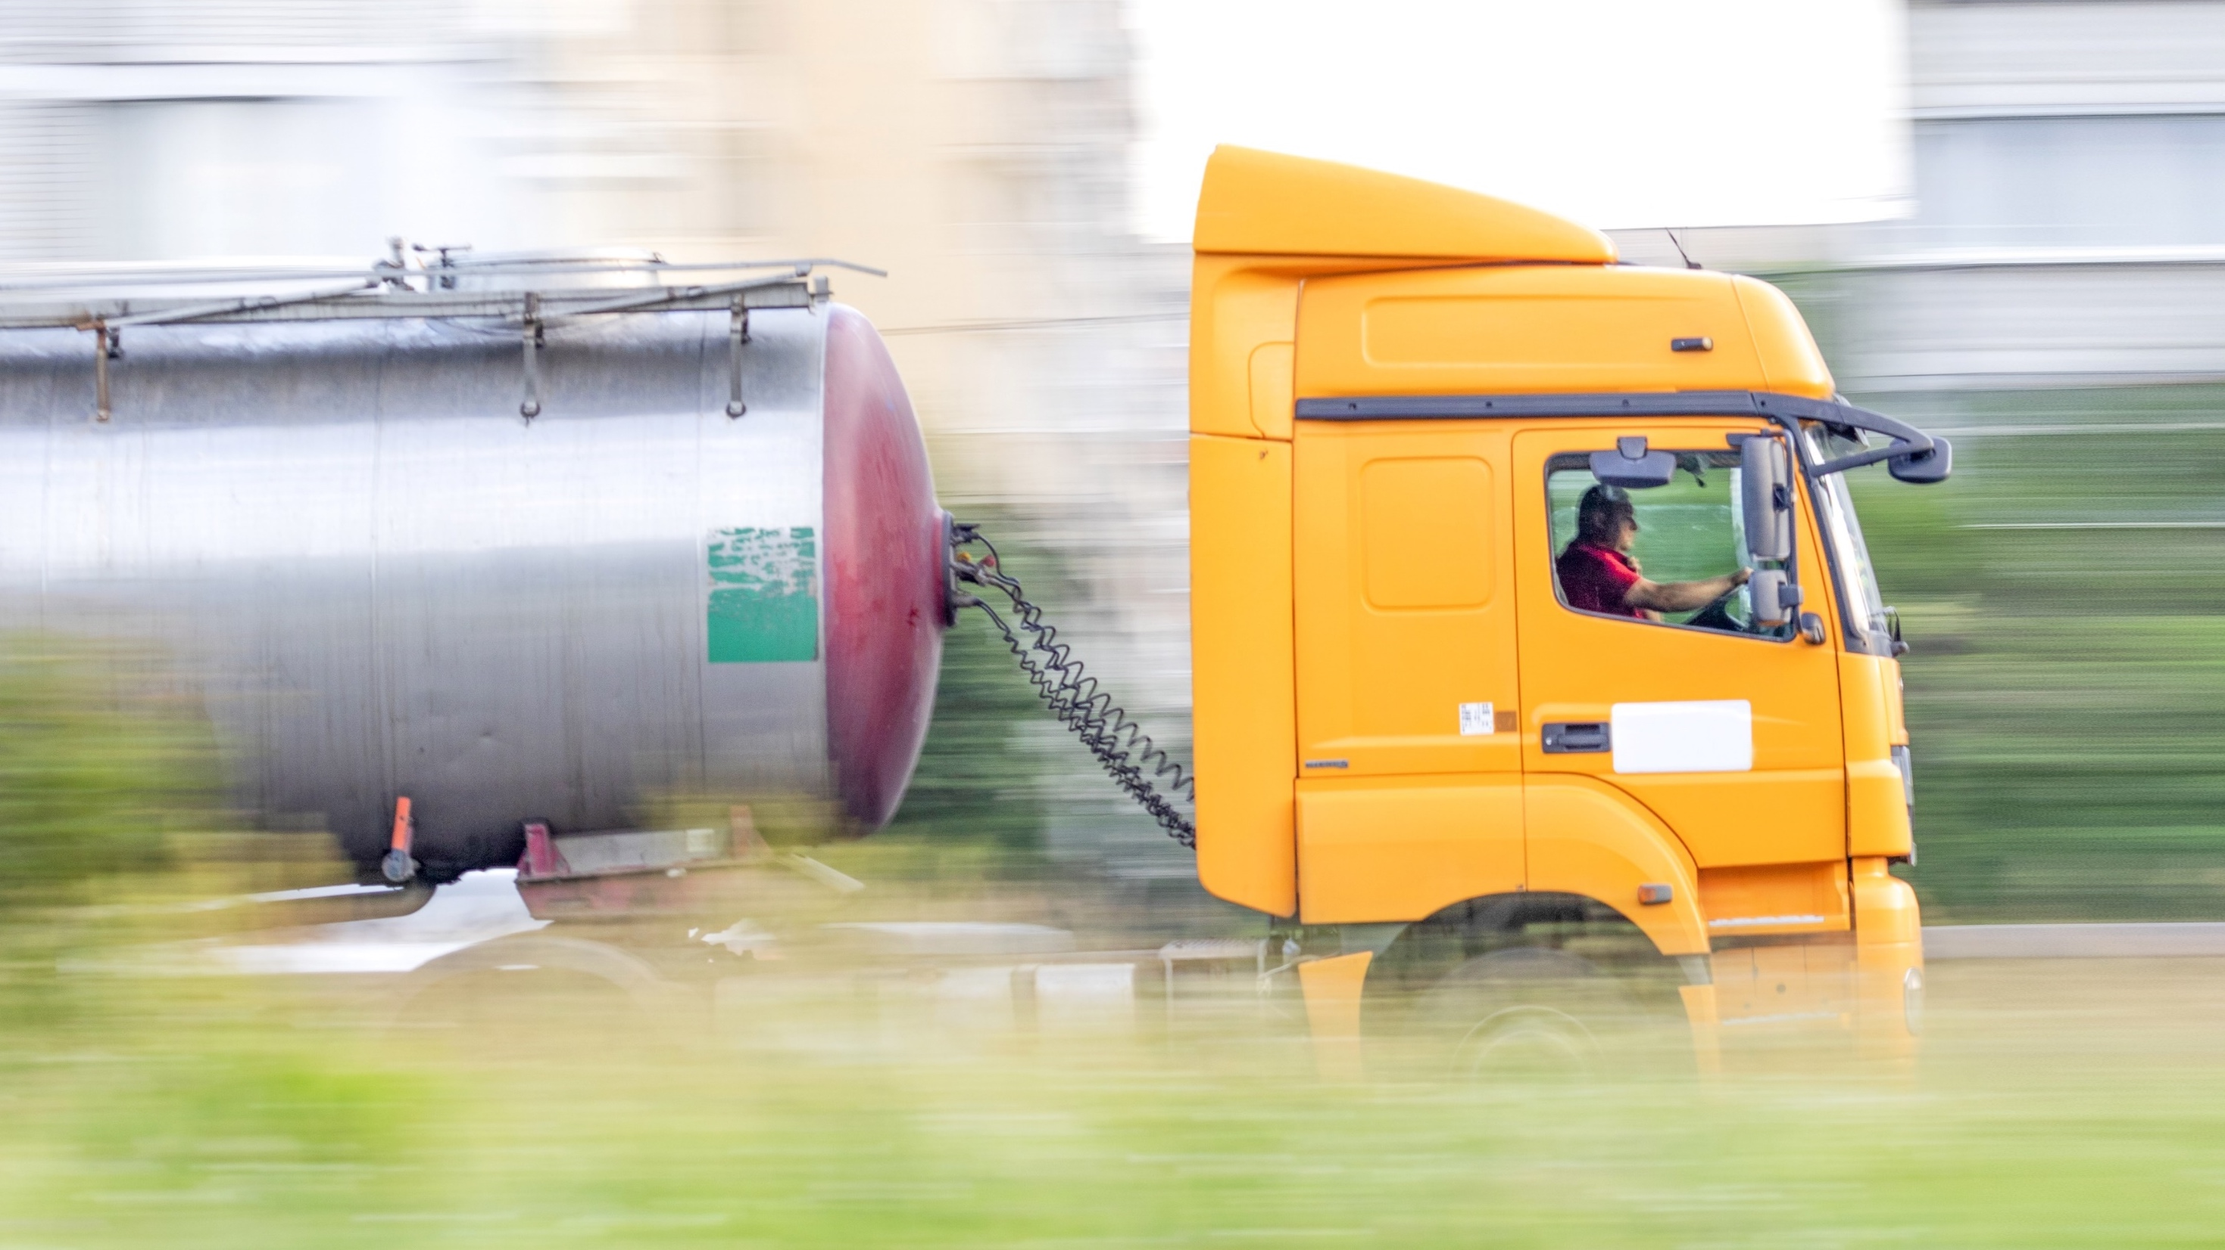

IRU is the world road transport organisation
As the voice of more than 3.5 million companies operating mobility and logistics services in over 100 countries, we lead solutions to help the world move better.

Slide 3
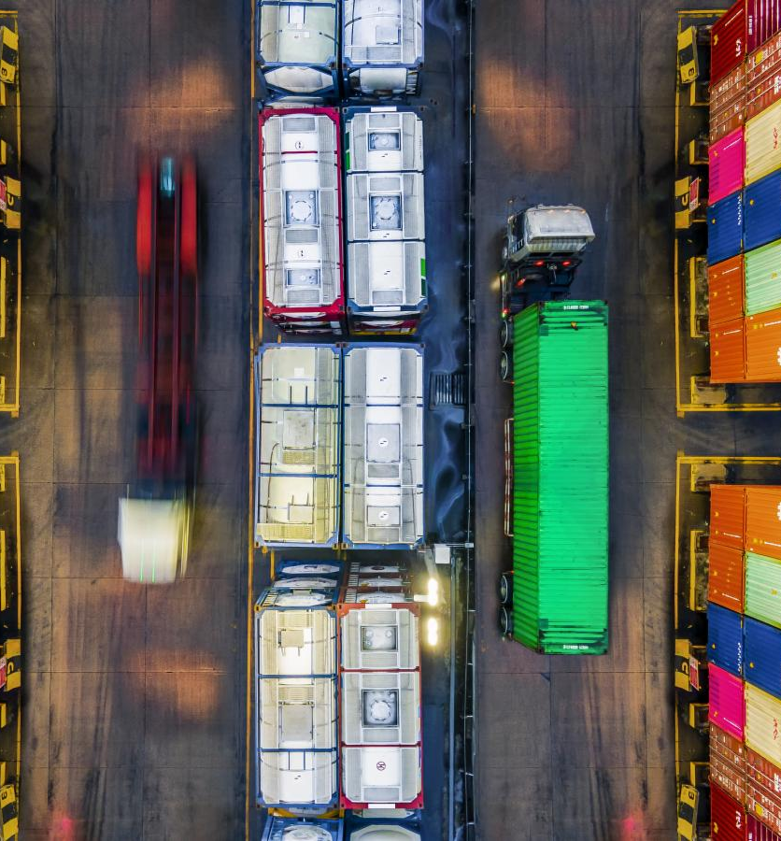
Transport is the Backbone of the Economy and Trade
Efficient transport systems reduce costs, shorten delivery times, and enhance the competitiveness of businesses and national economies.
Well-connected transport networks link regions, facilitate multimodal operations, and ensure continuity of trade even in times of disruption.

Slide 4
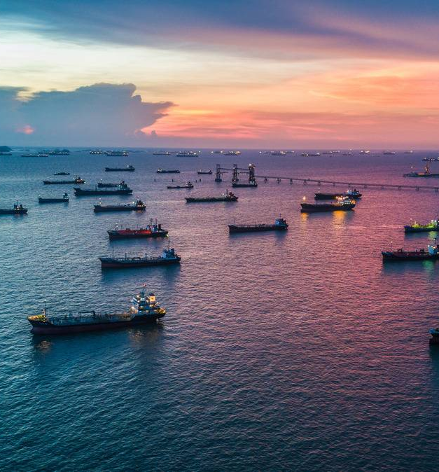
Recent Global & Regional Developments
Attacks, blockades, threats, sanctions, and border issues are just a few of the daily challenges facing transport operations
Logistics operators and shippers try to navigate this constantly changing dynamic to keep services and supply chains moving.
Shifting modes from one to another and increasing demand for road transport

Slide 5
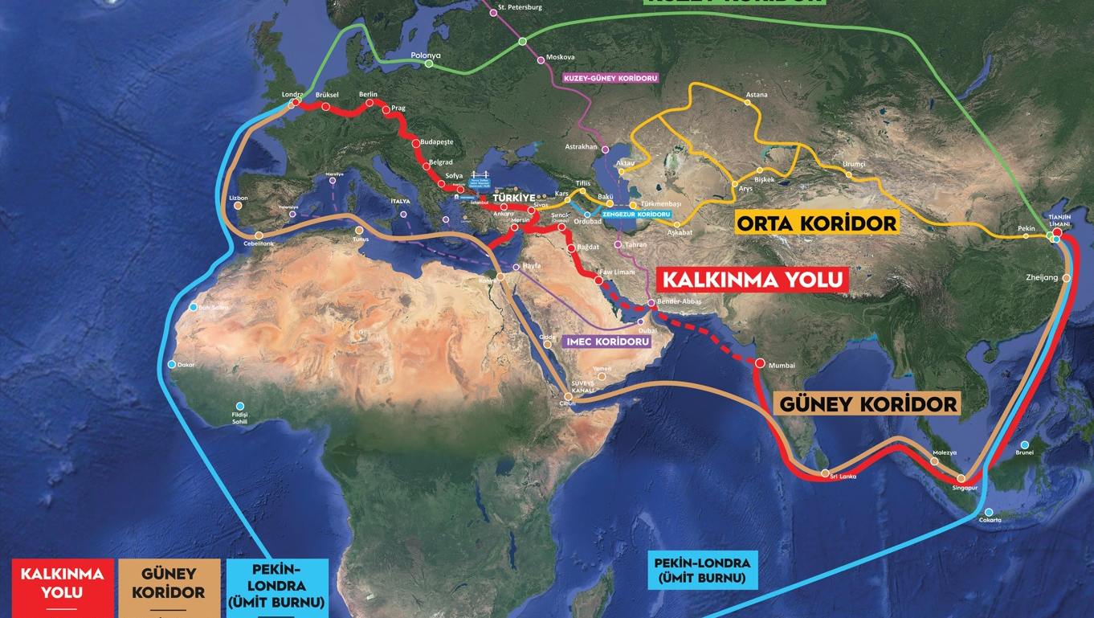
Importance of Corridors during the Distributed Supply Chain
Middle Corridor
Transit via Türkiye +60%
Key corridor in China-Europe connectivity
Development Road
Strategic corridor linking Asia to Europe
Boosts regional integration and logistics efficiency
In operation since April 2025

Slide 6
TIR is the key to multimodal corridor resilience
UZB
KRG
TUR
CHN
SYR
IRQ
JOR
TIR cuts border transit times by up to 92% and lowers transport costs by up to 50%.
To the Gulf: 30 days by sea, vs just 4-6 days with TIR!
Sea + Road under TIR is the key to seamless, fast and reliable multimodal transport.
KUW
SAU
QAT
UAE
OMN

Slide 7
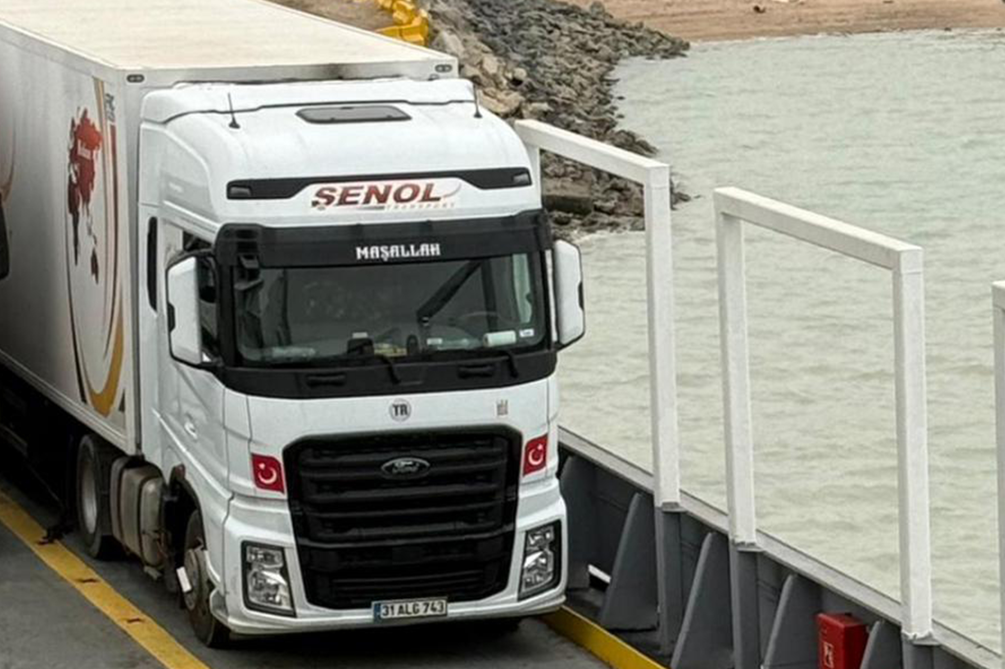
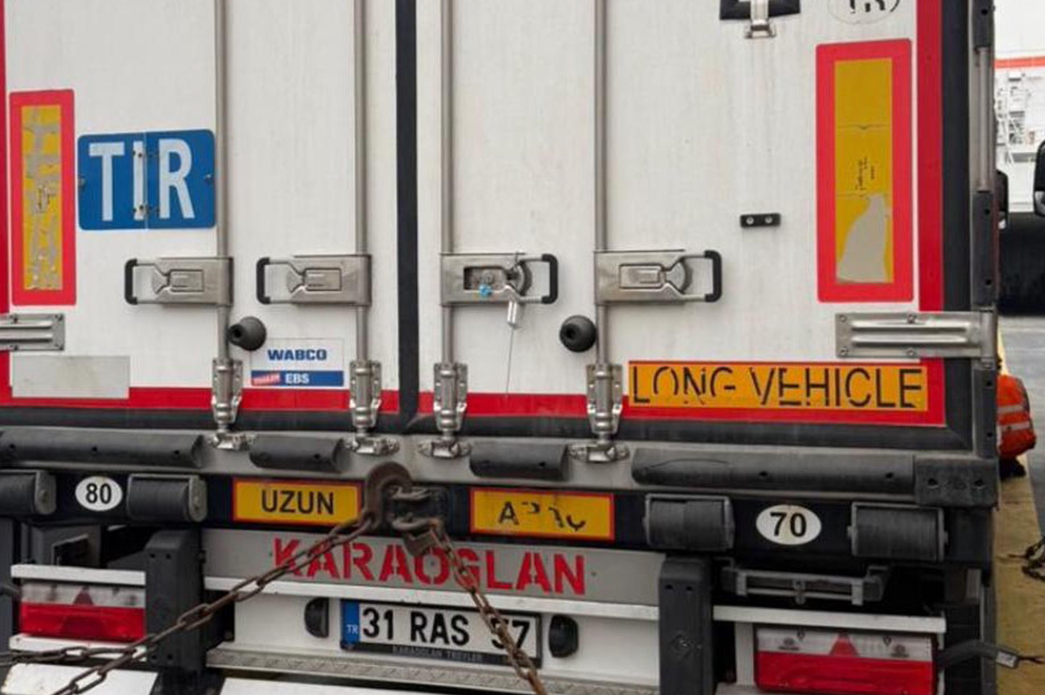
How IRU Integrates Multimodal Transport Systems
Global, harmonised system: TIR operates in 78 countries, providing standardised and trusted transit procedures worldwide.
Powerful multimodal enabler: Seamlessly integrates road, sea, and rail under a single, unified customs transit framework.
End-to-end guarantee: One TIR guarantee secures the entire journey across multiple borders and transport modes.
Digital efficiency (TIR-EPD): Advance cargo data exchange enables faster, more predictable, and fully paperless transit.
Faster borders with TIR Green Lanes: Priority treatment significantly accelerates border crossings and reduces delays.
Public–private partnership led by International Road Transport Union: IRU connects public authorities and the transport industry, ensuring globally coordinated, secure, and efficient transit operations.

Slide 8
Erman EREKE
IRU General Delegate to the Middle East and Region
erman.ereke@iru.org
For a world in motion

