Slide 1

April 20th, 2026
COMCEC PROJECT SUPPORT PROGRAMS
26th Meeting of COMCEC Trade Working Group
Eda AKÇA
Expert
Department of Programs and Projects
COMCEC
COORDINATION
OFFICE
cpf@comcec.org

Slide 2

Outline
Overview of the COMCEC Project Support Programs
Objectives and Main Characteristics of the COMCEC Project Funding (CPF)
Project Preparation and Submission
  How to prepare a project proposal
  Online Project Submission
Timeline of Call for Project Proposals
5. Trade Projects under CPF in 2026
COMCEC
COORDINATION
OFFICE

Slide 3
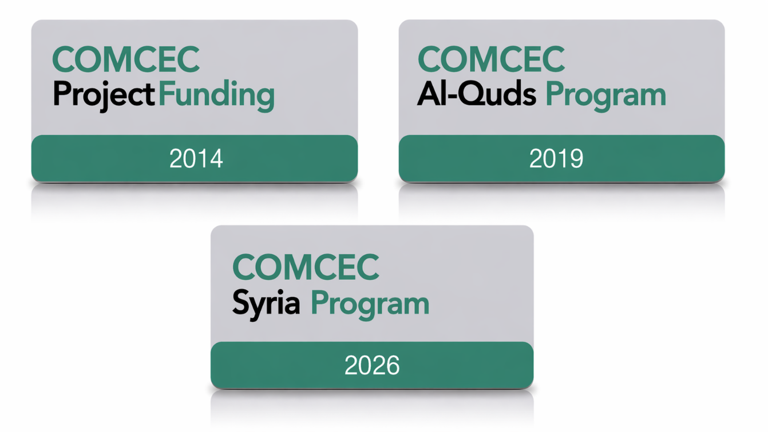
1) Overview
COMCEC
COORDINATION
OFFICE

Slide 4
2) Objectives and Main Characteristics
WHAT?
A grant-based finance mechanism, was introduced by COMCEC Coordination Office in 2014 as a policy support instrument under the COMCEC Strategy
WHY?
Increasing institutional and human capacity
Supporting implementation of policy recommendations adopted by COMCEC Ministerial Sessions
Enhancing cooperation and solidarity among the member countries
WHO CAN APPLY?
Relevant public institution of a Member Country ( Registered to Relevant Working Group) or an OIC Institution/Organ operating in the field of economic and commercial cooperation
COMCEC
COORDINATION
OFFICE

Slide 5
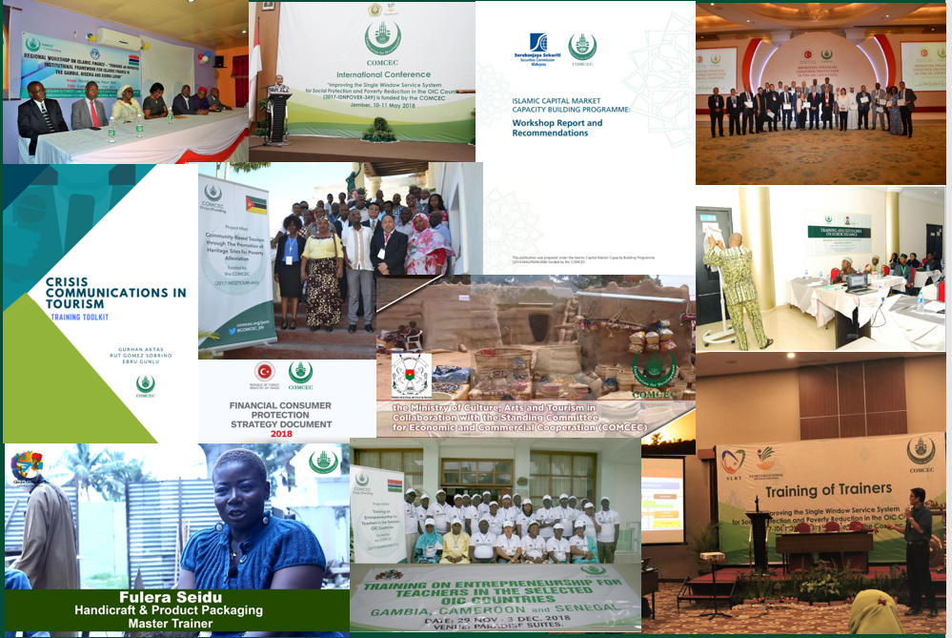
2) Objectives and Main Characteristics
* 178 Projects from 32 Countries and 6 OIC institutions (35 Projects in Trade)
* Almost all member countries as a beneficiary
COMCEC
COORDINATION
OFFICE

Slide 6
2) Objectives and Main Characteristics
HOW?
Financing projects in eight main areas;
* Agriculture * Financial Cooperation * Digital Transformation
* Trade * Tourism * Poverty Alleviation
* Transport and Communications *Small and Medium Enterprises (SME’s)
MAIN PROJECT TYPES
Training , Study Visit, Workshop, Conference and Seminar , Publicity Meetings and Preparation of Audio, Visual and Written Materials
Peer-to-Peer Experience Sharing
Needs Assessment
COMCEC
COORDINATION
OFFICE

Slide 7
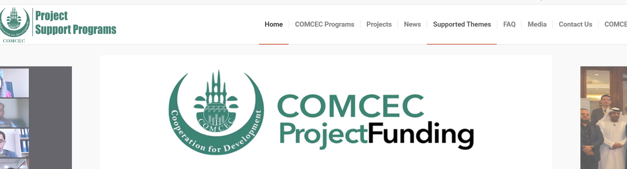
2) Objectives and Main Characteristics
SUPPORTED THEMES IN TRADE THIS YEAR
https://programs.comcec.org/
Supported Themes
COMCEC
COORDINATION
OFFICE

Slide 8
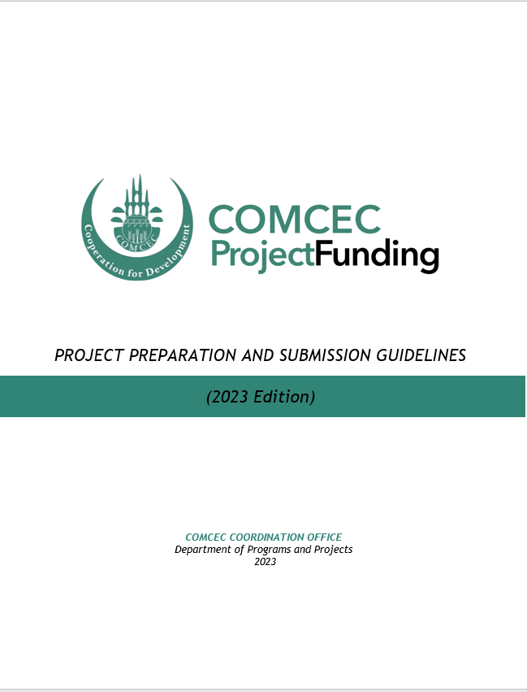
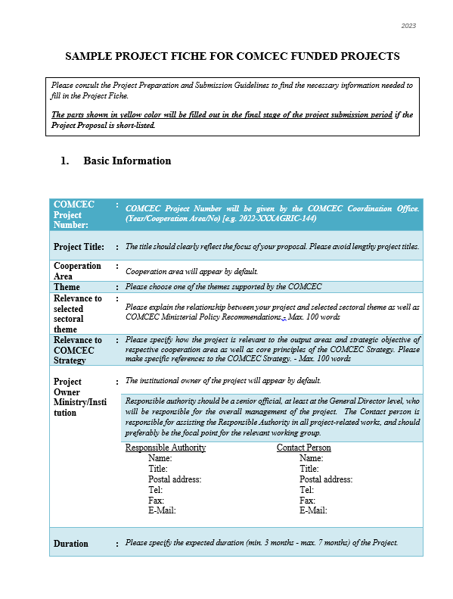
3) Project Preparation and Submission:
a) How to Prepare a Project Proposal
Review the reference documents on the Project Management Information System (https://project.comcec.org/) and Programs Website (https://programs.comcec.org/)
  Project Preparation and Submission Guidelines
  Sample Project Fiche
  Supported Themes
  COMCEC Strategy
Send the relevant documents to the interested national institutions/departments
Fill out the online project fiche through Project Management Information System
Feel free to consult with the CCO
Project Preparation and Implementation Guidelines
Sample Project Fiche
COMCEC
COORDINATION
OFFICE

Slide 9
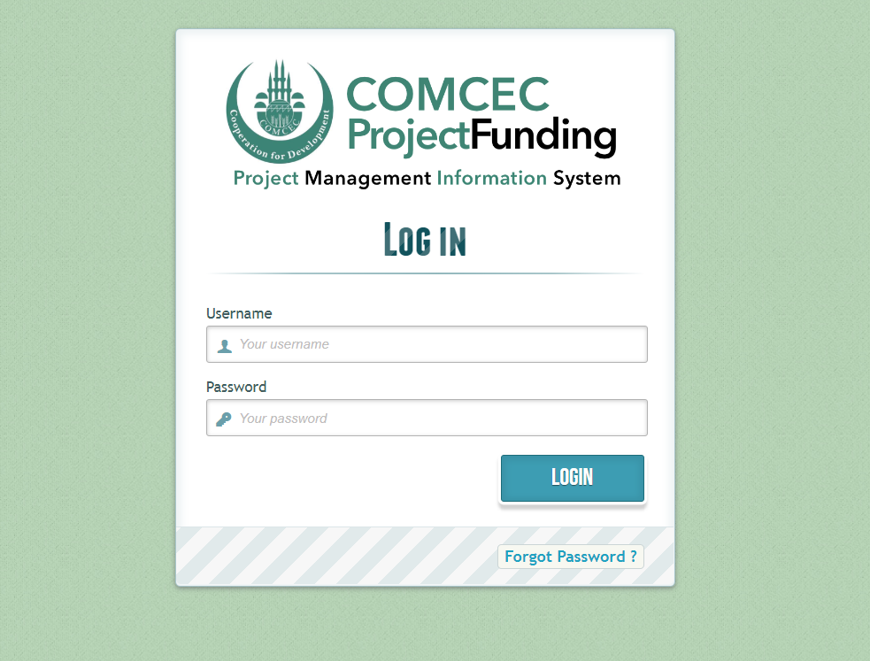
3) Project Preparation and Submission:
b) Online Project Submission
ONLINE PROJECT SUBMISSION: https://project.comcec.org/
The Username and Password are only provided to the sectoral focal points.
If you do not have username and password, please contact cpf@comcec.org.
Username and Password
COMCEC
COORDINATION
OFFICE

Slide 10
4) Timeline Cycle of the Project
13th Call for Project Proposals
Declaration of the Final List of Successful Project Proposals
Submission of the Final Version of Project Proposal by the Project Owner
Declaration of Short List
October 1st- 31st 2026
Early December 2026
End of December 2026
February-March 2027
April 2027
Finalization of Contract Procedures
Project Implementation Period
Organizing a Training Activity
April-December 2027
COMCEC
COORDINATION
OFFICE

Slide 11

5) Trade Projects under CPF in 2026
Project Title : Strengthening Digital Market Surveillance and Commodity Distribution in Bangladesh
Project Owner : Ministry of Commerce
Project Partners : Türkiye
Project Activities : Study Visit and Training
Project Purpose : To strengthen the institutional capacity of the Trading Corporation of Bangladesh (TCB) through learning from advanced digital systems in Türkiye for commodity tracking, market surveillance, and strategic distribution.
BANGLADESH
COMCEC
COORDINATION
OFFICE

Slide 12

5) Trade Projects under CPF in 2026
Project Title : Strengthening Maldivian MSMEs Through Regional Cooperation and Exchange
Project Owner : Ministry of Economic Development
Project Partners : Türkiye
Project Activities : Training
Project Purpose : To strengthen Maldivian MSMEs by training trainers, fostering experience sharing and building regional cooperation.
MALDIVES
COMCEC
COORDINATION
OFFICE

Slide 13

5) Trade Projects under CPF in 2026
Project Title : Digital and Institutional Capacity Enhancement of the Palestinian Garment and Textile Industries
Project Owner : Ministry of National Economy
Project Partners : Jordan
Project Activities : Training , Workshop, Conference/ Seminar
Project Purpose : To develop a pilot digital membership and reporting system for the Federation, strengthen staff capacities through targeted digital-skills training.
PALESTINE
COMCEC
COORDINATION
OFFICE

Slide 14

5) Trade Projects under CPF in 2026
Project Title : Enhancing the Capacity of the Metrology Department in Suriname
Project Owner : Ministry of Economic Affairs, Entrepreneurship & Technological Innovation
Project Partners : Türkiye and Guyana
Project Activities : Peer-to-Peer Experience Sharing
Project Purpose : To enhance the institutional, technical, and operational capacity of the Metrology Department in
Suriname by adopting international best practices and comparative models.
SURINAME
COMCEC
COORDINATION
OFFICE

Slide 15
THANK YOU
cpf@comcec.org
COMCEC
COORDINATION
OFFICE
cpf@comcec.org

