Slide 1
20 April, 2026
COMCEC PROJECT SUPPORT PROGRAMS
26th Meeting of COMCEC Transport and Communication Working Group
Muhammed Ziya SARI
Program Coordinator
Department of Programs and Projects
cpf@comcec.org

Slide 2

Outline
Overview of the COMCEC Project Support Programs
Objectives and Main Characteristics of the COMCEC Project Funding (CPF)
Project Preparation and Submission
  How to prepare a project proposal
  Online Project Submission
Timeline Cycle of the Project
Transport and Communication Projects under CPF in 2026

Slide 3
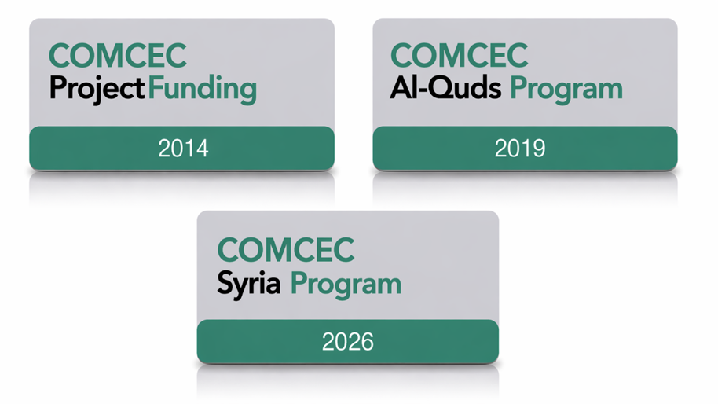
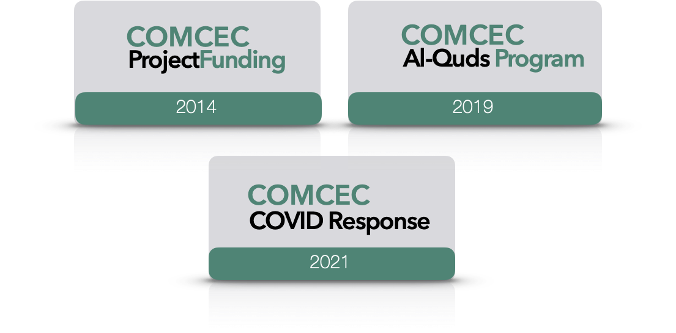


1) Overview
COMCEC
COORDINATION
OFFICE

Slide 4
2) Objectives and Main Characteristics
WHAT?
A grant-based finance mechanism, was introduced by COMCEC Coordination Office in 2014 as a policy support instrument under the COMCEC Strategy
WHY?
Increasing institutional and human capacity
Supporting implementation of policy recommendations adopted by COMCEC Ministerial Sessions
Enhancing cooperation and solidarity among the member countries
WHO CAN APPLY?
Relevant public institution of a Member Country ( Registered to Relevant Working Group) or an OIC Institution/Organ

Slide 5

1) Overview
* 178 Projects from 32 Countries and 6 OIC institutions
* Almost all member countries have benefited from project outputs

Slide 6
2) Objectives and Main Characteristics
HOW?
Financing projects in seven cooperation areas;
* Agriculture * Financial Cooperation * Digital Transformation
* Trade * Tourism * Poverty Alleviation
* Transport and Communications * Small and Medium Enterprises
MAIN PROJECT TYPES
Training, Study Visit, Workshop, Conference and Seminar, Publicity Meetings and Preparation of Audio, Visual and Written Materials
Peer-to-Peer Experience Sharing
Needs Assessment
Moreover, Opportunity to implement project individually

Slide 7
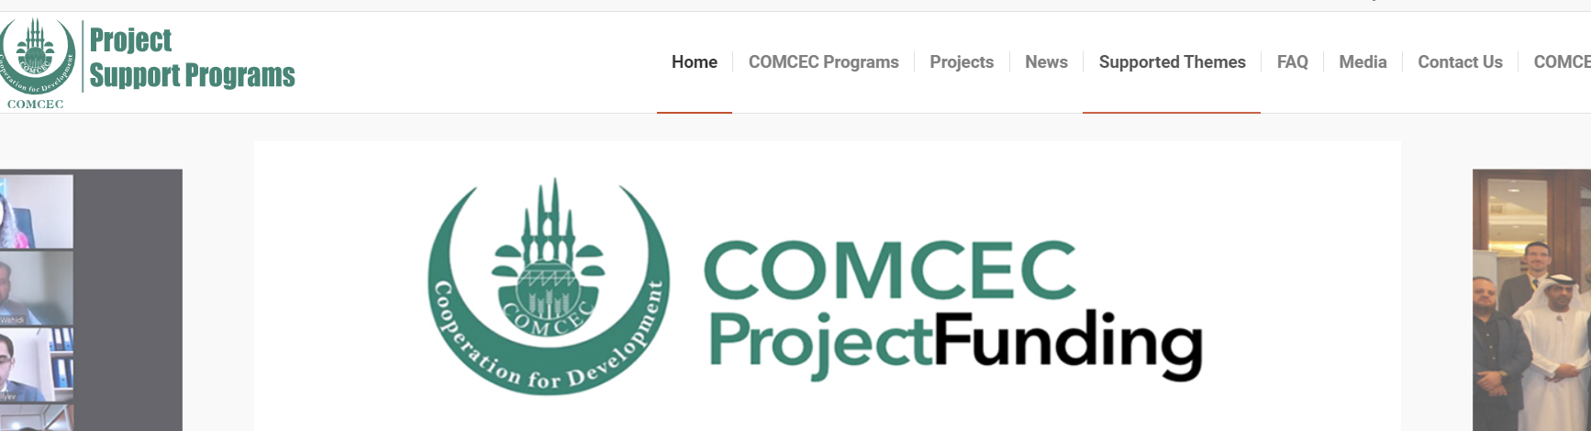
2) Objectives and Main Characteristics
SUPPORTED THEMES
https://programs.comcec.org/

Slide 8

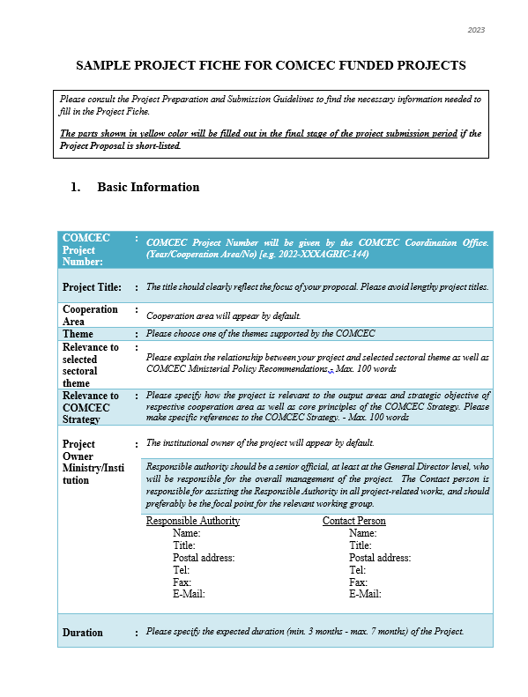
3) Project Preparation and Submission:
a) How to Prepare a Project Proposal
Review the reference documents on the Project Management Information System (https://project.comcec.org/) and Programs Website (https://programs.comcec.org/)
  Project Preparation and Submission Guidelines
  Sample Project Fiche
  Supported Themes
  COMCEC Strategy
Send the relevant documents to the interested national institutions/departments
Fill out the online project fiche through Project Management Information System
Feel free to consult with the CCO (cpf@comcec.org)
Project Preparation and Implementation Guidelines
Sample Project Fiche

Slide 9
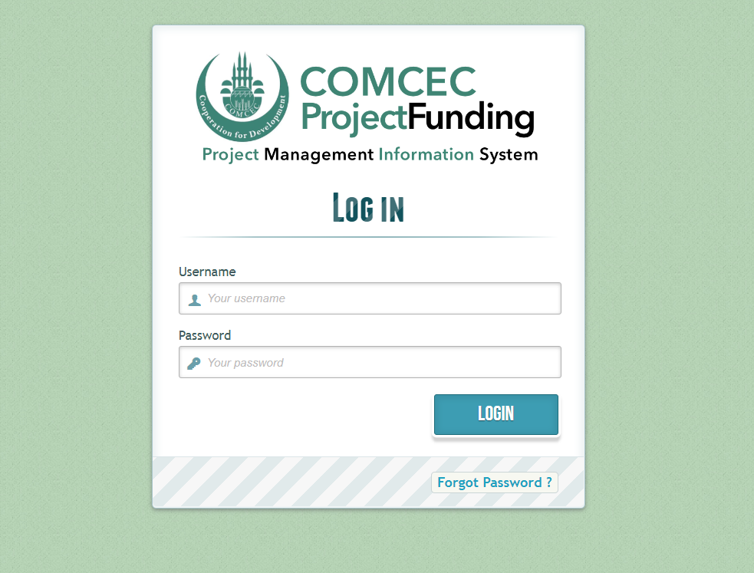
3) Project Preparation and Submission:
b) Online Project Submission
ONLINE PROJECT SUBMISSION: https://project.comcec.org/
The Username and Password are only provided to the sectoral focal points.
If you do not have username and password, please contact cpf@comcec.org.
Username and Password

Slide 10
4) Timeline Cycle of the Project
Opening of 13th Call for Project Proposals
Declaration of the Final List of Successful Project Proposals
Submission of the Final Version of Project Proposal by the Project Owner
Declaration of Short List
October 1st- 31st 2026
Early December 2026
End of December 2026
February-March 2027
April 2027
Finalization of Contract Procedures
April-December 2027
Project Implementation Period
Organizing a Training Activity

Slide 11
Transport and Communication Projects under CPF in 2026
Jordan | Fostering a Common Regulatory Framework for ITS-Based Ride-Hailing Services in OIC Member States: Building Capacity and Data Integration through a Jordanian Pilot

Slide 12

5) Transport and Communication Projects under CPF in 2026
Project Title : Fostering a Common Regulatory Framework for ITS-Based Ride-Hailing Services in OIC Member States: Building Capacity and Data Integration through a Jordanian Pilot
Project Owner :Ministry of Transport
Project Activities :Project activities of this project is Study Visit and Workshop
Project Purpose :This project aims to enhance the regulatory governance of ride-hailing services in OIC Member States through the sharing of experiences, data integration, and institutional capacity building.
JORDAN

Slide 13
THANK YOU
cpf@comcec.org
cpf@comcec.org

