Slide 1


COMCEC STRATEGY: THE STATUS OF PROGRESS
13TH ANNUAL COORDINATION MEETING OF
THE COMCEC WORKING GROUP FOCAL POINTS
9-10 June 2026, Ankara
Gürkan POLAT
Director

Slide 2
Outline
01
Vision and Mission
02
Research Efforts of the COMCEC
03
COMCEC Project Support Programs
-COMCEC Project Funding
-COMCEC Al-Quds Program
04
Contributions of the OIC Institutions
05
2

Slide 3


1.Vision and Mission
Sales Manager
Vision
Mission
To build a prosperous Islamic ummah based on;
  Solidarity and Interdependence
  Enhanced Mobility
  Good Governance
To provide a forum to;
Produce and disseminate knowledge
Share experiences and best- practices
Develop a common language/ understanding
Approximate policies
3

Slide 4
2. Research Efforts of the COMCEC
Focal Points Meeting
Desk based county analysis
Field Visits
Themes identified
2026
September
June-July
February
February-March
April
June-August
Launch of research
2nd Working Group Meetings
1st Working Group Meetings
Formulation of PRs
4

Slide 5
2.1. Case Analysis Towards Member Countries (2013-2026)
5

Slide 6
2.2. Sectoral Working Group Meetings in 2026
SECTOR | THEME | FIRST MEETINGS (Virtullay Held) | SECOND MEETINGS (To be held in person)
TRADE | Developing Effective Trade Financing Tools for Increasing Export in the OIC Member Countries | 20 April 2026 | 14-15 September 2026
TRANSPORT AND COMMUNICATIONS | Designing Integrated Multimodal Transport Systems in OIC Member Countries | 20 April 2026 | 14-15 September 2026
POVERTY ALLEVIATION | Preventing Skill Mismatch in the Labour Markets of the OIC Member Countries | 21 April 2026 | 16-17 September 2026
TOURISM | Impacts of Climate Change and Mitigation Strategies for Sustainable OIC Tourism | 21 April 2026 | 16-17 September 2026
AGRICULTURE | Promoting a Resilient Agriculture Sector against Climate Change in OIC Member Countries | 22 April 2026 | 21-22 September 2026
FINANCIAL COOPERATION | Potential of Crowdfunding for Economic Development in the OIC Member Countries | 22 April 2026 | 21-22 September 2026

Slide 7
2.2. Sectoral Working Group Meetings in 2026
12 Sectoral Working Group Meetings
16 Desk Based Studies and 14 Field Visits
6 Policy Guides/ Research Reports
Surveys and Interviews
7

Slide 8
2.3. Case Studies Being Conducted in 2026
Trade
Transport and Communications
Field Visits: Malaysia, and Egypt
Desk Based Studies: Nigeria, Germany, and United Kingdom
Field Visits: Azerbaijan, and Egypt
Desk Based Studies: Türkiye, Netherlands, and Vietnam
Tourism
Poverty Alleviation
Field Visits: Maldives, and Egypt
Desk Based Studies: Türkiye, Indonesia, and New Zeland
Field Visits: Pakistan, and Saudi Arabia
Desk Based Studies: Malaysia, Nigeria, and Germany
Agriculture
Financial Cooperation
Field Visits: Uzbekistan, and Morocco
Desk Based Studies: Türkiye, Saudi Arabia, Netherlands, and Australia
Field Visits: Indonesia, Kazakhstan, Nigeria, and Bahrain
Desk Based Studies: United Kingdom
8

Slide 9
2.4. Registration and Participation Status to the WGs (2013-2026)
9

Slide 10
3.COMCEC Project Support Programs
01
COMCEC Project Funding
02
COMCEC Al-Quds Program
03
COMCEC Syria Program
10

Slide 11
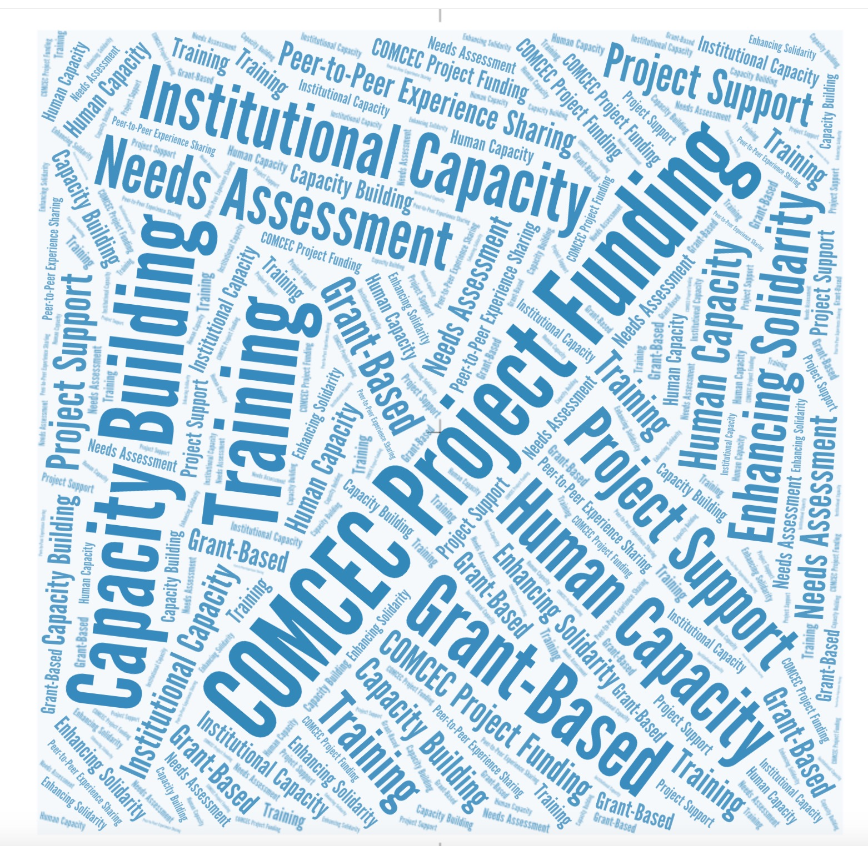
3.1. COMCEC Project Funding
01
Policy support instrument
02
Mobilizing and enhancing human and institutional capacities
03
Well-defined project cycle stages
04
Grant-based funding
11

Slide 12
3.1. COMCEC Project Funding
Distribution of the Projects According to Supported Areas (2014-2026)
12

Slide 13
Distribution of the COMCEC Projects according to OIC Regional Groupings (2014-2026)
3.1. COMCEC Project Funding
13

Slide 14
3.1. COMCEC Project Funding
Countries Benefited the Most from CPF (2014-2026)
Malaysia
Mozambique
Uganda
Define Values
Define Values
COMCEC Project Funding
The Gambia
Indonesia
Nigeria
Suriname
Mali
Benin
Iran
14

Slide 15

3.2. COMCEC Al-Quds Program

Slide 16
3.2. COMCEC Al-Quds Program
Capacity Building
Empower Women and Youth
Develop Human Capital
01
02
SME Development
Enterpreneurship
03
04
Sustainable Livelihood
05
06
Vocational Education

Slide 17
3.2. COMCEC Al-Quds Program
The List of Project Being Implemented in 2026
Advancing Employability, Digital ADR, and Innovation Pathways for Al-Quds Youth
Youth-led Digital Transformation of Al Quds’s Old City SMEs
Reviving the Traditional Khayzaran Craft to Strenghten Livelihoods in Al-Quds
Empowering Young Jerusalemites as Cultural Heritage Storytellers and Archivists
Empowering Jerusalemite Youth and Women through Vocational Training and Community Engagment
AI Agentic Engineering Professional Training Program
Empowering Al-Quds: Preserving Cultural Heritage and Fostering Economic Growth
Empowering Youth through Ceramic Arts and Digital Innovation in Al-Quds
The Palestinian Heritage Museum: A Living Center for Culture, Creativity, and Economic Empowerment
Enhancing the Healthcare Services & Emergency Services in Al-Quds
17

Slide 18

3.3. COMCEC Syria Program
Enhancing Human and Institutional Capacities in Syria
1
2
Assisting revitalization of economic activities in Syria
Project Support in the relevant thematic areas
3
18

Slide 19
4. Contributions of the OIC Institutions
The relevant OIC Institutions conduct various activities aligned with COMCEC Strategy.
 | Workshop on "Advancing Entrepreneurship in Rural Tourism | 6-7 January 2026
 | Training on Halal Conformity Assessment Requirements as per the Global Halal Standards | 26-28 January 2026
 | Awareness Workshop on the OIC Trade Preferential System (TPS-OCI) | 13 January 2026
 | Workshop on Expert Roundtable on Climate-Smart Livestock Breeding | 22-23 December 2025
 | B57+ Business Leaders’ Summit | 2 November 2025
Institution
Activity
Date
SESRIC
SMIIC
ICDT
IOFS
ICCD
19

Slide 20
Thank You
For any further queries;
Necatibey Cad. No:110/A
06580 Ankara-TÜRKİYE
Phone : (90) (312) 294 57 10 – 294 57 30
Fax : (90)(312) 294 57 77 - (90)(312) 294 57 79
comcec@comcec.org

