Slide 1


June 9-10th, 2026
COMCEC PROJECT SUPPORT PROGRAMS
13th Annual Coordination Meeting of the COMCEC Focal Points
Mehmet Celalettin AKTAŞ
Director of Programs and Projects
COMCEC
COORDINATION
OFFICE
cpf@comcec.org

Slide 2
Outline
Objectives and Main Characteristics of the COMCEC Project Funding (CPF)
Project Cycle and Major Actors
Project Preparation and Submission
  Requirements for Submission
  How to prepare a project proposal
  Online Project Submission
Main Selection Criteria
Timeline of Call for Project Proposals
COMCEC
COORDINATION
OFFICE

Slide 3
Objectives and Main Characteristics of the
COMCEC Project Funding (CPF)
MAIN CHARACTERISTICS
Supporting implementation of policy recommendations adopted by COMCEC Ministerial Sessions
Improving Institutional and human capacity of member countries
Enhancing cooperation and solidarity among member countries
Regular grant mechanism serving to development of Islamic Ummah
Focus on concrete policy actions and tangible results
Well-defined rules and procedures
COMCEC
COORDINATION
OFFICE

Slide 4
2) Project Cycle and Major Actors
Identification
Appraisal
Implementation
(Execution)
Monitoring
Evaluation
(Closing)
IDEA
(Initiation)
Member Country Direct Involvement and
CCO Support
COMCEC
COORDINATION
OFFICE

Slide 5
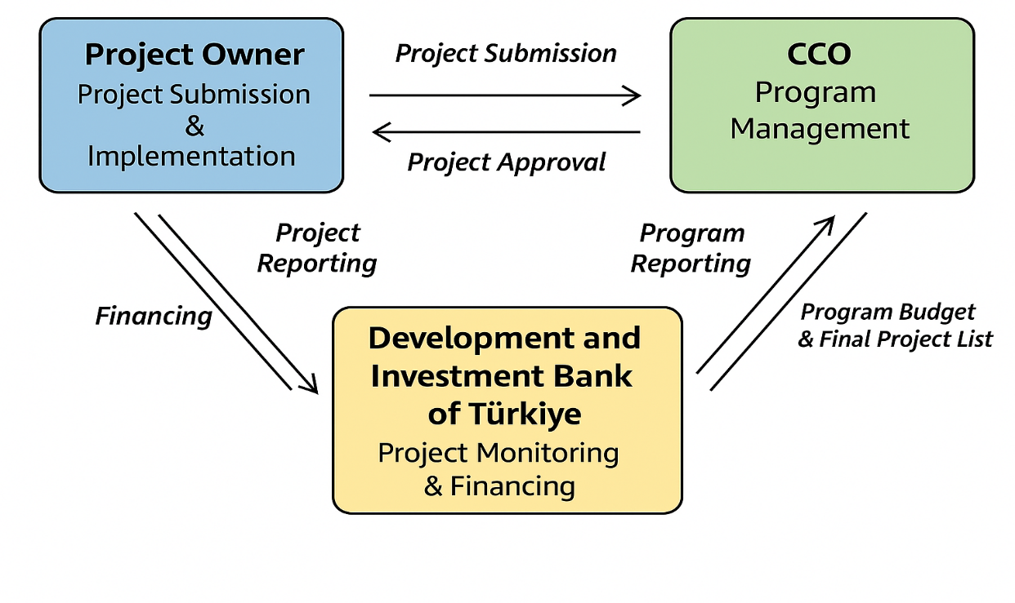
2) Project Cycle and Major Actors
COMCEC
COORDINATION
OFFICE

Slide 6
3) Project Preparation and Submission:
a) Requirements for Submission
Who can Submit Project Proposals?
Must be a sectoral focal point or submitted through a sectoral focal point
Using a username and password for Project Management Information System (https://project.comcec.org/)
Only in the relevant area
Need for coordinating interesting national institutions in submitting projects, if any
How many Project proposals can be submitted under the CPF?
For each cooperation area, 3 proposals can be submitted
If more than three projects from relevant institutions and departments are received, focal points need to select only three of them for online submission.
COMCEC
COORDINATION
OFFICE

Slide 7
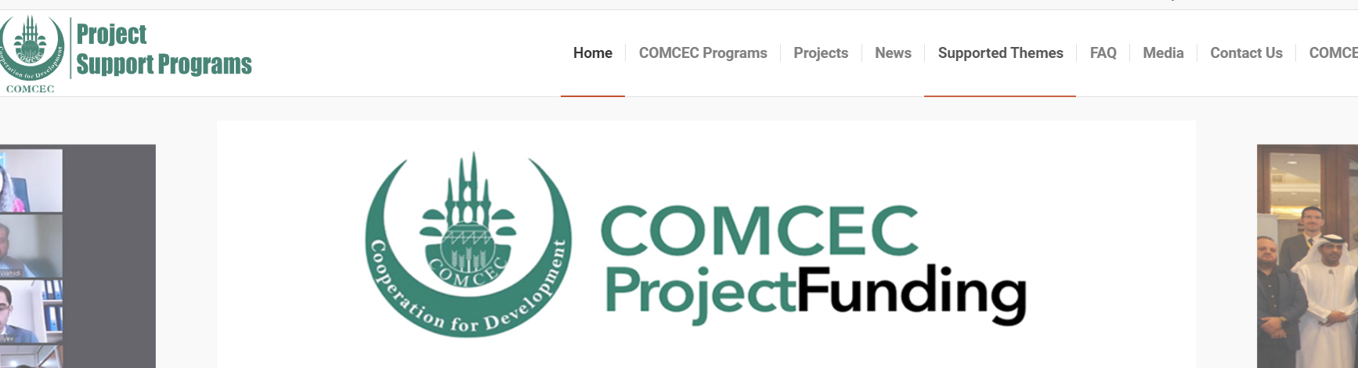
3) Project Preparation and Submission:
a) Requirements for Submission
Which topics are supported under the CPF?
Sectoral themes (formulated according to Policy Recommendations) supported by the CPF
Thematic areas under the COMCEC High-Level Digital Transformation Cooperation
Programme and COMCEC SME Program
Will be updated by October 1st (https://programs.comcec.org/supported-themes/)
Supported Themes
COMCEC
COORDINATION
OFFICE

Slide 8
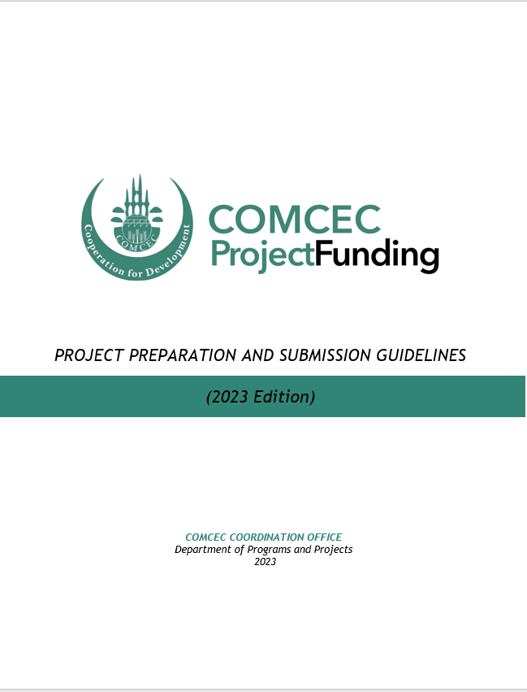
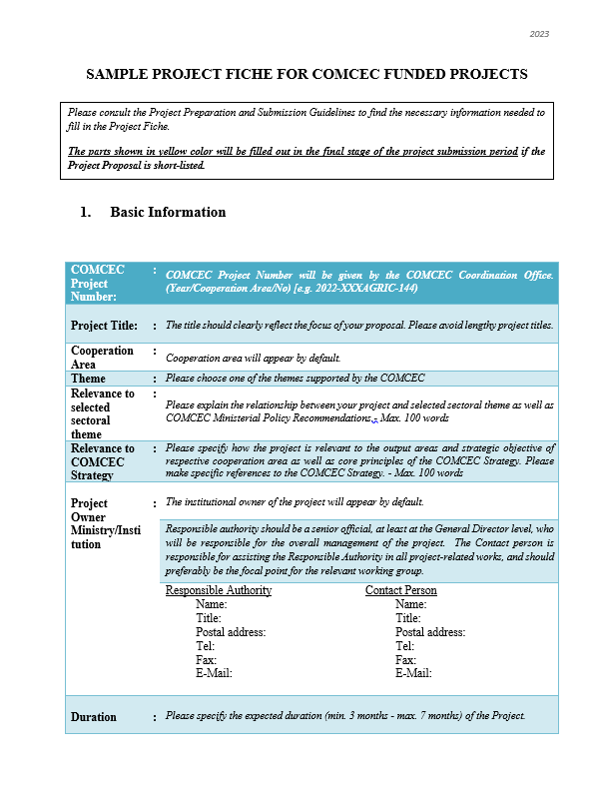

3) Project Preparation and Submission:
b) How to Prepare a Project Proposal
Review the reference documents on the Project Management Information System (https://project.comcec.org/) and Programs Website (https://programs.comcec.org/)
  Project Preparation and Submission Guidelines
  Sample Project Fiche
  Supported Themes
  COMCEC Strategy
Send the relevant documents to the interested national institutions/departments
Conceptualize your Project in line with the supported themes
Fill out the online project fiche through Project Management Information System
Feel free to consult with the CCO
Project Preparation and Implementation Guidelines
Sample Project Fiche
COMCEC
COORDINATION
OFFICE

Slide 9
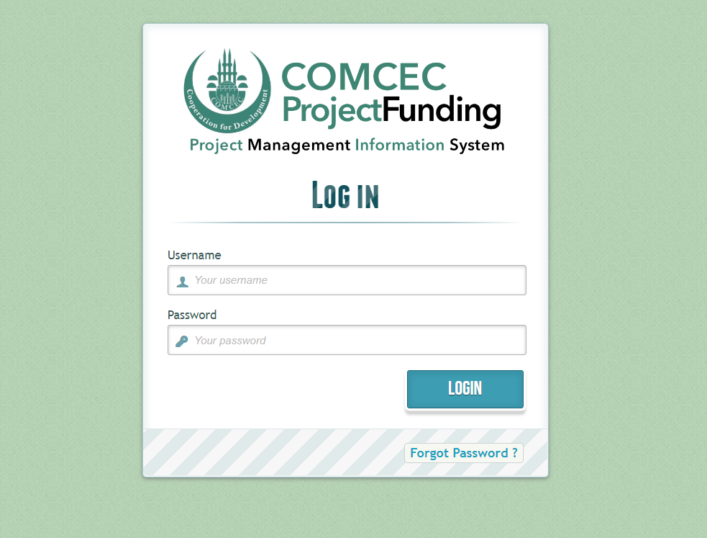
3) Project Preparation and Submission:
c) Online Project Submission
ONLINE PROJECT SUBMISSION: https://project.comcec.org/
The Username and Password are only provided to the sectoral focal points.
If you do not have username and password, please contact cpf@comcec.org.
Username and Password
COMCEC
COORDINATION
OFFICE

Slide 10
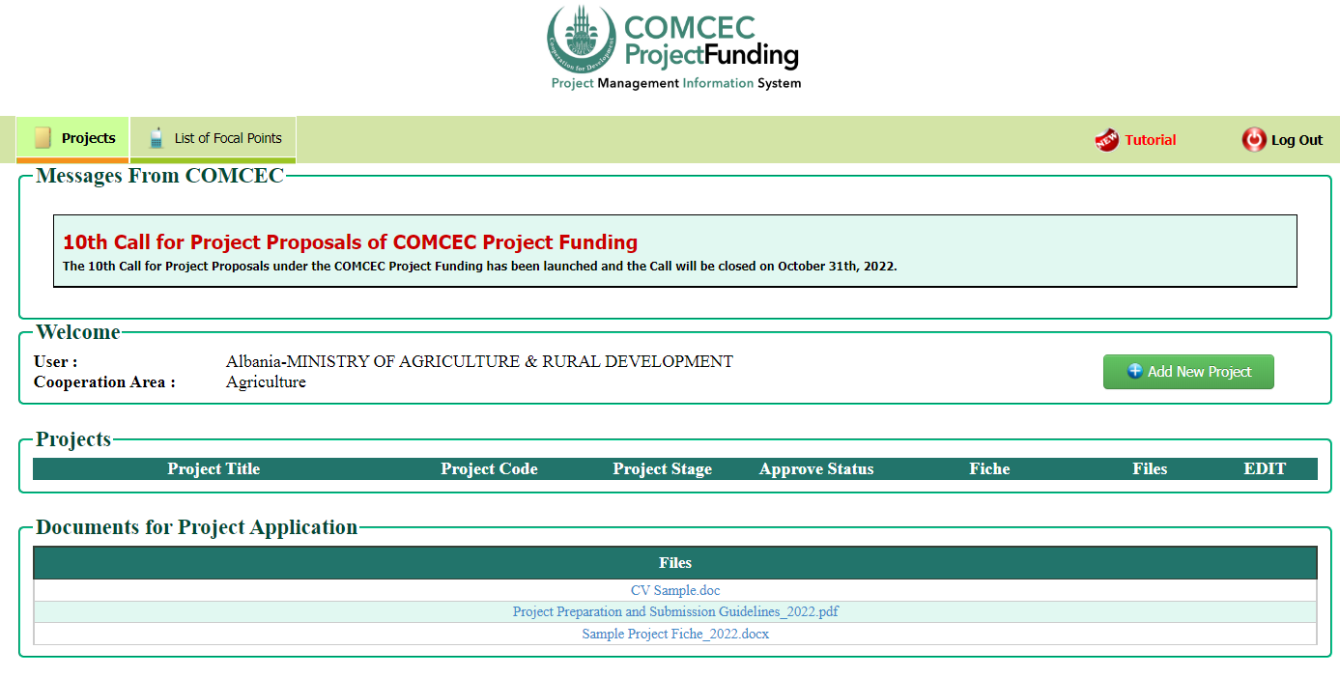
3) Project Preparation and Submission:
c) Online Project Submission
ONLINE PROJECT SUBMISSION
Click button to start
COMCEC
COORDINATION
OFFICE

Slide 11
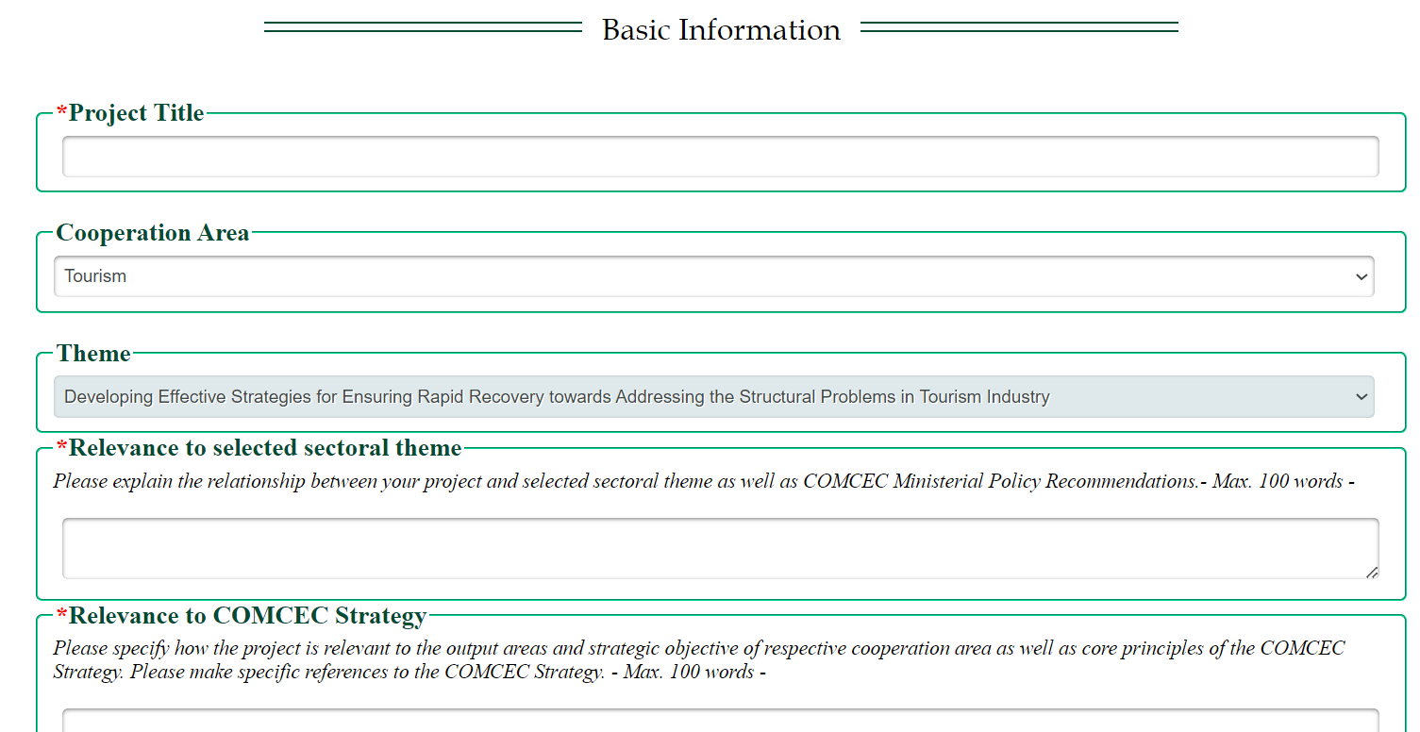

3) Project Preparation and Submission:
c) Online Project Submission
ONLINE PROJECT SUBMISSION
Need for establishing direct link between the Project Title and the relevant sectoral theme (and COMCEC Strategy)
COMCEC
COORDINATION
OFFICE

Slide 12

4) Key Issues in Designing Project Proposals
Relevance to the COMCEC Strategy
Principles
Strategic Objective of Respective Cooperation Area
Output Areas of Respective Cooperation Area
Compliance with the COMCEC supported themes published on the COMCEC Programs website
Regular participation to the relevant Working Group Meetings
Filling out the Project Fiche properly and with sufficient details
Qualifications of the proposed project personnel
Reasonable cost estimations in the project budget
Cooperation and communication with the CCO
COMCEC
COORDINATION
OFFICE

Slide 13
5) Timeline of Call for Project Proposals
Opening of 14th Call for Project Proposals
Declaration of the Final List of Successful Project Proposals
Submission of the Final Version of Project Proposal by the Project Owner
Declaration of Short List
October 1st- 31st 2026
Early December 2026
End of December 2026
February-March 2027
April 2027
Finalization of Contract Procedures
April 1st - October 31st 2027
Project Implementation Period
Organizing a Training Activity
COMCEC
COORDINATION
OFFICE

Slide 14
THANKYOu
cpf@comcec.org
COMCEC
COORDINATION
OFFICE

