Slide 1


COMCEC STRATEGY
Making Cooperation Work
For Building an Interdependent Islamic World
COMCEC
FINANCIAL OUTLOOK
Assoc. Prof. Mücahit Özdemir
Consultant, CCO
26th Meeting of COMCEC Financial Cooperation Working Group
September 21st, 2026
Ankara, Türkiye

Slide 2
OUTLINE
  Recent Global Economic Developments
  Financial Outlook of the OIC Countries
  Islamic Finance

Slide 3
Global Economic and Financial Developments
Figure 1. GDP Growth Rates of Selected Country Groups (%)
Global growth is projected to slow to 2.5% in 2026 (from 2.9% in 2025), driven by the energy price shock — the weakest pace since the pandemic.
Headline inflation is set to rise to 4.0% in 2026 before easing to 3.1% in 2027, as expectations for central bank rate cuts fade.
Brent crude is forecast to average USD 94/bbl in 2026 (+36% YoY), keeping financial conditions tight.
Growth should firm to 2.8% in 2027-28 as energy supplies recover; risks stay skewed to the downside, with growth potentially falling to 1.3% if disruptions worsen.
The rising EMDE debt, and the pace of AI-related investment will dominate the global economic agenda.
Source: World Bank Global Economic Prospects, June 2026

Slide 4
Global Economic and Financial Developments
OIC countries’ average growth rate rose to 4.6 percent in 2025 from 3.9 percent in 2024, but is projected to slow to 3.7 percent in 2026 as the recent developments weighs on OIC-HIG and OIC-UMIG economies.
Growth is expected to rebound sharply to 5.4 percent on average in 2027-28 as energy supplies recover.
OIC-HIG growth is projected to fall sharply to 1.9 percent in 2026 (from 5.4 percent in 2025); Guyana remains an outlier, still growing at double-digit rates on new energy discoveries.
Figure 2. GDP Growth Rates for OIC Country Groups (%)
Source: Calculated based on World Bank Global Economic Prospects Database, June 2026

Slide 5
OUTLINE
  Recent Global Economic Developments
  Financial Outlook of the OIC Countries
  Islamic Finance

Slide 6
Financial Outlook of the OIC Countries
World Bank World Development Indicators and IMF Financial Soundness Indicators are used, alongside the World Bank Global Economic Prospects. These sources include measures of;
degree to which individuals can and do use financial services (access),
size of financial institutions and markets (depth),
efficiency of financial intermediaries and markets in intermediating resources and facilitating financial transactions (efficiency)
stability of financial institutions and markets (stability)
In order to achieve a well-functioning system, financial markets require financial depth, access, efficiency and stability.

Slide 7
Financial Outlook of the OIC Countries
These indicators used to measure the characteristics of the financial markets are given in the table below:
Table 1. Selected Indicators
CATEGORY | INDICATOR
ACCESS | ATMs per 100,000 adults Bank branches per 100,000 adults
DEPTH | Private credit by deposit money banks to GDP (%) Stock market capitalization to GDP (%)
EFFICIENCY | Bank return on assets (%, after-tax) Bank return on equity (%, after-tax)
STABILITY | Bank non-performing loans to gross loans (%) Bank capital to total assets (%) Bank regulatory capital to risk-weighted assets (%)
Source: World Bank World Development Indicators (Access, Depth, and part of Stability) and IMF Financial Soundness Indicators (Efficiency, and part of Stability), latest available (2022-2024).

Slide 8
Financial Outlook of the OIC Countries
OIC Member Countries have been categorized into four major groups according to the World Bank Income Grouping Methodology:
Table 2. OIC Country Groups
CATEGORY | COUNTRIES | NUMBER OF COUNTRIES
OIC-Low income group (1,175 USD or less) | Afghanistan, Burkina Faso, Chad, Gambia The, Guinea-Bissau, Mali, Mozambique, Niger, Sierra Leone, Somalia, Sudan, Syrian Arab Republic, Uganda, Yemen | 14
OIC-Lower middle income group (1,176 USD to 4,635 USD) | Bangladesh, Benin, Cameroon, Comoros, Cote d'Ivoire, Djibouti, Arab Rep. of Egypt, Guinea, Kyrgyz Republic, Lebanon, Mauritania, Morocco, Nigeria, Pakistan, Palestine, Senegal, Tajikistan, Togo, Tunisia, Uzbekistan | 20
OIC-Upper middle income (4,636 USD to 14,375 USD) | Albania, Algeria, Azerbaijan, Gabon, Indonesia, Iran, Iraq, Jordan, Kazakhstan, Libya, Malaysia, Maldives, Suriname, Türkiye, Turkmenistan | 15
OIC-High income group (14,375 USD or more) | Bahrain, Brunei Darussalam, Guyana, Kuwait, Oman, Qatar, Saudi Arabia, United Arab Emirates | 8
Source: Composed by the author according to the FY27 income classification (effective 1 July 2026), World Bank, https://datahelpdesk.worldbank.org/knowledgebase/articles/906519-world-bank-country-and-lending-groups, access date: 17 September 2026. Note: Green = upgraded: Jordan (Lower-Middle→Upper-Middle), Togo (Low→Lower-Middle). Syria is newly rated, added to Low income.

Slide 9
Financial Access
Figure 3. ATMs Per 100,000 Adults (2022-2024)
Figure 4. Bank Branches Per 100,000 Adults (2022-2024)
Data Source: World Bank World Development Indicators, latest available (2022-2024)

Slide 10
Financial Depth
Figure 6. Stock Market Capitalization to GDP (%, 2022-2024)
Figure 5. Private Credit by Deposit Money Banks to GDP (%, 2022-2024)
Data Source: World Bank World Development Indicators, latest available (2022-2024). Figure 6 excludes OIC-LIG: no member country reports stock market data.

Slide 11
Financial Efficiency
Figure 7. Bank Return on Assets (%, after tax, 2022-2024)
Figure 8. Bank Return on Equity (%, after tax, 2022-2024)
Data Source: IMF Financial Soundness Indicators, 2022-2024

Slide 12
Financial Stability
Figure 10. Bank Capital to Total Assets (%, 2022-2024)
Figure 9. Bank Regulatory Capital to Risk-Weighted Assets (%, 2022-2024)
Figure 11. Bank Non-Performing Loans to Gross Loans (%, 2022-2024)
Data Source: Figure 9: IMF Financial Soundness Indicators, 2022-2024. Figures 10–11: World Bank WDI, 2022-2024

Slide 13
OUTLINE
  Recent Global Economic Developments
  Financial Outlook of the OIC Countries
  Islamic Finance

Slide 14
Islamic Finance
The total assets of the Islamic finance sector increased to USD 4.40 trillion in 2025, with a 13.4% YoY growth rate [2024: comparable pace], adding USD 1.7 trillion since 2020 (5-year CAGR of 10.3%).
Islamic banking remained the dominant segment, with 69.2 percent of total IFSI assets in 2025. The Islamic banking sector grew 9.7 percent and reached USD 3,050.94 billion in the relevant year.
Table 3. Breakdown of IFSI by Sector and by Region (2025, USD billion)
Region | Islamic Banking | Outstanding Sukuk | Islamic Funds' Assets | Islamic Insurance Assets | Total | Share
GCC | 1,759.65 | 543.29 | 34.21 | 30.22 | 2,367.37 | 53.8%
EAP | 375.85 | 491.40 | 46.54 | 22.49 | 936.28 | 21.3%
MENA (excl. GCC) | 702.00 | 6.80 | 0.11 | 13.64 | 722.54 | 16.4%
ECA | 104.35 | 37.71 | 71.62 | 3.32 | 217.00 | 4.9%
South Asia | 94.74 | 3.44 | 6.19 | 1.44 | 105.82 | 2.4%
SSA | 14.36 | 1.19 | 15.20 | 0.04 | 30.79 | 0.7%
Others | - | 16.99 | 6.60 | - | 23.60 | 0.5%
Total | 3,050.94 | 1,100.83 | 180.47 | 71.14 | 4,403.39 | 100.0%
Share | 69.2% | 25.1% | 4.1% | 1.6% | 100.0%
Source: Islamic Financial Services Board, Islamic Financial Stability Report 2026 (published 26 May 2026; data as of 2025)

Slide 15
Islamic Finance
The GCC region still holds the most significant share (53.8%), USD 2,367.37 billion in 2025.
East Asia and the Pacific (EAP), the successor to the former South-East Asia grouping under IFSB’s updated classification, remains one of the most significant regions, accounting for 21.3% of global IFSI assets in 2025.
The composition of Islamic finance segments remained broadly stable in 2025, where Islamic banking is still the dominant segment of the industry with a 69.2% share.
Figure 12. Breakdown of IFSI by Region (2025, %)
Figure 13. Breakdown of IFSI by Islamic Finance Segments (2025, %)
Source: Islamic Financial Services Board, Islamic Financial Stability Report 2026 (data as of 2025).

Slide 16
Islamic Finance - Banking
Figure 14. Islamic Banking Sectors Domestic Share in Selected OIC Member Countries as of 2025Q3
Total assets of Islamic banking grew to USD 3,050.94 billion in 2025, up 9.7% year-on-year, and now account for 69.2% of total IFSI assets
Islamic banking now exceeds 15% of domestic banking assets in 16 jurisdictions as of 2025Q3 (down from 17, due to Palestine’s declining share).

Slide 17
Islamic Finance – Capital Markets
Global sukuk issuances reached a record USD 262.9 billion in 2025, up 28.2% year-on-year (IIFM, 2026), rebounding sharply after a 3.3% dip in 2024. International issuances rose 50.8% to USD 98.9 billion, and domestic issuances rose 25.7% to USD 163.9 billion.
2025 saw further new entrants: Jordan issued its debut international sukuk, and Egypt significantly expanded its international sukuk programme. Global sukuk outstanding crossed USD 1 trillion for the first time (USD 1.02 trillion as of 31 December 2025, per IIFM).
ESG and green sukuk issuances continued to grow in 2025: IFSB (2026) reports green sukuk issuances up 94% year-on-year and sustainability sukuk up 33% year-on-year.
Figure 15. Global Sukuk Issuances (2016-2025, USD billion)
Source: IIFM Sukuk Report 2026

Slide 18
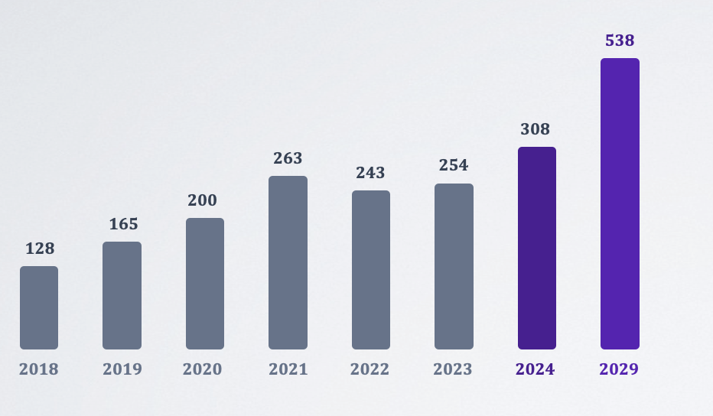
Islamic Finance – Capital Markets
Global Islamic funds AuM reached USD 308 billion in 2024 (+21% YoY, 2,610 funds outstanding) (LSEG & ICD, 2025).
Other MENA (103bn) and GCC (77bn) lead by region, followed by Europe (64bn), SE Asia (40bn), Other (13bn) and Americas (11bn). IFSB's narrower measure: USD 180.47bn (+25.6% YoY); 2025 returns ranged 4.2–49.2% by fund type.
Figure 16. Islamic Funds AuM Outstanding Growth (US$ billion, 2018-2024, with 2029 projection)
Source: LSEG & ICD, Islamic Finance Development Report 2025.

Slide 19
Islamic Finance – Takaful
Figure 17. Global Takaful Assets Growth
(US$ billion, 2018-2024, with 2029 projection)
Global takaful assets reached USD 136 billion in 2024, up 25.9% year-on-year, and are projected to reach USD 237 billion by 2029 (LSEG & ICD, 2025) — a compound annual growth rate of about 12%.
237
136
108
76
83
54
63
45
2018
2019
2020
2021
2022
2023
2024
2029
Source: LSEG & ICD, Islamic Finance Development Report 2025.

Slide 20
COMCEC STRATEGY
Making Cooperation Work
For Building an Interdependent Islamic World
Thank You
26th Meeting of COMCEC Financial Cooperation Working Group
September 21st, 2026
Ankara, Türkiye

