Slide 1
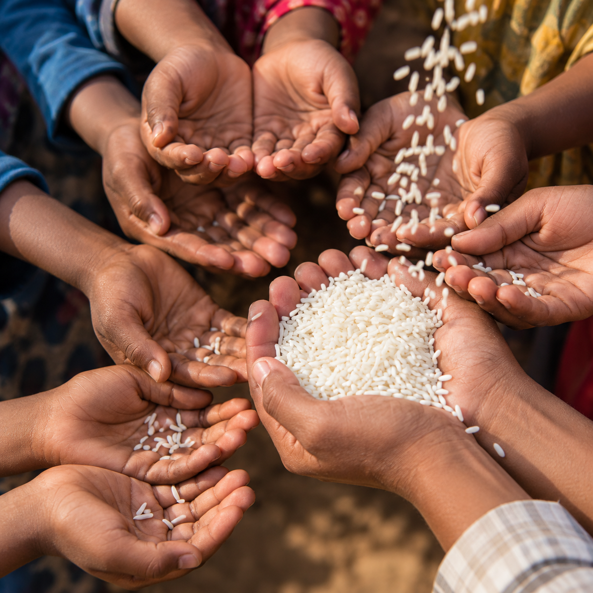
COMCEC POVERTY OUTLOOK 2026

Slide 2
GDP Per Capita (PPP) (Curr. Int. $) in the World

Slide 3
Poverty Headcount Ratio at US$3.00 a day (PPP) (% of Population) --World

Slide 4
GDP Per Capita (PPP) (Curr. Int. $) in the OIC

Slide 5
Poverty Headcount at US$3 a day (PPP) (% of Population) in the OIC

Slide 6
OIC Countries
21 of 44 Least Developed Countries are OIC Members

Slide 7
GDP Per Capita (PPP, Current Int. $) in the OIC, 2025- High Income Countries

Slide 8
GDP Per Capita (PPP, Current Int. $) in the OIC, 2025 –Upper Middle Income Countries

Slide 9
GDP Per Capita (PPP, Current Int. $) in the OIC, 2025 –Lower Middle Income Countries

Slide 10
GDP Per Capita (PPP, Current Int. $) in the OIC, 2025 –Low Income Countries

Slide 11
Poverty Headcount at US$3.00 a day (PPP) (% of Population) in the OIC

Slide 12
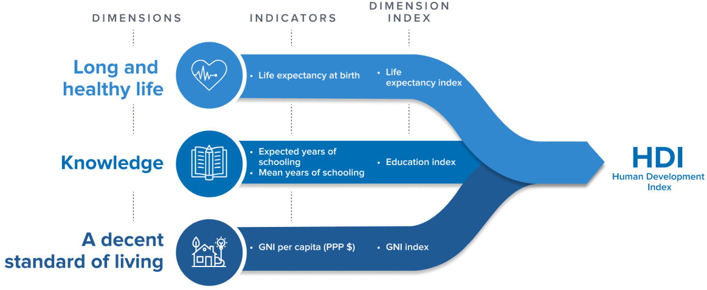
Human Development Index

Slide 13
Trends in Human Development Index, 1990-2023

Slide 14
Annual growth rate in HDI between 1990 and 2023

Slide 15
Human Development in OIC Member States

Slide 16
Income Levels vs Human Development
 |  | Low income | Lower-middle income | Upper-middle income | High income | Total
Low Human Development | # of countries | 12 | 5 | 0 | 0 | 17
 | % | 70,59% | 29,41% | 0,00% | 0,00% | 100,00%
Medium Human Development | # of countries | 2 | 9 | 1 | 0 | 12
 | % | 16,67% | 75,00% | 8,33% | 0,00% | 100,00%
High Human Development | # of countries | 0 | 6 | 10 | 1 | 17
 | % | 0,00% | 35,29% | 58,82% | 5,88% | 100,00%
Very High Human Development | # of countries | 0 | 0 | 4 | 7 | 11
 | % | 0,00% | 0,00% | 36,36% | 63,64% | 100,00%

Slide 17
Human Development Index by Income Groups- OIC Members
High Income
0.776
0.940
Upper Income
0.695
0.853
Lower Income
0.500
0.754
Low Income
0.419
0.603
HDI: 0 (Low Development)- 1 (High Development)

Slide 18
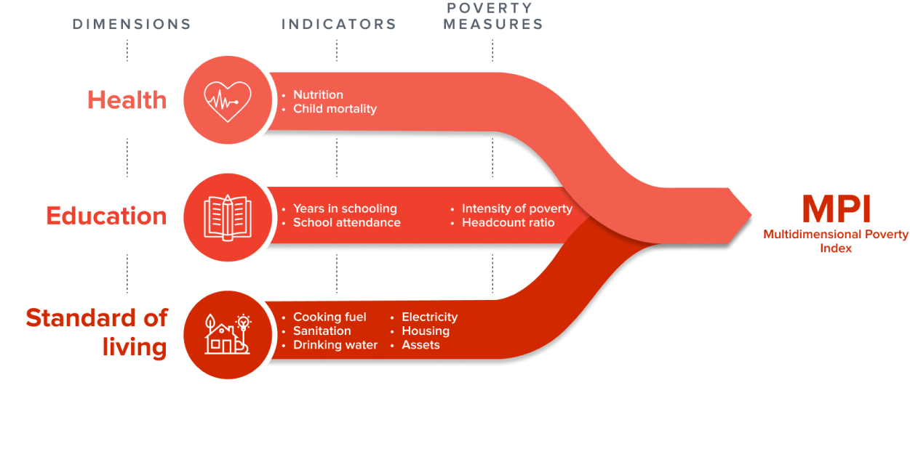
Multidimensional Poverty Index

Slide 19
Multidimensional Poverty by Region (% of population with multidimensional poverty)

Slide 20
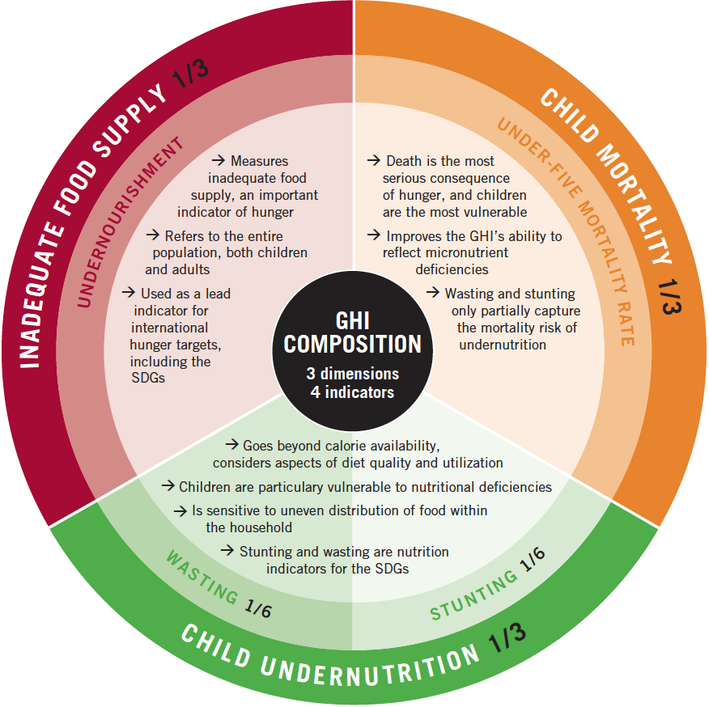
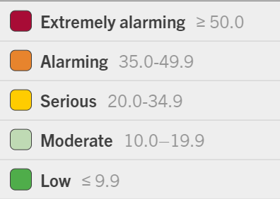
Global Hunger Index

Slide 21

Global Hunger Index

Slide 22
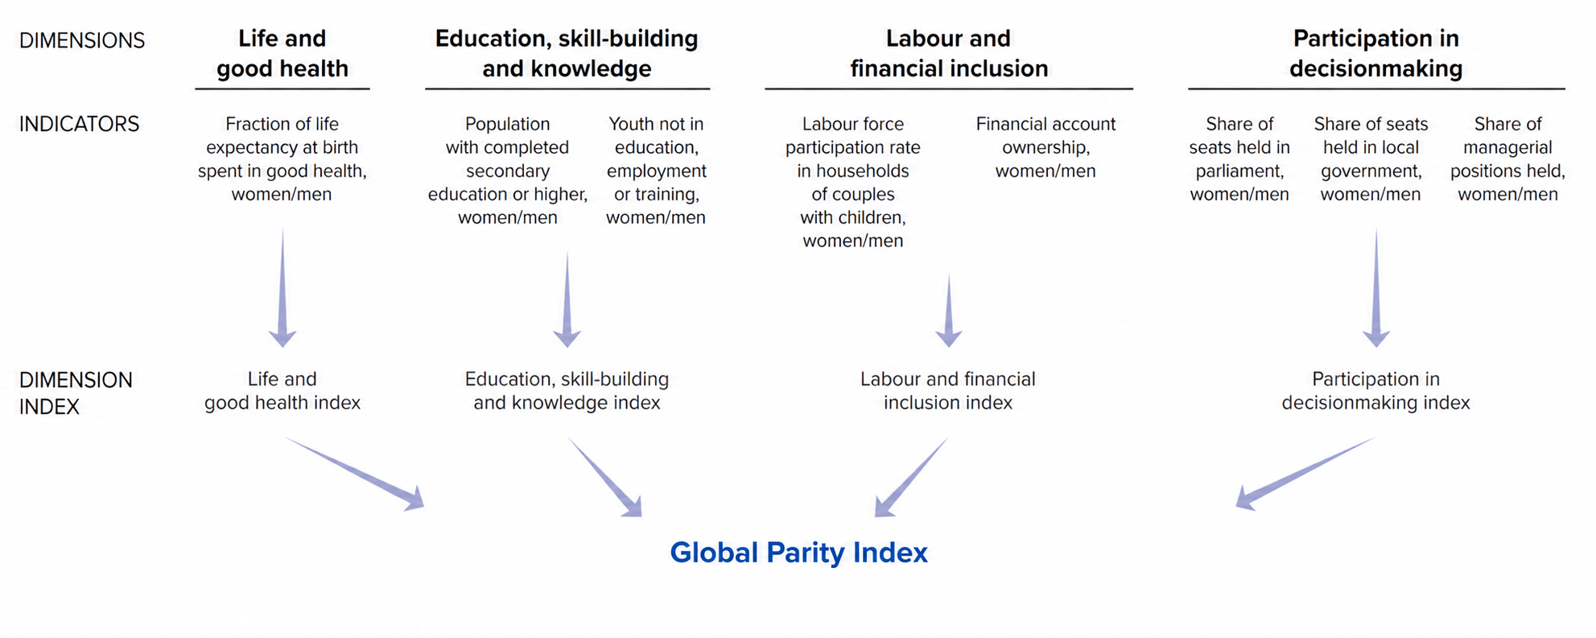
Global Parity Index

Slide 23
Global Parity Index

Slide 24
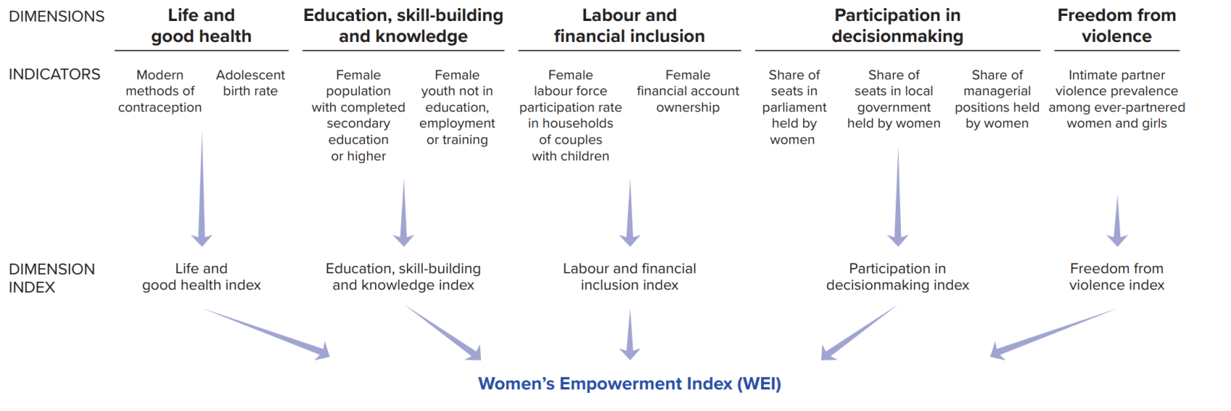
Women Empowerment Index

Slide 25
Women Empowerment Index

Slide 26
Summary
The OIC Member Countries do not form a homogenous group in terms of poverty.
21 out of 44 Least Developed Countries (LDCs) are members of the OIC.
Although developing countries have recorded considerable improvements in monetary and non-monetary poverty alleviation in the last decades, poverty rates are still high for a sizeable number of countries.
There are around 400 to 450 million people living in poverty in the OIC region
Poverty alleviation is a permanent agenda item and cooperation areas of the COMCEC.
Through the collaborative efforts and support of COMCEC, individual member states should continue working towards sustainable development that encompasses crucial aspects such as health, education, a decent standard of living, the reduction of gender inequality, and the empowerment of women.

Slide 27
Thank you for your attention…
Prof. Belgi Turan
belgituran@etu.edu.tr

