Slide 1

www.lc-oic.org
TH
27
MEETING OF THE COMCEC
POVERTY ALLEVIATION WORKING GROUP
Preventing the Skill Mismatch in the Labour Markets of the OIC Member States
© OIC Labour Centre. All rights reserved.

Slide 2
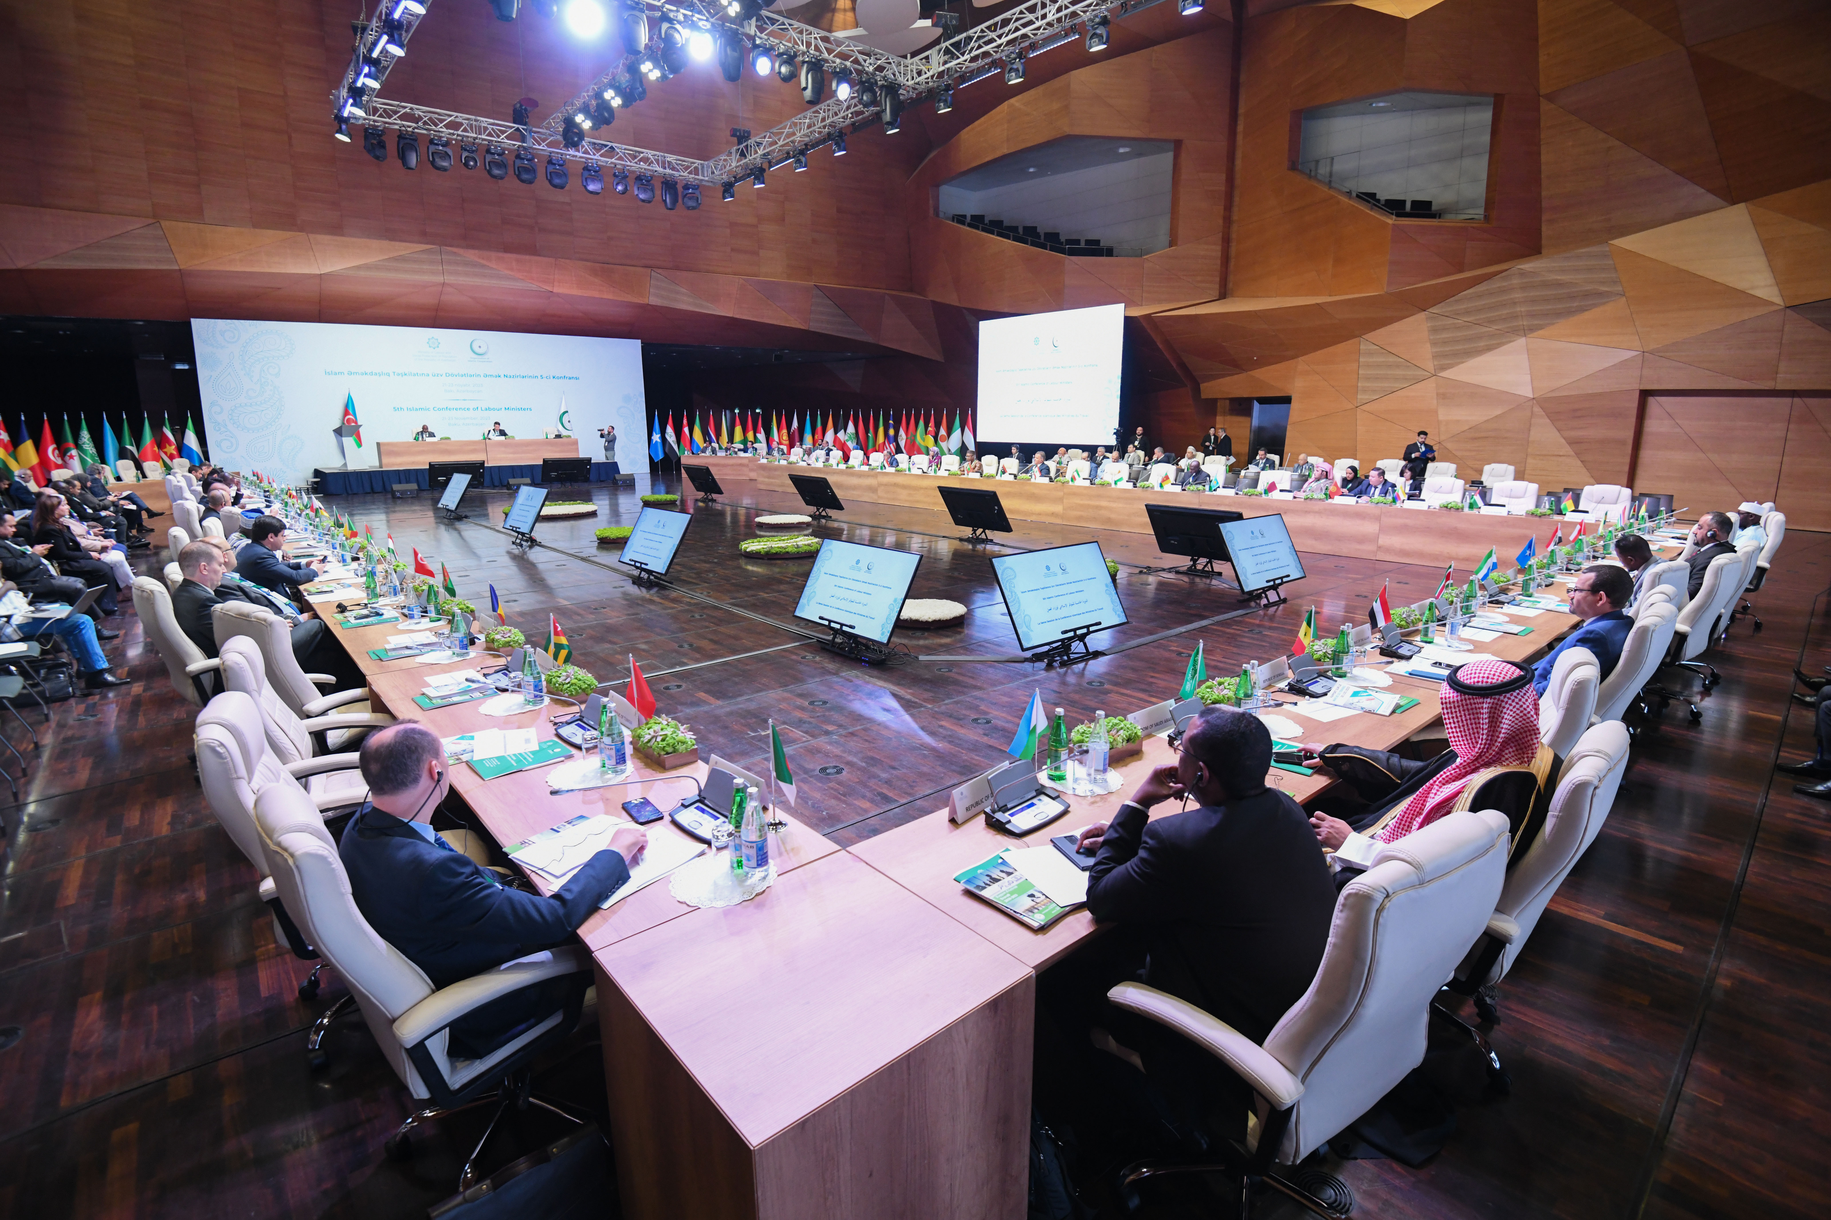

ABOUT US
The OIC Labour Centre is an Intergovernmental Organisation aimed at enhancing labour conditions, promoting employment opportunities, and fostering social protection systems across 57 Member States. It emphasises the crucial need to ensure decent work, sustainable social protection, and poverty reduction within OIC Member States, in alignment with the objectives of the OIC Charter.
As an intergovernmental organisation, the Centre operates in accordance with the provisions outlined in its Statute.
Our Vision
Our Mission
The OIC Labour Centre envisions inclusive, fair, and resilient labour markets across Member States, built on decent work for all and strengthened by effective social protection. It advances cooperation, international labour principles, and policy innovation—promoting social inclusion, skills recognition, and fair labour mobility to support shared prosperity and social justice.
Our mission is to consolidate and empower socio-economic efforts. The goal of the Centre is to enhance labour conditions, promote equitable employment opportunities, and foster sustainable social protection systems across OIC Member States, ensuring decent work, poverty reduction, and socio-economic development in alignment with the principles of the OIC Charter.
© OIC Labour Centre. All rights reserved.

Slide 3





SKILLS MISMATCH IN OIC MEMBER STATES
With a total population of 2.1 billion, the OIC faces a 62% skills mismatch rate which is significantly higher than the 43% in developed countries
With only 16.2% of the workforce classified as high-skilled, OIC Member States exhibit a significant deficit, compared to 44.9% in other developing countries
44.9%
16.2%
Source: OIC Labour Market Report 2025
© OIC Labour Centre. All rights reserved.

Slide 4


SKILLS MISMATCH IN OIC MEMBER STATES
While providing 21.5% of the world’s labour force, the high mismatch prevents the OIC Member States from translating its massive human capital into global competitiveness
Despite a 55.5% Employment-to-Population Ratio (EPR), over half of these active workers are in roles that do not align with their qualifications
Source: OIC Labour Market Report 2025
© OIC Labour Centre. All rights reserved.

Slide 5
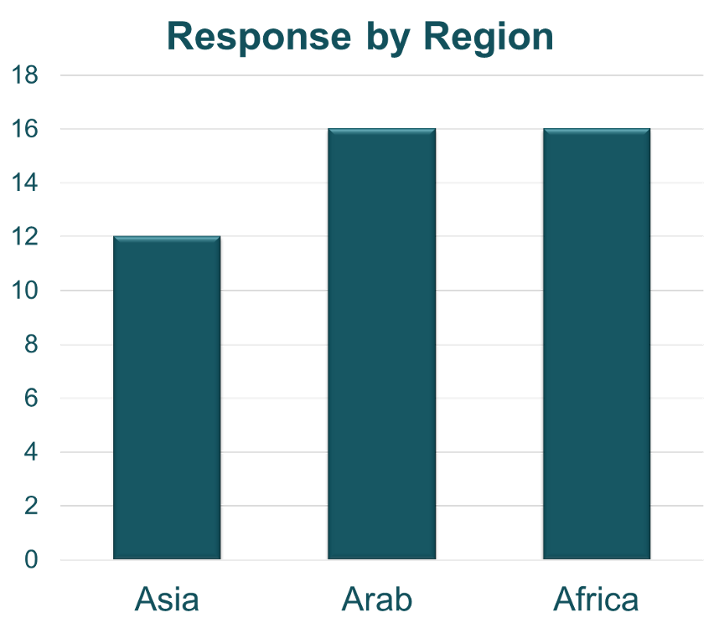

LABOUR MARKET SURVEY
Purpose
Response by Country Groups
To conduct labour market needs and capacity assessment to identify priorities, skills gaps, and key challenges across OIC Member States, and to inform targeted programmes and policy interventions
Number of
responses
from Countries
© OIC Labour Centre. All rights reserved.

Slide 6
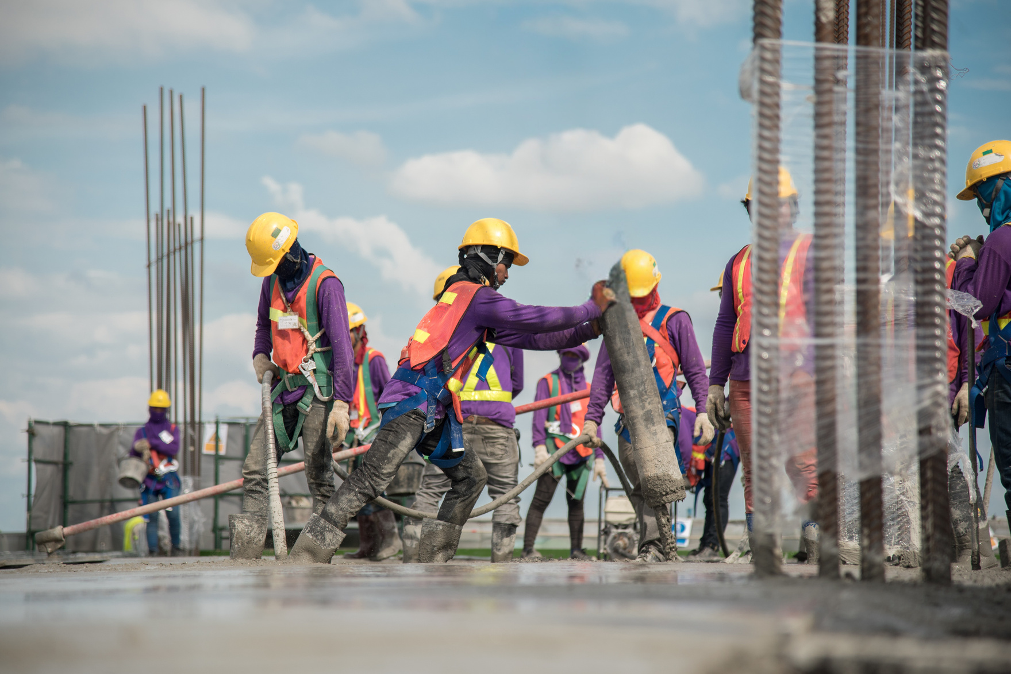
CURRENT STATE OF
LABOUR MARKET
Low Supply of Skilled Workforce and Oversupply of Unskilled Workforce
Systemic imbalance in workforce structure
Skills mismatch deemed as the top driver
of labour shortages
© OIC Labour Centre. All rights reserved.

Slide 7


EXTENT OF SKILLS MISMATCH
25 out of 44 respondents report significant skills mismatch and only 2
reported no skills mismatch.
Identified as a top labour market challenge and the most difficult one to address
(OIC Labour Market Strategy 2025)
© OIC Labour Centre. All rights reserved.

Slide 8


YOUTH EMPLOYMENT
Top-ranked challenges for Youth Employment
FAVOURABLE
CONDITIONS
#1
MISMATCH BETWEEN QUALIFICATIONS AND LABOUR MARKET DEMANDS
NON - FAVOURABLE
#2
LACK OF RELEVANT WORK EXPERIENCE
CONDITIONS
#3
LIMITED ACCESS TO VOCATIONAL AND
TECHNICAL TRAINING
The youth employment challenge is not only about creating jobs — it is also about matching skills to jobs.
#4
INADEQUATE CAREER GUIDANCE AND EMPLOYMENT SERVICES
© OIC Labour Centre. All rights reserved.

Slide 9
KEY WORKFORCE SKILLS GAPS
1
4
Technology Use
Planning & Organising
AI Literacy
2
5
Communication
3
6
Problem Solving
Initiative & Enterprise
© OIC Labour Centre. All rights reserved.

Slide 10

RESPONSE BY MEMBER STATES
Increasing Vocational Training Programmes
Strengthening Public-Private Partnerships
Encouraging Reskilling & Upskilling Initiatives
Providing Scholarships for Education in Key Sectors
© OIC Labour Centre. All rights reserved.

Slide 11



Future Cooperation Areas
Strengthen Education–Employer Partnerships
Enhance/ Establish Skills Forecasting & Labour Market Analysis Systems
Provide Continuous Reskilling/Upskilling Support
Reforming Educational Curriculum
Develop Career Guidance Systems
© OIC Labour Centre. All rights reserved.

Slide 12


FUTURE OF WORK
Technology, AI & Digital Services
Emerging Demand
Renewable Energy
Top
Growing
Sectors
Healthcare & Biotech
Green Industries
Manufacturing & Automation
© OIC Labour Centre. All rights reserved.

Slide 13

FUTURE OF WORK
1
Emerging Demand
2
AI and Automation
Digitalization
3
Key Drivers
Among the 44 survey responses, 37 indicated that further preparation is needed to respond effectively to future-of-work transformations, while 7 indicated a higher level of readiness
Green Transition
© OIC Labour Centre. All rights reserved.
© OIC Labour Centre. All rights reserved.

Slide 14

PRIORITY INTERVENTIONS FOR A FUTURE-READY WORKFORCE
Integrating AI & Digital Skills Into Curriculum
Strengthening Public-Private Partnerships
Expanding Vocational Training Systems
Improving Digital Infrastructure
Promoting STEM Education
© OIC Labour Centre. All rights reserved.

Slide 15




Member State priorities for the
OIC LABOUR
CENTRE
Policy Design Support
Carry Out Capacity Building Programmes
Initiate Knowledge-Sharing Across Member States
Conduct Labour Market Research & Skills Mapping
© OIC Labour Centre. All rights reserved.

Slide 16
FROM FINDINGS
GREEN
TRANSITION
TO ACTION
Translating Member State priorities into practical initiatives
FUTURE SKILLS
WORKFORCE
CAPACITY
© OIC Labour Centre. All rights reserved.
© OIC Labour Centre. All rights reserved.

Slide 17
OIC LABOUR CENTRE IN ACTION
Since the previous meeting of this Working Group (Online)
WUF13 — GREEN TECHNOLOGY
SOCIAL INNOVATION
19 MAY 2026 | ONLINE
22 MAY 2026 | BAKU
Green skills
Future-skills anticipation
Emerging occupations
Skills alignment
Workforce planning
AI-supported labour information
Training-system alignment
Cross-border skills recognition
Labour-market systems
that respond faster
Preparing skills systems for
the green transition
© OIC Labour Centre. All rights reserved.
© OIC Labour Centre. All rights reserved.

Slide 18
OIC LABOUR CENTRE IN ACTION
Since the previous meeting of this Working Group (Online)
WOMEN’S ECONOMIC EMPOWERMENT
WORKPLACE CAPACITY
15 MAY 2026 | BAKU
23 JULY 2026 | GENEVA
Skills-to-employment pathways
Inclusive workplace management
Changing labour-market requirements
Institutional capacity
Digital & green transition
Safe & respectful workplaces
Career progression & formal employment
Practical workplace solutions
Building management capabilities
for more productive workplaces
Connecting skills development with access, retention and advancement
© OIC Labour Centre. All rights reserved.
© OIC Labour Centre. All rights reserved.

Slide 19
FORESIGHT SKILLS LAB (FSL)
Bridging Today’s Skills with Tomorrow’s Jobs
PROJECT OWNER
PRINCIPAL
IMPLEMENTING PARTNER
KNOWLEDGE AND
STUDY-VISIT PARTNER
Ministry of Planning, Development and Special Initiatives of the Islamic Republic of Pakistan
OIC Labour Centre
Malaysia
WHAT THE PROJECT DOES ?
FORECAST
ALIGN
TRAIN
TRANSFER
Anticipate evolving skill
needs
TVET & curricula with labour demand
Build national forecasting
capacity
Share practical foresight
methods
© OIC Labour Centre. All rights reserved.

Slide 20
OCCUPATIONAL SAFETY AND HEALTH
89%
82%
73%
73%
IDENTIFIED OSH STANDARDS AS REQUIRING FURTHER STRENGTHENING
IDENTIFIED GAPS IN OSH TRAINING AND EDUCATION
IDENTIFIED CONSTRAINTS IN ENFORCEMENT CAPACITY AND RESOURCES
IDENTIFIED EMPLOYER AWARENESS AND COMPLIANCE AS AREAS REQUIRING FURTHER ATTENTION
STANDARDS
SKILLS
CAPACITY
AWARENESS
#1 FACTOR
#2 FACTOR
#3 FACTOR
REGULATION + COMPETENCE + INSTITUTIONAL CAPACITY = STRONGER OSH SYSTEMS
© OIC Labour Centre. All rights reserved.

Slide 21
OIC LABOUR CENTRE ACTION
ON OCCUPATIONAL SAFETY AND HEALTH
5th Annual
HSE Conference
Managing Psychosocial
Risks at Workplaces
Risk management
Prevention OSH standards
Emerging risks,
Awareness & training, Prevention
25
APR
27
APR
28
APR
Safety at Work is the
Foundation of Effective Activity
Worker protection,
Labour standards, Social dialogue
© OIC Labour Centre. All rights reserved.
© OIC Labour Centre. All rights reserved.

Slide 22

OIC LABOUR CENTRE
STRATEGIC PARTNER AT THE 24th WORLD CONGRESS ON SAFETY AND HEALTH AT WORK
Memorandum of Understanding signed with the Ministry of Civil Service, Labour and Public Service Reform of the Republic of Senegal
Global OSH Cooperation
OIC Member States Engagement
Knowledge & Capacity Development
© OIC Labour Centre. All rights reserved.

Slide 23

FROM TRAINING
MEMBER
STATES
TO COMPETENCE:
TRAINING PROVIDERS
Occupational Safety and Health Excellence Framework (OSHEF)
OSH PROFESSIONALS
INTERNATIONAL
ORGANISATIONS
EDUCATIONAL INSTITUTIONS
© OIC Labour Centre. All rights reserved.
© OIC Labour Centre. All rights reserved.

Slide 24
“
Looking
Ahead:
The OIC Labour Centre remains committed to addressing skills mismatch by strengthening labour market systems, workforce skills and inclusive employment, while advancing practical, demand-driven solutions with Member States and other relevant partners
What’s next for us?
“
© OIC Labour Centre. All rights reserved.

Slide 25
THANK YOU
© OIC Labour Centre. All rights reserved.

Slide 26

www.lc-oic.org
OICLabourCentre
OIC Labour Centre
in
OIC Labour Centre

